Slide 1
Pay Attention: Developing Protocols for ADHD Across the Lifespan
UPMC St. Margaret
Family Medicine Residency
Patricia McGuire, MD
September 14, 2017

Slide 2
Disclosures
No financial disclosures

Slide 5
LEARNING OBJECTIVES:
Recognize key elements in the ADHD assessment process
Develop standardized protocols to systematically evaluate ADHD across the lifespan (children, teens, and adults)
Describe ADHD protocol implementation with multidisciplinary participation and point of care tools

Slide 6
NEED
Increased ADHD diagnosis in US
CDC - increased ADHD prevalence in school aged children over past decade
Increased number of adults seeking treatment for ADHD in primary care
Access to care issues
Limited availability of specialty psychiatric / mental health care
Concerns about ADHD in Family Med training /clinics
Concerns for adequacy of training in diagnosis / treatment
Concern for over-diagnosis
Concern for misuse of stimulants

Slide 7
EDUCATE: Essentials of Initial ADHD Assessment
Didactic lectures for PCP’s
ADHD across the life span
Prevalence
Comorbid conditions
Diagnostic criteria
Functional impairments
ADHD assessment strategies – child, teen, adult
ADHD treatments
Medication
Non-pharmacologic treatment
Multidisciplinary team training on ADHD

Slide 8
What is ADHD?
Neuro-developmental disorder
Cardinal symptoms:
Inattention
Impulsivity/Hyperactivity
DSM 5; American Psychiatric Assn., 2012; http://www.dsm5.org

Slide 9
Genetic / Environmental Factors
Genetic risk factors
Genetic factors may account for ≅ 65% phenotypic variance
Environmental / clinical risk factors
Prenatal exposure to alcohol, tobacco
Complications of pregnancy and birth
Brain injury
Lead exposure in childhood
Kunsti J; Behav Brain Funct 2006; 2:27
Froehlich TE;Pediatrics 2009;124(6):e1054-e1063
Notes:
ADHD has strong genetic component, suggesting that genetic factors would account for ≅ 65% of phenotypic variance
Only a few genes assoc. with ADHD have been identified; these genes account for only about 3% of phenotypic variance
Environmental factors – risk of ADHD is doubled/tripled with maternal smoking

Slide 10
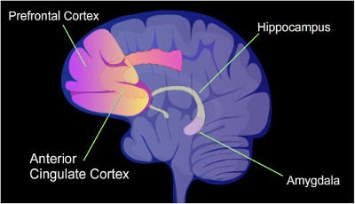
Neuro-biology of ADHD
Dysfunction of DA pathways – attention, motivation/reward
Dysfunction in NE pathways – executive function
Arnstein AF; J Am Acad Child Adolesc Psychiatry 2012;80:139-150
Notes:
Brain imaging studies:
Brain imaging - dysfunction of dopamine and norepinephrine
Dopamine pathways involved in attention, executive function (EF), motivation/reward
Noradrenergic pathways innervate prefrontal cortex involved in executive functioning (EF)
Stimulant medications enhance dopaminergic and noradrenergic signaling

Slide 11
How Common is ADHD?
Prevalence in school aged children: 5-11%
Persistence into adulthood: 40-60%
Gender ratio
Childhood - male / female ≅ 4:1
Adult - male / female ≅ 1:1
Prevalence in adulthood
Males: 5.4%
Females: 3.2%
Klein RG; Arch Gen Psychiatry 2012;69:1295-1303
Kessler RC; Am J Psychiatry 2006; 163:716-723

Slide 12
Potential Areas of Impairment
ADULTS
CHILDREN
Academic limitations
Occupational problems
Relationship problems
Legal difficulties
ADHD
Low self esteem
Motor vehicle accidents
Injuries
Smoking
Substance abuse
ADOLESCENTS

Slide 13
DSM 5 criteria
Symptoms of inattention or hyperactivity/impulsivity present by 12 years of age
Criteria for ADHD met in 2 or more settings (home, school, work or with friends/relatives)
Clear evidence that symptoms interfere with social, academic, or occupational functioning
Symptoms not better accounted for by another mental disorder
DSM 5; American Psychiatric Assn., 2012; http://www.dsm5.org
Notes:
Functional Impairment:
Inconsistent with the person’s developmental level
Directly affects social, academic or occupational activities

Slide 14
Hyperactivity/Impulsivity ≥ 6 for kids/teens; ≥ 5 for ages 17 and older
Fidgety, squirms in seat
Gets up out of seat repeatedly
Runs about or climbs excessively; restlessness
Difficulty playing or working quietly
Often “on the go” or “driven by a motor”
Often talks excessively
Blurts out answers, talks out of turn
Has difficulty waiting turn
Often interrupts or intrudes on others
DSM 5; American Psychiatric Assn., 2012; http://www.dsm5.org

Slide 15
Inattention ≥ 6 for kids/teens; ≥ 5 for ages 17 and older
Inattentive to details, makes careless mistakes
Difficulty sustaining attention in tasks or play
Does not seem to listen when spoken to directly
Fails to finish schoolwork, chores
Difficulty organizing tasks, activities
Avoids/dislikes tasks requiring sustained mental effort
Often loses things needed for tasks or activities
Easily distracted by extraneous stimuli
Often forgetful in daily activities
DSM 5; American Psychiatric Assn., 2012; http://www.dsm5.org

Slide 16
ADHD symptom-like behaviors
Can be present in adults without pathological condition
Can be feigned to obtain stimulant medications for diversion or non-medical use
Teter CJ. Pharmacotherapy 2006;26:1501-1510

Slide 17
Overlap with Med/Psych Conditions
Medical conditions
Thyroid disease
Sleep disorders
Disruptive Behavior disorders – ODD, CD
Learning disabilities
Substance-use disorders
Anxiety disorders
Depression and other mood disorders
Kolar D. Neuropsychiatric Dis Treat 2008;4:107-121

Slide 18
Educate: ADHD Assessment
Obtain history of symptoms and functional impairment
Confirm ADHD symptoms existed in childhood
Obtain collateral information
Assess for other conditions (medical, psychiatric, substance abuse)
Obtain records of prior ADHD evaluation and treatment
Utilize validated screening tools
Vanderbilt Parent and Teacher Rating Scales
Adult ADHD Self-Report Scale (ASRS)
http://www.help4adhd.org/documents/adultadhdselfreportscale-asrs-v1-1.pdf
Barkley RA; J Abnorm Psychol 2002;111:279-289
Notes:
Self-report of current symptoms in adults can be problematic, since it is less predictive than reports from others regarding problems with employment (e.g., job dismissal and failure to be promoted), domestic life (e.g., strained relationships with one’s spouse and children or divorce) and social activities (e.g. friendship breakups)
DSM-5 recommends obtaining information from friend or family member with long-term knowledge of person
Review prior records, including critical appraisal of adequacy of records in establishing ADHD diagnosis

Slide 19
Educate: ADHD Assessment
Obtain history of symptoms and functional impairment
Confirm ADHD symptoms existed in childhood
Obtain collateral information
Assess for other conditions (medical, psychiatric, substance abuse)
Obtain records of prior ADHD evaluation and treatment
Utilize validated screening tools
Vanderbilt Parent and Teacher Rating Scales
Adult ADHD Self-Report Scale (ASRS)
http://www.help4adhd.org/documents/adultadhdselfreportscale-asrs-v1-1.pdf
Barkley RA; J Abnorm Psychol 2002;111:279-289
Notes:
Self-report of current symptoms in adults can be problematic, since it is less predictive than reports from others regarding problems with employment (e.g., job dismissal and failure to be promoted), domestic life (e.g., strained relationships with one’s spouse and children or divorce) and social activities (e.g. friendship breakups)
DSM-5 recommends obtaining information from friend or family member with long-term knowledge of person
Review prior records, including critical appraisal of adequacy of records in establishing ADHD diagnosis

Slide 20
Educate: ADHD Assessment
Obtain history of symptoms and functional impairment
Confirm ADHD symptoms existed in childhood
Obtain collateral information
Assess for other conditions (medical, psychiatric, substance abuse)
Obtain records of prior ADHD evaluation and treatment
Utilize validated screening tools
Vanderbilt Parent and Teacher Rating Scales
Adult ADHD Self-Report Scale (ASRS)
http://www.help4adhd.org/documents/adultadhdselfreportscale-asrs-v1-1.pdf
Barkley RA; J Abnorm Psychol 2002;111:279-289
Notes:
Self-report of current symptoms in adults can be problematic, since it is less predictive than reports from others regarding problems with employment (e.g., job dismissal and failure to be promoted), domestic life (e.g., strained relationships with one’s spouse and children or divorce) and social activities (e.g. friendship breakups)
DSM-5 recommends obtaining information from friend or family member with long-term knowledge of person
Review prior records, including critical appraisal of adequacy of records in establishing ADHD diagnosis

Slide 21
Educate: ADHD Assessment
Obtain history of symptoms and functional impairment
Confirm ADHD symptoms existed in childhood
Obtain collateral information
Assess for other conditions (medical, psychiatric, substance abuse)
Obtain records of prior ADHD evaluation and treatment
Utilize validated screening tools
Vanderbilt Parent and Teacher Rating Scales
Adult ADHD Self-Report Scale (ASRS)
http://www.help4adhd.org/documents/adultadhdselfreportscale-asrs-v1-1.pdf
Barkley RA; J Abnorm Psychol 2002;111:279-289
Notes:
Self-report of current symptoms in adults can be problematic, since it is less predictive than reports from others regarding problems with employment (e.g., job dismissal and failure to be promoted), domestic life (e.g., strained relationships with one’s spouse and children or divorce) and social activities (e.g. friendship breakups)
DSM-5 recommends obtaining information from friend or family member with long-term knowledge of person
Review prior records, including critical appraisal of adequacy of records in establishing ADHD diagnosis

Slide 23
Develop: Standardized ADHD PROTOCOLS
Assessment protocols
Patient handout on protocol – What to expect
Adaptation for Child, Teen, Adult
Rating scales
Recommendations for assessment
Tips for ADHD symptom management
Recommendations for providers
Initial visit
Behavioral health team involvement between PCP visits
Return visits

Slide 24
Protocol: Patient Handout

Slide 25
Protocol: Expectations for ADHD patients
NO MEDS on first visit
Must review old records, if reports previous ADHD diagnosis
Urine toxicology screen at first visit
Referral to social work for screening for comorbid psychiatric conditions
Monthly visits - sometimes multiple
To establish a new diagnosis
To determine prior or current behavioral attempts at home/school/work

Slide 26
Protocol: Tips for ADHD symptom management
Handout with age appropriate behavioral modifications
Tips for parents (child/teen) and adults with ADHD

Slide 27
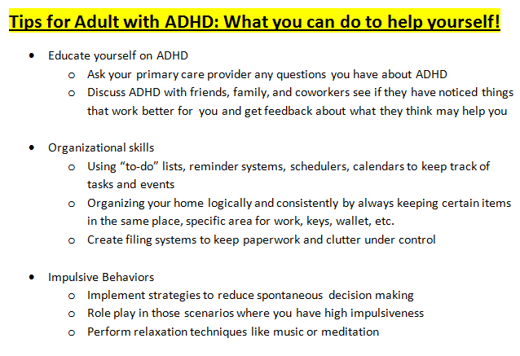

Slide 28
Protocol: Recommendations for Providers
Initial visit
Medical history and physical exam
History of ADHD symptoms, functional impairments
Screening for depression, anxiety, substance abuse
ADHD rating scales –self, parent, teacher, collateral
Obtain prior records
No meds on 1st visit
Urine toxicology screen
Warm hand-off to Behavioral Health team
Return visit – 1 month

Slide 29
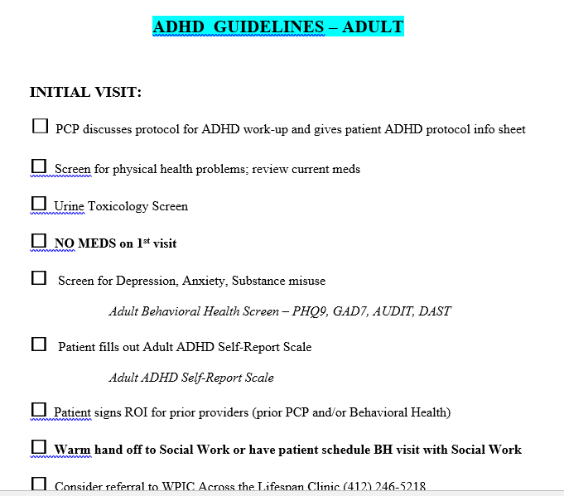

Slide 32
Protocol: Recommendations for Providers
Return visits
Review prior records, screening, rating scales, BH team assessment
Controlled substance agreement, if stimulant meds prescribed
Check PDMP, if stimulant meds prescribed
Follow-up every 1-3 months
Review current symptoms and functional impairments
Repeat rating scales
Review med adherence and side effects
Review recent behavioral attempts at home/school/work

Slide 33
Implement: ADHD Protocol w/ Multidisciplinary Team
Multidisciplinary team
Family Med residents and faculty
Front desk
Nursing
Pharmacists
Behavioral Health clinicians – Social Work, Psychiatry

Slide 34
Implement: Protocol Access
Multiple ways to access website with ADHD protocol and forms:
Paper
EHR links
Website

Slide 35
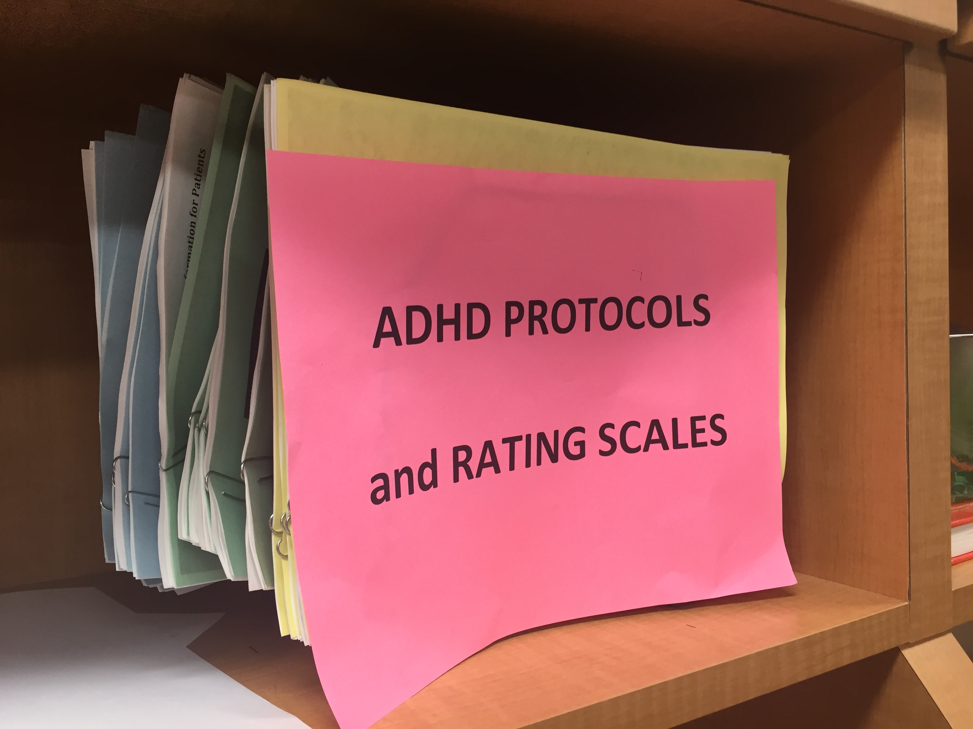
Protocol on Paper

Slide 36
Implement: Electronic Health Record templates
EHR - EPIC Smartphrases
Prompts to follow protocol
Assists in documentation
Adapts protocol to age group
.ADHDCHILD
.ADHDTEEN
.ADHDADULT

Slide 37
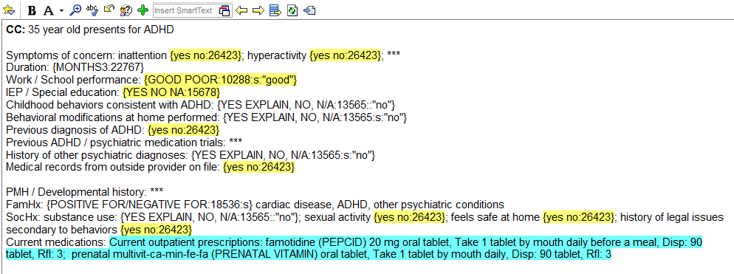
Sample Smartphrase
Set up like a well child template with protocol built in:

Slide 38
Smartphrase Assessment / Plan

Slide 39
UPMC St. Margaret Family Med Residency BEHAVIORAL HEALTH website
SMFMRESBEHAVHEALTH Google Site
https://sites.google.com/site/smfmresbehavhealth/
MedHub – Behavioral Health
https://upmc.medhub.com/index.mh

Slide 40
WEBSITE - ADHD Links
NEW behavioral health website link built into smartphrase note
https://sites.google.com/site/smfmresbehavhealth/
Click BH Protocols -> ADHD Protocols -> Choose age group -> forms on website

Slide 41
Website includes:
New Policy for ADHD visits (for patients)
Handout with age appropriate behavioral modifications (Tips for parents/ adults with ADHD)
All ADHD assessment tools including Vanderbilt Child / Teen, Adult ADHD scale, PHQ9 for teens and adults, substance screening questions
Controlled substance contract
Handout with ADHD Across the Lifespan clinic info
Updated chart with ADHD medication information

Slide 42
Patient Handout about ADHD Protocol

Slide 43
Website includes:
New SMH Policy for ADHD visits (for patients)
Handout with age appropriate behavioral modifications (Tips for parents/ adults with ADHD)
All ADHD assessment tools including Vanderbilt Child / Teen, Adult ADHD scale, PHQ9 for teens and adults, substance screening questions
Controlled substance contract
Handout with ADHD Across the Lifespan clinic info
Updated chart with ADHD medication information

Slide 44
Website includes:
New SMH Policy for ADHD visits (for patients)
Handout with age appropriate behavioral modifications (Tips for parents/ adults with ADHD)
All ADHD assessment tools including Vanderbilt Child / Teen, Adult ADHD scale, PHQ9 for teens and adults, substance screening questions
Controlled substance contract
Handout with ADHD Across the Lifespan clinic info
Updated chart with ADHD medication information

Slide 45
Website includes:
New SMH Policy for ADHD visits (for patients)
Handout with age appropriate behavioral modifications (Tips for parents/ adults with ADHD)
All ADHD assessment tools including Vanderbilt Child / Teen, Adult ADHD scale, PHQ9 for teens and adults, substance screening questions
Controlled substance agreement
Handout with ADHD Across the Lifespan clinic info
Updated chart with ADHD medication information

Slide 46
Website includes:
New SMH Policy for ADHD visits (for patients)
Handout with age appropriate behavioral modifications (Tips for parents/ adults with ADHD)
All ADHD assessment tools including Vanderbilt Child / Teen, Adult ADHD scale, PHQ9 for teens and adults, substance screening questions
Controlled substance contract
Handout w/ ADHD Across the Lifespan clinic info
Updated chart with ADHD medication information

Slide 47
Website includes:
New SMH Policy for ADHD visits (for patients)
Handout with age appropriate behavioral modifications (Tips for parents/ adults with ADHD)
All ADHD assessment tools including Vanderbilt Child / Teen, Adult ADHD scale, PHQ9 for teens and adults, substance screening questions
Controlled substance contract
Handout with ADHD Across the Lifespan clinic info
Updated chart with ADHD medication information

Slide 48
Assess: Resident Protocol Use and Satisfaction
Resident surveys August 2016/April 2017:
Most of our upper level PGY 2 and PGY 3's have used it and have positive things to say!
Most said paper is most valuable to them right now
TONS of positive responses about EHR SmartSet!

Slide 49
Assess: Lessons Learned
Need to work with both health system and EHR framework
Importance of multiple modalities
Repetition for practice change
Patient acceptance of thorough assessment
Continuity of project over time

Slide 50
Additional References
Post RE, Kurlanski ST; Diagnosis and Management of Attention-Deficit/Hyperactivity Disorder in Adults. AM Fam Physician 2012; 85 (9) 890-96.
Volkow ND, Swanson JM.Adult Attention Deficit-Hyperactivity Disorder. NEJM 2013;369 (20)1935-44.
JAMA 2011 Dec 28;306(24):2723.
Drugs for Treatment of ADHD;Treatment Guidelines from The Medical Letter • May 1, 2011 (Issue 105) p. 23
Safren SA, et.al. Mastering Your Adult ADHD. Oxford University Press 2005.
DSM 5; American Psychiatric Assn., 2012; http://www.dsm5.org
http://www.nimh.nih.gov/statistics/1ADHD_ADULT.shtml

Slide 51
Questions / Discussion

