Slide 1
A Tweet Is Worth A Thousand Words:
How to Use Social Media to Disseminate Evidence Based Medicine
Notes:
Today we will be discussing social media and its role in medical education, particularly as it pertains to promoting evidence-based medicine

Slide 3
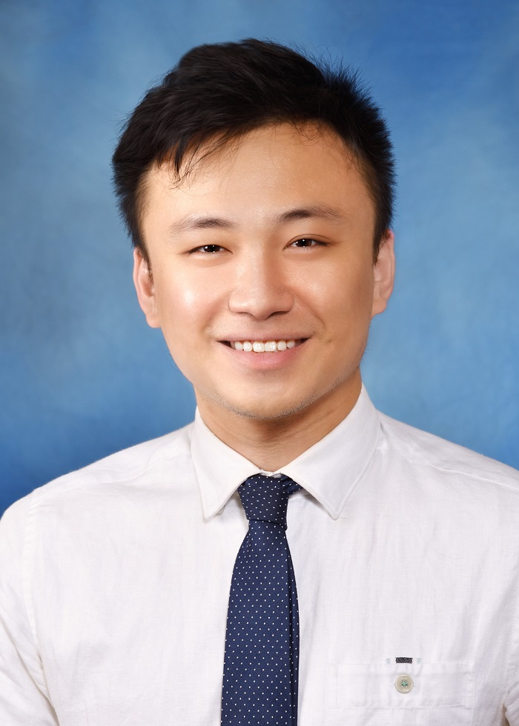
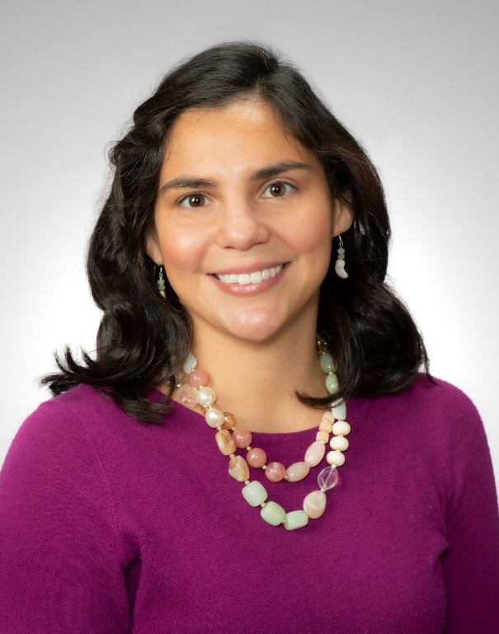
Greg Castelli, PharmD
Director, PGY1 Pharmacy Residency Program
Director, Interprof Pharm Education
Director, Medical Decision Making
Yufei Ge, MD
Faculty Development Fellow
Stella Winters, MD
Assistant Medical Director Lawrenceville FHC

Slide 4
Disclosures
ABFM National Journal Club Grant Recipient
The material presented here is being made available for educational purposes only. Please note that medical information is constantly changing; the information contained in this activity was accurate at the time of publication. This material is not intended to represent the only, nor necessarily best, methods or procedures appropriate for the medical situations discussed. Rather, it is intended to present an approach, view, statement, or opinion of the faculty, which may be helpful to others who face similar situations.

Slide 5
Objectives
List three different social media (SM) platforms that improve participation in evidence-based medicine (EBM) principles
Describe the best practices involved in translating EBM into a social media activity
Outline how to apply EBM teaching using one social media platform
Notes:
Say these are slightly different

Slide 6
Social Media and Graduate Medical Education
Critical review of medical literature is an essential component of medical education and an ACGME requirement
Challenging for busy learners to engage in traditional evidence-based medicine (EBM) instruction, such as journal club, for a variety of reasons
Having digestible, easily accessible evidence makes it more likely to be applied to patient care
Notes:
But before we get into all of that, let’s take a step back and ask why are we even bothering on evidence-based medicine? Like, why is there a focus on innovating the way EBM has traditionally been accessed?
Critical review of medical literature is essential for residency training both because 1. It makes good doctors and 2. because it is an ACGME requirement. However, as we all know, it is incredibly challenging to engage busy learners in traditional instruction. And, especially with “generation z” learners, medical education has kind of evolved into presenting information in a way that is more digestible and easily accessible.

Slide 7
Social Media and EBM
Larger and more diverse conversations
Representation by multiple tiers of medical training, including lay population
Not limited by geographic location or institutional access
Brings the opportunity for critical appraisal to a broader community
Archived and available for as needed
Notes:
Why social Medicine? It kind of aligns with the more modern features of medical education
I just want to point out why social media works so well for EBM: First of all, it allows for more large-scale and diverse conversations with representation across multiple tiers of experts, trainees, and the lay public. And this is possible because the content can be accessed independent of institutional access and geographic location. It’s like crowd-sourcing a critical appraisal.
Figure 2: Critical appraisal to the social table.pdf
Twitter Journal Clubs: Medical Education in the Era of Social Media – PubMed (nih.gov)

Slide 8
Social Media Studied for EBM Teaching
Blogs
Videos/
Twitter
Podcasts
Notes:
The three most common ways EBM has been implemented in social media are as blogs, videos , podcasts, or via Twitter.

Slide 9
Social Media Studied for EBM Teaching
Blogs
Videos/
Twitter
Podcasts

Slide 10
Blog
Personal “journal” that is virtual and publicly accessible
Notes:
A blog is essentially a virtual, publicly accessible journal where one could write about any topic, including summarizing or critiquing a recent publication. There are usually hyperlinks, graphics, and “leave a reply” text boxes to encourage engagement and some semblance bi-directional discussion

Slide 11
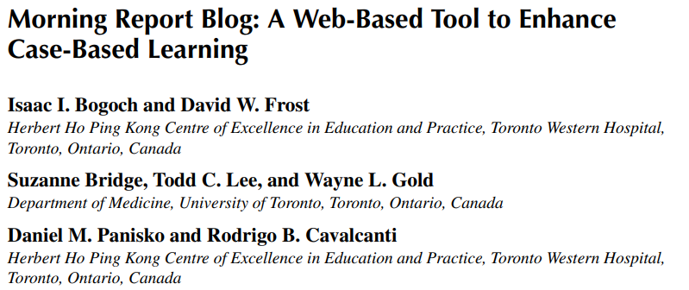
Blogs and EBM
Notes:
Morning Report Blog: A Web-Based Tool to Enhance Case-Based Learning (tandfonline.com)

Slide 12
Blogs and EBM
Notes:
There was a study in 2012 that looked at the implementation of a “Morning Report Blog” by an internal medicine residency based out of Toronto. Essentially, after morning report each day, the chief resident would update the blog with pertinent clinical topics, links to journal articles, and medical images and the residents were emailed later in the day with a link to the blog. According to the article, residents found the blog to be “a useful learning tool and cited it to be among the top 3 educational resources accessed during their rotation”.
Morning Report Blog: A Web-Based Tool to Enhance Case-Based Learning (tandfonline.com)

Slide 13
Notes:
Morning Report Pearls | UCSF Internal Medicine Chief Resident Hub | …because we can't all make it to morning report. (wordpress.com)
Making the Rounds – University of Iowa Department of Internal Medicine (internalmedicineiowa.org)
Chiefs Blog | Internal Medicine Residency Program (wustl.edu)
Internal Medicine Chief Blog (imiowa.com)
WCH Medicine Blog – An Educational Hub for Trainees at Women's College Hospital (wchcmr.org)
EMCrit Blog - Emergency Department Critical Care & Resuscitation
Blog | Brown Pediatrics Residency (brownpedsresidency.org)
Home - REBEL EM - Emergency Medicine Blog
Blogs | RheumNow
ACG Blog - American College of Gastroenterology (gi.org)
Voice of Radiology Blog | American College of Radiology (acr.org)

Slide 14
FM Blog Example
Notes:
There are a lot of medical education blogs out there. Specific to Family Medicine, the University of Utah Family Medicine Program has a blog that is regularly updated and, although not specific to EBM, is overall a great and practical way of having a social media presence.
https://fammedvitalsigns.com/
Resident Roundup: Alex Rice, MD | Duke Duke Department of Family Medicine and Community Health

Slide 15
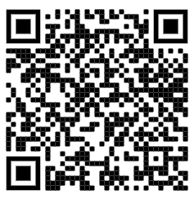
Blogs Test Drive
Let’s build a list!
What Blog-based EBM teaching resources do you like?

Slide 16
Blogs: Key Points
Wide reaching audience
Easily shareable, no accounts needed
Adaptable and can include images and links
Not restricted to character count
Asynchronous discussion (if at all)
Notes:
In summary, the benefit of blogs are they have a wide-reaching audience and easily shareable. They can be adaptable with graphics, videos, and links, and unlike other platforms are not restricted by character count or time limits. The downside for blogs is that, although there can be an option for leaving comments, that discussion happens generally happens asynchronously.

Slide 17
Social Media and EBM
Blogs
Videos/
Twitter
Podcasts

Slide 18
Videos and EBM
90% of respondents reported using videos for surgical preparation
Increased knowledge
High levels of learner satisfaction
Increased levels of confidence
Notes:
Videos are popular because they are inherently engaging– fast paced and very visual
YouTube is the most common platform.
Recently, the Association of Medical Medical Science Educators published a literature review of different studies involving YouTube as an educational tool.
Common themes that emerged were increased knowledge, high levels of learner satisfaction, and increased levels of confidence.
A kind of ‘niche’ for videos has been in teaching procedures or anatomy-related topics.
In 2016, the Department of Surgery at the University of Iowa surveyed 4th year medical students going into surgery, general surgery residents and faculty surgeons and found that 90% of respondents used videos for surgical preparations
*YouTube as an Educational Resource in Medical Education: a Scoping Review (nih.gov)
YouTube is the Most Frequently Used Educational Video Source for Surgical Preparation - PubMed (nih.gov)
YouTube is the Most Frequently Used Educational Video Source for Surgical Preparation - ScienceDirect

Slide 19
Videos and EBM
Notes:
F. Perry Wilson, MD - YouTube

Slide 20
Video Test Drive
Let’s build a list!
What video-based EBM teaching resources do you like?

Slide 21
Videos: Key Points
High level of engagement
Easy to communicate complex topics
Open access, easily shareable
Adjustable playback speed
Time and cost commitment
Asynchronous discussion (if at all)
Notes:
The main benefit of videos is their relatively high level of engagement.
You can communicate complex information very simply and quickly if done well.
Also, YouTube is open access, so the content can be shared with anyone.
Lastly, videos can be paused or sped up or re- watched depending on the preferences of the individual learner.
The biggest downside is that these can be pretty time consuming or expensive to create.
And, like other social media platforms, there is no peer-review or quality control process.
Discussion is asynchronous

Slide 22
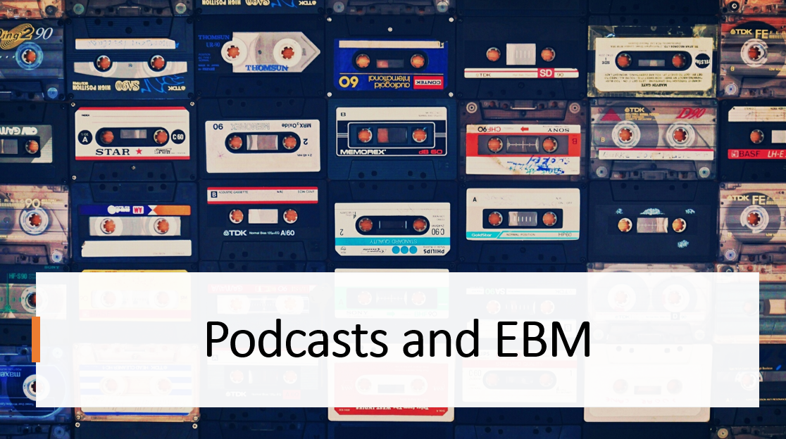
Notes:
Podcasts are similar to videos: they are the audio without the visual
Have been used for disseminating EBM

Slide 23
Podcasts and EBM
Useful for learning
Improves scores/ performance
Notes:
In 2017, a group out ouf UCSF

Slide 24
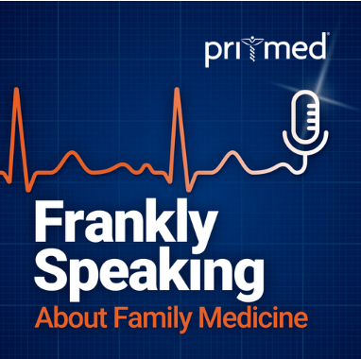
Podcasts and EBM
Notes:
All podcasts (hopkinsmedicine.org)
Medical RSS Feeds and Podcasts: The New England Journal of Medicine (nejm.org)
Internal Medicine Podcasts | CME & MOC Available | ACP (acponline.org)
Listen to podcasts from JAMA Network
The Lancet Voice
Journal of Clinical Oncology (JCO) Podcast (libsynpro.com)
AFP: American Family Physician Podcast (aafp.org)
A weekly podcast series covering newsworthy topics in Family Medicine. | Pri-Med
BS Medicine Podcast - Listen to the Latest Evidence (peerevidence.ca)

Slide 25
Podcast Test Drive
Let’s build a list!
What podcasts-based EBM teaching resources do you like?

Slide 26
Podcasts: Key Points
Easy to consume
Adjustable playback speed
Dialogue format
Less time and cost commitment than videos
Asynchronous discussion (if at all)
Some require a subscription

Slide 27
Social Media and EBM
Blogs
Videos/
Twitter
Podcasts

Slide 28
and EBM
Character number limitation
Posts are succinct and bi-directional
Same pace as a conversation

Slide 29
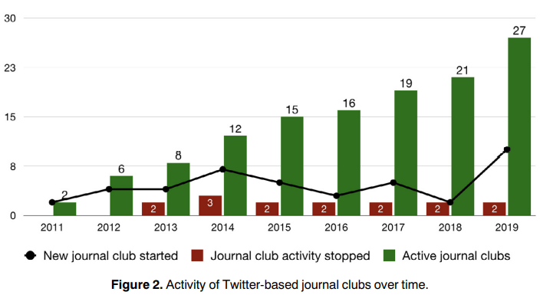
Twitter and EBM
Notes:
Table 1: Critical appraisal to the social table.pdf

Slide 30
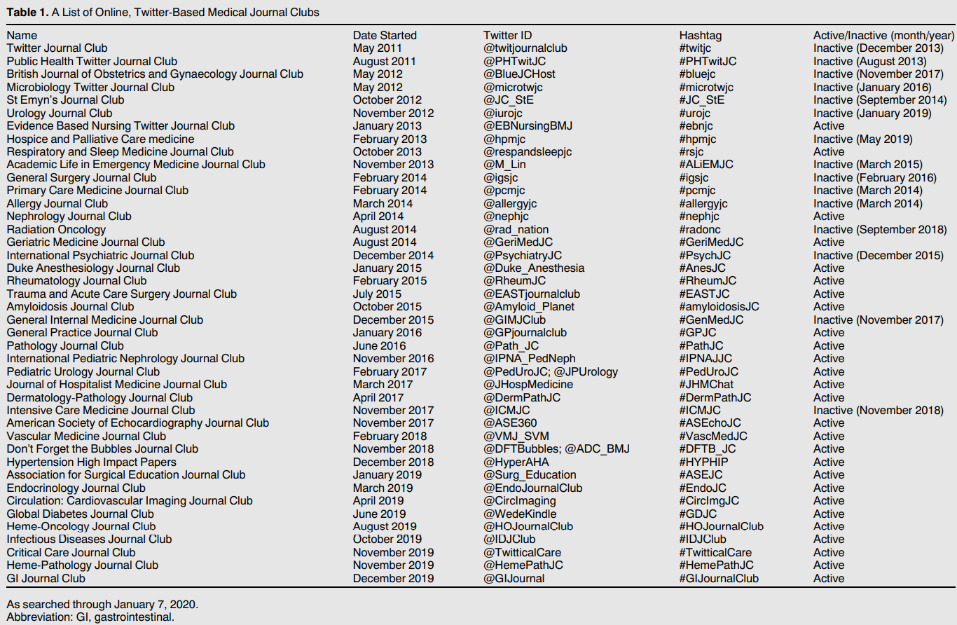
Notes:
Table 1: Critical appraisal to the social table.pdf

Slide 31
Synchronous, 1-hr session
Every 2 weeks
Distribution to subscribers:
Written summary + visual abstract
Website/blog, newsletter email, tweets
Recruit participation:
Authors
Experts in the field
Moderator:
Summarize methods and outcomes
Facilitates participation
Average session:
173 participants
700 tweets
‘Twitter Moment’
Discussion is curated and archived

Slide 32
Twitter and EBM: The SMART-ME Initiative
#AMReport
Highlights relevant articles and teaching points from morning report
#ChiefRounds
Summarizes learning points from teaching rounds
#DocOfTheDayPearl
Sharing of teaching point by urgent-care outpatient clinic res
#LibraryRounds
In-depth clinical query of an EBM topic relevant to inpatient ward team’s clinical question
Overall, perceived favorably by residents
Notes:
*doi:10.3402/meo.v21.29332 (nih.gov)

Slide 33
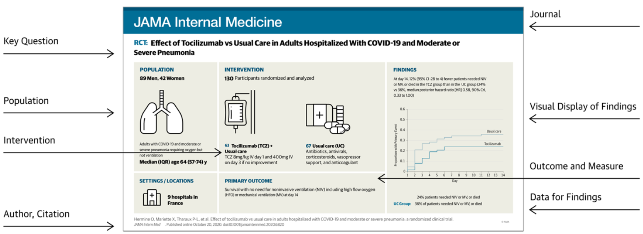
Visual Abstract
Graphical summary of a journal article
Notes:
Visual Abstracts: Key Findings and Conclusions of Randomized Clinical Trials | JAMA Network | JAMA Network

Slide 34
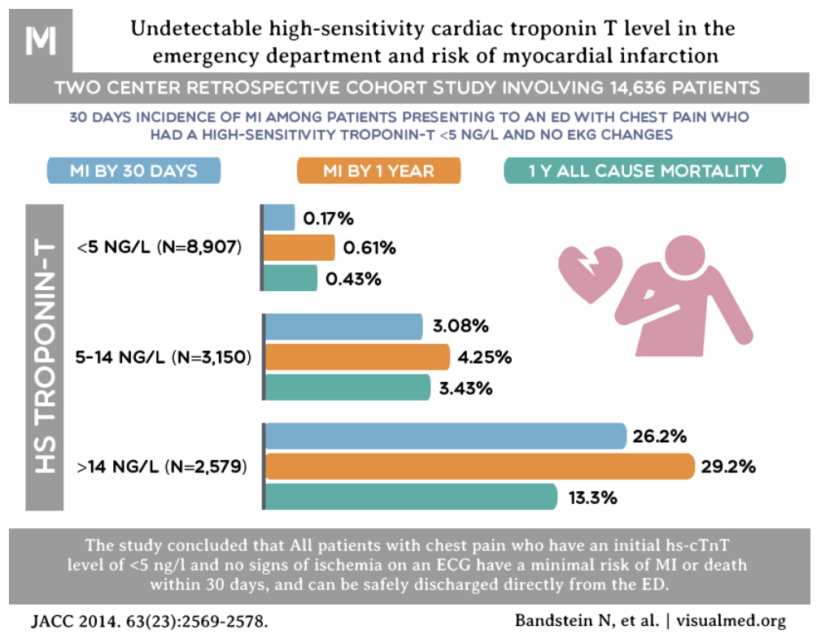
Notes:
Visual Abstracts | Cardiology Now (cardiologynownews.org)

Slide 35
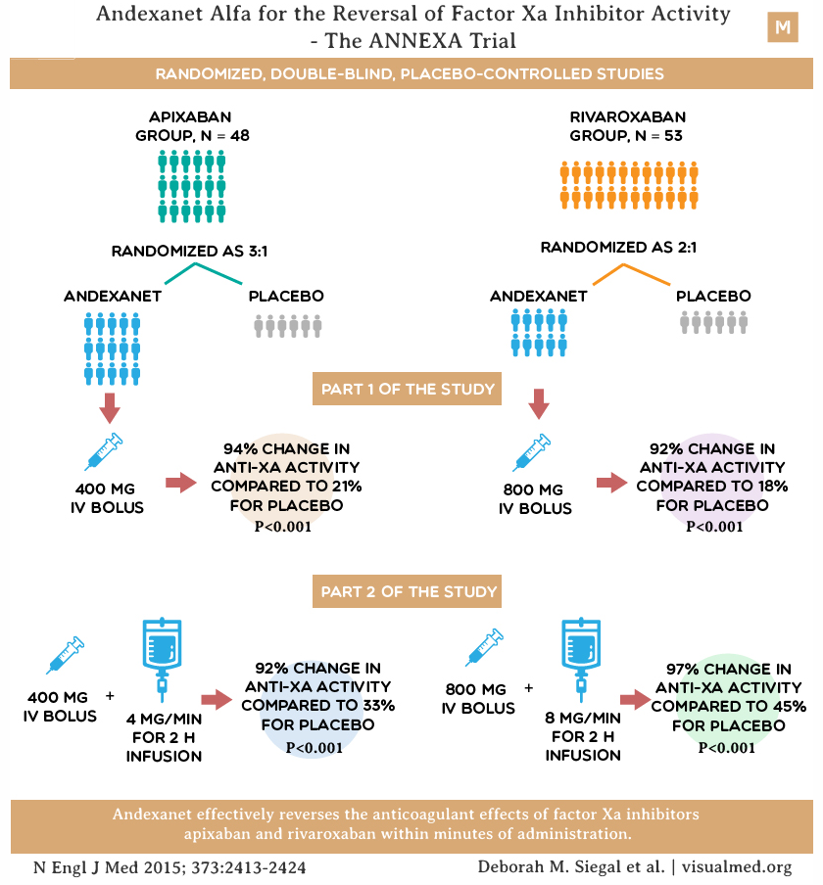
Notes:
Visual Abstracts | Cardiology Now (cardiologynownews.org)

Slide 36
Twitter Test Drive
Let’s build a list!
What Twitter-based EBM teaching resources do you like?

Slide 37
Twitter: Key Points
Open access, far-reaching
Synchronous option with real-time dialogue
Retrievable information
Regular audience to get off the ground
Time commitment to organize

Slide 38
Small Group Activity

Slide 39
Social Media and EBM → UPMC St. Margaret
Blogs
Videos/
Twitter
Podcasts
Stories
Several Platforms

Slide 40
Our Approach
Our intention is to communicate the take home message of the article through stories
ABFM Funded through National Journal Club Initiative
Original research articles relevant to summarized by videos of role play of fictional characters
Review clinical results and statistical topics
Disseminate through SM
Notes:
(takes the form of audio content curation)

Slide 41
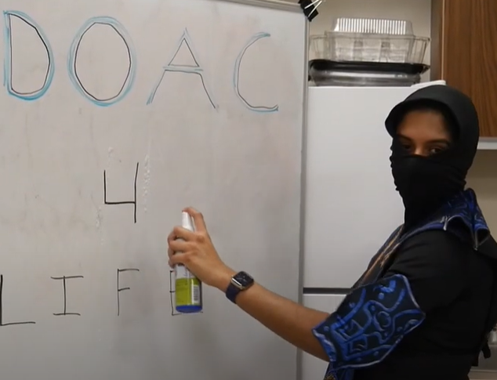
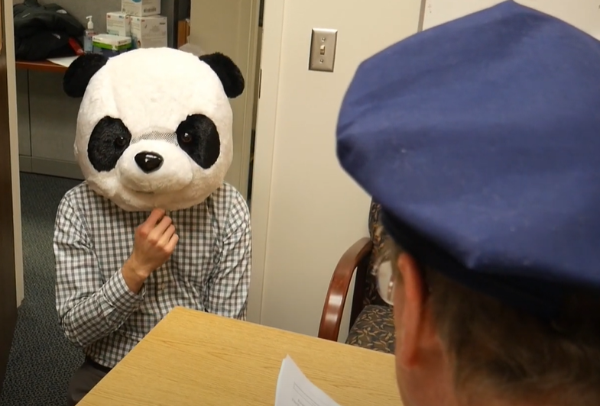
Example: Rivaroxaban for bioprosthetic valves
Police chief gets call from the mayor.
Detective Bloomfield’s questions allow for EBM teaching
The detectives attempt to ask questions of a DOAC-tivist
Detective St. Marg shows up with a PICO
Detective St. Marg gets a witness statement from a Warfarin Vet
In interrogation, we learn the DOAC-tivist has been using NI trials incorrectly

Slide 42
Summary
SM is a useful teaching tool and can be powerful for teaching EBM principles and new articles
Many examples exist if you need a starting place and you don’t have to “go viral” right away
We hope that combining multiple strategies will help with knowledge retention and concept utilization
Notes:
Say these are slightly different

Slide 43
References
Sterling M, Leung P, Wright D, Bishop TF. The Use of Social Media in Graduate Medical Education: A Systematic Review. Acad Med. 2017 Jul;92(7):1043-1056. doi: 10.1097/ACM.0000000000001617. PMID: 28225466; PMCID: PMC5487290.
Colbert GB, Topf J, Jhaveri KD, Oates T, Rheault MN, Shah S, Hiremath S, Sparks MA. The Social Media Revolution in Nephrology Education. Kidney Int Rep. 2018 Feb 17;3(3):519-529. doi: 10.1016/j.ekir.2018.02.003. PMID: 29854960; PMCID: PMC5976821.
Stoneman S, Hiremath S. Twitter-Based Journal Clubs: Bringing Critical Appraisal to the Social Table. Semin Nephrol. 2020 May;40(3):264-272. doi: 10.1016/j.semnephrol.2020.04.004. PMID: 32560774.
Curran V, Simmons K, Matthews L, Fleet L, Gustafson DL, Fairbridge NA, Xu X. YouTube as an Educational Resource in Medical Education: a Scoping Review. Med Sci Educ. 2020 Jun 29;30(4):1775-1782. doi: 10.1007/s40670-020-01016-w. PMID: 34457845; PMCID: PMC8368389.
Bogoch II, Frost DW, Bridge S, Lee TC, Gold WL, Panisko DM, Cavalcanti RB. Morning report blog: a web-based tool to enhance case-based learning. Teach Learn Med. 2012;24(3):238-41. doi: 10.1080/10401334.2012.692273. PMID: 22775788.

Slide 44
References
University of Utah Family Medicine Residency Program in Salt Lake City, UT. Family Medicine Vital Signs, 19 Jan. 2022, https://fammedvitalsigns.com/.
Rapp AK, Healy MG, Charlton ME, Keith JN, Rosenbaum ME, Kapadia MR. YouTube is the Most Frequently Used Educational Video Source for Surgical Preparation. J Surg Educ. 2016 Nov-Dec;73(6):1072-1076. doi: 10.1016/j.jsurg.2016.04.024. Epub 2016 Jun 14. PMID: 27316383; PMCID: PMC7263439.
Wilson, F Perry. Do diet drinks work? YouTube, https://www.youtube.com/watch?v=e5IcYfuCuzk&t=162s.
“NEPHJC.” NephJC, http://www.nephjc.com/. Thomas B, Topf J, Hiremath S, Madariaga H, Lim M, Leon S, Shingada A, Colbert G, Sparks M. NephJC Primer on Twitter Journal Clubs. Version 1.4. www.NephJC.com/Primer
Galiatsatos P, Porto-Carreiro F, Hayashi J, Zakaria S, Christmas C. The use of social media to supplement resident medical education - the SMART-ME initiative. Med Educ Online. 2016 Jan 8;21:29332. doi: 10.3402/meo.v21.29332. PMID: 26750511; PMCID: PMC4707390.
Cho D, Cosimini M, Espinoza J. Podcasting in medical education: a review of the literature. Korean J Med Educ. 2017 Dec;29(4):229-239. doi: 10.3946/kjme.2017.69. Epub 2017 Nov 29. PMID: 29207454; PMCID: PMC5717411.
Rodman A, Trivedi S. Podcasting: A Roadmap to the Future of Medical Education. Semin Nephrol. 2020 May;40(3):279-283. doi: 10.1016/j.semnephrol.2020.04.006. PMID: 32560776.

