Slide 1
Finding Resiliency, Hope and Compassion through Reflective Writing, Storytelling and Story Listening
Colleen T. Fogarty, MD, MSc.
Paul Gross, MD
Jonathan Han, MD
Lucille Marchand MD, BSN, FAAHPM
Jo Marie Reilly, MD
Johanna Shapiro, PhD

Slide 2
No disclosures

Slide 3
Learning Objectives
Identify our innate qualities that foster well-being and connect us to our deepest self, our calling, our values, and our heart.
Experience 4 writing methods that can be incorporated into personal reflection, professional team building and care, and teaching.
To foster resiliency, hope, and compassion by integrating self-reflective writing, story telling and story listening into:
Contemplative personal practice
Teaching learners
Clinical team care

Slide 4
Our Innate Qualities
Compassion
Resiliency
Hope

Slide 5
The Quality of our Work
Work as calling – service
Work as a career
Work as a job
Does our work renew us?
Notes:
Let’s let audience ponder this for a moment.
We can then ask each other this question – ex. Kevin, at what age were you called to make a difference in this world? Then Lu…..
Our work can be a job. We get up in the morning, put in our 10 hours or more, and then go home to our real life. The part of our life that matters. Our job is what we do to provide money for the necessities and other pleasures of life.
Our work can be a career. We try to find work that is intellectually stimulating and will lead to recognition of our expertise. We can have satisfying work, it pays well, we are promoted.
There is nothing wrong with our work being a job or career. But when we consider work as renewal, it might need to go deeper.
Our work as service or calling. Infused with meaning and purpose.

Slide 6
Hope
“Hope does not lie in a way out, but in a way through.”
Robert Frost
Notes:
Hope as a noun centers on the mind. It is static. What can be fixed? What can be cured? What is in our toolbox? Hammer and nail? Medicine has limited hope when cure and fix are no longer possible or desirable. Hopelessness and false hope are easy when hope is so limited in scope and imagination.
When hope is a verb or process, it is dynamic, fluid, creative. Hope can lie outside of our boxes. It can lie in the patient’s goals, values, what they see as important. Hope can change just as life changes. It is stronger and more supple, and less rigid and vulnerable to moving into hopelessness and helplessness.
What are the contemplative practices that help us move through uncertainty and challenge?
What are the stories we tell ourselves that keep us in fear and immobilized, or allow us to keep moving through?
Hope as a process can be big enough to allow for uncertainty, new options and possibilities. It allows for patient centeredness and empowerment.

Slide 7
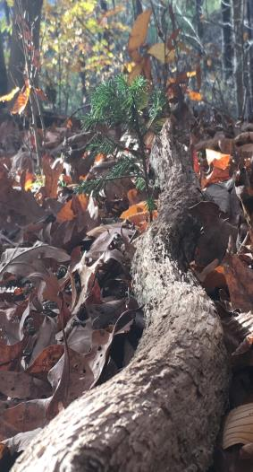
Resiliency
The urge to move forward despite great uncertainty and challenge.
Clinician resiliency skills can be learned and enhanced.
Proactive rather than reactive and problem centered.
Individual skills vs workplace factors.
Authors below are testing a skills based intervention that addresses both.
Back AL, Steinhauser KE, Kamal AH, Jackson VA. Building resilenc for palliative care clinicians: an approach to burnout prevention based on individual skills and workplace factors. J Pain Symptom Manage 2016;52:284-291.
Notes:
Resiliency is more than just bouncing back from adversity. When we see challenge, we also see possibility and growth. We can move through our work with courage.
In resiliency, we can allow our emotions to be information to guide us. When emotions are acknowledged, we can connect to our deeper self and to others.
We can move through challenge and uncertainty.
When something in our lives needs to change and grow, our emotions are often are first clue. In resiliency, we respond in a way that nurtures growth and connects us to what really matters most to us.

Slide 8
Stages of professional growth in working with dying patients – emotional self regulation
Intellectualization (emotions are dangerous)
Emotional survival (feeling, acknowledging, and valuing emotions)
Depression (grief and loss)
Emotional arrival (emotions are helpful and normal)
Deep compassion (emotional self regulation through mindfulness and contemplative practices)
Lu’s interpretations in italics.
Harper, B. Death: The Coping Mechanism of the Health Professional. Greenville, S.C.: Southeastern University Press, 1977
Notes:
Gave me my first understanding of a developmental process to developing compassion. We are innately compassionate, but clinical training can undermine this innate compassion with anxiety, fear, urge to fix and cure even in situations where that is not possible. We can turn away, unless our emotions are recognized as valuable but needing understanding and spiritual practices that nourish our capacity to be compassionate.
Traditionally in medicine, emotions were judged as bad or distracting, especially if the emotions were sadness, grief or anger, or stimulated tears.
We were trained to deny emotions in ourselves, patients and others.
WE were trained in burn out and compassion fatigue, and vulnerable to hopelessness and helplessness.
We were shamed and humiliated.

Slide 9
Challenging Situations Bring Up Emotions!
Emotions are information!
How do we work with our emotions?
What is the story behind our emotion?
Contemplative practices can help us….
Writing and storytelling can help us…
Back AL, et al. “Why are we doing this?”: Clinician Helplessness in the Face of Suffering. J Pall Med 2015; 18(1): 26-30
Notes:
Engaging emotions and regulating emotion to maintain relationality rather than distance from suffering.

Slide 10
The heart is needed to balance the mind.
Heart and mind working together,
open, curious,
in presence,
is mindfulness.
Nurtured and learned through skill acquisition and practice.
Notes:
Engaging emotions and regulating emotion to maintain relationality rather than distance from suffering.
Engaging emotions and regulating emotion to maintain relationality rather than distance from suffering.
Safety and certainty
Problems to solve
Solutions to problems
Fixing
What happens when that is not possible?
Panic!!!
Exit!!!!
Hopeless!!
Fear!!!

Slide 11
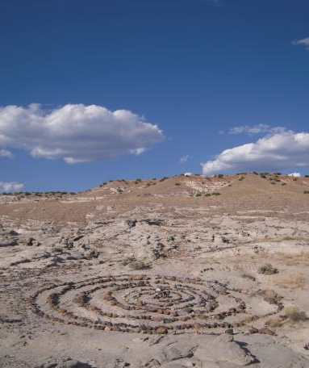
Contemplative Practices for Self and Others
Prayer/meditation
Spiritual practices
Meditative movement
Art
Retreat
Reflective writing/storytelling
Notes:
Kevin, what are the contemplative practices you do in your work and life that nurture your compassion, resiliency and hope? Lu, what are yours?
What are the qualities of those practices? They help me pause, meditate, breathe consciously, meditatively move my body with intention, relax my mind. They keep me uplifted and moving forward in a direction that matters to me, that makes a difference.
Contemplative practices allow us to find our way back to our spirit, our calling, our compassion, resiliency and hopefulness.
What are those practices that resonate with us? With you?
What is your approach to patient care that gives you renewal? Rather than exhaustion.

Slide 12
Noticing…Reflecting…Healing: writing as contemplative practice
Noticing: Awareness, mindfulness and presence. Allowing the hidden to become visible.
Reflecting: writing and sharing the story. Connect thinking with the heart and soul.
Healing: As we experience the vulnerable places in others and in ourselves, we have the opportunity to heal and renew ourselves.
Marchand L, Gasper A, Go L, Schaefer E, Beasley J. More 55-Word Stories: Noticing, reflecting, healing. American Academy of Hospice and Pallliative Medicine Quarterly.2014 ; Summer (15): 14-15.

Slide 13
What are the qualities of our stories?

Slide 14
Story-telling and Story-listening
Allowing ourselves to hear the story of another without interruption or advice giving (fixing and problem-solving), but with generous listening, presence, witnessing, mindfulness and compassion.
Telling our stories to others- finding our voice.

Slide 15
Writing methods
Journaling- what touched you, what surprised you, what inspired you?
Writing the story – free write
Storytelling and story listening - dyads
Sharing in small group
55 Word story
Haiku
6 word story
Sharing in large group

Slide 16
Preparing to write
Notes:
Pause and lead through a mindfulness time refocusing on innate qualities of compassion resiliency and hope

Slide 17
Presence
The Pause and Breathing Consciously
Being still. Being able to be silent yet attentive.
Generous listening (Rachel Remen, MD)
Listening to what is inside you and what is coming from the other person both verbal and nonverbal – connection.
Active relaxation – activation of parasympathetic nervous system

Slide 18
Breathing Consciously
Basic practice of many contemplative traditions
Deep relaxed belly breathing – the long exhalation
Well-being, relaxation, and presence

Slide 19
Journaling (Rachel Remen, MD)
For one month, every day, reflect back on your day, and describe something that day about each question:
What surprised me today?
What moved or touched me today?
What inspired me today?
Rachel guarantees that this practice will bring meaning to your work and life, joy, and hope
http://www.ishiprograms.org/

Slide 20
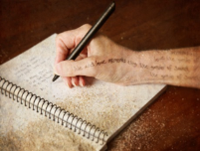
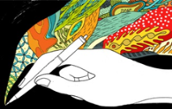
Free Write: Pre-Writing Technique
Write continuously for a set period of time 5-15 minutes
Disable internal editor, censor
Ignore grammar, spelling, punctuation, style, topic, logic –
no going back!
If you can’t think of anything to write, write:
“I can’t think of anything to write”
Keep your hand moving – keep writing!

Slide 21
Discussion
What was it like for you to write your story?
What was it like to tell your story?
What was it like to listen and witness the other person’s story?
Any other thoughts or feelings to share about this experience/method?

Slide 22
The 55 Word Story
Moss, Steve. The world's shortest stories: 55 fiction. 1995.
Late editor of the San Luis Obispo New Times. Originator of the method
Anne Scheetz, MD, Mary Fry MD. The stories. JAMA 2000;283:1934. Adapted this form for use in medical narratives.
“To tell—in 55 words exactly—a story that helps us to understand, or to appreciate, something about a patient or about an experience of health care.”

Slide 23
Writing the 55 Word Story
Take 15 minutes to write a 55 word story
Write as many words as you can for 10 minutes without editing. Then, take 5 minutes to remove any unnecessary words until you get to 55 words. Title not included.

Slide 24
Haiku
5 syllables, 7 syllables, 5 syllables

Slide 25
6 WORD STORY

Slide 26
Circle of Sharing
Form a large group circle and share/read our 6 word story in large group.
Then say one word that expresses what you want to bring home with you.
Sharing of any of our stories in large group and reflections on today’s workshop.
Please complete your evaluations. Thank you for your feedback.

Slide 27
Contact Info for Faculty
Colleen T. Fogarty, MD, MSc. University of Rochester Colleen_Fogarty@urmc.Rochester.edu
Paul Gross, MD Montefiore, Bronx pgross@pulsevoices.org
Jonathan Han, MD UPMC St. Margaret hanxjk@UPMC.EDU
Lucille Marchand MD, BSN, FAAHPM University of Washington, Seattle lrm19@uw.edu
Jo Marie Reilly, MDUniversity of Southern California, Los Angeles jmreilly@usc.edu
Johanna Shapiro, PhD University of California, Irvine jfshapir@uci.edu

Slide 28
Addendums and References
Resources on writing and publishing your writing
Free writing method
55 word story:
Marchand L, Fleming E, Mastrocola J, Gasper A, Marty E. Noticing, Reflecting, Healing: 55 word stories. American Academy of Hospice and Palliative Medicine Quarterly.2014 ; Spring (15): 7.
Fogarty C. Fifty-five word stories: “small jewels” for personal reflection and teaching. Family Medicine. 2010;42(6):400-2.

Slide 29
Thank you!

