Slide 1
The Dual Imperative in Ending the HIV Epidemic: Primary Care and Social Determinants of Health for Persons Living with HIV
Yury Parra MD, FAAFP, AAHIVS
(she/her/hers)
Clinical Assistant Professor
Department of Family & Social Medicine/Albert Einstein College of Medicine
NYC Health + Hospitals Corporation
Yasmin Hashemi, DO, AAHIVS
(she/her/hers)
PGY3 Family Medicine Resident
Icahn School of Medicine at Mount Sinai Family Medicine Residency Program
The Institute for Family Health
Acknowledgements:
Radeeb Akhtar MD MPH AAHIVS (he/him/his)
Associate Program Director. Icahn School of Medicine at Mount Sinai Family Medicine Residency Program. The Institute for Family Health
Marshal N. Miller, MD, AAHIVS (he/him/his)
Clinical Assistant Professor. Associate Residency Program Director. HIV Primary Care Fellowship Director. Department of Family & Community Medicine. Thomas Jefferson University
Notes:
Brief names

Slide 2
Disclosures
None

Slide 3
Objectives
Understand how structural factors impact the outcomes of people living with HIV/AIDS (PWH) with a particular emphasis on housing instability.
Identify strategies and available resources to support PWH.
Become familiar with how to become an advocate for PWH.
Apply the unique immunization schedule and screening testing when providing primary care for PWH.
Recognize the impact of HIV status on risk stratification of bone and cardiovascular health.

Slide 4
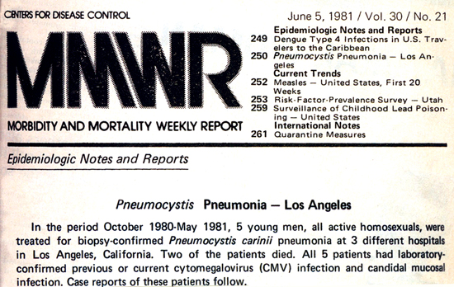
Timeline
(1981) First official statement of what will be known as AIDS appears on the The Morbidity and Mortality Weekly report.
(1981) Reports on KS and PCP in New York and California among MSM.
(1984) Lymphadenopathy Associated Virus (LAV) or Human T lymphotropic virus type II is (HTLV II) identified as the cause of AIDS.
(1985) FDA licenses the first commercial blood test, ELISA.
(1985) Ryan White goes to speak publicly against AIDS stigma and discrimination.

Slide 5
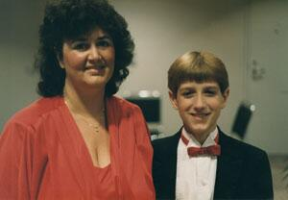
Ryan White
Ryan White was 13 when he was diagnosed with AIDS after a blood transfusion in December 1984.
Ryan tried to return to school, he faced AIDS-related discrimination in his Indiana community
He gained national attention and became the face of public education about the disease.
https://ryanwhite.hrsa.gov/about/ryan-white
Notes:
Ryan white review
had hemophilia
Famous for ifghtin to go to school
born in Kokomo Indiana
Talk about the exhibition at the children’s museum

Slide 6
Timeline (continued)
(1986) Surgeon General C. Everett Koop makes it clear that HIV cannot be spread casually and calls for nationwide educational campaign.
(1986) The virus which causes AIDS is officially known as Human Immunodeficiency Virus (HIV).
(1987) The FDA approves the first antiretroviral drug, zidovudine (AZT).
(1989) The number of reported AIDS cases in the U.S. reaches 100,000.
(1990) Congress enacts the Ryan White Comprehensive AIDS Resources Emergency Act.
Notes:
Protease inhibitors-> hope

Slide 7
Ryan White Comprehensive AIDS Resources Emergency (CARE) Act
Ryan White HIV/AIDS Program (RWHAP)
Part A | Provide medical and support services to cities and counties most severely affected by HIV
Part B | Improve the quality of and access to HIV health care and support in the U.S. Provide medications to low-income people with HIV through AIDS Drug Assistance Program
Part C | Provide outpatient ambulatory health services and support for people with HIV Help for community-based groups to strengthen their capacity to deliver high-quality HIV care
Part D | Provide medical care for low-income women, infants, children and youth with HIV Offer support services for people with HIV and their family members
Part F | AIDS Education and Training Center (AETC) Program – Provide training and technical assistance to providers treating patients with or at risk for HIV Special Projects of National Significance (SPNS) – Develop innovative models of HIV care and treatment to respond to RWHAP client needs Dental Programs – Provide oral health care for people with HIV and education about HIV for dental care providers Minority AIDS Initiative – Help RWHAP recipients improve access to HIV care and health outcomes for minorities
Source: https://ryanwhite.hrsa.gov/about
Notes:
Audience Participation: Does anyone work at Ryan White funded health centers? What are you experiences?
passed in 1990 a few months after he died
People with low income live with HIV
the program essentially the program supports comprehensive HIV care for those without health insurance and provides essential services not covered by health insurance.
https://ryanwhite.hrsa.gov/about
First authorized in 1990, the RHWAP was funded at $2.21 billion in fiscal year 2021. View the RWHAP Legislation and Budget webpages to learn more.

Slide 8
Timeline (continued)
What is the current state of HIV?
(1992) AIDS becomes the number one cause of death for U.S. men aged 25-44.
(1995) The FDA approves the first protease inhibitor. (Saquinavir) → Highly Active Antiretroviral therapy.

Slide 9
The Current State of HIV
36,801 New HIV diagnoses in 2019, 69% were among gay and bisexual men, 23% were among heterosexuals, 7% among people who inject drugs.
Gay, bisexual, and other men who reported male-to-male sexual contact] are the population most affected by HIV.
Transgender people accounted for 2% (671) of the 36,801 new HIV diagnoses.
Source: Diagnoses of HIV infection in the United States and dependent areas, 2019 https://www.cdc.gov/hiv/statistics/overview/ataglance.html
Notes:
Source: CDC. Diagnoses of HIV infection in the United States and dependent areas, 2019. HIV Surveillance Report 2021;32.
https://www.cdc.gov/hiv/statistics/overview/ataglance.html

Slide 10
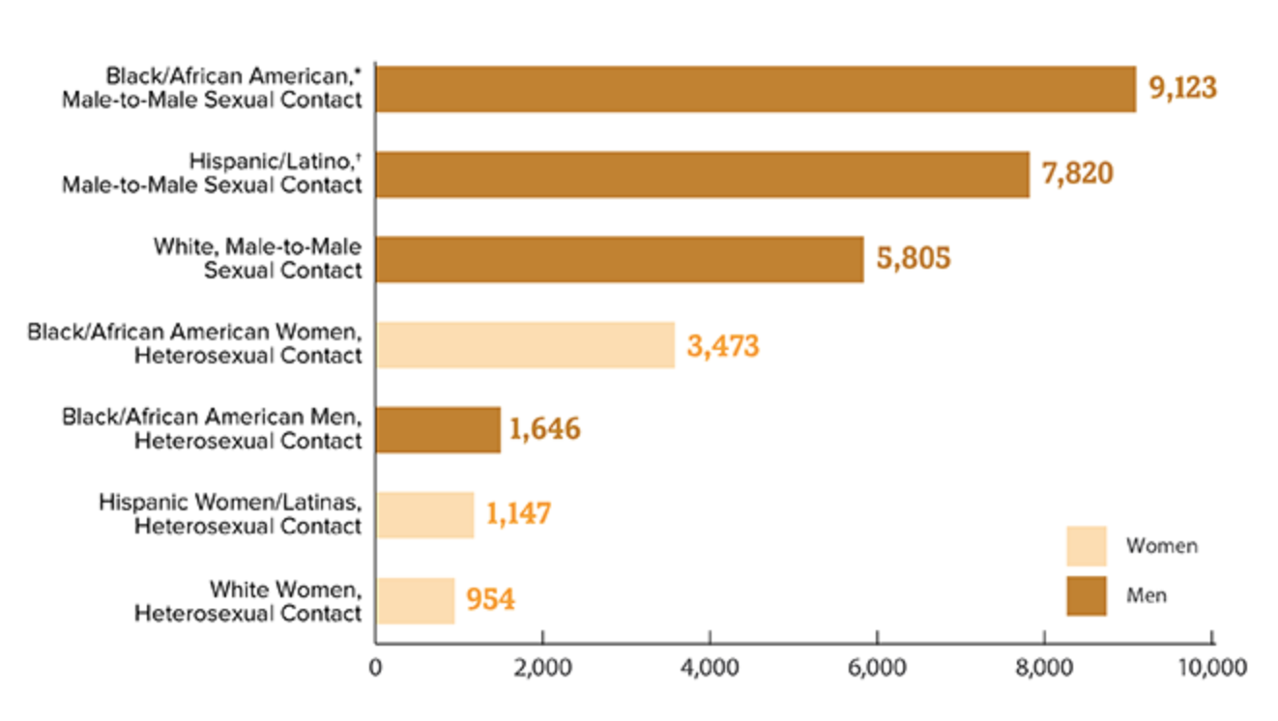
New HIV Diagnoses in the US and Dependent Areas for the Most-Affected Subpopulations, 2019
Source: Diagnoses of HIV infection in the United States and dependent areas, 2019 https://www.cdc.gov/hiv/statistics/overview/ataglance.html
Notes:
Gay and bisexual men are the most affected populatins
Let’s not forget of other communities - Black cis gender women and Black trasngender women

Slide 14
Notes:
goal to 95% of virally suppressed by 2025

Slide 15
WHY?
Notes:
Audience participation: Why?

Slide 16
S
D
o
H
Notes:
Social Determinants of Health

Slide 17
Racism and other discrimination

Slide 18
Racism and other discrimination
Housing

Slide 19
Racism and other discrimination
Neighborhood
Housing

Slide 20
Racism and other discrimination
Neighborhood
Housing
Education

Slide 21
Racism and other discrimination
Neighborhood
Housing
Education
Access to Healthcare

Slide 22
Racism and other Discrimination
Neighborhood
Employment
Housing
Education
Access to Healthcare
Immigration Status

Slide 23
Racism and other Discrimination
Safety
Neighborhood
Employment
Finances
Housing
Mobility
Education
Access to Healthcare
Immigration Status
Literacy & Numeracy

Slide 24
Housing Instability
Analysis of Integrated HIV Housing and Care Services by: Mathematica Policy Research and The Cloudburst Group. 2014
PWH who lack stable housing are more likely to delay entering HIV care and less likely to have access to regular care, to receive anti-retroviral therapy (ART), or to adhere to their HIV medication regimen.
Data indicate that individuals with HIV infection suffer far greater housing instability and homelessness than the general population: an estimated one-third to one-half are homeless or at risk of becoming homeless.
Homelessness and unstable housing are linked to higher risk of HIV infection, inadequate health care, poor health outcomes, and early death.
Housing instability is a structural factor contributing to worse outcomes.
Source: “Housing Status, Medical Care, and Health Outcomes Among People Living With HIV/AIDS: A Systematic Review” by Aidala et al.
https://aspe.hhs.gov/reports/analysis-integrated-hiv-housing-care-services-0
Notes:
Intersection of HIV and unstable housing
increased risk of acquiring the infection but also worse outcomes if the patient living with HIV
“Housing Status, Medical Care, and Health Outcomes Among People Living With HIV/AIDS: A Systematic Review” by Aidala et al.
https://aspe.hhs.gov/reports/analysis-integrated-hiv-housing-care-services-0
(White House Office of National AIDS Policy 2010).
(Rourke et al. 2010).
(National AIDS Housing Coalition 2007).

Slide 25
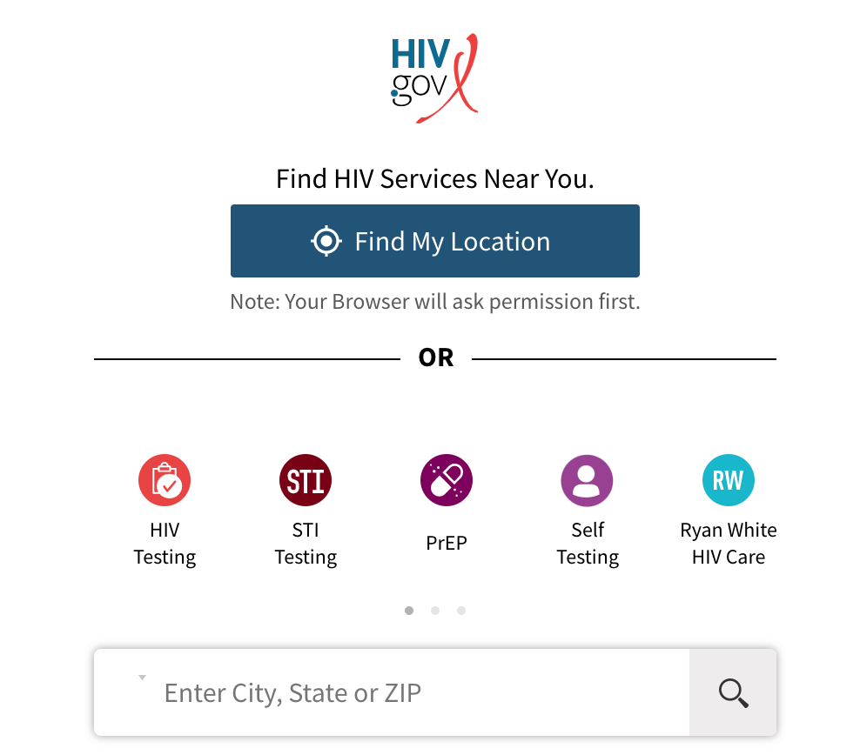
Housing is Medicine - What to do?
Screen frequently for housing instability
Familiarize with housing programs for people living with HIV
Housing Opportunities for Persons With AIDS (HOPWA) program.
https://locator.hiv.gov/
short-term and long-term rental assistance, community residences, or provide other supportive housing facilities
Also eligible for other housing programs in addition to HIV specific programs
Notes:
Federal programs that gives grants- US Department of Housing and Urban Development
https://targethiv.org/sites/default/files/supporting-files/Housing%20and%20HIV%20Health%20Outcomes%20Final.pdf
Indianapolis, IN 46225

Slide 26
What can you do?
Join the Ryan White Medical Providers Coalition: Click Join Now!
https://www.hivma.org/policy--advocacy/ryan-white-medical-providers-coalition/ryan-white-medical-providers-coalition/
Take action (local/state/federal) to support policies that provide a comprehensive approach to the prevention and treatment of HIV and are centered in addressing structural barriers to care.
Notes:
QR code here

Slide 27
What can you do?
Support the training of diverse HIV workforce:
Incorporate HIV Medicine in the core training of family medicine residencies.
Support the creation of HIV tracks.
Training Resources
National HIV curriculum
American Academy of HIV Medicine- Core Curriculum
HIVMA
HIVMA Clinical Fellowship
ACTHIV
National Clinical Consultation Center

Slide 28
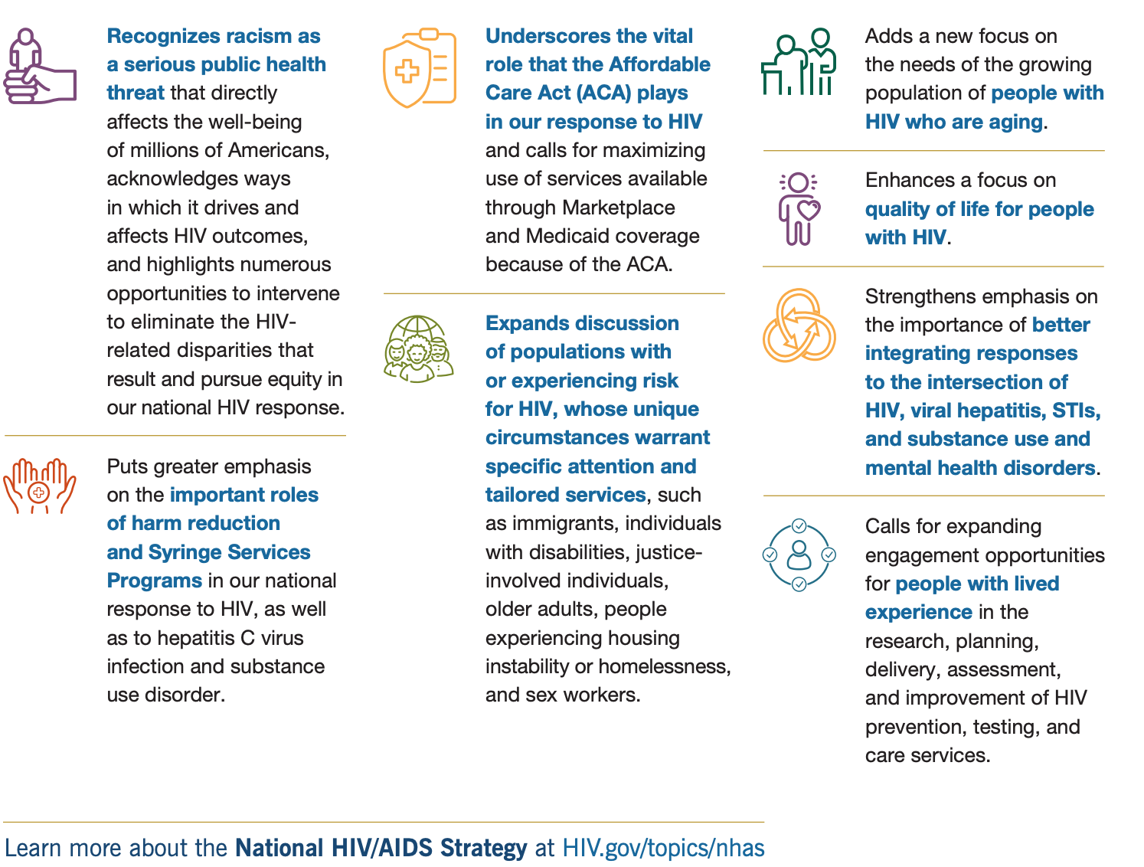
National HIV/AIDS Strategy (2022-2025)
Source: https://hivgov-prod-v3.s3.amazonaws.com/s3fs-public/NHAS-2022-2025-2Pager.pdf
Notes:
https://hivgov-prod-v3.s3.amazonaws.com/s3fs-public/NHAS-2022-2025-2Pager.pdf

Slide 29
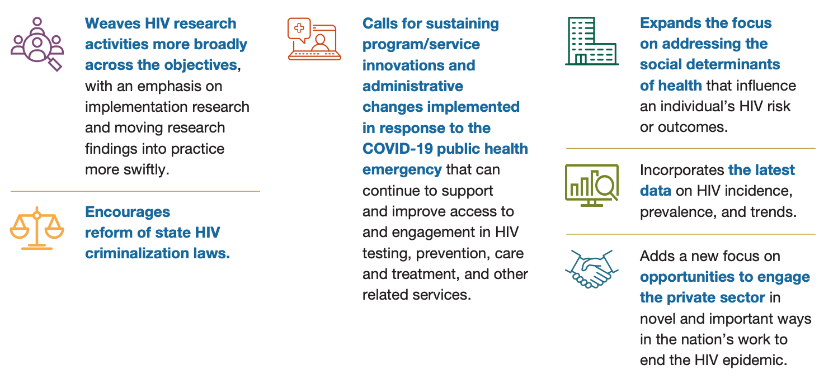
National HIV/AIDS Strategy (2022-2025)
Source: https://hivgov-prod-v3.s3.amazonaws.com/s3fs-public/NHAS-2022-2025-2Pager.pdf
Notes:
https://hivgov-prod-v3.s3.amazonaws.com/s3fs-public/NHAS-2022-2025-2Pager.pdf

Slide 30
HEALTH MAINTENANCE FOR PWH

Slide 31
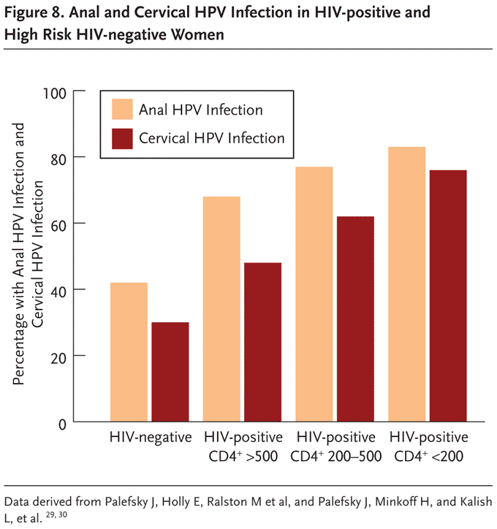
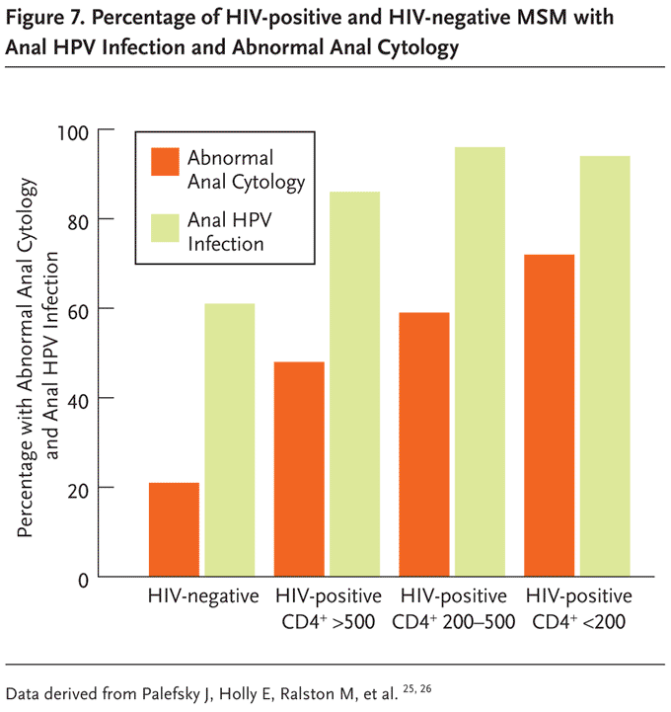
HIV and HPV Co-infection

Slide 32
HIV and Anal Cancer Risk
Source: https://anchorstudy.org/

Slide 33
Anal cancer prevention: A paucity of quality data
Anal cytologic screening or high-resolution anoscopy (HRA) for men and women who are HIV+ has been controversial. (CIII)
Annual digital anal examination (BIII) and screening for symptoms such as anorectal bleeding, anorectal pain, and palpable anorectal masses or nodules also may be useful. (CIII)
Screening for anal cancer with anal cytology should not be done without the availability of referral for HRA.
Notes:
Panel on Guidelines for the Prevention and Treatment of Opportunistic Infections in Adults and Adolescents with HIV. Guidelines for the Prevention and Treatment of Opportunistic Infections in HIV-infected Adults and Adolescents: recommendations from the Centers for Disease Control and Prevention, the National Institutes of Health, and the HIV Medicine Association of the Infectious Diseases Society of America. Available at https://clinicalinfo.hiv.gov/en/guidelines/adult-and-adolescent-opportunistic-infection.
If Cytology indicates ASC-US, ASC-H, LSIL, or HSIL, should be followed by HRA (BIII)
Visible lesions should be biopsied to determine the level of histologic changes and to rule out invasive cancer (BIII)
ANCHOR TRIAL
RCT comparing anal HSIL treatment (n=2237) vs active monitoring (n=2222) to reduce anal cancer incidence
Inclusion criteria: PLWH >35yo with biopsy proven anal HSIL
Primary endpoint was time-to-incident anal cancer
Most participants treated with office-based electrocautery (92.7%), 8.2% treated topically
Outcome: median follow-up of 25.8 months treatment of HSIL resulted a 57% reduction in anal cancer (95%CI 6%-80%, P=.029) vs active monitoring
Source: Palefsky J, Lee J, Darragh T, et al. Treatment of Anal High-Grade Squamous Intraepithelial Lesions to Prevent Anal Cancer [CROI Abstract 106]. Abstracts From CROI 2022 Conference on Retroviruses and Opportunistic Infections

Slide 34
Cervical Cancer screening (Age <30):
Pap test at the time of initial diagnosis with HIV for persons aged 21-29.
If initial Pap test is normal, repeat Pap test in 12 months. (BII)
If 3 consecutive Pap tests are normal, repeat pap every 3 years. (BII)
Co-testing (Pap test and HPV test) is not recommended.
Notes:
Panel on Guidelines for the Prevention and Treatment of Opportunistic Infections in Adults and Adolescents with HIV. Guidelines for the Prevention and Treatment of Opportunistic Infections in HIV-infected Adults and Adolescents: recommendations from the Centers for Disease Control and Prevention, the National Institutes of Health, and the HIV Medicine Association of the Infectious Diseases Society of America. Available at https://clinicalinfo.hiv.gov/en/guidelines/adult-and-adolescent-opportunistic-infection.
The national guidelines say 3 in a row
If HPV/cervical cytologic co-testing is performed in an individual with HIV and results are positive for high-risk HPV but negative for abnormal cytology, then repeating the Pap test at a shorter interval and/or performing colposcopy may be warranted for further evaluation of abnormal cells that may have been missed initially [Keller et al. 2015]. Females with HIV, a normal Pap test, and a positive high-risk HPV test result have four times the risk of having an abnormal finding on colposcopy [Musa et al. 2014].

Slide 35
Cervical Cancer screening (age >30):
Screening is lifetime: Does NOT stop at age 65.
Pap Testing Only:
Same screening guidelines as persons aged 21-29.
Pap and HPV Co-Testing:
Test at HIV diagnosis or age 30. (BII)
Those who co-test negative/negative (i.e., a normal Pap cytology and negative HPV test) can repeat screening in 3 years.
Notes:
Panel on Guidelines for the Prevention and Treatment of Opportunistic Infections in Adults and Adolescents with HIV. Guidelines for the Prevention and Treatment of Opportunistic Infections in HIV-infected Adults and Adolescents: recommendations from the Centers for Disease Control and Prevention, the National Institutes of Health, and the HIV Medicine Association of the Infectious Diseases Society of America. Available at https://clinicalinfo.hiv.gov/en/guidelines/adult-and-adolescent-opportunistic-infection.

Slide 36
HPV Vaccination for PWH
Target age for HPV recombinant 9-valent vaccine is 11 to 12 years. (AIII) PWH age 13-26 years: HPV vaccine is recommended (lower efficacy if after onset of sexual activity). (BII) PWH ages 27-45+: HPV vaccine not recommended (AI) In some situations, there might be vaccine benefit (e.g., PWH with minimal HPV exposure) - use shared decision making For patients who have completed a vaccination series with the recombinant bivalent or quadrivalent vaccine, consider full series (three doses) of recombinant 9-valent vaccine (CIII)
Notes:
Panel on Guidelines for the Prevention and Treatment of Opportunistic Infections in Adults and Adolescents with HIV. Guidelines for the Prevention and Treatment of Opportunistic Infections in HIV-infected Adults and Adolescents: recommendations from the Centers for Disease Control and Prevention, the National Institutes of Health, and the HIV Medicine Association of the Infectious Diseases Society of America. Available at https://clinicalinfo.hiv.gov/en/guidelines/adult-and-adolescent-opportunistic-infection.

Slide 37
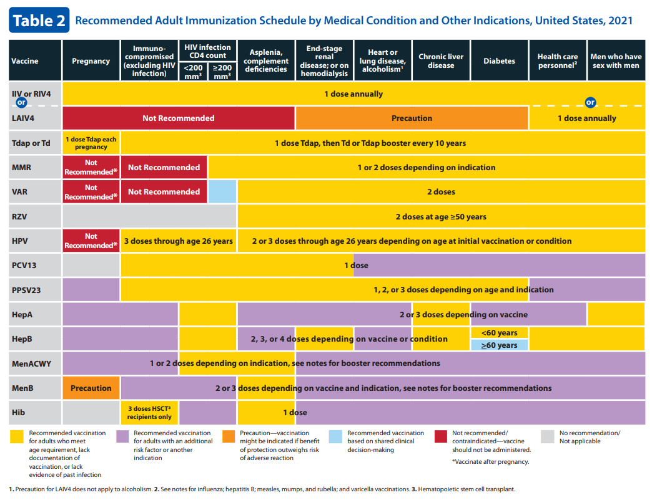
Source: adult-combined-schedule.pdf (cdc.gov)
Notes:
Contraindications
Live attenuating influenza vaccine.
CD4 <200 – all other live virus vaccines.

Slide 38
Covid-19 Vaccination
PWH should receive the full series of a COVID-19 vaccine, regardless of CD4 count or viral load- mRNA vaccines preferred
Persons with advanced HIV (CD4 <200, <14%) should receive 3rd dose >28d after 2nd dose of primary series or mRNA/ >4wks after J&J
PLWH should receive booster doses
CD4>200: 5 months after 2 dose series
CD4<200: 3 months after 3 dose series
Notes:
Guidelines Working Groups of the NIH Office of AIDS Research Advisory Council. Guidance for COVID-19 and People with HIV. Available at https://clinicalinfo.hiv.gov/en/guidelines/guidance-covid-19-and-people-hiv/whats-new-covid-19-and-hiv-guidance.

Slide 39
Influenza Vaccination
People with HIV at greater risk of severe morbidity.
They can receive inactivated influenza vaccine(IIV).
Live, attenuated should not be used.
Notes:
Guidelines Working Groups of the NIH Office of AIDS Research Advisory Council. Guidance for COVID-19 and People with HIV. Available at https://clinicalinfo.hiv.gov/en/guidelines/guidance-covid-19-and-people-hiv/whats-new-covid-19-and-hiv-guidance.

Slide 40
Hepatitis A Vaccination
Test immunity.
Non-immune: BOOST Hep A: 2 or 3 or 4 dose series
Complete post-vaccination serologic testing after boosting (1-2 months after last dose).
Re-Boost if post-vax serological testing is non-immune.
Consider waiting until CD4>200 before second booster.
Source: Immunizations for Preventable Diseases in Adults and Adolescents Living with HIV | NIH

Slide 41
Hepatitis B Vaccination
Test immunity.
Non-immune: BOOST Hep B: 3 dose series
Complete post-vaccination serologic testing after boosting (1-2 months after last dose).
Re-Boost if post-vax serological testing is non-immune.
Consider waiting until CD4>200 before second booster.
Consider double dose or switching to 2-dose Hep B vaccine.
Isolated Hep B Core Ab positive: BOOST or partial BOOSTER.
Source: Immunizations for Preventable Diseases in Adults and Adolescents Living with HIV | NIH
Notes:
Partial Booster: Administer 1-dose of Hep B Vaccine for PWH with isolated core Ab+. If no response after 1-2 month recheck of titer, complete full booster series or can give double dosage.

Slide 42
Meningococcal Vaccination
PWH with prior vaccination and age > 7 years, repeat vaccination every 5 years with quadrivalent conjugated Meningitis vaccine.
If no prior vaccination history give 2 doses >8 weeks apart.
Serogroup B meningococcal vaccination is not routinely indicated.
Source: Immunizations for Preventable Diseases in Adults and Adolescents Living with HIV | NIH

Slide 43
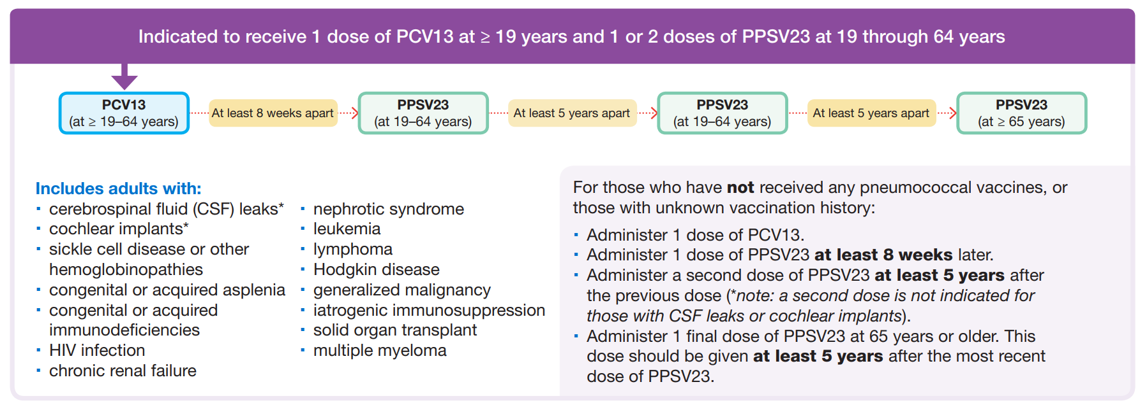
Pneumococcal Vaccination
Source: Pneumococcal Vaccine Timing for Adults-June 25, 2020 (cdc.gov)

Slide 44
Pneumococcal vaccination
Notes:
Kobayashi M, Farrar JL, Gierke R, et al. Use of 15-Valent Pneumococcal Conjugate Vaccine and 20-Valent Pneumococcal Conjugate Vaccine Among U.S. Adults: Updated Recommendations of the Advisory Committee on Immunization Practices — United States, 2022. MMWR Morb Mortal Wkly Rep 2022;71:109–117. DOI: http://dx.doi.org/10.15585/mmwr.mm7104a1external icon.

Slide 45
HIV AS A CHRONIC DISEASE

Slide 46
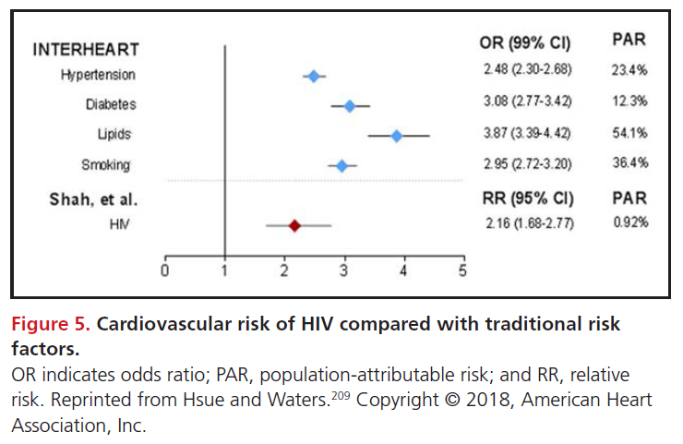
Cardiovascular Disease
HIV infection seems to be an independent atherosclerotic cardiovascular disease risk factor.
Chronic inflammation and immune activation are described as mechanisms of action in HIV with virological suppression.
No research on therapeutics in CVD risk in PWH (i.e. statin, asa).
Traditional ART was once blamed for this, but current standard ART likely does not contribute to CVD risk except perhaps with weight gain.
Reference Feinstein et al. 2019 Characteristics, Prevention, and Management of Cardiovascular Disease in People Living With HIV: A Scientific Statement From the American Heart Association | Circulation (ahajournals.org)
Notes:
Numerous studies have now established that chronic inflammation just from HIV infection is a risk factor for cardiovascular disease. This is despite being on ART and achieving virological suppression. This is also independent of risk factors such as tobacco smoking. Higher levels of inflammatory markers are notable in HIV infection, including IL6, TNF receptors. Immunologic markers like monocyte activation
Feinstein, et al. Circulation 2019.

Slide 47
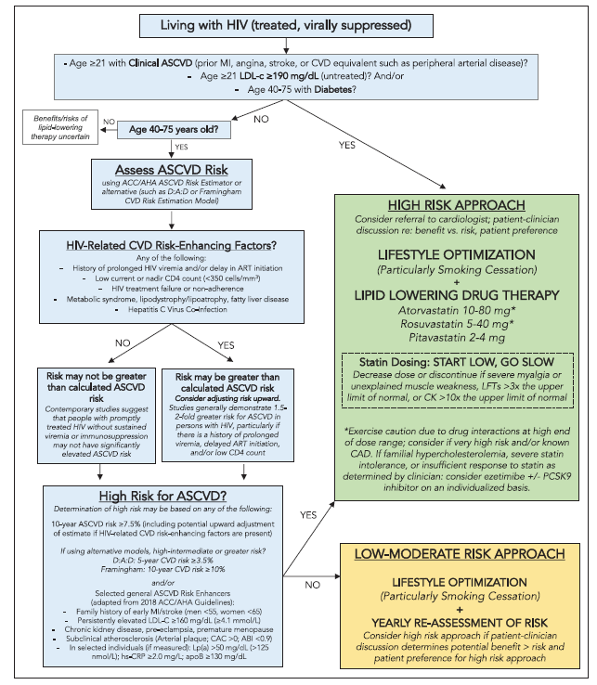
Reference Feinstein et al. 2019 Characteristics, Prevention, and Management of Cardiovascular Disease in People Living With HIV: A Scientific Statement From the American Heart Association | Circulation (ahajournals.org)
Notes:
Pragmatic approach to Primary Prevention of cardiovascular disease

Slide 48
Bone Health
Fracture rates are higher in PWH.
Multifactorial progression of bone loss in PWH.
Host risk factors such as concurrent medical problems like CKD, smoking, weight loss etc.
HIV infection itself can directly or indirectly affect bone cells via chronic inflammation and immune activation. Osteoclast bone resorption induction is noted.
ART initiation is associated with 2-6% decrease in bone mineral density.
Reference Foundations of HIV Medicine AAHIVM
Notes:
PLWH undergo accelerated bone loss; living with HIV is considered a risk factor for osteoporosis .
Risk Factors: Low body weight, cigarette smoking, alcohol and/or opioid use, hypogonadism and vitamin D deficiency
Pro-inflammatory state of HIV.
Drug Side Effects: TDF increases risk of osteoporosis, PIs linked to greater loss of bone density.

Slide 49
Preventing Bone Disease
ALL age >50: Calcium 1200mg/d + Vitamin D 800-100 IU/d, weight-bearing and muscle strengthening exercise for fall prevention, smoking cessation, etc.
IDSA recommends screening PWH: Male sex at birth >50 years, and post menopausal female sex at birth.
Start therapy for BMD T-Score -2.5 or less at femoral or spine.
Start therapy based on FRAX score for persons with low bone mass (T Score -1 to -2.5, osteopenia).
Insufficient evidence regarding screening for Vitamin D deficiency.
Reference Foundations of HIV Medicine AAHIVM
Notes:
FRAX Score interpretation using DEXA scan results –
Check for persons with Osteopenia to further stratify → 10-year hip fracture probably 3% or greater, or a 10-year major osteoporosis related fracture probability of 20% or greater merits treatment.
How does this impact ART management?
“Baseline bone densitometry by DXA should be performed in all postmenopausal women and men aged ≥50 years, based on expert opinion with limited supporting evidence”

Slide 50
Conclusions
Structural factors including racism, housing, employment, immigration status, etc impact PWH.
There are resources and strategies to support PWH, including advocacy.
Join the Ryan White Medical Providers Coalition! → → →
Apply the unique immunization schedule and screening testing.
HIV as a chronic disease, effects cardiovascular and bone health.
Apply an adjusted ASCVD Score to risk stratify PWH.
Continue furthering your knowledge and comfort level to provide high quality evidence-based primary care for PWH!

