Slide 1
Timmy Global Health: Twenty Years of Service & Learning

Slide 2
Chuck Dietzen MD Chief of Pediatric Rehabilitation Riley Hospital for Children at IU Health
Founder/Volunteer Timmy Global Health www.timmyglobalhealth.org

Slide 3
Mercy Obeime, M.D., FAAFP, FAAHPM
Community and Global Health Director
Franciscan Health
5330 A East Stop 11
Suite 250
Indianapolis, IN 46237
Founder
Mercy Medical Mission at TGH

Slide 4
What is Timmy Global Health?
Timmy Global Health is an Indianapolis-based nonprofit that expands access to healthcare and empowers students and volunteers to tackle today’s most pressing global health challenges
Notes:
Describe Timmy’s work (Latin America & West Africa); include clinical care, preventive work & education.

Slide 5
How did it all begin?
Timmy Global Health……
Chuck’s beginning……..
Mercy’s beginning…..
Notes:
Give brief history of Timmy Foundation & Mercy Medical Missions

Slide 7
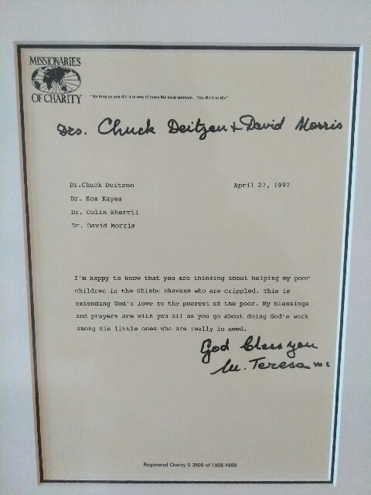

Slide 8
Most Powerful Legacy
Beyond giving medical care to people who need it, this work has been about building bridges
Deep emphasis on
cross-cultural connectedness
mutual respect
ethical engagement
Notes:
Beyond giving medical care to people who need it, this work has been about building bridges.
Deep emphasis on:
cross-cultural connectedness
mutual respect
ethical engagement
Inspires careers and engagement in serving the underserved—at home and abroad, through health care or through other avenues. (Examples: Paul Park, Dion, Michael Hole)

Slide 9
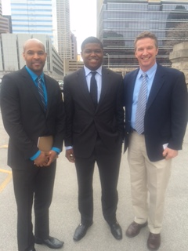
Health Shield Bill 1145

Slide 10
Signing of Health Shield Bill 1145 “2016”

Slide 11
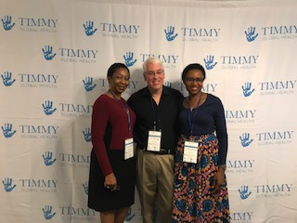
Brown County Student Retreat

Slide 12
A Changing Landscape For Medical Missions
Global health field is evolving
Medical missions have historically been about bringing care to the underserved, responding in the moment to meet urgent needs, at an individual level.
Notes:
Global health field is evolving.
Medical missions have historically been about bringing care to the underserved, responding in the moment to meet urgent needs, at an individual level.
Global Health steps back and asks about how to strengthen health systems for the long term – and asks whether short-term medical service is the best way to address global inequities in access to care.
In recent years, critiques of:
Whether dollars spent on medical service trips would be better invested directly in local health system
Medical service trips creating relationships of dependency – and a “get out of jail free” card for governments to skimp on health care investments, because someone will come in from the outside and provide the services needed, at no cost to the country budget
“Helicopter” missions that drop in with care for a community and then leave with no plan for return & follow-up
How free services or free medicines can undermine the local health care economy
Medical missions as a tool for privileged Northern / Western hemisphere volunteers to tour an “exotic” location in a “feel-good” way, or worse, as an avenue to practice medicine with insufficient training and preparation
All of those critical questions have merit, but not all apply to the work of Timmy Global Health—nor to many other organizations that apply strict standards of quality, equivalent to what would be done in the U.S., and commit to promoting responsible and respectful service work.
But they are also worthy of consideration…

Slide 13
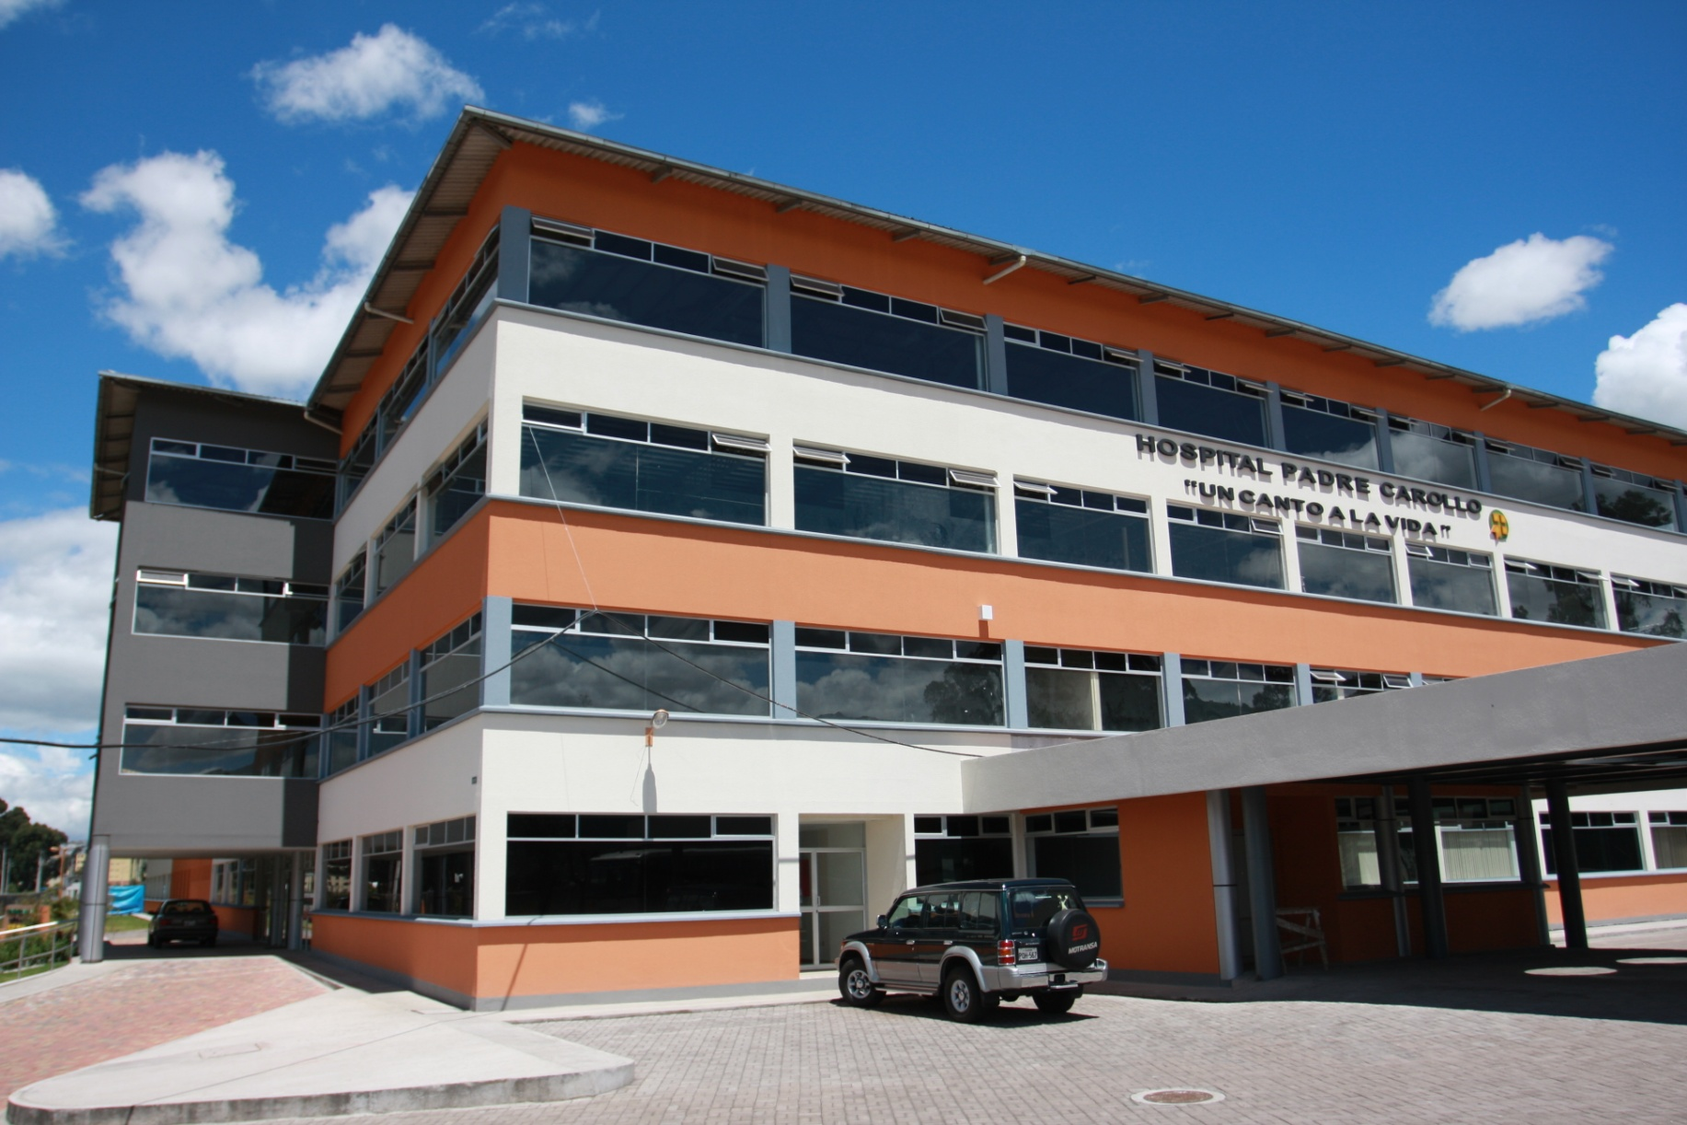
My life is not my own.” - Padre Carollo

Slide 14
Timmy evolves
With the field of global health to respond to these areas of concern.
How?
Establishing trust
Creating a referral system
Building long-term partnerships
Introducing public health and prevention activities
Strengthening education and advocacy
Launching a monitoring & evaluation function
Shifting towards community-owned solutions
Notes:
…and so Timmy has evolved with the field of global health to respond to these areas of concern.
How?
Establishing trust through recurring visits: sending teams to a handful of Timmy sites, 4-5 times per year, for many years
Creating a referral system that plugs into local health care system: if patient needs cannot be met w/ Timmy mobile clinic, the Timmy staff person (on the ground year-round) will ensure that the patient is referred to a specialist, and will accompany the patient to the follow-up visit
Building long-term partnerships with in-country groups, investing in them, in CHPs, in local clinics that handle referrals
Introducing public health and prevention activities: instead of focusing on treatment alone, seek ways to avoid the most common health problems seen in clinic (nutrition, safe water, education)
Strengthening education and advocacy through engagement with college chapters, who are introduced to global health through a lens of partnership and empowerment, who are set up to LEARN as the primary objective
Launching a monitoring & evaluation function to track the impact of Timmy’s work
Shifting towards community-owned solutions to health care access challenges, and planning for when Timmy will step back – when health care access & quality have improved within its partner communities

Slide 15
Current organizational structure
www.timmyglobalhealth.org

Slide 16
But the core values remain
Timmy retains a priority focus on cross-cultural connectedness, mutual respect, and ethical engagement.
Notes:
Throughout these changes, Timmy retains a priority focus on cross-cultural connectedness, mutual respect, and ethical engagement.
And Timmy recognizes that an important part of its impact is the way it introduces volunteers to partner communities—emphasizing these values and inspiring service as a bridge-building mechanism across individuals and across cultures, whether in another country or here at home.

Slide 17
Timmy Global Health in Nigeria
Timmy Global Health works in three states in southern Nigeria: Edo (Uromi, Dr. Mercy Obeime), Anambra (Amichi, Dr. Ukamaka Oruche) and Rivers (Bane, Bodo, Bori, Scott Pegg).

Slide 18
The Nigerian Context
Nigeria is ranked 152nd out of 185 countries on the UNDP’s 2016 Human Development Index.
By comparison, Guatemala is 125th, the DR is 99th and Ecuador is 89th.
Life expectancy at birth is 53.1 years (Nigeria), 72.1 (Guatemala), 73.7 (DR) and 76.1 (Ecuador).
Nigeria’s maternal mortality rate (560) is 20 times higher than the US rate (28) per 100,000 live births (2013) and more than 100 times higher than Norway’s rate (4).

Slide 19
A Small Footnote in Timmy History
Dr. Chuck Dietzen being made an honorary chief in the village of Bane, Rivers State, Nigeria, June 2004.

Slide 20
The Importance of Female Students
“There is probably no higher return on investment in the developing world than primary and secondary education for girls” Larry Summers, Professor of Economics, Harvard. In a July 2015 headcount 51.37% of our students across all three schools were girls.

Slide 21
Expanding Deworming Treatment
Deworming has expanded from 100 students in Bodo (2012-13) to all the students in Bodo (2013-14) to all the students in Bodo and Bori (2014-15) to all the students in Bane, Bodo, Bori and St. Patrick’s Nursery and Primary School in Bodo (2015-16).

Slide 22
If You Want to Deworm and Immunize Children, First You Have to Build a Wall
A worker constructing a perimeter wall around the property of our school in Bane in 2016.

Slide 23
Phase IV: Nutrition
We started a 6 month pilot nutrition program with 50 of the poorest children at our school in Bodo in February. This program is largely based on three widely available local ingredients: crawfish, soybeans and millet.

Slide 24
3-day health screen program 9 brigades serving over 5972 patients

Slide 25
Provided 50 cataract surgeries and glaucoma treatment

Slide 26
Distributed 2500 reading glasses

Slide 27
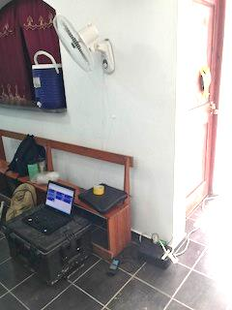
Timmy Care

Slide 28
Mentoring the Next Generation of Healers

Slide 31
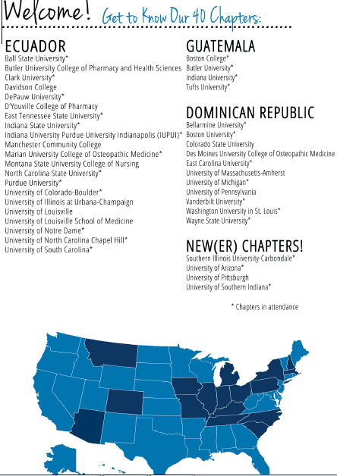

Slide 33
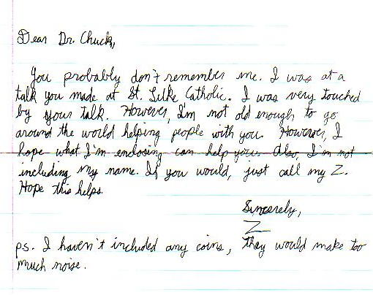

Slide 34
www.timmyglobalhealth.org

Slide 35
Thank you, thank you, thank you!

