Slide 1
Creating a Novel Population Health and Leadership Curriculum at Your Institution
Achieving the Triple Aim:
Holly Hofkamp, MD, Emily Waterman, MD, Anthony Cheng, MD,
Roger Garvin, MD, Patrice Eiff, MD, Elaine Waller
STFM Annual Spring Conference
May 7, 2017

Slide 2
Disclosures
None

Slide 3
Learning Objectives
Use Population Health Milestone report to identify gaps in population health training in your program
Define 2 population health learning objectives that address gaps in your home institution’s current curriculum
Utilize resource list and community partnerships to achieve population health learning objectives in your program

Slide 4
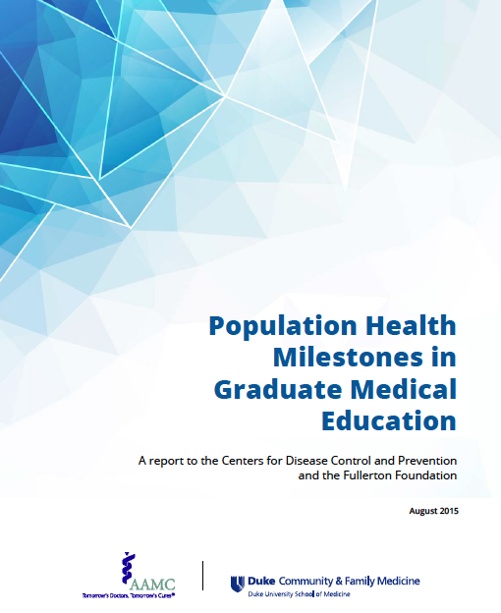
Population Health Milestones
Highlights current family medicine milestones that are related to population health
Goes a step further in creating specific population health milestones in 4 competency domains for all residencies

Slide 5
OHSU Curriculum

Slide 6
OHSU Opportunities for Growth
Learning objectives created in all 4 competency domains
Public Health
Primary Care/Public Health Collaboration
Essential functions of Public Health
Critical Thinking
Population data analysis
Guidelines/Benchmarks
Translating evidence into policy
Community Engagement
Social Determinants of Health
Health Equity
Community Needs Assessment
Community Organizing
Team/Leadership Skills
Advocacy/Health Policy
Leading Diverse Teams
Change Management
Practice Management

Slide 7
OHSU Population Health and Leadership Curriculum
Builds on the residency’s existing improvement science and leadership curriculum which already addressed many of the population health milestones in the critical thinking and team/leadership skills domain.
Addresses both issues of population health (broader determinants of health ) and population management
Longitudinally delivered over 1 year during dedicated protected ½ day per week

Slide 8
Learning Strategies
Interactive Workshops (Triple Aim Tuesdays)
Group, on campus experiences led by community partners
Metropolitan Alliance for Common Good
Portland Metro Area Public Health Departments Portland State University College of Urban and Public Affairs
State legislators
Formal longitudinal community organizing curriculum
Action Learning
Individualized, off campus experiences
Public health department
NW Kaiser Permanente Population Management Department
Legislative advocacy experience
Clinic medical directors/managers meetings
Service Learning
Group, off campus experiences
Oregon Food Bank, local housing organization

Slide 9
Other Learning Strategies
Online Modules
Institute for Healthcare Improvement (IHI)
STFM and AAFP advocacy modules
Practical Playbook
NW Center for Public Health Practice
Childhood Hunger Coalition Food Insecurity
AAFP Practice Management Readings
Notes:
Can address barriers at this stage
Scheduling – coordinator greatly helped
Multiple off site partners and resident rigid schedules made scheduling challenging
Need for active learn by doing activities – need to think outside the box
Time – helped that it was protected and regular
Dedicated faculty – just one,others were all volunteer and wonderful!

Slide 10
Evaluation and Results

Slide 11
Mixed Method Evaluation
Pre/Post self-perceived competency surveys
Narrative evaluations after each set of experiences
Focus group
Content analysis performed by immersion/crystallization technique to determine themes and exemplar quotes

Slide 13
Highly competent
Moderately competent
Somewhat competent
Not competent at all

Slide 14
Themes
Curriculum helped with skills to address SDH in patients.
Curriculum helped reinforce the resident’s role as a PCP and the role in the community.
Instruction in health policy should be relevant to resident’s local context and advocacy role.
Mapping data to understand health risk in the community is important.
Exposure to public health leads to better connection to the community and knowing where to get information.
Residents gained skills in how to screen for SDH (food insecurity) and felt more empowered and confident to address them.
Curriculum was balanced and provided protected time.

Slide 15
Reflecting back, it changed the way I interact with my patients and how I address their social determinants of health.
Themes
Curriculum helped with skills to address SDH in patients.
Curriculum helped reinforce the resident’s role as a PCP and the role in the community.
Instruction in health policy should be relevant to resident’s local context and advocacy role.
Mapping data to understand health risk in the community is important.
Exposure to public health leads to better connection to the community and knowing where to get information.
Residents gained skills in how to screen for a SDH (food insecurity) and felt more empowered and confident to address them.
Curriculum was balanced and provided protected time.

Slide 16
“It’s been a great bridge of both understanding patient’s individual health and the choices we make for our community.”
Themes
Curriculum helped with skills to address SDH in patients.
Curriculum helped reinforce the resident’s role as a PCP and the role in the community.
Instruction in health policy should be relevant to resident’s local context and advocacy role.
Mapping data to understand health risk in the community is important.
Exposure to public health leads to better connection to the community and knowing where to get information.
Residents gained skills in how to screen for a SDH (food insecurity) and felt more empowered and confident to address them.
Curriculum was balanced and provided protected time.

Slide 17
Themes
“We need to focus on health policies that are in operation locally or that relate to our context.”
“Some of us just want to be effective doctors and advocates for our patients.”
Curriculum helped with skills to address SDH in patients.
Curriculum helped reinforce the resident’s role as a PCP and the role in the community.
Instruction in health policy should be relevant to resident’s local context and advocacy role.
Mapping data to understand health risk in the community is important.
Exposure to public health leads to better connection to the community and knowing where to get information.
Residents gained skills in how to screen for a SDH (food insecurity) and felt more empowered and confident to address them.
Curriculum was balanced and provided protected time.

Slide 18
Themes
“The asthma mapping was useful in terms of thinking about exposures in communities.”
“How to use data within a system. How to run a report. I feel like that is something I’ll do quite a bit of.”
Curriculum helped with skills to address SDH in patients.
Curriculum helped reinforce the resident’s role as a PCP and the role in the community.
Instruction in health policy should be relevant to resident’s local context and advocacy role.
Mapping data to understand health risk in the community is important.
Exposure to public health leads to better connection to the community and knowing where to get information.
Residents gained skills in how to screen for a SDH (food insecurity) and felt more empowered and confident to address them.
Curriculum was balanced and provided protected time.

Slide 19
Themes
“Knowledge of many services and resources comes up nearly weekly for me now!”
“I have a better sense of the resource available and how to access them in the community.”
Curriculum helped with skills to address SDH in patients.
Curriculum helped reinforce the resident’s role as a PCP and the role in the community.
Instruction in health policy should be relevant to resident’s local context and advocacy role.
Mapping data to understand health risk in the community is important.
Exposure to public health leads to better connection to the community and knowing where to get information.
Residents gained skills in how to screen for a SDH (food insecurity) and felt more empowered and confident to address them.
Curriculum was balanced and provided protected time.

Slide 20
“I am much more consistent about screening for food insecurity and more confident about knowing how to help patients who screen positive.”
Themes
Curriculum helped with skills to address SDH in patients.
Curriculum helped reinforce the resident’s role as a PCP and the role in the community.
Instruction in health policy should be relevant to resident’s local context and advocacy role.
Mapping data to understand health risk in the community is important.
Exposure to public health leads to better connection to the community and knowing where to get information.
Residents gained skills in how to screen for a SDH (food insecurity) and felt more empowered and confident to address them.
Curriculum was balanced and provided protected time.

Slide 21
Themes
“A great balance of experiential and discussed-based activities.”
Curriculum helped with skills to address SDH in patients.
Curriculum helped reinforce the resident’s role as a PCP and the role in the community.
Instruction in health policy should be relevant to resident’s local context and advocacy role.
Mapping data to understand health risk in the community is important.
Exposure to public health leads to better connection to the community and knowing where to get information.
Residents gained skills in how to screen for a SDH (food insecurity) and felt more empowered and confident to address them.
Curriculum was balanced and provided protected time.

Slide 22
Breakout Groups

Slide 23
Breakout Groups
Review general and family medicine population health related milestones and identify how/where various topics are taught at your institution.
Identify gaps in your curriculum as well. Come up with 1-2 learning objectives that could address some of these gaps.
Think BIG - don't limit your ideas by current curricular/logistic constraints

Slide 24
Discussion
What topics areas are covered well?
Where were the gaps?

Slide 25
Bridging the Gap
Learning strategies and resources
Potential community partners

Slide 26
Tools to take back
Syllabus
Evaluation tools
Pre/Post
Narrative evaluations of experiences
Focus group questions
Population Health Milestones In GME report
Resource list

Slide 27
Thank You

