Slide 2
Mind the Gap: What, Why, and How to Improve the Gender Pay Gap in Medicine
Maya Bass MD, MA, FAAFP and
Krys Foster MD, MPH, FAAFP

Slide 3
Disclosures
No Financial Disclosures for Either Author
Territory Acknowledgement: (https://native-land.ca/)
We are on currently on the lands of the Kiikaapoi, Kaskaskia, Myaamia nations
https://iuw.org/2021/07/19/native-based-resources-organizations-in-indiana-nationwide/ has a list of indigenous lead organizations in this area.
Our research looks at the gap between cis-gendered people due to a lack of research identifying gender diverse populations.
However, it is likely that these populations face the same or worse inequities

Slide 4
Objectives:
Establish
Establish evidence of the gender pay gap in medicine.
Discuss
Discuss working theories as to why there is still a gender pay gap, especially for women of color.
Highlight
Highlight mechanisms of change that individuals can take part in to decrease the gender pay gap.

Slide 5
Outline:
Evidence on the Gender Pay Gap
Break Out Groups
Discussion
Action Items
Q&A

Slide 6
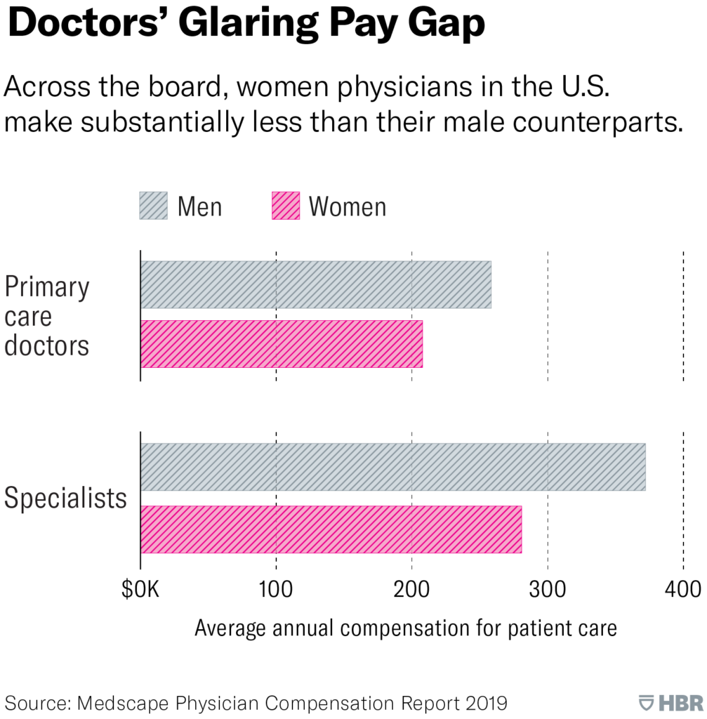
In 2020, the gender pay gap widened from 25.2% to 28%,
with female doctors earning an average of $116,289 less than male doctors.
(Annual Physician Compensation Report)

Slide 7
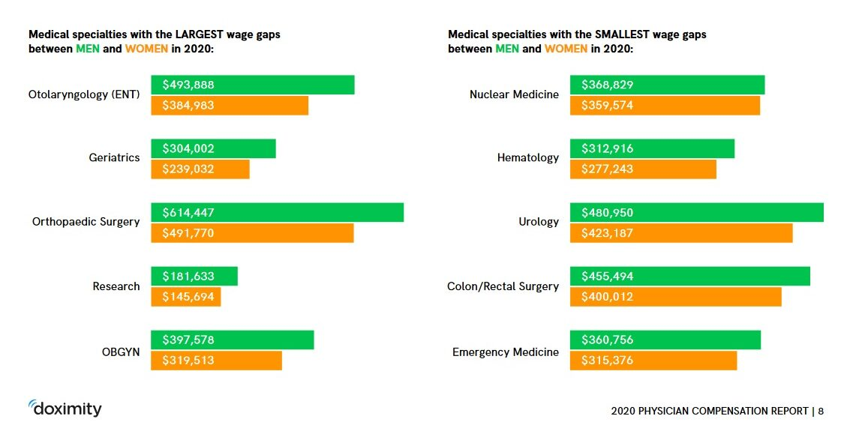

Slide 8
Where does Family Medicine fit in?
16% Less

Slide 9
Rank​ | Gender​ | Count​ | Median​ | Mean​
Instructor​ | Female​ | 62​ | 215​ | 211.2​
Instructor​ | Male​ | 36​ | 225​ | 243.6​
Assistant Professor​ | Female​ | 607​ | 207​ | 212.4​
Assistant Professor​ | Male​ | 488​ | 219​ | 227.1​
Associate Professor​ | Female​ | 215​ | 224​ | 225.2​
Associate Professor​ | Male​ | 233​ | 233​ | 240.6​
Professor​ | Female​ | 77 ​ | 234​ | 248​
Professor​ | Male​ | 146​ | 247​ | 252.6​
Chief​ | Female​ | 11​ | 246​ | 249​
Chief​ | Male​ | 15​ | 226​ | 247​
Chair​ | Female​ | 18​ | 358​ | 370.3​
Chair​ | Male​ | 49​ | 350​ | 346.2​
Excerpt from AAMC Faculty Data 2019-2020 - Table 35a
Family Medicine

Slide 10
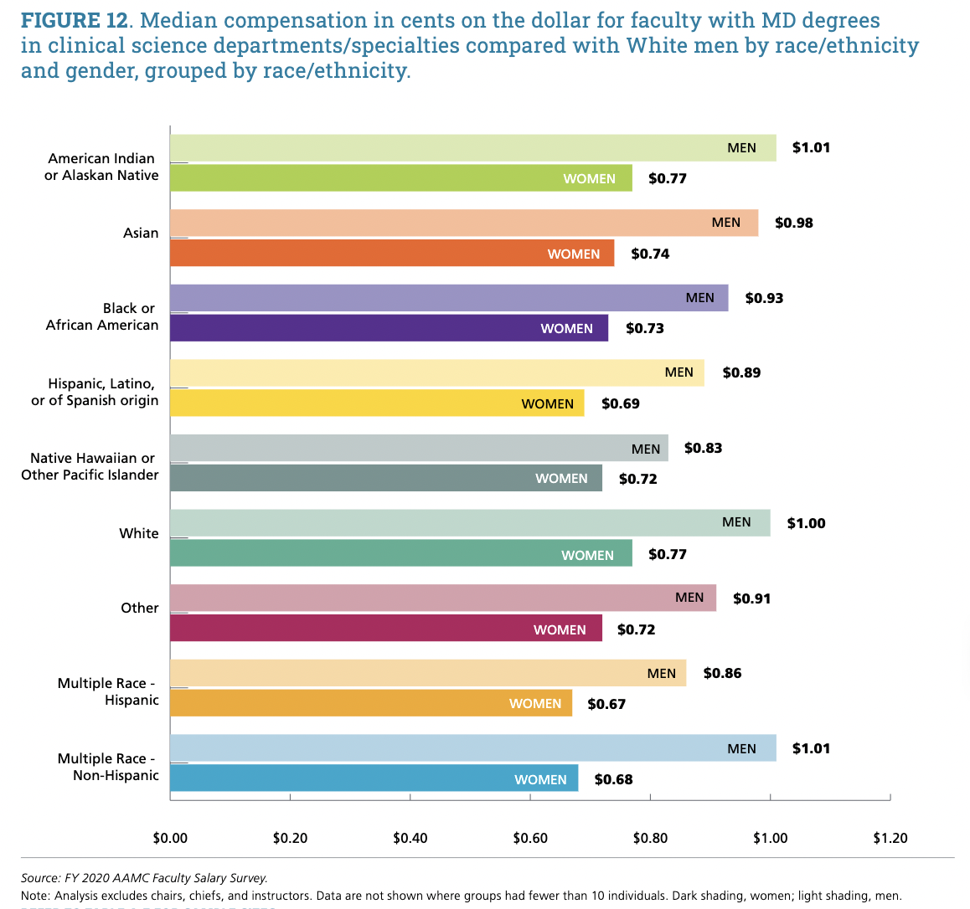

Slide 11
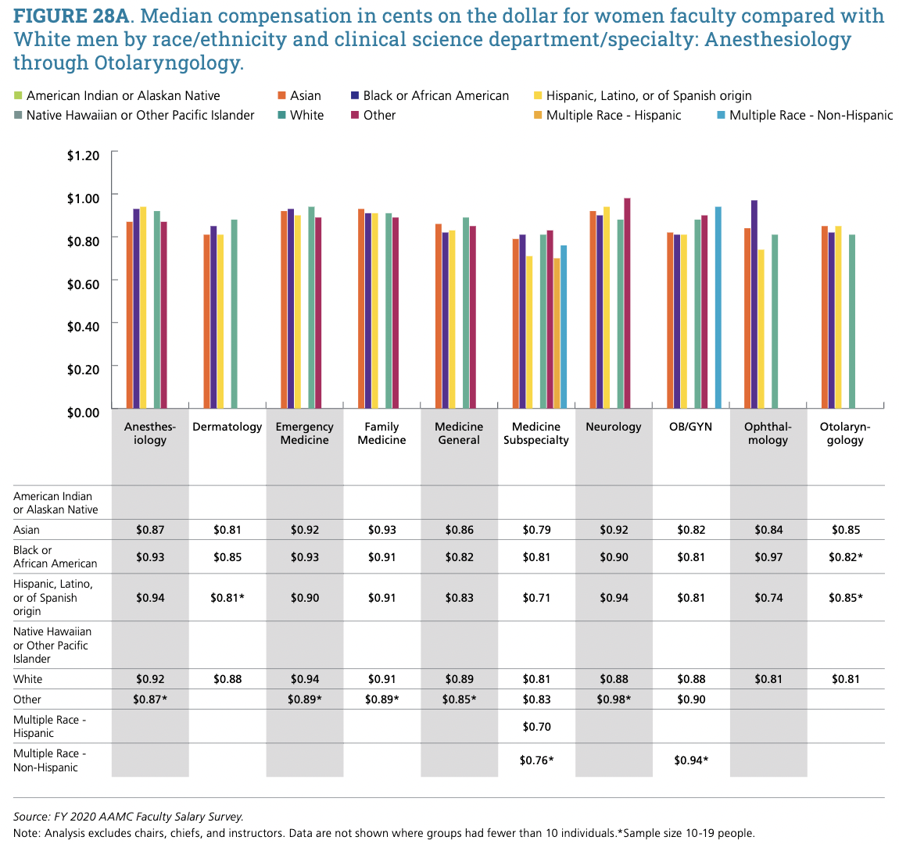

Slide 12
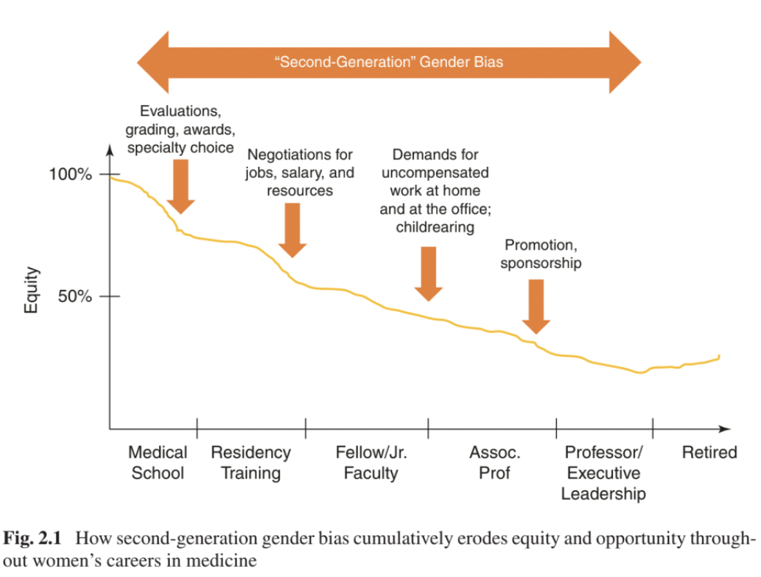
"Second-Generation" Gender Bias

Slide 13
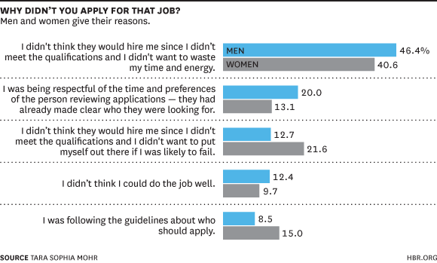

Slide 14
Key Points
Women physicians are paid less than their male peers across medical specialties, regions, and rankings
Gender Bias Plays a role starting in medical school and continues throughout careers
Compensation disparities are further exacerbated by ethnicity and race, however more data is needed
The problem has been worsened by the Pandemic

Slide 15
Small Group Breakouts

Slide 16
In your small groups
Identify a note taker
Identify ways your org is improving the gender pay gap
Identify ways your org is worsening the gender pay gap

Slide 17
Back to Large Group

Slide 18
Best Practices

Slide 19
Submit 1 Best Practice
Text: KRYSFOSTER688 to 22333 to join
Or
Go to PollEv.com/krysfoster688

Slide 20
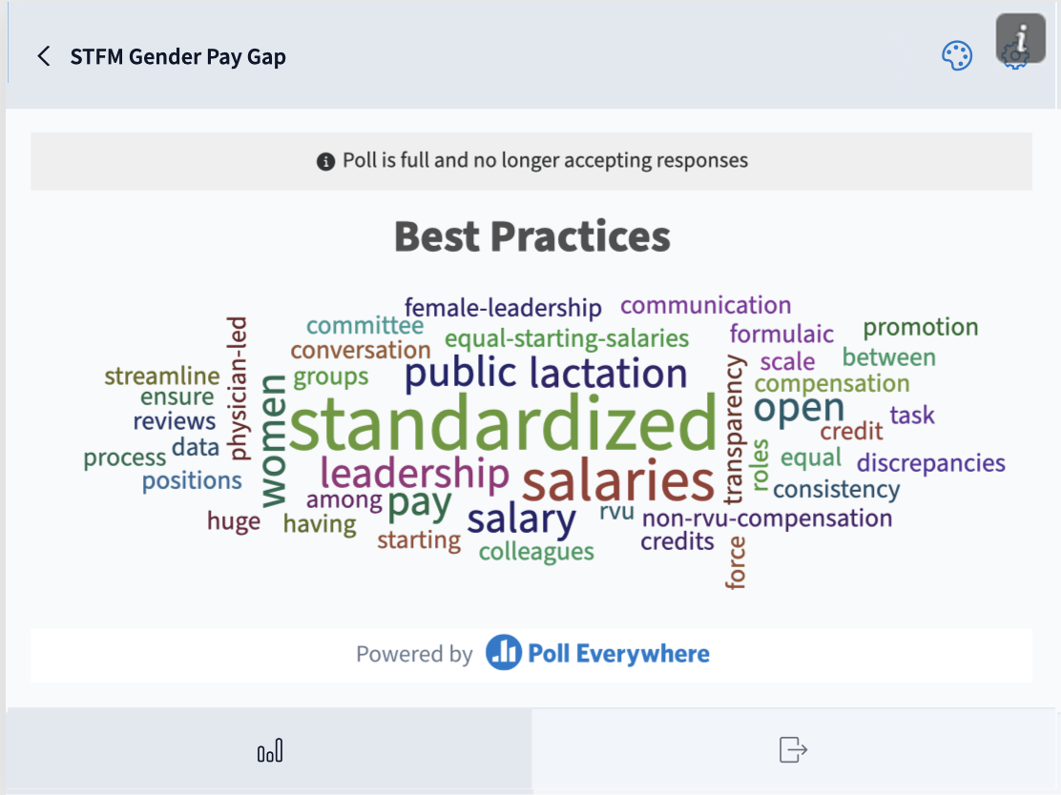
Notes:
Participant responses 5/1/2022

Slide 22
Best Practices
Salary Transparency
Residents Education
Universal paid parental leave
Value Based Care
Billing Workshop and training
Mentorship
Tools for contract negotiation
Gender Equity Advocacy through AAFP & NCCL
Notes:
Here is a link for the AMA contract negotiation workshop video: https://www.youtube.com/watch?v=KFwl9Ekw5gU

Slide 23
Best Practices (continued)
Standardize base salary by role
Diversity of interviewer panels
Upstanders/Sponsorship
Addressing Implicit Bias (C-suite)
Restructuring of promotion criteria
Encourage Promotion
Buddy system

Slide 24
AMWA’s #GIVEHERAREASONTOSTAY

Slide 25
Challenges

Slide 26
Submit 1 Challenge
Text: KRYSFOSTER688 to 22333 to join
Or
Go to PollEv.com/krysfoster688
This Photo by Unknown author is licensed under CC BY.

Slide 27
Notes:
Participant responses 5/1/2022

Slide 28
Challenges
Lack of transparency
Discomfort with sharing salaries/benefits
RVU reimbursement
Representation on National Society Boards
Primary Caregiver burden

Slide 29
MAKE A SMARTIE GOAL TO ADDRESS THE GENDER PAY GAP IN YOUR ORGANIZATION
S
Specific
Iron out all the details
M
Measurable
Identify what success looks like
A
Attainable
Make sure it is in your power to do
R
Realistic
Make it likely for you to succeed.
T
Time Bound
Make a due date or check-in
I
Inclusive
Engage traditionally marginalized communities
E
Equity
Incorporate fairness and justice
Adapted from The Management Center

Slide 30
SMARTIE GOAL SUBMISSION
https://tinyurl.com/PayGapSMARTIEGoal

Slide 31
Summary: The Problem
Women physicians are paid less than their male peers across medical specialties, regions, and rankings.
Gender Bias Plays a role starting in medical school and continues throughout careers
Compensation disparities are further exacerbated by ethnicity and race.
The problem has been worsened by the Pandemic

Slide 32
Summary: Solutions
Transparent
Salaries
Mentorship and Sponsorship
Advocacy through National Agencies
Parental Leave
and Accessible Child Care
Value Based Care
Education Initiatives

Slide 33
Please complete the evaluation on the STFM app

Slide 34
References:
Armijo PR, Silver JK, Larson AR, Asante P, Shillcutt S. Citizenship tasks and women physicians: additional woman tax in academic medicine? J Womens Health (Larchmt). 2021;30(7):935-943. doi:10.1089/jwh.2020.8482
Ash AS, Carr PL, Goldstein R, Friedman RH. Compensation and advancement of women in academic medicine: is there equity? Ann Intern Med. 2004;141(3):205-212. doi:10.7326/0003-4819-141-3-200408030-00009
Dandar VM, Lautenberger DM. Exploring Faculty Salary Equity at U.S. Medical Schools by Gender and Race/Ethnicity. AAMC; 2021. Accessed April 19, 2022. https://store.aamc.org/exploring-faculty-salary-equity-at-u-s-medical-schools-by-gender-and-race-ethnicity.html
Gottlieb, MD, FACP AS, ed. Closing the Gender Pay Gap in Medicine: A Roadmap for Healthcare Organizations and the Women Physicians Who Work for Them. Springer International Publishing; 2021. doi:10.1007/978-3-030-51031-2
How to Close the Gender Pay Gap in U.S. Medicine. Accessed April 23, 2022. https://hbr.org/2019/11/how-to-close-the-gender-pay-gap-in-u-s-medicine
Jabbarpour Y, Wendling A, Taylor M, Bazemore A, Eden A, Chung Y. Family medicine’s gender pay gap. J Am Board Fam Med. 2022;35(1):7-8. doi:10.3122/jabfm.2022.01.210086
Jagsi R, Griffith KA, Stewart A, Sambuco D, DeCastro R, Ubel PA. Gender differences in the salaries of physician researchers. JAMA. 2012;307(22):2410-2417. doi:10.1001/jama.2012.6183
Jagsi R, Guancial EA, Worobey CC, et al. The “gender gap” in authorship of academic medical literature--a 35-year perspective. N Engl J Med. 2006;355(3):281-287. doi:10.1056/NEJMsa053910
Jena AB, Olenski AR, Blumenthal DM. Sex differences in physician salary in US public medical schools. JAMA Intern Med. 2016;176(9):1294-1304. doi:10.1001/jamainternmed.2016.3284
Tsugawa Y, Jena AB, Figueroa JF, Orav EJ, Blumenthal DM, Jha AK. Comparison of hospital mortality and readmission rates for Medicare patients treated by male vs female physicians. JAMA Intern Med. 2017;177(2):206-213. doi:10.1001/jamainternmed.2016.7875
Warner AS, Lehmann LS. Gender wage disparities in medicine: time to close the gap. J Gen Intern Med. 2019;34(7):1334-1336. doi:10.1007/s11606-019-04940-9

