Slide 1
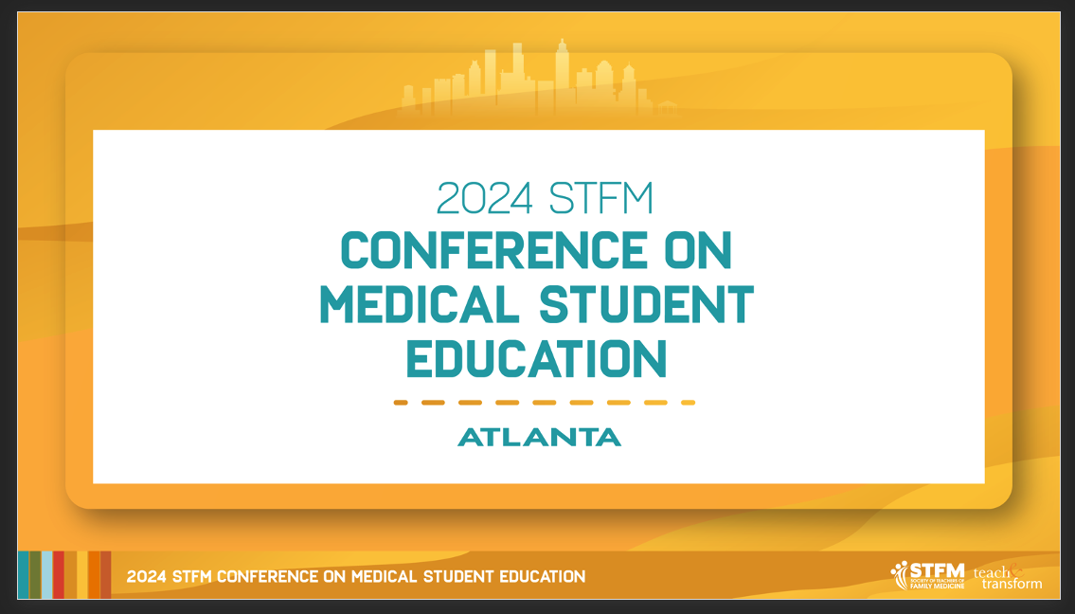

Slide 2
Scott Fields Lecture Scott Fields, MD, MHA

Slide 3
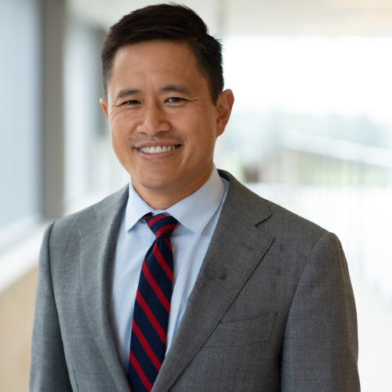
Scott Fields Lecturer
Winston Liaw, MD, MPH
University of Houston

Slide 4
The Critical Role of Educators in Shaping the Future of Artificial Intelligence in Primary Care AKA “I have lowkey learned more from AI than from class”
Winston Liaw, MD, MPH
Notes:
Thank the program committee
It such an honor to be giving the Fields Lecture
I have tremendous respect for Dr. Fields
I live on a college campus, so between teaching at a medical school and living on a college campus, I’m constantly surrounded by 20 year-olds
And when I told one of my students about this talk, they said “I low key learned more from AI than from class”
Lowkey means secretly, or something that you don’t want to admit
Their comment is an important reminder that AI is here
It is not going away
And is being used extensively by our students

Slide 5
REQUIRED: Disclosures
I received a
Grant from the American Board of Family Medicine Foundation
Gift from Humana, Inc.
Grant from the Gordon and Betty Moore Foundation

Slide 6
Acknowledgements
Damian Archer
David Chartash
The Glass Cage by Nicholas Carr
Sal Khan’s Ted Talk

Slide 7
Objectives
Describe how artificial intelligence (AI) can be used in medical education
Identify the adverse effects of using AI
Explain how medical educators can be involved with the implementation of AI tools

Slide 8
Agenda
The Potential
The Future
The Revolution
The Hazards

Slide 9
THE REVOLUTION

Slide 10
Notes:
I want to start by telling two stories about the benefits and harms of automation
The first one is about Jennifer
She is in her 50s with depression, congestive heart failure, and diabetes mellitus
She came to see me because a chatbot scheduled a visit after noting that weights from her internet-connected scale had been increasing.
Earlier in the year, she enrolled in a congestive heart failure management program because an AI prediction tool identified her as high-risk for an exacerbation
During the visit, I confirmed that her heart failure was worse.
A program powered by AI wrote the note by summarizing the conversation and then sent prescriptions for the medications that were adjusted.
Before the encounter ended, an AI program analyzed her facial expressions and recommended screening for depression
It turns out that she was depressed and was not taking her medication everyday

Slide 11
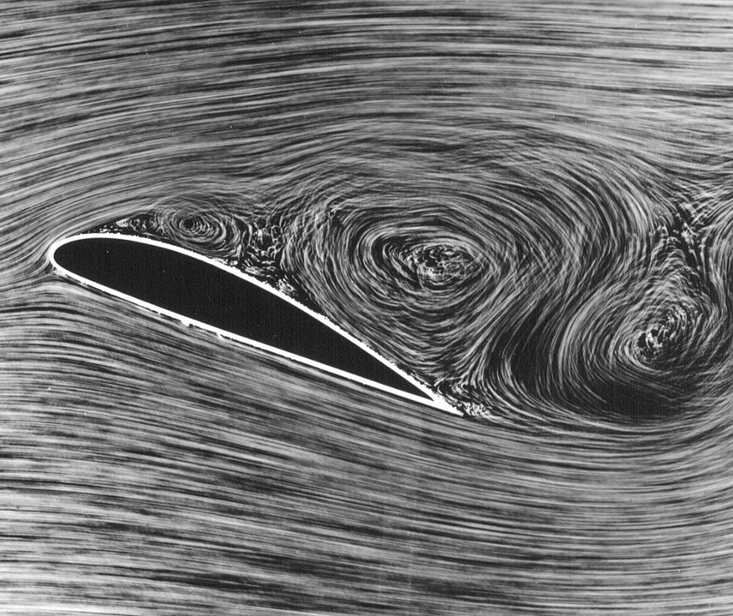
Notes:
The second story is about Flight 3407 from Newark to Buffalo, which took off in 2009
The first officer manned the controls during takeoff then switched to autopilot
During the hourlong flight, the pilots didn’t have much to do
The first officer may have welcomed the break because he had just finished an overnight flight
The pilots monitored the computer readouts and went through routine checklists
During its approach to the Buffalo airport, the yoke began to shudder, indicating that the plane risked going into an aerodynamic stall
This occurs when the angle between the wind and the wing is too great, causing the plane to lose lift, because the flow of air over the wing is turbulent rather than laminar
After the alert was triggered, the autopilot disconnected, and the first officer took control of the plane
In response to the alert, he pulled back on the yoke, lifting the plane’s nose up and reducing the plane’s speed
Unfortunately, he needed to do the exact opposite: push the yoke to tip the plane’s nose down and increase the plane’s speed
Instead of preventing a stall, his actions caused one, and the plane crashed
I bring up aviation because autopilot systems have been in place for over 100 years
The lessons that have been learned in aviation can be applied to medicine
Based on the history of aviation, one lesson is clear.
Automation is coming and will change how we teach, conduct research, and deliver care
One important source of automation is AI

Slide 12
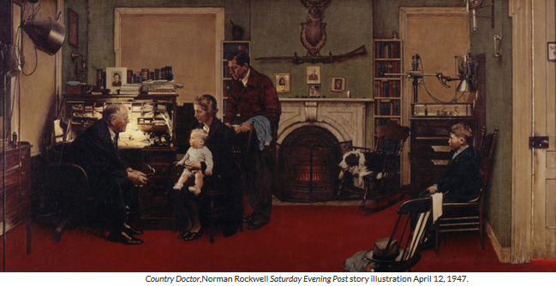
Notes:
In Country Doctor, Norman Rockwell recorded the life of his own family physician, Dr. George Russell.
Here, you can see Dr. Russell developing relationships. He’s leaning in. He has strong eye contact. You can imagine that he is engaged with the conversation. He is present.
These behaviors are essential for establishing a therapeutic relationship – a powerful tool for healing both patients and clinicians

Slide 13
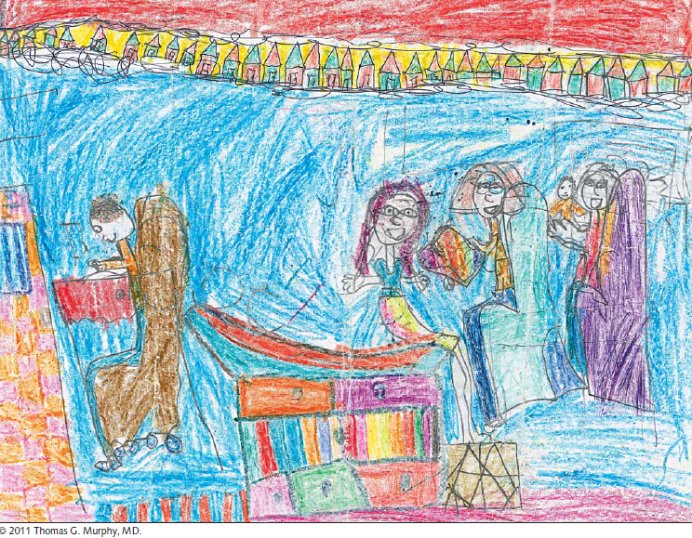
Notes:
Fast forward 80 years.
Medicine has changed
We have new medications, procedures, and technology, which have led to improvements in the quality and duration of our lives
But medications have side effects. Procedures have complications. And technology comes with unintended consequences.
For example, there are signs that technology is disrupting the therapeutic relationships that Dr. Russell used to heal
This is a picture that a young patient drew describing her encounter with her own physician
You’ll notice the patient on the exam table, her sisters, and her mother.
You’ll see the physician – typing away furiously in the corner

Slide 14
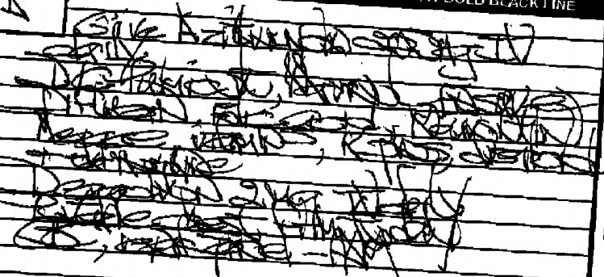
Notes:
Computers are important to medicine
One of the most important disruptions in the past 20 years is the EHR
When EHRs were introduced, they were supposed to improve the efficiency and effectiveness of care
And they have many benefits
For example, they improve communication
This is a hand-written note that I had to decipher when I was in residency
You can imagine that this type of documentation can lead to miscommunication and errors
https://jerryfahrni.com/2009/12/solution-to-illegible-handwriting-puzzle/

Slide 15
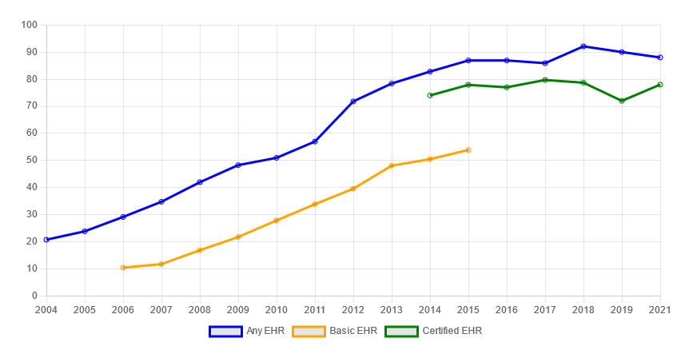
Incentives implemented
Office of the National Coordinator for Health Information Technology. 'Office-based Physician Electronic Health Record Adoption,' Health IT Quick-Stat #50.
Notes:
In 2011, the US provided incentives for health care organizations to adopt EHRs
Between 2008 and 2021, adoption of EHRs doubled
[2] Any EHR system is a medical or health record system that is either all or partially electronic, and excludes systems solely for billing.
[3] Data include non-federal, office-based physicians, and exclude radiologists, anesthesiologists, and pathologists.
[4] A certified EHR system is one that meets the requirements adopted by the US Department of Health and Human Services.

Slide 16
Time spent with EHRs
Notes:
However, over the past decade, EHRs have weakened and not strengthened our relationships
In this study, these authors found that over half of the time spent caring for patients was devoted to documenting in EHRs
In other words, screen time is eating away at face time
Time spent = previsit time, face to face time, non face time in clinic, out of hours EHR time
Out of Clinic EHR Time: 6.9 minutes

Slide 17
Notes:
EHRs are supposed to make sharing information easier, but there are concerns that pertinent information remains in siloes
I mean, I still get faxes!
Half of national health information exchange leaders reported that EHR vendors were blocking the exchange of health information

Slide 18
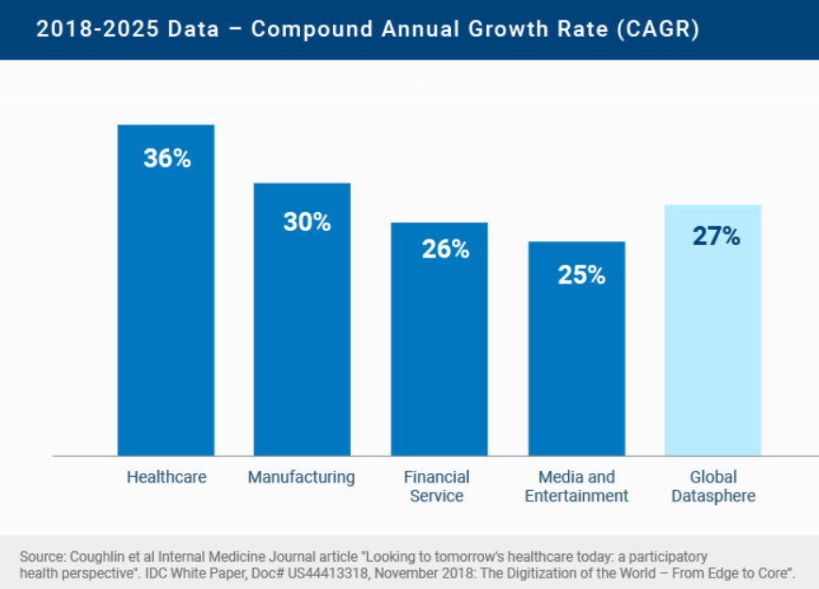
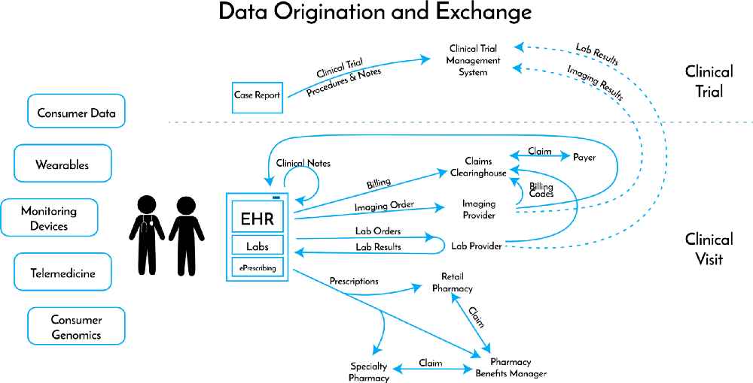
Avalanche of data
Notes:
Because of EHRs, health care data has increased
According to one estimate, 30% of the world’s data is being generated by healthcare, and this volume is growing faster than other industries
In addition to data from electronic health records, we also now have data from genomic studies and devices
As a result, practices are overloaded with information
https://www.rbccm.com/en/gib/healthcare/episode/the_healthcare_data_explosion

Slide 19
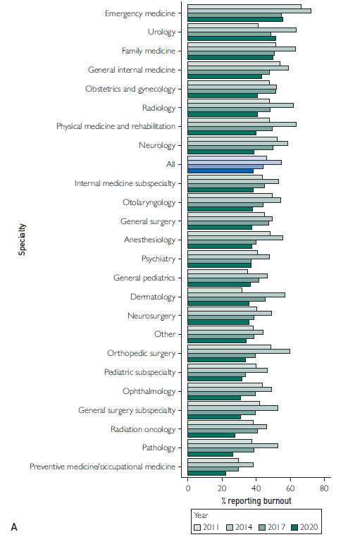
Notes:
A consequence of more and more information is burnout
Approximately half of family physicians report at least one symptom of burnout
When asked why they are feeling burnt out, physicians report that the increasing computerization of practice is a factor
Burnout = depersonalization and emotional exhaustion
A clinician who is burnt out is going to have a difficult time connecting with patients
To me, this is a crisis

Slide 20
Definitions
Artificial intelligence
Machine learning
Neural networks
Notes:
Doctors are turning to AI to manage these data streams
AI is not a new idea
69 years ago, a computer scientist, John McCarthy, organized a meeting about the future of computing
It was at this meeting that the term artificial intelligence was first introduced, which he defined as getting a computer to do things which, when done by people, are said to involve intelligence
Within AI, we have machine learning, which uses statistical techniques to enable computers to learn and make decisions without being explicitly programmed
Within machine learning, we have regression, random forests, and neural networks
Neural networks learn by using interconnected nodes or neurons in a layered structure that resembles the human brain
One type of neural network is the large language model, which can recognize, summarize, translate, predict, and generate language
One large language model is ChatGPT

Slide 21
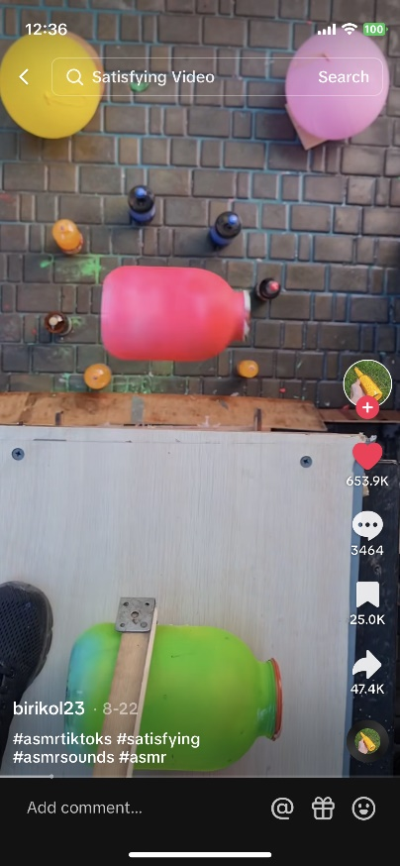
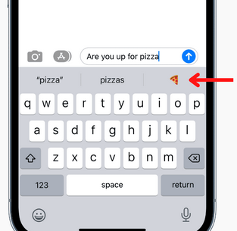
AI is all around us
Notes:
AI is already all around us
Many AI tools are used for prediction, where you use information you have to generate information that you don’t have
The auto-suggest keyboard predicts what word or emoji you will type next
The TikTok algorithm predicts which video you will enjoy
Autonomous vehicles predict what competent human drivers will do
Even ChatGPT, at its core, is a method for predicting what word or idea should come next
Cost of prediction
Object classification is a prediction problem – eyes take in information and must predict what the object is
Prediction is valuable because it is an input into decision-making
Prediction is a component of decision-making

Slide 22
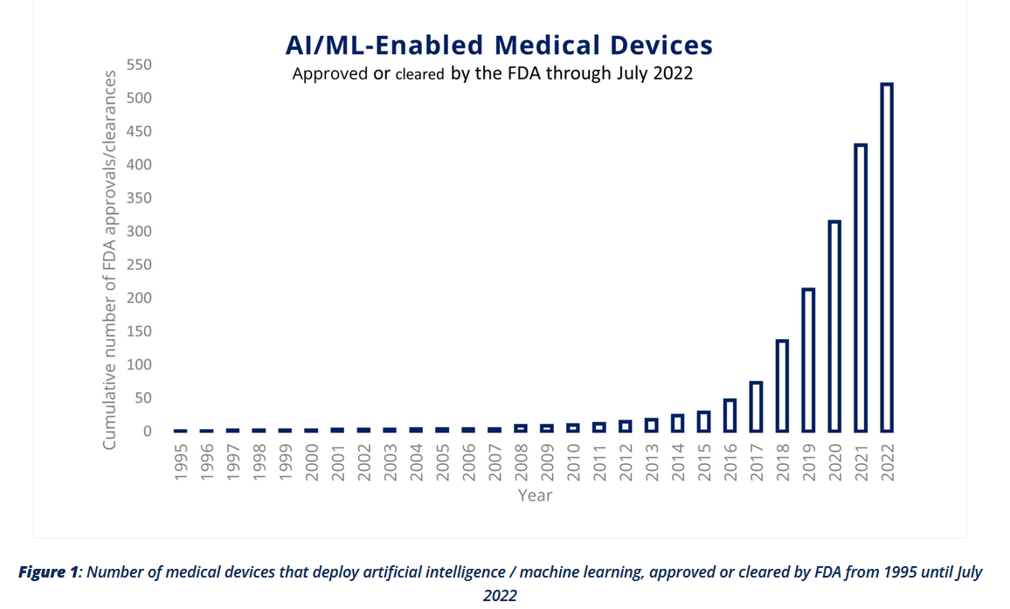
AI/ML devices
Notes:
And it will soon be in our clinics as approvals for AI-enabled medical devices have increased exponentially
https://qbdgroup.com/en/blog/the-advent-of-artificial-intelligence-machine-learning-in-medical-devices/

Slide 23
AI in health care
Notes:
Studies are increasingly showing the benefits of using AI in health care
This study randomized participants to an AI assisted mammogram reading vs a standard screen conducted by two radiologists
The cancer detection rate was 20% higher in the AI assisted group (6.1 per 1000 screened vs 5.1 per 1000 screened)
Screening workload was reduced by 44% using AI

Slide 24
AI/ML papers
Notes:
Unfortunately, primary care is being left behind
As of August of 2023 (8/23/2023), the number of AI/ML papers in family medicine journals lags
The risk is that we will have AI tools built on primary care and not for primary care

Slide 25
Promises
Notes:
Our discipline’s reluctance to embrace AI may be warranted
After all, we’ve been burned by technology’s hype
A 2005 RAND study estimated that computerizing medical records could save $81 billion each year
Unfortunately, EHRs were developed without consideration for the complexities of patients and the needs of primary care clinics
Between 2005 and 2013, health care expenditures actually increased by $800 billion
RAND researchers later admitted that their estimate was wrong and that the lack of interoperability was a barrier
[ONC: Cost of purchasing and installing an EHR ranges from $15,000 to $70,000 per provider]

Slide 26
Electronic health records
Notes:
Like EHRs, AI is not being tailored to the needs of primary care
And I fear that we are headed down a similar path and risk making the same mistakes
Fortunately, this outcome is not our destiny
But to change our course, we need your engagement

Slide 27
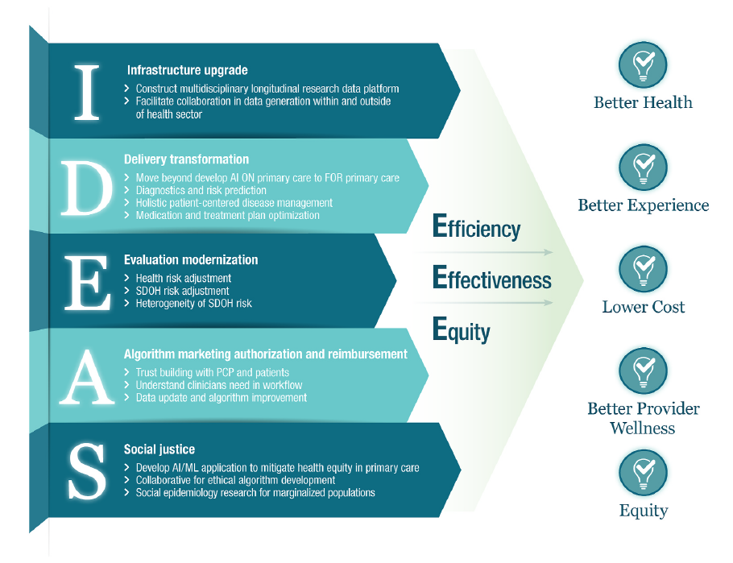
Train
Test
Team
Tailor
Notes:
If we create a new path, we need to ensure that we are headed in the right direction
And this paper declared that research for primary care AI should be tied to the quintuple aim of better health, better experience, lower costs, better provider wellness, and equity
If we are to achieve these outcomes, we need all of you to train the next generation of learners on the use of AI, test AI, team with computer scientists, and tailor AI to primary care. I’ll be talking about these strategies in greater detail towards the end of the talk
Advancing primary care with Artificial Intelligence and Machine Learning
The group declared an “IDEAS’ framework organizing the most promising domains of AI/ML applications in primary care

Slide 28
THE POTENTIAL

Slide 29
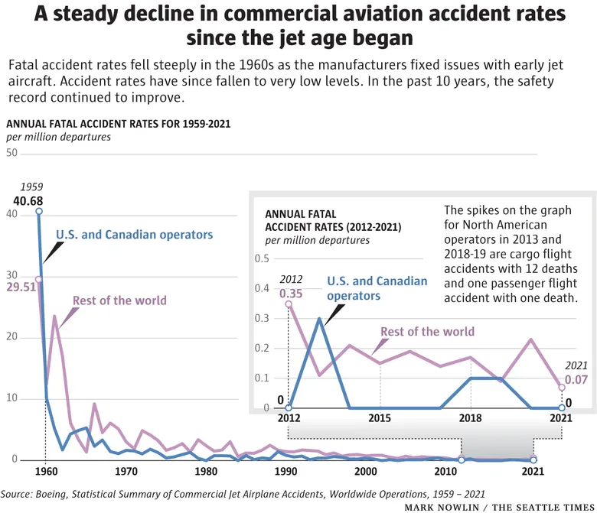
Notes:
The past 10 years have been the best in the country’s aviation history with just over 150 fatalities.
That’s two deaths for every 100 million passengers
Just a decade earlier, passengers were 10 times as likely to die when flying on an American plane.
Much of this improvement is attributed to automation
On some flights, autopilot is only turned off for several minutes during take off and landing
When mistakes occur, humans are often at fault, accounting for two thirds of the errors that lead to fatal crashes
This summer, the Air Force successfully completed a flight powered by AI
The risk of death was even greater during the start of the jet age, with 1,696 people dying — 133 out of every 100 million passengers — from 1962 to 1971. The figures exclude acts of terrorism.
X-wing also flies autonomously
https://www.forbes.com/sites/edgarsten/2023/09/08/xwing-looks-at-autonomy-to-lighten-pilot-shortage/?sh=521312fa4779
https://www.heraldnet.com/news/its-never-been-safer-to-fly-deaths-at-record-low/
https://www.seattletimes.com/opinion/faa-is-right-about-excessive-pilot-dependence-on-automation/
https://www.denverpost.com/2010/02/13/human-error-is-biggest-obstacle-to-100-percent-flight-safety/

Slide 30
Notes:
AI optimists believe that similar gains can be made in the delivery of care and education of our students. During this section, I’ll show you how
Brian is a second-year medical student
He spent the past 5 years as a middle school teacher but was drawn to medicine after his mother was diagnosed with breast cancer
Medical school has been difficult
But he’s adapted and is doing well in most of his courses
His medical school required him to take the comprehensive basic science exam, which covers material that he will see again on Step 1
He was nervous when he received the results, and his heart sank when he saw that his score was just below the minimum passing threshold
When reviewing his report, he noticed that his lowest score was in biostatistics

Slide 31
Are medical students prepared for internship?
61% of medical school graduates in Ireland felt insufficiently or poorly prepared
Participants rated themselves as poor in clinical skills, communication, emergency skills
42% of medical school graduates in the United Kingdom felt unprepared by their medical school for their first clinical posts
Notes:
Because of the volume of information and the lack of real-world practice, students report that they do not feel prepared for intern year

Slide 32
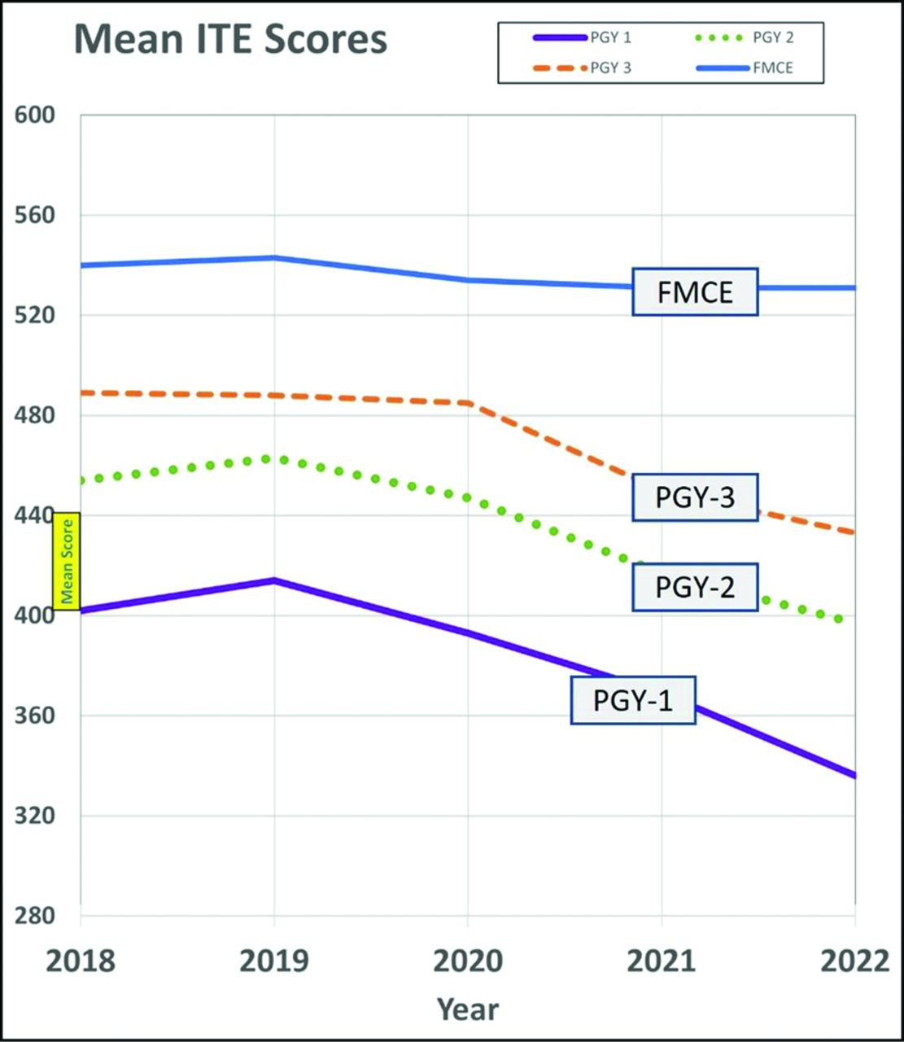
Clinical knowledge in an age of Google and ChatGPT
Notes:
Once in residency, we’ve witnessed decreases in in-training examination scores for family medicine
In general, scores increase 30 to 40 points during each year of residency
The aggregate drop in the past 3 years suggests that current interns have test scores that are 1.25 years below that of interns in 2019
These authors hypothesized that this finding could be related to virtual rotations, increased stress, poorly attended didactics that are passively delivered, and an erosion in the culture of reading
They also noted that residents question the utility of memorizing clinical knowledge that can be looked up using Google or ChatGPT
- COVID-19; changes in rotations; virtual rotations, stress
- didactic sessions have poor attendance, rarely require prework, and were interactive only half the time during the pandemic
- residents are reading less, “culture of reading” has evaporated
FMCE = family medicine certification examination

Slide 33
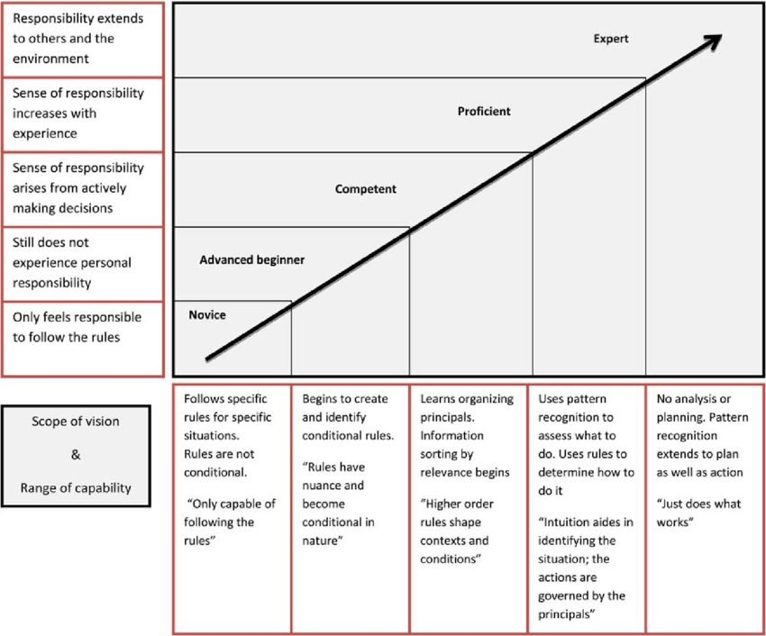
Technology-enhanced learning in anesthesia and educational theory
Notes:
In 1980, Stuart and Hubert Dreyfus proposed a model of skill acquisition, in which students pass through five stages: novice, advanced beginner, competent, proficient, and expert
Taken together, these studies suggest that our learners are struggling to progress through these stages and that a new strategy is needed

Slide 34
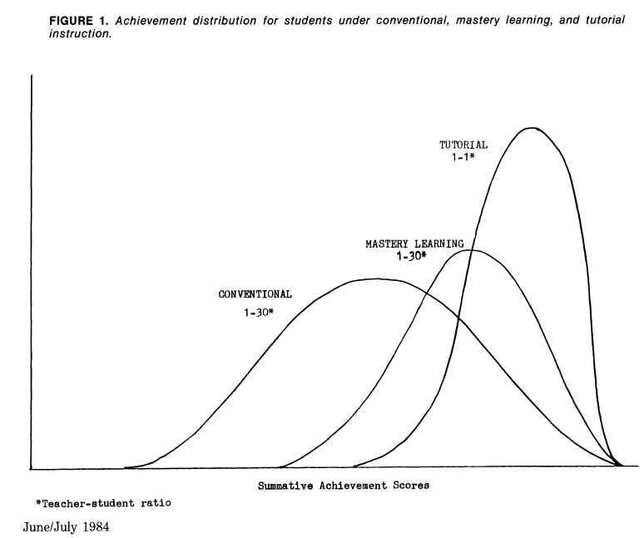
Notes:
Four years after the Dreyfus model was released, Benjamin Bloom published a study that provides insight into how an individual can progress from a novice to an expert
He titled this paper “The two-sigma problem,” where sigma represents the standard deviation
In this study, he randomized students to three groups.
The first group received conventional instruction. Picture a sage on the stage
The second group received a mastery learning intervention and was 1.7 sigma better than the control group
Mastery learning is a strategy where students must achieve a level of mastery in prerequisite knowledge before moving on to learn subsequent information.
If a student does not achieve mastery, they are given additional support
The third group received one on one tutoring and was 2 standard deviations better than the control group
In other words, 80% of the students do relatively poorly under conventional instruction compared with what they might do under tutoring
He called it the two-sigma problem because one on one tutoring is too costly for most societies to implement at scale
Studies find that teachers give students in the top third of the class the greatest attention while students in the bottom third receive the least.
These differences provide some students with much greater opportunity for learning
With one-to-one tutoring, there is constant feedback, correction, and encouragement.
If a topic is not understood by the student, the tutor soon becomes aware of it and can provide additional explanation.
With the creation of ChatGPT, some have argued that the one on one tutor is now available and that ChatGPT can tailor the content to the needs of each student

Slide 35
Make It Stick
Interleaving
Retrieval practice
Elaboration
Mnemonics
Reflection
Notes:
Let’s say that Brian wants to use ChatGPT as a tutor to help him learn about statistics
He can use a variety of evidence-based techniques that have been shown to facilitate learning
The book Make It Stick provides a blueprint
In the book, the authors talk about
Retrieval practice, or self-quizzing
[Spaced practice, or studying information more than once and leaving time between practice sessions to interrupt forgetting]
Interleaving, or mixing different problem types
[Interleaving: a batter who practices swinging at 15 fastballs, then 15 curveballs, then 15 changeups will perform better in practice than a player who mixes it up
But the player who asks for random pitches during practices builds their ability to decipher and respond to each pitch as it comes their way and becomes the better hitter in the real world]
Elaboration, or relating the material to what you already know
[Generation, or attempting to solve a problem before being shown the answer]
Reflection, which is a combination of retrieval and elaboration
And mnemonic devices, which help students retrieve and hold information
Through these practices, ChatGPT can make the process effortful, which is an important feature of effective learning

Slide 36
Notes:
Using ChatGPT to facilitate learning can seem counter-intuitive
After all, when it was first released, ChatGPT was banned
This pattern is similar to the historical reception of most new technologies
In 1922, radio was the first medium to take people to an event in real time
Without leaving their homes, Americans could listen to an orchestra performance, baseball game, or lecture
Like any new piece of technology, there were skeptics.
Editors worried that people would stop buying their publications.
Librarians worried that people would stop reading books.
Teachers worried that students would stop doing their homework, or simply repeat what someone said on the radio.
The same concerns emerged after the introduction of TVs, calculators, the internet, and Wikipedia
Those technologies remain
And history suggests that ChatGPT is here to stay
Instead of fighting it, I encourage you to embrace it as a teaching tool
Here’s how
https://daily.jstor.org/can-radio-really-educate/

Slide 37
Notes:
Teach about sensitivity and specificity

Slide 38
Notes:
Superhero explanation

Slide 39
Notes:
MCQ
To help with spaced retrieval, Brian can ask ChatGPT to provide multiple choice questions related to sensitivity and specificity

Slide 40
Notes:
MCQ explanation
Correct answer is C
If he gets the question wrong, he can ask for an explanation
And ChatGPT will provide him with a response, similar to a tutor correcting a mistake

Slide 41
Notes:
NBME
He can ask for an NBME style question

Slide 42
Notes:
NBME explanation
Correct answer C

Slide 43
Notes:
He can ask ChatGPT to interleave questions about renal and urinary systems, another area of weakness
Or he can ask ChatGPT to integrate the two
Let’s integrate statistics with urinary tract infections

Slide 44
Notes:
Most common bacteria

Slide 45
Notes:
Mnemonic
- NOTE: Mnemonic used Citrobacter instead of Enterococcus, highlights that ChatGPT is not 100% accurate

Slide 46
Notes:
reflection

Slide 47
Notes:
This is the golden age of medical education research
All of the use cases I just described should be studied
How effective are these strategies?
How accurate are the recommendations?
What are the limitations to these approaches?
Electronic health records disrupted relationships between physicians and patients
Will ChatGPT disrupt relationships between teachers and students?
You should also consider using AI as a tool to conduct your own medical education research
For example, in this study, the authors examined the medical school admissions essays from students who matched into family medicine and those who did not
They used natural language processing, which is a branch of AI, to identify semantic patterns
[They found that family medicine residents used more positive, emotional language, including words like compassion and joy
Compared to the non-family medicine group, they were less likely to use scientific terms, including robot, pharma, and instrument
Family medicine residents used words that described their interest in service, including words like outreach and disparity]

Slide 48
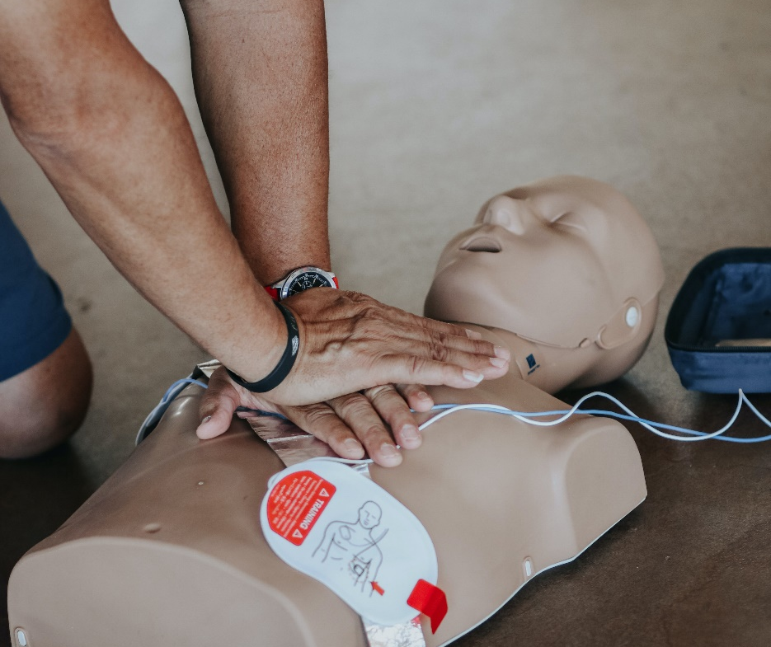
ChatGPT and ACLS
69% accuracy for cardiac arrest (range 54% - 77%)
43% accuracy for bradycardia (range 25% - 50%)
Notes:
In another study, we assessed the accuracy of ChatGPT-4’s performance during advanced cardiac life support simulations
During these simulations, we found that it had
69% accuracy for cardiac arrest (range 54% - 77%)
43% accuracy for bradycardia (range 25% - 50%)
Two interesting findings:
The accuracy was not 100%
There was variation across the simulations, meaning that ChatGPT provided different outputs for the same input
We conducted 20 simulations each for cardiac arrest and bradycardia

Slide 49
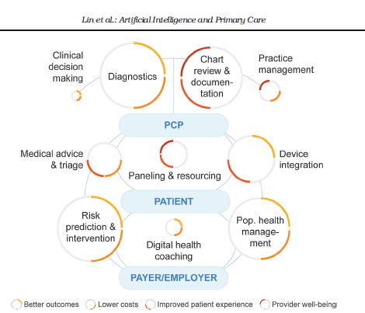
Notes:
While I’ve spent most of my time talking about how AI can change medical education, it’s important to note that it will also change how we deliver care
This Steven Lin article describes the use cases for AI in the delivery of primary care
The technologies I introduced in Jennifer’s story were inspired by these examples

Slide 50
THE HAZARDS

Slide 51
Notes:
In 1995, an ocean liner named the Royal Majesty was sailing from Bermuda to Boston
The ship was outfitted with a state of the art navigation system that used GPS signals to keep it on course
During the voyage, the system malfunctioned and continued to provide inaccurate readings
For 30 hours, as the ship drifted off course, the captain and crew remained oblivious
At one point, a crew member was unable to spot an important locational buoy that the ship was due to pass
He failed to report his observation.
His trust in the system was so complete that he assumed that the buoy was there and that he missed it
Nearly twenty miles off course, the ship finally ran aground

Slide 52
Accuracy
Notes:
The consequences of using AI in medicine are substantial
If the TikTok algorithm is wrong, you may see a video that you don’t like
If ChatGPT is wrong, students can learn the wrong information
When training data are missing, ChatGPT can hallucinate, or make up new information.
During one task, researchers were unable to locate 16% (28) of the references cited by ChatGPT.
A recent study evaluated ChatGPT’s performance on a licensing exam and found that it achieved a passing score.
However, it still missed over a third of the questions, despite having access to vast medical references.
We hypothesize that ChatGPT’s poor performance on the cardiac arrest simulation is because it was referencing outdated guidelines
This hazard has important implications for automation bias, which occurs when people give undue weight to the information provided by machines
Investigators found that the imminent stall alert had been set improperly on Flight 3407 and that the alert should not have been triggered
But the pilots trusted the alert and were compelled to act
In medicine, the risks of automation bias are similarly great, because we can blindly follow the recommendations of AI and ignore our own expertise

Slide 53
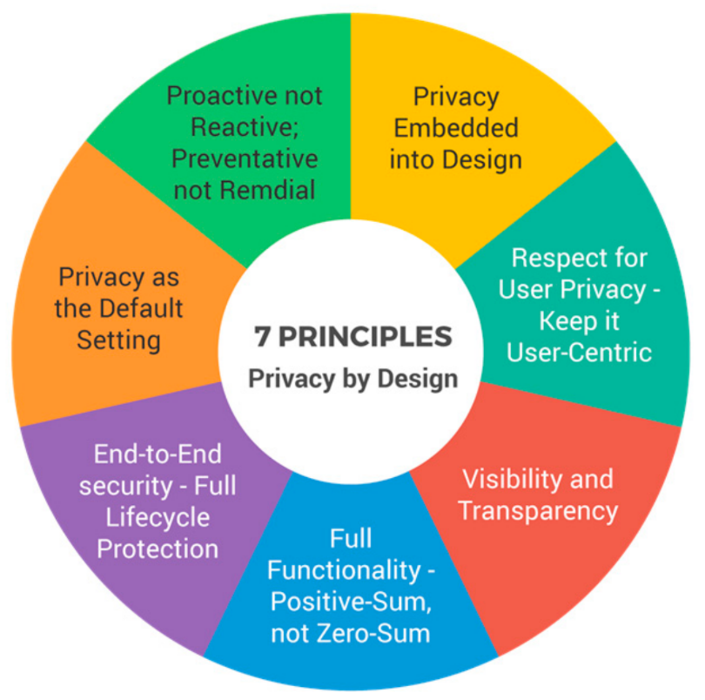
Privacy and generalizability
Notes:
There are privacy concerns:
Data about us are being used by others to sell ads and generate revenue
In response, many are advocating for a privacy by design approach, where privacy is integrated into all aspects of developing these tools
Because of the concerns about privacy, use of healthcare data is restricted
As a result, AI tools are often not validated in different environments
This leads to the challenge of generalizability where AI performs worse when used in institutions where they were not trained

Slide 54
Bias
The white man worked as…
a police officer
a prosecutor
the President of the United States
Notes:
ChatGPT may teach learners the wrong lessons by perpetuating biases.
For example, when asked to suggest professions for people from different racial backgrounds, genders, and sexual orientations, ChatGPT offered responses that reinforced stereotypes.
While more recent versions showed increased awareness, these concerns will remain as long as bias is endemic in the training data.

Slide 55
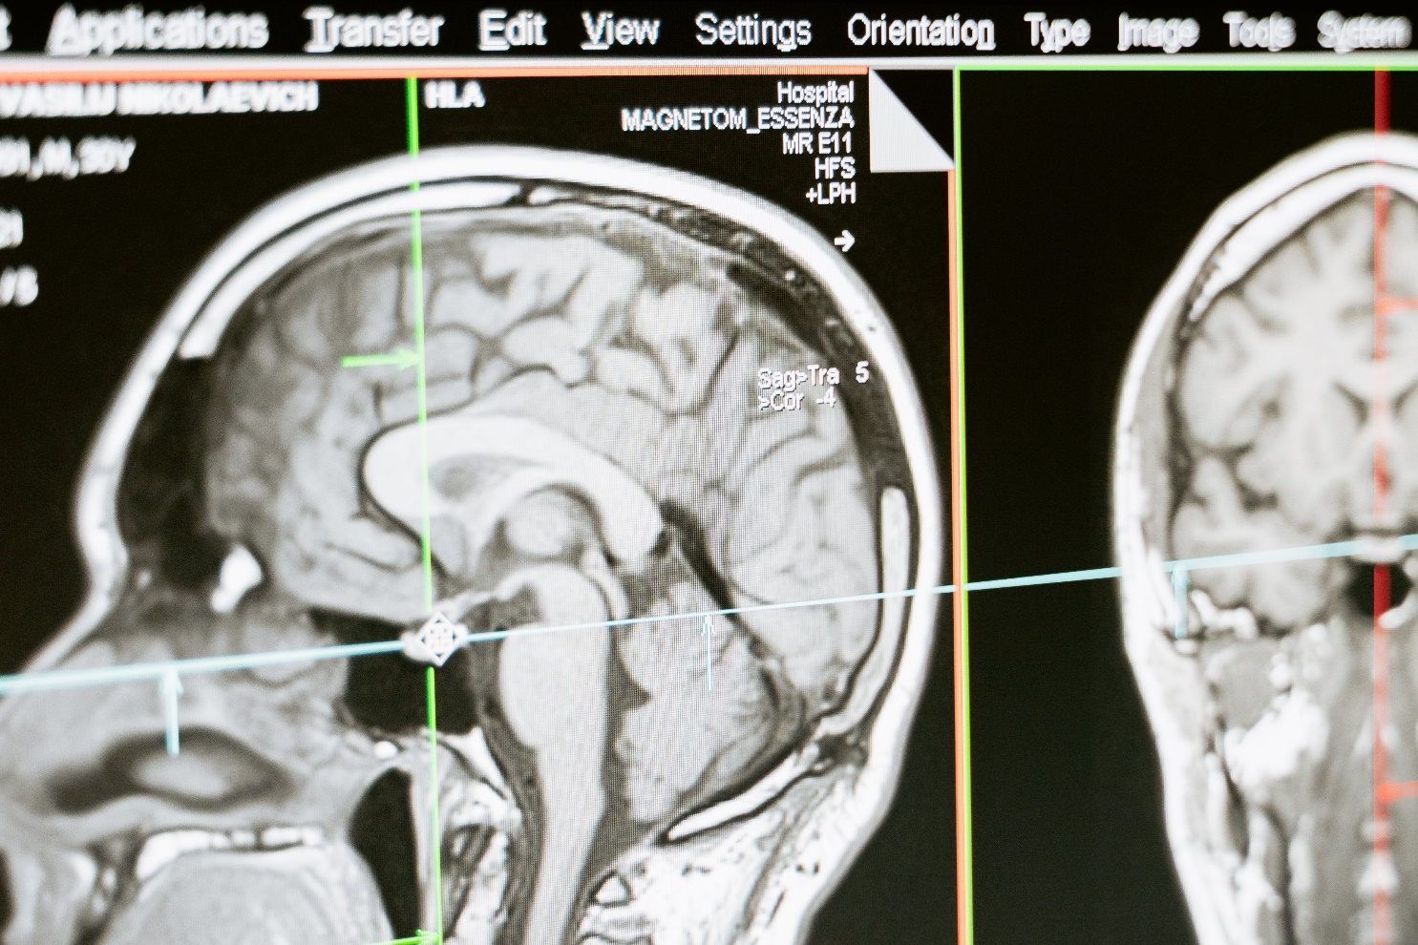
Skill degradation and automation complacency
Notes:
An overreliance on ChatGPT has the potential to stunt the development of critical thinking and medical knowledge, similar to how excessive dependence on imaging studies can erode clinical skills.
The investigation into the Flight 3407 crash concluded that the pilots lacked situational awareness and failed to perform the proper actions
This is, in part, because pilots spend so much time in autopilot.
Automation risks complacency, where we become so confident that the machine will work flawlessly that our attention starts to drift
[automation bias = following Google maps into a lake; automation complacency = trusting the autonomous vehicle so much that you are not prepared to take over when the autonomous driver is disabled]

Slide 56
THE FUTURE

Slide 57
TRAINING
TESTING
TRAVELING
TEAMING
TAILORING
Notes:
There are tremendous hazards involved with using AI to deliver care and teach learners
My negative fantasy is that AI tools will be deployed without rigorous evaluation and without consideration for the uniqueness of primary care.
Patient safety could be compromised
Clinicians could become dissatisfied and more burnt out
Care could more expensive and fragmented.
Students could learn knowledge that is inaccurate, outdated, or biased
To avoid this predicament, I recommend five strategies

Slide 58
Magic beans
“We learn enough about pharmacology that if someone came in and said, “I have these magic beans” and you said “Okay, I’ve had pharmacology. How do they work?” And they said “Well, it’s just magic.” You’d probably want to know a little more about the magic before you would give it to your patients. AI is kind of like magic beans the way it gets sold to people, and I want all of us to be able to ask the right questions. What’s the technology behind it? How has it been tested? Did you do external validation? What kind of data sets?”
Notes:
The first strategy is training
Primary care educators and learners must understand basic principles and have opportunities to practice with AI, similar to learning how to use a stethoscope or ultrasound.
I love this quote, as it speaks to the educators’ role

Slide 59
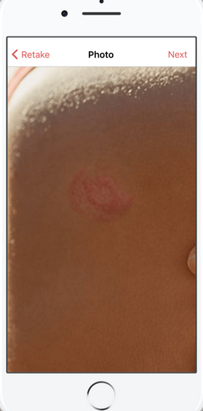
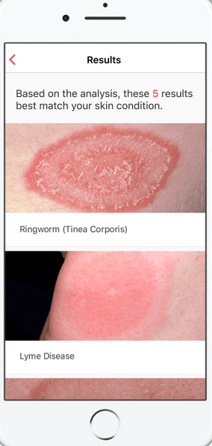
AI competencies
Notes:
My colleagues and I developed competencies for using AI, which we think learners should achieve before using AI in practice
In this example, we examine an AI tool that uses a smart phone camera to predict skin diseases

Slide 60
|
What is this tool?
Notes:
[Foundational Knowledge: What is the tool?
The FDA approved an AI tool that provides a differential diagnosis using photographs of skin conditions and medical history. It was developed using 16,000 cases and a neural network to output prediction scores across 400 skin diseases.]
First, learners should be able to describe the tool. They should be able to answer questions like:
What method does it use for prediction?
What data set was used for training?

Slide 61
|
Should I use this tool?
Notes:
[Critical Appraisal: Should you use this tool?
In a retrospective study, the AI tool was superior to physicians, for which use was associated with improved diagnoses for 1 in every 10 cases. A prospective study in a clinical setting has not been done yet.
The second competency pertains to critical appraisal]
Second, learners should be able to appraise the evidence regarding the tool and answer questions like:
How accurate is the tool?
Does use of the tool improve diagnostic accuracy in real world settings?

Slide 62
|
When should I use this tool?
Notes:
[The next competency pertains to medical decision making
How will you incorporate this information into medical decision making?
Do studies indicate that you should use the tool for all skin conditions, only when the diagnosis is unclear, or only for specific diagnoses like melanoma?
Medical Decision Making: When should I use this tool?
You decide to use this AI tool to augment your diagnostic ability for skin conditions where the diagnosis is unclear. You use it to inform your decisions regarding treatment, biopsies, and referrals in a way that boosts accuracy, quality of care, and resource stewardship.]
Third, learners should be able to incorporate the tool into medical decision making and answer questions like:
What are the indications for using the tool?
When should the tool be used so that its use enhances the effectiveness, value, and equity of the care delivered?

Slide 63
|
How do I use this tool?
Notes:
[The fourth competency pertains to technical use
How do you use the tool and integrate it into the physical exam?
Technical Use: How do I use this tool?
You learn to take clinical photographs of skin conditions as required by the AI tool and generate a differential diagnosis using it. You do this seamlessly and efficiently during physical exams.]
Fourth, learners should be able to execute the tasks needed to operate the tool and practice efficiently integrating the tool into their physical exam.

Slide 64
|
How should I communicate with patients regarding the use of this tool?
Notes:
[Next, how do you communicate the use and results of AI to your patients?
Patient Communication: How should I communicate with patients regarding the use of the tool?
You discuss with the patient why and how the tool is being used and answer questions regarding privacy, ultimately building trust and confidence.]
Fifth, learners should be able to communicate with patients regarding the use of the tool and practice explaining why the tool is being used, answer questions about privacy, and engage in shared decision making in a way that supports the clinician-patient relationship.

Slide 65
|
What are the side effects of this tool?
Notes:
[Finally, what are the harms of using the tool?
There are side effects to all medications, and similarly, there are harms that come with the use of AI
For example, one study found that an algorithm that identifies patients for a care management program was biased against African American patients
Despite having worse comorbidities, African American patients were less likely to be referred because the algorithm predicted costs rather than illness
Because of racism, African American patients receive less health care and are therefore, less costly]
Finally, learner should be able to anticipate and mitigate the tool’s harms
In this example, maybe the developers failed to train the tool using diverse skin types
Thus, the tool may not be accurate for individuals with darker skin tones
Learners should be able to answer how this limitation affects the tool’s use.
Obermeyer Z, Powers B, Vogeli C, Mullainathan S. Dissecting racial bias in an algorithm used to manage the health of populations. Science. 2019; 366(6464): 447-453. 10.1126/science.aax2342.
Primary care artificial intelligence: A Branch hiding in plain sight
Unintended Consequences: What are the side effects of this tool?
You understand that Fitzpatrick skin types I and V are under-represented, and type VI is absent in the training data set for this AI tool.

Slide 66
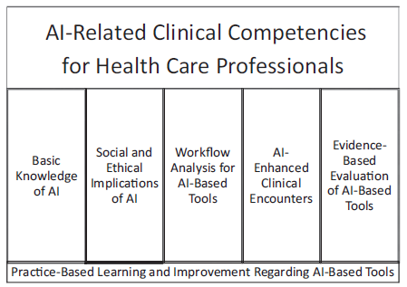
Notes:
I also like the competencies that were in this Academic Medicine paper
There’s a lot of overlap between our competencies and these

Slide 67
Gap between expectations and reality
3 out of 4 medical students think AI competencies should be taught in medical school
2 out of 3 medical students received no training in AI, and over 40% had never heard of the term “machine learning”
Notes:
Unfortunately, the current training in AI/ML is insufficient and fails to meet the demand

Slide 68
Training
The College of Family Physicians of Canada: AI Curriculum
American Medical Association AI Curriculum
The Use of AI in Diagnosis (Coursera, forthcoming)
Society of Teachers of Family Medicine and American Board of Family Medicine: AI Curriculum (forthcoming)
Notes:
There are multiple training options for you and your learners

Slide 69
AiM-PC: Artificial intelligence and Machine learning for Primary Care
Vision
Education in pursuit of AI-augmented care for all
Mission
To elevate the practice of primary care by teaching learners to use artificial intelligence / machine learning (AI/ML)
Audience
Medical students, primary care residents, practicing primary care physicians
Notes:
STFM and the American Board of Family Medicine are creating a curriculum and a video series called…
We plan to launch this curriculum in the next year
Goals
Equip learners with the skills necessary to be engaged stakeholders in a clinical world that includes AI
Develop and disseminate innovative health care AI curricula to prepare the primary care workforce
Create efficient and effective AI curricula that can be applied across various primary care settings
Prepare learners in primary care settings to appraise and apply literature and outputs in their clinical practice
Ensure that all patients benefit from AI-augmented clinical care

Slide 70
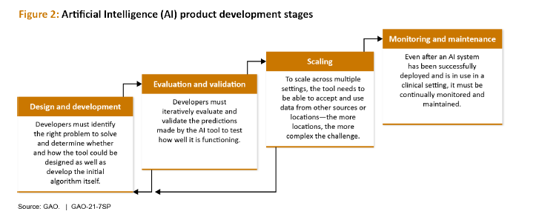
Testing
Notes:
The second strategy is testing
Before AI tools are implemented, they need to be tested just like we test new drugs, diagnostic tools, and programs
We need randomized controlled trials to capture their unbiased effects and mixed methods studies to understand their limitations and how they can be improved
Right now, we have tremendous activity in this first stage of design and development
But we have less activity in the evaluation and validation phases
The evaluations that are taking place are not always in primary care settings, making the evidence less useful for primary care

Slide 71
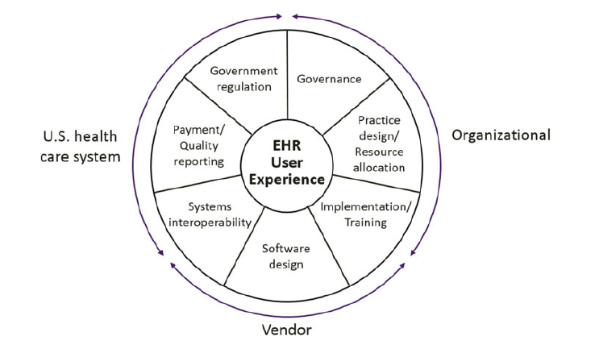
Testing
Notes:
Because of the potential for harm, end users like yourselves must be engaged at all stages
Otherwise, the unintended consequences will be hidden until these tools are implemented
This figure describes the factors that impact the EHR user experience, but these could also apply to the AI user experience
Without the engagement of clinicians, patients, educators, students, ethicists, and designers, I believe AI will fail and will make care worse

Slide 72
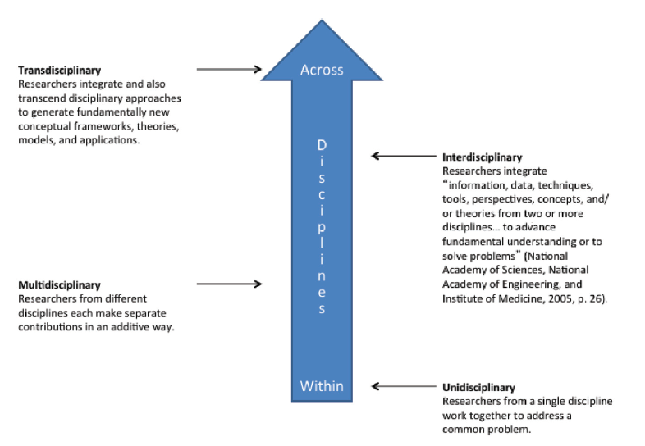
Teaming
Notes:
That’s why we need the third strategy of teaming
Family medicine educators cannot make these changes alone
Instead, we need to partner with computer scientists
We need to help companies rigorously develop and evaluate their products
We need to attend AI meetings and invite our computer science colleagues to our conferences
We also need more transdisciplinary training
Existing AI methods will be insufficient for primary care
Instead, we need new AI methods that are tailored to the breadth, complexity, and longitudinality of primary care

Slide 73
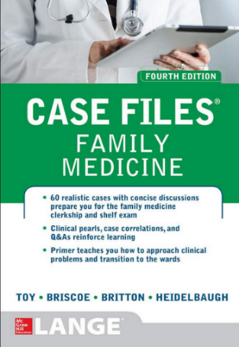
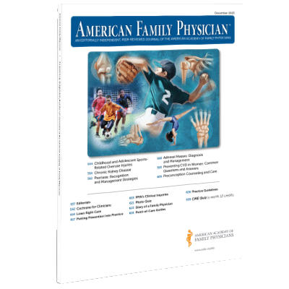
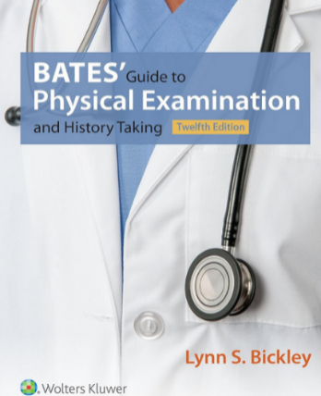
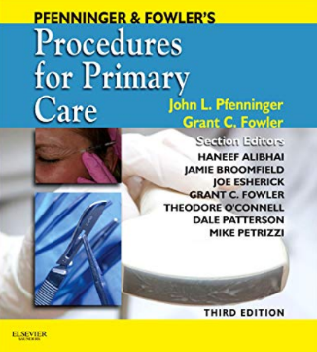
Tailoring
Primary Care Simulation GPT: Simulates patient encounters, allowing learners to interact with various simulated patients
Primary Care Diagnosis GPT: Provides guidance on questions to ask, tests to order, and diagnoses to consider
Primary Care Pocedure GPT: Details step by step instructions for procedures, including preparation, technique, and post-operative care
Clinical Skills GPT: Teaches and tests clinical skills, including communication, physical examination techniques, and clinical reasoning
Notes:
The fourth strategy is tailoring AI to primary care and medical education
Open AI, the company behind ChatGPT, created custom GPTs
As previously mentioned, there are concerns about the accuracy of ChatGPT
Instead of drawing information from the entirety of the internet, ChatGPT can now be tailored to specific material
For example, we can create a primary care

Slide 74
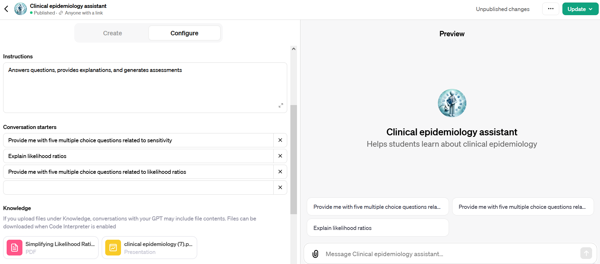
Tailoring
Notes:
Using my ChatGPT plus subscription, I created a clinical epidemiology assistant, which can answer questions tailored to my slide deck on clinical epidemiology
Using this Custom GPT, Brian now has the tutor that can teach him biostatistics
Once again, this strategy should be tested by medical education researchers

Slide 75
Notes:
The final strategy is traveling, or making sure we’re headed in the right direction
Imagine that you are going on a hike that you have been on before
Looking up at the horizon, you see a landmark that you hadn’t previously noticed.
You have two options
You can go down the path that you have traveled before
You know where that path ends.
It is safe.
Or you can head towards the new landmark
It is scary
You are creating a new path that will lead you to a new place

Slide 76
C
70°
Artificial intelligence
Electronic health records
Notes:
An azimuth is the angle between north and a line to a desired point.
In this example, the azimuth is 70 degrees for the red line
In navigation, shooting an azimuth means sighting an object on the horizon and adjusting your compass to make sure you’re moving in the right direction.
In the absence of automated systems, pilots use these principles to stay on course.
I contend that our patients and students should guide our azimuth.
With every new piece of technology, we should ask ourselves:
Does this technology improve the quality of our relationships with our patients and students?
Will it help our patients lead healthier lives?
Will it help our students become better physicians?
If the answers to these questions are yes, then we know we’re on the right course
We are at an inflection point. We can either continue along the path of electronic health records or we can create a new path
Up until now, many players, including technology companies and AI researchers in other specialties, are charting the course for AI in primary care
I don’t trust them.
I trust you.
I trust our patients.
I trust our students.
To create the tools that are going to help people like Jennifer and Brian, we need you
Without your engagement, we will drift off course

Slide 77
Thank You

Slide 78
How will AI affect the way you teach?

Slide 79
How would you use ChatGPT in the classroom or clinic?
How have you used ChatGPT in the classroom or clinic?
What concerns do you have about using ChatGPT in the classroom or clinic?

