Slide 1
Therapeutic Thursdays: A Mindfulness-Based Curriculum for Family Medicine Residents
The 39th forum for behavioral science in family medicine
Wellness Symposium
Stacey Nickoloff, DO
LIMOR GILDENBLATT, PHD, LCSW
INYOUNG NA, DO
SN

Slide 2
We have no disclosures…
SN.

Slide 3
Why is this so important?
BURNOUT
Physical/Emotional Exhaustion
Depersonalization (negative attitude towards patients and their concerns!)
Reduced sense of personal accomplishment
SN

Slide 4
Let’s Fight!
Round 1: Medical School
50% of medical students experience burnout; 10% experience SI at some point
Round 2: Residents
25-75% of residents experience burnout at any given time
Round 3: Attendings
1/3 or up to 60% experience burnout at any given time
SN

Slide 5
Introduction
What is Tangible Wellness?
SN

Slide 6
LongitudInal Curriculum
Wellness Committee (once/month)
E.g., Wellness Newsletter
Incorporated into Behavioral Science Lectures (bi-monthly)
Ongoing research project on tracking resident wellness (yearly)
15-minute Wellness Breaks during didactics (weekly)
THERAPEUTIC THURSDAYS (weekly)
IN

Slide 7
“THERAPEUTIC THURSDAYS” GOALS
Carve out short SCHEDULED wellness activities for physicians & students
Take a break for wellness
Practice mindfulness
EXPAND Physician Toolbox /provide patients with broader list of interventions to treat anxiety/depression
IN
Notes:
Focus of the presentation is about this curriculum – discuss it and practice it!

Slide 8
List of Activities & Participants!
Laughter Yoga/Chair Yoga
Mandala Drawings
Journaling
Tai-Chi/Jazzercize (yep, we said it!)
Mindful Eating
Music Therapy
Recreational Wellness Walks
Cloud Watching
Stretching Exercises
Breathing Exercises
Zumba
*Comprehensive list in your folders
Family Medicine Rotators
(Medical Students)
Family Medicine Interns
Family Medicine Senior Residents
Faculty on Inpatient Service
Faculty Behavioral Scientist
TY/OB/ER Rotators (residents)
Anybody who wants to be well!
LG
Notes:
-Mention that this is led by me and the senior residents, switch off each week
-Often times, have them do a quick reading out loud on why this activity is a mindful one, then activity, then discussion – sometimes just activity, then discussion

Slide 9
Unsolicited feedback
Overall, our residents speak highly of Therapeutic Thursdays
Last week PGY-1 said “I’m jealous it’s Therapeutic Thursdays and I’m not on the medicine service”
Other residents involved such as TYs – recently provided feedback in their monthly meeting that they feel supported during inpatient service in regards to wellness
A rotating medical student that had participated in Therapeutic Thursdays referred to it as “The best part of the week”
LG
Notes:
-Limor?

Slide 10
Let’s Try it out! - ACTIVITY 1
Laughter Yoga!
LG
Notes:
*Laughter and mindfulness – why is this a mindfulness activity
*activity (include reading in folders)

Slide 11
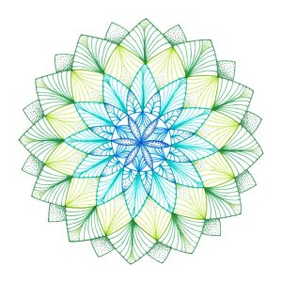
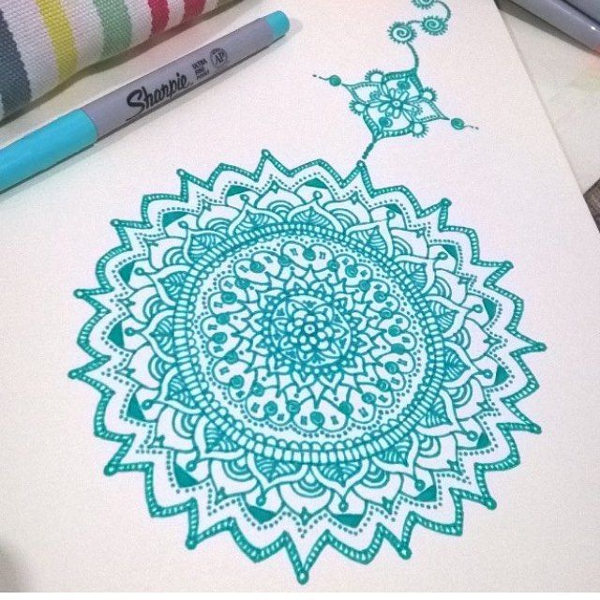
ACTIVITY 2 – MANDALA DRAWINGS
SN
Notes:
Readings
Activity
*include readings in folders
*cut them up and number them – 4 people read the explanation of mandalas and mindfulness
-copy the link for music

Slide 12
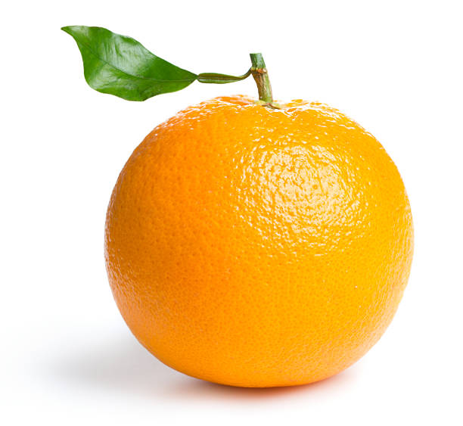
ACTIVITY 3 – TAKE HOME ACTIVITY
TAKE HOME ACTIVITY
Script for mindful eating of Oranges or Clementines
Lead residents in discussion about what their experience was like
Inquire about barrier to mindful eating, pros to mindful eating etc.
Encourage them to slow down and try to mindfully each for a few minutes every day, even if it’s not possible during all meals – enjoy food and practice mindfulness!
IN

Slide 13
DISCUSSION/Questions?
Feel free to contact us for more information....
Forbes Family Medicine – Pittsburgh, PA
Stacey Nickoloff, DO:
Stacey.Nickoloff@ahn.org
O: 412-457-1100
Limor Gildenblatt, PhD:
Limor.gildenblatt@presencehealth.org
O: 773-990-6390
Inyoung Na, DO
Inyoung.Na@presencehealth.org
SN

