Slide 1
Addiction Medicine is Primary Care
George Maxted, MD, Capt. USPHS (ret)
Medical Director, SSTAR
gmaxted@sstar.org
FMEC 2018

Slide 2
The Harm Reduction Model
https://www.ted.com/talks/mark_tyndall_the_harm_reduction_model_of_drug_addiction_treatment
Mark Tyndall - 2017
Principles of harm reduction
Naloxone for everyone (esp first responders, law enforcement, families)
Needle exchange and other clean needle programs
Supervised injection sites
Allowing people to inject in a clean environment with clean supplies, surrounded by people who care, with access to treatment.
INSITE in Canada – dramatic reduction in overdose deaths
Abstinence is not the goal (at least not initially)
The goal is to prevent unnecessary death, disability, sickness, hospitalization, community/family/personal distress
Turn away from failed policies – criminalization, the “war on drugs”,prohibition

Slide 3
Goals and Objectives
This is about addiction – Substance Use Disorder – but we will focus primarily on Opioid Use Disorder
Review the current state of OUD in primary care, particularly family medicine, and its place in the panoply of chronic illnesses.
Gain some knowledge about Medication Assisted Treatment, and how it may be incorporated into family medicine using a variety of models.
Describe the SSTAR integrated care model
Interact with one another and share knowledge and experience about treatment of OUD in primary care, and the teaching thereof in medical school and residency.

Slide 4
Resources
Providers Clinical Support System – PCSS – pcssnow.org
DHHS Opioid Crisis center - https://www.hhs.gov/opioids/
SAMHSA - https://www.samhsa.gov/medication-assisted-treatment
NIDA - https://www.drugabuse.gov/drugs-abuse/opioids/
Facing Addiction and NCADD - https://www.facingaddiction.org
Surgeon General’s Report - https://addiction.surgeongeneral.gov/sites/default/files/OC_SpotlightOnOpioids.pdf
STFM – Addictions Collaborative
FMEC - Chronic Pain/Opioids/Substance Abuse Learning Community
Apps
CDC OpioidGuideline
Opioids

Slide 5
Definitions and terminology
Opioid – a substance that binds to mu receptors in the brain
Opiate – opioids derived from opium – mainly morphine, codeine, thebain
Heroin is derived from morphine. Street: Big H, Horse, Smack, hell dust
SUD – Substance Abuse Disorder (other psychoactive substance abuse)
OUD – Opioid Use Disorder.
OTP – Opioid Treatment Program.
MAT – medication-assisted treatment
Methadone, buprenorphine and naltrexone
OBOT – Office-Based Opioid agonist Treatment
Methadone and buprenorphine

Slide 6
Language matters
People suffer from opioid use disorder, or other substance use disorder
Avoid “addict”, “alcoholic” – names that are about character or that may stigmatize
Even “abuse” sounds judgmental
Try to build a culture of courtesy and respect for everyone
Avoid sarcasm, “dark humor”
But acknowledge that “dissing” is prevalent. Imagine what it must be like …
Given the nature of the illness, sometimes people “need a higher level of care”.
Use “adherence”, not “compliance”.
Crucial Conversations
What is the story that is playing in your head?
How does your story inform the way you are approaching the patient?
Never give up

Slide 7
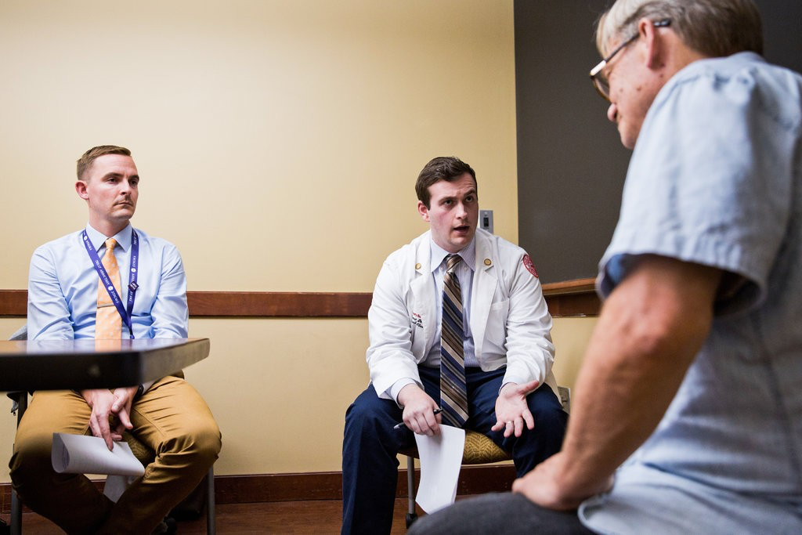
https://www.nytimes.com/2018/09/10/health/addiction-medical-schools-treatment.html
Most Doctors Are Ill-Equipped to Deal With the Opioid Epidemic. Few Medical Schools Teach Addiction.
Matthew DeFazio, center, a medical student at Boston University, asks a fictional patient, portrayed by Ric Mauré, right, about his drug use. Dr. Bradley M. Buchheit coaches.
Kayana Szymczak for The New York Times

Slide 8
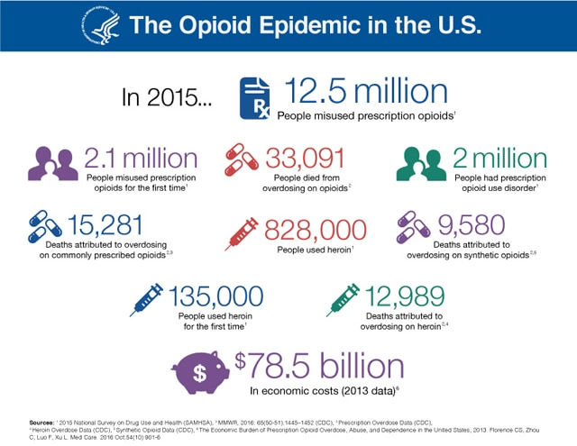

Slide 9
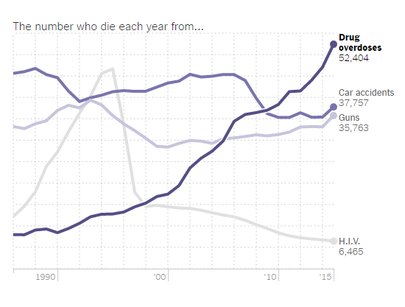

Slide 10
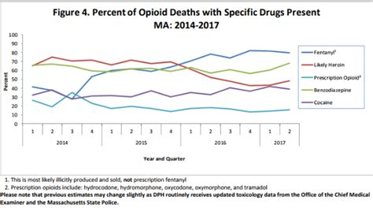

Slide 11
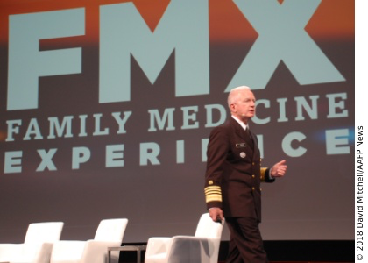
https://www.aafp.org/news/2018-congress-fmx/20181016fmx-opioids.html
Prescribe opioids only when indicated according to CDC and professional society guidelines.
Co-prescribe naloxone for high-risk patients.
Provide input to HHS through advisory committees and meetings.
Screen all patients for substance use disorders.
Establish connections with local recovery and addiction specialists.
Obtain a waiver to prescribe buprenorphine.
Brett Giroir, M.D., HHS assistant secretary for health,

Slide 12
DHHS: Strategy to Combat Opioid Abuse, Misuse, and Overdose A Framework Based on the Five Point Strategy - 2017
Prevention – “science-based education campaigns”
Treatment – “evidence-based affordable treatment”
Recovery – “culturally and linguistically appropriate education and support”
Better Data and Research
Better Pain Management - “evidence-based guidance on appropriate management “
$800 million in grants

Slide 13
Opioid Use Disorder is a Chronic Disease
“What is a Chronic Disease?” – Frontiers in Public Health vol4:159, August 2016
CDC – “conditions that last 1 year or more and require ongoing medical attention or limit activities of daily living or both”
OUD is not on their list, even though tobacco use and excessive alcohol are listed as major contributers (both are disorders of addiction)
Wikipedia – “a disease that is persistent or otherwise long-lasting in its effects….often applied when the course of the disease last for more that three months.” Similar to WHO.
Addiction is included in the list of examples
NIH/NIDA: Drug addiction shares many of the features with other chronic illnesses, including a tendency to run in families, an onset and course that is influenced by environmental conditions and behavior, and the ability to respond to appropriate treatment, which may include long term lifestyle modification.
Relapse, remission,need for continued care, complex care management

Slide 14
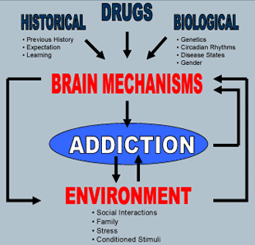

Slide 15
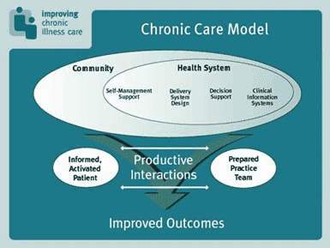

Slide 16
Key areas in the chronic care model of OUD
Self Management Support
Managing relapse. Group visits. Primary care collaboration
Delivery System Design
Team care – define responsibilities. Don’t do this alone.
Decision Support – EBM and support from specialty center
Clinical Information Systems
Use the Problem List. E-prescribing. Registries. Prescription Monitoring Program
Organization of Health Care – leadership, physician champions
Community – gap analysis

Slide 17
Geographic and Specialty Distribution of US Physicians Trained to Treat Opioid Use Disorder - 2015http://www.annfammed.org/content/13/1/23
2.2% of US physicians have buprenorphine waivers
41.6% are psychiatrists, 36.7% primary care
16.2% of psychiatrists, 15.2% in pain mgt, 5.3% of physiatrists, 3.6% of FPs
Physicians aged less than 35 years (not residents) were sig less likely to have a waiver.
More men than women have the waiver, and age 55 to 64 have highest percentage waivered ( 3%)

Slide 18
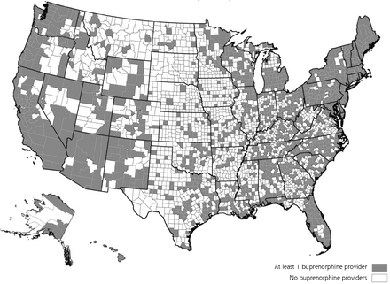
US counties with physicians with waivers to prescribe burenorphine

Slide 19
Barriers to providing buprenorphine treatment
Lack of training, mentoring – low rate among young physicians
Lack of institutional support
Inadequate support from nursing and office staff
Lack of mental health practitioners
Payment issues
Opposition from partners
Stigmata – NIMWR (not in my waiting room)

Slide 20
ICD -10 codes
Opioid abuse, uncomplicated – F11.10
Opioid dependence, uncomplicated – F11.20
Opioid use, unspecified, uncomplicated – F11.90
“Uncomplicated” is important. Some payers will not cover MAT if you put something like “in remission”

Slide 21
MAT for opioid use disorder
Buprenorphine – office-based opioid agonist/ antagonist that blocks other narcotics while reducing withdrawal risk; daily dissolving tablet, cheek film, 6-month implant under the skin, monthly injection
Naltrexone – office-based non-addictive opioid antagonist that blocks the effects of other narcotics; daily pill or monthly injection
Methadone – clinic-based opioid agonist that does not block other narcotics while preventing withdrawal while taking it; daily liquid dispensed only in specialty regulated clinics

Slide 22
PCSS-B training (buprenorphine)
PCSS – Providers Clinical Support System - funded by Substance Abuse and Mental Health Services Administration (SAMHSA)
Partner organizations include AMA, AAAP, AAFP, ASAM, AAP, …etc,etc
Training, support, mentoring – OBOT/MAT. Treating chronic pain and avoiding OUD
The DATA 2000 waiver – SAMHSA
Training formats
4 hours with expert (in person or webinar) then 4 hours on-line
8 hours on line or at conference
HR 6 – SUPPORT – June 2018
No longer an initial limit of 30 patients with the waiver – can go to 100 right away

Slide 23
Training Formats for Physicians
Half and Half (In-Person) Training
Physicians sign up for and attend a 4 hour live training taught by a clinical expert in their area. Once completed, participants will receive the second half of the course – a 4 hour online self-study portion. At the end of the course, participants are required to pass an exam with a 75% or higher before applying for their waiver.
Half and Half (Webinar)
Physicians sign up for and attend a 4 hour virtual webinar via computer taught by a clinical expert. Once completed, participants will receive the second half of the course – a 4 hour online self-study portion. At the end of the course, participants are required to pass an exam with a 75% or higher before applying for their waiver.
8 Hour Full Day Training
Physicians sign up for and attend a full day training led by a clinical expert in various locations throughout the year. View calendar of events to search for upcoming 8 Hour in-person trainings in your area.

Slide 24
Success Stories
Hamilton County, OH. Addiction Treatment Collaborative.
34% decrease in OD deaths, 50% increase in # people in treatment
Malden Family Medicine Center – Tufts Family Medicine Residency – Cambridge Health Alliance
Group Suboxone program – 2012
All residents rotate through the program and get MAT training
Greater Lawrence Family Medicine Residency – team based addiction care, including buprenorphine, methadone and naltrexone training

Slide 25
Models of primary care management of addiction
SBIRT – Short, brief intervention, referral to treatment
Screening, diagnosis, symptom management, then referral to an OTP program
One-on-one individual MAT – up to the max of the waiver per provider
May or may not include “induction” with medication. Some refer to OTP for induction, with plan for patient to return for maintenance
Group MAT
Need dedicated nurse, support staff (medical assistant), space
Integrated care: primary care, behavioral health, intensive outpatient treatment
Comprehensive – inpatient and outpatient integrated care

Slide 26
SSTAR – Stanley Street Treatment and Resources, Fall River, MA – a fully integrated program
Inpatient
ATS – 20 beds – 3-7 days
DDS – dual diagnosis – 16 beds – 7-10 days
CSS – step down – 32 beds
Outpatient
Open access, walk in OTC – opiate triage center – also behavioral health
IOP – intensive outpatient program
MAT – buprenorphine and naltrexone – 600 patients – 6 nurses/2 MAs/one front desk/one trouble-shooter (insurance, etc)
LifeLine – methadone – 700 patients
Family Health Care Center – primary care
Adult Behavioral Health
Women’s Center
ARISE – family interventions
AWARE – confidential screening and counseling
HIV, HCV treatment

Slide 27
Don’t do this alone
Minimum: a nurse who has had experience and/or training in addiction management, who is really excited to be part of a team doing MAT, and who has the time and energy to do everything to the limits of license.
Coordinating and researching refills. Outreach on no-shows, labs, other clinical issues
Maintains registry
Optimum: Above plus at least one MA who also is interested and excited
Intake, UDS, PMP/PDMP, screening for socioeconomic indicators
Also best to have a front desk person or insurance/resource coordinator who can help with payers, prior authorizations
If you can swing it:
Case manager(s). Behavioral health (counseling, crisis intervention). Recovery coach. Family intervention specialist. Child care.

Slide 28
Don’t do this alone
Have a consultant whom you can either refer to, or at least discuss cases with.
At SSTAR, we have a psychiatrist who subspecializes in addiction medicine.
Contact with someone who is fellowship-trained is optimal
Telemedicine may offer an alternative
Telepsychiatry companies are able to bill for services

Slide 29
Ancillary Medications
Symptom control
Clonidine – at least early on
Narcan - naloxone
Polyethylene Glycol – PEG (Miralax)

Slide 30
Insurance Coverage
HHS: The Mental Health Parity and Addiction Equity Act (MHPAEA) of 2008 requires health insurers and group health plans to provide the same level of benefits for mental and/or substance use treatment and services that they do for medical/surgical care. Includes Medicaid and CHIP
On line tool on web site - https://www.hhs.gov/opioids/treatment/insurance-coverage/index.html
Insurers try to control their costs by limiting access to certain formulations of buprenorphine – eg Bunavail.

Slide 31
Know your community - users
Slang for opioid addiction? Chasing the dragon, Daytime, Evening, Dip and Dab, Do Up, Jolly Pop, Paper Boy…
Heroin? H, Tar, Chiva, Junk, Brown Sugar, Junk, Skag, Dope, Boy, White…
What’s going on out there?
What is selling on the street? Suboxone, oxy, heroin, fentanyl, Percs....
Virtually all of the heroin in our area is laced with fentanyl. More fentanyl = more overdoses (and more lethality)

Slide 32
Know your community
Emergency Departments, and other “entry points”
Recovery units (try to avoid calling it “detox”) – generally inpatient
Addiction Treatment Services (ATS). Clinical Stabilization Services (CSS, “step down”).Community Support Programs (CSP), Transitional Support Services (TSS)
Intensive Outpatient Services (IOP) – free standing, integrated
Recovery Support Centers (RSC)
Other primary care providers – supporting, encouraging
Groups – AA, NA
Find out which ones, if any, are opposed to MAT
Faith-based organizations

Slide 33
Caveats and Conundrums
Benzodiazepines – consider the “2mg max rule”
Psychostimulants – amphetamine, cocaine
Cannabis – on UDS or medical or reported by patient
UDS and the “dirty urine”
Fentanyl keeps showing up in UDS

Slide 34
Urine Drug Screens
Know your lab and have a contact there who is an expert on the test(s)
Amphetamines – 48 hours – lots of cross reactants
BZDs – 3 days (longer with diazepam) – clonazepam may not always show
Cocaine – 2-4 days
Opioids – 2-4 days – poppy seeds?
Bad sample: creat < 20, SG<1.003 or > 1.020, temp within 4 minutes <33C. Shake sample – if bubbles then may have soap in it

