Slide 1
Diagnosis and Management of Diabetes in the Developing World
Dr. Calvin Wilson
Clinical Professor of Family Medicine
University of Colorado Anschutz School of Medicine

Slide 2
Learning Objectives
By the end of this session, participants should be able to:
Describe the epidemiology and characteristics of diabetic patients in the developing world
Identify appropriate management goals for diabetics in resource-constrained settings
Discuss cost-effective and evidence-based management strategies adapted to the developing world
Discuss the ethical challenges of caring for a diabetic in a resource-constrained setting

Slide 3
Case Study
History: Ali is a 62 year old male in Bangladesh who presents complaining of fatigue, general weakness, blurry vision, and difficulty sleeping intermittently over the past year. He can only work about half the day, and notes that much of his difficulty sleeping is because of frequent rising to urinate at night. He took some medicine that seemed to help this several months ago, but ran out of the medicine and the symptoms recurred.
Exam: Wt. 158 lbs, BMI – 24, BP – 146/96, RR – 16, T – 98.2° F.
HEENT – clear, Neck – normal thyroid, nodes, and carotids, Chest – clear to auscultation, Heart – no murmurs or gallops, but mild enlargement, Ext. - no edema or skin changes, Neuro – some decreased pin sensation and no monofilament sensation.

Slide 4
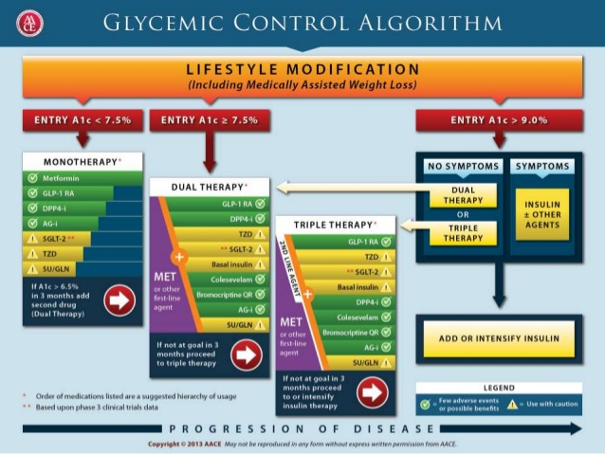
Typical Diabetes Management Protocol

Slide 5
SHOULD we provide the same standard of diabetic care in a limited-resource environment as in our own U.S. setting?
CAN we provide the same standard of diabetic care in a limited-resource environment as in our own U.S. setting?

Slide 6
First Challenge – Identification of Diabetic Patients
Epidemiology
8-10% of population diabetic in developing world (WHO) – rapidly increasing
8-20% of population diabetic (34% including prediabetes) in developed world (WHO/CDC)

Slide 7
Diabetes in the Developing World
Common characteristics of diabetics (e.g. Rwanda)
70% with slim body habitus, 30% obese
Walk 5-10 miles/day
Eat primarily fruits, vegetables, some starches
Average age at discovery ~45 years
Diabetics rarely diagnosed during preventive exams:
Most type I diabetics present in diabetic coma (5-20 years age)
Most type II diabetics present with gangrene of extremity
Only secondarily found to have weight loss, polyuria, nocturia, polydipsia

Slide 8
Diagnosis of Diabetes
Challenge – early detection in time to avoid complications
Requires community and population-based education and approach
Education of the general population in common presenting symptoms
Combined with selected screening of potentially high risk populations:
Obese men and women (only about 10-20% of population in many African countries)
Acute weight loss or change in urinary pattern
Appearance of non-healing foot lesions, loss of sensation, atrophic skin changes

Slide 9
Pathophysiology of Diabetes
United Kingdom Prospective Diabetes Study (Br Med J. 1998) showed that aggressive glycemic control in Type 2 diabetes had NO STATISTICALLY SIGNIFICANT effect on MACROVASCULAR complications (myocardial infarction, stroke, peripheral vascular disease)
Cardiovascular disease (i.e., macrovascular complications) is the cause of death in 75-80% of patients with Type 2 diabetes

Slide 10
Management of Diabetes – System Changes
“Continuous Care” - Patients and providers must commit to long-term, regular communication and visits
Some FPs manage this via weekly “Diabetes clinics” – often the first chronic disease clinics in the health system!
Can set up systematic checking of BP, UA dip, weight, vision (and/or optic fundi), foot check, sensation check, and FBS/blood work
If possible, attempt to streamline medication dispensing – especially insulin – to minimize barriers

Slide 11
Management of Diabetes - Goals
Determine therapeutic goals that are outcome oriented and feasible within the resources of the existing health system :
Decrease cardiovascular mortality from diabetes
Decrease selected morbidities:
gangrene and amputations
episodes of ketoacidosis
macrosomic babies and complicated deliveries
end-stage renal disease
Prevention of diabetes in high risk young people (obese, sedentary, strong family history)

Slide 12
Management of Diabetes – Cost-Effective Interventions
Intervention | Description | Applicable Population | Major Impact
Level I – Available to all, very cost-effective and inexpensive
Moderate glycemic control | Oral hypoglycemics, diet, exercise, possibly insulin | Diabetics of all ages with HbA1C level >9 | Reduction in microvascular disease
Blood Pressure control | Available medication | Diabetics with hypertension – all ages | Reduction in macrovascular disease and death
Foot Care | Patient and provider education, foot exam and hygiene, proper footwear | Diabetics middle-aged or older | Reduction in amputations
Diabetes Education | Patient self-management | All diabetics | Reduction in HbA1C, better compliance with lifestyle changes
“How should Developing Countries Manage Diabetes”, Canadian Medical Association Journal, September 26, 2006 vol. 175 no. 7

Slide 13
Management of Diabetes – Cost-effective Interventions
Intervention | Description | Applicable Population | Major Impact
Level II – Cost-effective, but some cost involved (<$1500/QALY saved)
Preconception care | Education and Self-management | Women with diabetes who plan on pregnancy | Reduction in hospital care and complications
Lifestyle interventions | Diet and physical activity – weight loss | Those at high risk for diabetes | Reduction in diabetes by 58%
Influenza vaccination | Vaccination | Elderly with diabetes | Reduction in hospitalization and death
Annual eye exam | Formal retinal exam (ophthalmoscopy) | Diabetics middle-aged or older | Reduction in significant vision loss
Smoking cessation | Counseling, nicotine replacement | Diabetics who smoke | Reduction in cardiovascular disease
ACE inhibitor use | Medication | All diabetics with some evidence hypertension, CV, or renal disease | Reduction in nephropathy, CV disease, and death

Slide 14
Management of Diabetes – Less Feasible or Cost-Effective Interventions
Intervention | Description | Applicable Population | Major Impact
Level III – Less feasible or cost-effective ($1650-$8550/QALY saved)
Metformin therapy for pre-diabetics as prevention | Medication | Population at high risk for diabetes | Reduction in diabetes of 33%
Cholesterol control | Statins | All ages with high cholesterol and diabetes | Reduction in CV events and death
Intensive glycemic control | Insulin or multi-drug treatment | All ages with diabetes and HbA1C >8 | Reduction in microvascular disease, not death!
Screening for undiagnosed diabetes | Screening and treatment of positives | All diabetics | Reduction in microvascular disease
Screening for microalbuminuria | Screening and treatment of positives | All diabetics | Reduction in end-stage renal disease
“How should Developing Countries Manage Diabetes”, Canadian Medical Association Journal, September 26, 2006 vol. 175 no. 7

Slide 15
Medication Management in Developing Country
Commonly available medications – metformin, glyburide or glibenclamide, regular/NPH insulin
Most TZD, SGLT-2, GLT-1, DPP-4, basal insulins, ultrashort-acting insulins very expensive, especially for chronic use, or not available
In most cases, follow sequence of:
Insulin often considered last resort because of uncertain supply, refrigeration, patient acceptability, and cost
Up to 85% of diabetic patients moderately controlled (HbA1C < 8.5) with this regimen, especially if ACEI added
Metformin
Glyburide/glibenclamide
Regular/NPH insulin
₊
+

Slide 16
SHOULD we provide the same standard of diabetic care in a limited-resource environment as in our own U.S. setting?
YES, ethically we should work toward the same standard of diabetes care, but we will need to focus initially on identifying major desirable outcomes in the local context
CAN we provide the same standard of diabetic care in a limited-resource environment as in our own U.S. setting?
NO, often not initially, but we can reduce morbidity and mortality with relative simple and well-chosen interventions, and work toward more comprehensive care in the long-term.

Slide 17
Summary – Management of Diabetes in the Developing World
Identify diabetics as early as possible, and implement a system of continuous, comprehensive care for this population
Identify feasible, cost-effective disease management goals appropriate to the local context and health system
Implement evidence-based interventions that work toward these goals, consistent with the available local resources.
Work toward consistently improved care and tighter diabetic control as local resources and systems improve.

