Slide 1
Physician communication effects on medication adherence
Kwanza Devlin, MD – Associate Program Director
Brian Carey, DO – PGY3
Jeff Freund, PharmD – Clinical Pharmacist
Froedtert Menomonee Falls Hospital Family Medicine Residency
Medical College of Wisconsin

Slide 2
Drugs do not work on patients who do not take them
C. Everett Koop – Former Surgeon General

Slide 3
Background
Known barriers
Physician non-modifiable – social environment, difficult remembering, education, beliefs
Physician partially modifiable – cost, complexity, trust in provider (dx & plan)
Physician modifiable - ??
Physician frustration/helplessness
Where to start?

Slide 4
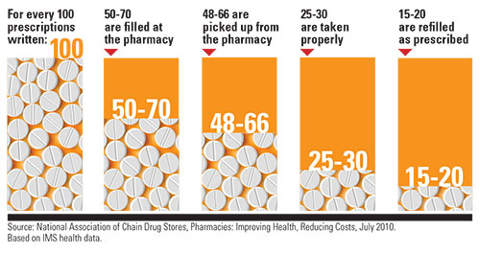
Start at the very beginning…

Slide 5
The Project
Most research looked at broad strokes (addressing cost, regimen simplification)
Practical
Efficient
Are there statements made by the provider that impact patient’s likelihood of picking up a prescription?

Slide 6
The Words
Did you say the name of the medicine? (WHAT?)
Did you say the name of the condition the medicine is treating? (WHY?)
Did you explain how the medicine works? (HOW?)
Did you explain why you selected this medication instead of another medication(s)? (WHY NOT)
Did you discuss side effects? (WORRIES?)

Slide 7
Methods
Set up clipboards in the precepting area to track
Residents and faculty encouraged to continue care as usual
Pharmacy staff pulled data on prescription fills

Slide 8
Inclusion
All ages
Residents and faculty
Acute prescriptions and chronic prescriptions
Exclusion
Refills
Change of dose

Slide 9
The Data
Did the use of Statement X impact the likelihood of the patient picking up the prescription?
Used a Fisher Exact Test of Independence to determine significance

Slide 10
P=.015
P=.07
P=.61
P=.15
P=0.15

Slide 11
Conclusions
Of the discussion points, saying the name of the new medication was the only point that seemed to have an impact on whether the patient picked up the prescription (p=.015)
Saying the disease or condition that the med was being used for appeared to be a close second (p=.07)

Slide 12
Other areas to study
Demographic impact – did some questions mean more to some groups?
Insurance or other confounding factors
Physician perception/belief – did patients respond more to the passion/intensity of the “pitch”?
Speaking to patients directly

Slide 13
Summary
We aimed to assess the impact of physician communication on new prescription adherence, namely picking up the prescription
We collected data about what was said in the room and whether the script was picked up from pharmacy
We showed that saying the name of the med made a significant impact on patients picking up a prescription (likely followed by saying the disease being treated)
Still more work to be done in this area

Slide 14
Questions? Comments?

Slide 15
References
Conn, Vicki. (2017). Medication adherence outcomes of 771 intervention trials: Systematic review and meta-analysis. Preventive Medicine, 99, 269-276. doi: 10.1016/j.ypmed.2017.03.008
Viswanathan, Meera (2012). Interventions to Improve Adherence to Self-administered Medications for Chronic Disease in the United States: A Systematic Review. Annals of Internal Medicine, 157(11), 785-795. doi: 10.7326/0003-4819-157-11-201212040-00538
Young, Henry. (2017). How does patient-provider communication influence adherence to asthma medications? Patient Education and Counseling, 100(4), 696-702. doi: 10.1016/j.pec.2016.11.022
National Association of Chain Drug Stores. Pharmacies: Improving Health, Reducing Costs, July 2010. Based on IMS Health Data.

