Slide 1
Introduction to Osteopathic Principles and Practice
Sarah Cole, DO, FAAFP

Slide 2
Disclosures
I have no disclosures to report.

Slide 3
Learning Objectives
Be able to name the four tenets that define osteopathic principles and practice (OPP).
Be able to define somatic dysfunction and it’s characteristics.
Understand who can safely and successfully perform osteopathic manipulative therapy (OMT).
Be familiar with evidence regarding the effectiveness of OMT for health conditions.

Slide 4
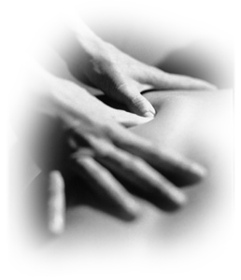
Osteopathic principles & Practice
An Incomplete History of OPP

Slide 5
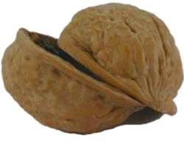
Because of the close proximity between vertebrae and the autonomic nervous system, the neuromuscular system is vital to maintaining homeostasis.
Osteopathic philosophy in a

Slide 6
Tenets of osteopathic principles and practice
The body is a unit.
Structure and function are interrelated.
The body has intrinsic healing properties.
Osteopathic treatment is based on an understanding of the above three tenets.
Notes:
Remarkably similar to the biopsychosocial model and intuitive to almost every family physician

Slide 7
How did osteopathy come to be?
Founded in 1874 by Andrew Taylor Still, MD, his intent was not to create a separate profession but “to improve our present system of medicine by giving it a more rational and scientific basis.”
Notes:
Or when did MDs become allopaths?

Slide 8
A frame of reference: Medicine in the 19th century
As Dr. Still faced the epidemics of the 19th century (cholera, smallpox, tuberculosis), he because disenchanted with prevailing medical practices of his time: bloodletting, mercury or alcohol-based compounds.
Notes:
It’s important to understand the state of medicine in 1874. There were no antibiotics. Foxglove (digitalis) and willow-bark were mainstays of pharmacotherapy. Sterile technique and surgical anesthetic had been used for the first time ever approximately 9 years earlier and were not yet routine. Dr. Still relinquished his prior practice involving bloodletting and compounds. Instead he advocated for good nutrition, regular sleep, regular exercise and proper alignment.

Slide 9
Innate capacity for self-healing
Dr. Still believed the body’s function was closely related to its structure and that problems in one organ affected other parts of the body.
He maintained the physician could best promote health by ensuring the musculoskeletal system was in alignment, thus minimizing obstructions to blood and lymph flow.
Notes:
Osteopathic Medicine is based upon a science of healing discovered by Andrew Taylor Still, MD in 1874. Dr. Still based this new science upon an absolute faith in a human beings innate capacity for self healing and a belief that if the Osteopath could remove the obstructions in the system, nature would provide the healing. It was his view that what we call disease is really just an effect of an abnormality or imbalance within a person’s body. “Disease in an abnormal body is just as natural as is Health when all the parts are in place”

Slide 10
The first osteopathic schools & organizations
In 1892, he opened the American School of Osteopathy, now Kirksville College of Osteopathic Medicine.
In 1897, the American Academy of Osteopathy was formed, now the American Osteopathic Association and the main governing body for the osteopathic profession.
Notes:
I was taught that Andrew Still and David Palmer, the founder of chiropractic medicine, met in northern MO or southern IA in around 1893 and collegially determined that their philosophies were different enough to remain separate. I have since discovered there is some debate as to whether this meeting actually occurred.

Slide 11
Brief History of Osteopathic Medical Education
American School of Osteopathy opens in MO.
Flexner Report leads to improved medical curricula.
AOA moves to 4 year course for osteopathic medical schools.
Pharmacology & surgery become required osteopathic curricula.
Residencies are approved for osteopathic postgraduate training.
US Dept Health, Educatfon & Welfare recognizes AOA as accrediting body.
DOs are licensed in all 50 states and D.C.
Single Accreditation System is announced between AOA and ACGME.
AOA-accredited programs must have achieved ACGME accreditation.
DO representatives join ACGME Review Committees and two new Review Committees established for osteopathic focused GME.
1892
1910
1915
1929
1947
1957
1973
2014
2015
2020
Notes:
In between 1991 and 2011, two other events happened: In 1991, AOA recognized ACGME training as a second pathway to obtaining medical licensure AND in 2001, all states accepted NOBME for licensure.
?Add ACGME landmarks?

Slide 12
Today…
Today, more than 20 % of medical students in the United States are training to be osteopathic physicians.
33 osteopathic medical schools in US
Sixty percent of current US osteopathic medical school graduates practice primary care, compared to 20% of current US allopathic graduates.
Most of these are in Family Medicine, followed by Internal Medicine and Pediatrics.
http://www.aacom.org/become-a-doctor/about-om
Accessed 3/29/17
Notes:
Osteopathic training includes, not only the study of all branches of medicine and surgery, but also up to 500 hours of additional training in manual diagnosis and treatment. Today, there are more than 80,000 osteopathic physicians in the United States whose practices cover the entire range of specialties, such as emergency medicine, neurosurgery, cardiology, and psychiatry. More than 60% of DO’s choose primary care specialties, such as family practice, internal medicine, obstetrics, and pediatrics, as opposed to only 20% of MD’s.

Slide 13
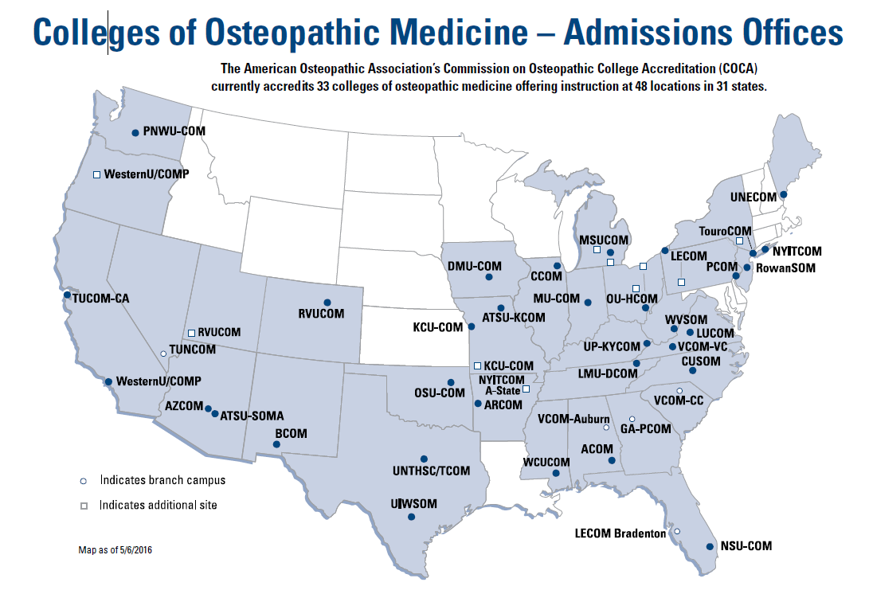

Slide 14
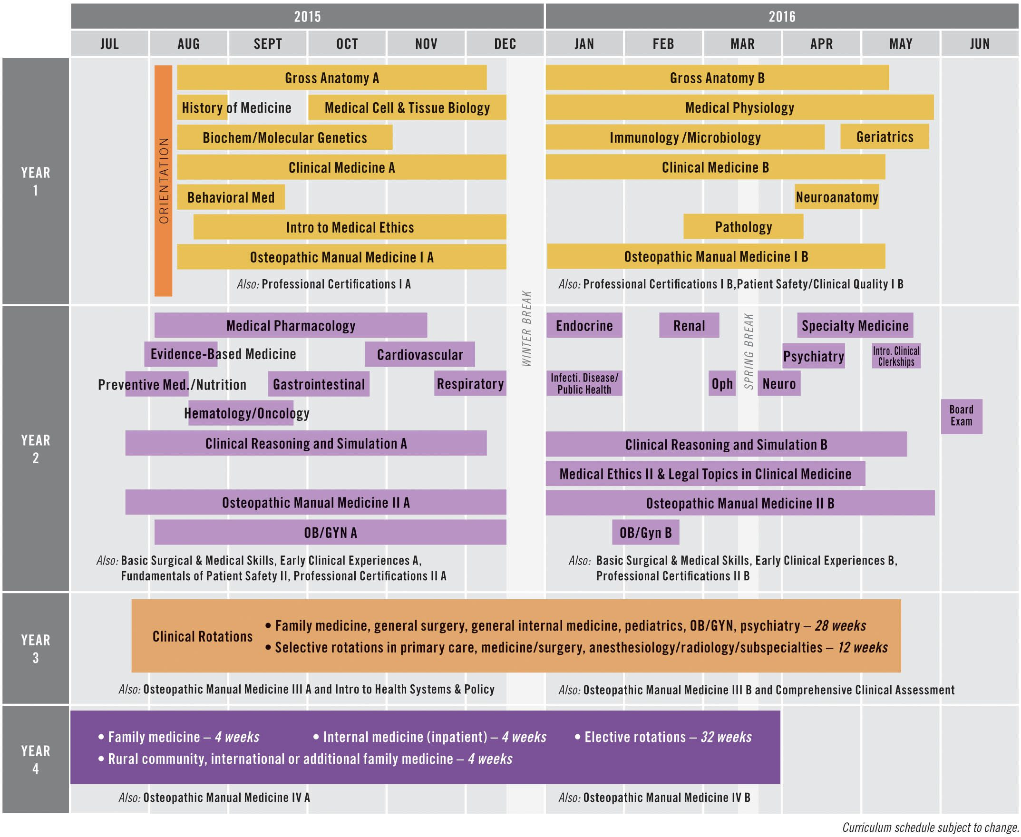
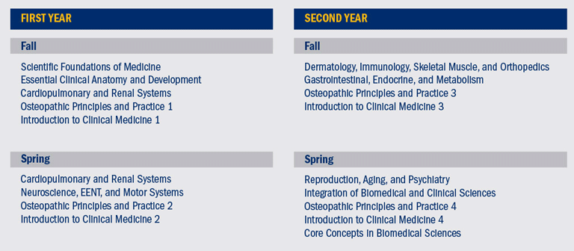
Curriculum at osteopathic medical school
Notes:
Marian’s 1st two years
DMU’s

Slide 15
COMLEX
Comprehensive Osteopathic Licensing Exam of the United States
3-step licensing exam administered by the National Osteopathic Board of Medical Examiners (NBOME) comparable to the USMLE

Slide 16
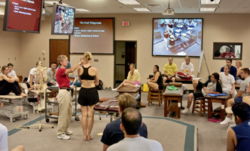
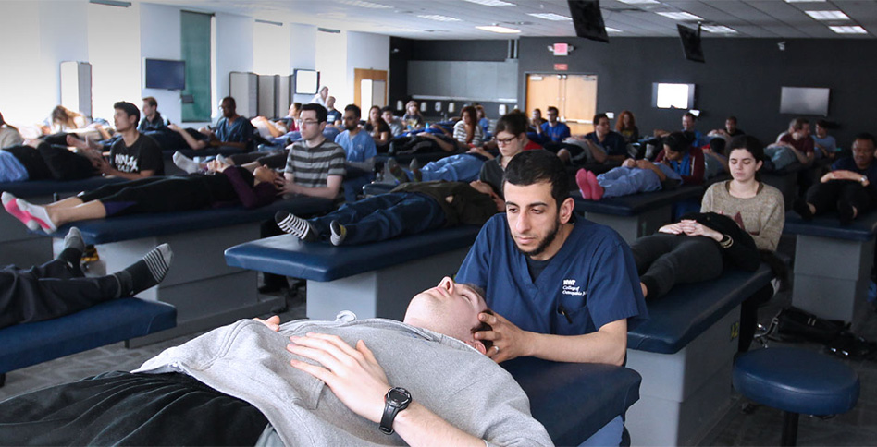
What does OPP/ OMT teaching look like?
Lecture followed by
Lab
Comfortable clothes
Large space
Paired at tables
IT equipment helpful
Hands-on
Notes:
Ohio University
And New York

Slide 17
What are the differences?
Osteopathic physicians | Chiropractic physicians | Manual physical therapists
4 years of osteopathic medical school | 4 years of chiropractic school | 3 years of doctor of physical therapy program
3+ years of residency required for Board certification | Residency optional | Residency optional
Licensed to practice medicine, surgery & manipulation | Licensed to practice manipulation | Licensed to practice physical therapy
Thrust & other techniques, usually manual only | Historically primarily use thrust techniques, often with instruments | Historically use non-thrust techniques, often with modalities
Coding & billing for manipulation is in addition to E/M code for injury/pain | Coding & billing is for manipulation only | Coding & billing is for therapy with modalities only Requires a prescription from a MD or DO

Slide 18
Who can perform OMT?
Any osteopathic medical school graduate who has completed an AOA or ACGME-accredited residency and ongoing osteopathic-accredited CME may perform OMT within scope of practice and specialty
Any allopathic physician who has completed osteopathic-accredited CME may perform OMT within scope of practice, specialty and CME certification
Any osteopathic or allopathic physician who has completed a 3-year residency in osteopathic manipulation and is AOA-board certified or eligible in that specialty
Notes:
FM (most common specialty to use)
FM+OMT
NMM

Slide 19
Who uses OMT and for what?
96% of surveyed DOs perceive OMT as efficacious
Family Medicine is the specialty, other than NMM (OMT specialists), most likely to use OMT
70% of osteopathic family physicians use OMT compared to 31% of other primary care specialists and 23% of non-primary care specialists
HVLA is the most oft-used technique followed by muscle energy, articulatory and counterstrain respectively
Johnson & Kurz Osteopathic manipulative treatment techniques preferred by contemporary osteopathic physicians, JAOA 2003
Spaeth & Pheley Use of osteopathic manipulative treatment by Ohio osteopathic physicians in various specialties, JAOA 2003

Slide 20
Why are you here?
Because 85% of primary care MD residents believe OMT is helpful in the management of musculoskeletal disease.
Because up to 80% of MD residents may be interested in learning more about OMT.
Allee et al Survey of Osteopathic and Allopathic Residents’ Attitudes to OMT. JAOA Dec 2005

Slide 21
Can an MD physician learn OPP/OMT in a short time?
Yes!
Rubeor et al Introducing osteopathic medical education in an allopathic residency. JAOA 2008.
Lieber J Allopathic family medicine residents can learn OMT in a 1-month elective. Fam Med 2005.
Notes:
In our own program, we have increased confidence level from

Slide 22
Osteopathic Manipulative therapy/treatment
An Introductory Description of OMT

Slide 23
Osteopathic diagnosis & treatment
Changes in the musculoskeletal system can affect other organs (somatovisceral reflex) or allow visceral pathology to manifest as aberrations in musculoskeletal tissue texture and articular motion (viscerosomatic reflex).
These musculoskeletal changes are known as SOMATIC DYSFUNCTION.
Somatic dysfunction is palpable on structural examination and can be treated with manual medicine, including osteopathic manipulation.
Notes:
Give examples of each

Slide 24
Somatic Dysfunction
Impaired or altered function of ANY part of the soma: skeletal, myofascial, and related vascular, lymphatic and neural elements
Diagnosed via PALPATION
Freedom of motion vs. Restricted motion
Findings
T – tenderness
A – asymmetry
R – restricted range of motion
T – tissue texture changes

Slide 25
Barriers to Range of Motion
Physiological Barrier
Limit of normal motion
Tested actively
Anatomical Barrier
End range of motion
Tested passively
Elastic Barrier
Range of motion between physiological and anatomic barriers
Restrictive Barrier
Abnormally diminishes physiological range of motion
This is the barrier we work with in OMT

Slide 26
Barriers to Motion
Physiologic
Barrier
Physiologic
Barrier
Restrictive
Barrier
Anatomic
Barrier
Anatomic
Barrier
N
Tissue Damage
Active ROM
Passive ROM

Slide 27
Tissue Texture Changes
Acute
Chronic
Immediate
Vasodilation
Edema/swelling
Increased moisture
Heat/redness
Rough texture
“Boggy” tissue
Longstanding
Fibrosis
Pruritic
Cool
Ropy or stringy tissues
Dryness
Thin texture

Slide 28
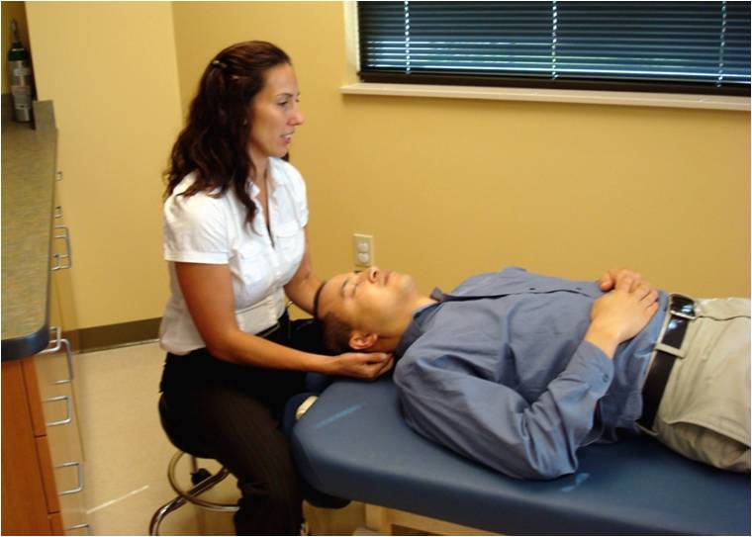
Using OMT to Heal Somatic Dysfunction
Forty different OMT techniques are noted in the AACOM Glossary of Osteopathic Terminology

Slide 29
Categories of OMT
Direct
Indirect
Moves through the restrictive barrier
Examples:
High velocity, low amplitude
Muscle energy
Moves away from the restrictive barrier to allow a release or relaxation
Examples:
Facilitated positional release
Counterstrain
Combined or Either
Examples:
Still’s technique
Myofascial release

Slide 30
Physiologic Effects of OMT
Mechanically: OMT can cause articular release, causing freeing of motion and release of joint tension of vertebrae, long or short bones with or without an accompanying noise
Neuromuscularly: OMT generates afferent input, which diminishes motor neuron discharge and relaxes muscle fibers
Vascularly: OMT increases nitric oxide concentration in blood, thus promoting vasodilation and increasing blood flow to peripheral vascular tissue
Neurochemically: OMT transiently increases serum anandamide, stimulating cannabinoid receptors in the brain
May increase water content of collagenous and cartilagenous structures
May stimulate glycosaminoglycan synthesis
Notes:
Bone being put back in place
Narrowing of joint space, causing synovial fluid to be rushed into already bulging capsule
Momentary vacuum produced by joint separation
Change in pressure of joint from subatmospheric to atmospheric pressure
NOBODY KNOWS!
<add reference>

Slide 31
Contraindications to OMT
Contraindications vary by technique.
HVLA, for example, has the most contraindications.
Some examples include osteoporosis, fracture, malignancy or osteomyelitis.
Other techniques, however, may be limited only by patient’s ability to follow directions or lie still.

Slide 32
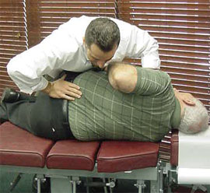
Evidence for OMT
A Brief Literature Review of OMT

Slide 33
“Comparison of OMT with standard care for patients with low back pain.” NEJM 1999.
155 patients with low back pain lasting > 3 weeks and < 6 months
72 randomized to receive standard care (NSAIDs, analgesics, muscle relaxants, active PT) and 83 randomized to receive OMT weekly for 4 weeks then every 2 weeks for another 4 visits

Slide 34
Comparison of OMT with standard care for patients with low back pain.” NEJM 1999.
Standard Care (N=72)
Osteopathic Manipulation (N=83)
P-value
Pain (mm on visual analog scale)
26.3 +/- 24.1
32.0 +/- 23.0
0.19
Use of NSAIDs
54.3%
24.3%
<0.01
Use of muscle relaxer
25.1%
6.3%
<0.01
Use of physical therapy
2.6%
0.2%
<0.05
Authors concluded OMT has similar efficacy to standard care in low back pain of more than 3 weeks duration, however, lower use of medication and physical therapy could result in cost savings.

Slide 35
“OMT for chronic low back pain.” Spine 2003.
91 subjects with nonspecific back pain of >3 months duration
48 subjects randomized
to OMT
23 subjects randomized
to sham therapy
20 subjects randomized
to control
32 subjects oompleted trial
19 subjects completed trial
15 subjects completed trial
Osteopathic and sham manipulation subjects were treated for a total of seven visits over 6 months.
OMT was provided to any diagnosed somatic dysfunction in the low back or adjacent areas.
Sham therapy included range of motion and light touch.
Controls received no trial interventions but were allowed to pursue their usual care of low back pain.

Slide 36
“OMT for chronic low back pain.” Spine 2003.
Both OMT and sham treatment showed significant improvement in back pain (on a scale of 1-10) at 1, 3 and 6 months compared to usual care.
No difference in pain between OMT and sham treatment groups, so authors are unclear whether benefits of OMT are due to therapy itself or placebo effect of time with patient.

Slide 37
“Randomized OMT study (ROMANS): pragmatic study for spinal pain in primary care. Fam Pract 2003.
201 patients with spinal (neck or back) pain of 2-12 weeks duration
109 allocated to usual care & 92 allocated to usual care + 3 OMT sessions

Slide 38
“Randomized OMT study (ROMANS): pragmatic study for spinal pain in primary care. Fam Pract 2003.
Authors concluded OMT for spinal pain significantly improves intermediate-term physical and psychological outcomes.

Slide 39
“Cost-utility analysis of osteopathy in primary care: results from the ROMANS trial.” Fam Pract 2004
No difference in cost analysis of health service costs and lost functionality between usual care and usual care + OMT group at 2 and 6 months of follow-up.
Authors conclude OMT group improves more and at no additional cost to health care system.

Slide 40
“OMT for low back pain: a meta-analysis.” BMC Musculoskelet Disord 2005.
Analyzed 6 trials, involving 525 subjects with low back pain of at least 3 weeks' duration
318 in OMT group and 231 in control group
Significant 30% reduction in pain associated with OMT group (P=.001, 95% CI -0.47- -0.13)
reduction was seen across short-term (<4 weeks), intermediate-term (4-12 weeks) and long-term (>12 weeks) follow-up intervals

Slide 41
Institute for Clinical Systems Improvement 2006 Guideline for Adult Low Back Pain Reaffirmed 2012
“When conservative therapy fails after 2 weeks, the patient and/or physician should request a trained spine therapy professional to provide therapies for the patient based on effective techniques supported by literature.
Individuals who may have training in these therapies include physical therapists, chiropractic providers, osteopathic or allopathic physicians.”

Slide 42
Institute for Clinical Systems Improvement 2006 Guideline for Adult Low Back Pain Reaffirmed 2012
“Indications for referral include:
Failure to make improvement with home self-care after two weeks
Severe incapacitating and disabling back or leg pain
Significant limitation of functional or job activities
Within 3-4 visits, the patient must display documented improvement in order to continue therapy. Otherwise comprehensive re-evaluation should be performed for other causes of low back pain.
Typically no more than four to six visits are needed.”

Slide 43
“ACP/APS 2007 Clinical Practice Guidelines for Diagnosis and Treatment of Low Back Pain” Ann Int Med Oct 2 2007
Spinal manipulation is nonpharmacologic modality that may be of benefit in acute or chronic low back pain. (weak recommendation based on moderate-quality evidence)

Slide 44
“Osteopathic manipulation in back pain associated with pregnancy” Am J Obstet Gyn 2010 Jan
RCT, 144 patients
Randomized to Usual OB Care or Usual OB Care + OMT
Back-specific functioning on the Roland-Morris disability questionnaire deteriorated significantly less in the UOBC+OMT group (p=0.001)

Slide 45
"Osteopathy for musculoskeletal patients: a systematic review of RCTs.“ Clin Rheum Feb 2011
2011 systematic review of 16 RCTs
Authors conclude collective data shows osteopathic manipulation is not of significant benefit
5 RCTs with a significant reduction in pain
11 RCTs with no change in pain

Slide 46
“Association of spinal manipulative therapy with clinical benefit and harm for acute LBP” JAMA Apr 2017
Meta-analysis of 26 RCTs
Heterogeneity between studies
Modest improvement in both pain and function at 6 weeks f/u compared to sham or alternative treatments

Slide 47
Other
Number of small randomized controlled trials and pilot studies with positive results or retrospective reviews with equivocal results investigating role of OMT in:
Reduction of PE tube placement for AOM in children
Functionality after knee or hip arthroplasty
Irritable bowel syndrome
Fibromyalgia
Infantile postural asymmetry/torticollis
Muscle spasticity
Joint pain
Labor pain or back pain in pregnancy
Adult asthma or COPD

Slide 48
Evidence Summary
OMT for back pain of greater than 3 weeks’ duration may safely and cost-effectively improve pain and functionality in adults.
There is a small body of evidence supporting the use of OMT for headaches, neck pain, infantile colic and recurrent acute otitis media.

Slide 49
Learning Objectives
OPP is defined by the four tenets of osteopathic medicine.
OMT is a set of techniques used to treat somatic dysfunction found on structural examination.
DOs train in OPP/OMT. There is evidence that postgraduate MDs can also successfully train in OPP/OMT.
OMT is one modality that can safely improve pain and functionality for back pain as well as other medical conditions.

Slide 50
In addition to articles previously cited, source material included:
http://www.aacom.org/become-a-doctor/about-om. Accessed 3/28/17.
https://www.osteopathic.org/inside-aoa/single-gme-accreditation-system/Pages/default.aspx. Accessed 3/28/17.
Leosho E. An overview of osteopathic medicine. Arch Fam Med. 1999; 8: 477-84.
Ward RC, Ed. Foundations for Osteopathic Medicine. Baltimore, MD: Williams & Wilkins; 1997; 3-14.
Salamon E, Zhu W and Stefano G. Nitric oxide as a possible mechanism for understanding the therapeutic effects of osteopathic manipulative medicine. Int J Mol Med. 2004; 14: 443-49.
McPartland JM et al. Cannabimimetic effects of osteopathic manipulative treatment. J Am Osteopath Assoc. 2005; 105: 283-91.
Johnson SM and Kurtz ME. Conditions and diagnoses for which osteopathic primary care physicians and specialists use osteopathic manipulative treatment. J Am Osteopath Assoc. 2002; 102: 527-32.

Slide 51
Questions?

Slide 52
Please evaluate this presentation using the conference mobile app! Simply click on the "clipboard" icon on the presentation page.

