Slide 1
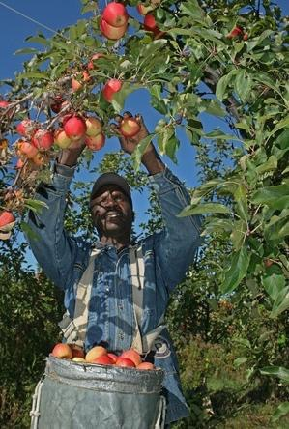
Developing Structural Competence in Family Medicine Residents through Migrant Farmworker Health
Carrie Griffin, DO; Cheryl K. Seymour, MD
Maine-Dartmouth Family Medicine Residency
Jonathan Fricke, MD, MPH; Gayle Thomas, MD
UNC Family Medicine Residency

Slide 2
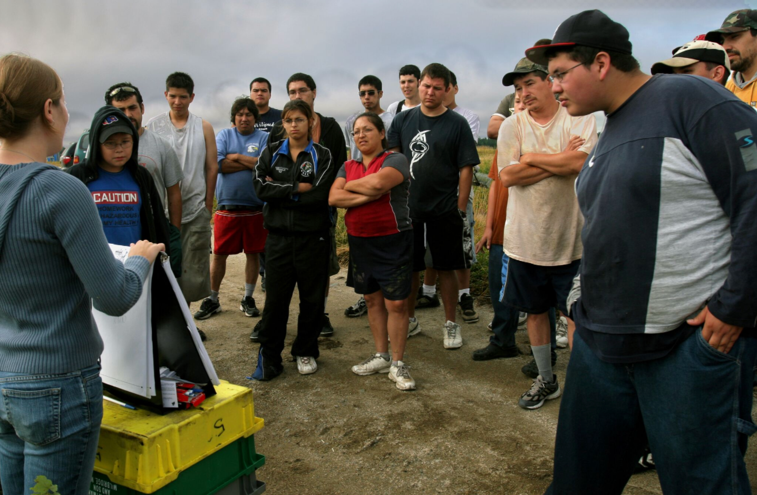
Introductions

Slide 3
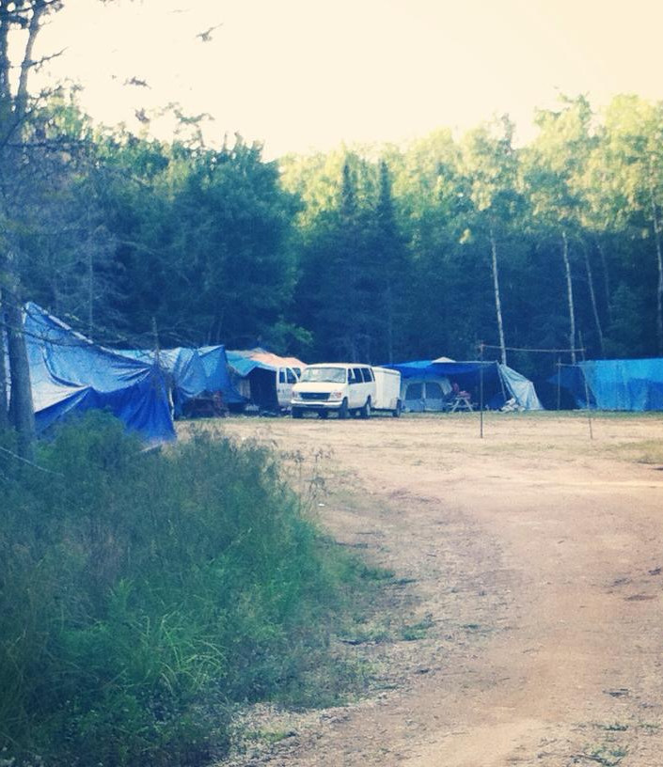
Objectives
At the end of this session, learners will be able to…
1) Describe the size and demographics of the farmworker population in the US, as well as their unique barriers to care, medical needs and similarities to underserved populations in developing nations.
2) Explain different ways that care for farmworkers can be incorporated into physician training.
3) Articulate the definition of structural competence and how caring for farmworkers can foster the development of critical attitudes and practices leading to expertise in structural competence.

Slide 4
Key Terminology
Structural competency
The trained ability to discern how a host of issues defined clinically as symptoms, attitudes, or diseases (e.g., depression, hypertension, obesity, smoking, medication “non-compliance,” trauma, psychosis) also represent the downstream implications of a number of upstream decisions about such matters as health care and food delivery systems, zoning laws, urban and rural infrastructures, medicalization, or even about the very definitions of illness and health.
Five Skill-Sets
Recognizing the structures that shape clinical interactions
Developing an extra-clinical language of structure
Rearticulating “cultural” presentations in structural terms
Observing and imagining structural intervention
Developing structural humility
Structural competency: Theorizing a new medical engagement with stigma and inequality; J.M. Metzl, H. Hansen / Social Science & Medicine 103 (2014) 126e133

Slide 5
Case #1
You are on a night of obstetric call and a 31 year G2 P1001 Mexican woman presents in active labor. She has been working in Florida as a migrant farmworker and has not received any routine prenatal care. She has an uncomplicated second stage; however the baby is born without arms and legs. As you ask more questions regarding her history, you learn that she picks tomatoes for a large agricultural company and she and other farmworkers have been regularly experiencing nausea, dizziness, headaches and rashes for the past seven months since the start of using several new herbicides and pesticides.
Based on the case above, how would you define structural violence?

Slide 6
Case #2
As the medical director of a migrant health program, you are required to report out on a number of clinical quality measures to the federal government on an annual basis. These include HTN control, HA1c of patient with diabetes and rates of Pap smears and colon cancer screening in appropriate demographic groups.
The majority of the patients that you serve are in the state for less than 2 months. Your rates of meeting established clinical quality targets are sub-optimal. At a strategic planning retreat, you facilitate a working group to design interventions and allocate limited resources to reduce these disparities and improve chronic disease outcomes. Your board chair (a hospital-based physician) asks if it is even reasonable to hold a migrant health program to the same standards of quality as a health center with a non-mobile, or less high risk population. How would you respond?
Based on the case above, how would you define symbolic violence?

Slide 7
Demographics
Estimated >3 million
~75% are foreign born
68% born in Mexico
Central America, Caribbean, and SE Asia
Increasing indigenous, non-Spanish speaking Mexican workers
70% male
8th grade education
½ million children
National Agricultural Workers Survey (NAWS) 2013 - 2014.

Slide 8
History
WWII farm labor shortages -> Bracero program in 1942
1964 - H2 Temporary Guest Worker program
H2-A
Guaranteed minimum wage
Housing and transportation standards
Guaranteed pay for at least 75% of hours promised
Sufficient labor versus complying with laws
165,000 H2A visas in 2016 (of 3 million workers)
Migrant vs seasonal
National Agricultural Workers Survey (NAWS) 2013 - 2014.
AP/University of Texas El Paso .

Slide 9
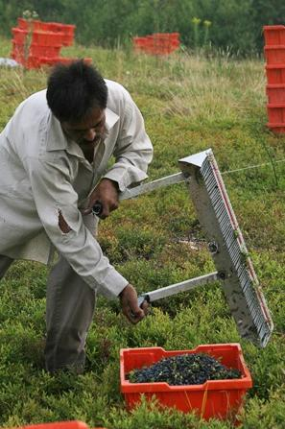
Occupational Hazards
Agriculture is dangerous
Heavy machinery
Physical labor, repeated movements
Pesticide, heat, and plant toxins
Factors predisposing to risk:
Grower-provided housing, transport
Toilet and showers
Long hours, few breaks
No overtime, often shorted on pay
Pesticide brought home often
Isolation (depression, anxiety, drinking, high-risk sex)
Lack of insurance
Rarely have access to worker’s compensation
14 states require it for all, but most make exceptions
Arcury TA. AJPH. Dec 2015; National Center for Farmworker Health 2013

Slide 10
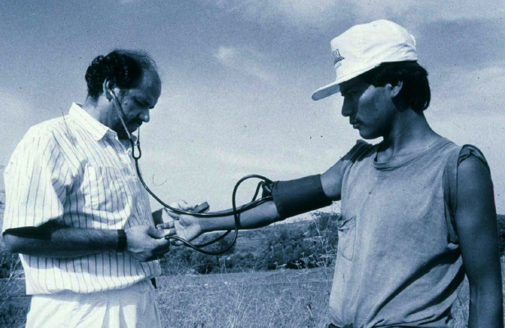
Common Health Conditions
Unique to farm work:
Heat and sun exposure
Pesticide exposure
Brought home on clothing, family members exposed as well.
Infectious diseases
34% of water samples in camps found unsafe for human consumption
MSK injuries
Respiratory illnesses
Skin disorders
Fungal, irritant contact dermatitis, sunburn, acne mechanica
Eye injuries
(2x the general rate), as well as cataracts and pterygia
In addition to common chronic conditions:
Obesity, HTN, DM, anxiety, depression
No healthy immigrant paradox
National Center for Farmworker Health 2013.

Slide 11
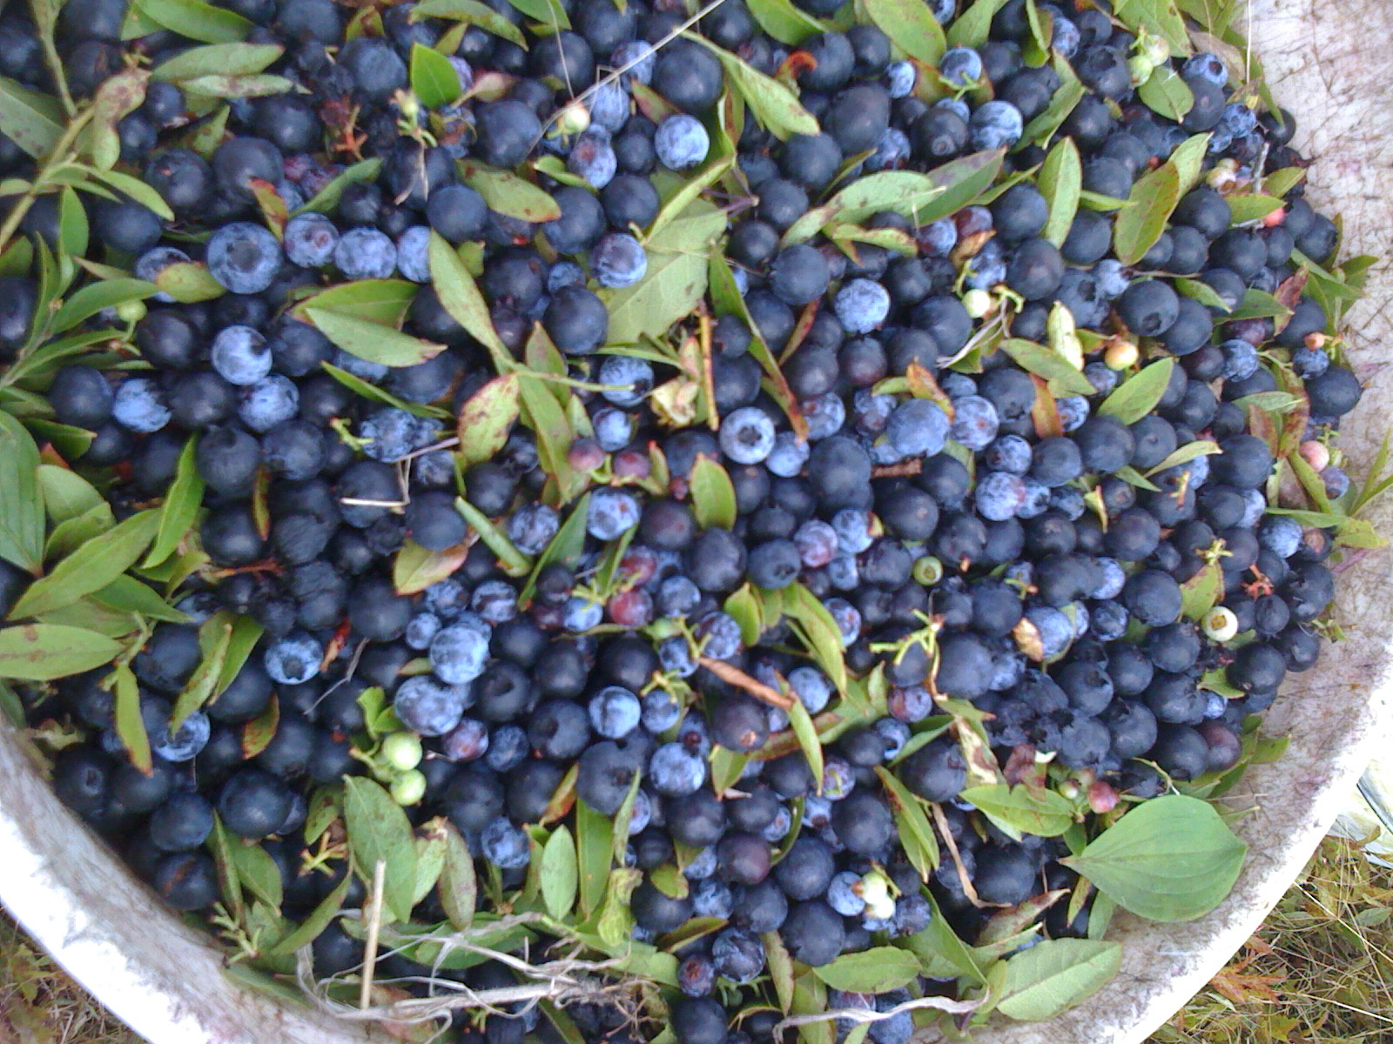
Why is health worse?
Frequently identified factors
Genetics
Language
Education
Culture
Cost
No PCP
Holmes SM. Social Science & Medicine. 2012.

Slide 12
Why is this important?
Medical training emphasizes individual and cultural factors, but often overlooks social, economic, or political factors.
“Social and economic structures in health care and subtle cultural factors in biomedicine keep medical professionals from seeing the social determinants of suffering of their unauthorized migrant patients. These barriers lead clinicians inadvertently to blame their patients - specifically their biology or behavior - for their suffering.”
Emphasis on cultural competence can come to imply that the culture of the patient is the problem
It is often the structure and the culture of biomedicine that functions as a barrier to effective care.
Holmes SM. Social Science & Medicine. 2012.

Slide 13
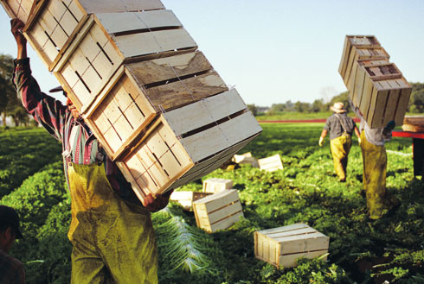
Why is health worse?
Not frequently identified
Loss of agency
Hierarchy
Racism/social class follows indigenous migrant workers to the fields in the US
Limited transport
Safety disincentives
Frequent relocation
Toilets, showers
Isolation, out of public eye
Arcury TA. AJPH. Dec 2015, Holmes SM. Social Science & Medicine. 2012.
.

Slide 14
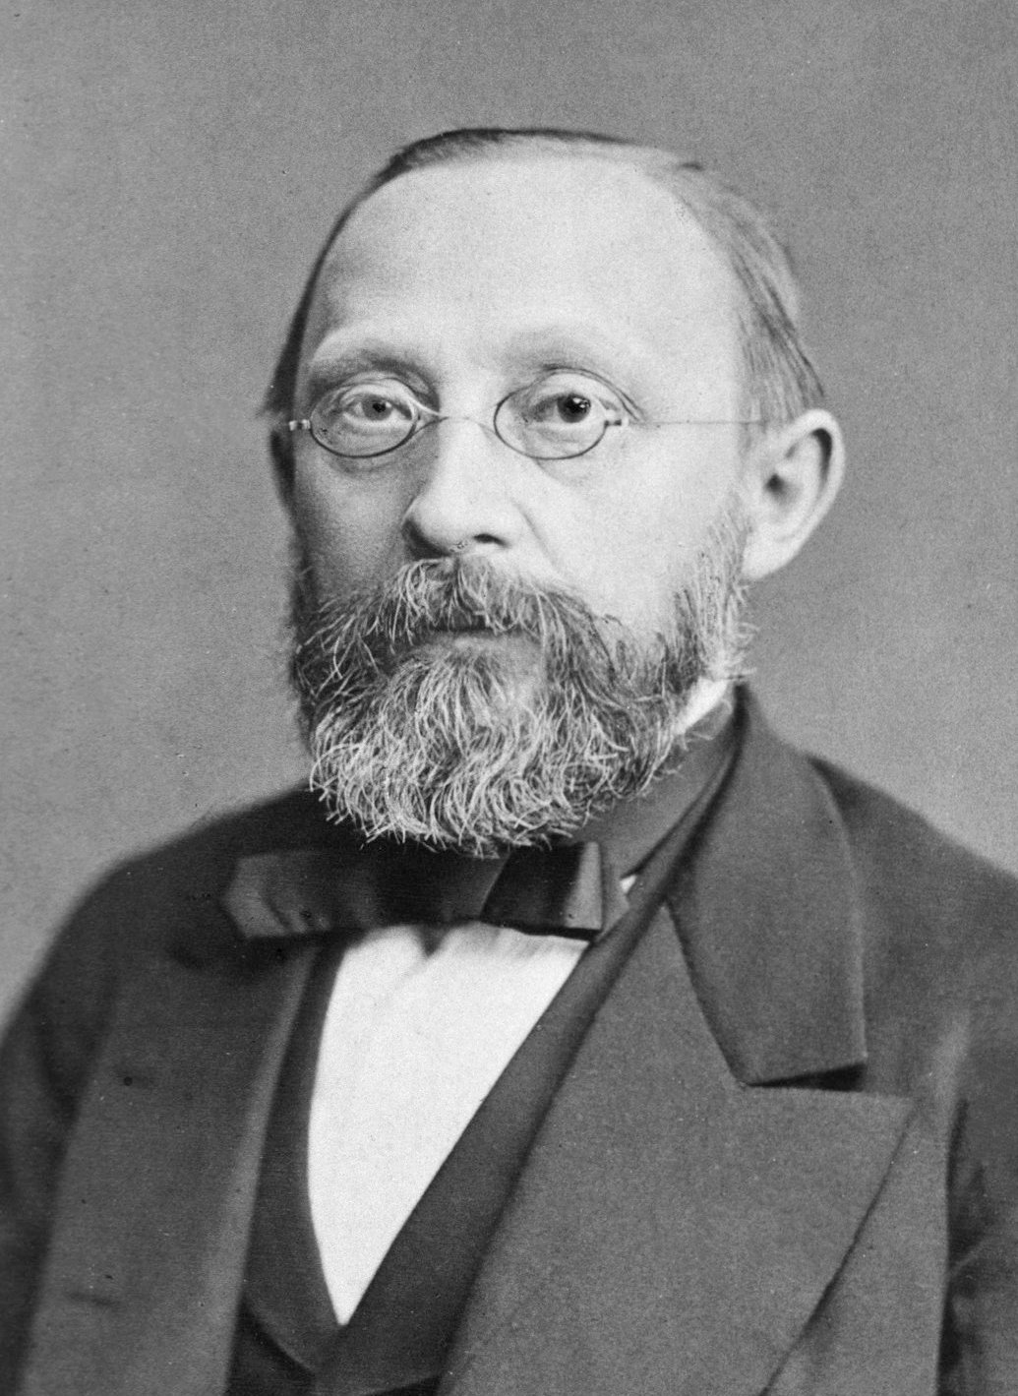
Why is this important?
“The physicians are the natural attorneys of the poor, and the social problems should largely be solved by them.”
– Rudolf Virchow
.

Slide 15
Why is this important?
Hypercoagulability
Dangerous work
Endothelial
Injury
Stasis
Structural Vulnerability
Barriers
to Care
Farmworker’s Triad
Virchow’s Triad

Slide 16
Why is this important?
“Without the addition of social analysis in medical education, trainees are left with only biological and behavioral lenses through which to understand their patients’ suffering.”
Seth Holmes, MD, PhD
Holmes SM. Social Science & Medicine. 2012.

Slide 17
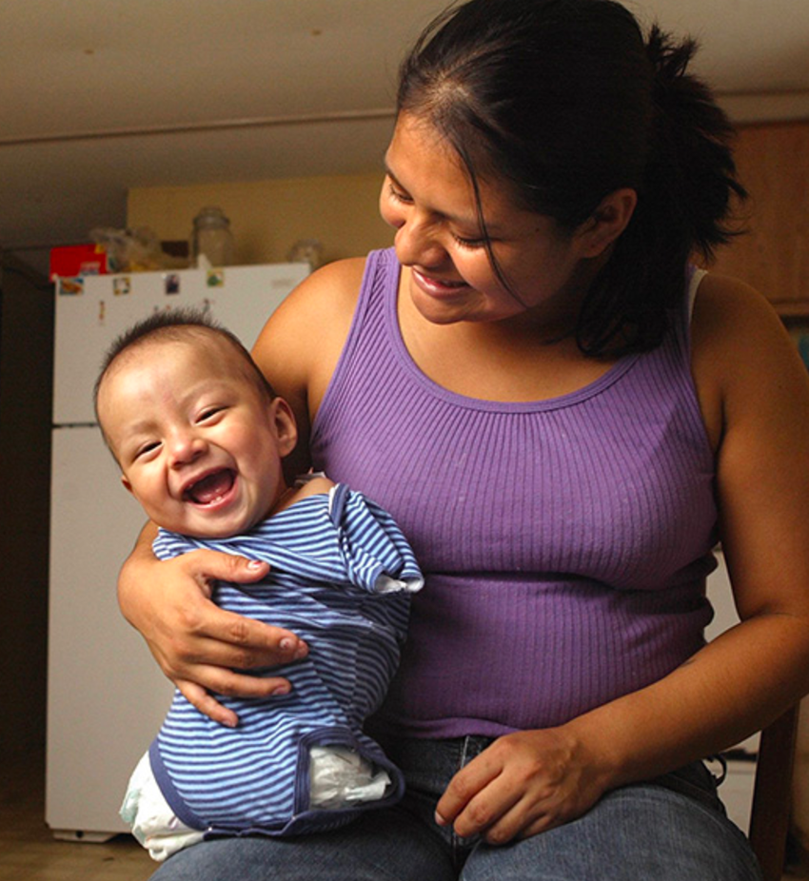
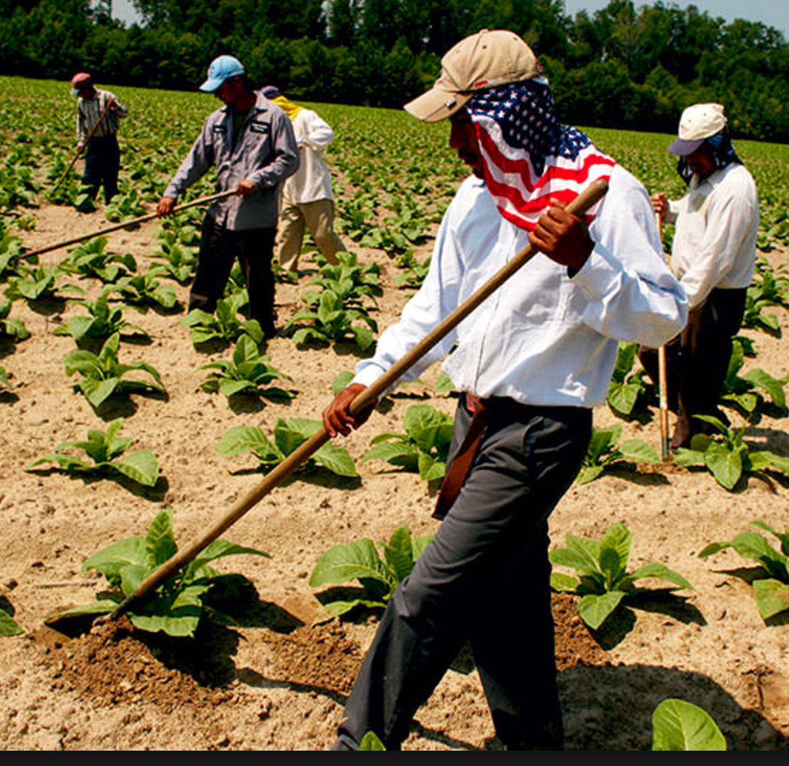
Cases Re-visited

Slide 18
Key Terminology
Structural violence
The term “structural violence” is one way of describing social arrangements that put individuals and populations in harm's way. The arrangements are structural because they are embedded in the political and economic organization of our social world; they are violent because they cause injury to people (typically, not those responsible for perpetuating such inequalities).
Symbolic violence
The imposition on subordinated groups by the dominant class of an ideology which legitimates and naturalizes the status quo.
Structural violence: Farmer PE, Nizeye B, Stulac S, Keshavjee S (2006) Structural Violence and Clinical Medicine. PLoS Med 3(10): e449.
Symbolic violence: Oxford Press

Slide 19
Key Terminology
Structural competency
The trained ability to discern how a host of issues defined clinically as symptoms, attitudes, or diseases (e.g., depression, hypertension, obesity, smoking, medication “non-compliance,” trauma, psychosis) also represent the downstream implications of a number of upstream decisions about such matters as health care and food delivery systems, zoning laws, urban and rural infrastructures, medicalization, or even about the very definitions of illness and health.
Five Skill-Sets
Recognizing the structures that shape clinical interactions
Developing an extra-clinical language of structure
Rearticulating “cultural” presentations in structural terms
Observing and imagining structural intervention
Developing structural humility
Structural competency: Theorizing a new medical engagement with stigma and inequality; J.M. Metzl, H. Hansen / Social Science & Medicine 103 (2014) 126e133

Slide 20
Models in Resident Education
UNC
Required 2 week rotation in second year called “Vulnerable Populations”
Includes
Mobile clinic in farmworker labor camps with supervising provider
Accompanying outreach workers to camps to do health assessments
Evening clinic in health center dedicated to farmworkers
Prison clinics at Men’s and Women’s Prisons (ID and Ob-Gyn)
Optional readings and videos on Migrant Health and Prison Medicine

Slide 21
Resident Evaluations - UNC
 | 2014-2015 | 2016-2017
1=very dissatisfied, 5=very satisfied
Clear Learning Objectives | 4.5 | 4.1
Resident Role Well Defined | 4.2 | 4.1
Overall Workload | 4.3 | 4.4
Exposure to Procedures | 2.7 | 4.1
Variety of Patient Care Issues | 3.9 | 4.3
Ability to Attend Conference | 3.9 | 4.4
Quality of Support From Team | 4.3 | 4.6
Quality of Teaching | 4.2 | 4.4
Relevance to Family Medicine | 4.4 | 4.4
Overall | 4.3 | 4.4

Slide 22
Resident Comments - UNC
I enjoyed the experience with the migrant population and also being out at the prison. Definitely a different patient population and I appreciate learning about different approaches to healthcare.
I had an amazing time with outreach workers and learned a lot from the introductory presentation about our farmworkers. The home visits were eye opening -meeting older AA men who were retired farmworkers, and seasonal young families. It was eye opening seeing the trust and faith this population has in the outreach workers! This was a fantastic rotation.

Slide 23
Resident Comments - UNC
Enjoyed the rotation thoroughly and love that it is a standard part of our training. The Thursday clinics in Benson were the most educational and the Tuesdays with the mobile van were the second best. The Monday night outreach was interesting but did not improve my clinical skills
This is a great rotation and feel very fortunate to be a part of it. I only wish it could be a little longer and that there were perhaps a few more opportunities to do more of the outreach work.

Slide 24
Challenges
Migrant Farmworkers arrive in North Carolina in March and leave in October
Residency schedules are year round
Balance of Migrant Health and Prison Medicine experiences vary by the season
Migrant Farmworkers are found in rural areas, far from university centers. Residents drive 1.5 hours each way.

Slide 25
Models in Resident Education
Maine-Dartmouth / Maine Mobile Health Program
One month elective in August
Third year residents +/- fourth year MS
Mobile clinics in farm-worker labor camps during the blueberry harvest
Multi-disciplinary group discussions, reflective writing, field trips, supplemental readings
Annual seminar for all second year residents
4 hrs embedded in “community medicine rotation”
Flipped classroom using true clinical cases
Cases exemplify concepts from anthropology, based on themes in Fresh Fruit, Broken Bodies (S. Holmes)

Slide 26
Resident Comments - MMHP Seminar
“This will prompt me to keep my eyes and heart open, with awareness for how our system impacts and propagates disparities / injustices…”
“Appreciated words / constructs / phrases to apply to a lot of what we see every day - somehow makes it seem less insurmountable…”
“I appreciate now even more the need for populations to have strong advocates…I hope to be like this in some form in my community in the future…”

Slide 27
Learner Comments- MMHP Elective
“Though most people can empathize with the struggle of others given enough second-hand information, a different level of understanding is reached by glimpsing these struggles in person, second only to experiencing them oneself. Working in what most medical professionals would consider relatively austere conditions, seeing patients in their own environment using their native language... it is difficult to describe the effect this type of connection with others has on the soul. It was fun, it was challenging, it was educational, and I am planning to seek out similar experiences again…”
- Matt Libby, DO

Slide 28
Learner Comments - MMHP Elective
“I came to medical school hoping for clinical experiences like the ones I had working on the mobile clinic in Maine. I am so grateful to have had the opportunity to work with the MMHP, and I can’t wait to do it again…”
-Holly Schroeder, MD
“This was an enriching learning experience that went far beyond clinical skills to the cultural and societal context in which we were providing care… the innovative curriculum provided us with a comprehensive understanding of the health and social issues that affect farmworkers in Maine.”
-Meaghan Kennedy, MD

Slide 29
Learner Comments - MMHP
From a reflective writing assignment…
All I really want to do is love people, practically and well. I still think that becoming a physician is the best way for me to do that. Nonetheless, I am haunted by a simple question from a chaplain who worked with migrant farm-workers, at the end of Harvest of Shame:
“ Can there be love without justice?”
-Kate Lewis Peters, DO

Slide 30
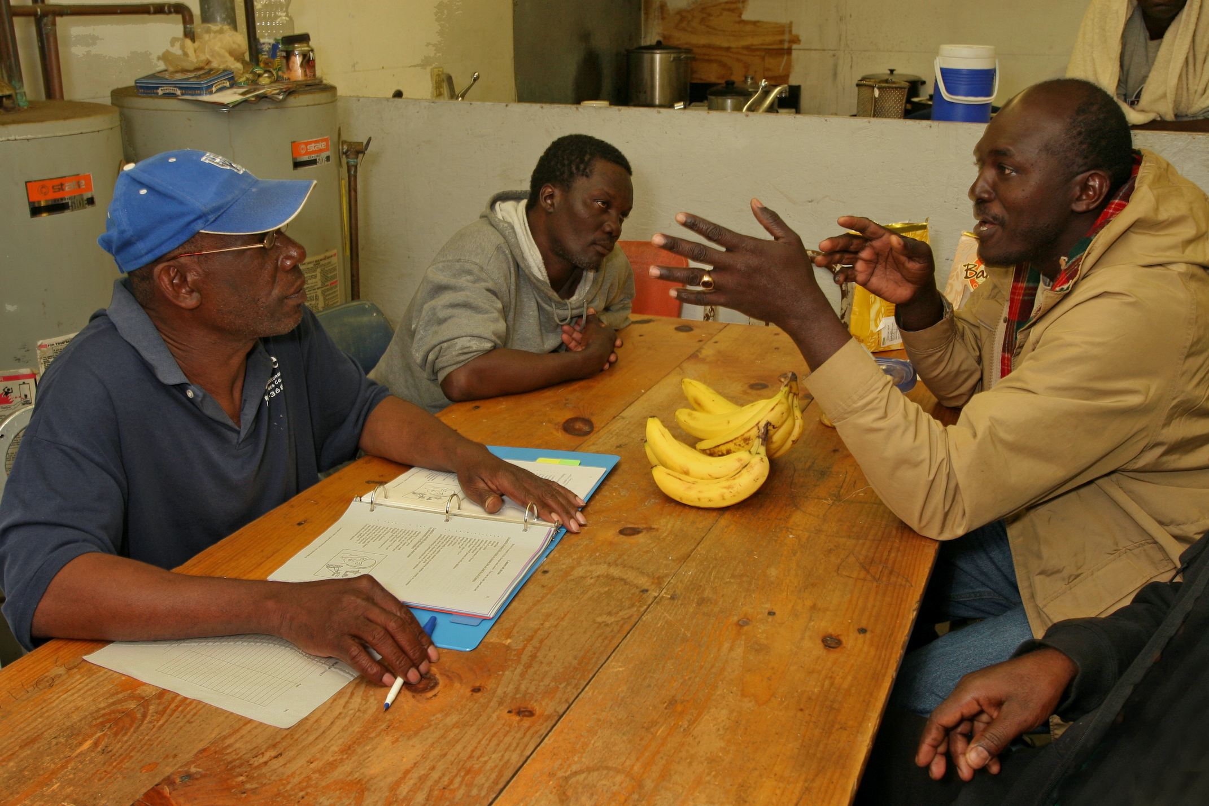
Action
How are the concepts and ideas discussed today relevant in your daily professional lives?
What concrete action will you take in response to this presentation?

Slide 31
“A small act of resistance” – Beth Russet, FNP – MMHP 2007
https://youtu.be/wl8UKPFSKZc

Slide 32
Resources
All photographs in this presentation borrowed from
Farmworkers Feed Us All by Earl Dotter and Tennessee Watson
Migrant Clinician’s Network
http://www.migrantclinician.org/

