Slide 1
Trauma-Informed Care: Understanding and Responding to the Effects of Adverse Life Experiences (Virtual Patient Cases)
Miranda M. Huffman
Alec Chessman, Emily Jacobs, Nancy Tobi
Sheela Raja, Shairi Turner, Michelle Hoersch

Slide 2
Disclosures
None – Huffman
Federal contract support – Chessman, Jacobs, Tobi, Raja, Turner

Slide 3
Objectives
List the objectives of the Trauma-Informed Care (TIC) virtual patient cases
Explain the creation process for TIC
Imagine incorporating TIC cases into the curriculum

Slide 4
Content:
Sheela Raja: TIMe Project Leader and Assistant Professor at the University of Illinois at Chicago
Shairi Turner: TIMe Project Leader and Medical Consultant with the Division of Disability Determinations with the Florida Department of Health
Michelle Hoersch: OWH Contract Officer
Instructional Design:
Emily Jacobs: Project Manager and Instructional Designer
Nancy Tobi: Sr. Project Manager and Instructional Designer
Translation:
Alec Chessman: TIMe Editor-in-Chief and Professor of Family Medicine at MUSC

Slide 5
Development
Title | Role in TIC | Professional Role
Content experts | Develop and oversee process | One MedPeds physician One behavioral scientist
Project manager | Provide instructional design expertise | MedU employee
Editor-in-chief | Ensure clinical realism | Family physician
4 teams of physicians and behavioral scientists | Write cases | Family physicians, neonatologists, pediatricians, social workers, psychologists
Notes:
The point of this slide is – recounting the structure in the first 3 rows: content experts, instructional design / project management experts, and a simple sounding board (me).
The fourth row is important for how we actually create the cases, with each case the collaboration between a behavioral science expert, like a clinical psychologist, and a medical expert, like a family physician or neonatologist.

Slide 6
Development
Title | Role in TIC | Professional Role
Content experts | Develop and oversee process | One MedPeds physician One behavioral scientist
Project manager | Provide instructional design expertise | MedU employee
Editor-in-chief | Ensure clinical realism | Family physician
4 teams of physicians and behavioral scientists | Write cases | Family physicians, neonatologists, pediatricians, social workers, psychologists
Notes:
This pairing of a behavioral scientist with a physician (or similar clinician) is both at the highest level of management and the case authoring level.

Slide 7
Advisory Committee
Experts in Trauma-Informed Care

Slide 8
Trauma-Informed Care (TIC)
Collaboration between:
US Department of Health and Human Services Office of Women’s Health
MedU (of fmCASEs fame)

Slide 9
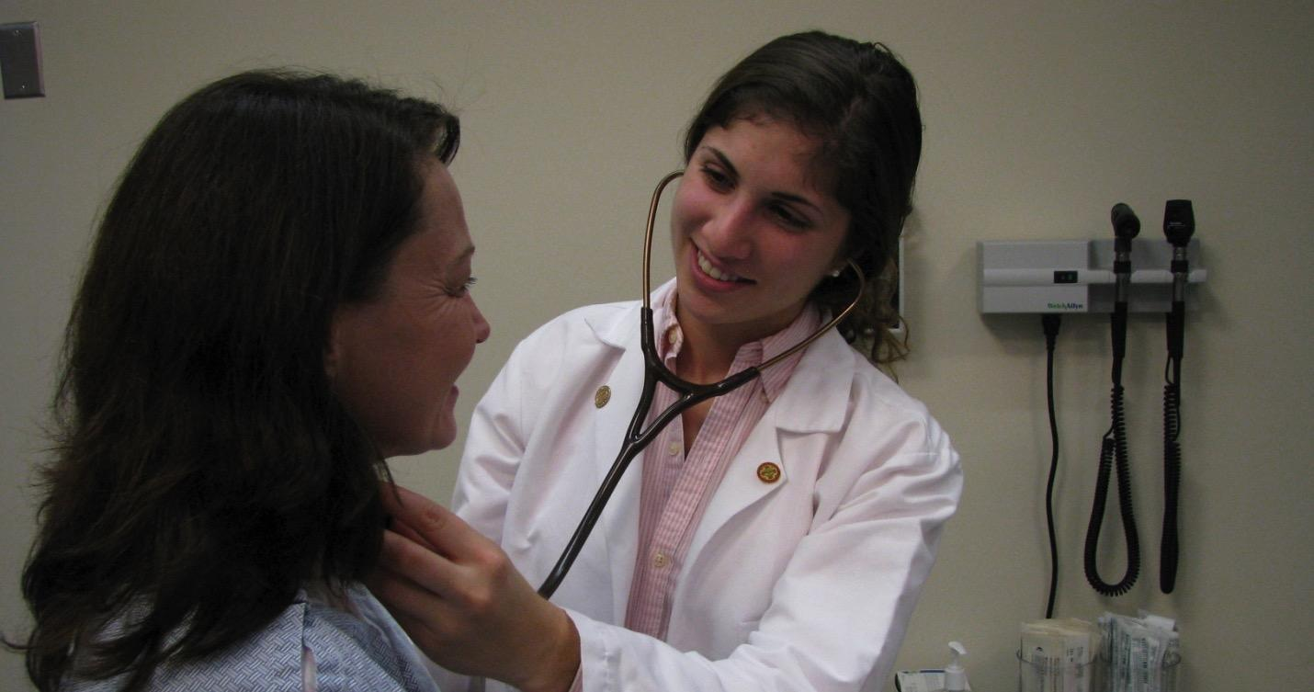
MedU Mission
MedU is dedicated to delivering the best health care education
through collaborative development and research
into innovative, high-impact virtual teaching and learning methods.

Slide 10
2000 - Present
MedU
Virtual Patients.
Real Learning.
CLIPP
Notes:
Scaled the one course to 5 courses
Added one affiliated partner
Modest extension of new medical school subscribers
Maintaining revenue
Small sustaining innovations accomplished
Small grant income for one free course

Slide 11
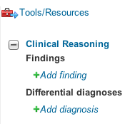
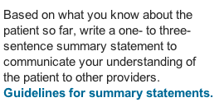
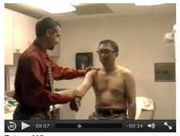
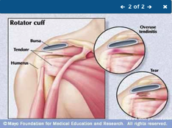
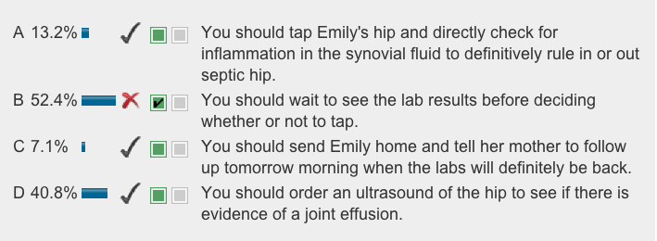
pedagogy
analytics
Virtual Patient Cases: The MedU Approach
case pedagogy
MedU cases…
Offer a dynamic clinical reasoning interface that promotes ongoing development of students’ diagnostic skills.
Contain multimedia resources that bring the cases alive for students and teach them about other valuable online resources.
MedU cases are developed and maintained by teams of leading medical educators who collaborate with their national education organizations to build courses that meet their unique teaching and learning needs.
Our interactive, dynamic approach promotes individualized and engaged learning, clinical reasoning, and in-depth exploration of content.
A continuously updated curriculum map ensures comprehensive and appropriate coverage of all core learning objectives.
1. Students are asked to record key findings and begin composing a differential diagnosis from the start.
2. Students’ clinical reasoning can be captured in real time as the story unfolds.
3. Students write a summary statement incorporating key findings from the history and physical exam.
Incorporate interactive questions with rich feedback, including thorough explanations and peer response to allow for student-to-student comparison.
Include Expert comments that offer additional in-depth information.
Create a safe learning environment where students can explore, make mistakes, and learn at their own pace.

Slide 12
Trauma-Informed Care Goals
Promote provider-patient relationship.
Improve provider effectiveness.
Improve patient engagement in care.
Prevent re-traumatization of patient.
Improve patient outcomes.
Notes:
Promoting the relationship and increasing provider effectiveness can mean, for some physicians, helping them not to be frustrated with a patient who appears to be making poor life choices. Understanding how a patient may be handling the effects of trauma by counter-productive coping mechanisms, such as smoking cigarettes or avoiding healthcare, can help the clinician feel less frustrated, more connected to the patient.

Slide 13
TIC is Needed
Trauma is a major public health issue.
Patients unlikely to disclose trauma.
Online CME:
Equal or better than paper or in-person delivery.
Can result in behavior change

Slide 14
Trauma-Informed Care
Trauma is common
IPV
Sexual assault
Child abuse
Terrorism
Natural disasters
Community violence
Historical trauma

Slide 15
Trauma-Informed Care
Developed to train clinicians to interact with patients with histories of trauma, both disclosed and undisclosed
Free to access (summer 2017)
CE credit available (future)
Each case takes ~15 minutes
60 total cases – expect 15 hours of CE credit

Slide 16
Objectives
Detail the nature and prevalence of trauma
Implement patient-centered communication and care
Explain the neurobiology of trauma
Describe the health effects of trauma
Implement inter-professional collaboration
Consider provider personal and trauma history
Integrate “peers with lived experience” into the system of care
Advocate for system change
Perform screening for trauma history

Slide 17
Development
Year 1 – 12 cases created
Year 2 – 16 cases created
Year 3 – 16 cases planned
Year 4 – 16 cases planned
Cases from Years 1 and 2 have been developed and are under review
Now

Slide 18
Implementation
28 cases currently undergoing review
32 to be created
Anticipate publicly available summer 2017

Slide 19
Peer Review – 12 cases
95% of pilot participants report that “I am now more likely to understand patient-centered communication and care, and implement ‘universal trauma precautions’ in my practice”.
100% of pilot participants report that “The material in the cases focuses on the relevant issues that a clinician should learn about this topic”.
95% of pilot participants report that “I am now more likely to understand the prevalence of trauma and recognize different presentations of patients with effects from past trauma.

Slide 20
Examples
Regular care
Trauma-informed care = the WHY
New twists
Walk in front, not behind, a patient
Give patients as much control as possible
Effects of trauma
Ineffective coping
Avoid re-traumatization
Neurologic / physiologic changes
Notes:
Some of the cases describe Good Care, that is, Patient-Centered Care. Some of the clinical methods described are what medical students (and PA and NP) students learn in their first year of education.
But what isn’t always clear is WHY.
My personal example is when I went to see the dermatologist because I was worried that I had malignant melanoma. (I’m fine. For now.) I was put in the room by the nurse, given a gown, and asked to change. As I was halfway between my clothes and the gown, standing in my underwear, the physician knocked on the door and entered. Now… I don’t care… It’s all I got… It is what it is… BUT, if I had ever been traumatized in certain ways, this event could have made me feel terrible. As it is, I can’t forget this story. But I recall it mainly now as a cautionary tale to myself and other clinicians. That’s the WHY – WHY it’s important is that, if you don’t practice sound Patient-Centered Care, some patients will go ballistic on you, retreat into a shell, never open up or explain their concerns, etc. Trauma-Informed Care explains WHY this clinical behavior is important.
There are also new things that I’ve learned through the cases –points like “you should walk in front of, not behind, a patient” so that you do not re-create a sense of being stalked. And some of the examples in the cases of giving patients control – slightly annoyed me – but were very helpful in helping me to see the importance of, above all, granting a sense of control to the patient. Maybe, on that day, for that person, giving a sense of control was the most therapeutic thing that was going to happen.
Other content areas include:
Ineffective coping – explaining to me why some patients self-medicate with alcohol or tobacco, to fight some of these feelings triggered by circumstance and internal patterns
I finally got permission for something I started doing 20 years ago, within 10 years of leaving medical school. I stopped asking for details about every person’s trauma history. I had decided that I was pressing for information that benefited me, only. Just because I was interested. But the patient did not get any benefit, and actually could feel worse, by going through the details with me, too soon, at my pressuring.
The neurobiology of what trauma does to us is fascinating and new, even down to the level of affecting the genome.

Slide 21
The Future….
Integration into pre-clinical education
Integration into clerkships
Integration into residency education
Integration into faculty development
Notes:
Some of these cases can be used to EXPLAIN WHY patient-centered behavior is important. These introductory cases SUPPORT the standard interviewing competencies. So some of these cases could be used in Year 1 of medical school. Others are more sophisticated and detailed, and could be used in residency training.
Perhaps a family medicine resident is conducting a quality improvement project

Slide 22
References
Casebeer, L, Bennett, N, Kristofco, R, Carillo, A, and R Centor. Physician Internet Medical Information Seeking and On-line Continuing Education Use Patterns. J Contin Educ Health Prof. 2002; 22: 33-42.
Curran, V, and L Fleet. A review of evaluation outcomes of web-based continuing medical education. Medical Education, 2005; 39: 561-567.
Fordis, M, King, J, Ballantyne, C, Jones, P, Schneider, K, Spann, S, Greenberg, S, and A Greisinger. Comparison of the Instructional Efficacy of Internet-Based CME with Live Interactive CME Workshops: A Randomized Controlled Trial. JAMA 2005; 294(9) 1043-1051.
Harris, J, Kutob, R, Suprenant, Z, Maiuro, R, and T Delate. Can internet-based Education Improve Physician Confidence in Dealing with Domestic Violence? Family Medicine. 2004; 34(4): 287-92.
Manning, PR and L Debakey. Continuing medical education: The paradigm is changing. J Contin Educ Health Prof. 2001; 21: 46-54.
Wutoh, R, Boren, SA, and A Balas. eLearning: A Review of Internet-Based Continuing Medical Education. J Contin Educ Health Prof, 2004; 24: 20-30.

Slide 23
Please evaluate this presentation using the conference mobile app! Simply click on the "clipboard" icon on the presentation page.

