Slide 1
Family Medicine Cares International: Patient Care, Service, Medical Education and Faculty Development in Haiti
Donald Briscoe, MD
Anna Doubeni, MD MPH
Neubert Philippe, MD
Mary Jo Welker, MD

Slide 2
Disclosures
Presenters have no Conflicts of Interest or Financial Disclosures to report

Slide 3
Learning Objectives
List the activities performed by the volunteers in the AAFP Foundation’s Family Medicine Cares International Program
Describe the role of faculty development in medical capacity building in Haiti
Provide support for family medicine educators in developing countries to promote the availability of well-trained family physicians throughout the world

Slide 4
What is Family Medicine Cares International?
Humanitarian program created to provide sustainable and accessible health care to underserved populations around the world.
Provides patient care, delivers education and training in Family Medicine, and works to improve the health and quality of life of people in Haiti.

Slide 5
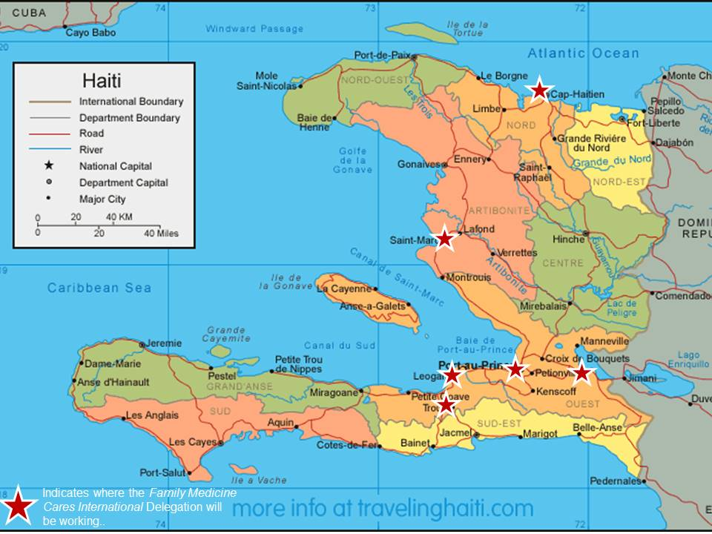

Slide 6
Family Medicine Cares International
Program Components
Patient Care
Medical Education and Training
Children and Youth Projects
Medical Equipment and Supplies
Work is Accomplished Through
Annual Delegation
Faculty Development Trips
Ongoing Communication and Mentoring

Slide 7
Annual Delegation Trip
The Annual Delegation trip is a one-week volunteer opportunity that includes both medical and non-medical individuals.
Delegation has three teams:
Patient Care
Medical Education
Service
2018 Delegation: February 24 – March 3

Slide 8
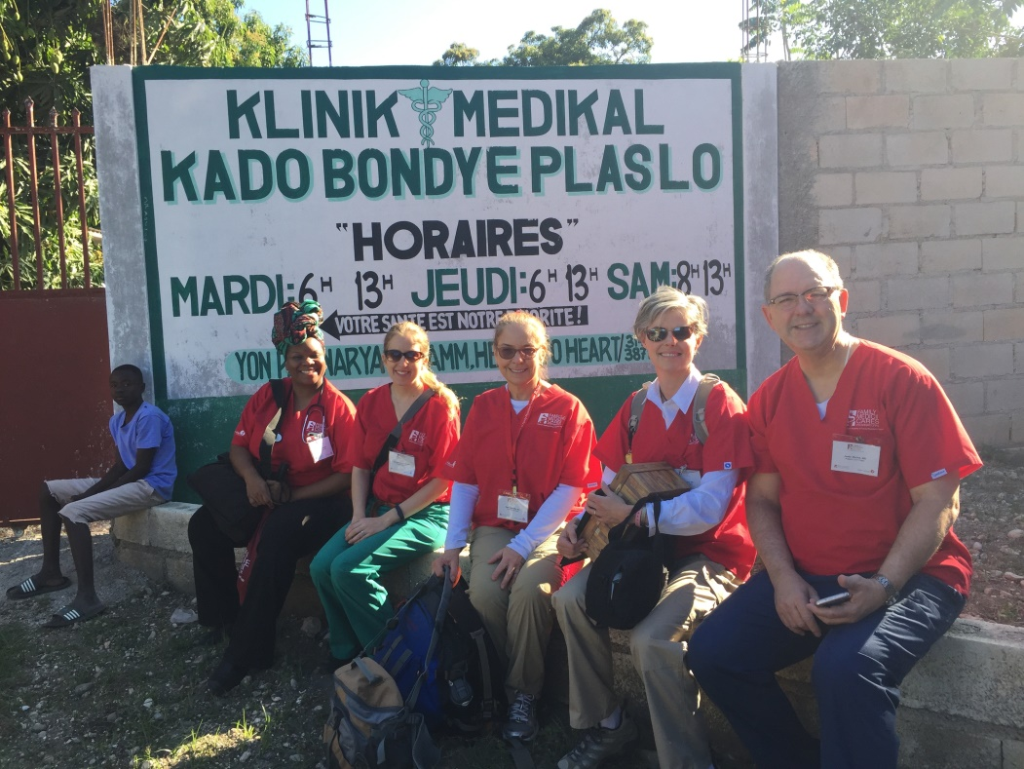
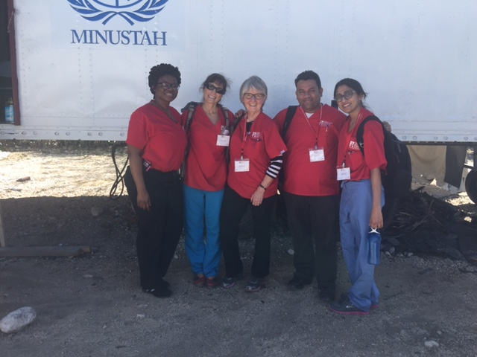
Patient Care Team
682 Patients were seen!

Slide 9
Service Team
Seeks to improve the quality of life and the health of children in Haiti, as well as provide health and hope to Haiti’s youth. It also allows non-medical Delegation members to participate in meaningful volunteer efforts.
Notes:
400 Children were impacted by the Service Team
2 schools and 1 orphanage
Painted playground equipment
Painted 1 school interior
Painted 1 school exterior and a fence
Painted chairs and tables
Assisted with well child exams
Provided hundreds of school supplies, soccer balls, jump ropes
CompHealth donated:
500 Treat Bags and provided $2,000 to purchase French children's books in Haiti.

Slide 10
Patient Care and Service Team Collaboration
Patient Care Team performed physical examinations for school age children and made necessary follow up for those in need.
Service Team delivered toys, sports equipment, and school supplies to the children upon completion of their visits.
10
Notes:
172 Well child visits were accomplished with the help of the Service Team.

Slide 11
Medical Education Team
Haitian Medical Education System
5 medical schools in Port au Prince
1 public, 4 private
5-6 years
Internship Year
Social Service Year

Slide 12
Medical Education Team
29 Residency Programs
2 FM Residencies
Most medical school graduates do not go to residency

Slide 13
Medical Education Team
6-8 volunteer FM Faculty Members and AAFP Foundation Staff
Activities
Symposia
Promotion of FM Specialty
Faculty Development

Slide 14
Symposia
Full day, CME-type conference
Topics/themes recommended by Haitian faculty
Recent: Women’s Health, Mental Health, Adolescent Care
Presented in Cap Haitien and Port au Prince
Speakers are both FMCI and Haitian faculty
In French
30-50 participants at each location

Slide 15
Promotion of FM Specialty
Meeting with Deans of Medical Schools
Encourage incorporation of FM education into curriculum
Meeting with MSPP
Promote support for FM specialty and FM residencies
Consideration of new FM residency

Slide 16
Faculty Development: Program Philosophy and History
Philosophy
Mission work is important but not enough
Need committed, well-trained, local medical community
History
Started with a request for a book…
Led to a meeting at the PAP airport…
Spurred discussion with the Foundation

Slide 17
Faculty Development: Curriculum Development
Needs Assessment
Survey conducted of faculty and leadership of both programs
Structure adapted from UNTHSC Faculty Development Center

Slide 18
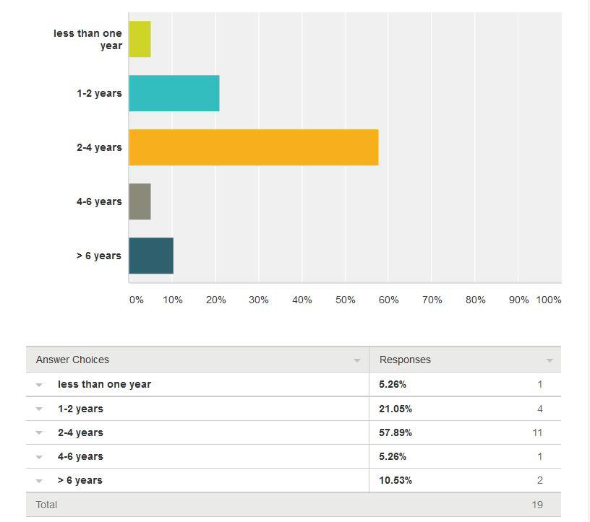
Initial Survey Results (2014)
How long have you been a faculty member?

Slide 19
Initial Survey Results (2014)

Slide 20
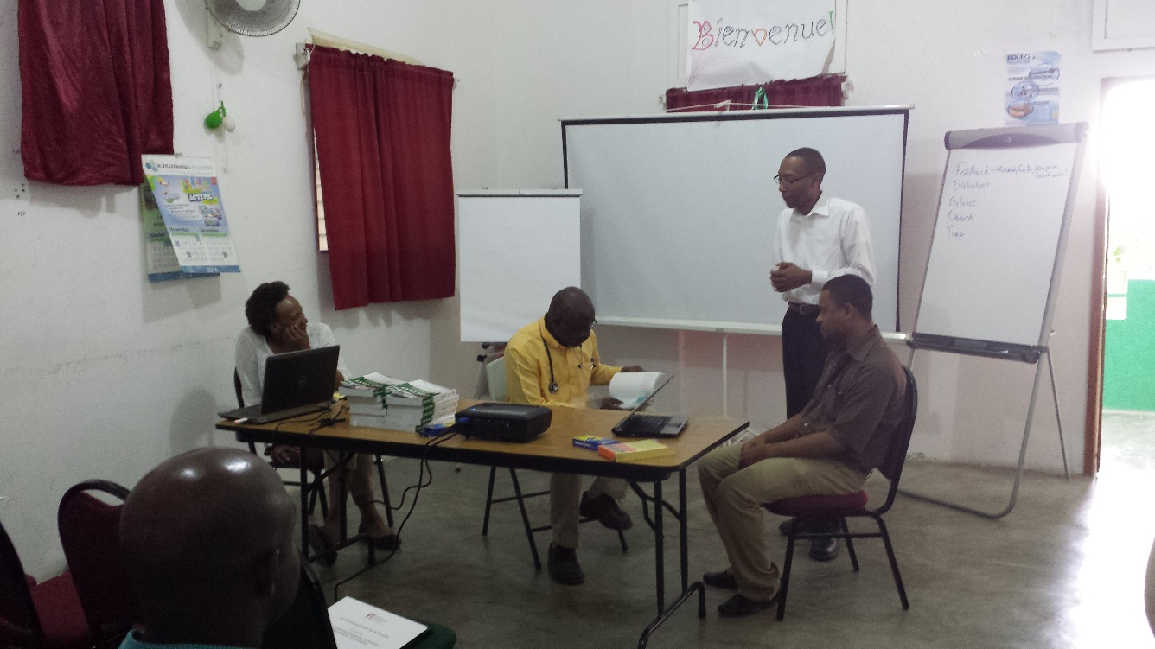
Faculty Development: Visits/Teams
2 visits per year
Delegation team
Dedicated FD trip
2-3 days per visit
Team
6 to 8 during delegation
3 during FD only trips
AAFP Foundation Staff

Slide 21
Faculty Development: Topics Presented
Precepting Techniques
Giving Feedback
Fair Evaluation
Large Group Teaching
Small Group Teaching
Adult Learning Theory
Curriculum Development
Scholarly Activities
Research
Mentoring
Public Speaking

Slide 22
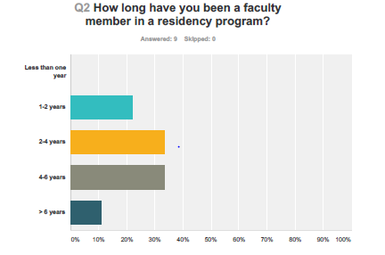

Slide 23
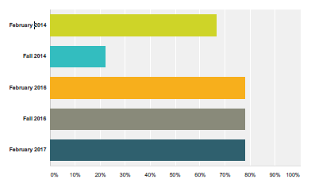
Faculty Development Participation

Slide 24
Faculty Development: Outcomes

Slide 25
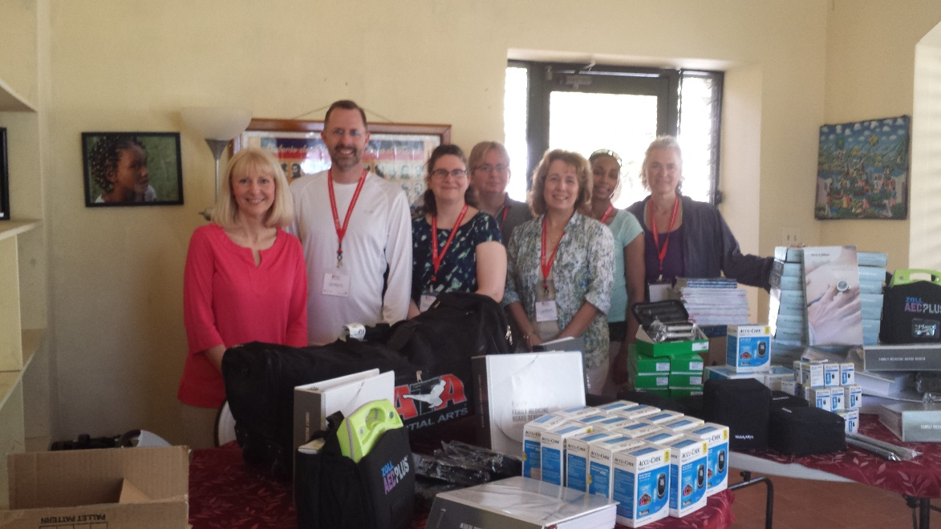
Faculty Development: Other Outcomes
International Academic Participation
Ongoing Mentoring Relationship
Informal Communications
Development of other partnerships
NRN
AFMRD/RPS
AAFP
Materials and supplies

Slide 26
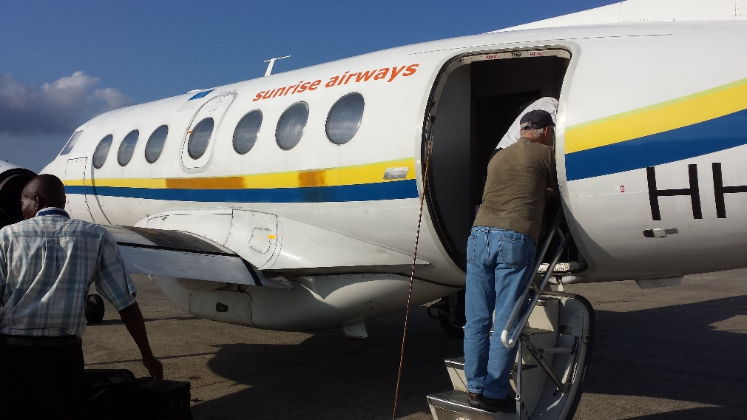
Faculty Development: Challenges
Logistics, logistics, logistics
Language
Politics
Funding of Residency Programs
Faculty Turnover

Slide 27
Faculty Development: Future Plans
Re-attempt to leverage technologies
Separation of tracks for the 2 programs
Support development of Haitian FM Society
Support to future FM Residency (if/when started)

Slide 28
Faculty Development: Exportability
Has been done in other countries
Needs
Dedicated Local Faculty/Program(s)
Committed and Experienced Mentors
Lots of logistical support

Slide 29
Faculty Development: Exportability
Very Exportable Model
Low material costs
No shortage of willing volunteer faculty
Requires long-term vision

Slide 30
Thanks
Faculty of Hospital St. Nicolas, St. Marc
Faculty of Hospital Universitaire Justinien, Cap Haitien
UNTHSC Faculty Development Center
AAFP Foundation

