Slide 1
Health Through a Culturally Sensitive Lens:
Characterizing the Patient Dynamics of
Colonia Margarita Moran, Mexico
Flying Samaritans at UCLA
Allison Ong, Sarah Brown, Ashley Villa-Rangel, Melody Wang, Cynthia Zarate, Josue Fraga, Dr. Margarita Loeza

Slide 2
Overview
Overview of clinic
Filing
Evaluation Organization
Creating Patient IDs
Strategies for Patient Data Collection/Analysis in a Setting that Lacks Patient Continuity and Electronic Files
Google Sheets Database
PracticeFusion
Surveys
Interpreting Data for Individual Health Improvements
Diabetes - A Case Study for Patient Consultations
Using Population Health to Discover and Address Community Need
Interpreting Data for Population Health Improvements
Global Health Ethics
Common Scenarios
Undergraduate Involvement
Social Justice
Cultural Competency
Training our students and doctors

Slide 3
I. Colonia Margarita Moran in Tijuana, MX
15 Minutes from the US-Mexico border
3 Hours from UCLA
Origin: these community members were displaced from their homes by a flooding disaster
Notes:
Flying Samaritans at UCLA is a student-run organization that offers free medical care to an underserved community in Colonia Margarita Moran, Mexico. Every third Saturday of the month, we bring health care professionals to our clinic to provide patient consultations, treatment, and prescriptions that are filled at our on-site pharmacy. We are an RCO (Recovery Community Organization) associated with the national nonprofit, Flying Samaritans. Hence, we are funded through grants through the Community Activities Commission at UCLA and smaller fundraising initiatives. Most of our medications and medical supplies are donated from Venice Family Clinic.

Slide 4
I. Colonia Margarita Moran in Tijuana, MX
Mexican Ministry of Health (MoH) reports that chronic kidney disease, hypertension, type 2 diabetes, and heart disease altogether account for 85-88% of the financial burden of chronic disease on the MoH and Mexican Institute of Social Security.
Supported by our top three prescribed medicines:
Metformin
Acetaminophen
Ibuprofen
Many of our patients come to us with uncontrolled blood glucose or complaints of back and shoulder pain from repetitive factory work.
Our public health surveys suggest that many consider medication for these ailments, among others, too expensive. This reflects the lack of accessibility to Mexico’s national healthcare system of Seguro Popular, in which only 47% of Mexico’s population is enrolled. The rest, 46.5%, must pay out-of-pocket for their healthcare. In Colonia Margarita Moran, our surveys indicate that many members of our population falls into this category of uninsured.
Figueroa-Lara et. al. 2016
Notes:
Figueroa-Lara, Alejandro, Miguel Angel Gonzalez-Block, and Jose Alarcon-Irigoyen. "Medical Expenditure for Chronic Diseases in Mexico: The Case of Selected Diagnoses Treated by the Largest Care Providers." PLOS ONE. Public Library of Science, 8 Jan. 2016. Web. 28 July 2017.

Slide 5
I. Colonia Margarita Moran in Tijuana, MX
“...The only jobs available where I lived before provided low wages. The workers only get paid 100 pesos a day. It would have been difficult to provide my kids with an education. That’s why I made the decision to move to Tijuana, so I could prosper economically. Here I can have a secure job that pays a little more and provides me with healthcare. Everything I do is for my children, so that they have a stable home and have the chance to succeed.”
“...My grand dream is that my children can get a higher education and career. I don’t know if I’ll be able to do it, but that’s my intention and I’m going to do everything that I can to accomplish it.”

Slide 6
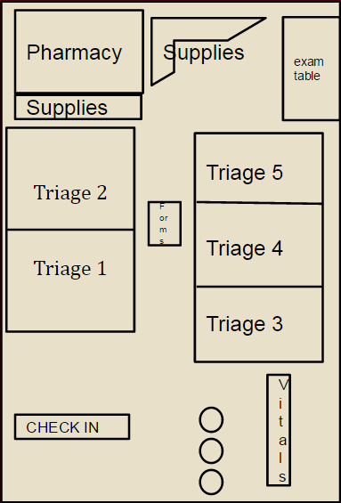
I. Our Clinic
Clinic Flow
Check In
Vitals
Triage/Doctor Consult
Pharmacy
Next door: Health Ed, specialty services

Slide 7
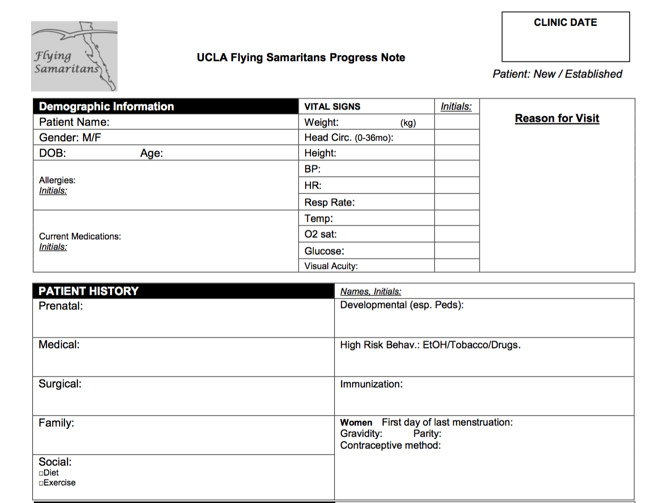
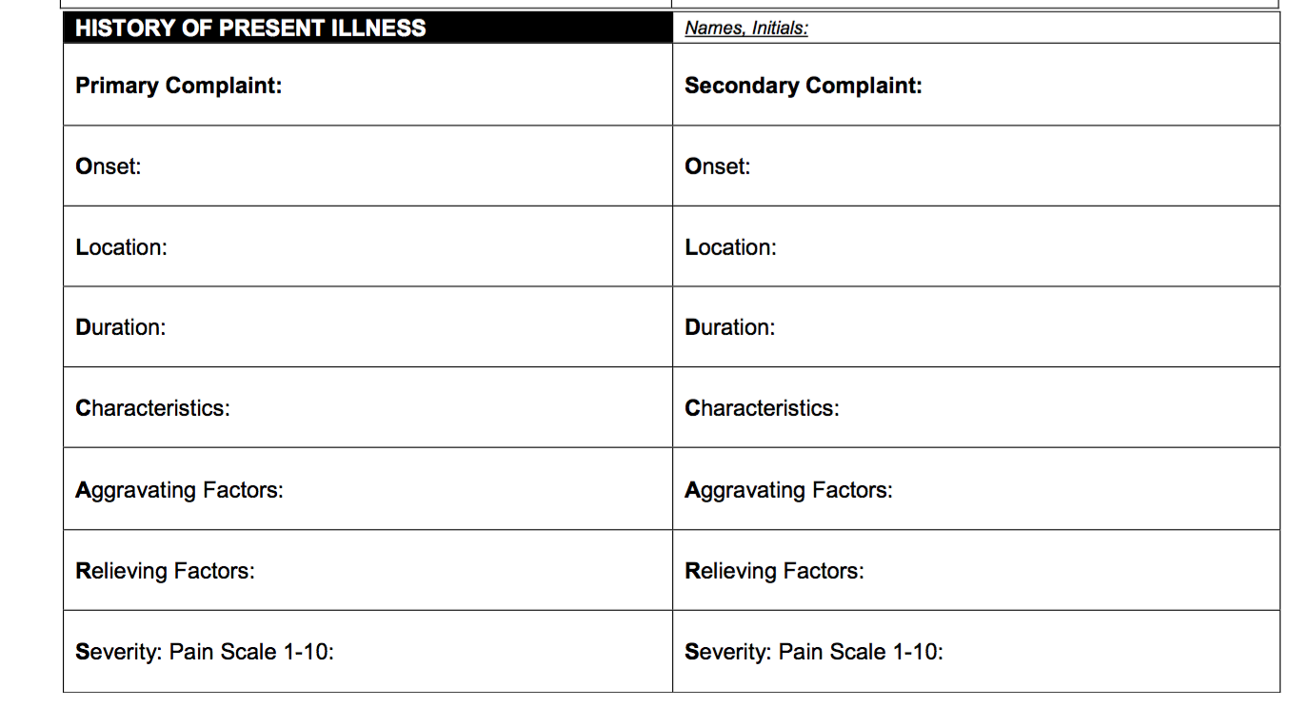
II. Filing
Notes:
typical rhythm of clinic: patients sign in -> we pull up their file -> they get their vitals done -> they are asked about their complaint by students -> a medical professional is called in to see what the problem is/prescribe medication if necessary -> the file will go to the pharmacy, where the patients can then pick up their medication.
each of our new patient files have these 3 patient outtake sheets. The first two go on the right side, the phrams page goes on the left. (1/3)
Each clinic, we bring a team just to do vitals. This team will consist of nurses, registered EMTs, and sometimes students who are also certified.
The student volunteers of our club team up in groups of 3 to figure out the OLDCARS section.

Slide 8
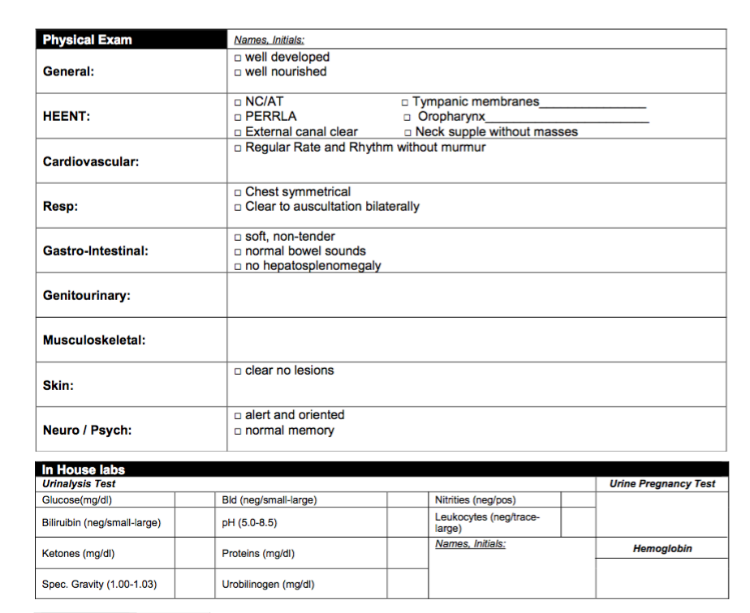
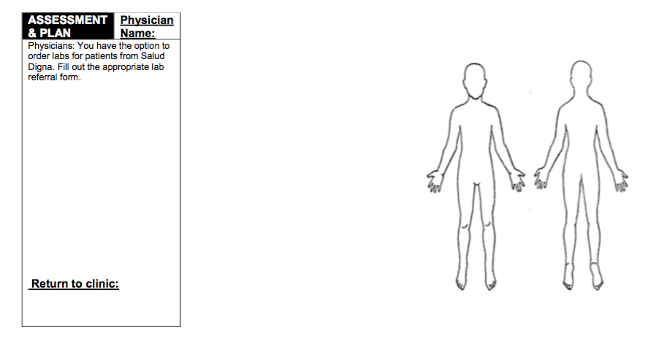
Notes:
(2)

Slide 9
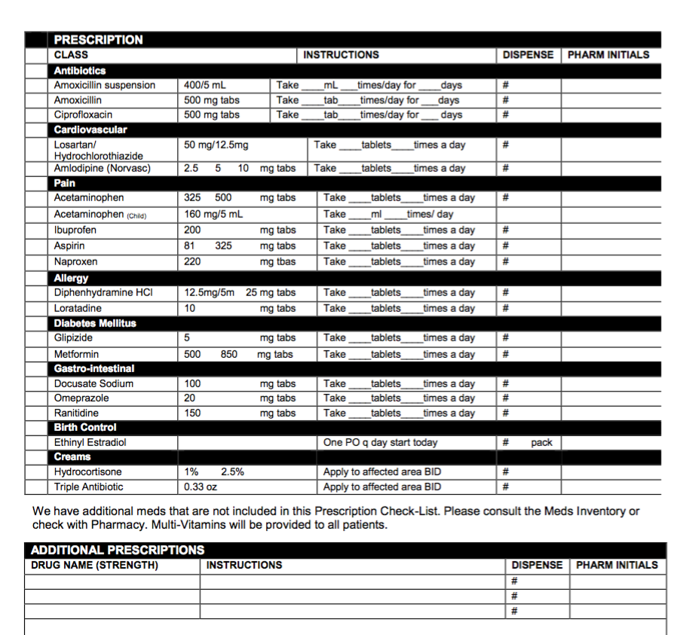
Notes:
the most commonly used medications are listed. anything else is written on the bottom of the sheet, with signature of approval from doctor.

Slide 10
III. Data Collection: Electronic Medical Records (EMR)
All physical files of our patients remain at our clinic in Colonia Margarita Moran.
A digital copy of all patient vitals are kept and constantly updated on our Google Drive.
Each month, an updated master list of all patients is downloaded onto a tablet, which we use to find files at clinic.

Slide 11
PERSONAL ID SYSTEM
A 1017 001
First letter of
last name
last identifier, determined by numerical order of other patients with the same last name
Month/Year of their first clinic (MMYY)

Slide 12
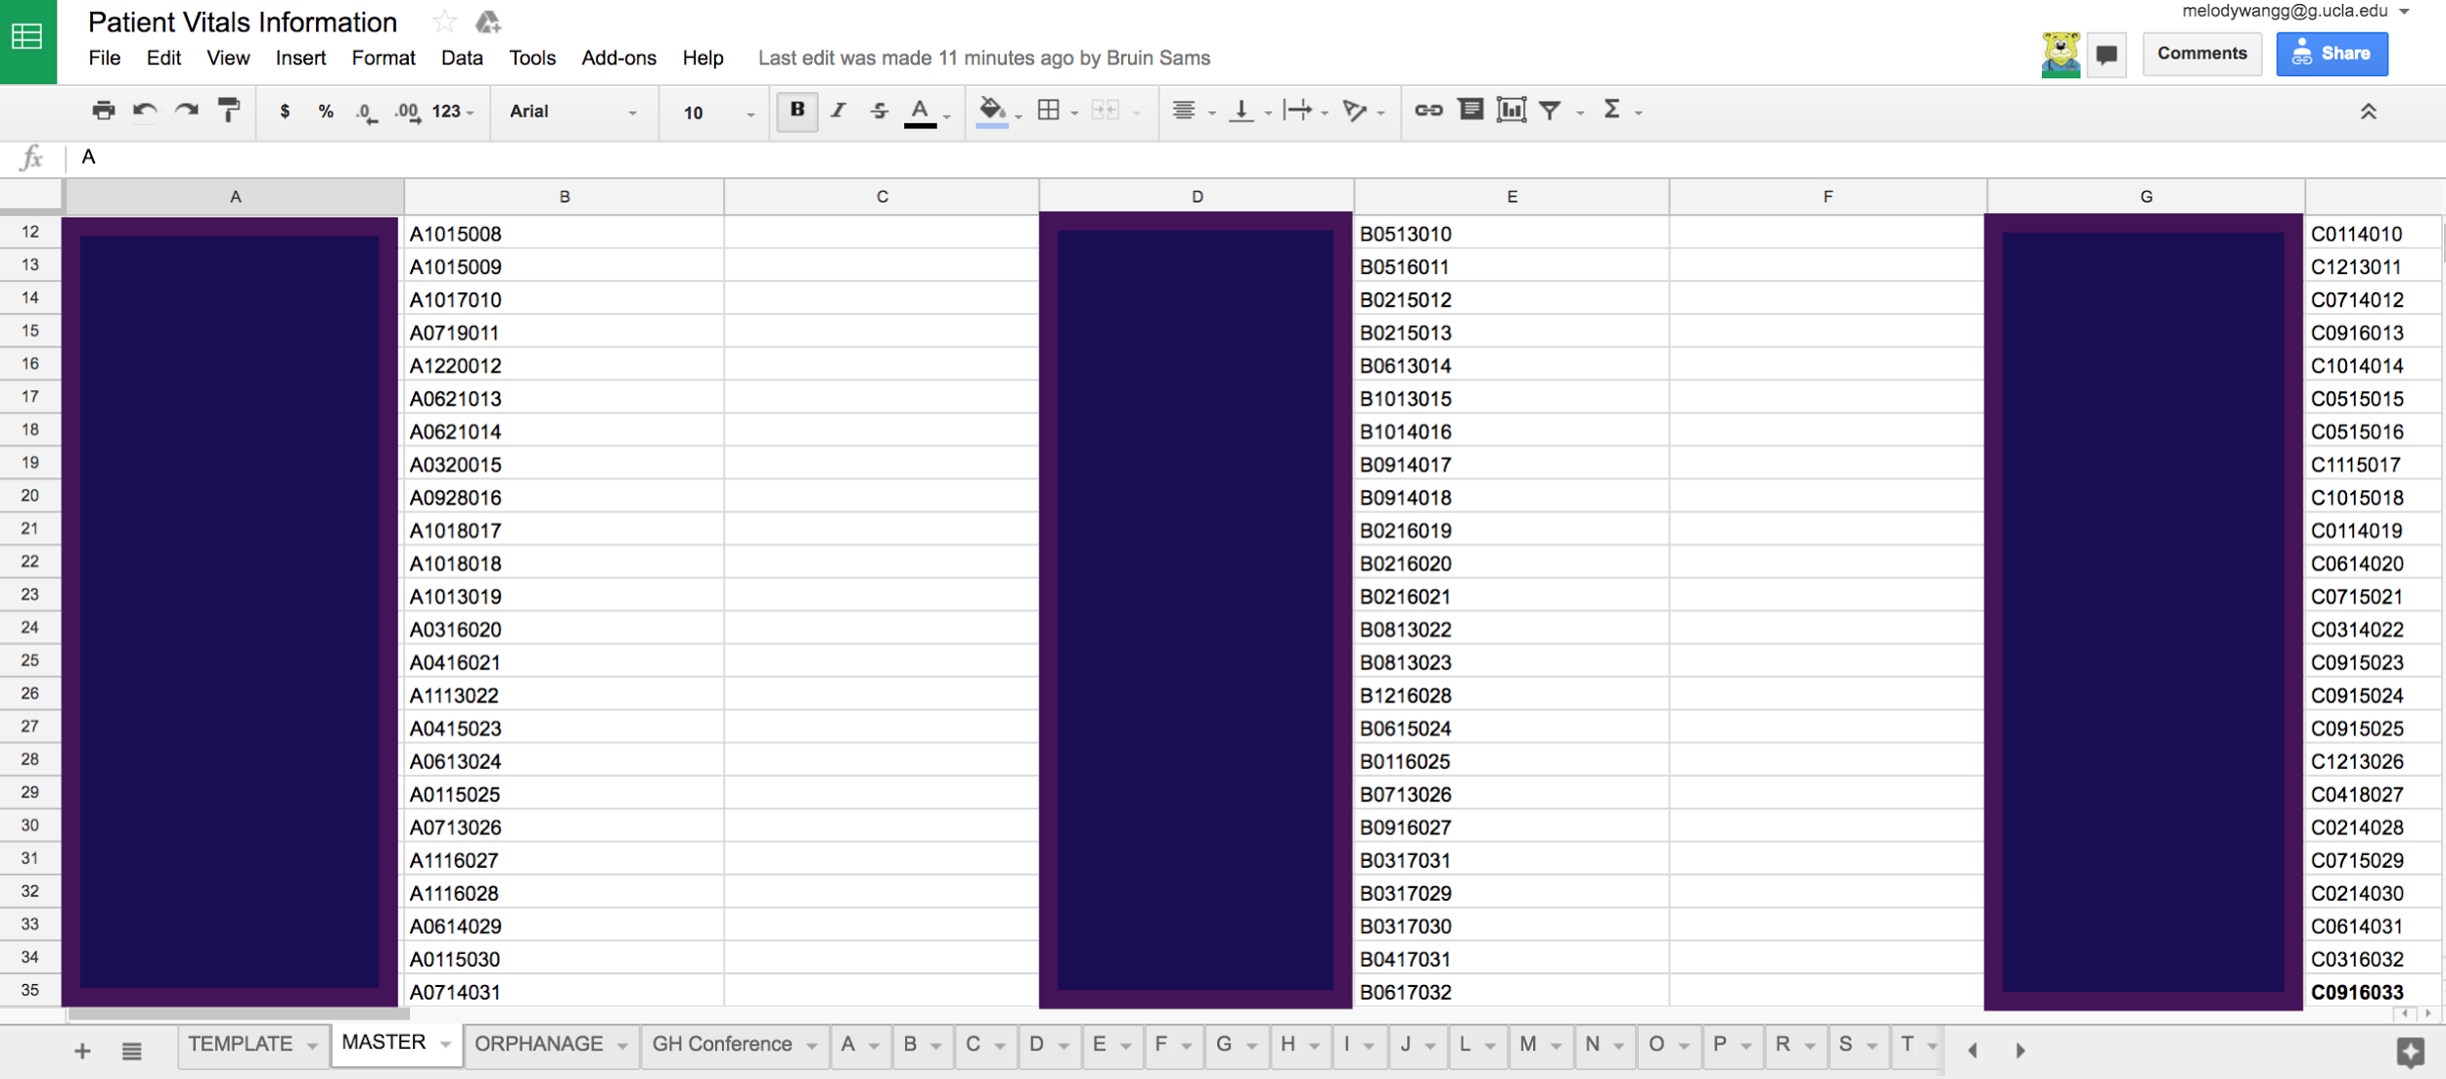
Notes:
names are blocked out due to patient confidentiality
This is our master list, which just has the patient name and ID number.
Each patient has designated ID number
For instance: A1015008: Patient has a last name starting with A, their first clinic was October of 2015, and they are the 8th patient we filed with an A last name.
Patients sign in, we find the name on our tablet, see the corresponding ID, and pull out the appropriate file.
On the bottom, you will also see tabs with individual letters. These pages go into more detail about the patient, i.e. birth date, weight, blood pressure, etc.

Slide 13
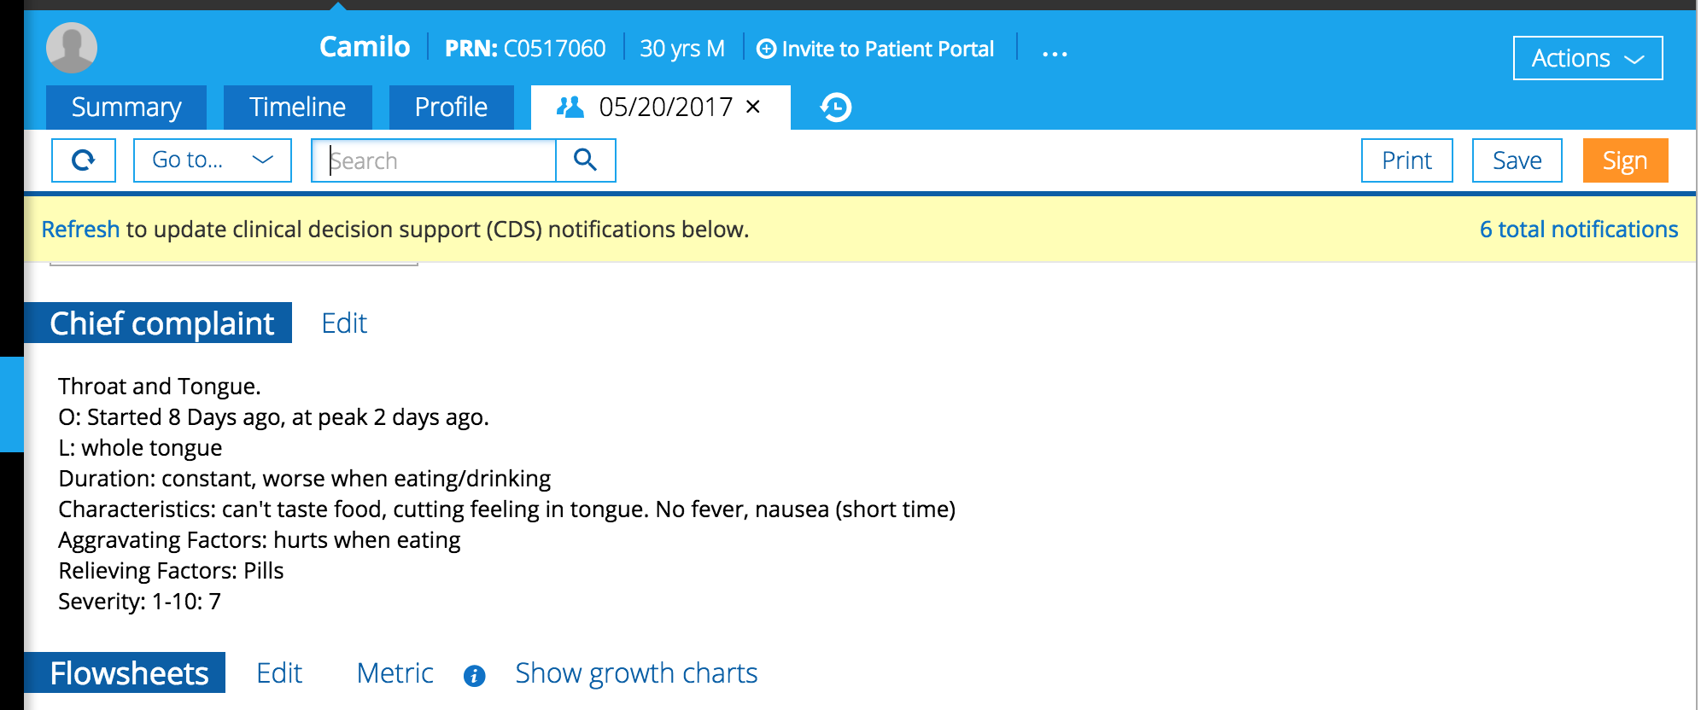
PatientFusion
Notes:
As you can see from our Google Docs masterlist, there wasn’t really an efficient way to insert all the information we had on our patient.
Our new mission this year is to adapt all of our files onto this new platform.
On top we have our patient, ID # and age. Each tab with a date will be for each individual clinic.
Here we have the cheif complaint. As you can see, our patient had issues with his throat.

Slide 14
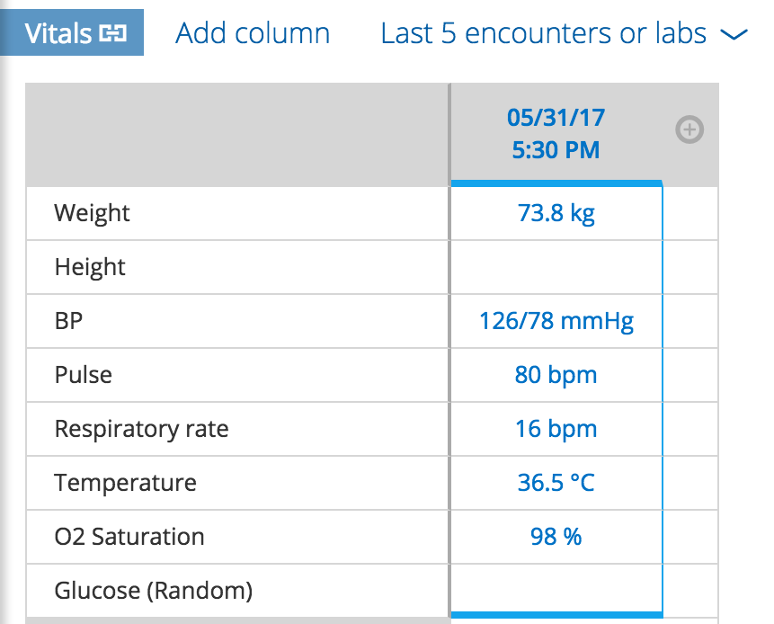

Slide 15
III. Data Collection: Surveys
From a Community Outreach perspective, we have also began surveying our population.
“How long does it take you to travel to our Flying Samaritans clinic? How do you travel to clinic?”
“Where do you acquire medication outside of clinic if needed?”
Notes:
our big ongoing project for public health is to provide a comprehensive list of services and specialties for patients if they have a certain condition that might need extra care we cannot provide.
at clinic, we will scout a variety of local pharmacies, clinics, and hospitals. we look these up in the internet or remember certain places we see on the road, but we have also began to ask the community for some recommendations.
other questions consist of asking our patients if they can recommend other services they know of.

Slide 16
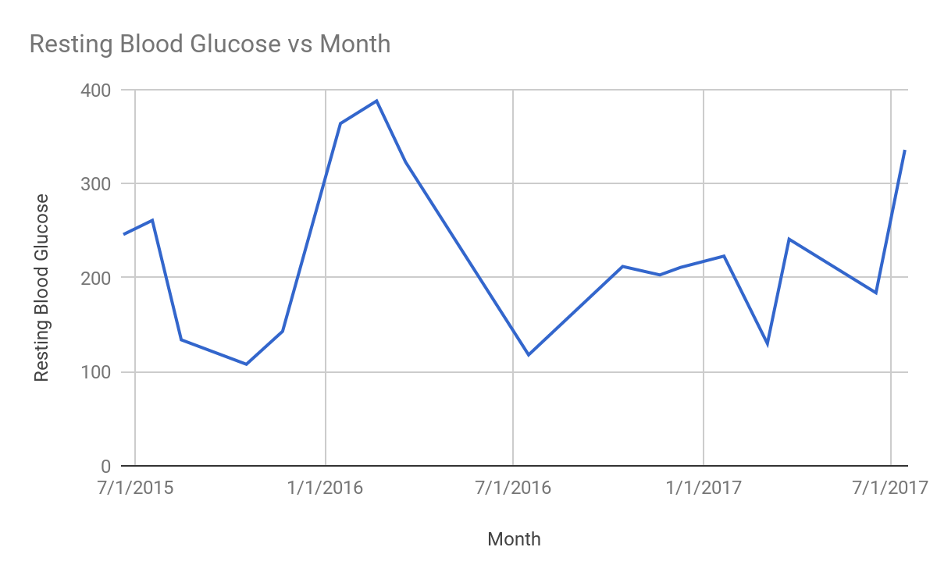
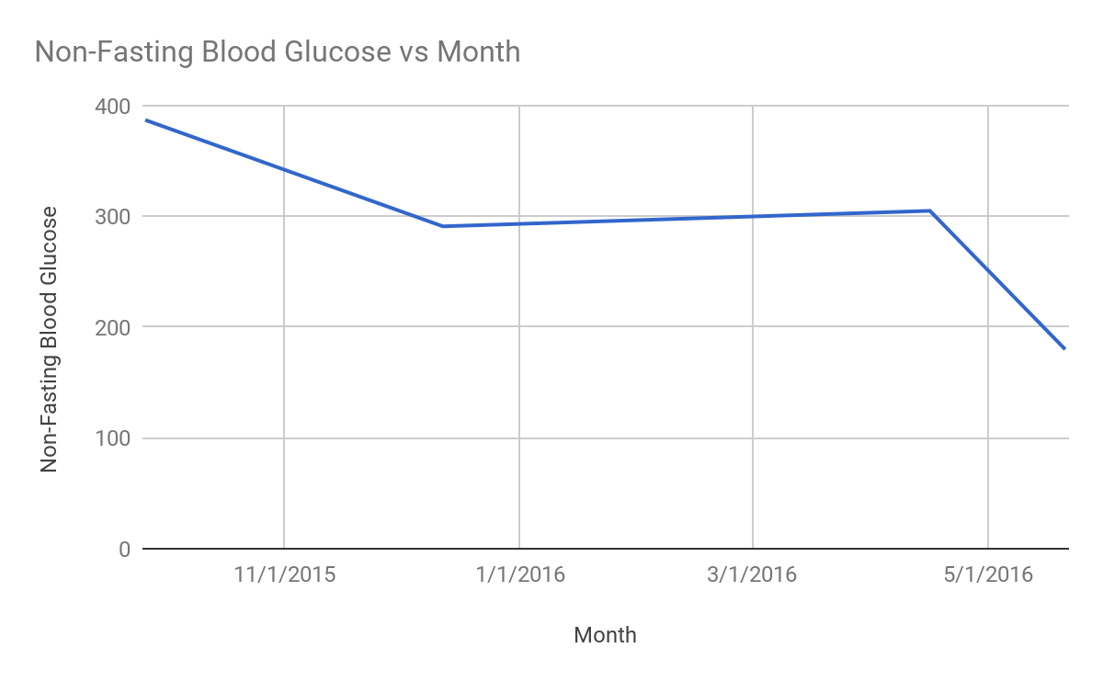
IV. The Power of Data: Transforming Individual Care
Tracking Diabetes
Blood Glucose
Notes:
We can use simple data collection in Google Sheets or Excel to visualize changes in a patient with chronic illness. For example, this patient has had type II DM since she started attending our clinic in 2015. Some factors that we can track are: Resting Blood Glucose, Fasting Blood Glucose, Body Weight, and Systolic/Diastolic BP. This patient is consistently on Metformin. During June and July Clinic, our doctors increased her dosage. However, based on her history, we know she is consistently out of the Resting Blood Glucose Level recommended by the American Diabetes Association, 70-130 mg/dL. Recommended Non-Fasting Blood Glucose for diabetics is less than 180 mg/dL.

Slide 17
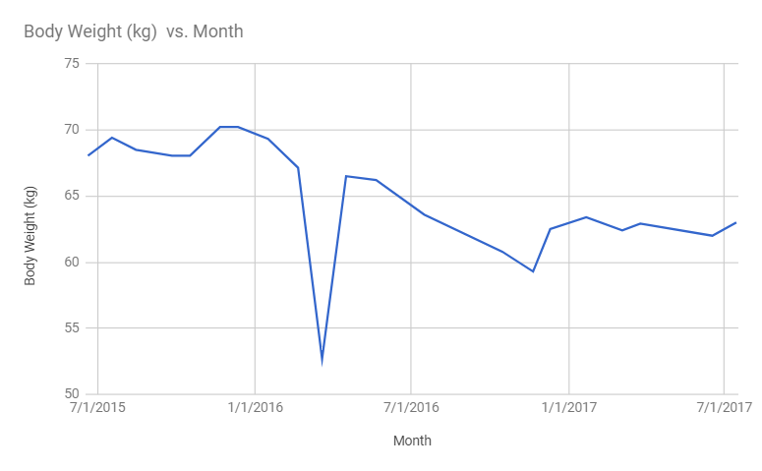
IV. The Power of Data: Transforming Individual Care
Tracking Diabetes
Blood Glucose
Body Weight
Patient is female and 162 cm, or 5 ft 2 in
Patient answered “none” or left blank exercise inquiries starting from December, 2016
Notes:
This patient is a woman who is 5”2’. From June 2015 to July 2017, her BMI dropped from approximately 27 to the border of 25/26 according to the American Diabetes Association BMI Calculator. However, this is still classified as overweight or the upper range of healthy weight. Additionally, the patient tells us that she does not exercise.
A healthy BMI range for this patient would be 102-136 lbs or 46-62 kg. She is hovering around the upper range of a healthy weight.
Note: The steep BW drop in March 2016 could be due to the patient’s complaint of abdominal pain during that visit.

Slide 18
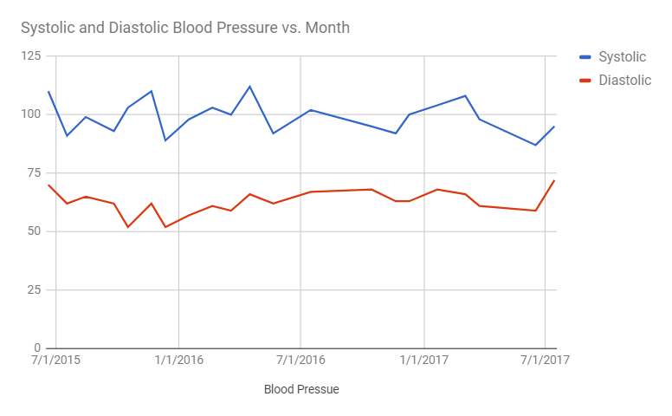
IV. The Power of Data: Transforming Individual Care
Tracking Diabetes
Blood Glucose
Body Weight
Systolic and Diastolic Blood Pressure
Patient age 47
Notes:
Mayo Clinic says “If you have chronic kidney disease, diabetes or coronary artery disease, your treatment goal is less than 140/90 mm Hg.” The patient is within this range; we know that hypertension is not an aggravating factor of her diabetes.

Slide 19
IV. The Power of Data: Transforming Individual Care
Notes:
Limited data and lack of continuity can still yield meaningful results. All we used to complete this analysis was an incomplete spreadsheet, pictured on this slide. The drawback of this method is that we have to take the time to manually record information into the computer from our paper files.

Slide 20
IV. The Power of Data: Transforming Individual Care
Example of post-visit consult for this Patient X (from IV, based off the graphs from slides 15-16)
Introduction: why are we introducing the post-visit consults? How will we approach patient about the consult?
Assure that patient health is taken care of after clinic visit.
Create personal connections with patients.
Step-by-step structure of patient consult
Compare
Reflect
Address
Feedback
Track

Slide 21
IV. The Power of Data: Transforming Individual Care
Comparing today’s appointment to previous months
Comparing current data to previous data allows us to discuss any unusual changes, negative or positive, and track down the overall progress.
Ask patient to self-reflect:
Allows the patient to reflect what changes were made that could have affected their goals
What healthy changes did you make this month? What unhealthy habits did you have trouble with? What do you wish you could change? What goals did you set for yourself and how do you plan on getting there?
Address the changes discussed with patients
Discuss the changes that were made with the patient
Consistent? Doable? Difficult?
Notes:
-Why integrate data into appointments? Advantages, disadvantages? How do we make this information accessible and easy to understand? With what attitude/tone/perspective will we discuss results?
-Crucial to integrate data into appointments in order to compare to past and future visits and track health progress. Graphs make this information easy to understand and make it easy to pinpoint drastic changes.
-Ask the patient to set concrete goals

Slide 22
IV. The Power of Data: Transforming Individual Care
Feedback and Advice
brainstorm concrete changes they can make to their daily ritual
discuss alternative changes if previous changes need to be altered
Goal Tracking
identify specific quantitative goals for next month
record healthy habit changes the patient will strive for until next visit.
write those changes in two places: (a) the goal tracking folder and (b) a slip the patient can take home

Slide 23
IV. The Power of Data: Transforming Individual Care
Logistics of post visit consults
Keeping goal-tracking sheets separately from patient files for easily visible continuity/access
No computer/printer: Use Computer to graph what you have; then leave space to pencil in stats yourself for the next few months.
Ethics/logistics/pros/cons of… (and how we address issues)
Doing these consults in the first place
Assigning these tasks to students or non-medical personnel
Coming up with goals they can realistically adhere to
Being respectful; not making them feel discouraged/attacked etc

Slide 24
IV. The Power of Data: Limitations
Diabetics need A1C tests or more frequent and explicit fasting/non-fasting glucose measures.
There are not measures every month.
Patient consultations can only be within the limits of local resources.

Slide 25
V. The Power of Data: Insights for Population Health
Monthly Illness Incidence (Table 4)
Purpose: Characterizing the most prevalent health issues in our population in a limited time
Pie Graph option
Bar graph option
Uses: Planning Health Education seminars, adjusting clinical inventory
Illness Incidence by different demographic factors (Table 5)
Examples of demographic factors to sort by: sex, family history, type of work, children/no children, etc
Notes:
EXAMPLE for B: Pie/bar graphs by sex.

Slide 26
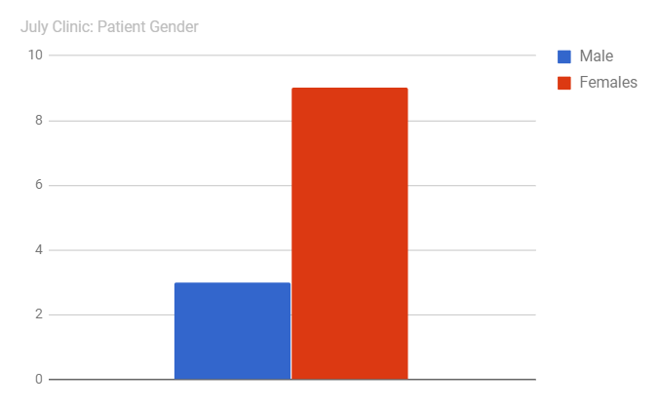
V. The Power of Data: Insights for Population Health
Why do we have more females coming to clinic than males? How can we address this?
Notes:
-Men are regularly too busy working an extensive amount of hours, depriving them from seeking medical attention, even though they need it as much as the women do. In fact, the few men that we see often come in with health complications/complaints caused by their job.

Slide 27
V. The Power of Data: Limitations
What creates “invisible” statistics?
Environmental & social factors affect patients’ decisions to attend clinic
I.e. proximity from home, daily business, children to care for
Patients may only visit doctor when condition reaches a “threshold of need”
Patients have differing degrees of self-efficacy, and may opt for self-care
Stigma attached to certain procedures or conditions
STD screening, drug/alcohol/smoking habits
Therefore, the ACTUAL incidence or prevalence of disease in any community is likely much higher than statistically reported.
Notes:
since we only come on Saturdays, we never receive regular Saturday workers
Threshold of need: Patient (including us) refrain from consulting professionals until our condition necessitates it. For example, We don’t visit the doctor for the common cold unless it becomes EXTREMELY inconvenient to our daily schedule, or when symptoms last longer or appear more strongly than usual. In the context of our clinic, we have patients coming in with back pain that has “lasted for xxx years find specific examples”, indicating that there are many factors that delay their decision to seek treatment: environmental or social factors mentioned above, for example, that override the patient’s decision to come in until the pain is unbearable, per say.
Social stigma: (Cite statistic). STD screenings, women or men may neglect their suspicions out of fear, whether it’s fear of being labelled or being seen attending an appointment. Stigma attached to drug/alc/smoking habits that affect our statistical reporting. For example, parents who bring their children into the triage room, as is common, may report habits differently. Even those who arrive at clinic alone may distort their actual habits due to personal bia.

Slide 28
VI: Global Health Ethics: Common Scenarios
Should we screen for depression if we cannot offer consistent counseling services or continuity?
How can we help our patients who face domestic violence or sexual assault? Where would we send them for support and what kind of law enforcement could we contact?
Should we screen for breast, skin, etc... cancer if we cannot offer the patient biopsy services and cancer treatment?
Is it unethical to use expired medications if research supports their lasting efficacy?
Notes:
We are strengthening our referral system to address these problem through our new Public Health Committee. We would also like to train some of the community members to monitor blood glucose or identify abuse while we are not there. We would also love to incorporate some community members into our Board of Directors.

Slide 29
VI: Global Health Ethics: Boundaries of Undergraduate Involvement
Students are required to introduce themselves as simply students, not medical providers. Patients sign waivers consenting to undergo patient intake by students.
Only undergraduate nursing students or EMT-licensed undergraduates are allowed to take patient vitals.
Prescriptions are filled by undergraduates with physician supervision.

Slide 30
VI: Global Health Ethics: Boundaries of Undergraduate Involvement
Students DO NOT give any affective indications (ex: worry, despair) during patient intake.
Students DO NOT perform patient physicals or diagnosis.
Students are required to be HIPAA certified to interview patients.
Students are required to have up-to-date vaccinations.
Students must pass a written and oral exam on appropriate patient intake techniques before they attend clinic.

Slide 31
VI: Global Health Ethics: Social Justice Over Charity
Social Justice: Promoting a just society by challenging injustice and valuing diversity
Equality in access to and quality of health care
The right to health for everyone
II. How does Flying Samaritans at UCLA promote Social Justice?
We see the Community of Colonia Margarita Moran as a partner instead of a recipient
We try to implement indirect service, advocacy, social action rather than direct service (like providing food).
We promote empowerment rather than dependence.
We promote social change instead of the status quo.

Slide 32
VII: Cultural Competency: Health Care and Health Education
Student volunteers receive a cultural competency crash course before they can attend clinic
Look patient in the eye, even when using a translator
Be aware of the Catholicism in the community. Be effective but not offensive.
Do not impose judgement on unfamiliar behaviors or homeopathic medicine.
Equipping our doctors
Notes:
Our new project is to give our doctors a “Crash Course” as well, which will include all of the resources in the clinic and a characterization of the community. Some of our doctors are vocal about being shocked by the poverty in the community which is not appropriate. They also try to make referrals to resources we cannot guarantee and prescribe medications that we do not have without consideration of alternatives that we could provide for free.

Slide 33
VII: Cultural Competency: Health Care and Health Education
Health education programs are community-focused
Train English-speaking Health Education Committee members to present in Spanish
Use Public Health Committee data on food at local markets to tailor diabetes and lifestyle medicine presentations
Focuses on physical activity that can be done without rooms, green spaces, or gyms
Does rather than tells
We are still learning!
Educated about Zika virus when the risk to our population was minor
Recently presented on hygiene using hand washing techniques under running water
Notes:
Our new project is to give our doctors a “Crash Course” as well, which will include all of the resources in the clinic and a characterization of the community. Some of our doctors are vocal about being shocked by the poverty in the community which is not appropriate. They also try to make referrals to resources we cannot guarantee and prescribe medications that we do not have without consideration of alternatives that we could provide for free.

Slide 34
Citations
Figueroa-Lara, Alejandro, Miguel Angel Gonzalez-Block, and Jose Alarcon-Irigoyen. "Medical Expenditure for Chronic Diseases in Mexico: The Case of Selected Diagnoses Treated by the Largest Care Providers." PLOS ONE. Public Library of Science, 8 Jan. 2016. Web. 28 July 2017.

