Slide 1
Development and Implementation of a Hypertension Program: Outcomes and Lessons Learned in Rural Nicaragua
Jennifer Lee, DO, MPH

Slide 2
Objectives
Learn strategies for program planning and development in LMICs.
Learn about the challenges of program implementation in Nicaragua
Learn about program outcomes and process evaluation that will guide future program improvements.
Discuss outcomes of the Hypertension program

Slide 3
University of South Carolina Global Health Fellowship

Slide 4
Introduction
Jan - Mar
2017:
Gather Data/Relationship Building
Aug – Nov
2017:
Implement
Feb 2018:
Evaluate
Aug
2016:
Establish/Scope
Notes:
I spent 6 months in Nicaragua as a part of my global health fellowship at UofSC where we already had a partnership with OneWorld Health which is a non-profit organization with the mission of creating medical facilities that will be operated by locals.

Slide 5
Considerations Before Starting a Program
Don’t recreate the wheel: What has been done before / Proven to work?

Slide 6
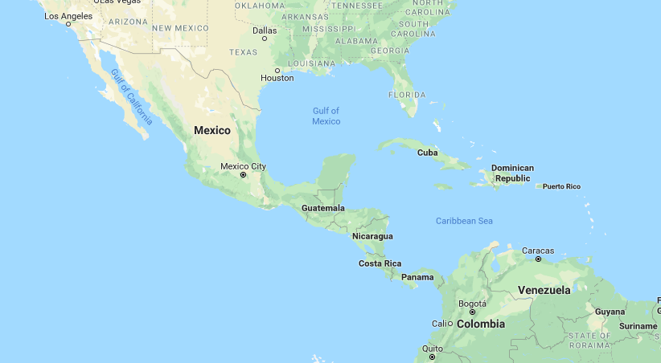
2) Determine support at home and abroad: In-country or host relationship established / viable?
OneWorld Health in Nicaragua
Notes:
Determine your support at home and abroad. How much time will you have to travel? Do you have residents or medical students who would be willing to travel and work with you? The distance component of global health research and interventions can’t be understated! In-country resources are necessary in order to be effective and also to avoid potentially insurmountable barriers when it comes to governmental regulations. You want to maintain good relationships and not hurt any ties.

Slide 7
3) Define your mission / goal: Does your mission align with your partnering organization?
Quality
Service
Education
Notes:
The mission statement of OWH is: “Our vision is to empower communities to achieve long-term improvements in health and quality of life through sustainable healthcare.
It was important for OWH to be known as providing high-quality healthcare. Their reputation for having high-quality laboratory services was a large portion of their business.
On the other hand, their in-office pharmacy had a reputation of running out of medications. Could we correct this with our program?
Education is a key component for health behavior change.

Slide 8
Program Planning
Jan - Mar
2017:
Gather Data/Relationship Building
Aug – Nov
2017:
Implement
Feb 2018:
Evaluate
Aug
2016:
Establish/Scope
Notes:
The actual planning phase occurred between March and August after looking at the data that we had collected (basically a needs assessment).

Slide 9
Program Examples
You’ve seen programs before:
Health Promotion Programs and Quality Improvement Initiatives
Diabetes Prevention Program (DPP)
Antibioitic Resistance Initiative
How can you design one that works? PLANNING IS KEY!
Notes:
Antibiotic Resistance Initiative: https://www.cdc.gov/drugresistance/solutions-initiative/antibiotic-stewardship.html

Slide 10
Program Planning can get COMPLICATED.

Slide 11
Program Planning
PUBLIC POLICY
national, state, local laws
Big picture first.
COMMUNITY
relationships among organizations
My Favorites:
Health Belief Model
*Social Ecological Model
Social Cognitive Theory
ORGANIZATIONAL
organizations, social institutions
INTERPERSONAL
family, friends, social networks
INDIVIDUAL
knowledge, attitude, skills
Notes:
When thinking about program planning, it helps to remember the big picture of how the individual functions within society. This is an illustration of the social ecological model, which I think is a great place to start when thinking about how your program in going to create change. Where do you want the emphasis of your program to be?

Slide 12
Program Planning
2. Get your bearings by utilizing a framework. Or, create objectives and deliverables based upon your goal.
Notes:
Since I did not know about these frameworks when I first began the Hypertension Program, I made my outcomes based upon what the CDC said should occur if we followed their recommendations and what the goals of OWH were, which is that hypertension would be better controlled and people would continue to stay in the program and receive higher quality healthcare. Also, not only did I want behavior to change, I also wanted to have data that I could collect.

Slide 13
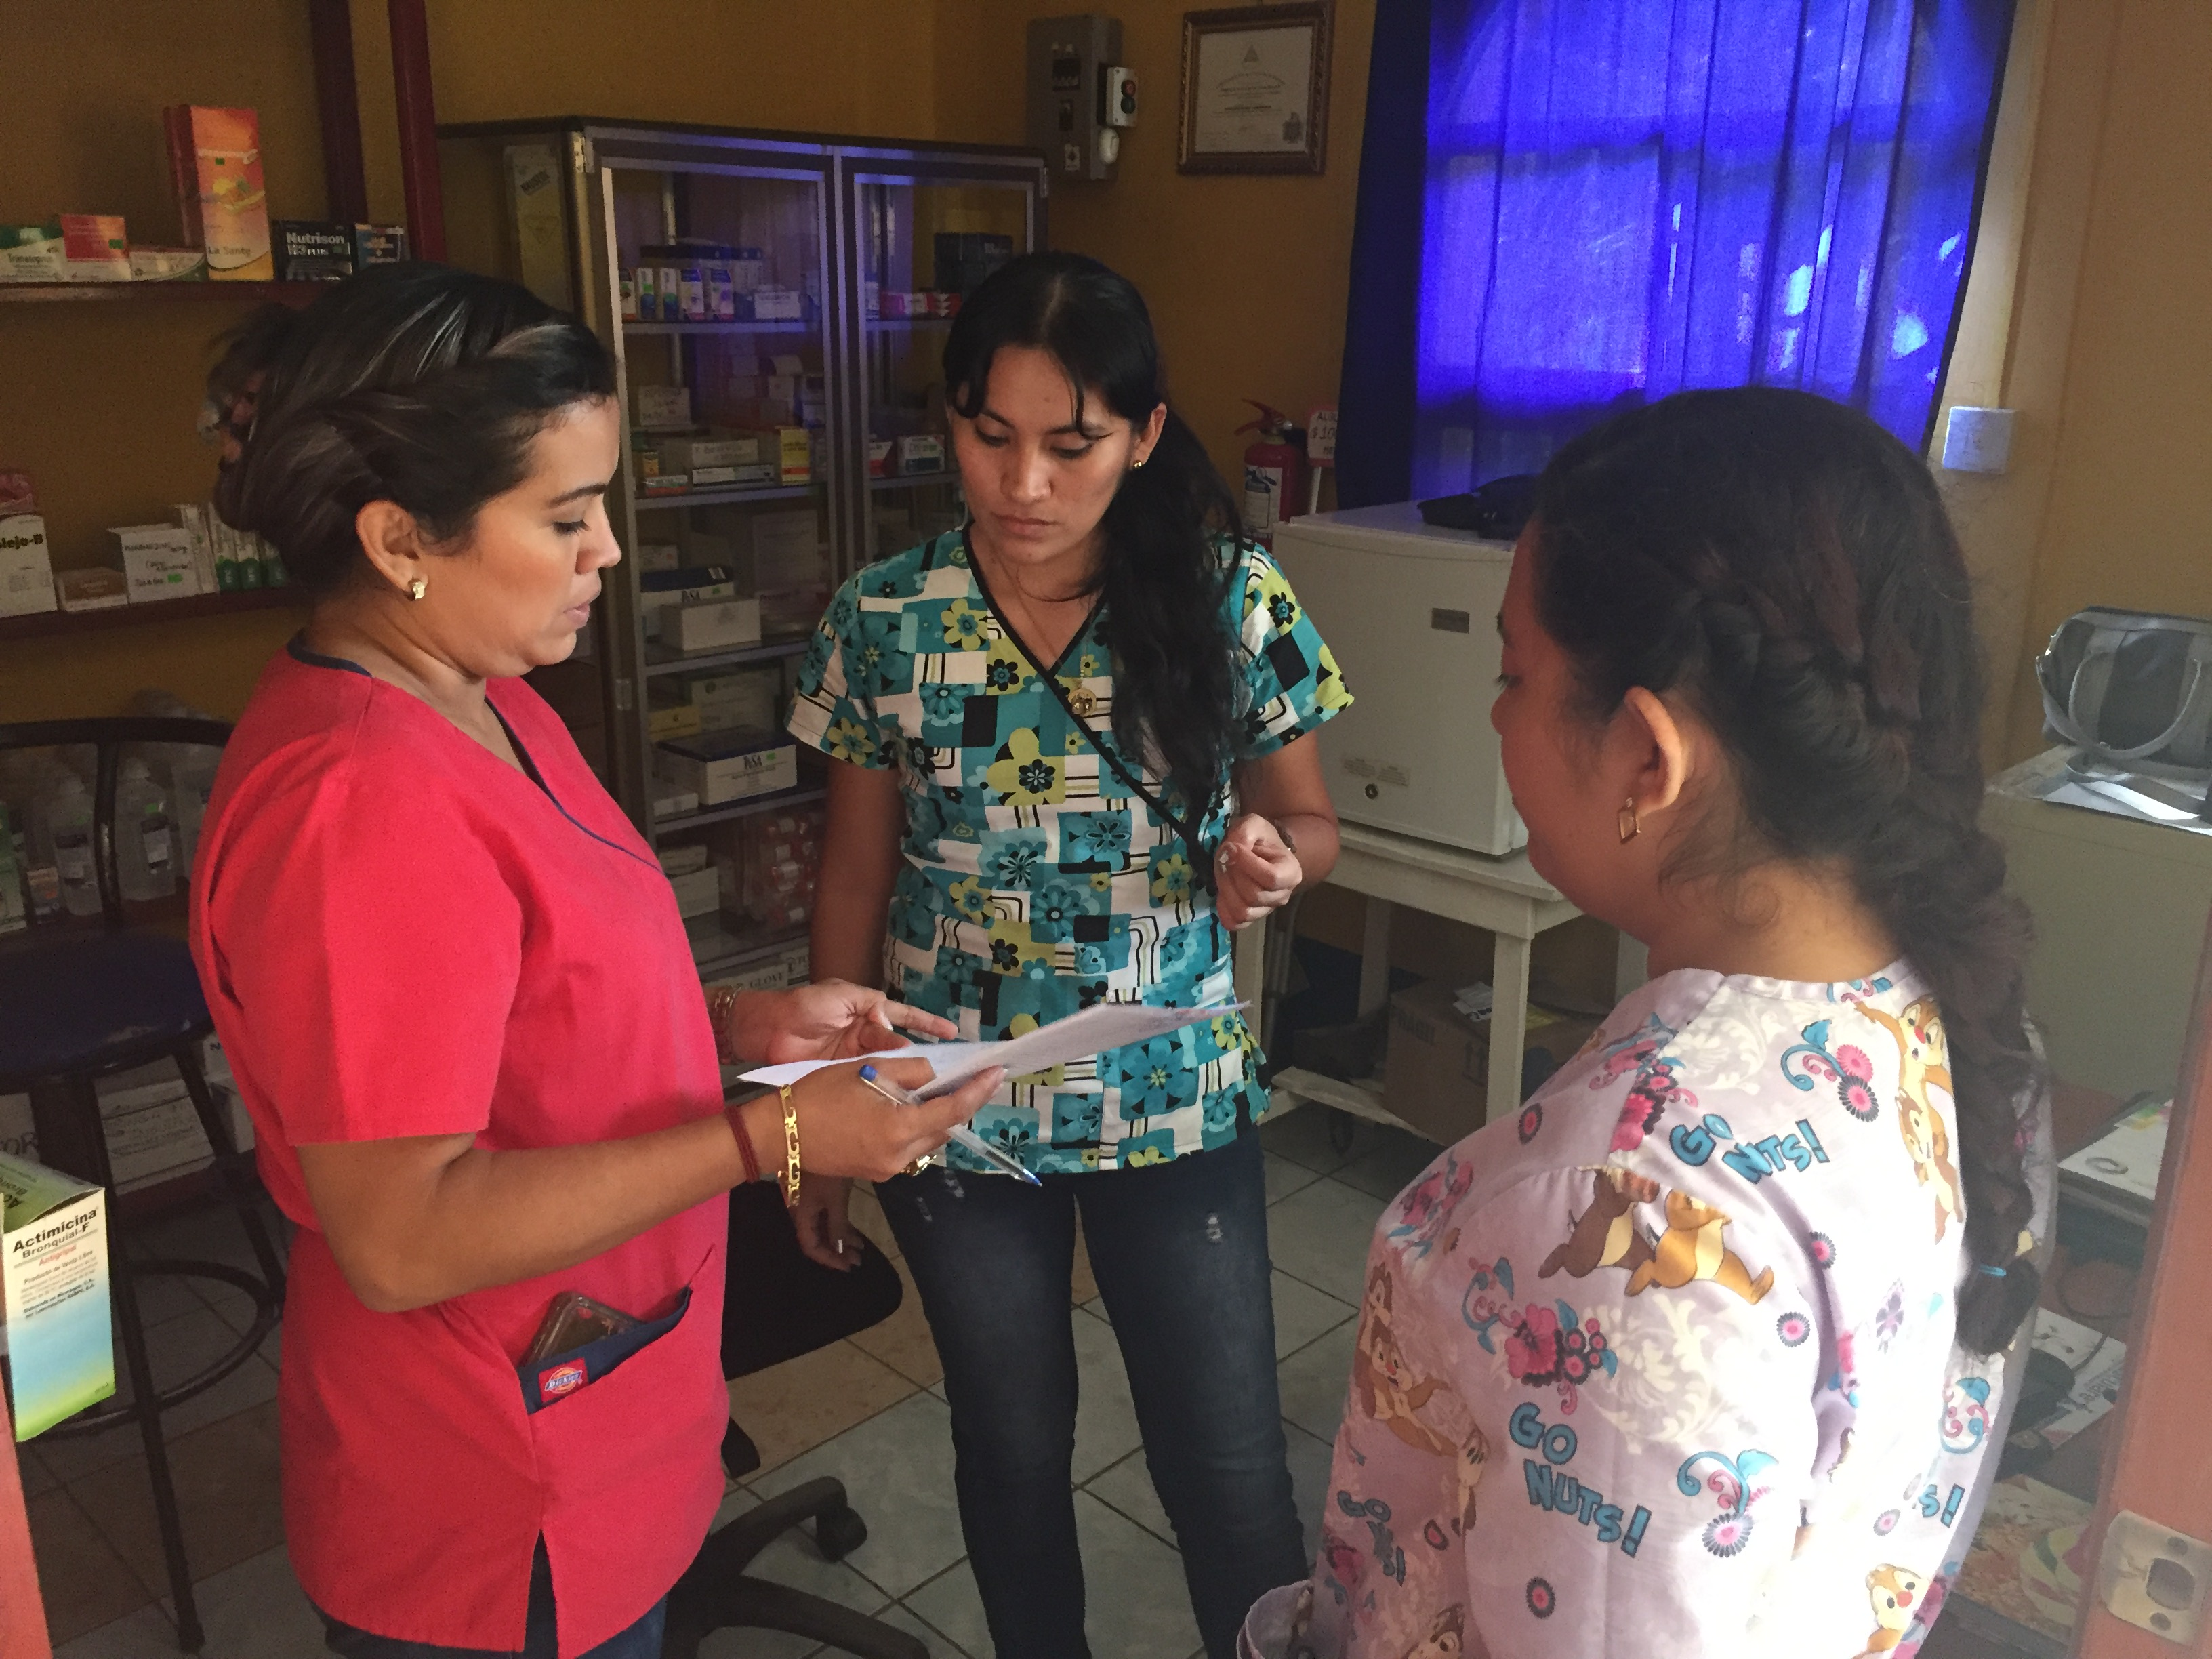
Program Planning
3. Barriers to target
Key informants
Organizational concerns
Surveys
Gathering data
Notes:
In Nicaragua, I identified key informants (a clinic nurse, the regional director) and administered surveys. The organization let me know what problems they were having. I gathered information from as many different “levels” as I could.
I asked questions like “Why are we always short on hypertension medications? What guidelines are the physicians following to diagnose hypertension? What are the beliefs of the patients about hypertension? How are we keeping records of who has hypertension?”
These can all become individual steps within themselves. My goal here is to help you get a roadmap in front of you and start aiming in that direction.

Slide 14
Program Planning: Highlights Between Here and Away
Many miles to cover = lots of time = potentially costly mistakes
Even more limited resources
Distance is difficult
Cultural differences
Extra effort toward preparation/explanation when others join your team

Slide 15
Jan - Mar
2017:
Gather Data/Relationship Building
Aug – Nov
2017:
Implement
Feb 2018:
Evaluate
Aug
2016:
Establish/Scope

Slide 16
Challenges You Might Face
Resistance to change
Develop relationships with gatekeepers to the community
Be genuine and listen - figure out why
- Limited resources
- Be creative and resourceful
- Try to plan for problems in advance: proofread!
- Lost in Translation
- PROOFREAD. Run it by as many eyes as you can at home and abroad.
- Delayed feedback
- Find a communication champion
- Developing useful materials
Notes:
Resistance to change - ex: physician was reluctant to give input
Limited resources - printer was down the street and around the corner
Lost in Translation

Slide 17
Program Evaluation
By data collection in February, 52 patients were enrolled.
Upon enrollment, 39% of patients were not at their goal for hypertension.
Initial follow up was good.
87% of patients who were initially enrolled in the program followed up for their first follow-up appointment with the pharmacist.
15.6% of patients dropped out of the program.

Slide 18
Program Evaluation
Questions to ask in Evaluation:
How does/do the community/individual patients feel about the program?
What feedback can you get about the successes/challenges and next steps?

Slide 19
Program Outcomes
Over 5 months…
The average number of follow up visits was 4.6.
85% (n=44) of patients who were enrolled attended 2 or more visits

Slide 20
Hypertension Policy Recommendations
(1) Incorporate Hypertension Registry training with new physician hires during orientation, including a simulated encounter.
(2) Reconcile differences between Hypertension Registry hypertension goals with MINSA guidelines that the physician may have previously used.
(3) Quarterly inquiry about the Hypertension Registry by the Medical Director of the Physician and Pharmacist for official reports of any problems.

Slide 21
Main Points
-Don’t do extra work – see what has been done before
-Do as much as you can to understand your target population’s needs and barriers.
-Relationships are everything.
-Be open to suggestions and change. Evaluate and revise your materials.

Slide 22
© 2018 American Academy of Family Physicians. All rights reserved.
All materials/content herein are protected by copyright and are for the sole, personal use of the user.
No part of the materials/content may be copied, duplicated, distributed or retransmitted
in any form or medium without the prior permission of the applicable copyright owner.

