Slide 1
Implementing SBIRT: An Evidence-Based Protocol for Addressing Substance Use
December 2, 2017
Duke/SR-AHEC

Slide 2
Disclosures
This project is funded by a grant from SAMHSA/CSAT

Slide 3
AGENDA
Introduce SBIRT
Learn SBIRT screening protocol
Review teaching strategies
Discuss implementation strategies

Slide 4
SBIRT History
1980
Meanwhile,
Addiction is not a moral failure. It’s a disease.
I found something. I’ll call it SBIRT.
SBIRT seems to work really well for alcohol problems!
We need to treat the broad spectrum of addiction using public health strategies.

Slide 5
Federal Programs
2003-Present
2015-2018
SBIRT cuts down alcohol and drug use.
Let’s see if it works in different settings.
We want to train a variety of medical professionals.

Slide 6
DUKE/SRAHEC Program
Multiple universities
Various Disciplines
Medicine
Pharmacy
Nursing
Mental health
Public health
Physical therapy
Train the Trainer model
Consultants:
Baylor College of Medicine
SAMHSA/CSAT
NC Governor’s Institute

Slide 7
SBIRT PROTOCOL

Slide 8
Structure
Screening
Content, video, practice
Brief Intervention
Content, video, practice
Referral to Treatment
Content, practice

Slide 9
SCREENING

Slide 10
Three-Step Process
STEP 1: Three questions
STEP 2: Quantity/frequency & screening tool (AUDIT or DAST)
STEP 3: Feedback on results

Slide 11
STEP 1: Three Questions
Do you smoke or use other tobacco products?
How many times in the last 12 months have you had 5 or more drinks (men) or 4 or more drinks (women) in a day?
How many times in the past year have you used an illegal drug or used a prescription medication for non-medical reasons

Slide 12
Initial Screening: Negative
If screening result is negative, then give a reinforcing prevention message:
“Based on your screening score you do not use tobacco or drugs, and if you drink you do so within healthy limits. Your alcohol and drug use is at a healthy level.
Please feel free to talk to me if you or a family member ever needs assistance or has questions about alcohol, tobacco, or drug use and your health.”

Slide 13
Initial Screening: Positive
Positive screening result?
Then use a full screening tool.
Screened positive for | Screening instrument
Alcohol | AUDIT
Drugs | DAST
Drugs and/or Alcohol (adolescents only) | CRAFFT
Tobacco | Quantity & Frequency Questions

Slide 14
STEP 2: Quantity and Frequency
What do you use?
How much?
How often?

Slide 15
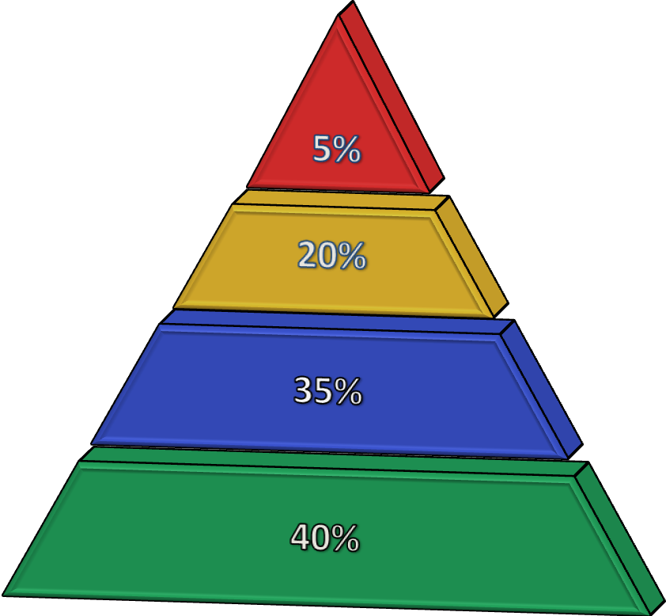
STEP 2: The AUDIT
What is it?
Strengths and Limitations
Dependent Use (20+)
Abuse/Harmful Use (16‒19)
At-Risk Use (8‒15)
Low Risk (0‒7)

Slide 16
STEP 2: The DAST
What is it?
Strengths and Limitations
High Risk (6+)
Abuse/Harmful Use (3‒5)
Hazardous Use (1‒2)
Abstainers (0)

Slide 17
STEP 3: Feedback & Results
Provide non-judgmental feedback
“Thank you for answering the questions”
“Based on your answers, you scored a [ ], meaning that your substance use is at a level that could cause harm to your health.”
Connect substance use to current health concern
“What we know about cocaine use and high blood pressure is …”
Ask permission to continue discussion
“Is it alright if we talk a little more about your alcohol use?”

Slide 18
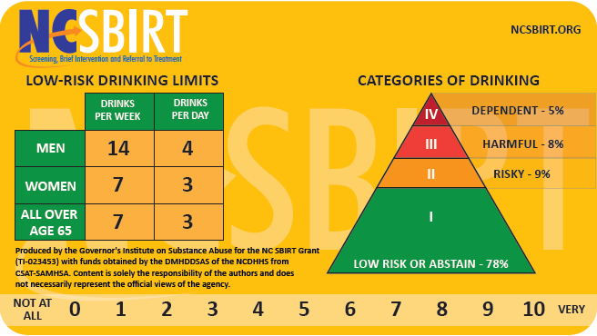

Slide 19
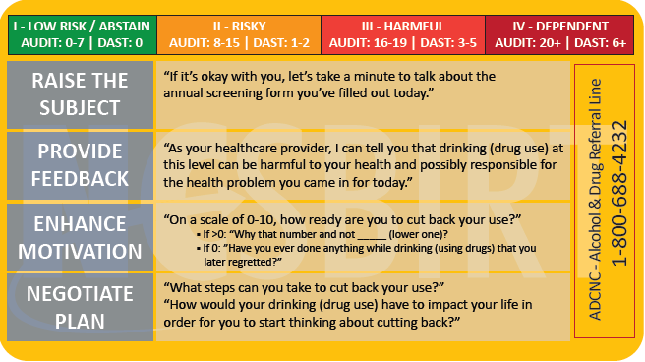

Slide 20
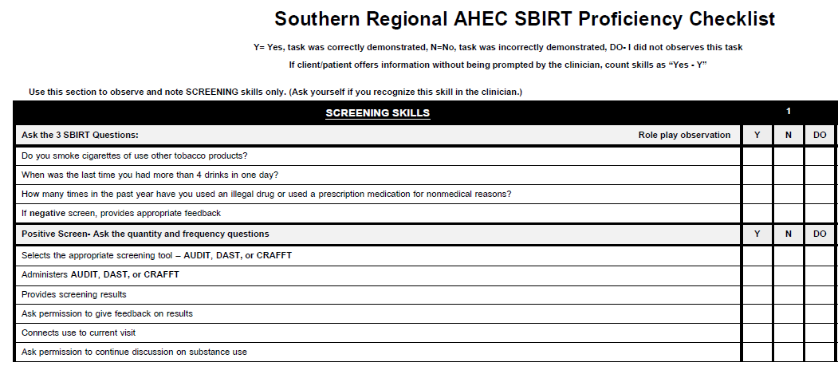

Slide 21
VIDEO
https://youtu.be/6P9kUl9yy7o

Slide 22
Practice
Clinician: Alcohol Screening Case
Patient: Alcohol Screening Case
Observer: Checklist

Slide 23
CURRICULUM

Slide 24
Train the Trainer
STUDENT
1h module
2h workshop
1h module
CHAMPION
2h workshop
2h addiction medicine
2h motivational interviewing
2h pedagogy

Slide 25
Observation & Feedback
VIDEO
Discipline-specific
Watch before practice
Teach ideal performance
LIVE OBSERVATION
Based on checklist
Feedback during student workshop
Duke/SRAHEC: observe in clinic and provide feedback

Slide 26
Adobe Captivate Presentation

Slide 27
Camtasia Presentation

Slide 28
Notes:
Pick a volunteer from the audience.
Ask them to describe the picture as best they can.
While they are describing it, make a mental note to do the following when they are finished describing it:
Ask how well they did describing it, let them answer.
Reinforce what they did well in their description
Correct what they didn’t do well
Ask them how they could learn to do it better in the future (e.g. take an art history course, learn how to read x-rays, etc.)

Slide 29
ARCH Feedback Model
Ask
Reinforce
Correct
Help
Developed by Dennis Baker, Ph.D. and Gregory Turner, Ph.D. @FSU

Slide 30
Student
https://youtu.be/9ROGM0azpMk

Slide 31
How did he do?
Ask
Reinforce
Correct
Help

Slide 32
Supervisor
https://youtu.be/_Ax8230ySRA

Slide 33
IMPLEMENTATION

Slide 34
Process
Large family medicine center
Students, residents, interns
Implementation committee:
clinic manager,
nurse manager,
clinical information manager,
behavioral health director
Steps:
1. Train all students and staff
2. Develop clinical documentation
3. Establish screening protocol
4. Develop referral process
5. Maintain treatment fidelity
6. Evaluate outcomes and improve quality

Slide 35
Process
Screening
65% of all new patients or wellness visits
Brief intervention
13% receive feedback

Slide 36
http://www.southernregionalahec.org/sbirttool/index.html

Slide 37
Lessons Learned
Many hands = light work + buy-in
Slow & steady wins the race
Evaluation: iterative process
Model fidelity is key

Slide 38
OUTCOMES

Slide 39
Participation
Students: 1801
Champions: 99
Universities: 6
Disciplines
Mental health: 172
Medicine: 375
Nursing: 299
Social work: 814
Other: 141

Slide 40
Outcomes
Satisfaction:
85% were still “Satisfied” with training even after 30 days
Knowledge: significant increase
“Which of the following substances do most people (male and female) use?”
Attitudes: significant increase
“Patients with substance use disorders can recover with appropriate treatment”

Slide 41
CHALLENGES AND NEXT STEPS

Slide 42
Challenges
Adaptation for non-medical disciplines
Positive response
Created videos
Allowed Champions to adapt
Implementation:
Data is king!
Long process
Skill attrition

Slide 43
Next Steps
Model fidelity
Chart audit
Feedback
Live observation
CRAFFT 2.0
Longitudinal evaluation
12 month f/u
Opioid curriculum

Slide 44
OPIOID EPIDEMIC
13,000 deaths in NC since 1999
NC dispenses 10 million prescriptions every year (one bottle for each man, woman, and child)
Prescription use can lead to heroin and fentanyl use
Heroin use increases risk of HIV and Hep C

Slide 45
Presenters
Matt Martin, PhD
mpmarti6@asu.edu

Slide 46
Please evaluate this presentation using the conference mobile app! Simply click on the "clipboard" icon on the presentation page.

