Slide 1
Using Clinical Competency Committee Tools for Resident Involvement in Their Own Progression Towards Competency
Rebecca Render, DO
Department of Family Medicine Chair, Clinical Competency Committee Core Faculty, Napa-Solano Family Medicine Residency Program
STFM - May 6, 2017
Notes:
Introduce yourself.
New program, about to graduate first class, whoot whoot!
Wanted a fresh way to use the CCC, not just to review residents and their academic progress, but use our committee to reach each resident to evaluate and help themselves.

Slide 2
Disclosures
None apply.

Slide 3
Goals and Objectives
Define the CCC and the role in motivating residents to move toward professional progress and graduation.
Utilize ILPs (Individual Learning Plan) for career planning and evaluating academic progress.
Utilize self-assessments as a tool for faculty to monitor resident wellness and residents to self-reflect on their own professional progress.

Slide 4
What is the CCC?
A review committee to evaluate resident progress, and give feedback to advisors, while keeping residents on track to graduate. The committee discusses and implements educational programs and evaluation tools for resident use.
How are we a “motivating” committee?
Utilize our advisors to be our resident advocate and motivator
Use our tools to help establish self-motivation within our residents—yielding adult learners/life-long learners.
Notes:
Historically, the CCC has been used to monitor resident progress and intervene when necessary. Our committee decided that all residents would be given the same attention whether in jeopardy or not. All residents would have an ILP each review and an action plan for improvement.

Slide 5
What are these tools?
CCC Orientation
ILP (Individual Learning Plan)
Self-Assessments
Notes:
Show forms as pop up after each bullet.
Have orientation binder as example and then show slide at the end with imbedded files to take home.

Slide 6
CCC Orientation
A way to set the stage with each resident.
Go over advising vs mentoring
Core Competencies
Patient Care, Interpersonal & Communication Skills, Professionalism, Medical Knowledge, Systems Based Practice, Practice-Based Learning
Milestones: levels 1-5
Define the review process
Reiterate, not punitive. Goal to utilize CCC, advisor and review process for professional growth and development.
Notes:
Have CCC orientation binder example and okay to imbed it or google doc downloadable for them.
How many of you had CCC orientation in residency?
Anyone know that you even had a CCC or that you were being reviewed? I did not. Had a check in with my program director once and with my advisor at random, but not to discuss how to “progress” as a resident.
Advisor is a set person—meet quarterly at minimum, your academic counselor, advocate, facilitator. Mentors you get to choose depending on interests.
Thought of changing this, but truly this has worked well for us. The advisor can be a mentor two, but they are not one and the same.
Milestones- help explain that this is no longer a grade, it’s a process. No one should start out as a 5 as an intern… no way to show improvement.
Review process- timing, goals and f/u with advisor. If resident does become in jeopardy, what should they expect.

Slide 7
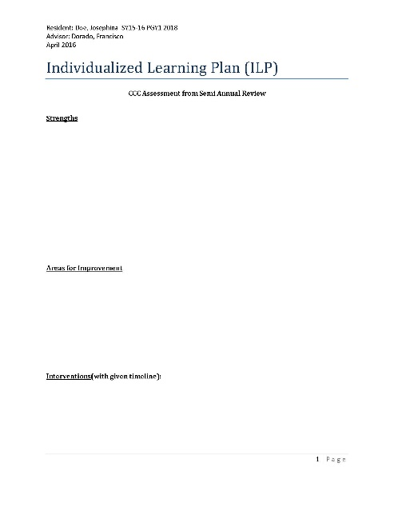
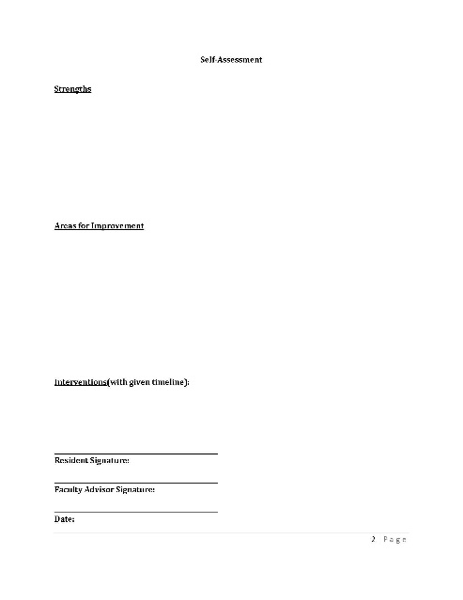
Individual Learning Plan
Residency and Career Goal Planning
used during orientation blocks each year
ILP used semi-annually during committee review and then with resident-advisor pair post review.
Notes:
Reiterate that traditionally this is used for a resident in jeopardy. We use this for every resident in order to get them actively involved in their own evaluation and progress as a professional. Important to instill self-reflection professionally as well as making a plan for improvement and timelines to check back with advisor if they have been meeting goals for improvement. If not, how else can they be supported? Etc.
Areas of excellence, likewise should be highlighted and applauded. This is not just to support resident wellness, but to guide residents perhaps when discussing career goals beyond residency.

Slide 8
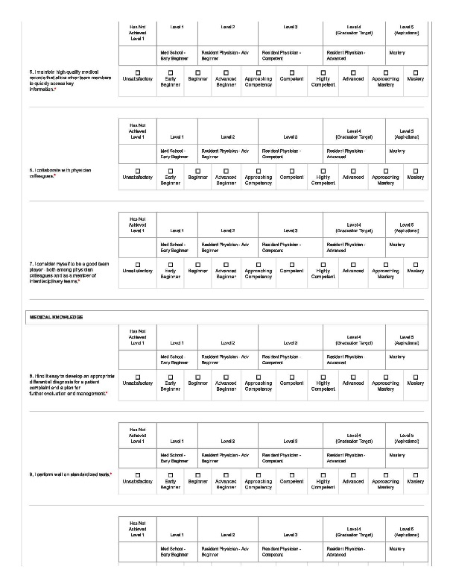
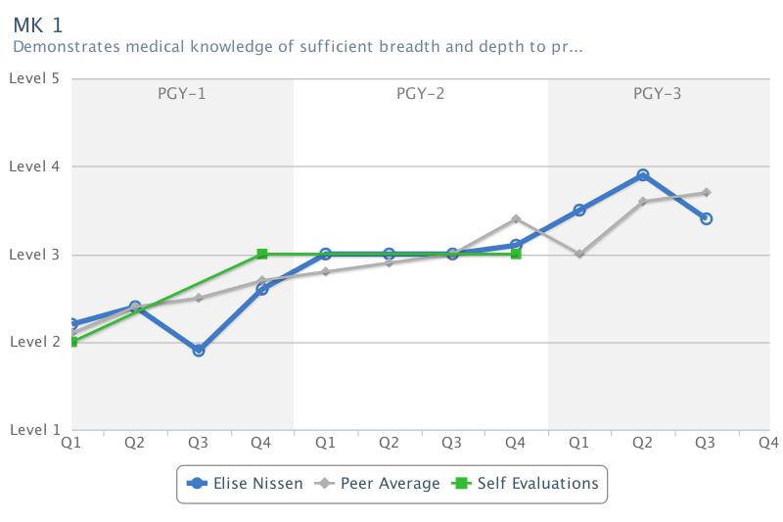
Self-Assessments
Sent out quarterly for residents to self reflect on their personal and professional progress.
Faculty advisors and CCC can use this as one way to monitor resident well being.
Resident
Notes:
Show medhub example of real resident’s self-assessment
Show graphs of 1st years.
A work in progress if this tool is actually effective, but interesting nonetheless. We may modify this or simply get rid of it if we can’t find utility in it. Will be surveying residents about utility and discuss if wellness tool be better.

Slide 9
Self-Assessments
Resident

Slide 10
Interactive session
ILP
Idea for faculty development as well.

Slide 11
How can we improve this process?
We have modified our ILP to map it to milestones.—look for us again to see how this is working! (Credit to Dr. Lowerre, thank you!)
Got resident feedback and modified our orientation and now have a Residency and Career Planning form.
Rethink the Self-Assessments. Scratch it or modify to wellness assessment? Also, limited use if residents don’t fill them out…
Where do you see improvement?
Either in this process given or in your own programs?
Notes:
The goal of the self assessment is to truly see if the resident is perceiving their growth similarly to our assessed level of growth through evaluations. If this is not being filled out, not enough data points to review. Also, not sure if good gage for wellness and we have other tools for wellness assessment.

Slide 12
Summary
The traditional model of remediating a resident in jeopardy isn’t as effective as being proactive with each learner from the start.
Orient your residents with clear goals and expectations.
Have the resident actively participate in their learning and review process, owning their participation in becoming a competent physician.
Give space for self-assessment.
End product: each resident with the skills to be a mature, life-long learning. All residents graduate with competency.
Notes:
Can’t show data that supports having less residents in jeopardy given our format, but that is not my stated goal at the moment. Our goal is to have more engaged, proactive learners that have a game plan for graduating with competency and feeling ready to go out and conquer their career goals. And IF, we have a resident in jeopardy, again, this format eliminates the surprise.

Slide 14
Take home stuff
Imbedded files to have…

