Slide 1
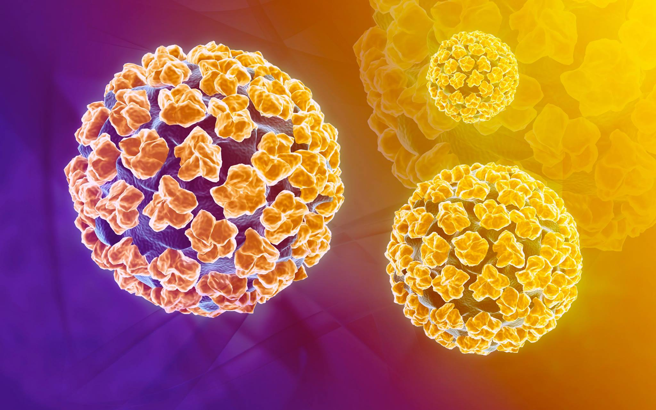
Vaccination, not procrastination: The HPV Vaccine Series

Slide 2
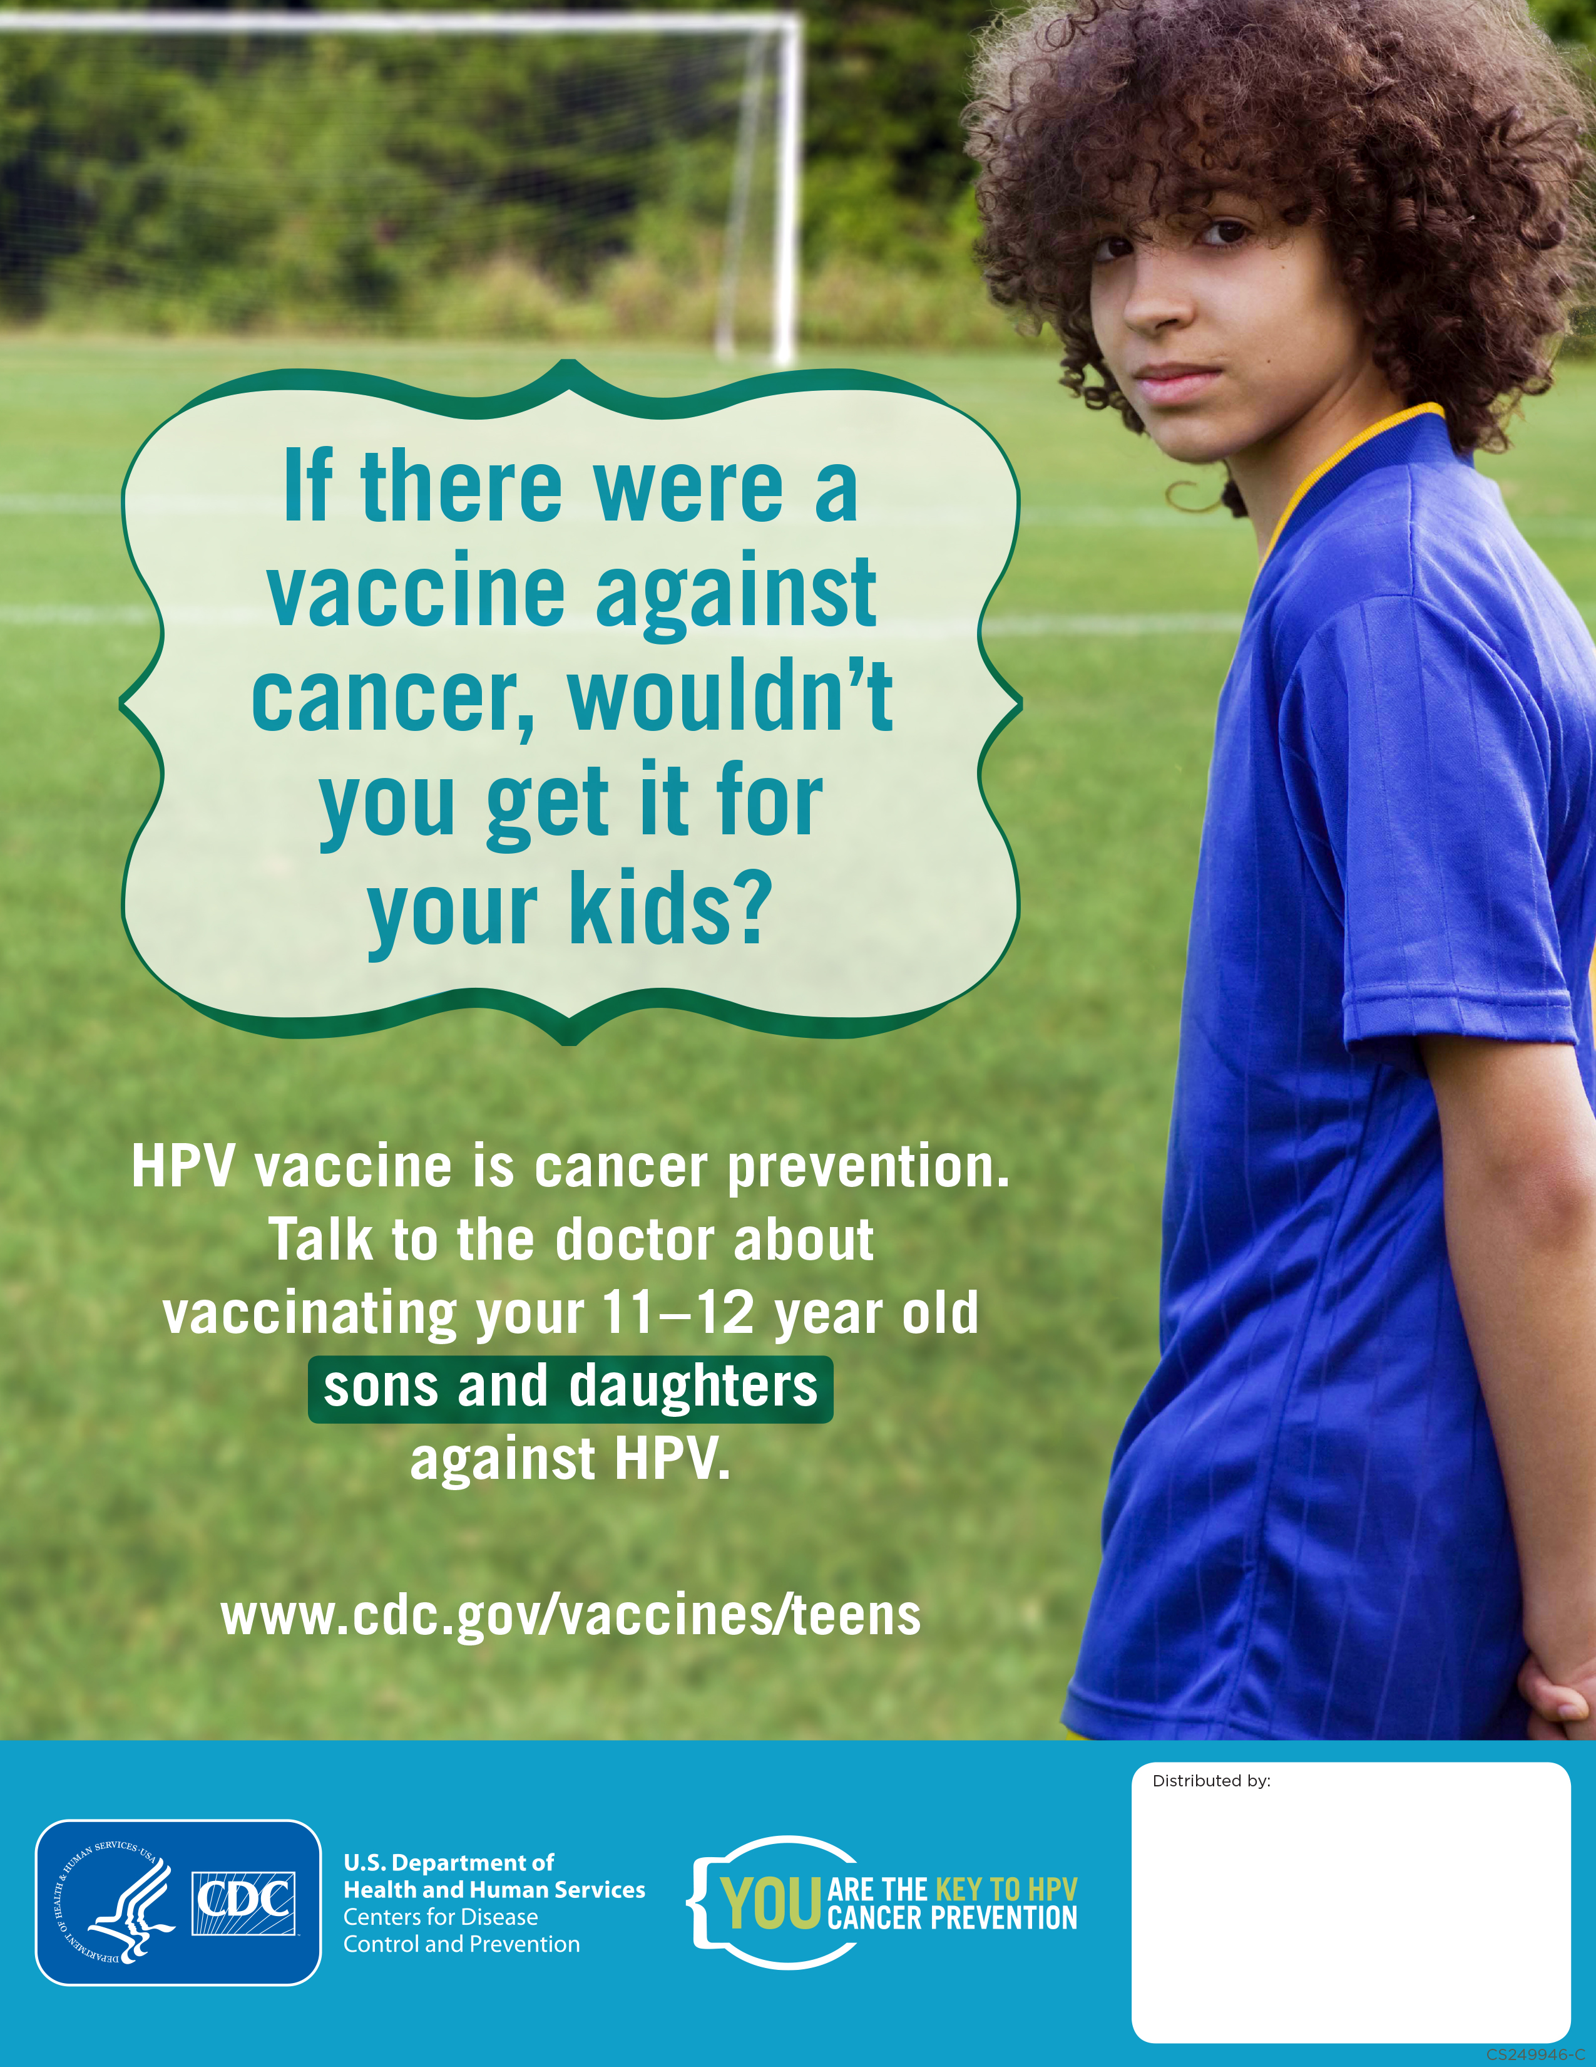
Macneal FMC rates of vaccination
As of 9/21/16, among patients 11-26 years of age (N=3160):
37% (1161) had completed the HPV vaccine series
41% of all females (N=1823)
30% of all males (N=1324)
63% (1986) have not completed the HPV vaccines series (includes those who have 0, 1, 2 shots
13 patients excluded

Slide 3
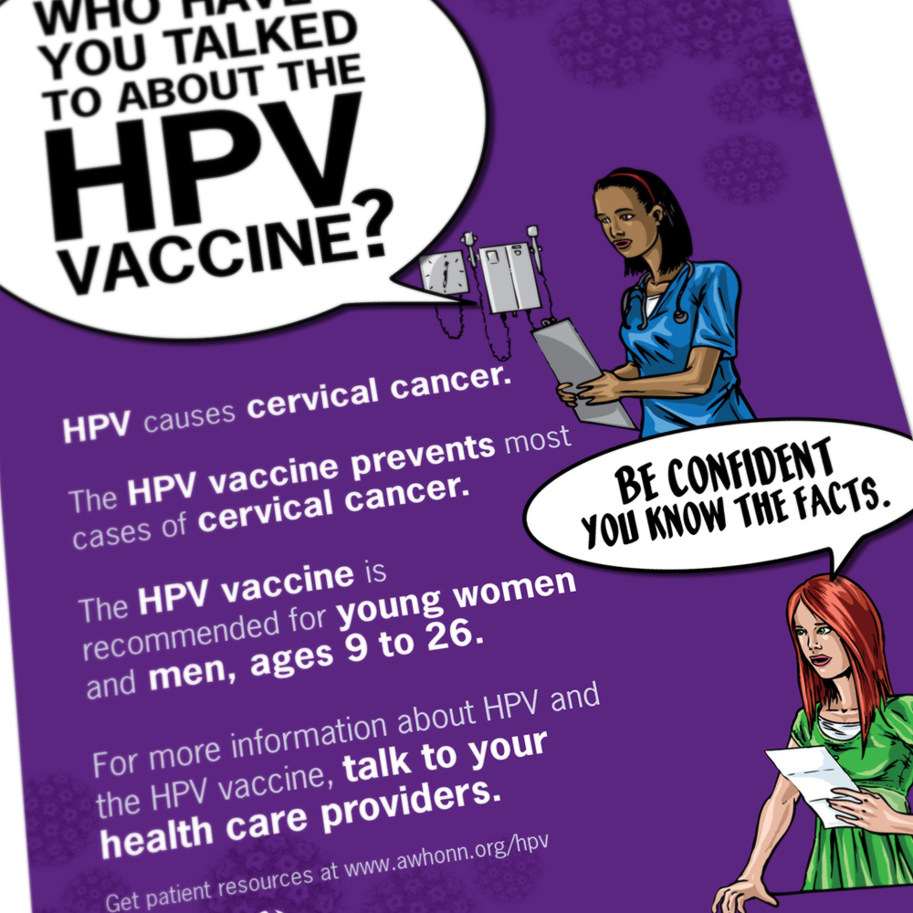
How can we increase rates of series completion?
Systematic approach involving:
Front desk staff/PSRs
Medical Assistants
Residents and faculty
EVERYONE HAS AN IMPORTANT ROLE IN HELPING OUR PATIENTS

Slide 4
Residents and faculty: How can I help?
Use direct language to promote the vaccine: “you are due for the HPV vaccine” instead of “would you like the HPV vaccine?”
At every well child/adult visit (and other follow-up visits):
Review the vaccine history and address the need for any missing shots
Create a tickler for the next shot with a nurse or at a follow-up doctor visit
Faculty:
When reviewing nurse visit vaccinations or other shots, see if patient is up-to-date on HPV vaccine

Slide 5
HPV vaccine: Updated CDC recommendations

Slide 6
HPV vaccine is routinely recommended for:
Females ages 9 through 26 years
Males ages 9 through 21 years
Males ages 22-26 who are gay, bisexual, and other men who have sex with men, transgender people, and persons with certain immunocompromising conditions
Ideally, adolescents should be vaccinated before they are exposed to HPV (we usually offer at 11 or 12 years of age).
People who have already been infected with one or more HPV types can still get protection from other HPV types in the vaccine.
Dosing schedule:
For patients who received their first HPV immunization < 15 years of age, they only need 2 shots separated by 6-12 months
For patients who received their first HPV immunization at 15 years or older, they still need 3 shots (at 0, 1-2, and 6 months)

Slide 7
FAQS
What if my patient has an immunocompromising health condition?
CDC recommends 3 doses of HPV vaccine (0, 1–2, 6 months) for immunocompromised people age 9 through 26 years (HIV, cancer, autoimmune disease, or taking immunosuppressant medications).
However, children < 15 years of age with asthma, diabetes, and other conditions that would not suppress immune response to HPV vaccination can receive a 2-dose schedule.
Can HPV vaccine be given during pregnancy?
No, it is not recommended during pregnancy, even though there are no known risks to the mother or fetus.
It can be given to breastfeeding women.
Pregnancy testing is not needed prior to vaccination.
If it is administered accidentally, it can be reported to the manufacturer to be logged in a registry.

Slide 8
FAQS
Will insurance cover the HPV vaccine?
Most insurance plans will cover the vaccine for females 9-26 years of age and men 9-21 years of age.
For children under 18, can use VFC.
For men 21-26 years of age, they should be encouraged to check with insurance plan and can also use Merck Vaccine Patient Assistance Program (MVPAP)

Slide 9
Case Examples
Question: A 22 y/o female has one documented HPV vaccine at age 14. Does she need 1 or 2 more HPV vaccines to complete the series?
Answer: She only needs 1 more HPV vaccine since she initiated the series < 15 years of age
Question: A13 y/o male had HPV #1 and #2 four and a half months apart. Does he need a 3rd HPV to complete the series?
Answer: Yes, he will need a 3rd HPV vaccine since the minimum amount of time between vaccine #1 and vaccine #2 in children < 15 years of age is 5 months, but ideally between 6-12 months
Question: A19 y/o female says she thinks she had 2 or 3 HPV vaccines when she was younger at a different clinic. What is best approach to ensure that she had adequate HPV protection?
Answer: Ask the patient sign a release to obtain her previous records or bring them in. Or look at I-care immunization records and update this in our Athena chart.

Slide 10
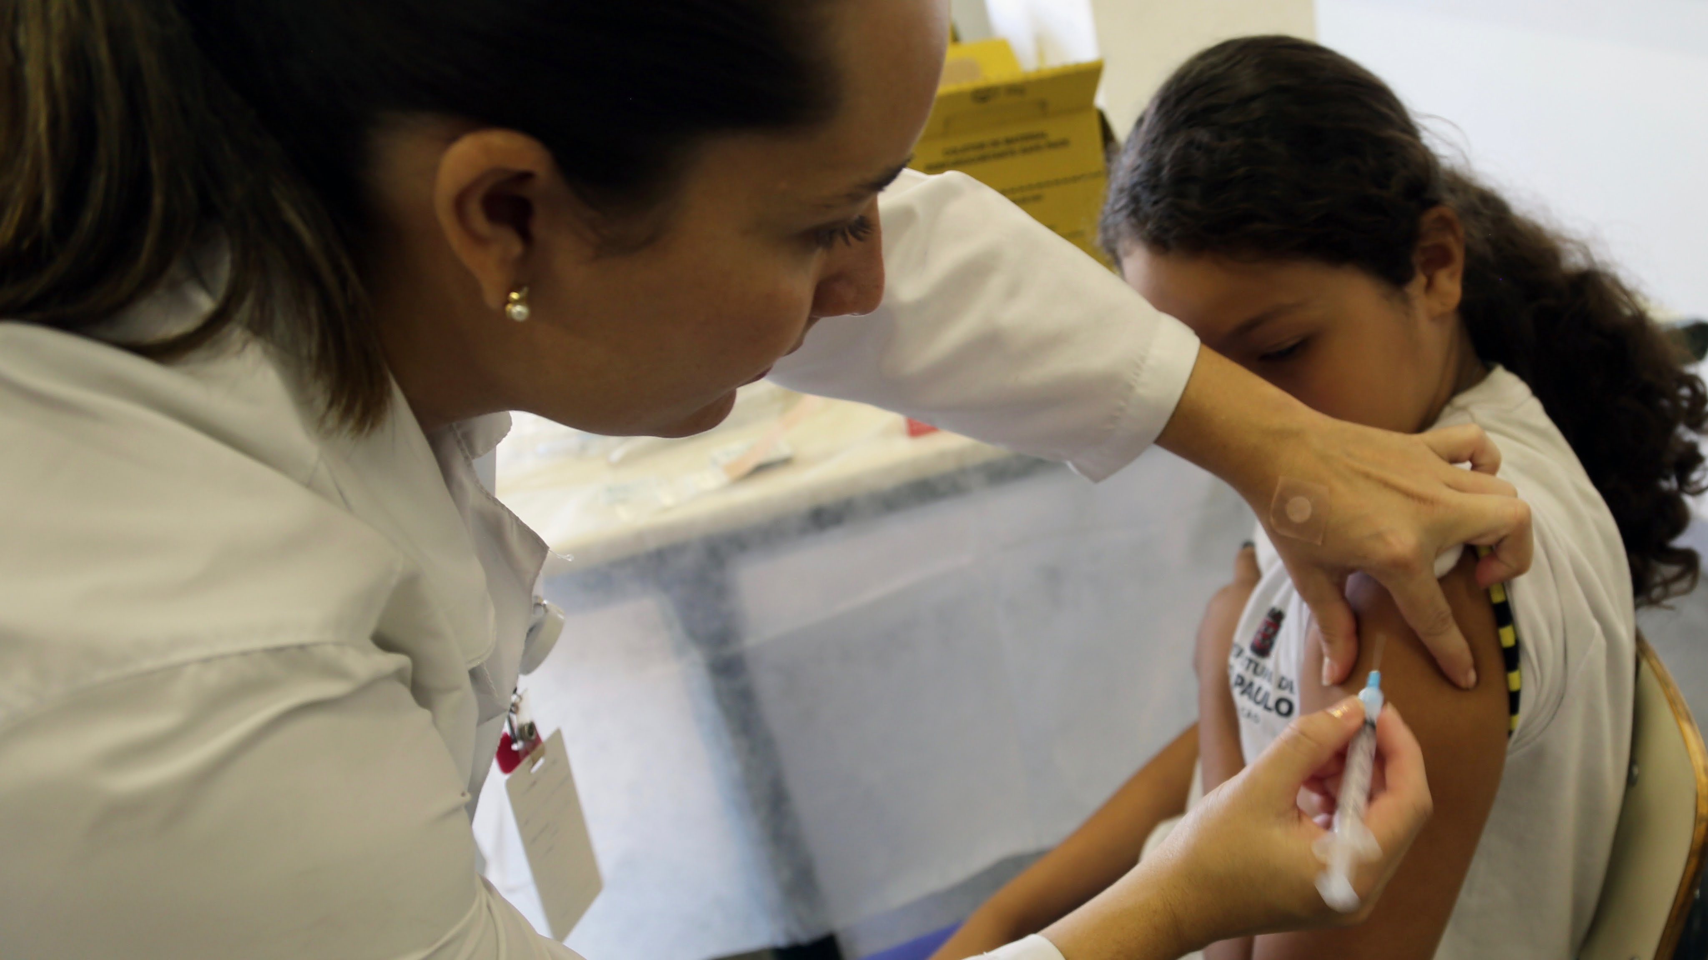
The future of our clinic…
Goal HPV series completion rate by Jan 2018: 50%
This translates to updating vaccinations for 400 children
We will provide quarterly updates on our rates

Slide 11
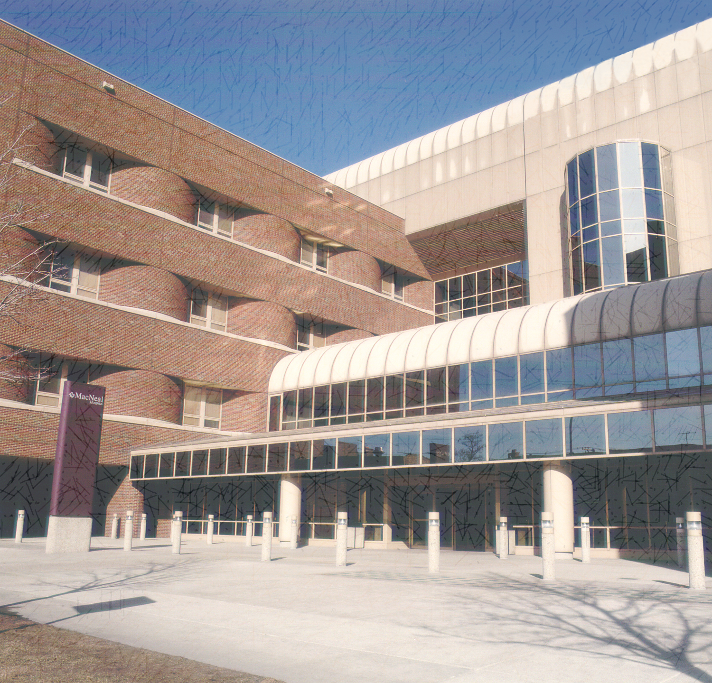
If we work together, we can make this happen and prevent cancers in our patients!

