Slide 1
Teaching about Patients with Disabilities: Leveraging Local Needs and Local Resources
Nathan F. Bradford, MD
Brian J. Mulroy, DO
Andrew Symons, MD
Leslie Thompson, MS-2

Slide 2
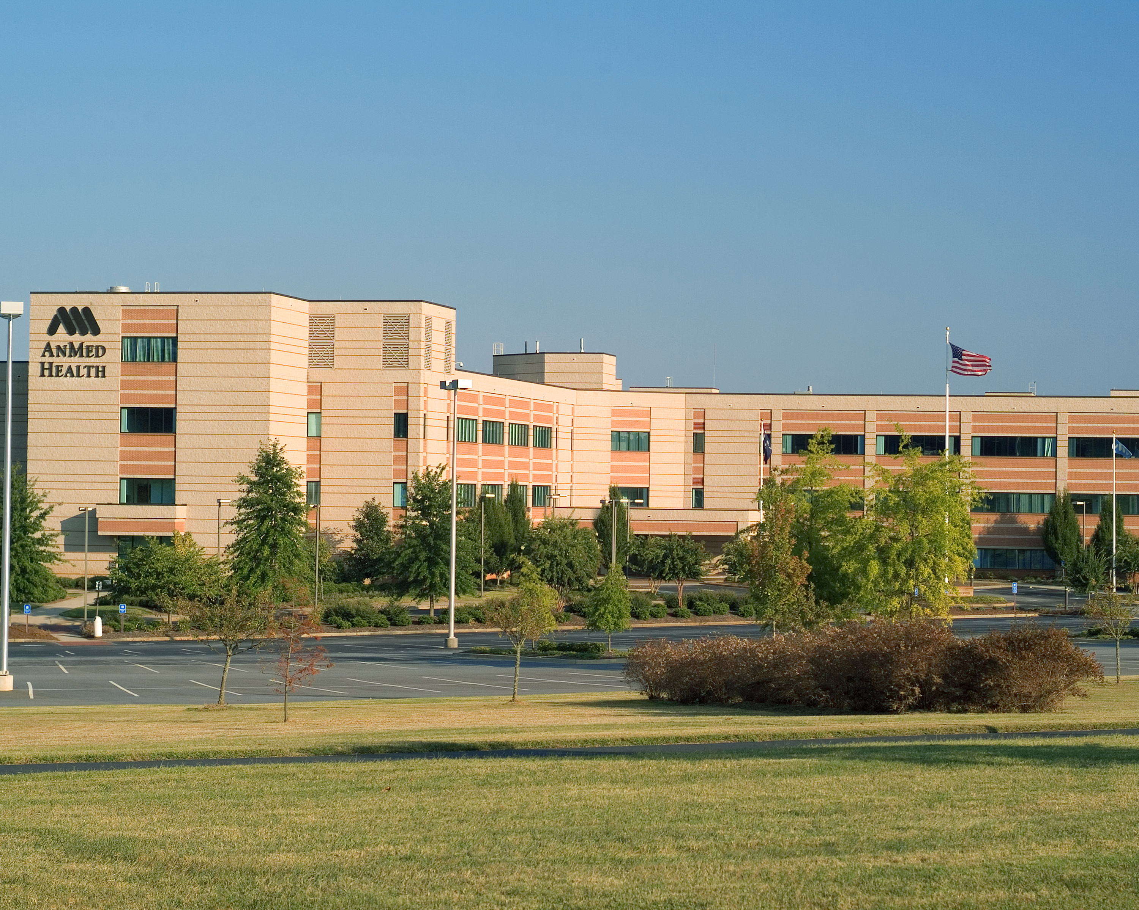
Disclosures
Nothing to disclose!

Slide 3
What is the problem to be addressed?
More patients with disabilities
Physicians and learners often not equipped to communicate nor to care for patients with disabilities
Physicians/learners not aware of local resources
From Medical Care for the Disabled Patient, in Residency Curriculum Resource

Slide 4
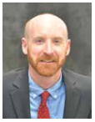
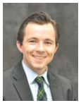
AnMed Health Anderson, SC
12 3rd year medical students

Slide 5
What knowledge and competencies do the learners need to acquire?
Cares for patients with chronic conditions (PC-2)
Advocates for individual and community health (SBP-3)
Demonstrates humanism and cultural proficiency (PROF-3)
Communicates effectively with patients, families, and the public (C2)
Effectively communicates with physicians, other health professionals, and health care teams (C3)

Slide 6
What are our overall objectives?
Improve verbal communication
Interact with local agencies
Improve the health care of a specific group of patients with disabilities

Slide 7
Which educational strategies are soundest for our project?
Brief didactic-“Medical Care for the Disabled Patient” from RCR
Video on disabilities-“Patient Voices”
Partnered with Physician Education Awareness Project-home visit
Transition Project-adolescent with disability

Slide 8
Disabilities Curriculum For Medical Students
Physician Education Awareness Project
Medical Care of the Disabled Patient
Transition Project
Medical Student Attitude Survey
“Patient Voices” – video

Slide 9
Medical Care for the Disabled Patient
Medical Care for the Disabled Patient
Caitlin D’Agata, MD
Deborah Dreyfus, MD, MSc
Clarissa Kripke, MD
Kim Bullock, MD
Kate Martin, MD, MPH, FAAFP
Nathan F. Bradford, MD
Caitlin D’Agata, MD
Deborah Dreyfus, MD, MSc
Clarissa Kripke, MD
Kim Bullock, MD
Kate Martin, MD, MPH, FAAFP
Nathan F. Bradford, MD

Slide 10
Patient Voices
Video produced by Lehigh Valley Health Network, Sacred Heart Hospital Family Medicine Residency, Dr. Sweety Jain

Slide 11
Med Students as Coaches in Transition of Youth with Special Health Care Needs (YSHCN)
Each MS-3 was assigned a YSHCN patient
Attended last visit at children’s clinic (exit visit)
Stayed in contact with their YSHCN
Attended entrance visit at family med clinic
Worked on independent living skills using validated checklist (gottransition.org)
Reflective piece

Slide 12
Physicians Education Awareness Program

Slide 13
What is our implementation plan?
Spread the pieces over the first half of the academic year
Impetus to complete transition project comes from patients
All of the surveys, didactics, and patient meetings were done on Friday afternoons during med student didactics

Slide 14
How will we best demonstrate that we achieved our objectives, and that the learners learned?
Review of email communication with transition patients
Medical student attitudes survey
Reflective piece

Slide 15
Disabilities Curriculum For Medical Students
Physician Education Awareness Project
Medical Care of the Disabled Patient
Transition Project
Medical Student Attitude Survey
“Patient Voices” – video

Slide 16
References
Jain, Care of Patients with Disabilities: An Important and Often Ignored Aspect of Family Medicine Teaching, Fam Med 2006;38(1):13-5.
D’Agata, Dreyfus, Kripke, Bullock, Martin, Medical Care of the Disabled Patient, Family Medicine Residency Curriculum Resource, STFM
Physician Education Awareness Program, Family Connections SC
Symons, et al., Development of an Instrument to Measure Medical Students’ Attitudes toward People with Disabilities, Intellectual and Developmental Disabilities 2012, Vol. 50, No. 3, 251–260
Kripke, C. C. (2014). "Primary Care for Adolescents with Developmental Disabilities." Prim Care 41(3): 507-518

Slide 17
Please evaluate this presentation using the conference mobile app! Simply click on the "clipboard" icon on the presentation page.

