Slide 1
BURNOUT Where the Rubber Meets The Road
2017 STFM Conference on Practice Improvement
Deb Bren, DO; Frank Sperrazza, DO; Grant Greenberg, MD
Notes:
ENOF. Get people up and moving and saying Hi

Slide 3
Recognizing Burnout
Changes/drops in FTE
Resignation
Early retirement
Dysfunctional relationships with colleagues and family
Uncooperative/disruptive behavior
Drop in meeting/social attendance
Drop in Patient Satisfaction Scores
Notes:
Discussing what burnout is and how it manifests

Slide 4
Recognizing Burnout
Cynicism (depersonalization)
Exhaustion
Inefficiency
Disillusioned
Disengaged
Negative impact on physical and mental health
Substance abuse

Slide 5
Burnout costs to Healthcare Organization
Business Case
Replacement cost of physician/APC
Increased medication errors
Increased risk of mortality
Increased malpractice claims

Slide 6
Financial Burden
1999
Cost of recruiting a physician was estimated to be $250,000 (Buchbinder 1999)
2016
Recruitment cost has risen up to $300,000. (Combating Physician Burnout, Advisory Board Medical Group Strategy Council 2016)
2004
estimated loss of revenue from turnover $2,000,000. (Misra-Hebert, Preventing Physician Burnout, DeChant 2004)
Today, these costs are far greater

Slide 7
Financial Burden
According to some estimates, a PCP directs about $1.6 million/year to his or her Health Care Organization through referrals, imaging and procedures. (Merritt Hawkins 2013)
10% reduction in FTE = loss of $160,000 for each physician drop in clinical time.

Slide 8
LVHN Medical Staff Burnout Survey
Pooja Shankar, MS IV
USF-SELECT Program
Project Champion: Joseph Candio, MD
Project Supported by: Internal Medicine Professionalism Council
Capstone Mentor: Suzanne Templer, DO
Slides courtesy of Matt McCambridge, MD

Slide 9
Our Assessment
Maslach Burnout Inventory (22 questions)
7 demographics questions
2 qualitative questions
Domains of Burnout:
Emotional Exhaustion (EE)
Depersonalization (DP)
Loss of Personal Accomplishment (PA)

Slide 10
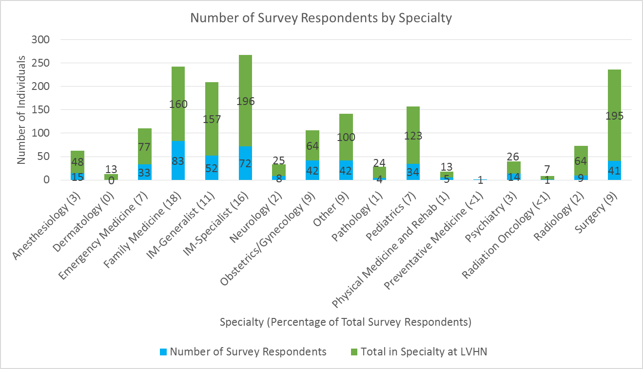
Response to Survey
Total # Surveyed:
1292 LVHN Physicians
Total # Responses:
459 (35% response rate)
Completion Rate:
97% (447 surveys completed)
Notes:
Site on the sheet or discuss Pooja Directly

Slide 11
Maslach Burnout Inventory

Slide 12
Maslach Burnout Inventory

Slide 13
Early Action
Socialization
Executive Committee convened
Medical Staff Committee on Wellness, Resiliency and Joy was chartered
Network Chief Wellness Officer
National speakers invited
Edward Hallowell, M.D
Michael Frisina, PhD
Mark Greenawald, MD

Slide 14
Early Action
FM Town Hall Meeting
APC Supervision
We sign every note
Compensation for APC Supervision
Answering service Pilot
First call RN Triage.
Feedback

Slide 15
Well-Being vs Wellness
Well-Being
Balint
Leadership Development
Meditation classes and apps (Headspace)
Coaching
EAP if needed
Wellness
Exercise: Our fitness centers are now FREE for employees

Slide 16
Ongoing Action
Adjusting staffing models
Scribes
Dragon
Level Loading
EHR Optimization
Standardization and Centralization
Epic Thrive
Clinician Elbow to elbow support
IT shadowing clinicians
Professional Development
Retreats

Slide 17
Ongoing Action
Epic Message of the Day
Banner/Radar
Lean
Healthy Scoop: Wellness newsletter

Slide 18
Daily Wellness and Resiliency Checklist
□Slept 6+ hours
□Ate Breakfast
□Socialized with colleagues – lounge, breakroom, cafeteria, etc.
□Spent spiritual time, meditation, prayer, etc.
□Took an adequate break to eat during the work shift – chose healthy diet
□Worked on optimism – recognized and “re-framed” negativity
□Mindful – stayed in the present
□Forgave myself, and others, for small transgressions
□Went home in pleasant mood (transition break?)
□Exercised
□Spent time with a hobby, musical instrument or other creative endeavor (non-work)
□Recalled and documented three “uplifting”, positive, events or occurrences
□Planned/Made appointment for health exam, a counselor or therapist, as needed, after self-assessment
Carmine Pellosie, MD

Slide 19
Remembering Burnout Is Not Just Clinicians
Working to establish standardized non traditional hours.
Centralization of refills
Prior authorization of imaging.

Slide 20
Tools:
Wellness Programs
Coaching
EAP
Lean
After hours RN first call
EMOD
Guest lecturers
Ballint
MSS Committee
Socialization
Town Halls
Profession Development
Meditation
Survey

Slide 21
WorkShop!

Slide 22
Contact Information:
Deborah.Bren@lvhn.org
Frank_A.Sperrazza@lvhn.org
Grant.Greenberg@lvhn.org

