Slide 1
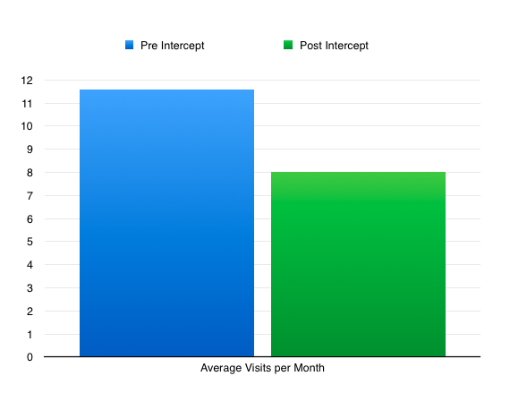
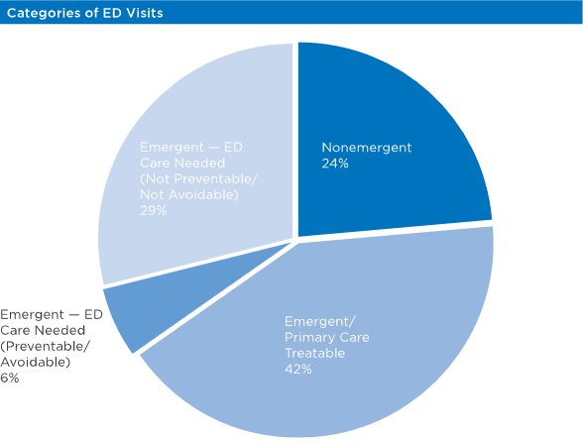
INTERVENTIONS TO REDUCE CONTINUED EMERGENCY PREVENTABLE TRIPS (INTERCEPT)
QUALITY IMPROVEMENT PROJECT
L.Kramp MD, J.Binz PharmD BCACP, P.Villarreal MD, P.Montiel MD, A.Nunez MD, WC Lock MD, N.Phillips MD, C.Velikovsky MD
University of Arkansas for Medical Science – West, Fort Smith, AR
Introduction
Methods
Preliminary Results
Discussion
Escalating healthcare costs are of great concern in this country. As primary care providers we are tasked with providing quality care, all while insuring good stewardship of the fiscal burden this care can incur the overall healthcare system.
One of the areas that could use improvement is our country’s increasing dependence on emergency departments for non-emergent reasons. Preventing these avoidable ED visits could significantly change and improve the quality of care to our patients.
Non-emergent ED visits are costly. The average cost for emergency room services is $1,423 per visit (1).
In a recent study, it was estimated that between 13.7 and 27.1% of all emergency department visits could have been treated outside of the ED (physician’s office, urgent care, etc.) (2).
Studies have shown slightly increased avoidable visits. As shown below, the pie graph demonstrates that there are an estimated 66% avoidable visits and 35% non-avoidable visits (4)
How were patients selected:
Pre Intervention: 25 patients generated 139 ED visits during a one year period
– Averaging11.6 visits per month
During this intervention period these 25 patients were:
Spoken to 119 times via the telephone
Seen in the clinic 67 times
All 25 were contacted by letter at least once for the delivery of a gold card. With 10 getting additional letters, as other means of communicating with them had failed
This project focused on avoidable ED visits to reach out to our highest-utilizing Medicare patients within CPCI. We attempted to utilize several interventions, including: providing same day (gold card) clinic access, placing regularly scheduled phone calls, scheduling regular office visits, providing handouts with detailed instructions on how to prevent ED avoidable visits, and informing patients to call our 24hr on-call center anytime they are considering visiting the ED.
Although we have collected data for only 3 months so far (11/15/16 - 2/15/17), there appears to be a decrease in the average of ED visits per month
Pre-intervention average monthly ED visits (11.6 visits per month) vs Post -intervention average (8 visits per month)
Method of communication was the largest barrier encountered. We were unable to reach some patients by phone and sent letters instead. We received several letters back as undeliverable as our patients changed addresses.
Patient feedback: some are not happy to be contacted every two weeks! Others seem to enjoy the physician contact.
For the Future:
Finish current study, examine data.
Consider expansion to other populations
Medicaid adults
Medicaid pediatrics
CPCI/CMS generated list of UAMS West patients who have utilized any emergency department in the nation
Patients selected for initial inclusion had 3 or more total ED visits in the period of 9/1/2015- 8/31/2016
5 physicians (three PGY-3 residents and two attending physicians) independently reviewed the available ED visits through our EMR to identify patients who had 3 or more avoidable ED visits within this time frame
An autonomous 3rd party compiled the physician results and selected patients with 3 or more avoidable ED visits (as determined by majority decision of the 5 physician team). Selected patients were equally distributed between resident physician members of the INTERCEPT team
Select References
1.Agency for Healthcare Research and Quality. Emergency Room Services-Mean and Median Expenses per Person With Expense and Distribution of Expenses by Source of Payment: United States, 2013. Medical Expenditure Panel Survey Household Component Data. Generated interactively. (March 31, 2017)
2.AMA: Weinick RM, Burns RM, Mehrotra A. How Many Emergency Department Visits Could be Managed at Urgent Care Centers and Retail Clinics? Health affairs (Project Hope). 2010;29(9):1630-1636. doi:10.1377/hlthaff.2009.0748.
3. Eric K. Shaw, Jenna Howard, Elizabeth C. Clark, Rebecca S. Etz, Rajiv Arya, Alfred F. Tallia. Decision-Making Processes of Patients Who Use the Emergency Department for Primary Care Needs. Journal of Health Care for the Poor and Underserved, Volume 24, Number3, August 2013, pp. 1288-1305 (Article) Published by Johns Hopkins University Press
4. Erni, Brian. Roderick, J PR. Truven Health Analytics Study Finds Most Emergency Room Visits Made by PrivatelyInsured Patients Are Avoidable. Truven Health Analytics. April 25, 2013. Pp 1-8. Published by Truven Health Analytics.
25 patients qualified
Duration of study: 11/15/16-5/15/17
Post Intervention: These same 25 patients generated 24 ED visits during a three month period
– Averaging 8 visits per month
– Study data gathered 11/15/17-2/15/17
Had these patients been seen in the appropriate setting, there could have been a potential cost savings of $4.4 billion annually (2).
Why do patients choose the ED for avoidable visits?
Access barriers to clinic (physician’s office was closed or PCP was unavailable)
They perceived racial issues in their primary care option
Patients believing their need as an emergency that required ED services,.
Transportation barriers to primary care option
Financial reasons: upfront fee to see PCP vs getting the bill later for ED (3).
Multi-tiered intervention:
Weekly phone call to patient by a physician team member to identify any patient needs or concerns that may cause them to present to the ED. This continued for 1 month, then decreased to once every two weeks for the remaining 5 months. If unable to contact them by phone, letters were generated.
Scheduled monthly appointments with PCP for 2 months, where they received an “ER is for Emergencies” handout, previously created and used by the Washington State Hospital Association. If unable to schedule a visit, these handouts were included in the letters that were mailed to the patients.
Patients received a ‘Gold card’, which guarantees same day appointments at our clinic (M-F, 8:30a-5:00p).
Every interaction mentioned above ends with a standardized 2-point reminder:
"Please remember that we always have a Resident Physician on call 24-hrs a day, 365-days a year, they may be reached at the main clinic line”
“With your Gold card you have access to a guaranteed same day appointment at our clinic (M-F)."
Limitations of the Study
Limitations of the Study
Small population size of 25 patients
Initial subjective determination of what is an “avoidable visit”
Data was limited as some ED visits were unaccounted for as visits not always available via our EMR, both pre and post intervention
Purpose and Objectives
Reduce avoidable ED visits by excessive ED utilizing Medicare patients
Improve and increase interactions with these high-utilizing patients in a Patient Centered Medical Home
Educate patients on what constitutes an avoidable ED visit
Acknowledgements
Thank you to Tabasum Imran MD, Elizabeth Petray LCSW, and Anna Mullis for their help in the planning of this project.

