Slide 1
Global Health Fellowships: Multidisciplinary Database Development and Program Survey
Wisconsin: Ann Evensen, MD and Sean Duffy, MD
Memorial University of Newfoundland: Russell Dawe MD, MDiv and Andrea Pike, MSc
Harvard: Brett D. Nelson MD, MPH, DTM&H

Slide 2
Workshop structure
Results from survey of 80 GH fellowships in N America
Background information for discussing the future of FM GH fellowships
Small groups discussing options for accreditation or certification
Certification/endorsement (eg EM global health)
ACGME accredited (eg FM sports medicine)
non-ACGME accredited (eg FM Integrative Medicine)

Slide 3
Learning objectives:
Describe the breadth of global health (GH) fellowships available in the US and Canada across all disciplines
Identify regions in North America that are underrepresented amongst available family medicine (FM) GH fellowships
List common challenges and unique aspects of FM GH fellowship programs currently available
Describe advantages and disadvantages of informal, certified and accredited fellowship models

Slide 4
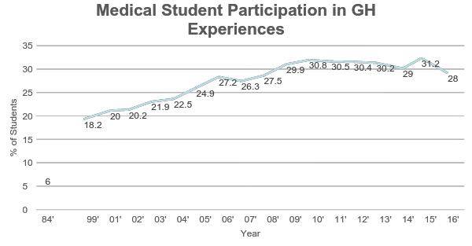
Background: increasing global health (GH) interest among medical trainees
Med student participation in GH experiences increased from 5.9% in 1978 to 31.2% in 2015
20% of residencies offer GH training programs
Increasing number of GH fellowship opportunities across various specialties
Association of American Medical Colleges. Medical School Graduation Questionnaire: All Schools Report.
Notes:
Drain et al. 2007, AAMC 2016, Kerry et al. 2013

Slide 5
2010 Survey of GH Fellowships
Objectives
Quantify and describe current GH fellowship opportunities
Methods
Web search
Online or phone survey
Results
80 fellowships in 7 specialties
Only 57% had graduated fellows
GH fellowship database created
globalhealthfellowships.org

Slide 6
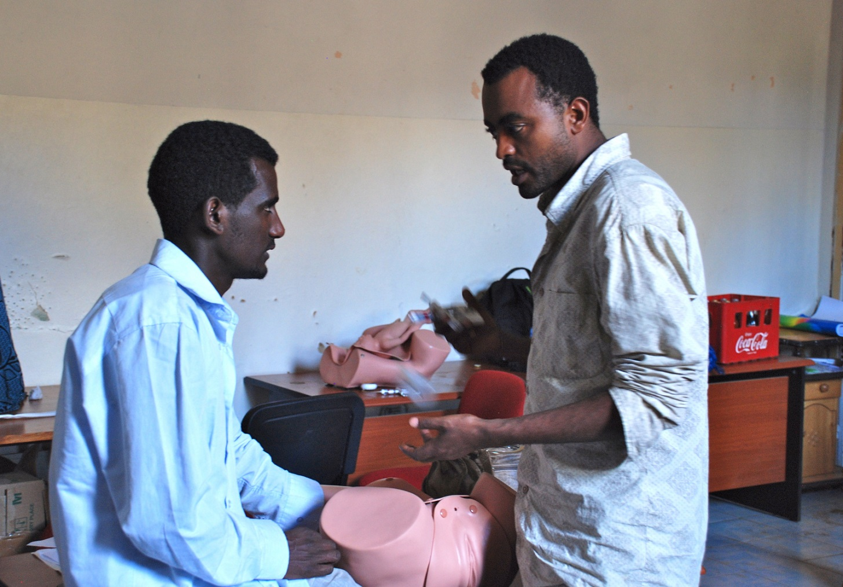
2017 Survey of GH Fellowships
Objectives
Update fellowship database
Learn more about current program characteristics
Differences from 2010
More restrictive definition of GH fellowships
Inclusion of Canadian programs
Increased focus on logistics, challenges, and unique features

Slide 7
Methods
Definition of GH fellowship
Formal training principally focused on global health beyond minimum required length of residency (subsequent to or integrated into residency)
Identifying programs and contacts
Contacts from previous survey
Literature review, google search, snowballing
Survey tool
32 questions, emailed, follow up for non-responders

Slide 8
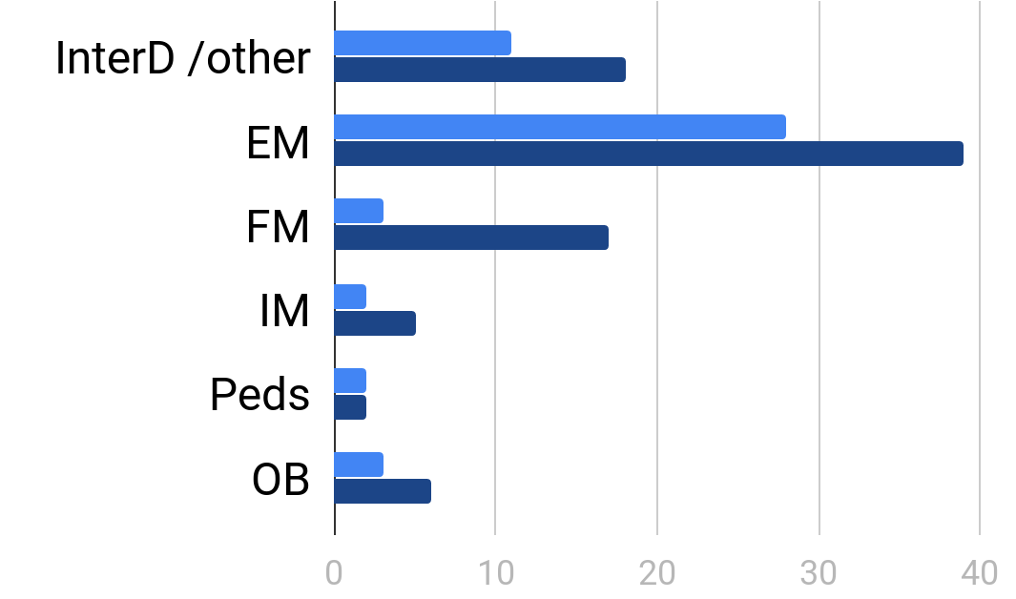
Programs surveyed in 2010 (light) and 2017 (dark)
Accepts more than one specialty/Other

Slide 9
2017 Survey Response
80 programs surveyed, 54 responded (68%)
Includes 18 programs based in FM depts
8 of 8 Canadian and 8 of 10 US programs responded
Of 54 respondents, 50 have active fellowships
Data on following slides represent 50 active programs unless otherwise stated

Slide 10
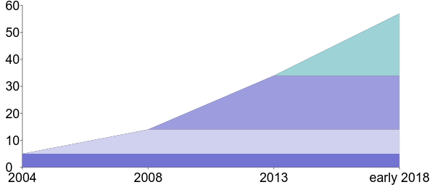
Cumulative fellowship programs by year of founding

Slide 11
Fellowship demographics
86% (43/50) of responding programs are in US
Most fellowship programs follow residency (92%)
Most fellowships are 12 (30%) or 24 (54%) months
Mean of 1.9 fellow per year (range 1-15)
Mean of 3.4 graduates from 2012-2016 (range 0-19)
13 programs (26%) had 0 grads to date

Slide 12
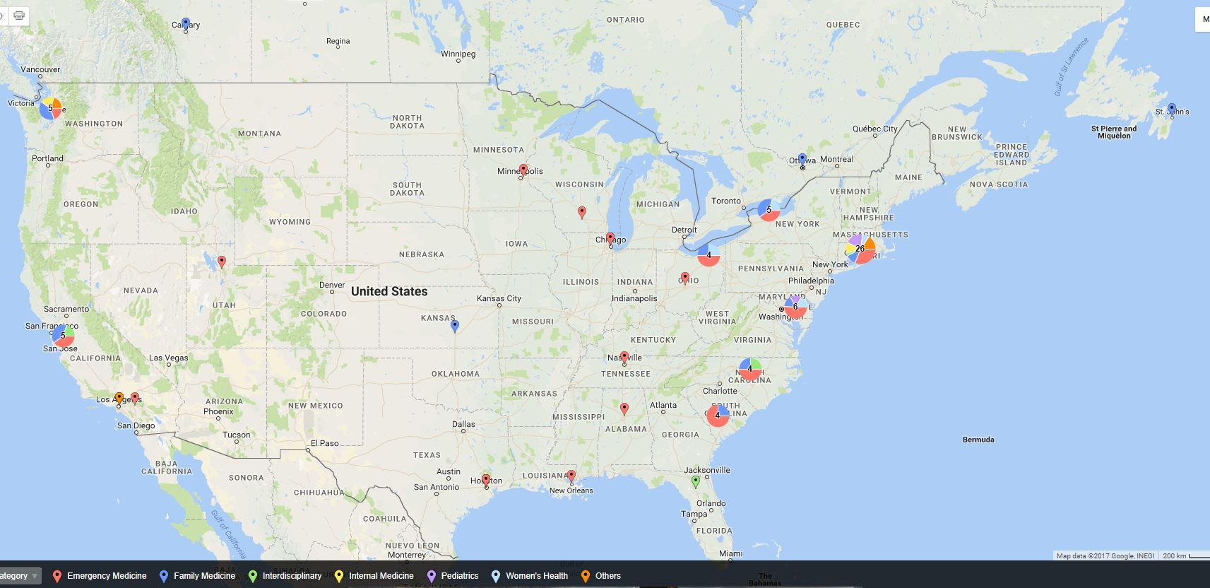
All fellowships by location
Notes:
https://batchgeo.com/

Slide 13
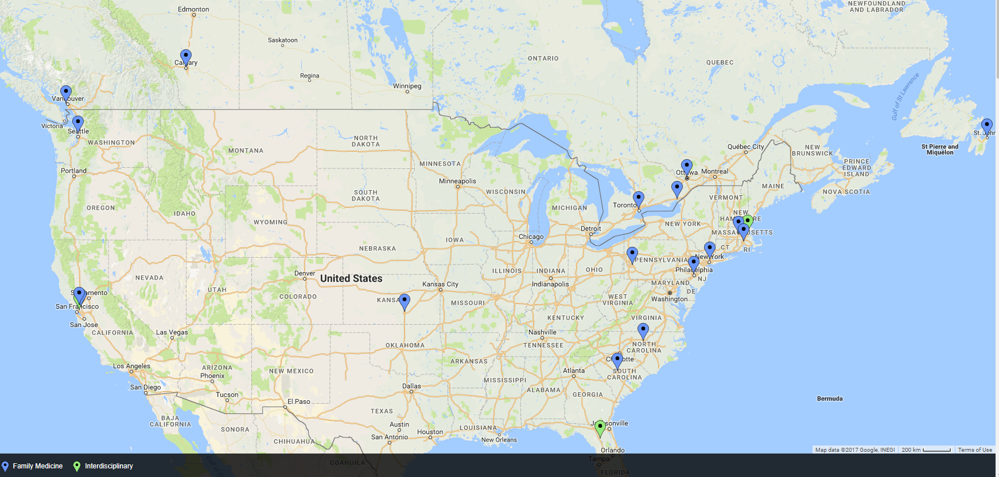
Fellowships accepting Family Medicine applicants

Slide 14
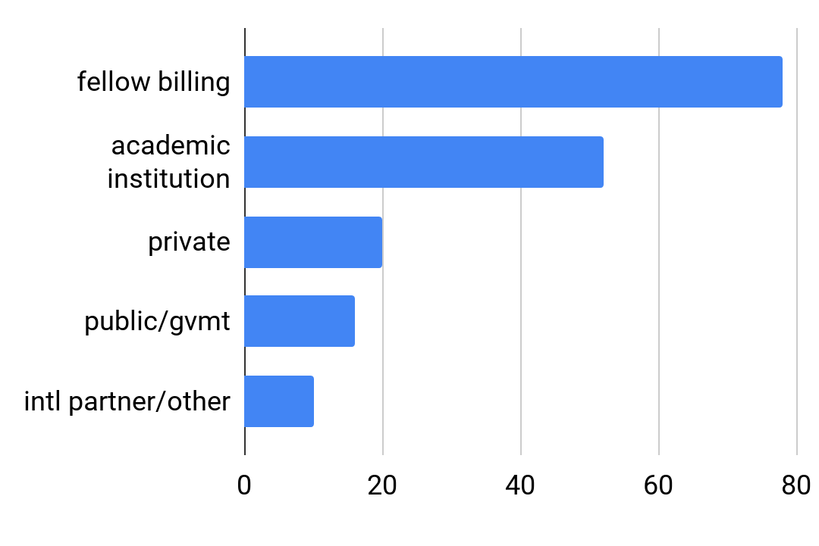
Percent of programs using funding source

Slide 15
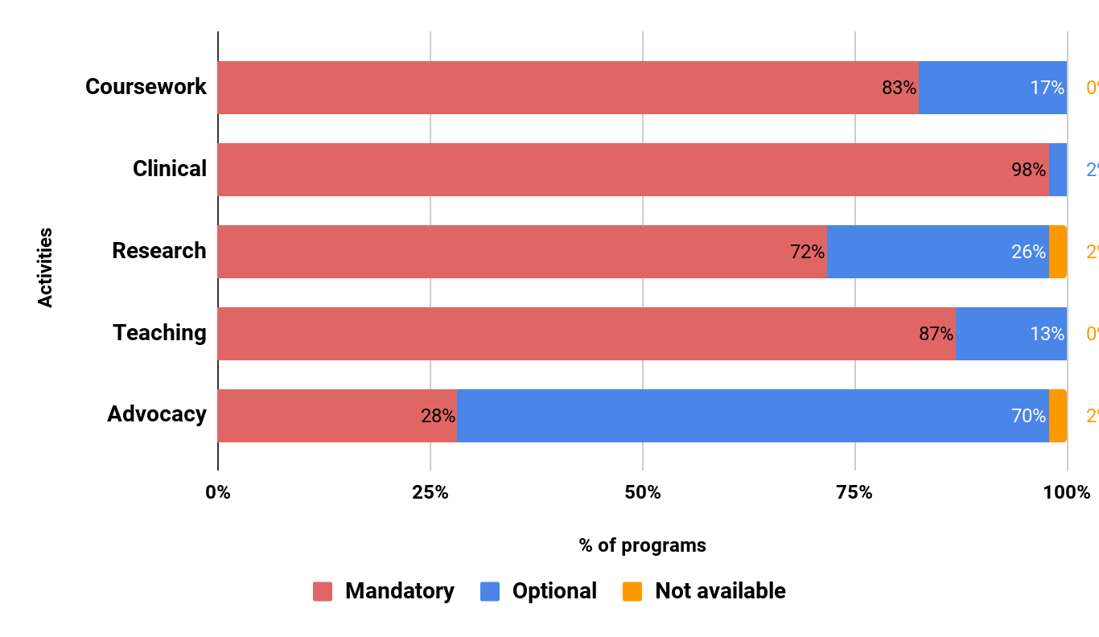
Fellowship Activities

Slide 16
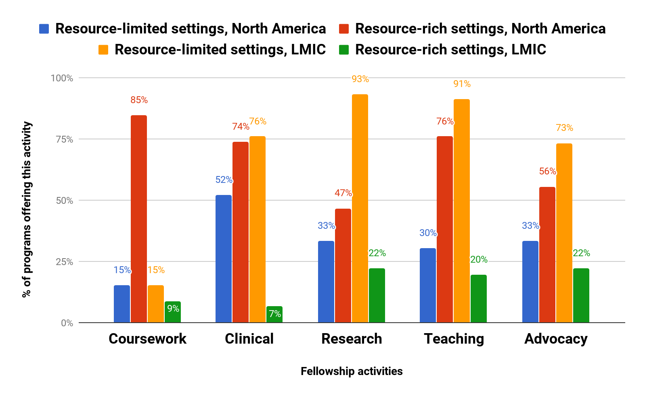
Work Settings

Slide 17
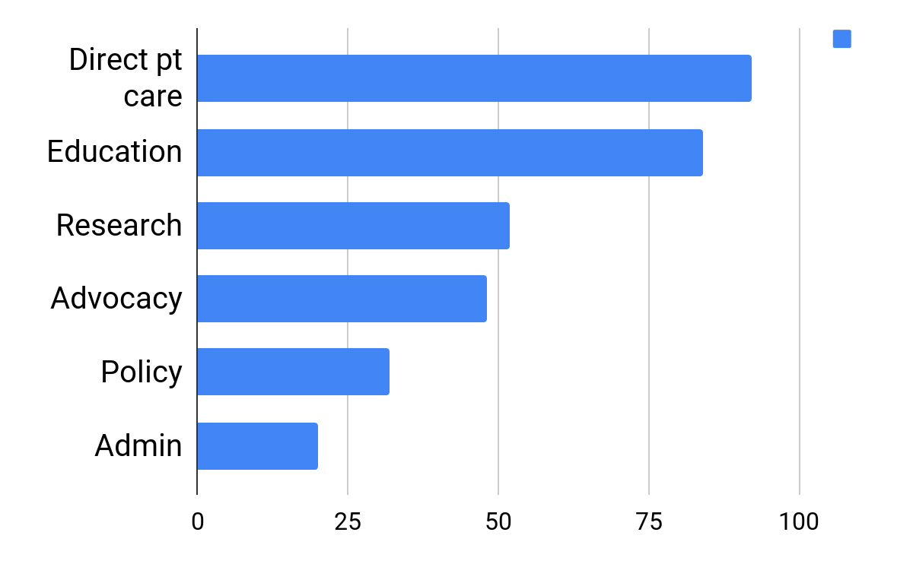
Percent of graduates in work activity

Slide 18
Innovations
Structural | Recruit fellow from underserved partner site for every US-trained fellow Serve in N America via indigenous, migrant farmworker or refugee clinics
Research | Pairs fellow from one discipline with senior investigator from different discipline
Education/training | Specialized training - ultrasound, trauma-informed care, low resource simulation Online Masters in Public Health
Field site | Partner with host institution to develop QI, residency curriculum, CME

Slide 19
Challenges
Recruitment** | Many programs, few applicants Particularly hard for new programs
Funding** | Difficulty with obtaining grants Priorities of funding agencies restrict fellow activities
Education/training | Lack of training standards/credibility Low volume for desired experiences
Field site | Political unpredictability Differences in priorities, administrative styles between US administration and partners abroad

Slide 20
Survey results interpretation
↑ fellowships mirrors ↑interest in GH at med school, residency
EM + FM = large majority of single-speciality GH fellowships
Fellowship candidates have few choices outside Northeast US
Fellow self-support is primary mode of funding
Recruitment and funding most biggest worries
Creative adaptations meet needs of fellows and partners

Slide 21
Preparing for discussion
Questions/comments about survey?
Background data/info
FM fellowship options
FM GH fellowship capacity
FM GH fellowship competencies
fellowship funding and admin
Small group discussion
Pros and cons of accreditation, certification, endorsement vs. status quo

Slide 22
FM options for fellowships
ACGME-accredited
Sports Medicine
Geriatrics
Hospice and Palliative Medicine
Clinical Informatics
Addiction Medicine spring 2018?
Examples of non-accredited
Sleep, Adolescent, Integrative Medicine
Research, Academic, Pain
Global health

Slide 23
Interest in FM Fellowship training
1063 FM residents planning fellowship training surveyed in 2014-2015
22 (2.1%) intended to enroll in GH/International fellowship
More common choices:
Sports Medicine (330, 31%)
Geriatrics (139, 13%)
Maternity Care (134, 12.6%)
Reference: Sairenji et al Fam Med 2017 49(8):618-621

Slide 24
FM GH fellowship capacity
18 primarily FM GH fellowships (10 US, 8 Canadian)
Assuming a mean of 1.9 fellowship positions/year/program
Approx 20 openings/year in FM in US, 16 in Canada
Additional spots possible in multidisciplinary programs
With current trajectory, likely more spots in future
Matches Sairenji, et al survey data about US FM GH interest

Slide 26
El Rayess, et al FM GH core competencies
Mirror ACGME competencies for residents
-Patient care -Leadership and communication
-Medical education -Teaching
-Professionalism -Scholarship
In some categories, specific means of achieving competency described

Slide 27
ACGME-accredited fellowships
For billing, fellows = residents = learners
Medicare funding available for some learner costs
“Indirect” funding: fellow counted same as resident
However...
“Direct” funding: 1.0 fellow FTE counted as 0.5 resident FTE
Cap for funded slots at each institution (1996 levels)
No Medicare funding for rotations abroad
Fellows can bill for moonlighting
Other sources of GME funding: Medicaid, VA, CHGME, THCGME

Slide 28
Non-accredited program sample budget
No GME funding, fellow = attending billing
First year fellow salary and benefits: $90,000
With favorable payor mix, full year of 1/2 FM clinic day/ week (10% FTE) = approx $50,000 revenue
20-40% FTE would be needed to cover fellow salary/benefits
Ability to cover international time with clinic work limited by time for education, teaching, advocacy

Slide 29
ACGME Accreditation
No GH fellowship in any specialty currently accredited
At least 2 Peds GH programs pair nonaccredited GH time with accredited subspecialty Peds time
Accreditation requires application to ACGME
22 page document of Common Requirements for 1 year fellowships (see handout)
-Duty hours, call, moonlighting, milestones etc
-Mandates fellowship director/coordinator positions

Slide 30
Non-ACGME Accreditation
Alternate accrediting agencies exist
Example: American Board of Physician Specialties is consortium of boards such as American Board of Integrative Medicine
Create fellowships examinations and other criteria for Diplomate recognition
Less rigorous and prestigious than American Board of Medical Specialties
ABFM belongs to ABMS

Slide 31
Certification or Endorsement
Independent of any governing board such as ABMS or ABPS
Example: Society for Academic
Emergency Medicine
has 3 year GH endorsement
Sets expectations for GH programs
Application and review required
All faculty must be members to apply for endorsement
Must be affiliated with ACGME-accredited EM residency

Slide 32
Tropical medicine certificate
ASTMH offers CTropMed certificate to recognize excellence in clinical tropical medicine and travelers' health
Complete pathway
“Diploma Course” pathway
18 approved diploma courses
“Practice” pathway
Take exam
Diploma courses not necessarily affiliated with GH fellowships
Notes:
http://www.astmh.org/getattachment/Education-Resources/Approved-Diploma-Course/Criteria-for-Diploma-Course-and-application-as-of-8-23-17.pdf
http://www.astmh.org/getattachment/Education-Resources/Approved-Diploma-Course/Diploma-Course-List-as-of-9-25-17.PDF

Slide 33
Divide into two groups to discuss the following questions
What are the pros and cons of a certification system or ACGME accreditation vs the status quo?
1 group will discuss certification
1 group will discuss ACGME or alternate board accreditation
What would be the next steps forward for your respective pathway?

Slide 34
Final thoughts
GH interest at medical school, residency and fellowship levels continues to grow
Characteristics of fellowships to date can frame expectations and shape decisions about individual programs and national standards
Send any corrections or additions about GH fellowships (no residency pathways please) to globalhealthfellowships.org

Slide 35
References
AAMC. Medical School Graduation Questionnaire - 2016 All Schools Summary Report.; 2016. Drain PK, Primack A, Hunt DD, Fawzi WW, Holmes KK, Gardner P. Global health in medical education: a call for more training and opportunities. Acad Med. 2007;82(3):226-230. Kerry VB, Walensky RP, Tsai AC, et al. US medical specialty global health training and the global burden of disease. J Glob Health. 2013;3(2):020406. Nelson B, Izadnegahdar R, Hall L, Lee PT. Global Health Fellowships: A National, Cross-Disciplinary Survey of US Training Opportunities. J Grad Med Educ.
2012;4(2):184-189.
Sairenji T, Dai M, Eden AR, Peterson LE, Mainous AG. Fellowship or Further Training for Family Medicine Residents?. Fam Med 2017;49(8):618-621.

