Slide 1
Family Systems Theory for the Family Physician:
Rebekah Schiefer, LCSW
John Muench, MD, MPH
Holly Hofkamp, MD

Slide 2
Disclosures
We have no conflicts to disclose.

Slide 3
Gratitude
Demetrio Sanchez, LCSW
Sheldon Levy, PhD MPH
Alex Verdieck, MD

Slide 4
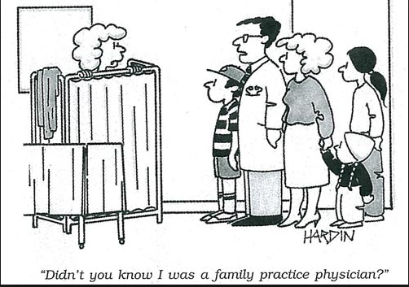
Notes:
The physician’s family is always in the room

Slide 5
Why Family Systems Curriculum?
“The aim of family medicine is to provide personal, comprehensive and continuing care for individual in the context of the family and community”
-World Organization of Family Doctors
Notes:
John will talk about abstract from our paper & include discussion of Korin paper.

Slide 6
Basic Structure
Curriculum year 3 of 4 year residency
Large residency
Longitudinal curriculum delivered over four months in eight two hour sessions
Assignment/reading on off weeks
Small groups of six

Slide 7
Curriculum Goals and Objectives
Develop and read a genogram
Identify and describe central concepts of family of origin theory
Understand family function/dysfunction and intervention
Learn how to elicit family of origin material in clinical encounter
Identify areas of strength, resilience and reactivity in self and patient/family
Notes:
These are directly from the syllabus. Another goal we had, though was less clearly defined, was to demonstrate the value of self reflection and self discovery and how that can assist in making one’s professional work more pleasurable or tolerable. For example, residents who gained recognition around certain patterns in functioning or behavior felt much more free to change their response and position and they were relieved when they recognized where those emotions and beahviors came from.

Slide 8
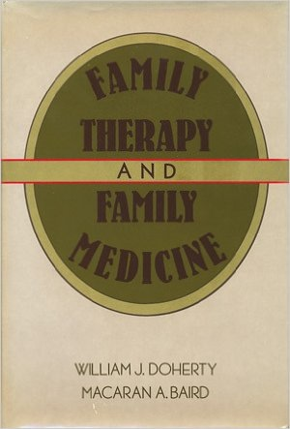
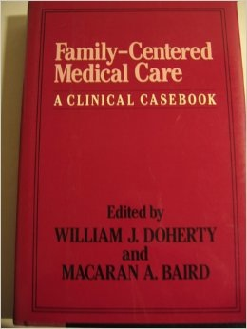
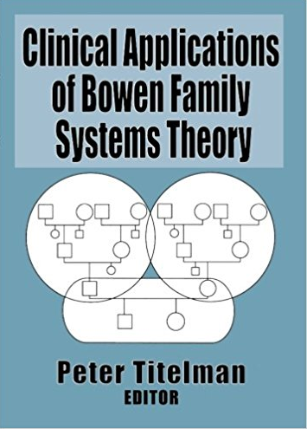
Materials: Texts

Slide 9
Example Articles/Readings
Physician Ineffectiveness Due to Family of Origin Issues, Mark Mengel
Bias, black lives and academic medicine: NEJM
Readings for Diversity and Social Justice: A Different Mirror, Ronald Takaki

Slide 10
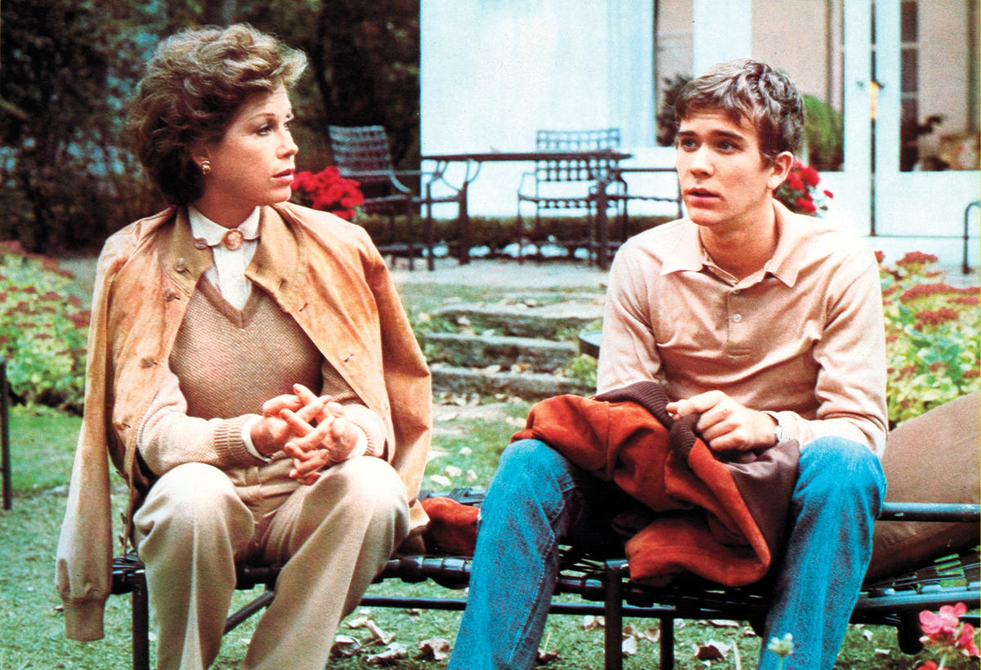
Films
Ordinary People The Namesake
Notes:
Ordinary people: Explore grief, loss, how death can change family dynamic, triangles and family projection process. Residents talk about how each of the family members might present in an office visit and what approach they might take.
The Namesake: We discuss fusion/differentiation, multi generational transmission of values, trauma, importance of family stories and how family of origin shapes our relationships. Also generates discussion of racism and how generational experience of racism impacts the family and family stress.

Slide 11
Doherty and Baird: Five developmental levels for residency family systems training
Level | Title | Description
Level One | Minimal Emphasis on Family | Communication with families only as necessary for practical and medical/legal reasons.
Level Two | Ongoing Medical Information and Advice | A beginning emphasis on listening and communication skills needed to understand family functions affecting the care of the patient.
Level Three | Feelings and Support | The ability to explore emotional content affecting family structure and health.
Level Four | Systematic Assessment and Planned Intervention | The ability to conduct basic primary care counseling of families who are developing dysfunction due to medical or situational crises.
Level Five | Family Therapy | Moving beyond the primary care domain into more intensive counseling.
Notes:
Each week we discuss a case study that demonstrates a physcian’s level of engagement with a family. Residents are encouraged to discuss whether they agree with the interventions, what they liked about how the physician handled the case and thoughts on next steps.

Slide 12
Family of Origin Work
Murray Bowen and Family Systems
Theory of human behavior using systems approach
Family as emotional unit
Patterns and attempts to diffuse anxiety
Seven interlocking concepts
Can be used for enhanced understanding of self and to improve relationships, reduce reactivity
Notes:
Murray Bowen was a psychiatrist who specialized in treating people with schizophrenia. He expanded family therapy and added additional ideas around family functioning. Central to his theory are the concepts of triangles, differentiation and the importance of recognizing and resolving own family of origin issues in order to maintain neutrality and avoid fusion or reactiveness with patients and their families.
Has anyone here ever felt reactive towards a patient or family and realized it was related to your own history or family experience?

Slide 13
Core Concepts
Triangles
Differentiation of self vs. fusion
Nuclear family emotional system
Family projection process
Sibling position
Multigenerational transmission process
Emotional cut-off

Slide 14
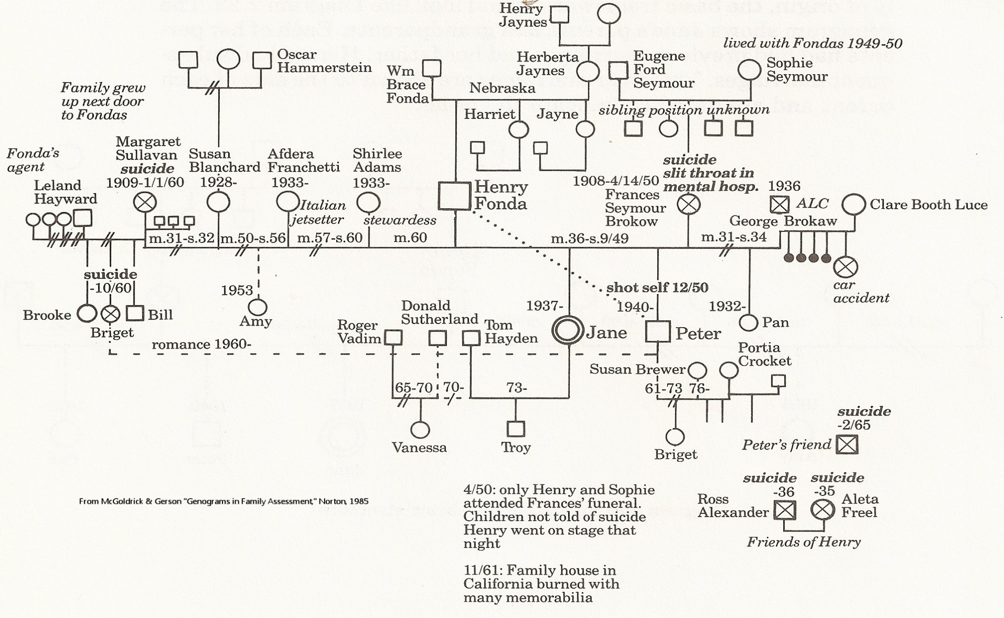
Genograms
Notes:
Residents asked to present their own family genogram and consider the following questions:
Questions to consider for your genogram presentation:
How are conflicts handled in your family of origin?
What strengths does your family have?
How is closeness and distance handled in your family of origin?
What are the ways in which your family of origin influenced your decision to become a physician?
What values from your family of origin influence your values as a physician?
Are there particular patients or patient care situations that you enjoy or find particularly challenging? How might this relate to your family of origin?
We ask residents to identify patterns, themes and to apply and discuss at least two family of origin concepts during their presentation.
Explain how our longitudinal curriculum is using genograms to understand Bowen’s interlocking concepts and how they are play out in resident’s lives. Additionally, resident’s are asked to form open-ended questions that they would like to ask the presenting resident to further understand his/her family structure. Hope is that learning this skill (often sensitive subject) with each other will translate to better family-centered questions with patients.

Slide 15
Final Project
Resident presentation of patient genogram
Presenting problem
Discussion of family functioning
Apply and discuss two Bowen concepts
Discuss treatments/interventions and what level of intervention is being used
Apply own FOO to case.
Notes:
Discuss how this patient’s presenting problems influence their family functioning and family members. Examples of presenting problems or issues/challenges/events that impact family functioning can include: Chronic disease, death/grief, divorce, substance use, mental health issues, marriage/divorce, parenting, illness in child or family member, diaspora, immigration, institutionalized racism/classism, homophobia, sexism.
Choose two Bowen concepts (triangulation, emotional cut off, fusion, etc) and apply these concepts to your patient and their family. Be prepared to discuss how you see these concepts appear in your own interactions with the patient and/or in witnessed interactions with their family members.
Discuss your treatment and interventions with this patient and their family. Be prepared to discuss what level (1-5 from Family Therapy and Family Medicine) of intervention you are using and why.
Keeping your own family of origin in mind, discuss areas for attention or reflection in your care of this patient. Are there things that are particularly easy, difficult, challenging or enjoyable about working with this patient? Why or why not? What have you learned about your own family of origin that may improve your care of this patient?

Slide 16
BH Faculty Role
Setting safe environment is imperative
BH Faculty role-models by sharing own genogram
Confidentiality
Facilitate vulnerability
Provide supportive feedback

Slide 17
Family Concepts Discussed
Marital/Divorce
Adoption
Step-parenting
Infertility/Pregnancy Loss
Death, Health, Illness
Mental Illness
Addiction
Race
Culture
Spirituality

Slide 18
Milestones: Subcompetencies
PC3 - Partners w/ the patient, family and community to improve health through disease prevention and health promotion
PROF4 - Maintains emotional, physical, and mental health and pursues continual personal and professional growth
PBLI 2 - Demonstrates self-directed learning. Ex. Residents identifying their own biases, how to deal with them, how they interfere then revise their approach to patient care.

Slide 19
Questions with 11-point rating scale (0-10). Pre- and post-curriculum responses averaged for all residents. All p-values less than 0.005.
Question | Pre-Test Mean Score | Post-Test Mean Score | P-Value
How well do you feel you know the mechanics of making genograms? | 3.35 | 8.45 | <0.05
How confident are you in using genograms in family practice? | 1.95 | 7.70 | <0.05
How confident are you in your ability to identify strengths and challenges that exist within families? | 4.30 | 7.25 | <0.05
How confident are you in your understanding of Family Systems Theory? | 2.50 | 7.25 | <0.05
How confident are you in your ability to use family systems to formulate assessment and intervention plans for patients? | 2.00 | 6.90 | <0.05
How confident are you in your ability to understand how families and family dynamics play a role in a patient’s health? | 4.70 | 8.10 | <0.05
How confident are you in your understanding of intergenerational trauma? | 3.60 | 7.33 | <0.05
How confident are you in your communication and interviewing skills? | 6.65 | 7.98 | <0.05
How confident are you in your interviewing skills with patients and families with history of trauma? | 4.20 | 6.77 | <0.05
How confident are you in your ability to connect with patients/families with emotional neutrality? | 5.05 | 7.40 | <0.05

Slide 20
How well do you know how your own family-of-origin affects your care with patients? | 4.60 | 8.30 | <0.05
How confident are you in your ability to coordinate team-based care for a family of patients to optimize their health? | 5.20 | 7.75 | <0.05
How confident are you in your ability to use family systems approaches to improve patient safety? | 3.00 | 6.90 | <0.05
How confident are you in your ability to understand how ethnicity, culture, socioeconomic status, religion, sexual orientation affect family systems? | 4.95 | 7.70 | <0.05
How confident are you in your ability to understand how the following concept affects families? Marital/Divorce | 5.30 | 7.30 | <0.05
How confident are you in your ability to understand how the following concept affects families? Adoption | 4.10 | 6.40 | <0.05
How confident are you in your ability to understand how the following concept affects families? Step-parenting | 3.85 | 6.60 | <0.05
How confident are you in your ability to understand how the following concept affects families? Infertility/Pregnancy loss | 4.70 | 6.93 | <0.05
How confident are you in your ability to understand how the following concept affects families?Death, Health/Illness | 5.80 | 7.75 | <0.05
How confident are you in your ability to understand how the following concept affects families? Mental Illness | 5.55 | 8.00 | <0.05
How confident are you in your ability to understand how the following concept affects families? Addictions | 5.23 | 7.70 | <0.05

Slide 21
Qualitative questions asked in the post-test.
Please provide short answer for following: What do you feel is the most important thing you have learned by participating in the BH longitudinal curriculum?
Can you list at least one way in which you anticipate your practice will change as a result of participating in the BH longitudinal curriculum?
Did you feel this curriculum was introduced at an appropriate time in your resident training? Why or why not?
Is there anything you learned in this curriculum that you are now using or would expect to use in the future to take better care of yourself as a physician?
What changes would you recommend to the curriculum? Content? Logistics? Leaders? Group size?
Is there anything else you’d like to tell us?

Slide 22
Responses
I believe I will focus and shift more attention to delving into a patient’s family history in encounters that have historically been more challenging.
One of the more important fundamental concepts I gained included foundations and developing genogram making skills. Using that to examine my own family to elucidate potential dynamic family patterns was enlightening. I think it allowed me to explore a concept of myself that I hadn’t examined prior.
Notes:
. In addition to completing a pre- and post-assessment rating scale, residents responded to several post-curriculum questions about the most relevant content learned and any anticipated changes in their practice (see Table 3). Their comments supported the positive results of the quantitative analysis. Residents demonstrated intention to continue using family systems thinking in their clinical care: “I believe I will focus and shift more attention to delving into a patient’s family history in encounters that have historically been more challenging.” Some residents stated improvement in self-awareness:
“One of the more important fundamental concepts I gained included foundations and developing genogram making skills. Using that to examine my own family to elucidate potential dynamic family patterns was enlightening. I think it allowed me to explore a concept of myself that I hadn’t examined prior.”
Several residents reported the curriculum also helped them with caring for themselves: “Understanding fusion characteristics in a patient can help me feel less inadequate when I feel like I’m not ‘helping’ someone.” Other residents expressed a general appreciation for developing clinical skills: “This curriculum has provided me with some of the most valuable patient care skills” and “It was one of the best longitudinal curriculums we’ve had!”

Slide 23
Responses
Understanding fusion characteristics in a patient can help me feel less inadequate when I feel like I’m not ‘helping’ someone.
This curriculum has provided me with some of the most valuable patient care skills.
It was one of the best longitudinal curriculums we’ve had!

Slide 24
Questions

Slide 25
Small Group Discussion
In groups of three, discuss the following questions:
As a preceptor, how often do I consider family systems in the intervention and treatment of an individual?
Do you as an educator think you can recognize some of the concepts discussed today to improve application in clinical practice?
How does your own family of origin affect your neutrality in your own practice?

