Slide 1
Tropical Dermatology Diagnosis and Treatment in LMIC
Stephen P. Merry, MD, MPH, DTM&H
Assistant Professor, Mayo Clinic College of Medicine
October 4, 2017
Global Health Workshop Pre-Conference
Houston, TX
Notes:
Never start with denouncing your abilities or value of presentation but…!
Specialist in generalities
Additional training in PH/GH and TM
Experience in Uganda teaching med school and clinical work in Fr W Africa Cote d’Ivoire, Togo, Guinea x 10 years building/developing a hospital and Comm HD and CME conference 160 Fr W Af physicians med students and NP’s. Similar to Kumasi Ghana conference.
Mayo since 2004 went there for leukemia care for my late wife and stayed for a job.

Slide 2
Disclosures
None

Slide 3
Learning Objectives
Understand the epidemiology and presentation of ulcerative dermatologic diseases low and middle income countries (LMIC)
Develop a syndromic approach in LMIC for diagnosis with minimal testing.
Plan a treatment strategy for a resource limited setting

Slide 5
Case 1:
45 year old man from Peru presents with ulcerating lesion to his right hand.
Began as boil.
Slowly progressive over a year.
Painless, minimal drainage, no fever, chills, night sweats, cough or constitutional symptoms.
Unresponsive to multiple antibiotics

Slide 6
Case 1:
Lesion is deeply undermined, but is not purulent or foul smelling. Quite clean looking.
Culture* grew coagulase negative staph and diphtheroids
*Not available in many LMIC
Notes:
C. diphtheriae and the non-diphtherial corynebacteria known as diphtheroids comprise the genus. These aerobic, non-sporulating, pleomorphic Gram-positive bacilli are usually commensals of the skin and mucous membranes. 1 2. In fact, infective endocarditis caused by Corynebacterium spp. was recognised as early as 1932, but diphtheroids are still disregarded when isolated.

Slide 7
Case 1:
Residence in jungle area of Peru.
Differential diagnosis is broad.
Infectious (parasitic, fungal, mycobacterial)
Non‐infectious (malignancy)
Biopsy and culture recommended

Slide 8
Biopsy (ZN stain)

Slide 9
Buruli Ulcer
Mycobacterium ulcerans
Third most common mycobacterial infection (after TB and leprosy)
Endemic in 32+ tropical countries
Exposure to water (vs water insects) in tropics.
Tyring, Lupi, and Hengge. Tropical Dermatology, 2006
Guerrant RL. Tropical Infectious Diseases, 2005.

Slide 10
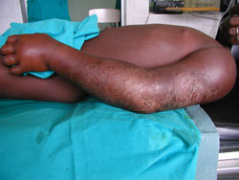
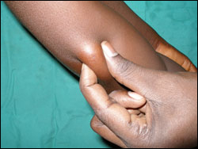
Buruli Ulcer
Firm, painless nodule or plaque and edema
Tyring, Lupi, and Hengge. Tropical Dermatology, 2006
Guerrant RL. Tropical Infectious Diseases, 2005
WHO at http://www.who.int/buruli/photos/nonulcerative/en/

Slide 11
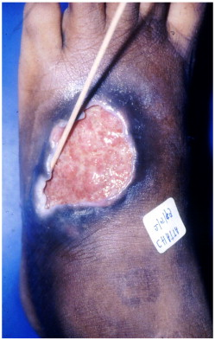
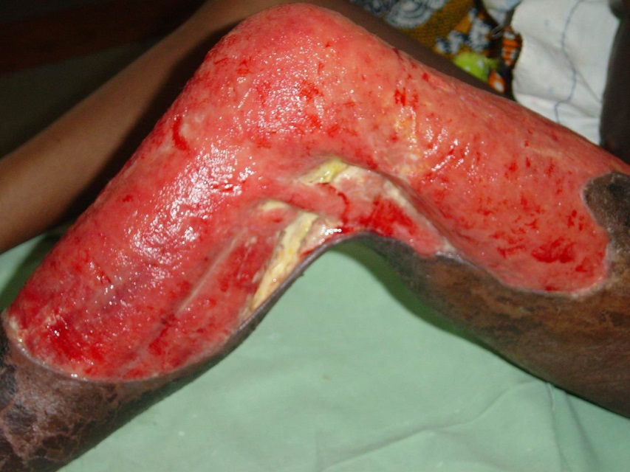
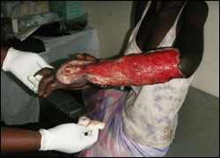
Buruli Ulcer
Vascular occlusion of subcutaneous tissues -> sloughing/ulceration of skin
Necrosis of subcutaneous fat -> undermining
AFB stain of slough
Tyring, Lupi, and Hengge. Tropical Dermatology, 2006
Guerrant RL. Tropical Infectious Diseases, 2005.
WHO 2017 at http://www.who.int/buruli/photos/nonulcerative/en/

Slide 12
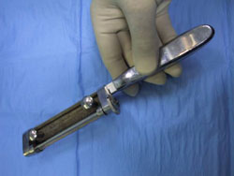
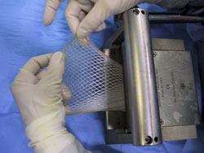
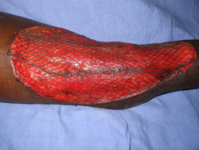
Buruli Ulcer Treatment
Rifampin for nodules/plaques
+/- clofazimine
Excision of nodule or small ulcerations.
Debridement of larger ulcers
Skin graft
Tyring, Lupi, and Hengge. Tropical Dermatology, 2006
Guerrant RL. Tropical Infectious Diseases, 2005.

Slide 13
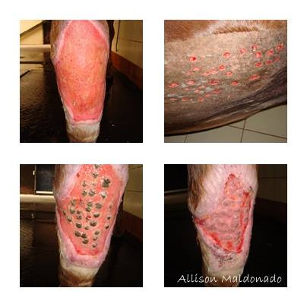
Pinch Grafts for Ulcers & Burns
Simple, outpatient
Small, 2 mm grafts to promote re-epithelialization from “islands”
Level of upper to mid-dermis
Topical EMLA or local anesthesia
Apply when ulcer “clean” – debrided well.
Harvest and apply pinch grafts; cover with non-adhering, occlusive bandage for 1 week
Donor site heals by second intention
Notes:
Picture of pinch grafts in horses! Done same way and commonly in humans (but difficult to find px on line)

Slide 14
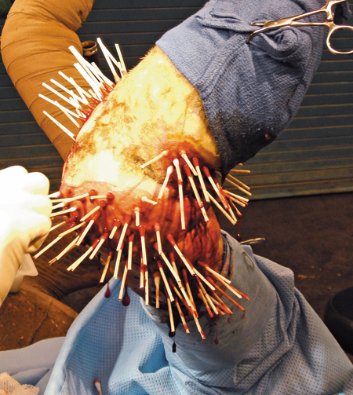
Pinch Grafts for Ulcers & Burns
Simple, outpatient
Small, 2 mm grafts to promote re-epithelialization from “islands”
Level of upper to mid-dermis
Topical EMLA or local anesthesia
Apply when ulcer “clean” – debrided well.
Harvest and apply pinch grafts; cover with non-adhering, occlusive bandage for 1 week
Donor site heals by second intention
Notes:
A horse of course. Q tips to plug the pinch graft holes (b/c they’re so deep!)

Slide 15
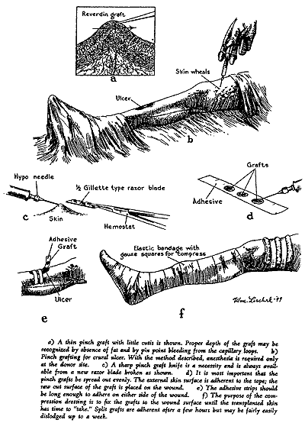
Pinch Grafting in AFP
Am Fam Physician. 2000 Oct 1;62(7):1474-1477

Slide 16
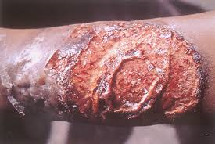
Things Like Buruli Ulcer
Tropical ulcer
“Phagedenic ulcer”
AKA Jungle rot, Aden ulcer, Malabar ulcer
Malnutrition, poor hygiene, insect bites
Fusobacterium fusiformis and Borrelia vincentii
Painful, foul smelling, but after rapid growth acute phase becomes painless
Edges not undermined
Risk osteomyelitis and SCC
Treat Tetracycline, wound care, grafting

Slide 17
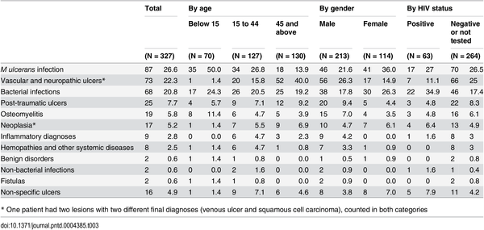
Table 3. Category of final diagnosis of patients with ulcerative skin lesions, by HIV status, age and gender, Buruli score study 2011–2013, Akonolinga, Cameroon.
Toutous Trellu L, Nkemenang P, Comte E, Ehounou G, Atangana P, et al. (2016) Differential Diagnosis of Skin Ulcers in a Mycobacterium ulcerans Endemic Area: Data from a Prospective Study in Cameroon. PLOS Neglected Tropical Diseases 10(4): e0004385. https://doi.org/10.1371/journal.pntd.0004385
http://journals.plos.org/plosntds/article?id=10.1371/journal.pntd.0004385

Slide 18
Table 3. Category of final diagnosis of patients with ulcerative skin lesions, by HIV status, age and gender, Buruli score study 2011–2013, Akonolinga, Cameroon.
Toutous Trellu L, Nkemenang P, Comte E, Ehounou G, Atangana P, et al. (2016) Differential Diagnosis of Skin Ulcers in a Mycobacterium ulcerans Endemic Area: Data from a Prospective Study in Cameroon. PLOS Neglected Tropical Diseases 10(4): e0004385. https://doi.org/10.1371/journal.pntd.0004385
http://journals.plos.org/plosntds/article?id=10.1371/journal.pntd.0004385

Slide 19
Case 2
30 yo male in Bolivia
3 month old lesion on leg; initially raised
Treated with steroid creams, cephalexin and clotrimazole w/out improvement.
Differential?

Slide 20
Case 2
30 yo male in Bolivia
3 month old lesion on leg; initially raised
Treated with steroid creams, cephalexin and clotrimazole w/out improvement.
Differential:
Infectious (mycobacterial, fungal, parasitic)
Non‐infectious (malignancy – BCC & SCC)

Slide 21
Case 2
30 yo male in Bolivia
3 month old lesion on leg; regional adenopathy
Treated with steroid creams, cephalexin and clotrimazole w/out improvement.
Differential:
Infectious (BU, phagedenic ulcer, fungal, parasitic)
Non‐infectious (malignancy – BCC & SCC)
Need Microscopy

Slide 22
Options: Touch Prep/Giemsa or Aspirate
Intracellular protozoa amastigotes Leishmania spp.
“Old world” and “New world”
Endemic in 88 countries
90% cutaneous cases from Afghanistan, Iran, Saudi Arabia, Syria, Brazil and Peru
Symptoms depend on spp.
(Muco)Cutaneous (vs visceral)
Transmitted by sandflies
Tyring, Lupi, and Hengge. Tropical Dermatology, 2006
Guerrant RL. Tropical Infectious Diseases, 2005.

Slide 23
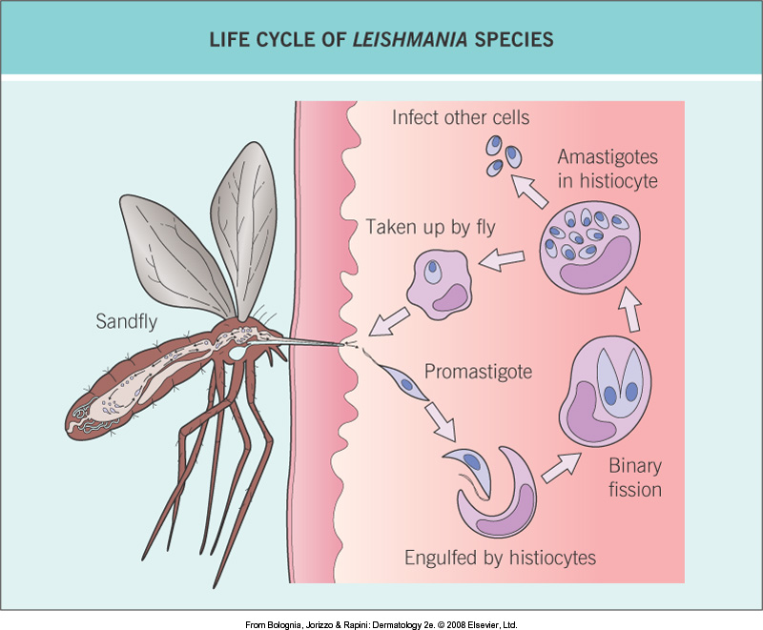

Slide 24
90% of cases in Afghanistan, Iran, Saudi Arabia, Syria, Brazil, Peru

Slide 25
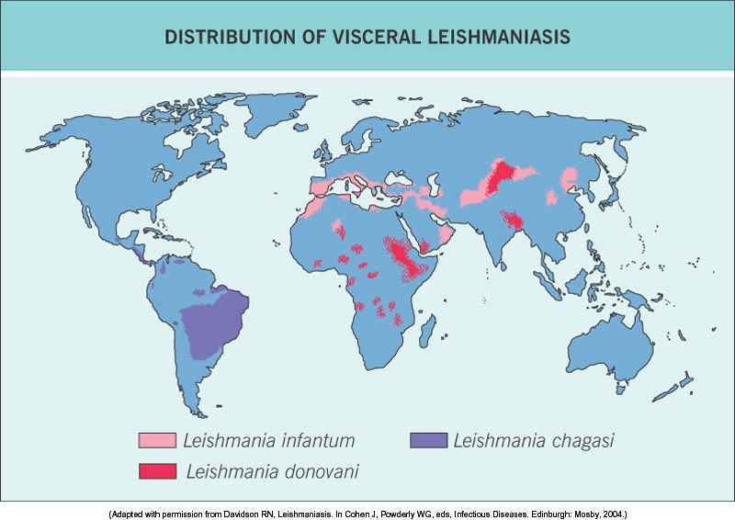
(Kala-azar)

Slide 26
Leishmaniasis Immunobiology
Immunologic spectrum parallels leprosy
T-cell mediated immunity very important
Th1 profile → cure
Th2 or lack of Th1 →susceptibility or worsening
Protective immunity
Cutaneous leishmaniasis
Over-reactive immune response
Mucocutaneous leishmaniasis
Under-reactive immune response
Diffuse cutaneous leishmaniasis
Little inflammation or risk of visceral disease
Poor resistance or immunosuppression
Visceral leishmaniasis

Slide 27
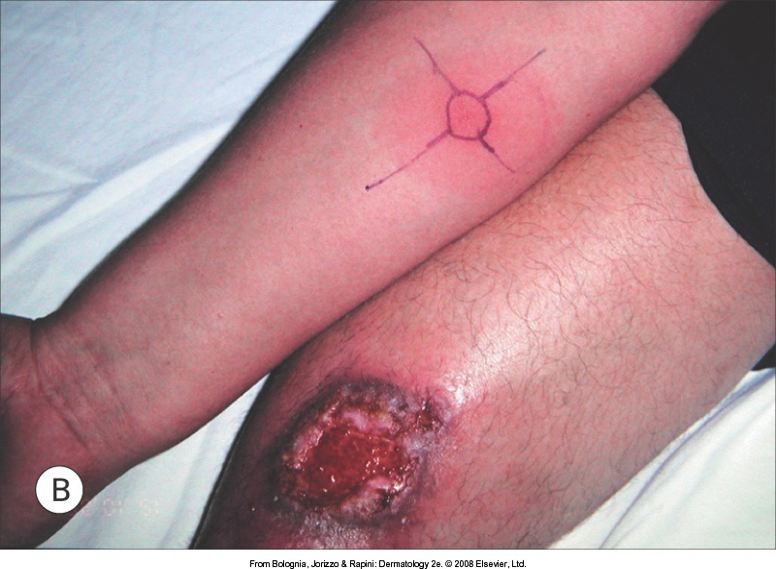
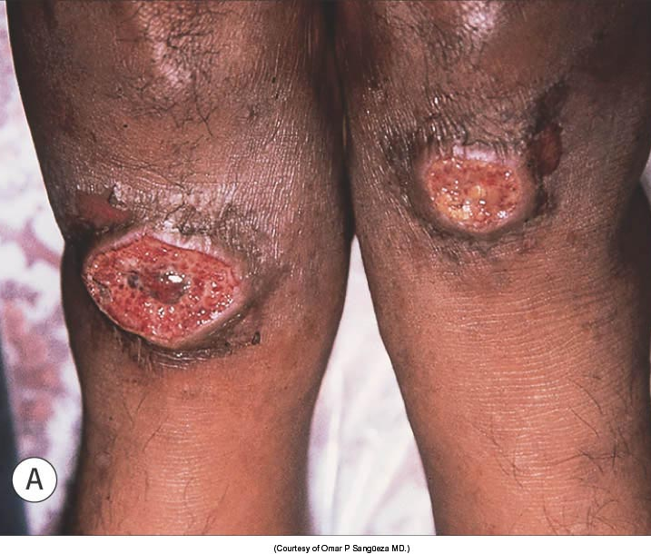
Cutaneous leishmaniasis:Ulcerated

Slide 28
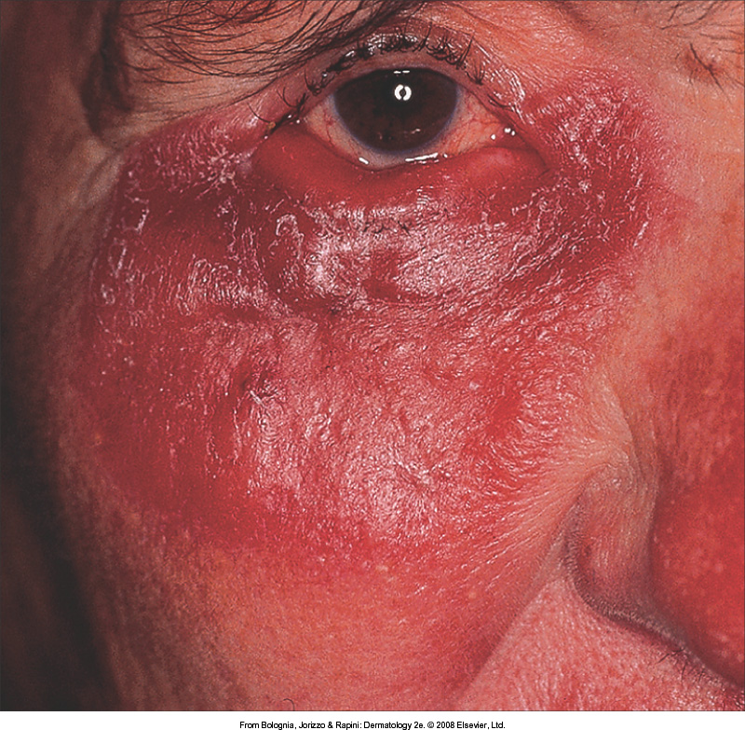
Cutaneous leishmaniasis: Sarcoid-like

Slide 29
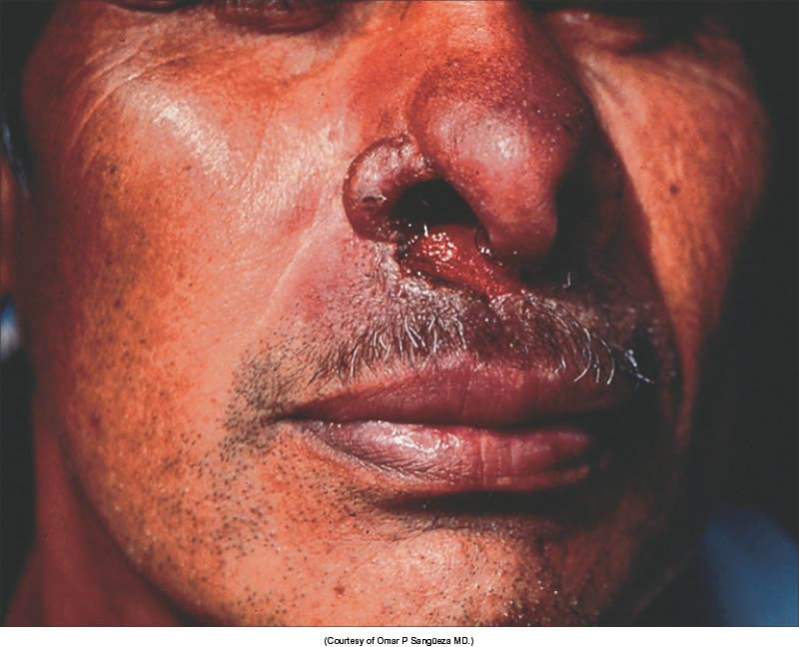
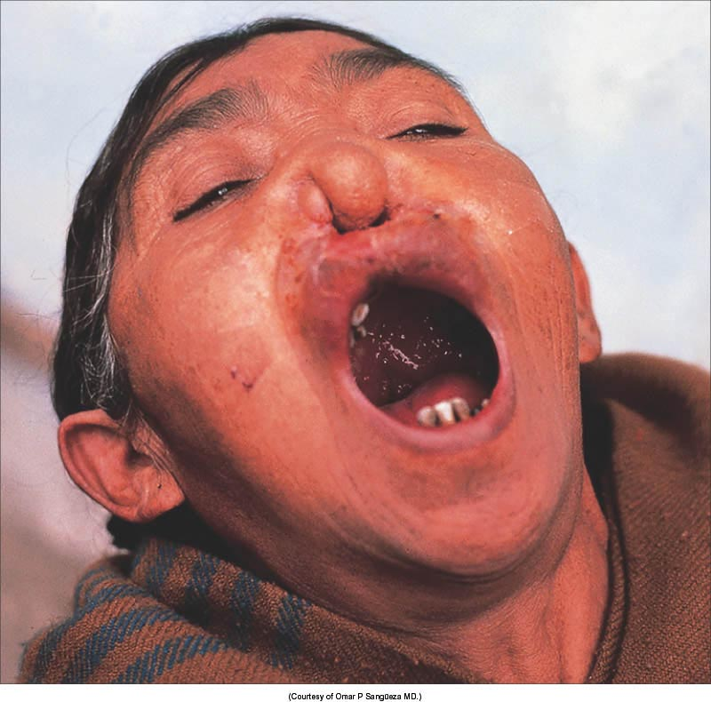
Mucocutaneous leishmaniasis

Slide 30
“Leishmaniasis” in Tropical Infectious Diseases: Principles, Pathogens & Practice 2nd Ed., Guerrant RL (ed.), 2005.

Slide 31
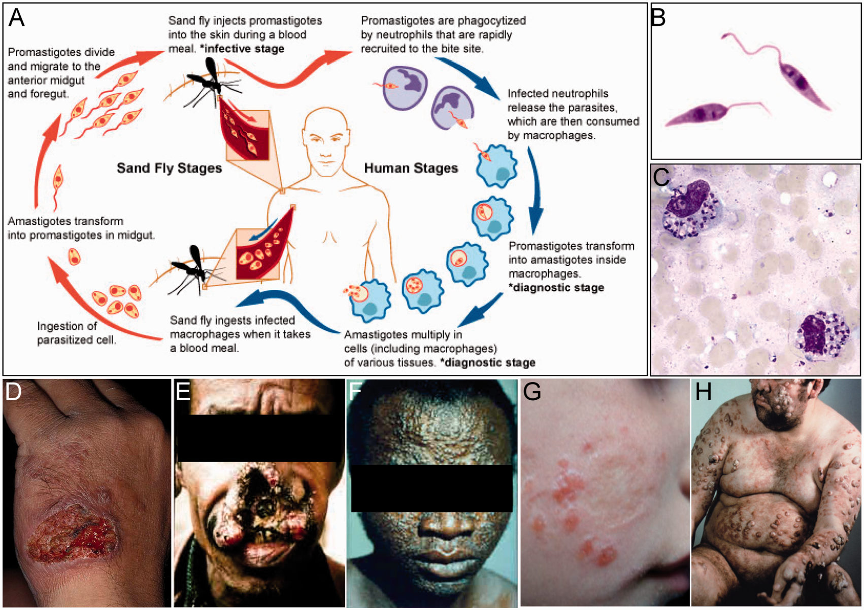
From: Leishmaniasis: clinical syndromes and treatment
QJM. 2013;107(1):7-14. doi:10.1093/qjmed/hct116
QJM | © The Author 2013. Published by Oxford University Press on behalf of the Association of Physicians. All rights reserved. For Permissions, please email: journals.permissions@oup.com
Notes:
Figure 1. Leishmania life cycle and clinical syndromes. (A) Diagrammatic depiction of life cycle of Leishmania. (B) Giemsa stained preparation of L. donovani promastigotes, (C) Giemsa staining of touch preparation of a cutaneous lesion showing presence of intracellular parasites inside macrophages, (D) CL lesion on the hand, (E) mucocutaneous lesion (MCL) of the mouth and nose, (F) facial lesions in a case of PKDL, (G) emerging lesions within the old CL scar in LR and (H) lesions throughout in DCL. Credit for pictures: Panels: A, obtained from NIAID; B, www.lookfordiagnosis.com; C, Centers for Disease Control, www.CDC.gov; D, www.Dermnet.com; E, www.Drugline.org; F, www.WHO.int, G, www.globalskinatlas.com and H, Medical Books Online, www.cixip.com.
31

Slide 32
Complex, Difficult, Dangerous Treatment…

Slide 33
Diagnosis
Montenegro skin test – delayed-type hypersensitivity
Widely used in S. America
Leishmanin for detection of cell-mediated immune response
Killed promastigotes injected into dermis
Extent of inflammatory infiltrate measured at 48 and 72 hours
Positive test: papule > 5 mm
Indicates contact with Leishmania, not diagnostic for disease
May be negative in visceral and diffuse cutaneous leishmaniasis and early cases of cutaneous and mucocutaneous disease
Positive in 82 to 89 percent of cases of localized CL

Slide 34
Old World Cutaneous Leish
Pentavalent antimonials + Allopurinol 2 weeks – 81% cured
Intralesional antimony (sodium stibogluconate) every other day for 10 injections – 85% cured
Liquid nitrogen spray monthly for 2 months – 73% cured
Fluconazole 200 mg daily for 6 weeks – 90% cured
Paromomycin/Gent ointment x 4 weeks

Slide 35
New World Cutaneous Leish
Antimony 10 days IV, 10 days off, repeat or 20 days continuous. (28 days for visceral)
Risk prolonged QT, sudden death, acute renal failure, pancreatitis, painful injections
Topical paromomycin/gentamicin mix
Fluconazole oral
Pentamidine isothianate
Ampho B. if refractory
Thermal therapy, cryotherapy, imiquimod

Slide 36
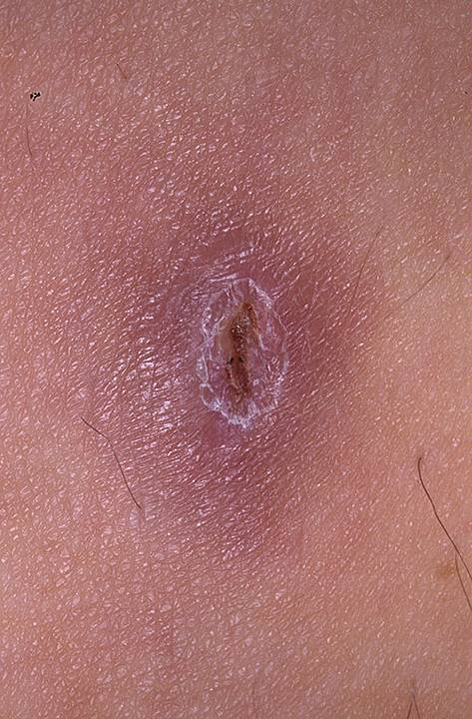
Case 3: The Unusual Boil
26 yo woman traveler w/painful lesion on arm.
3 week vacation Costa Rican rainforest
No known insect bite or injury to this area and otherwise feels well.
“I feel something moving around in my skin.”
www.dermtext.com

Slide 37
Case 3: The Unusual Boil
What is the most appropriate next step?
Cephalexin 500 mg q.i.d. x 10 days
Punch excision
Apply petroleum jelly
Ivermectin 200 mcg/kg x 1 dose
Referral to psychiatry for delusions of parasitosis
www.dermtext.com

Slide 38
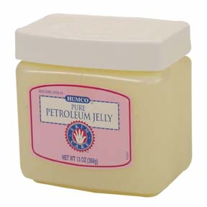
Case 3: The Unusual Boil
What is the most appropriate next step?
Cephalexin 500 mg q.i.d. x 10 days
Punch excision
Apply petroleum jelly
Ivermectin 200 mcg/kg x 1 dose
Referral to psychiatry for delusions of parasitosis
www.dermtext.com

Slide 39
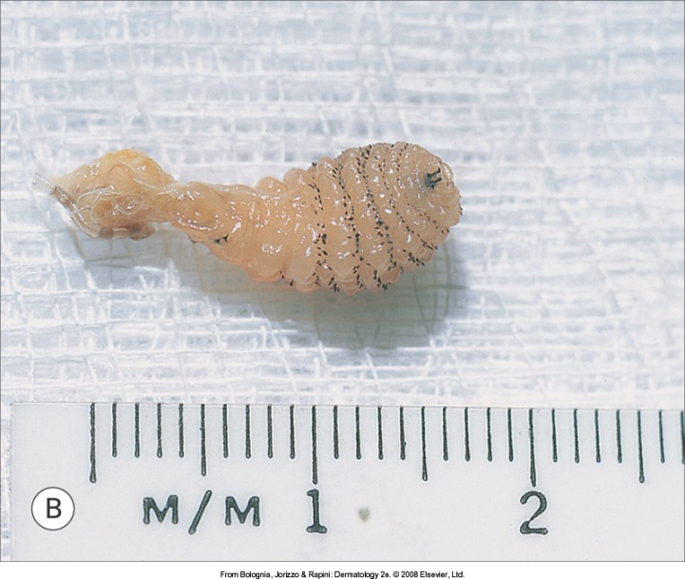
Cutaneous Myiasis
Infestation of skin with fly larva
Worldwide distribution
Tropical, subtropical, and warm temperate
Cutaneous myiasis most common form

Slide 40
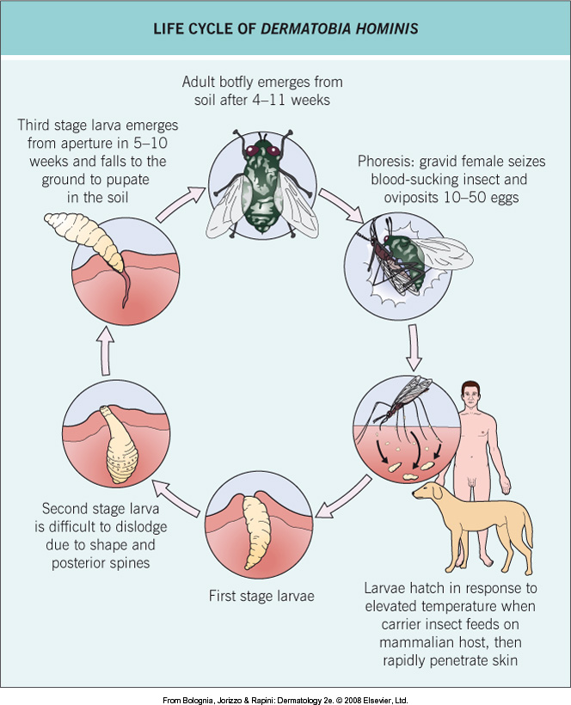

Slide 41
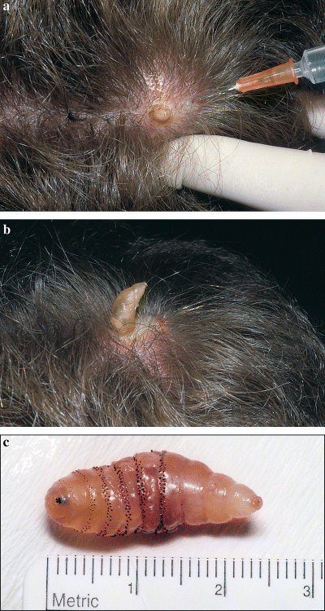
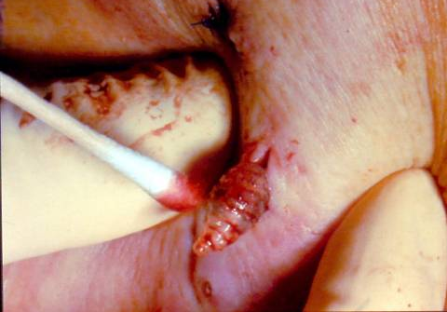
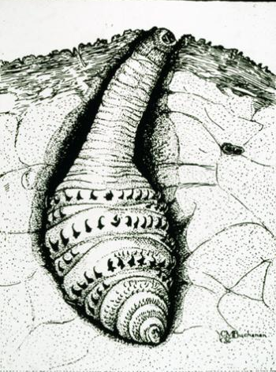
. . . and how do you know?
Notes:
Removal- injection of local anesthetic causes larva to bulge outward, also vaseline occlusion of opening of furuncle causes larva to migrate outward

Slide 42
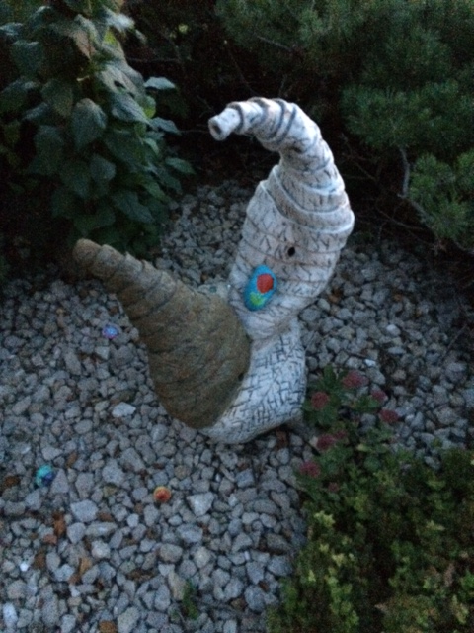
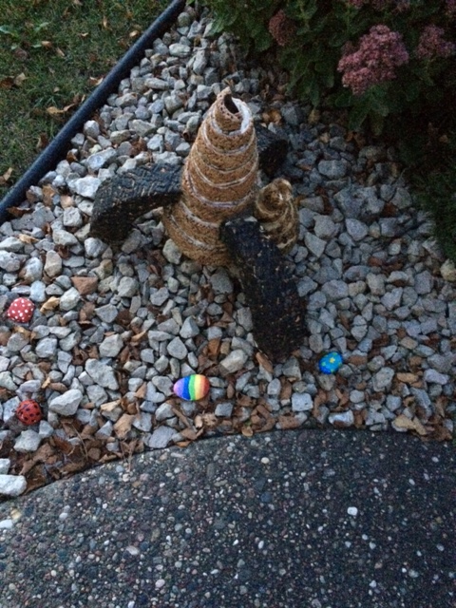

Slide 43
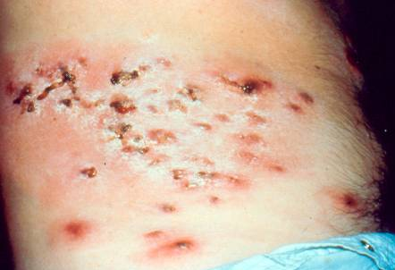
Old World Myiasis
Eggs deposited on clothing or ground - African tumbu fly, mango fly, Mputsi fly
Iron your undies (if dried on the line)!
Multiple lesions
Topical or oral ivermectin

Slide 44
Case 4: A 42 yo physician in Togo
Noticed a painful papule on medial heel that turned to nodule with black center
Recognized the diagnosis
Excised with cure…

Slide 45
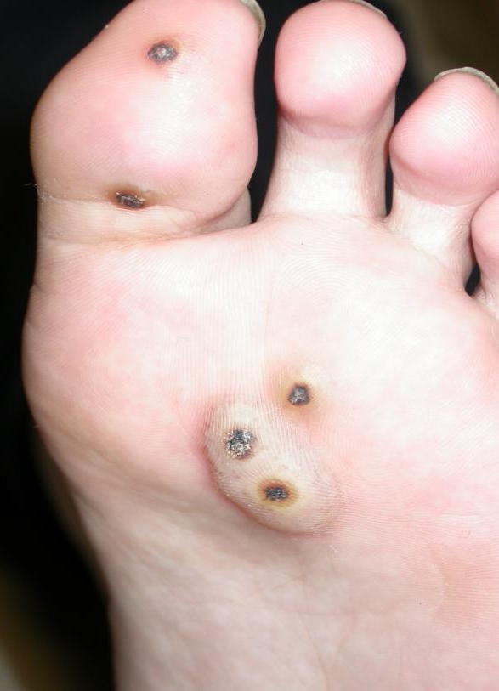
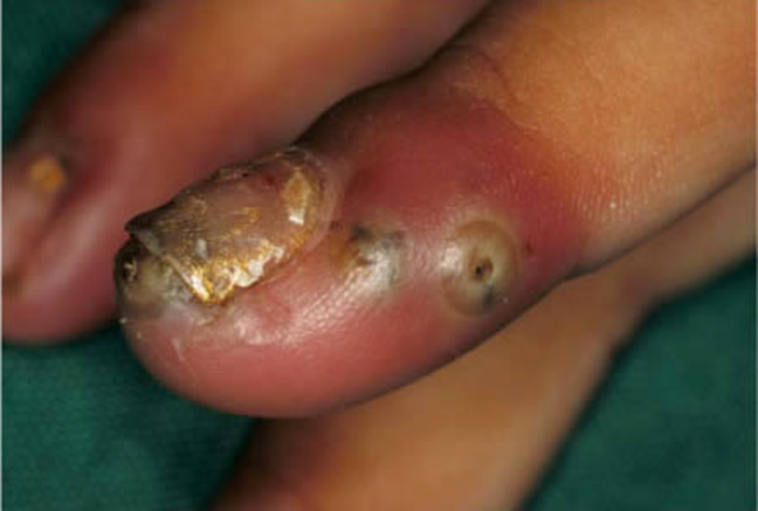
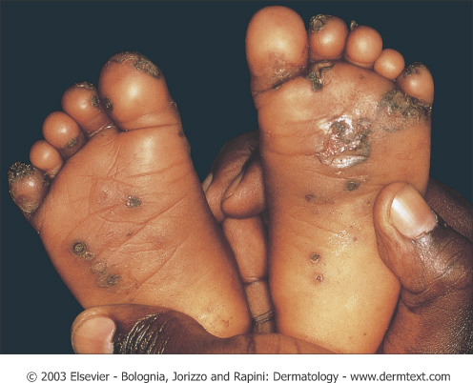
Case 4: A Bit Like Myiasis
Female burrows into skin (usually foot)
Painful red spot -> papule -> nodule with black dot (anal/genital area of flea) -> pearl-like papule (with eggs) -> black keratotic crust
A life cycle you can watch…in you!

Slide 46
Tungiasis
Gravid female burrows into flesh, leaving uterine pore open
Secondary infection is only harm.
Life cycle of 2-4 mm flea is 5-6 weeks
Infestation self-limited if not reinfected
Worldwide
Clin Dermatol. 2007 Mar-Apr;25(2):158-64.

Slide 47
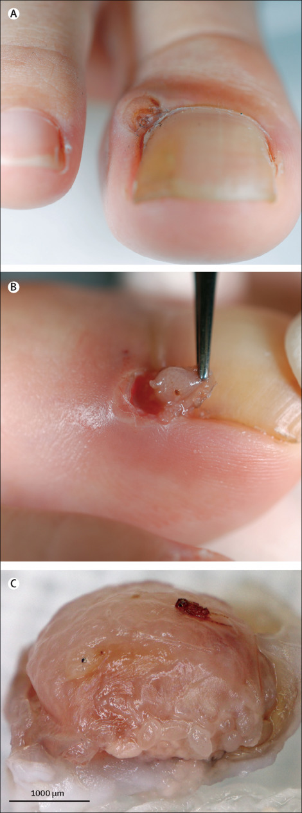
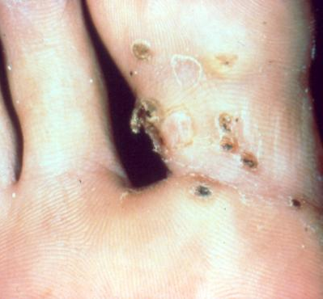
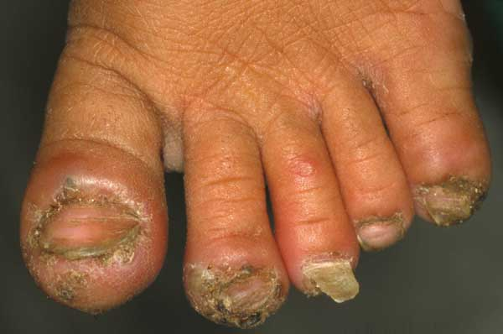
Treatment: Surgical Excision
Anti‐parasitic agents (Ivermectin, Thiabendazole) indicated if numerous lesions.
Td and TIG if not immunized
Matono, Lancet, 2016

Slide 48
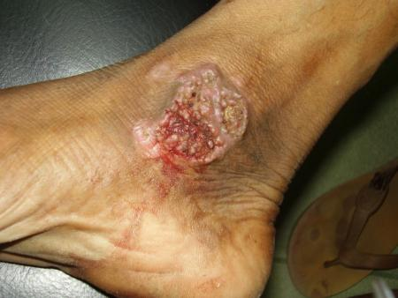
M. TB.
Inoculation from exogenous source (primary inoculation TB, Tuberculosis cutis verrucosa)
Endogenous cutaneous spread (Scrofuloderma, tuberculosis cutis oroficialis)
Hematogenous spread (Miliary TB, Lupus vulgaris)
Tuberculids (erythema induratum)

Slide 49
TB Scrofuloderma
Tuberculous involvement of the skin by direct extension from underlying lymphadenitis

Slide 50
Case 5: The edematous lumpy foot
33 yo farmer
Foot gradually swelling over 3 years
Sinus tracts discharging black “grains”, ½ to 3 mm in size

Slide 51
Case 5: Madura Foot
Usually foot; can be other
Traumatic inoculation
Swelling, tumefaction, draining sinuses, extruded “grains”
Destroys deep structures and bone
If grains black = eumycetoma
(If yellow or white, could be fungus or bacterial)

Slide 52
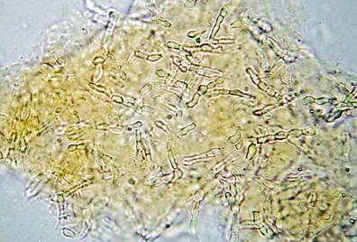
Case 5: Madura Foot
A fine needle aspiration smear.
Microscopy 20% KOH
See fungal structures and grains (broad, septate, and branching hyphae with large swollen cells at the edge) = eumycetoma
Tx: Itraconazole 6 months (or Vora/Posa/Keto) then surgery then 6 more months.
Up To Date, 2017

Slide 53
Case 5: Bacterial Madura Foot
White or yellow “grains”
Aspirate doesn’t show fungal hyphae.
Gram stain shows bacteria
Nocardia spp most common
Partially acid-fast filamentous branching rods
TMP-SMX 6-12 months (or Augmentin/TCN)

Slide 54
Other Stuff
Miscellany you should know before you go...

Slide 55
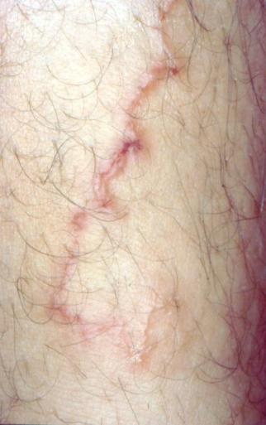
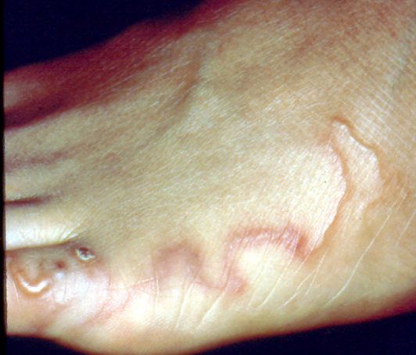
Cutaneous Larva Migrans
Dog or cat hookworm larvae on the beach
Unlike human hookworms, cannot fully penetrate and die within 2 months
Migrates ~ 2 cm/day
Course: self-limited 1-6 mos
Rx: topical thiabendazole or single dose of oral ivermectin

Slide 56
Skin complaints common among travellers.
17‐18% of presentations to travel clinics.
Some travel‐related skin disorders (up to 10% is some series) require hospitalization.
Int J Infect Dis. 2008 Nov;12(6):593-602. N Engl J Med 2006; 354:119-130

Slide 57
Skin lesions in returned travellers (n=4742) (Derm complaints were reason for visit 1/6)
Cut. larva migrans 9.8%
Insect bite 8.2%
Skin abscess 7.7%
Infected insect bite 6.8%
Allergic rash 5.5%
Rash, Unknown 5.5%
Dog bite 4.3%
Superficial fungal 4.0%
Dengue 3.4%
Leishmaniasis 3.3%
Myiasis 2.7%
Spotted fever 1.5%
Scabies 1.5%
Int J Infect Dis 2008; 12(6)593-602

Slide 58
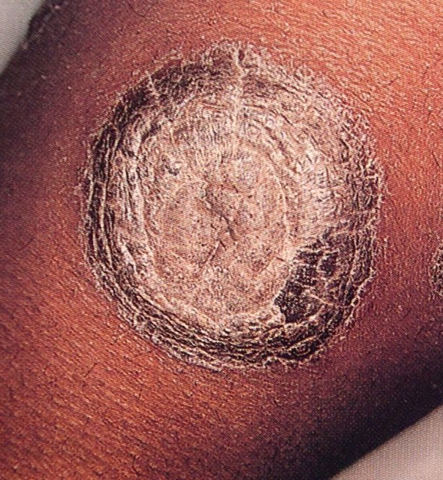
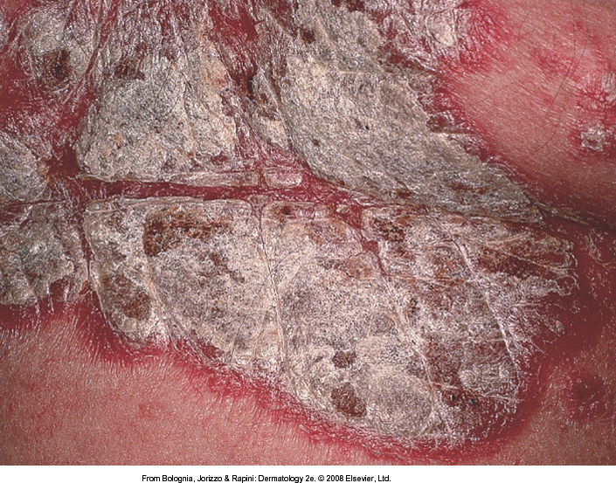
Psoriasis
Callen, 2006

Slide 59
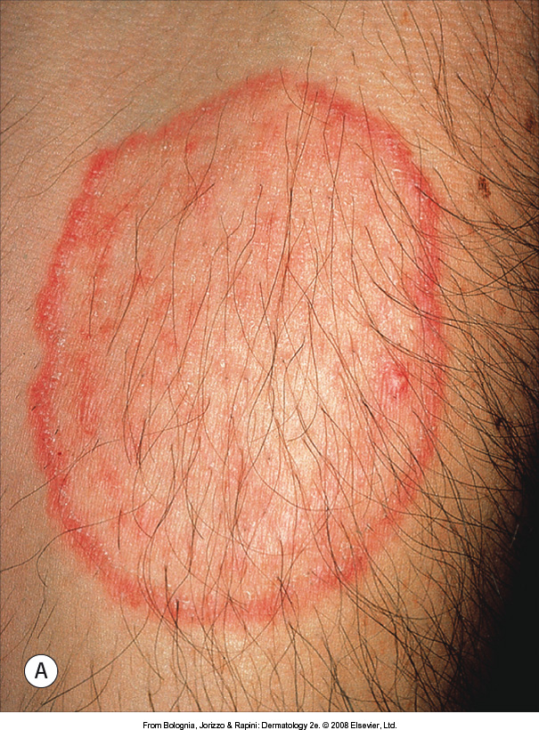
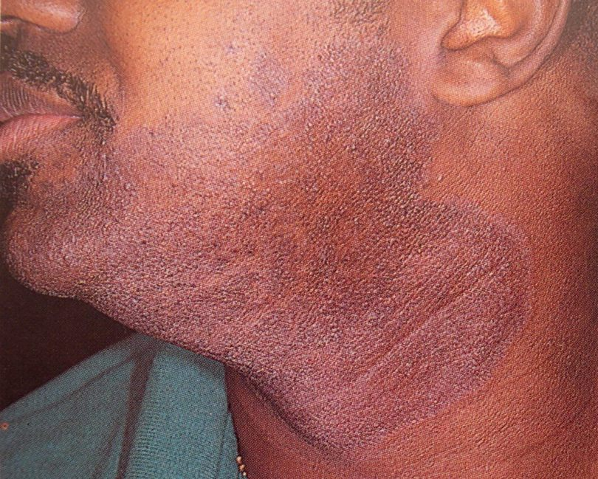
Tinea
Callen, 2006

Slide 60
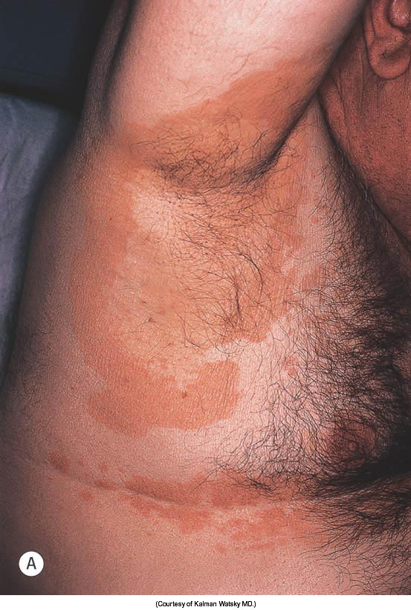
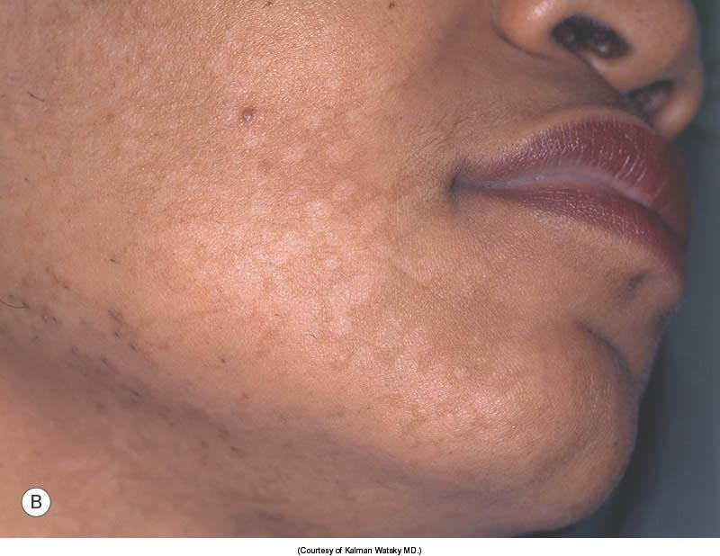
Pityriasis versicolor
Bolognia, 2008

Slide 61
DDx of Itchy Skin in the Tropics
Infestations: Scabies, pediculosis
Dermatitis: Atopic, contact
Miliaria
Insect bites
Pruritic papular eruption of HIV
Helminths: Onchocerciasis, cutaneous larva migrans
Dermatophyte infection
Schistosomiasis: Swimmer’s itch
Seabather’s eruption

Slide 62
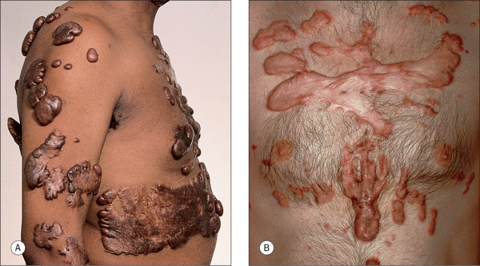
Keloidal scars
Keloid formation 3-18 times more common in dark vs. fair skinned persons
Possibly due to larger, multinucleated fibroblasts
Bolognia, 2008

Slide 63
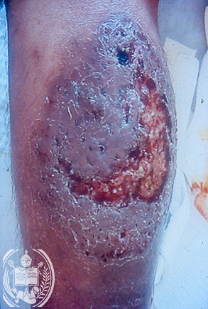
Leg Ulcers From Fungal Infections
Sporotrichosis
Blastomycosis
Coccidioidomycosis
Cryptococcosis
Histoplasmosis
Protothecosis
Chromoblastomycosis
protothecosis

Slide 64
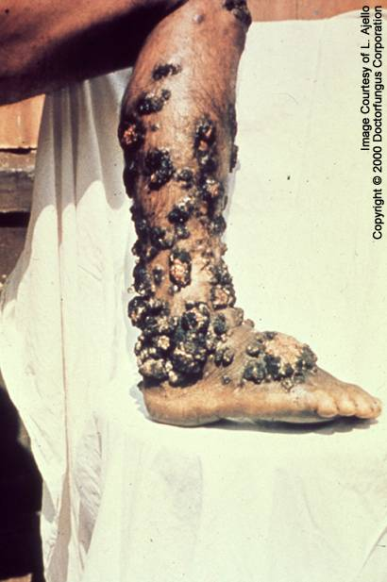
Chromoblastomycosis
Usually one lower extremity
Male Farmers
Fonsecaea pedrosoi
Notes:
Direct inoculation, start as pink scaly papule or warty growth, verrucous/nodular, atrophy/scarring

Slide 65
Sporotrichosis
Nodules with lymphatic spread and ulceration
Sporothrix schenkii
Worldwide
Itraconazole
Potassium Iodide

Slide 66
Sporotrichoid Spread Differential
(aka Lymphocutaneous syndrome)
Sporotrichosis
Nocardiosis
Leishmaniasis Tularemia
Atypical mycobacteria (esp M. marinum)

Slide 67
Chromoblastomycosis
Treatment is difficult
Small lesions: surgical excision or LN2
Itraconazole or Terbinafine
Below: fungal elements found in smear taken from ulcer
Notes:
10% fail therapy outright, only about 30% cured, >40% have recrudescence, amputation

Slide 68
Lobomycosis
Acquired from soil, water, vegetation in forested areas
Recurrence common
Amazonian wetlands
Small lesions- surgical excision
Itraconazole & Clofazimine

Slide 69
Rhinosporidiosis
Rhinosporidium seeberi
India, East Asia, Latin America
Mucosal polypoid lesions
Bleed easily
Notes:
Organism found in stagnant water, In genitals resemble condylomata, appear as spherules found in larger cystic sporangio- grayish white flecks are transepithelial elimination of sporangia

Slide 70
Rhinosporidiosis Treatment
Destruction of involved area by excision or electrosurgery
Antifungals are of little value
Notes:
Cultures easiest with microcystis aeruginosa (may represent synergistic infection of fungus and cyanobacterium0 try cipro)

Slide 71
Basidiobolomycosis
Entomophthoromycosis
Indonesia, worldwide
Indolent course
Basidiobolus ranarum
Subcutaneous
Notes:
2 types one perinasal dz, 2 caused by B. Ranarum subq nodules ext, buttocks, trunk

Slide 72
Basidiobolomycosis
Biopsy diagnosis- broad, thin-walled hyphae, aseptate, branched at right angles
Potassium iodide drug of choice, other Antifungals

Slide 73
Good resources for Tropical Dermatology
Tropical Dermatology (2017) by Stephen Tyring, Omar Lupi - Comprehensive text; good as a reference.
Tropical Medicine and Parasitology (2006) by Pasvol, Peters, Causa – more than dermatology. The classic global health picture book.

