Slide 1
Starting the Conversation: Integrating a Social Justice Curriculum Into an Urban Residency Program
Diana Carvajal, MD, MPH
Kristin Reavis, MD, MBS
Dea Sloan, MD, MPH

Slide 2
No Disclosures

Slide 3
Objectives
On completion of this session, participants should be able to:
Define social justice and how it relates to patients and provision of healthcare.
Identify strategies for creating a social justice curriculum.
Apply strategies for curriculum implementation within the context of clinical care and community involvement.

Slide 4
Coming Together During a Time of Uncertainty
In 2018 America, we are dealing with…
In our current political climate, we are dealing with…
Notes:
- the effects of racism, sexism, xenophobia, attacks on Muslims, anti-Semitism, equal access to healthcare, women’s reproductive rights, etc.
- Uncertainties about access to healthcare; women’s reproductive rights; threats to mental health access; deportation

Slide 5
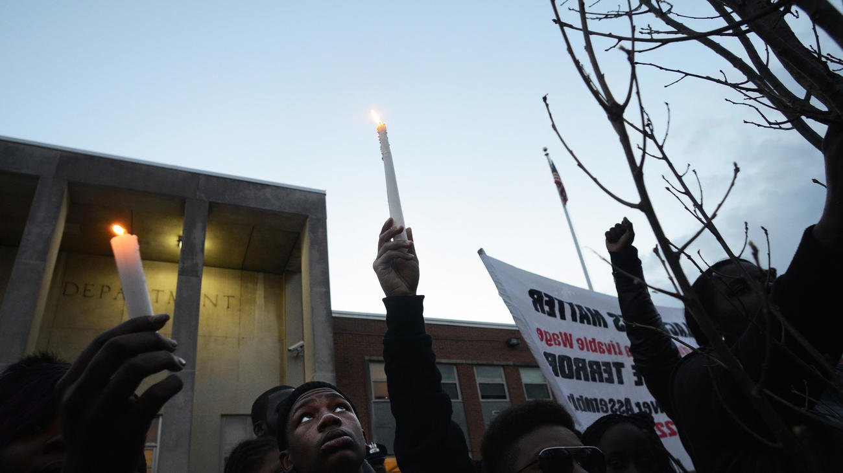
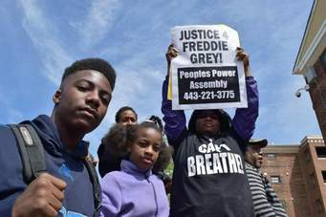
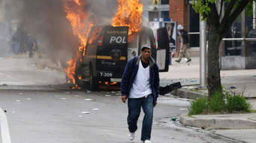
UPRISING… or Rising UP
Rise Up
Notes:
On April 12, 2015, Freddie Gray, a 25 yo black man was arrested in Baltimore, MD. This arrest ultimately resulted in the death of Mr. Gray on April 19, very possibly as a result of excessive force during his transport. As a result of his arrest, hospitalization, and untimely death, on April 25th, protests against police violence in downtown Baltimore City and across the nation escalated into civil unrest in the city.
Practicing in Baltimore City, minutes from the center of this, many of our patients and their families were in the midst of the uprising, which sparked our action and attempt to address issues of social justice within our residency curriculum and for our patient population.
In more recent updates about this situation, all 6 police officers who were involved in his arrest and transport have been found not guilty of any crime.
Reasons why this idea about social justice talk came out:
What got me thinking: Uprisings; confirmations of continued killing of unarmed men and women of color (blacks and latinos in particular)

Slide 6
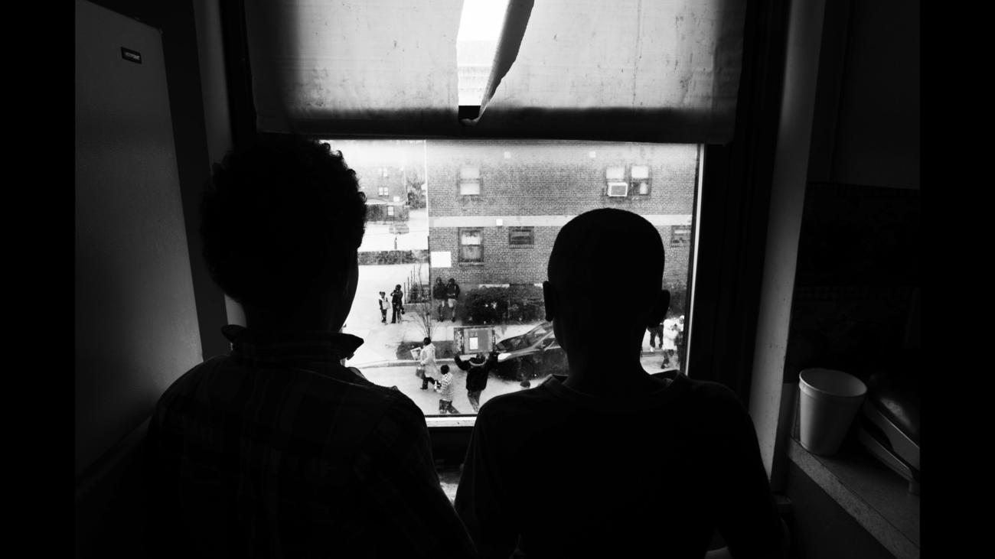
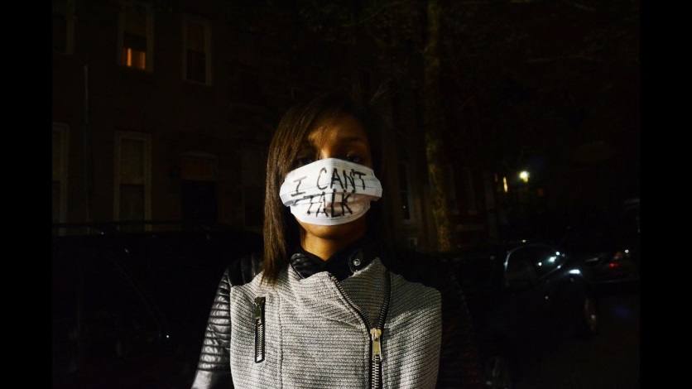
Achieving Health Equity:
Tools for A National Campaign Against Racism;
Dr. Camara Phyllis Jones, MD, MPH, PhD
Levels of Racism: A Theoretic Framework and a Gardener’s Tale
Notes:
The following year, we attended STFM where Dr. Camara Jones spoke about the impact and role of race and ethnicity in healthcare. This talk inspired us to transform our ideas into action… we started thinking about the real health disparities that exist in Baltimore and for OUR patients…and the importance of ensuring that our residents, some of whom have not ever been truly exposed to the reality of health disparity, begin to understqand how this truly impacts the care that our patients receive, both inside AND outside of our practice.
Thus, we began to devise a plan to create and integrate this curriculum into our residency education.

Slide 7
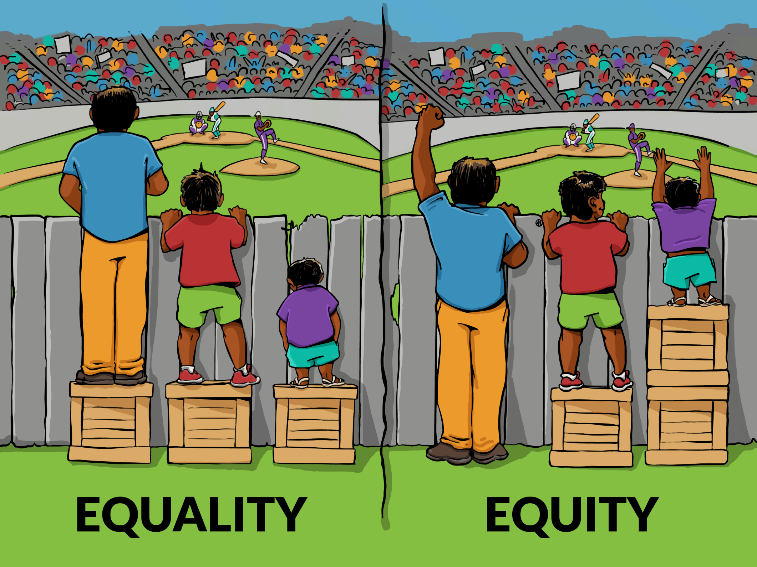

Slide 8
What is Inequity?
A system of structuring opportunity and assigning value based on _________ , that:
Unfairly disadvantages some individuals and communities
Unfairly advantages other individuals and communities
Zaps the strength of the whole society through the waste of human resources
Jones CP. Systems of Power, Axes of Inequity: Parallels, Intersections, Braiding the Strands. Medical Care 2014;52(10)Suppl 3:S71-S75.
Solar O, Irwin A. A conceptual framework for action on the social determinants of health, Social Determinants of Health Discussion Paper 2 (Policy and Practice); 2010.
Notes:
Axes of inequity:
Race
Gender
Ethnicity
Labor roles and social class markers
Nationality, language, and legal status
Sexual orientation
Gender identity/non-conformity
Disability status
Geography
Religion
Incarceration history
Age

Slide 9
What is Health Equity?
Health equity is assurance of the conditions of optimal health for all people
Achieving health equity requires:
Valuing all individuals and populations equally
Recognizing and rectifying historical injustices
Providing resources according to need
Health disparities will be eliminated when health equity is achieved
Jones CP. Systems of Power, Axes of Inequity: Parallels, Intersections, Braiding the Strands. Medical Care 2014;52(10)Suppl 3:S71-S75.
Notes:
Health Equity (WHO): The absence of unfair and avoidable/remediable differences in health among social groups.

Slide 10
Social Determinants of Health
Notes:
Reproduced from: https://nacchocommunique.com/tag/social-determinants-of-health/
What are Social Determinants of Health: The conditions under which people are born, grow, live, work and age. The factors that strongly influence health outcomes include a person’s:
Access to medical care
Access to nutritious foods
Access to clean water and functioning utilities
Early childhood social and physical environment, including childcare
Education and health literacy
Ethnicity and cultural orientation
Familial and other social support
Gender
Housing and transportation resources
Linguistic and other communication capabilities
Occupation and job security
Neighborhood safety and recreational facilities
Other social stressors (exposure to violence, ACEs)
Sexual identification
Social/socioeconomic status
Spiritual/religious values
SDH are important however because they are inextricably tied to health equity and of course by extension, to social justice

Slide 11
Conceptual Framework of Health Equity Social Determinants of Health Inequities
CSDH conceptual framework (Solar & Irwin, 2010)
Notes:
In thinking about implementing a sj curriculum, we felt we need to go one step further and consider a framework that specificially works on, includes, and calls
Out SD of inequities –realizing that all of these factors known as SDoH are inextricably tied to social inequities and injustice.
So we’ve chosen this apparently very busy and complicated slide that compasess some of the major isms associated with social injustices and therefore social inequities.
This framework departs from previous models by conceptualizing the health system itself as a SDH
It shows how social, economic, and political mechanisms give rise to a set of socioeconomic positions whereby populations are stratified according to income, education, occupation, gender, race/ethnicity, and several other factors; these SE positons in turn shape specific determinants of health (intermediary determinants) which reflect people’s place within society; based on this status, individuals experience differences in exposures and vulnerability to health-compromising conditions.
Of course, health and illness then ‘feedback’ to affect the functioning of social, economic, and political institutions --as an interminable cycle.
Note what is included within SE and political contexts.
Together, context, structural mechanisms, and the resulting SE positions of individuals are ‘structural determinants’ and in effect, it these determinants that are referred as the ‘SD of heath inequities’

Slide 12
So…What is Social Justice Anyway?
human rights
dignity
political, economical, social, and other equality
equal distribution of resources
justice - use of policy and laws removing inequality
societal participation in change
personal responsibility
creating access to opportunity and change through action.
Notes:
While there are many definitions of social justice, they are all variations on a theme involving the distribution of advantages and disadvantages within a society --undoubtedly related to health and health equity because achieving social justice involves achieving health equity!
Larger social injustice?

Slide 13
Alton Sterling
Tamir Rice
Terrence Sterling
Michael Brown
Oscar Grant
Philando Castile
Trayvon Martin
Freddie Gray
Brennan Walker
Walter Scott
Stephon Clark
Sandra Bland
Laquan McDonald
Renisha McBride
Terence Crutcher
Eric Garner
Notes:
Does anyone know what these names have in common?
Police killed 1147 people in 2017. Despite black people comprising 13% of the population, 25% of those killed by police in 2017 were black. 30% of those black victims were unarmed.
The fact that these events are now more and more mainstream and represent true cases of social injustice in our perspective ---really gave us the impetus to move forward with implementing our social justice curriculum
Source: Police Killed More than 1100 People This Year and a Quarter of Them Were Black. Newsweek Online. 29 Dec 2017. http://www.newsweek.com/police-shootings-killings-us-unarmed-black-reform-michael-brown-764787. Accessed 30 Apr 2018.
These name represent only a fraction of those who have been killed by police. These are examples that have occurred across the US. They represent many of the patients who we serve. They come from different backgrounds and are of varying SES, but many of them, especially the men, come from disadvantaged backgrounds, had previous arrests and traffic stops, were previously jailed. Despite these facts, little to none of this was known at the time of their killings, which often occurred from behind. This is the existence that many of our patients face.
We often teach our residents to gather histories about their patients, but it’s important to highlight the impacts that their social history, far beyond whether they smoke, drink, or use drugs, have on their patients’ health.
Alton Sterling – 7/5/2016, fatally shot by 2 Baton Rouge police officers – arrested for report that he was selling cds outside a convenience store
Terrence Sterling – 9/11/2016, washington dc – officer unlawfully pursued Sterling driving a motorcycle, sterling reportedly hit the cruiser with his motorcycle , fatally shot in the back and neck
Tamir Rice – 11/23/2014, cleveland, oh– 12 yo. Police received a call that a juvenile kept pulling a “probably fake gun” out of his pants. Officers arrived and quickly shot Tamir.
Michael Brown – 8/9/2014, ferguson, missouri – accused of a strong arm robbery, police engaged Brown who was fatally shot, at least 6 times in the chest
Philando Castile – 7/6/2016, Falcoln Heights, Minn – fatally shot during a traffic stop while reaching for his ID, after informing officer that he had a “legal” firearm in his car. officer acquitted of 2nd degree manslaughter. Aftermath broadcast on FB live by girlfriend who was in the car with her 4 yo daughter.
Trayvon Martin – 2/26/2012, Sanford, Fl – fatally shot by neighborhood watch volunteer who confronted Martin as being “suspicious” while returning home from the store. Called police to report, was told to disengage, continued to follow him.
Freddie Gray – Baltimore, MD arrested for possessing an illegal knife.
Brennan Walker – 4/12/2018, Rochester Hills, Michigan. 14 yo, missed bus, walked to school, knocked on a door to ask a neighbor for directions, homeowner started yelling, accusing him of trying to break into home, husband pulled a shotgun and fired on him as he fled, missing him.
Stephon Clark- 3/18/2018, sacramento, ca. killed by 2 officers who fired 20 rounds after being suspected of breaking car windows – killed in grandmother’s backyard.
Walter Scott - 4/4/2015, N. Charleston, SC. Stopped for a broken tail light in the parking lot of an auto parts store. Fled from police (had warrant for non-payment child support), officer fired 8 rounds and hit scott from behind.
Sandra Bland – Prarie View, TX – pulled over for failure to signal lane change, arrested after verbal altercation with police. Jailed, died by apparent suicide in her jail cell.
Laquan McDonald – 10/20/14, Chicago, Il – reported to be carrying a knife and breaking into cars. When approached, began walking away from police who shot him from behind, then once on the ground he was shot 16 additional times.
Renisha McBride 11/2/2013 – car accident in Detroit, MI – knocked on a door to ask for help, homeowner fatally shot her upon opening the door.
Terence Crutcher – 9/16/2016, Tulsa, Ok. Call about “abandoned vehicle” in the street. When police arrived, stated that he wasn’t following commands – shot by officer. No weapon found. officer found not guilty of manslaughter
Eric Garner – 7/17/2014, Staten Island, NY – approached for suspicion of selling loose cigarettes. Approached by officer who attempted to handcuff him from behind. Placed in chokehold by officers, brought to the ground. Repeated “I can’t breathe” 11 times while face down. Died en route to the hospital.
Oscar Grant – 1/1/2009, Oakland, CA – fatally shot while being detained, facedown, on a train station platform after reports of a fight on a BART train returning from NYE celebrations

Slide 14
Why Teach Social Justice?
Physicians have the responsibility to address patients’ emotional, cultural, & socioeconomic well-being.
STFM supports the fair distribution of health services & elimination of discrimination in health.
Residency faculty are charged with educating residents about the social needs of our most vulnerable patient populations.
Notes:
Besides all the things we already said…
As physicians, we have the social responsibility to address the emotional, cultural, and socioeconomic well being of patients.
Further, the STFM’s stance on social justice supports the fair distribution of health care services and the elimination of discrimination in health care
As residency faculty, we are charged with ensuring that our residents are aware of and sensitive to the social needs of our most vulnerable patient populations.

Slide 15
IMPLEMENTING SOCIAL JUSTICE

Slide 16
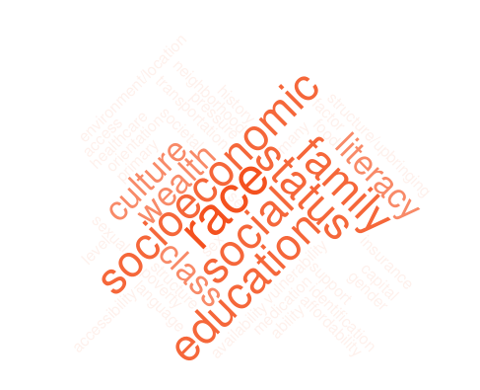
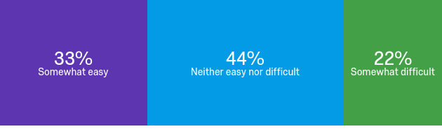
100% of residents feel race impacts healthcare delivery
56% vs 33%, feel comfortable discussing SJ themes with parties of same vs different backgrounds
44% of residents NEVER create treatment plans based on patients’ zip codes; 44% cite this info is somewhat/extremely difficult to collect
12% report they have never been asked about SDoH while precepting
Feelings towards incorporating SJ in to curriculum:
Notes:
statistics from survey
wordcloud - common qualitative themes of free text survey answers describing factors that impact health (aside from pathophysiology)

Slide 17
How do we develop a framework that is translatable across practice settings?
What are other factors affecting medicine outside of pathophysiology?
How do we better understand patients’ lives to provide better care?

Slide 18
Social Justice Curriculum
Grand Round and Core Lectures
Defining what is Social Justice
Guest Speakers
Unconscious Bias Training for residents and faculty
Morning Reports
Precepting
Social Justice Links on Residency Webpage
THINKING ABOUT IT DURING EVERY PATIENT ENCOUNTER.
Notes:
What else…
So how do we incorporate Social Justice in our Education and Practice ?? Audience respond…
I‘m not going to micromanage you guys in your Morning reports because I like we all have a little creativity in our lectures, but I challenge everyone to start incorprating social justice themes. I want it to be as standard as discussing medical history. We can create a standard template for all mornnig reports if people want.

Slide 19
Morning Report: Incorporate 3 key themes
Social barriers and challenges that could affect health outcome
Disease/illness prevalence surrounding patient
Cultural considerations
Notes:
Social barriers and challenges that could affect health outcome: (i.e. no transportation, trouble getting access to food, not a safe neighborhood, recently incarcerated, neighborhood statistics/st
Disease/illness prevalence surrounding patient? →neighborhood profiles
Cultural considerations: (i.e. observing religious holidays, does not eat Western/American food, ESL)
ate policies)

Slide 20
Current MR Templates
Case Based (FPI)
CC
HPI
ROS
DDx
Med hx, Surg hx, Meds, Family hx, Social hx,
Hospital Course
Teaching point
Topic Based
Epidemiology
Pathophysiology
Disease Presentation
DDx
Workup
Treatment
Notes:
Looking at our templates…how do we incorporate social justice into our MR? Audience participation

Slide 21
Case-Based
Case Based (FPI)
CC
HPI
ROS
DDx
Med hx, Surg hx, Meds, Family hx, Social hx,
Hospital Course
Teaching point
Mr. Jones is a 20 year old paraplegic s/p gun shot wound. He lives in the 21217 zip code which just this week had 6 homicides from shootings…
Social hx: Pt has less than HS education, based on the 2013 health disparities report card 76% of Baltimore city residents w/less than HS education have been told they have HTN.
Notes:
Other things from neighborhood profiles: food deserts; income; single parent homes; rate of unemployment

Slide 22
Notes:
example

Slide 23
Topic Based
Topic Based
Epidemiology
Social Barriers/Disease Prevalence/Cultural Considerations
Pathophysiology
Disease Presentation
DDx
Workup
Treatment

Slide 24
Preceptor Engagement
Create a ‘safe space’ for residents.
Increase preceptor knowledge of local health disparities.
Encourage residents to think about reasons patients are ‘non-adherent’ to care plans.
Notes:
Create a safe space for residents to incorporate social history into presentations (don’t rush them; try not to seem judgmental).
Explore the BCHD health maps to increase your own knowledge about the local health disparities.
Think about the health implications of our patients’ social histories.
Consider the health implications of a patient’s zip code.
Look out for residents who seem frustrated about patients who have not adhered to treatment plans. Specifically, challenge those residents to explore why patients are “noncompliant” or “non-adherent” to the treatment plans that we’ve recommended for them.
Some questions to ask during precepting sessions:
Where does the patient live?
What do we know about the health statistics in that area?
Can the patient afford the medications that we’ve prescribed to them?
Do patients have the financial and/or social means to institute the “lifestyle changes” that we’re recommending?

Slide 25
Preceptor Engagement
During precepting: ask residents to consider:
Where the patient lives
The health statistics in that area
Whether the patient can afford prescribed meds
Whether patients have the means to institute the recommended ‘lifestyle changes’

Slide 26
Future Plans
Partnership with community leaders
Focused home visits
Neighborhood walking tours
Patient panel discussions
Patient and community advisory boards
Racial caucusing of residents and faculty
Notes:
Interactions with the healthcare system
Interactions with police/authority
Mistrust of the healthcare system

Slide 27
Questions?
Thank You!
Please fill out your evaluations.

Slide 28
References
Jones CP. Systems of Power, Axes of Inequity: Parallels, Intersections, Braiding the Strands. Medical Care 2014;52(10)Suppl 3:S71-S75.
Notes:
delete

Slide 29
Personal Interactions
Patient panel discussions
Interactions with the healthcare system
Interactions with police/authority
Mistrust of the healthcare system
Intention of home visits
Invited speakers
Social workers
Community leaders
Community resources
Community engagement
Neighborhoods – truly meeting patients where they are
Visiting churches
Health fairs
Jails

