Slide 1
Reducing ED Visits in Two Clinics Utilizing Health Coaches – Lessons Learned John Malaty, MD, FAAFP; Elvira Mercado, MD; Cindy Lasley, RN, MS, BSN; Lisa Chacko, MD, MPH; Reathea Felder, RN; Peter Carek, MD, MS
Department of
Community Health &
Family Medicine
Notes:
Title and Authors listed as on submission but moved Cindy since 1st 3 are presenters at the conference. L108 - 12/8/18 1:40 PM - 2:10 PM Meeting Room 12
Submission:
Health care reform has recently highlighted the importance of cost-effective health care and has linked reimbursement to providing effective, outcome-based, cost-effective patient care. However, many family medicine practices are struggling with how to accomplish this with busy clinical practices. In Gainesville, Florida we identified a high-need/high-cost population of patients geographically in town via GIS/hotspotting that were disproportionally and potentially inappropriately utilizing the emergency department (ED) for nonemergent care. Utilizing RN health coaches at two family medicine clinics that were centered in this geographic area, we have been able to effectively reduce ED visits by initially focusing on high utilizers of the ED, and subsequently expanding efforts to non-high-utilizers. However, there was a learning curve to figure out how to do this in the most effective manner and we will discuss potential barriers and lessons learned at both clinic practices, which had different experiences. We will also provide a framework to incorporate a health coach into your practice, including discussion of what responsibilities you will need to consider prioritizing.
Upon completion of this session, participants should be able to:
incorporate a RN health coach into their practice, including details of day-to-day responsibilities;
utilize a RN health coach to improve high cost, unnecessary care, such as ED visits;
discuss 3 potential pitfalls when utilizing a RN health coach and in trying to reduce ED visits.

Slide 2
Objectives
Incorporate a RN health coach into a clinic practice, including details of day-to-day responsibilities.
Utilize a RN health coach to improve high cost, unnecessary care, such as ED visits.
Discuss 3 potential pitfalls when utilizing a RN health coach and in trying to reduce ED visits.
Notes:
Case Management – social determinants of health

Slide 3
Session Agenda
Introduction
Identifying high risk patients
Funding RN Health Coach
Implementation of RN Health Coach at two clinics with some differences
Impact of RN Health Coach on ED Visits
Questions and Answers
Notes:
Case Management – social determinants of health

Slide 4
INTRODUCTION
ED visits for non-emergent concerns and 30 day readmissions are common
Systematic reviews have been unable to identify a single or bundle of interventions that reliably reduce risk of non-emergent ED visits or readmissions
ED visits: Case Management with moderate impact
Readmissions: Single-center studies have demonstrated impact
No single intervention consistently associated with reduced rate
Notes:
Case Management – social determinants of health

Slide 5
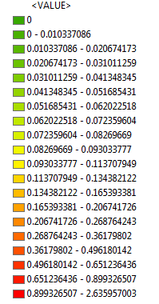
Hotspot – Patient Population
Patients per square kilometer

Slide 6
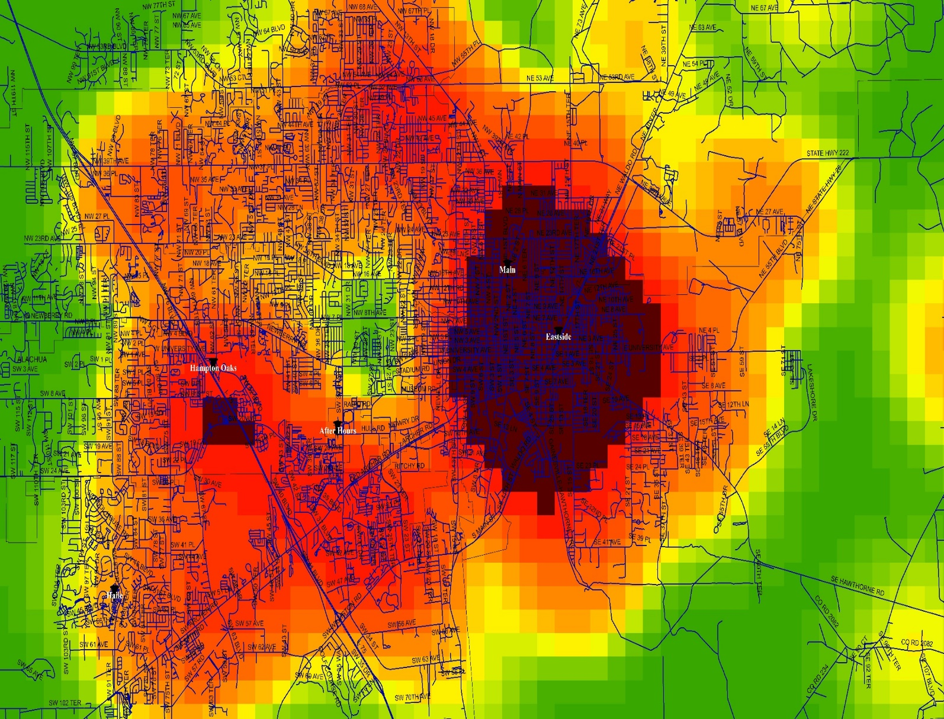
Hotspot for 30 Day Readmissions
Notes:
Focus on hot spots for readmissions but not the clinic sites at this point

Slide 7
High Need Population
Using GIS/Hotspotting helped us identify high need/high cost patient population
Social determinants of health impact health care
Notes:
Wanted to look at things outside of pure medical care…

Slide 8
Notes:
Dept. leadership went to UF to get RN support. Readmission project worked and quality outcomes in our clinics improved – proved we could help save them $ and they know they are going to lose $ with more ED visits and Readmissions… supported 1 RN Health Coach as a pilot. 1 grew to 2 which now has grown to 3 in our dept.
Clinic Leadership, Dept. Leadership, Organizational Leadership

Slide 9
A Tale of Two Clinics
Eastside Clinic
Main Street Clinic
Academic faculty clinic
7 MD, 1 DNP with dedicated pediatric clinic- 5.5 FTE
15,000+ visits per year
Payor Mix:
18% BCBS
5.9% commercial
57.5% Medicaid
15.8% Medicare
2.6% Self pay
Residency program clinic
9 MD, 1 ARNP, 27 residents- 4.05 FTE (faculty)
30,000+ visits per year
Payor Mix:
29% BCBS
9.5% commercial
28.3% Medicaid
29% Medicare
3.7% Self pay
Notes:
BCBS – lots of BCBS exchange

Slide 10
RN Health Coaches to reduce ED visits
University of Florida Eastside and Main Street Clinics hired RN Health Coaches to help high need/high cost patient population
Review ED list of patients attributed to these clinics weekly
Initial focus
High ED utilizers
6 or more ED visits in past 12 months
Notes:
Discuss attributed to – patients we can impact in primary care

Slide 11
RN Health Coaches to reduce ED visits
Later expanded to all ED utilizers
Pertinent Pts called
Moreso at Main Street
Referral to RN Health Coaches
Initially informally and now formally
Notes:
Discuss attributed to – patients we can impact in primary care

Slide 12
RN Health Coach Role
RN Health Coaches call patients and determine reason went to ED but not clinic
Assist with identified needs
Medication concerns
Transportation limitations
Facilitate durable medical equipment
Education about medical concerns
Facilitate behavioral change – Motivational Interviewing
Facilitates f/u appointment with Family Medicine
Facilitates needed specialty care if applicable

Slide 13
RN Health Coach Role (cont’d)
RN Health Coaches also attend weekly multidisciplinary readmission meetings and monthly ED meetings…
Work in concert with our inpatient Case Managers/Social Workers and the ED
Call patients for Transitional Care Management
Notes:
Eastside has been meeting with Pts.

Slide 14
RN Health Coach Role (cont’d)
Work on care plans
Alongside ED: High ED utilizer (MVP) group
Work in concert with specialty care
COPD Readmission Group
Work in concert with community resources
Gainesville Community Resource Paramedic Program
Intense in-home evaluation and follow-up
Meet with patients in clinic as needed
Notes:
2 Pts at a time per clinic – is that accurate?

Slide 15
Main St. – High Utilizer ED Rate
Notes:
This control graph done analyzing Cindy’s start date

Slide 16
Main St. – Overall ED Rate
Notes:
This control graph done analyzing Cindy’s start date

Slide 17
Impact of List Frequency
Notes:
Changing list from q6mo to q3mo has more impact on high utilizer (more points of interest) compared to overall rate – makes sense since goal is to catch high utilizers that you can impact

Slide 18
Eastside – High Utilizer ED Rate, List q3mo

Slide 19
Eastside – Overall ED Rate, List q3mo

Slide 20
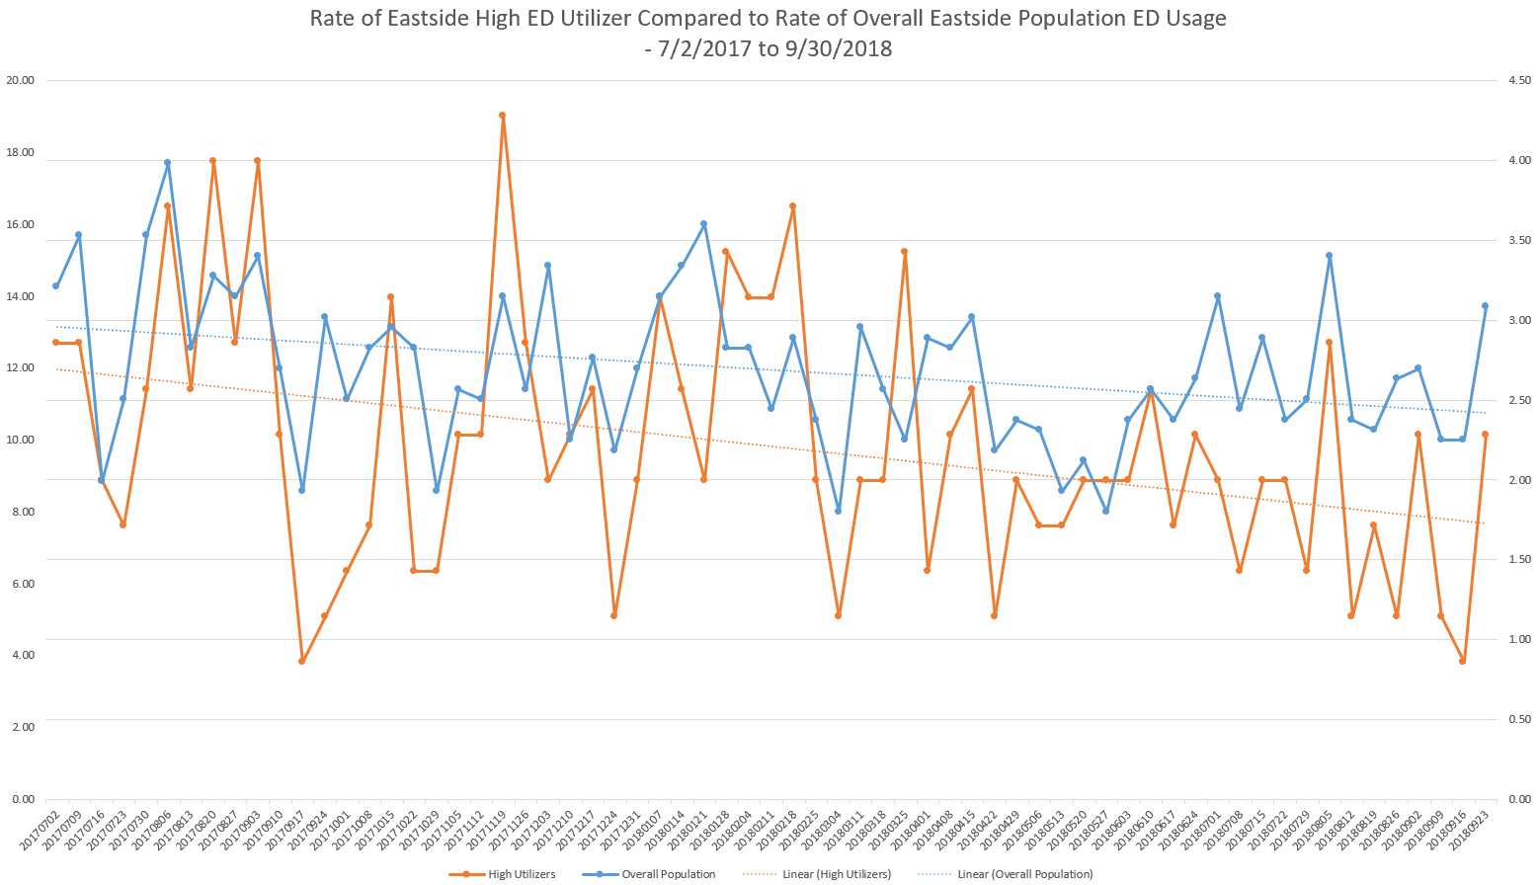
Notes:
When initially looked at control chart in 4/18: Eastside clinic: Initial improvement: after changed active list from q6mo to q3mo. Second improvement appeared to correlate with improvement at Main St – consider after redo control charts - looking into but maybe additional ideas/collaboration with additional Health Coach at Main St. (both working together)

Slide 21
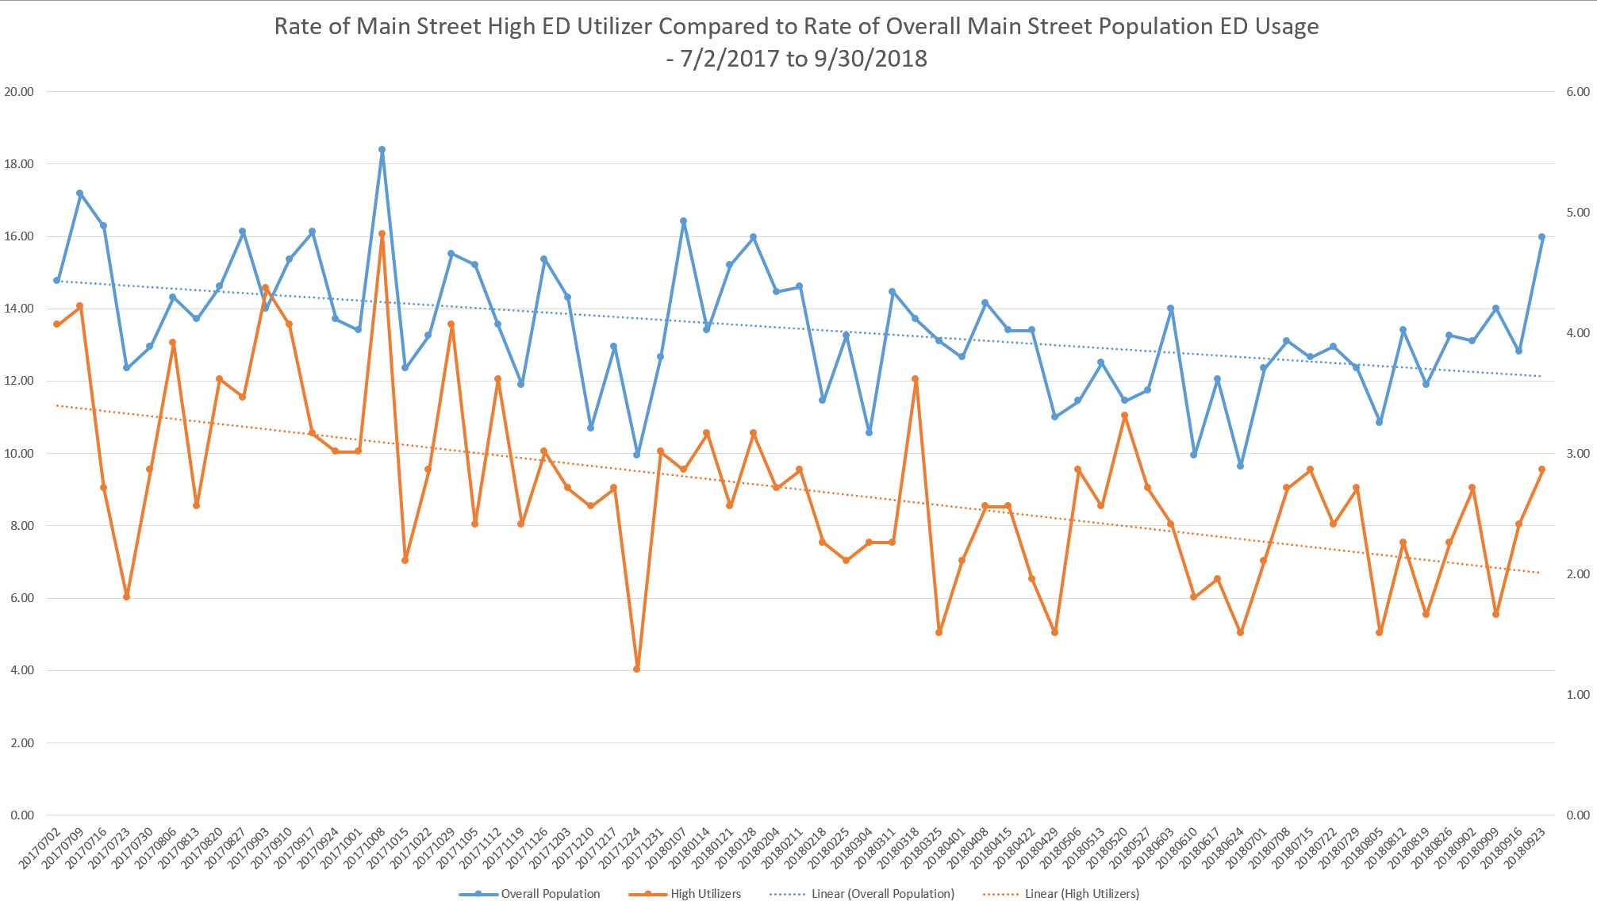
Notes:
Cindy Started in October 2017

Slide 22
DISCUSSION
Limitations
No one specific intervention occurred
This follows premise that different Pts have different needs
Unique patient population and health coaches
Notes:
Different driving social determinants of health…
Discuss effective personalities of our Eastside RN Health Coaches

Slide 23
DISCUSSION
Health Coach Considerations
Reasonable List Length
Initially thought Reathea could do both Main and Eastside and quickly realized this was an insurmountable task
Throughput approach (process approach) vs. “call me” (more focused on individual)
Protect from time/duty creep
Lead Nurse

Slide 24
DISCUSSION
60% vs. 100%
Initial ED Rate – impact?
Physical location of RN – interruptions vs. accessibility
Extended Hours January 2018

Slide 25
DISCUSSION
Effective attributes/vision of RN Health Coach
Energetic
Caring
Flexible
Not easily frustrated
Curious
Experienced
Willing to explore the unknown
Willing to learn informally and formally
National Society of Health Coaches (NSHC)
Focuses on people who are in the healthcare field

Slide 26
CONCLUSION
Identifying high need/high cost population and targeting their needs can significantly reduce ED visits
Multidisciplinary care
RN Health Coaches
It takes a village… and team…
Notes:
Targeting their social determinants of health…

Slide 27
QUESTIONS?
This Photo by Unknown Author is licensed under CC BY

