Slide 1
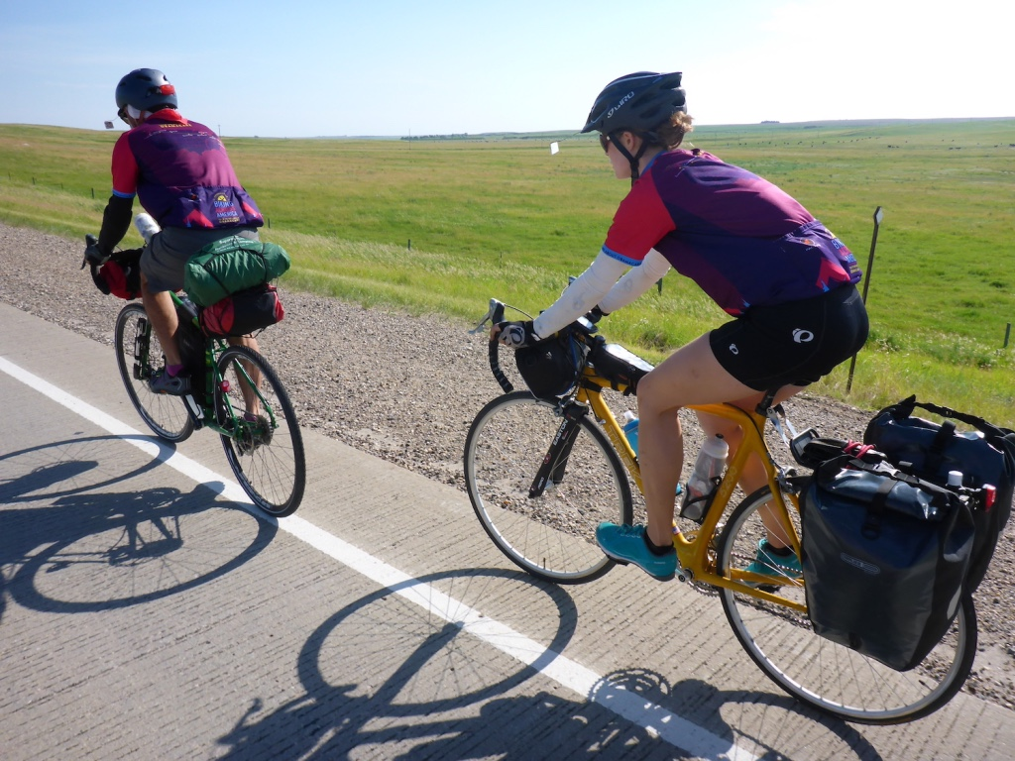
Opposition to Obama Care
Grand Rounds Presentation
Paul Gordon & Laurel Gray

Slide 2
Objectives
At the end of this presentation, participants should be able to:
Discuss to areas of misinformation our patients have regarding the Affordable Care Act
List one example of lack of care for fellow citizens related to the ACA
Define attentive listening

Slide 3
There are no Conflicts of Interest to Disclose

Slide 4
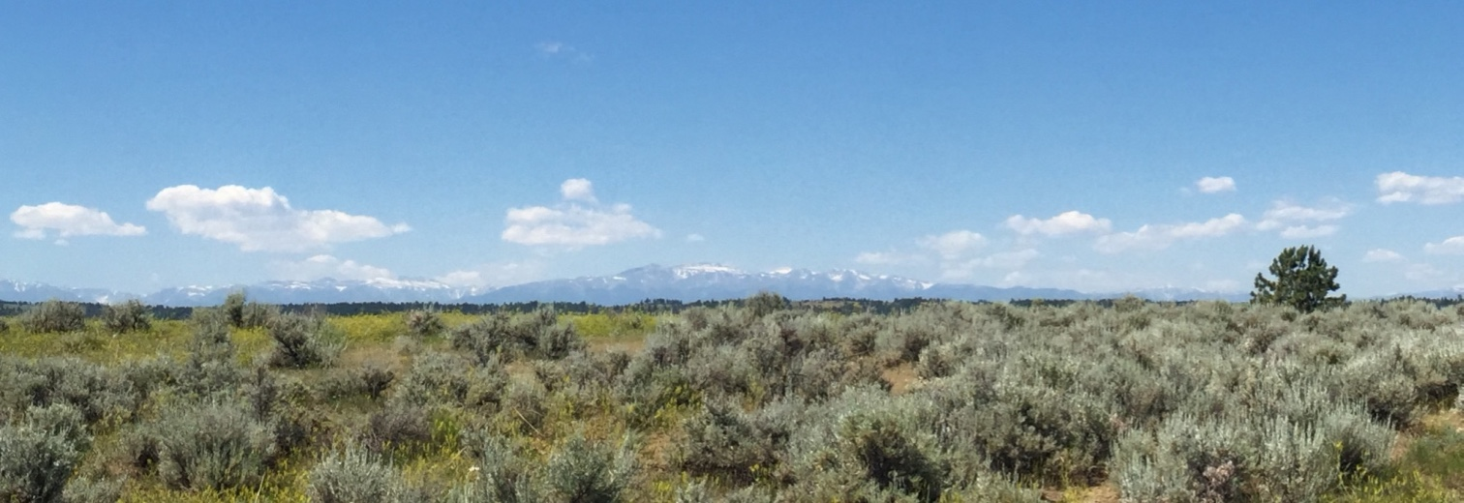
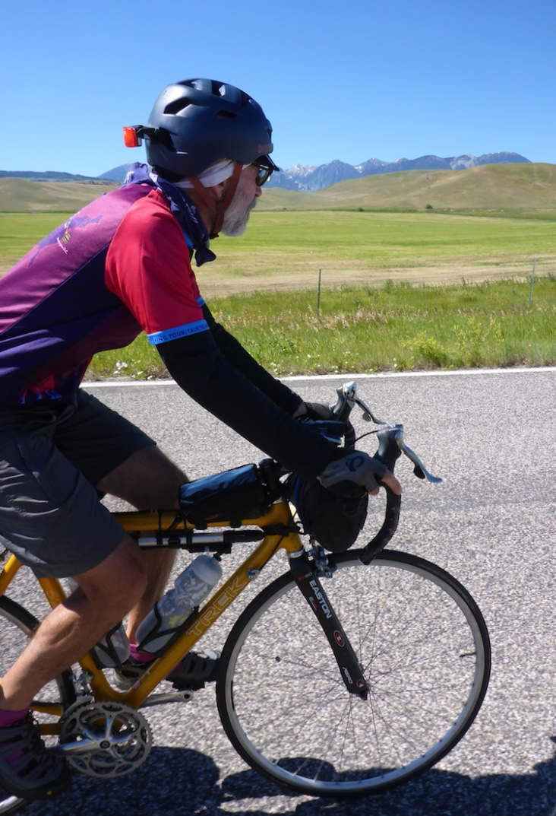
Sabbatical & Med Student Summer Research
We rode our bicycles across the US from Washington, DC to Seattle, WA
3,255 miles
79,550 feet of elevation climbing
293 hours in the saddle

Slide 5
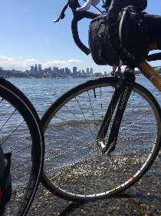
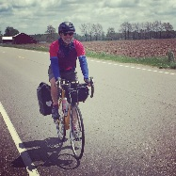
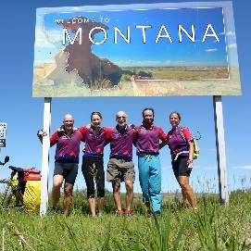
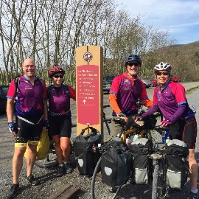
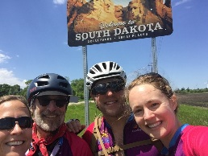
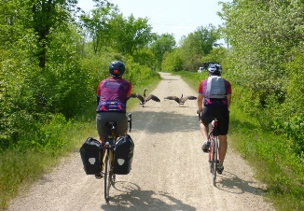
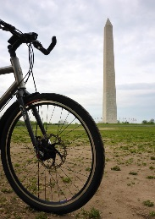

Slide 6
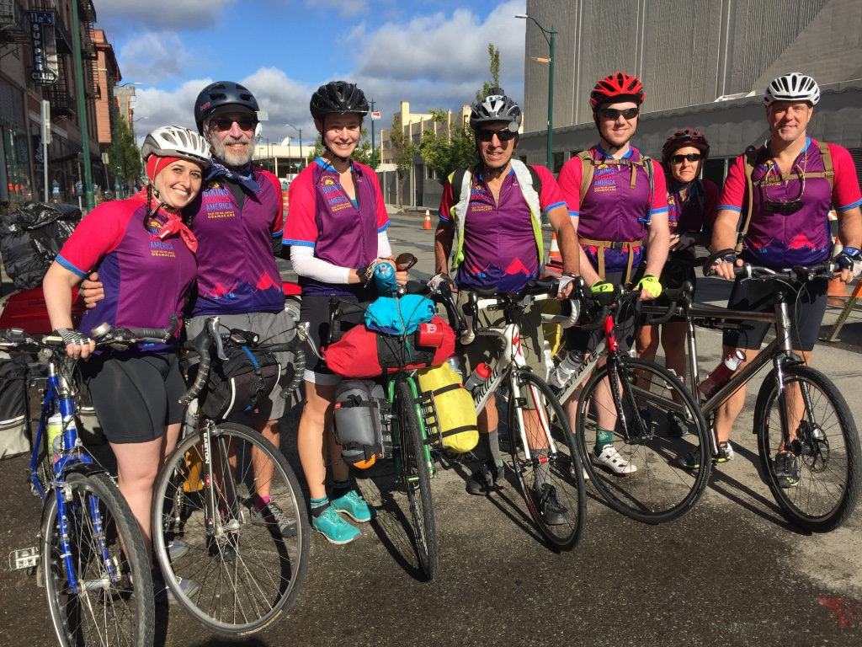

Slide 7
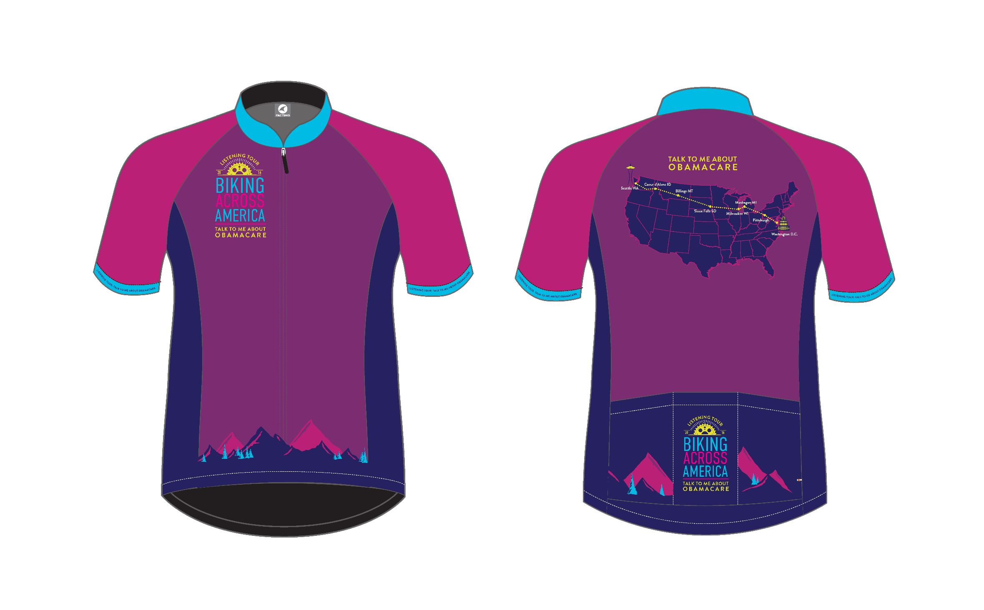

Slide 8
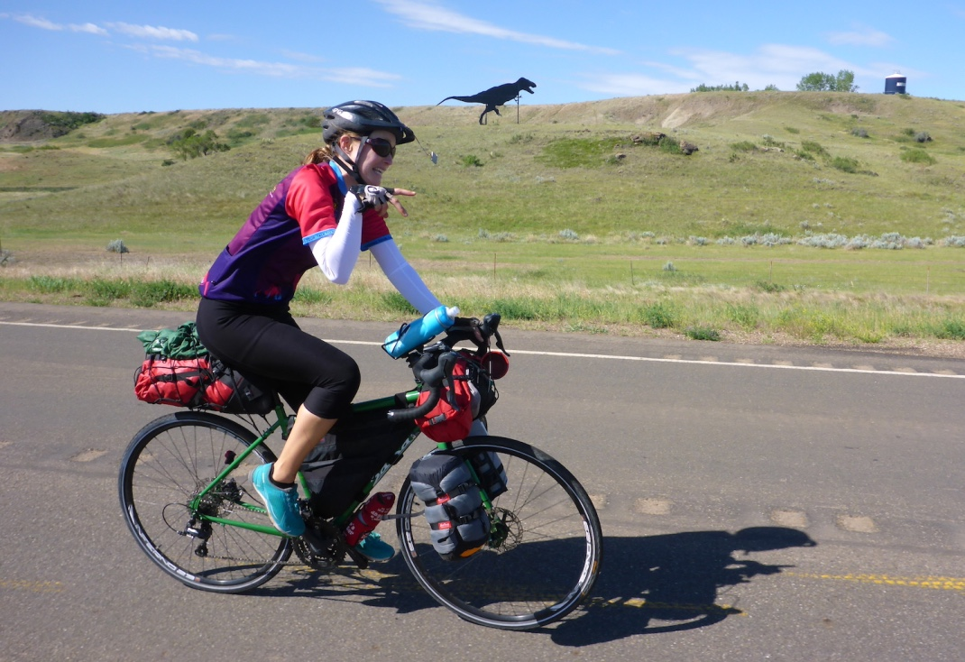
We’re riding our bicycles across the country…
And we’d like to hear what you have to say about Obama Care…

Slide 9
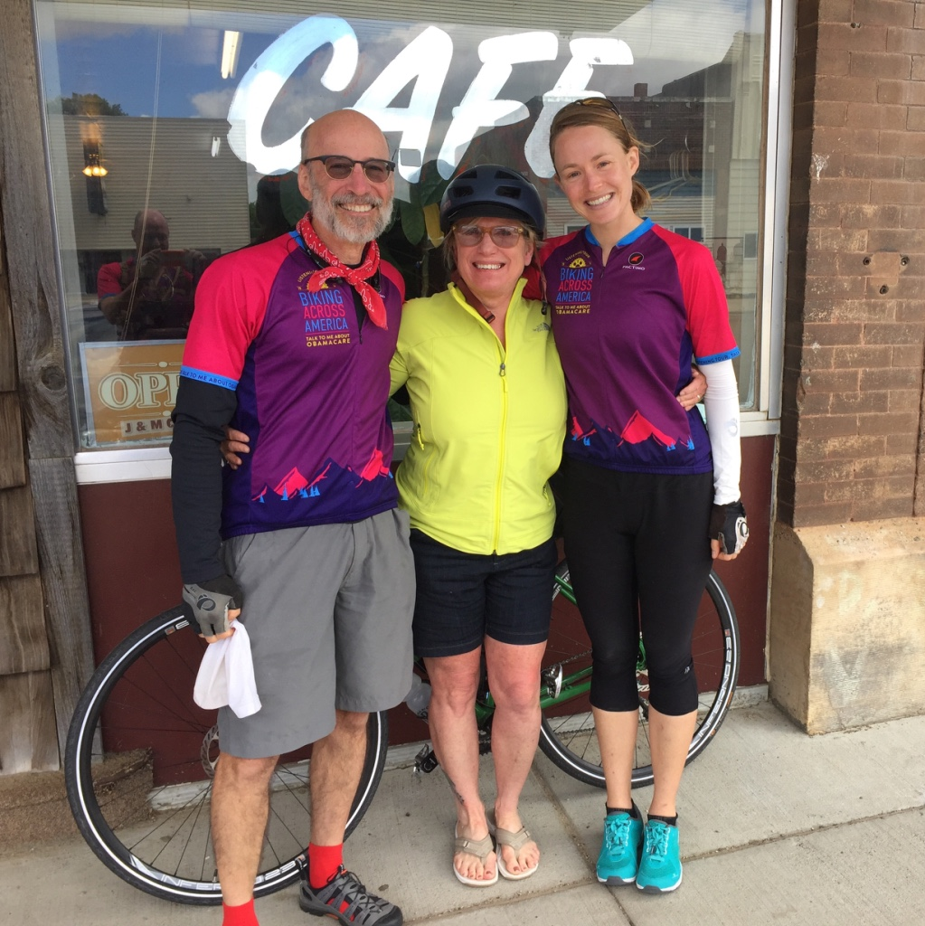
No, really…
We really want to hear…

Slide 10
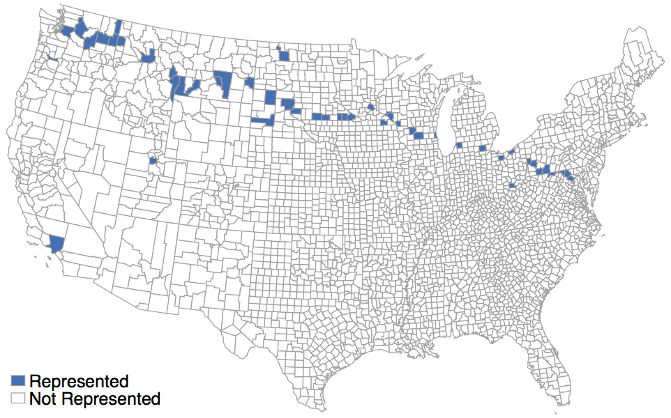
And they began to talk
We had 115 conversations with complete strangers across the US
Most were in rural areas

Slide 11
And continued to talk…
Interviews were open-ended, unstructured
15 to 30 minutes
Conversations were maintained via indirect prompting and the silent probe
Participants could speak freely without fear of being judged
Voice memos post conversations to assist with summarizing interviews later

Slide 12
www.bikelisteningtour.wordpress.com

Slide 13
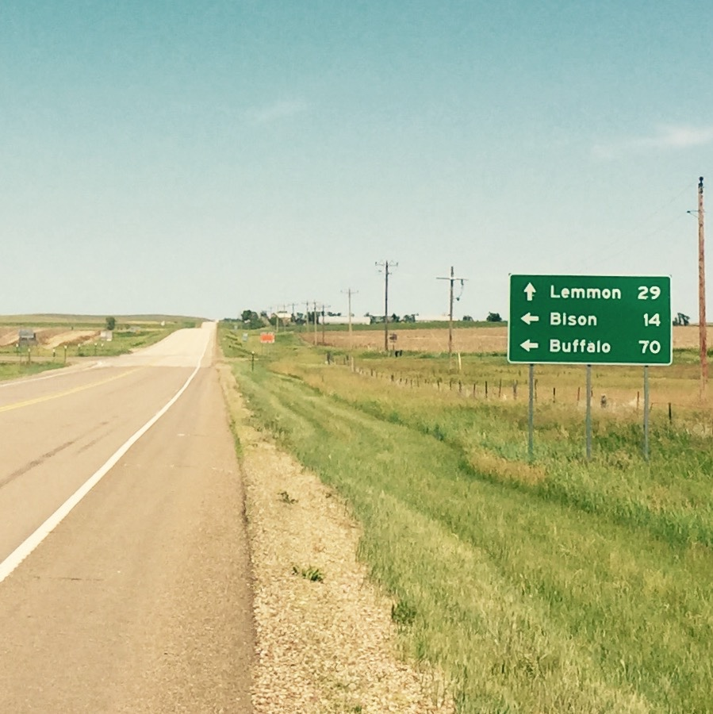
Results
Convenience sample: representative of the counties visited
Differ in some dimensions
Older, more likely to be Caucasian
More likely to be insured, and less likely to have Medicaid
Majority (54%) negative opinion of Obama Care
Costs

Slide 14
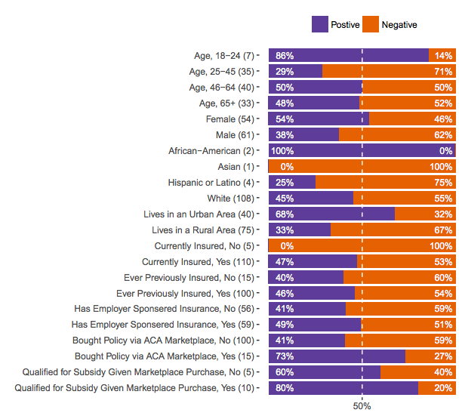
Majority interviewed (54%) held a negative opinion of Obama Care
Strongest predictor values:
Rural vs. Urban
Age

Slide 15
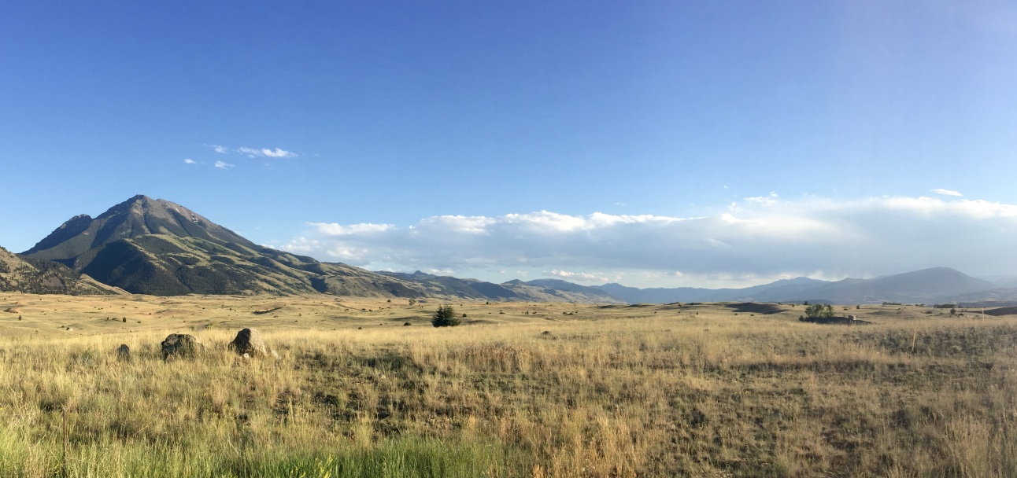
Results continued – 4 Themes
Obama Care has increased the cost of health insurance
Government should not tell people what to do
Who is responsible for the negative outcomes of Obama Care?
Insurance companies
Politicians who create too many regulations
Obama is to blame: Opposition based on partisan lines
Lack of concern for fellow citizens

Slide 16
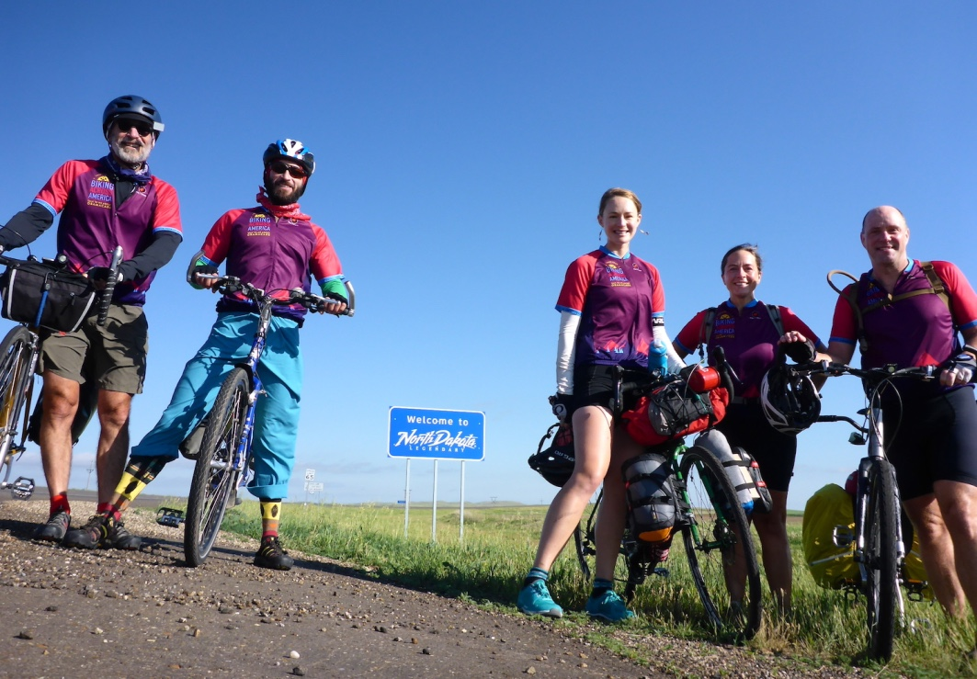
Increased Costs
Dana (42 years old, Rose Lake, ID) revealed that she us doesn’t go to the doctor anymore since she can’t afford the deductible.
Josh (43 years old, Red Wing, MN) believes that premiums increased and “struggled to find the ‘Affordable’ in the Affordable Care Act.”
Irene (60 years old, Heartline, WA) said “Obama Care helped the people who were previously unable to afford insurance, but now working people…are struggling.”

Slide 17
So who qualifies for Obama Care?
Federal Poverty Level (FPL):
$11,880 for individuals
$16,020 for a family of 2
$20,160 for a family of 3
$24,300 for a family of 4
$28,440 for a family of 5
$32,730 for a family of 6
$36,730 for a family of 7
$40,890 for a family of 8
Sources:
“Federal Poverty Level.” HealthCare.Gov. Accessed online 31 July 2016 <https://www.healthcare.gov/glossary/federal-poverty-level-FPL/>
Income between 100-400% FPL
You quality for a subsidy on the Marketplace.
Income below 138% of FPL
If your state has expanded Medicaid coverage, you qualify for Medicaid based only on your income
Income below 100% of FPL
If your state has not expanded Medicaid, you do not qualify for income-based Medicaid or a subsidy on the Marketplace
You may qualify still qualify for Medicaid based on your state’s current rules

Slide 18
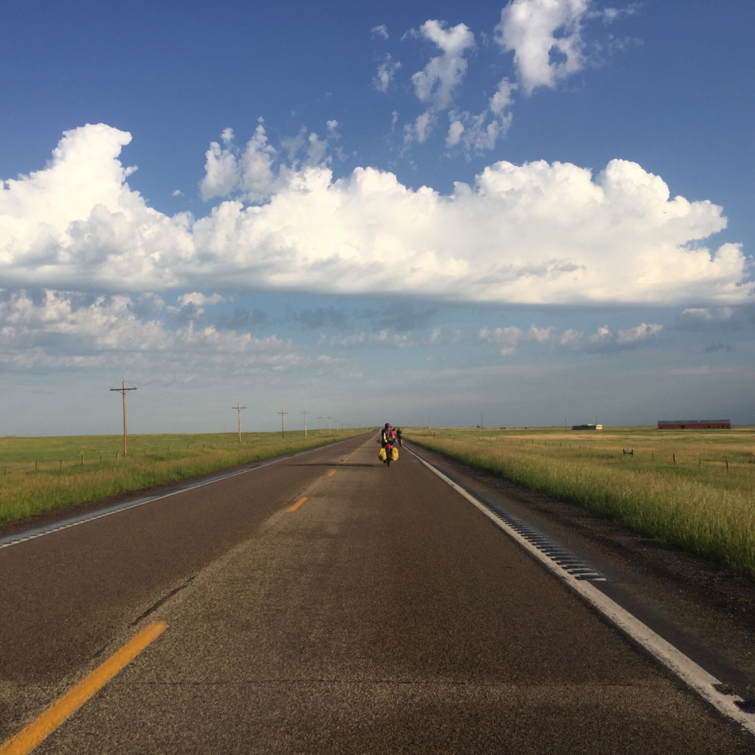
Government should not tell people what to do
John, (55 years old, South Haven, MI) said: “It’s wrong for the government to tell you that the insurance has to pay for things you don’t believe in.” As a business owner who doesn’t believe in abortion, why should he have to pay for insurance that covers abortion?
Zach, (35 years old, Strongsville, OH) a musician, reported he is not a fan of the individual mandate. “You can choose whether or not to drive a car, but you can’t choose whether or not to be alive and need health insurance.”
Henry (68 years old, eastern SD): “We don’t want the government in healthcare,” and emphasizes that the government should not offer handouts. “The government shouldn’t take care of you womb to tomb. There isn’t enough money in the budget.”

Slide 19
“Insurance Companies are to blame for negative ACA outcome”
Jeff (49 years old, Williamsport, MD) believes “it’s not Obama Care but just the greedy insurance companies”.
Joan (64 years old, Pittsburgh, PA) told us: “Maintaining the private insurance industry was a mistake. As for-profit companies, their first priority is to deliver dividends to their shareholders and secondarily to deliver health care. Obama made a pact with the devil.”
Penny (63 years old, Townsend, MT) views insurance companies as having too much control. “Who’s in charge here? When your health insurance determines your medical care, that’s a problem.”

Slide 20
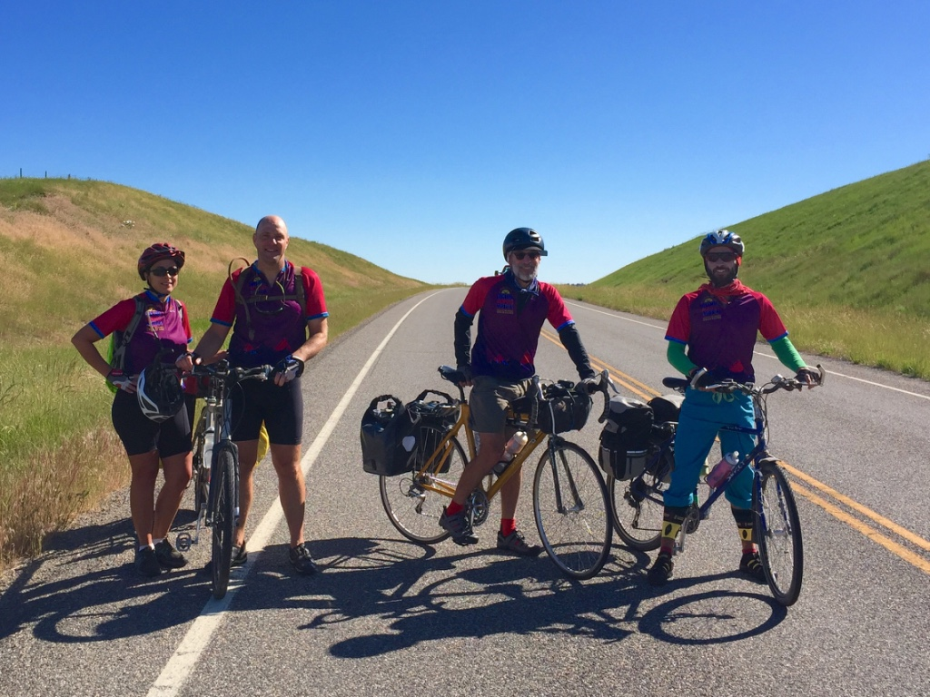
“Politicians are to blame”
Derek (36 years old, western PA) said “it’s all the regulations. When you have politicians trying to make health policy, it’s never going to work. Too many politicians and too much regulation – 2000 pages of regulation.”
Sean (69 years old, western WI) tells us: “It’s not perfect, since the politicians made it.”

Slide 21
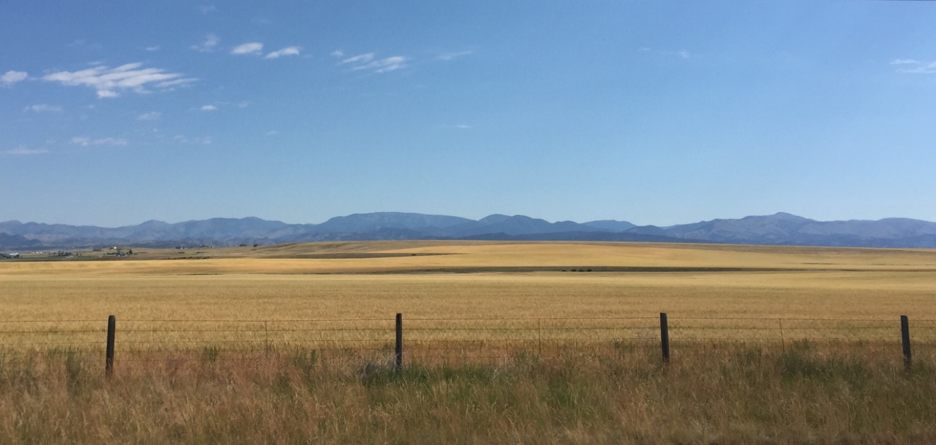
“It’s Obama’s fault”
Karen, (48 years old, eastern SD) summed it up by saying: “It would have been a lot better if Obama’s name wasn’t in the title. Maybe they could have just called it New Care.”
Ami (51 years old, Knoxville, MD) tell us: “people are just opposed to anything from the Democratic party.”
Betty (43 years old, Ivanhoe, MN) offered the sentiment “its good he only has one year left.”

Slide 22
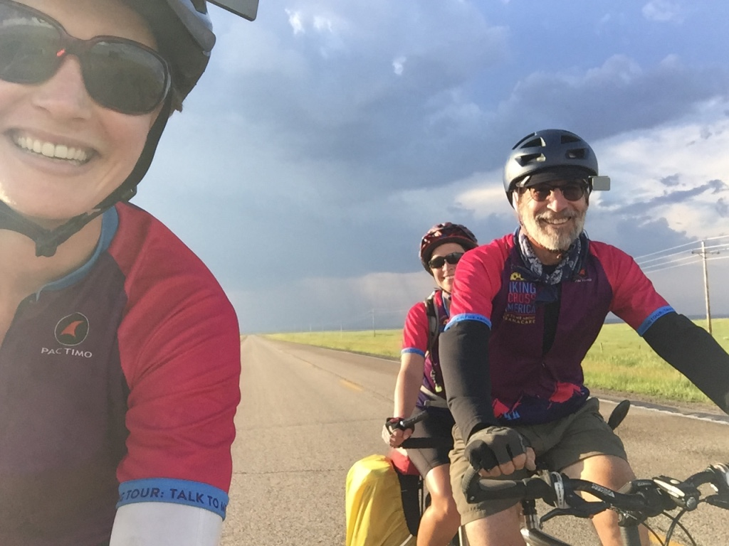
Lack of concern for fellow citizens
Karen, (48 years old, eastern SD) concluded: “he just gives all of the taxpayers’ money away to poor people.”
Jose (67 years old, Three Forks, MT) deeply values hard work and believes government handouts are wrong. “You need to earn everything.”
Ray (53 years old, Park City, MT) believes Obama Care “encourages people to take advantage of the system. People should go out and get an education and get a job where they are covered by insurance.”

Slide 23
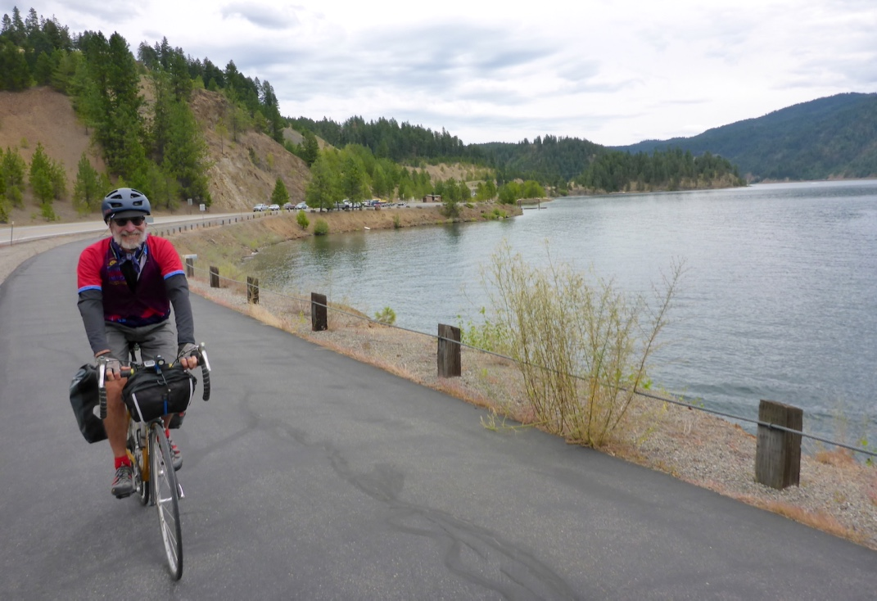
BIG PICTURE: Take-home messages

Slide 24
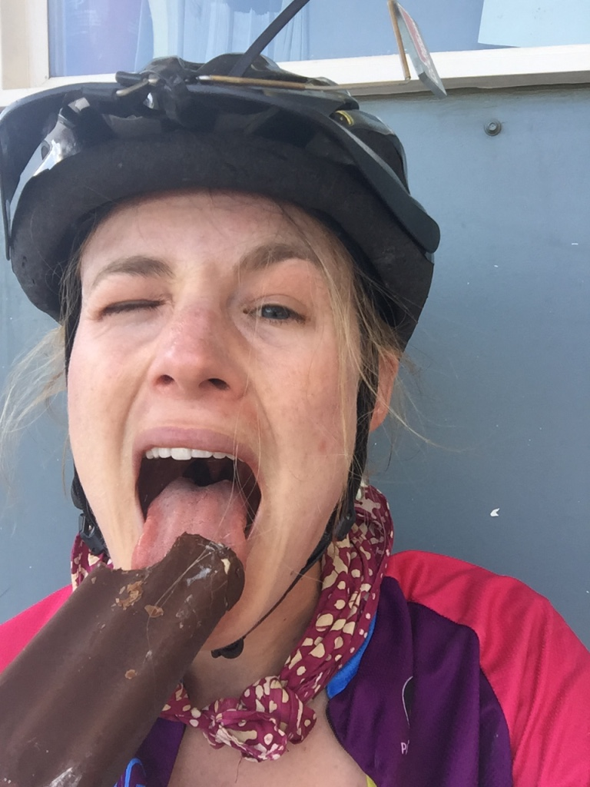
What did we learn
About strong headwinds
It’s really just ‘one day at a time’
“Ain’t no mountain high enough” – or maybe there is…
Research methodology evolves
Even seemingly crazy ideas can work out and produce scholarly work
Listening without correcting

Slide 25
