Slide 1
STFM research plenary
Frederick Chen MD, MPH
STFM Research Committee

Slide 2
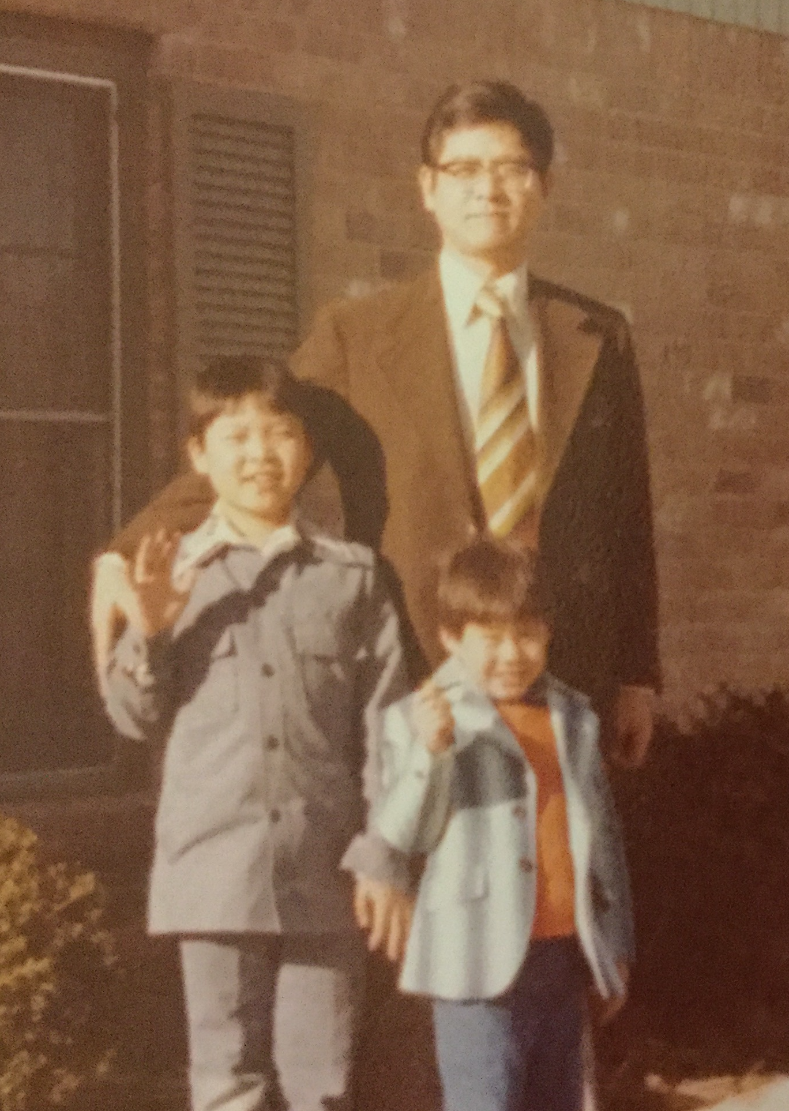

Slide 3
Why we start with Literature Review
Research is innovation, generation of new knowledge
But is also history -
Passing on knowledge
Honoring our past

Slide 4
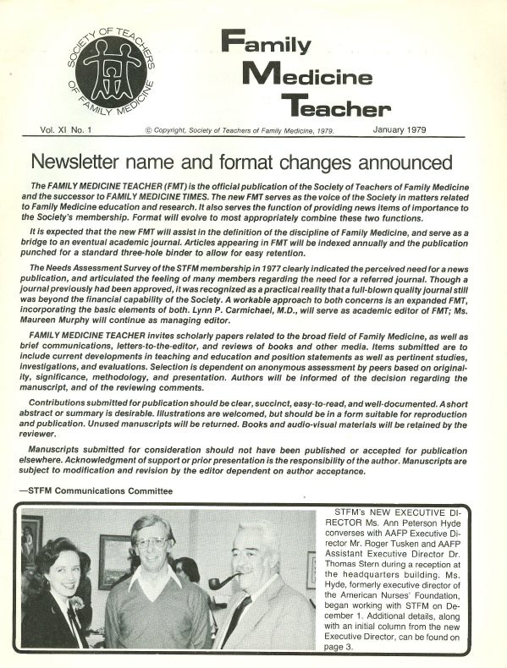

Slide 5
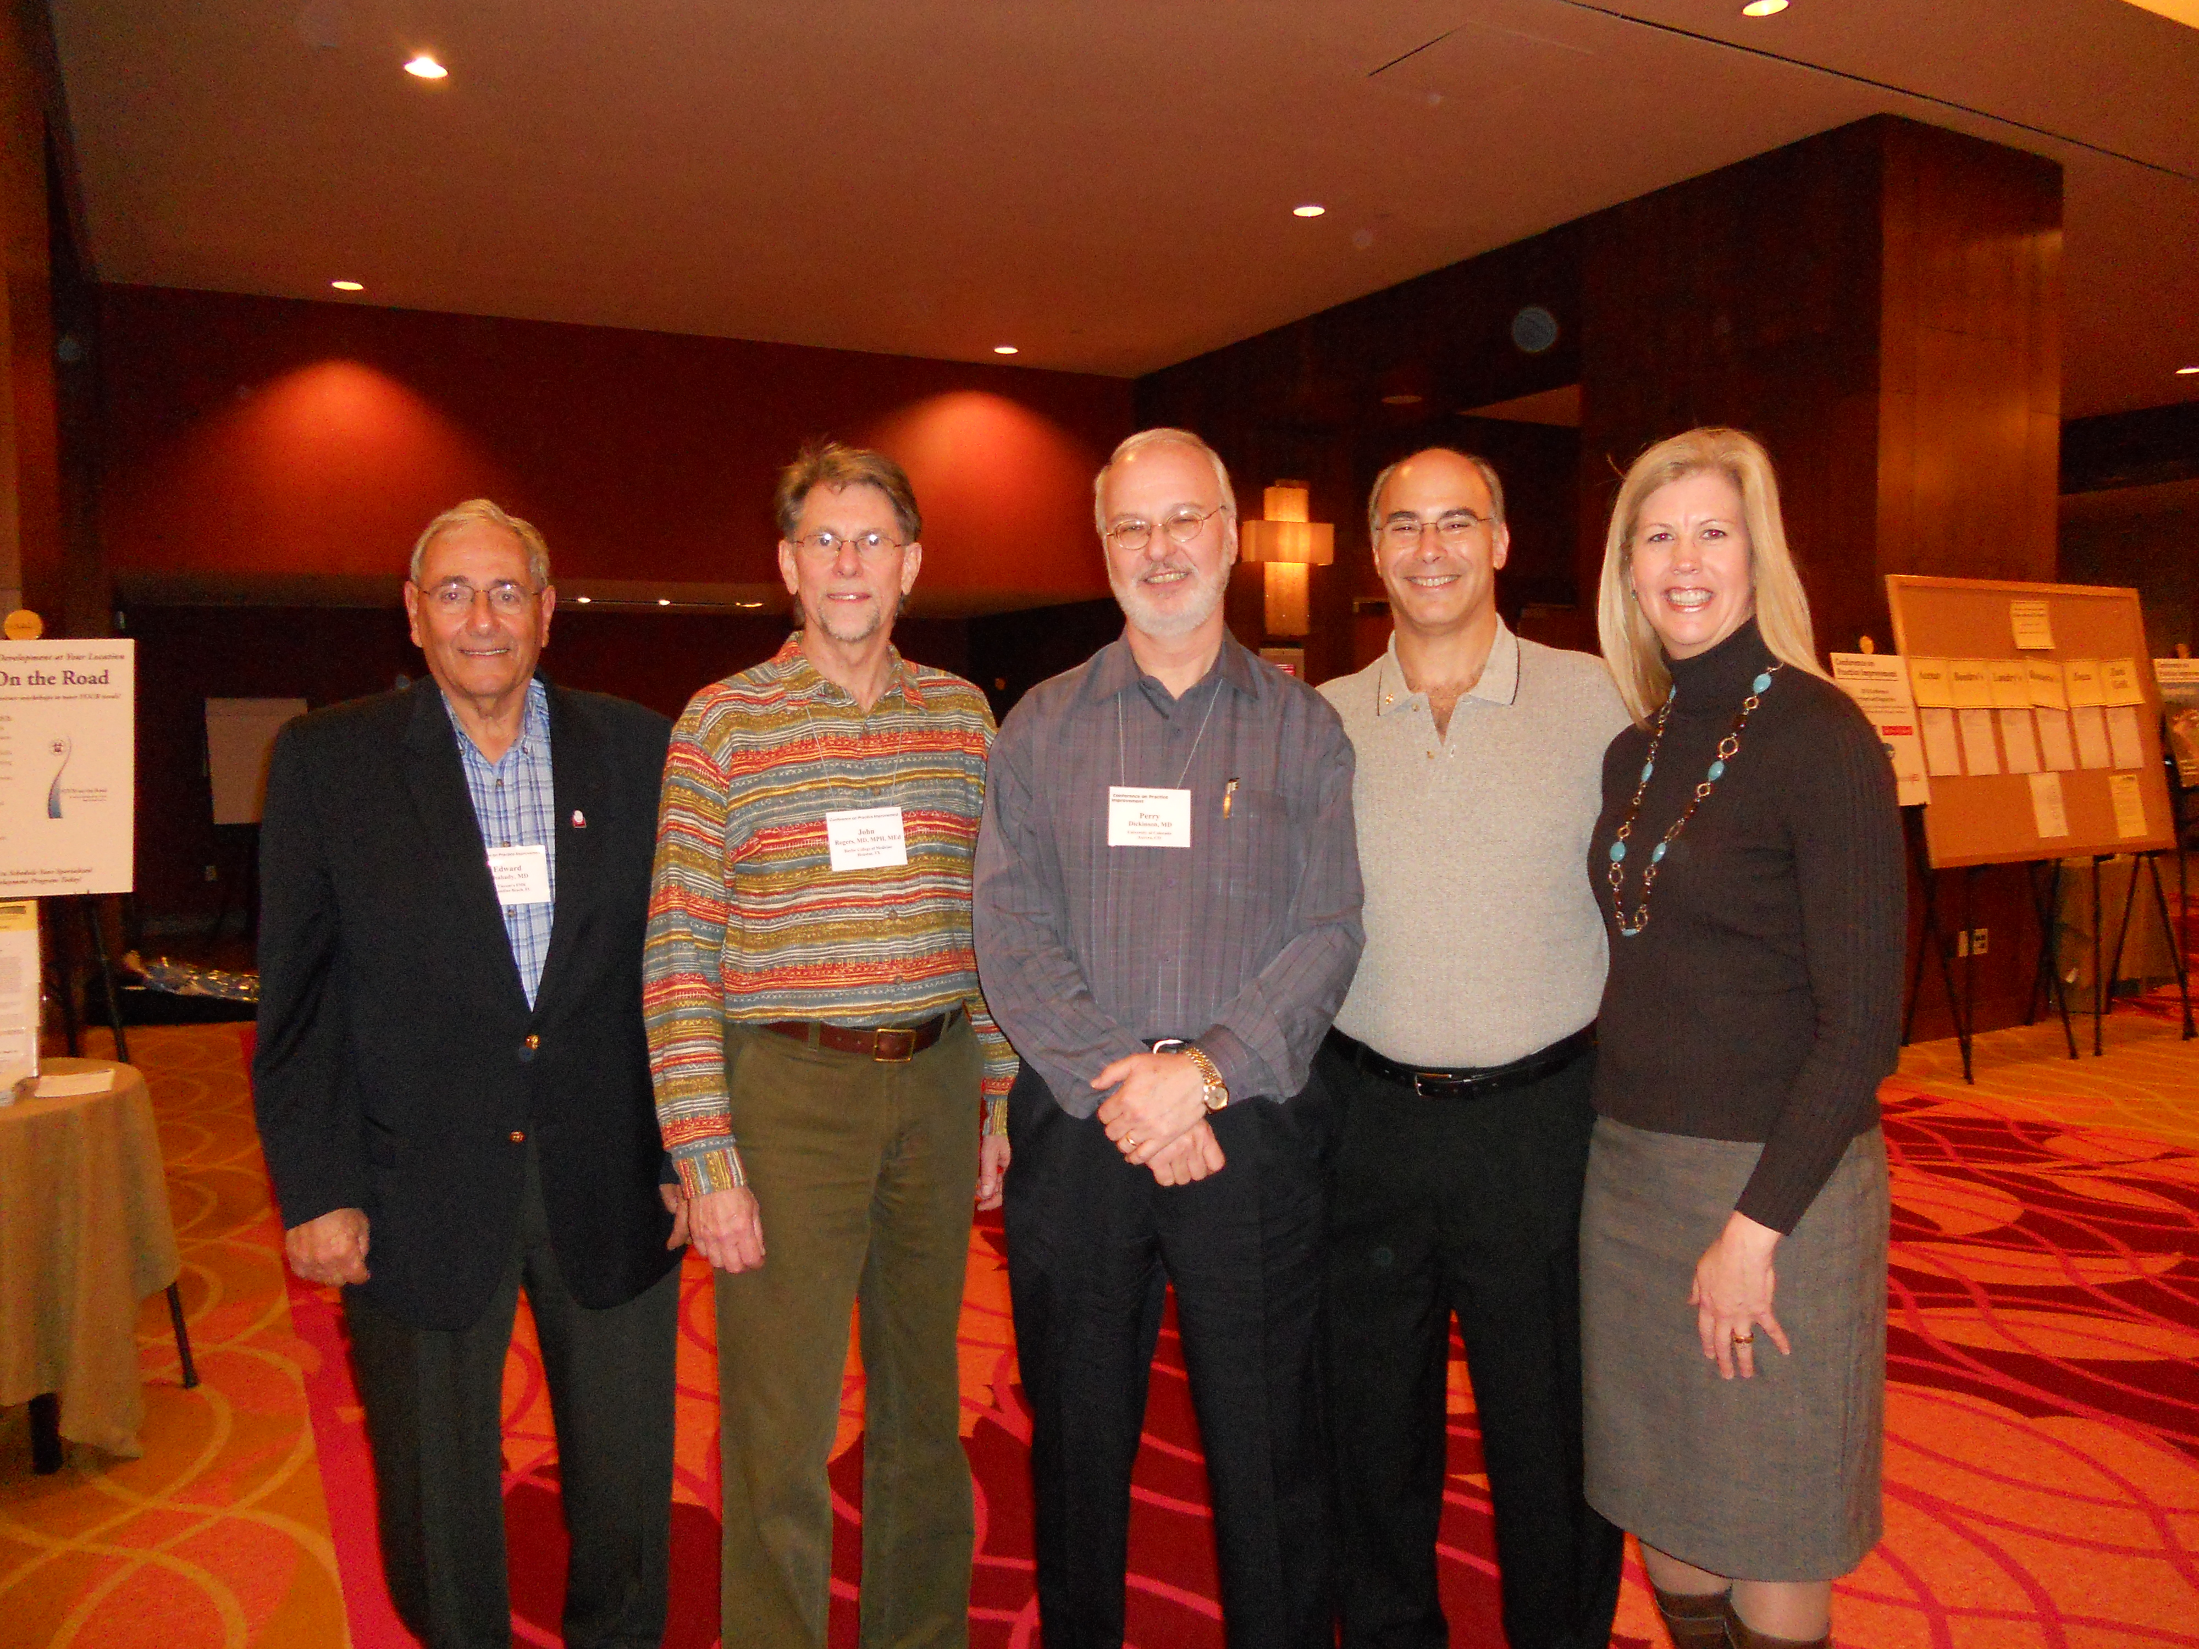

Slide 6
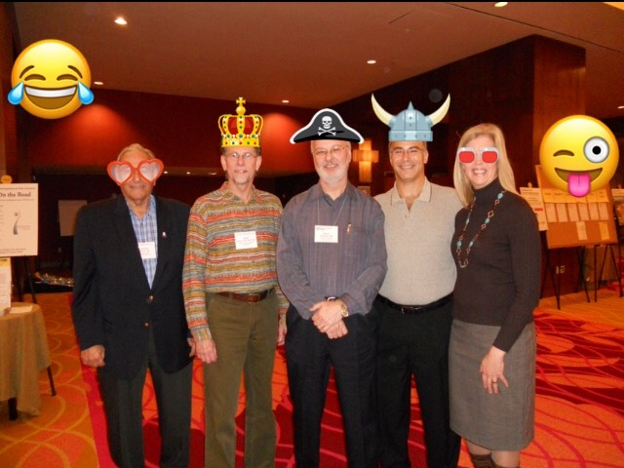

Slide 7
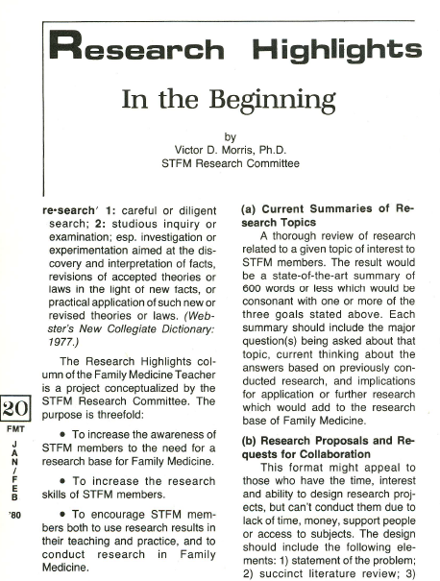

Slide 8
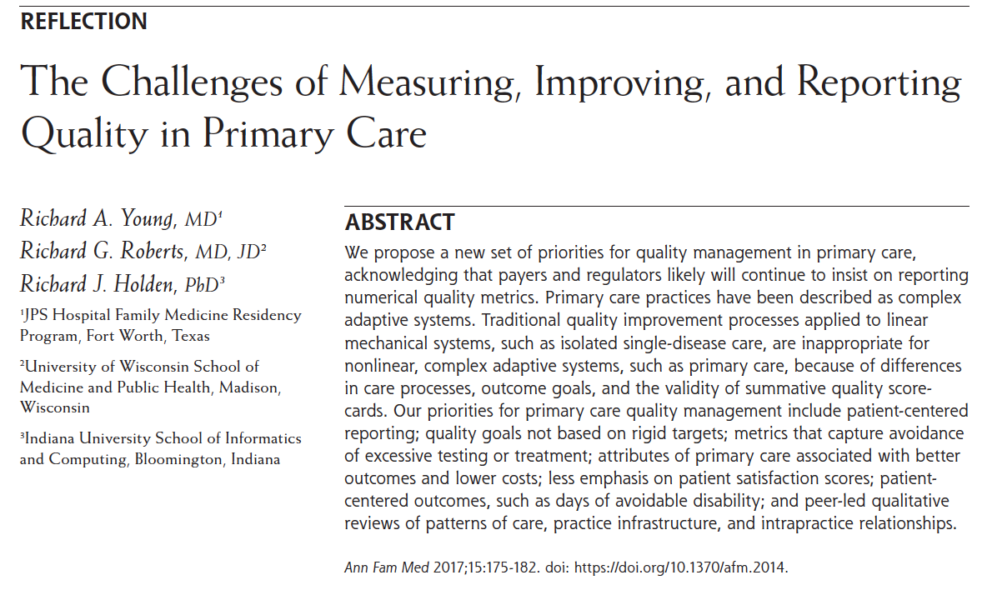

Slide 9
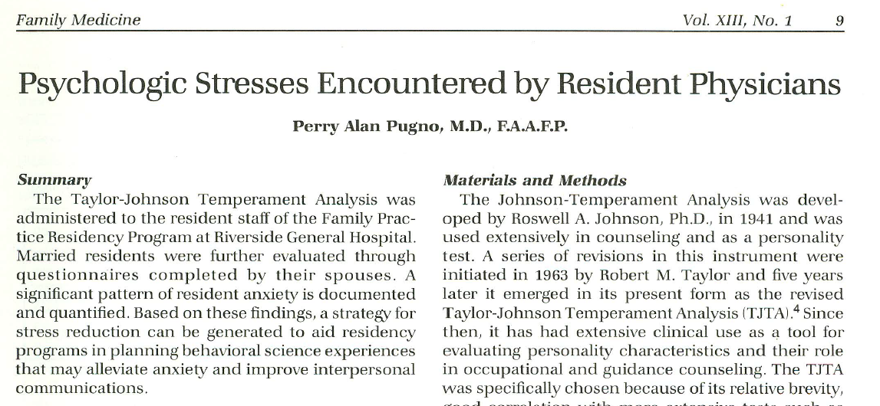

Slide 11
National graduate survey
2013 graduates
N=2069
Employee 85%
42 hours per week patient care
26 hours per week admin/charting
Delivering babies 13%
Outpatient pediatrics 77%
Inpatient medicine 41%

Slide 12
National graduate survey
Working as Faculty 12%
Teaching 78%
Research 14%
Satisfied with family medicine 84%
Burnout at least once a week 40%
Salary – average $199,095

Slide 13
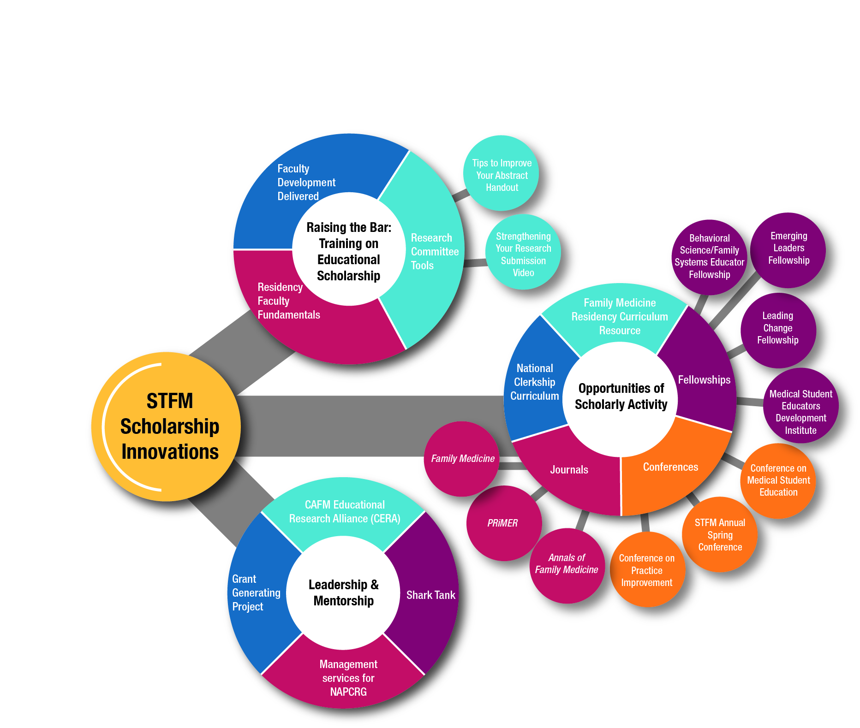

Slide 17
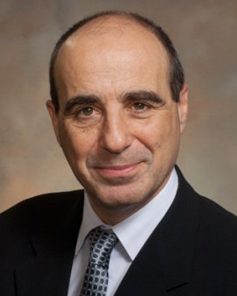
Research Plenary Speaker
Dr. Andrew Bindman
Professor of Medicine, UCSF
Former director, AHRQ

