Slide 1
What is cultural humility? How to practice and teach it
Therese Zink, MD, MPH
theresezink@gmail.com

Slide 2
Learning Objectives
Articulate the difference between cultural competence and culture humility
Identify methods to practice and teach cultural humility in global health practice
Evaluate your cultural humility to date (private exercise)

Slide 3
The road to hell is paved with good intentions.
--Bernard of Clairvaux, French Abbot (1090-1153)

Slide 5
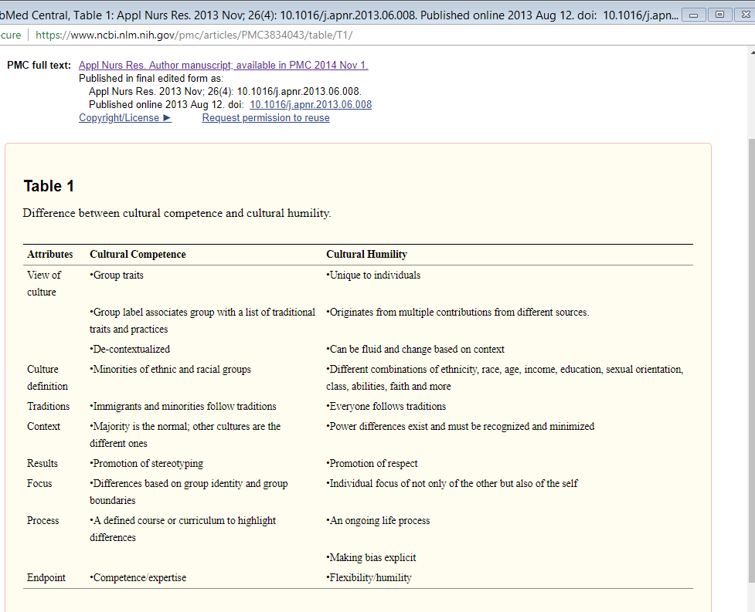
Notes:
The goal of cultural competence is to produce confident, competent health care providers with a specialized knowledge and skills that can then serve the communities of ethnic or racial minority groups. Other terms such as cultural awareness, cultural knowledge, and cultural sensitivity often are supported by these same assumptions of cultural competence

Slide 6
Cultural Humility vs Cultural Competence
Cultural humility is a process of self-reflection and discovery to understand oneself and then others in order to build honest and trustworthy relationships.
-Tervalon & Murray-Garcia, 1998
Notes:
Lifelong process

Slide 7
Toxic Charity ~Richard Lupton

Slide 8
What do we need to make this a safe space?
welcoming
Inclusive
Accepting
– Ability to Pass or Participate
– Respect of Differing Opinions
– Meet people where they are
– Use of “I” Statements
– All Questions are Valid
– Confidentiality
– Risk-Taking Encouraged
– Have FUN while learning
• Anything missing?
Respect
Safe
space

Slide 9
EXERCISE: Think
Pair
Share
Notes:
Introverts and extroverts

Slide 10
Reflection: Person
Notes:
In the process of cultural humility, personal values, beliefs, and biases that are derived from your own culture must be examined. Beliefs about race, ethnicity, class, religion, immigration status, gender roles, age, linguistic capability, and sexual orientation are explored. Family experiences and values, peer influences, relationships with different types of people are also reviewed. Where you live or grew up matters (i.e., rural, urban, suburban, affluent, or impoverished) and shapes your views of others. What neighborhood you live and work in influences who you deal with on a day-to-day basis and how you define community. Everyday activities such as where you shop, how you travel to work, and what you eat tell something about your values. Political views and the way you express them are important. All of these attributes and the value given to them are important to examine.
Examining and defining one’s culture is a complex process especially since today most individuals in the United States and other countries are a combination of more than one culture with many different variations and mixtures. Group identities often define our cultural perspective but these groups, whether based on religion, race, or ethnic classification, are broad categories. Minority groups such as American Indians, Alaska Natives, African Americans, Hispanics, Asians, or Pacific Islanders are often given certain cultural characteristics, but those descriptions can miss the mark. Within each group, many subpopulations exist with very different cultures, historical experiences, and views on health and illness. An individual’s culture is not a single identity; rather it’s a rich mixture of many influences and values. Thus understanding oneself and others is a complex and lifelong process.

Slide 11
Reflection Profession
Notes:
Professional identity of the clinical researcher is also an important area to reflect on. Specifically nurse researchers first must identify that their own values, perspectives, and biases are derived not only from their own cultural origin, but also from the biomedical world view of their professional training. Health care itself is a cultural system with its own specific language, values, and practices that must be translated, interpreted, and negotiated with patients and family members. Training in Western medicine using a bio-medical framework often influences how one sees the world. This perspective often defines ‘normal’ as the modern Western culture. In the stereotypical perspective, difference is generally defined as anyone who is non-white, non-Western, non-heterosexual, non-English speaking, and non-Judeo-Christian. Often the values of medical training, and to some degree nursing training, reflect a strong inclination toward medications, procedures, and cure, and less focus on psychosocial and spiritual influences. In addition, health care providers and clinical researchers must consider the privilege and power of their profession and its effect on practice and research.

Slide 12
What do we need to make this a safe space?
welcoming
Inclusive
Accepting
– Ability to Pass or Participate
– Respect of Differing Opinions
– Meet people where they are
– Use of “I” Statements
– All Questions are Valid
– Confidentiality
– Risk-Taking Encouraged
– Have FUN while learning
• Anything missing?
Respect
Safe
space

Slide 13
Exercise: Reflective Writing
Consider an experience where you did not exercise cultural humility.
Consider observing an interaction where cultural humility was missing.
Think about a future interaction where cultural humility will be needed.
Details—who are the characters, what is the setting,
Feelings . . .
What do differently? What are the missed or potential opportunities?
Notes:
Keep pen moving
Do not edit
Go back and underline /highlight what intrigues you.

Slide 14
EXERCISE: Think
Pair
Share
Notes:
Introverts and extroverts

Slide 16
© 2018 American Academy of Family Physicians. All rights reserved.
All materials/content herein are protected by copyright and are for the sole, personal use of the user.
No part of the materials/content may be copied, duplicated, distributed or retransmitted
in any form or medium without the prior permission of the applicable copyright owner.

