Slide 1
One Program’s Scholarly Activity Journey: Clinical Inquiries Process Evaluation and Improvement
Elizabeth Wickersham, MD; David Kelley, MD; Brian Coleman, MD; Laine McCarthy, MLIS
University of Oklahoma College of Medicine Department of Family Medicine

Slide 2
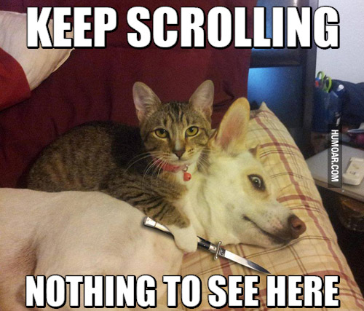
Disclosures
None

Slide 3
Learning Objectives
Upon completion of this session, participants should be able to:
Discuss a survey of faculty and residents concerning the benefits of the Clin-IQ process, including the challenges identified and possible strategies for improvement.
Share ideas for development of a Clin-IQ version of scholarly activity with their home programs.
Assess which portions of this presentation may be applicable to their home scholarly activity programs in order to increase faculty scholarly activity and increase the residents' ability to competently research specific clinical questions.

Slide 4
A Clin-IQ Paper is:
A brief 1,000 word review
3 short sections
Summary of Issues
Summary of Evidence
Conclusion
Graphic or figure
Plus an Abstract (generally required for publication)

Slide 5
Proven Success
Validated
Accepted by trainees and faculty
78+ published
47 indexed in PubMed (5 in indexing process)
4 in press
1 under peer review
16 in preparation
40 poster presentations at local meetings
2 presentations at national meetings
Winner, Ok Med Association Johnson Award for Best Clinical Paper by Resident or student 4 years in a row (2012-2015)

Slide 6
Challenges
Quality of “completed” work very variable
Mentors’ skill set for mentoring frequently lacking
Resulted in withdrawal from the leadership role
Poor accountability between team members and mentors
Disconnect between what residents believe they are accomplishing versus what they are actually accomplishing

Slide 7
Challenges
“Completed work” by the team was unfinished
This required more work than the initial investment to get it to a poster and potentially publishable level
Resident teams forfeited their learning opportunities

Slide 8
Challenges
The project completion is required for graduation
There has never been a process of accountability for this other than requiring a signature at the end of residency in order to graduate

Slide 9
Solutions Revamp Clin IQ process this year!
Clin-IQ handbook completed rewritten this year
Reoriented from a general handbook to one that specifically addressed then needs of the Family Medicine Residents
Tied Purpose and Goals with the appropriate CCC milestones
Started “Train the trainer” lectures for the mentors
Matched the mentors with the subject matter with which they felt most comfortable

Slide 10
Solutions Revamp Clin IQ process this year!
Added Evidence Table training for residents and mentors for analysis of papers to be included
Put the responsibility for poster development on the resident teams
Added Grading Rubric for presentation and posters
Administered pre and post intervention surveys to residents and faculty alike to assess changes they perceive as a result of the Clin IQ process changes

Slide 11
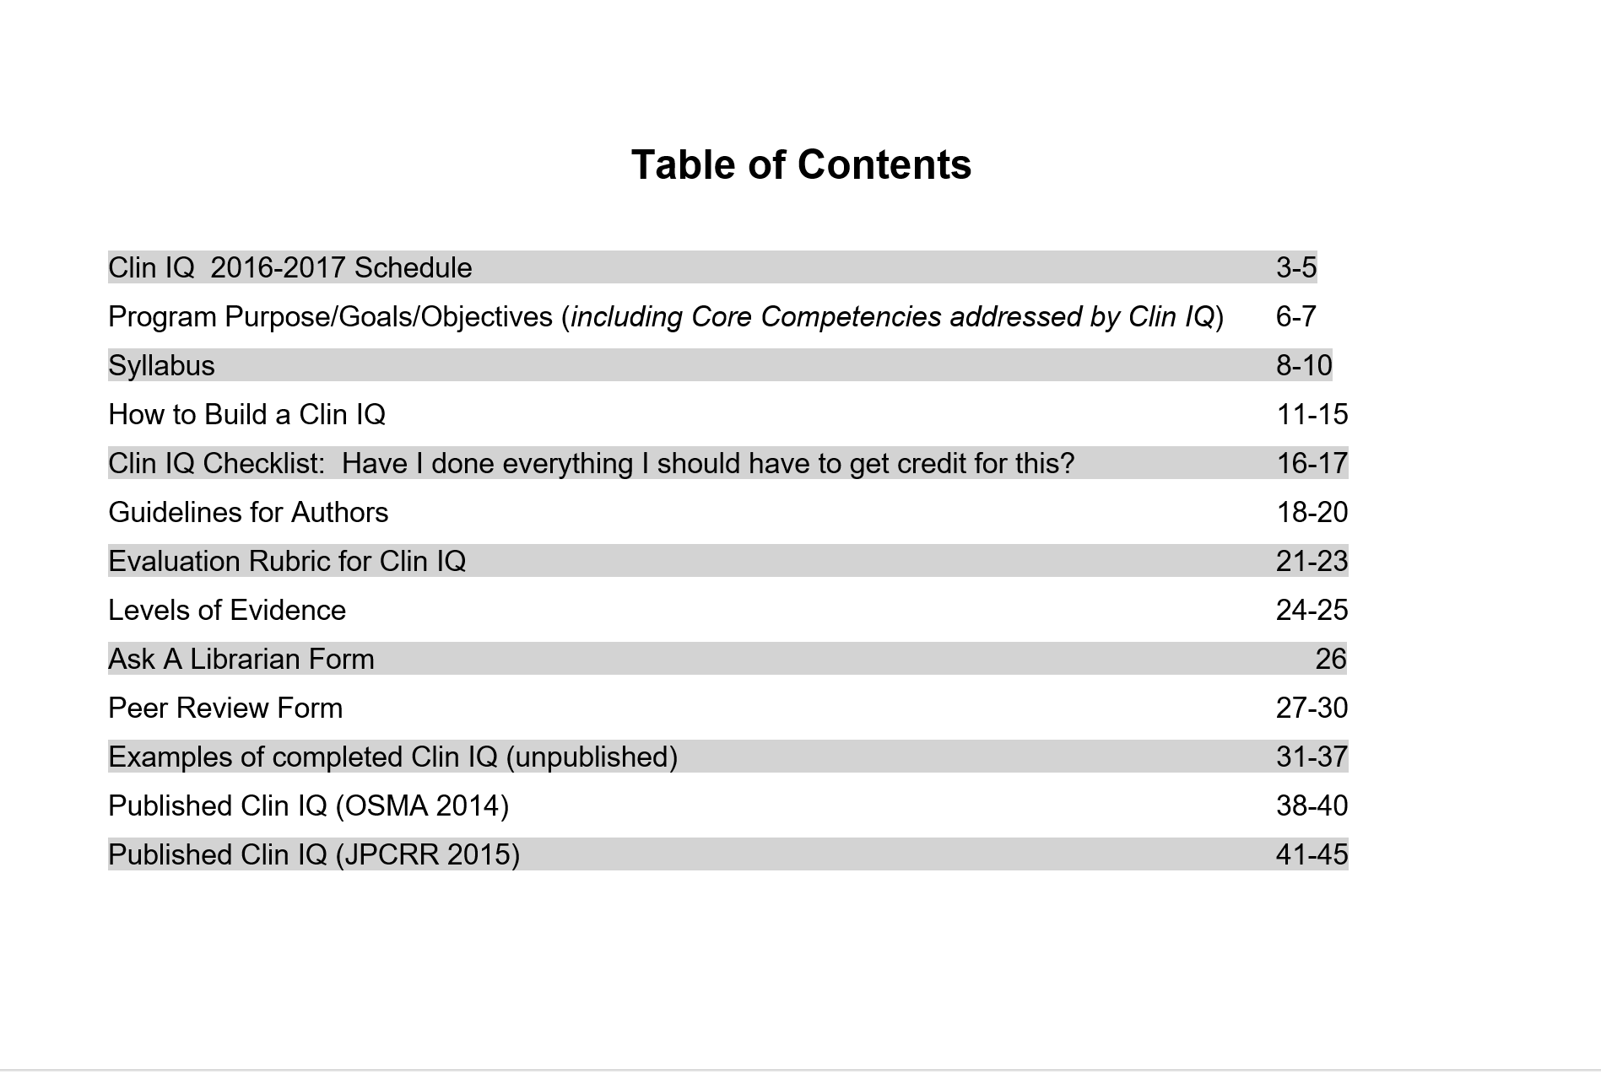
New Clin IQ Toolkit

Slide 12
Mentor Perspective
The initial approach is key
Getting a good question or recognizing a bad one changes everything.
Get your teams expectations at the beginning.
My excitement was almost more important than there knowledge.
Setting expectations that we were held together by was key.
Connecting them to the actual process of advancing knowledge really helps.
I wasn’t aware of what they were doing with evidence on a daily basis.
How do you get someone like me to be engaged?

Slide 13
Resident Survey with pre and post results
1 Scholarly activity is an important part of my graduate medical education. *(0.038) * (<0.001)
2 Identifying questions that arise during patient care is important to me.
3 I know what the PICO mnemonic means and how to apply it to the questions I have.
4 I am confident in my ability to find the most accurate, relevant, current answers to my clinical questions.
5 I am confident in my ability to identify levels of evidence in the medical literature.
6 I understand basic statistics and can apply them to interpret medical research results.* (0.049)
7 I understand the different types of research study designs and which designs are appropriate for different types of clinical questions (eg, diagnosis, treatment).
8 I am comfortable with my ability to recognize poor quality research . when I read it. * (0.016) * (0.006)
9 I confident in my ability to identify bias in the medical research articles I read.
10 It is important to me to participate in sharing relevant clinical information with colleagues, peers and broader audiences to improve patient care.
p<0.05: * PGY2 *PGY3 *PGY2&3

Slide 14
Resident: When I have a question in clinic I seek…
Up to date | 3
AAFP articles | 1
EBM Rx App | 1
FP Notebook | 1
Internet | 1
podcasts | 1
Magic 8 ball | 1

Slide 15
Faculty: When residents have questions they seek answers from…

Slide 16
Faculty: When I have a question in clinic I seek…

Slide 17
Faculty Survey
1. Scholarly activity is an important part of my faculty development.
2. The Clin-IQ process has helped me develop my scholarly activity.
3. I am comfortable leading a resident team through the Clin-IQ process.
4. My ability to answer questions that arise during patient care is important to me.
5. I know what the PICO mnemonic means and how to apply it to the questions I have.
6. I am confident in my ability to find the most accurate, relevant, current answers to my clinical questions.
7. I am confident in my ability to identify levels of evidence in the medical literature. * (<0.001)
* p<0.05

Slide 18
Faculty Survey, continued
8. I understand basic statistics and can apply them to interpret medical research results.
9. I understand the different types of research study designs and which designs are appropriate for different types of clinical questions (e.g., diagnosis, treatment).
10. I am able to determine the quality of research when I read it.
11. I confident in my ability to identify bias in the medical research articles I read.
12. It is important to me to participate in sharing relevant clinical information with colleagues, peers and broader audiences to improve patient care.
13. I feel the Clin-IQ process leads residents to proficiency in their ability to read and properly interpret medical research articles.

Slide 19
Faculty Comments
Faculty example and buy-in is pivotal. We must figure out how to secure these or we will be editing Clin-IQ papers "till the cows come home.“
Clinical research was not part of my residency or fellowship training, at least not a big part. I was at a disadvantage trying to mentor others in Clin-IQ. It has also put me at a disadvantage as a faculty member as far as promotion and tenure. I think a remedial course for the faculty is of great importance to eligibility for promotion/tenure and in being an effective mentor. This was certainly a gap in my training and I was not able to correct it outside a standardized format. Teaching sessions with the research faculty and staff "on the fly" just wasn't enough to make it stick.

Slide 20
Faculty Comments, continued
Ideally…accomplished in 1-2 afternoons…for the stated goal of helping residents to ask clinical questions and answer them through critical literature review, a 9 month process is unrealistic. Clinical questions in real life get answered the same day or get forgotten.
1. Limited well trained faculty teams. 2. Strict process timelines; 3. Mechanisms that enforce timeline and are actually help to by the team.

Slide 21
