Slide 1
Kentucky and the ACA
Steven L. Beshear
Governor of Kentucky
2007-2015

Slide 2
Kentucky at a Glance
120 Counties
Median Household Income $43,399
4.3 million Kentuckians
Abysmal health rankings

Slide 3
Kentucky’s Health Status in 2012 50th in smoking 40th in obesity 43rd in sedentary lifestyles 41st in diabetes 48th in poor mental health days 49th in poor physical health days 50th in cancer deaths 49th in cardiac heart disease 43rd in high cholesterol 48th in heart attacks 44th in annual dental visits

Slide 4
2013 PwC Study
1. Will create 17,000 new jobs over 8 years
2. Inject $15.6 billion into Kentucky’s economy over 8 years
3. Protect Kentucky hospitals from impact of cuts in indigent care funding
4. Have $802 million positive budget impact

Slide 5
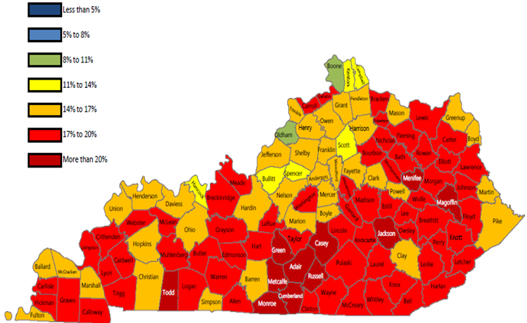
Impact In Kentucky
How Did We Get Here?
> 20% Un-Insured

Slide 6
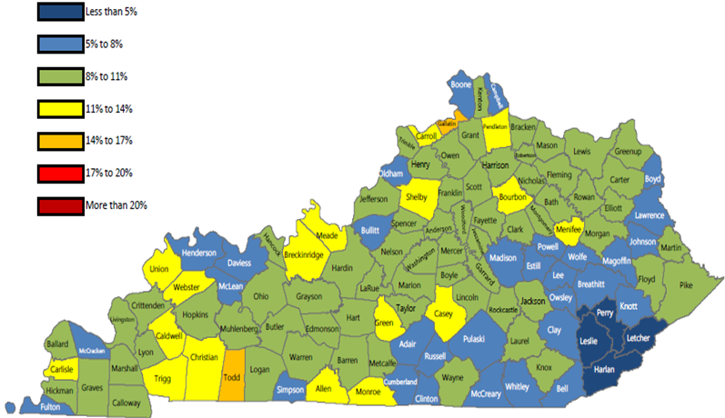
After year 1 ACA
How Did We Get Here?
< 12% Un-Insured

Slide 7
Impact In Kentucky > 20% Un-Insured
How Did We Get Here?
After year 1 ACA < 12% Un-Insured

Slide 8
2013 PwC Study
1. Will create 17,000 new jobs over 8 years
2. Inject $15.6 billion into Kentucky’s economy over 8 years
3. Protect Kentucky hospitals from impact of cuts in indigent care funding
4. Have $802 million positive budget impact

Slide 9
2015 Deloitte Study – 8-year Projections Based on First Year Actual Numbers 1. 12,000 actual new jobs created in first year – project 40,000 over 8 years 2. Almost $3 billion in new revenues for providers in first 18 months plus substantially less uncompensated care costs 3. $30 billion positive impact on Kentucky economy over 8 years 4. $300 million positive impact on the state General Fund in next two- year budget and positive net impact of $820 million over 8 years on state and local government

Slide 10
Impact on Health
1. Kentucky’s uninsured rate dropped from more than 20% to 7.5%
2. Uncompensated care rate dropped from
approximately 25% to less than 5%
3. Kentucky vs. Texas (Harvard’s School of Public Health Study) – low-income Kentuckians in better health, more likely have a doctor, to have their chronic disease or condition treated, and to have been screened for things like high blood sugar and high cholesterol

Slide 11
Impact on Health (continued) Dramatic increases in preventive health care by Kentucky Medicaid recipients between 2013 and 2014: Breast cancer screenings rose 111% Cervical cancer screenings rose 88 % Colorectal cancer screenings rose 108% Preventive dental services up 116% Physical exams up 187% Cholesterol screenings up 111% Flu vaccines up 143% Diabetic screenings up 55%

Slide 12
Essential Health Benefits
1. Ambulatory patient services
2. Emergency services
3. Hospitalization
4. Maternity and newborn care
5. Mental health and substance use disorder services including behavioral health treatment
6. Prescription drugs
7. Rehabilitative and habilitative services and devices
8. Laboratory Services
9. Preventive and wellness services and chronic disease management
10. Pediatric services, including oral and vision care

Slide 13
WHAT’S NEXT?

