Slide 1
Promoting Patient Safety and Quality Improvement Through Collaborative Faculty Development: A Success Story From Nigeria
Dr. Greg K Kirschner MD, MPH, FAAFP, FWACP
Advocate Lutheran General Hospital , Park Ridge, IL USA
Dr. George Chima, MBBS, FMCFM
College of Medicine and Health Sciences; Bingham University
Jos, Plateau State, Nigeria

Slide 2
Disclosures
No financial disclosures

Slide 3
Biases
We enjoy working together
What we are sharing is built on relationship
Anything that is good or lasting is bi-directional
What we look to share is what we ourselves are working on

Slide 4
Family Medicine in Nigeria has always been a collaborative endeavor
Involvement of the international community from the early days of training in FM
Government Teaching Hospitals and District/ Mission Hospitals
Father of Family Medicine in Nigeria – Pearson (Pearson Memorial lecture observed every year)

Slide 5
Family Medicine Postgraduate Training in Nigeria
The National Postgraduate Medical College of Nigeria
The West African College of Physicians

Slide 6
Collaborative Efforts in FM Faculty Development
Clinical Workshops Conducted by Visitors or Expatriate Workers
Training of Trainers Workshops
Annual Research Workshop
Patient Centered Clinical Method
ALSO
Visit by Dr. Warren Heffron and other educators
Site visits to Medical Schools and Mission Hospitals
Society of Family Physicians of Nigeria
Andrew Clark Pearson Memorial Lecture

Slide 7
The Bingham University College of Medicine and Health Sciences

Slide 8
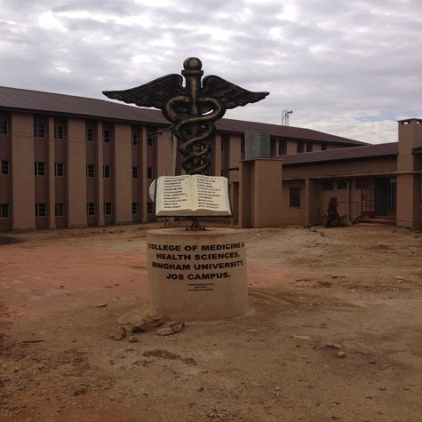
Bingham University College of Medicine and Health Sciences

Slide 9
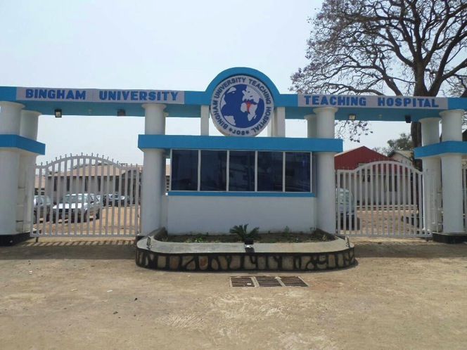
Bingham University Teaching Hospital (The former ECWA Evangel Hospital)

Slide 10
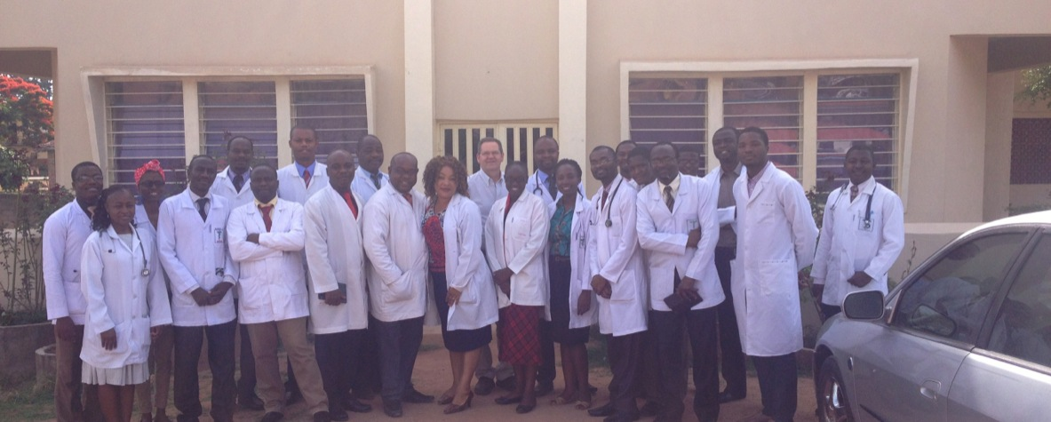

Slide 11
General Medical Practice in Nigeria
Government institutions
Medical Officers
Specialty Hospitals
Training Programs
Private Medical Practice
Private Hospitals
Private Clinics
A Requirement for Continuing Medical Education for Registration

Slide 12
Collaborating At A Distance
Helping to bring resource people, and resource materials, to the training setting
Helping to affirm the faculty development program of the Bingham University Teaching Hospital/Bingham University
Undergraduate and Postgraduate teaching
Helping to establish the CME program that Bingham University can sponsor for area doctors

Slide 13
Identifying relevant topics and resources
Ask the university sources:
Director of the CME program
Provost
Survey Attendees at conferences
Suggest topics from what WE are learning now in the U.S. as current issues and “gaps” in performance

Slide 14
Provide the CME planners a listing:
Relevant topics that can be accepted, rejected, modified
Something that could be relevant “on both sides of the ocean”
A “modified” needs assessment
Begin a dialogue

Slide 15
And of course there are challenges….
Working at a distance by e-mail…
Busy schedules
Unstable access to internet
Across the years: political instability, economic instability, terrorist activity, Ebola epidemic….
Financing
Logistics

Slide 16
Topics
Faculty Development
Mentoring
Patient Safety
Quality Improvement
Activated Learning
Physician Burnout/TEAM development

Slide 17
Topics
Faculty Development
Mentoring
Quality Improvement
Patient Safety
Activated Learning
Physician Burnout/TEAM development

Slide 18
FORMAT
Workshops presented over two days each
Department of Family Medicine serving as sponsor/host
CME accredited by the institution needed for annual practice license renewal
Expatriate facilitator/speaker and Nigerian speakers
Many alumni of the FM training program
Included Patient Voice!
Participants were charged—funds turned back for future CME endeavors

Slide 19
Activated Learning Principles
“The Brain Rules” reviewed and used
Used repetition
Kept sessions a bit shorter
Used visuals, cases
Frequently sought participant input
Some group work, although limited
Action Plan for each participant

Slide 20
EMBRACING QUALITY IMPROVEMENT IN NIGERIAN HEALTH CARE AN INTERNATIONAL PERSPECTIVE

Slide 21
Quality Disasters and Quality Successes
The Pursuit of Quality in Health Care
Challenges to Quality in the Nigerian Context—and around the world
Individual and Community Responsibility for Quality
The Centrality Of Measurement and The Use Of Data
The Science of Quality
Implementing Quality Improvement: The Test Of Small Change
Local Stories in Quality Improvement
Teams and the Pursuit of Quality
A Tool Box of Quality Improvement Tools
Quality Improvement Forum/Panel
The Importance of Pursuing Quality in the Academic Medical Center
Teaching Methods in Quality Improvement
The Relationship between Quality Improvement and Research

Slide 22
The Problem of MONEY
The Connection Between Quality and Cost
Patient Satisfaction and Quality Improvement
Lining Up The Incentives For Quality
Patient Education and Quality Improvement
Engaging patients in the Quality Journey
Glimmers of Hope: Current International and Local Stories
VVF Program
Engaging Leadership On The Quality Journey
Key Clinical Opportunities for Quality Improvement in Nigeria
Review: Culture Change For The Sake Of Patients and For Ourselves

Slide 23
Special features
More room for stories from area colleagues
Highlight the work of alumni from the program
Patient Voice was brought in by Nigerian colleagues
All participants were encouraged to fill out “Action Plans” along the way

Slide 24
QUALITY IMPROVEMENT ACTION PLAN
My definition of quality is
My Commitment To Quality Improvement Is:
I will work with
When I see the word “Quality” I will think of
Possible areas for quality improvement
I will focus on
Specific Skills I will pursue

Slide 25
COMMITTING TO PATIENT SAFETY IN NIGERIAN HEALTH CARE: THE TIME IS NOW

Slide 26
Safety in the Nigerian And International Context
The Particular Problem of Safety in the Nigerian Health Care Sector
Improving quality, reducing medical errors
First Do No Harm
Terms and Definitions
Understanding Medical Error: Basic Concepts
Creating a Culture of Safety:
The Concept of “Just Culture”
Patient Safety in the Nigerian Theatre
International Stories in Patient Safety
Nigerian Stories in Patient Safety
Open Patient Safety Forum: Panel
Health Care Associated Infection
Patient Safety in the Private Sector, Government Sector, and Academic Medical Center
Patient Safety in the Government Sector
Patient Safety in the Academic Medical Center

Slide 27
Tools in Patient Safety
The Role Of ALL Health Care Personnel In Creating Patient Safety
Teaching Patient Safety
Reporting Patient Safety
Challenging Concepts:
The Public Publication of Safety Data
Early Disclosure To Patients
Medical Malpractice and Patient Safety
Resident Workload and Supervision
Safety from the Patients Perspective
Nigeria Stories in Patient Safety
Resources
Regional Collaboration
The Safe Future Of Health Care in Nigeria

Slide 28
Patient Safety Workshop
64 participants from 11 institutions
Private practice physicians
Medical school and residency faculty
Professors and medical students
Chaplains, nurses, hospital administrators
Reported the content was highly relevant

Slide 29
Patient Safety Workshop
Many changes participants claimed they would make:
Infection control
Safety checklists
Implementing a safety/just culture
Measuring patient safety
Making safety a priority
Meeting with heads of units
Set up safety committee
Hand washing

Slide 30
Linking Safety Initiatives in the US with Nigeria

Slide 31
Suggested Future Workshop Topics From Participants
Ethics and clinical care
How research can improve practice
Restructuring the health system
Developing team work in view of patient safety
Medical legal issues
Cost effective care in a country with economic crisis
Conflict resolution in the health sector

Slide 32
References
Larson P, Chege P, Dahlman B, Gibson C, Evensen A, Colon-Gonzalez M, Onguka S, Lamptey R, Cayley W, Nguyen B, Johnson B, Getnet S, Hasnain M. Current Status of Family Medicine Faculty Development in Sub-Saharan Africa . Fam Med 2017;49(3):193-202.
Larson PR, Chege P, MD BD, Gibson C, Evensen A, Colon-Gonzalez M, Onguka S, Lamptey R, Jr WEC, Nguyen B, Johnson B, Getnet S, MD MH. Future of Family Medicine Faculty Development in Sub-Saharan Africa . Fam Med 2017;49(3):203-210.

Slide 33
References
Jesse Clark DO, Lisa Johnson MD, Ryan Draper DO, Christina Raguckas DO, Katie Westerfield DO, Lisa Harris DO, Christine Zarza DO, and Stephen Brawley MD AIM to ACT (Assessing and Improving Medical education through an Active Classroom Toolbox), May 2017
https://resourcelibrary.stfm.org/viewdocument/aim-to-act?CommunityKey=2751b51d-483f-45e2-81de-4faced0a290a&tab=librarydocuments
Maurer, Douglas. Making Adult Theory Come Alive. PDW Workshop, Kansas City, MO March 2017
Medina, John. Brain Rules (Updated and Expanded): 12 Principles for Surviving and Thriving at Work, Home, and School , Pear Press. 2014
Vella, Jane. On Teaching and Learning. Jossey-Bass, 1st edition , 2007

Slide 34
Additional lessons learned
Relationships are central to success and sustainability
Flexibility needs to be cultivated in international faculty participants
Ongoing creative solutions to funding issues need to be explored
High-quality faculty development can raise the image of a department and an institution . . .and hopefully increase the quality of their output

Slide 35
Additional lessons learned
Faculty Development topics can be developed over years
Faculty Development goes beyond the content

Slide 36
A Footnote….
The most recent workshops:
Burnout in the Health Professions: In Search of Team Solutions
Dynamic Teachers and Activated Learners: Designing and Implementing Effective Learning Activities in the Health Professions
International Perspectives on Leadership and Management: Principles, Pitfalls, and Promises

Slide 37
Questions and Observations

