Slide 1
Facilitation: An Invisible Skill in Successful Organizations
Kim Marvel, Ph.D.
Colorado Association of Family Medicine Residencies
October 11, 2018
The Forum for Behavioral Science in Family Medicine

Slide 2
Disclosures
The presenter has no conflicts of
interests to report

Slide 3
Intended Audience
General audience
Those in leadership, management, and/or administrative positions

Slide 4
Goals and Objectives
Define facilitation in a broad sense of “making processes and activities flow more easily”
Identify key characteristics of exemplary facilitators, particularly in staff positions
Describe potential applications of this information within your organization

Slide 5
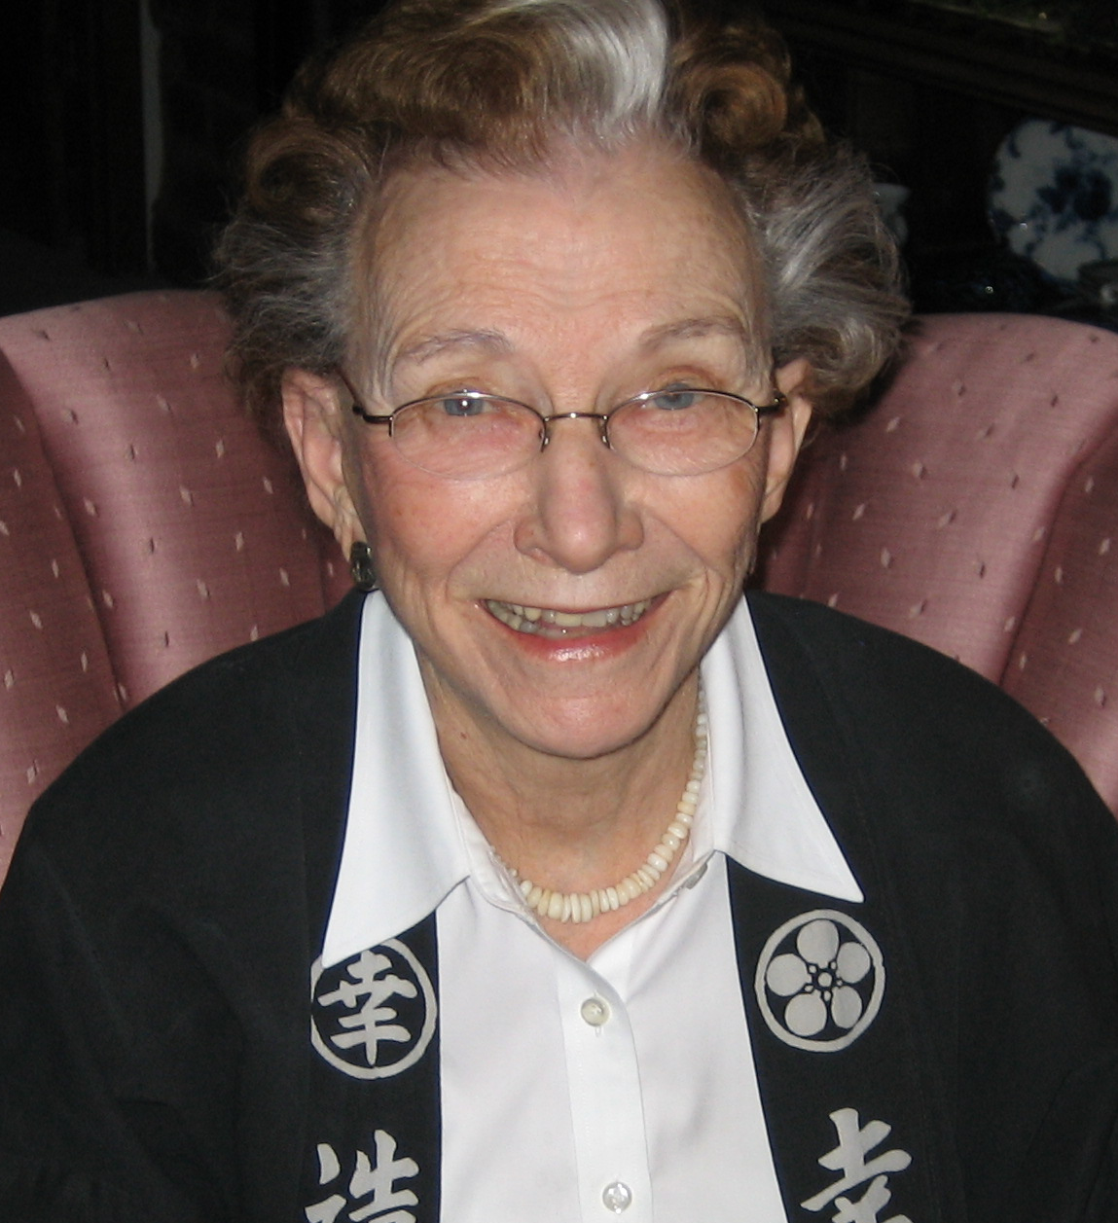
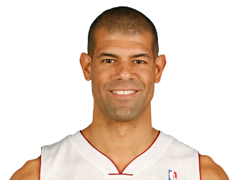
Why explore this topic?

Slide 6
Facilitate
To make easier, help bring about
To free from obstruction or difficulty
Synonyms:
Ease, grease, loosen (up), smooth, unclog
Related words
Advance, forward, further, promote, aid, assist, help, improve, disentangle, simplify, streamline
Antonyms:
Hinder, impede, retard, worsen, complicate, perplex

Slide 7
Identifying Effective Facilitators
Asked four program directors:
“Identify a person in your organization who is not in a formal leadership position, but is effective getting things done, particularly on teams or activities that involve more than one person. When this person is involved, things just seem to flow more easily with good outcomes.”

Slide 8
10 people were interviewed
7 identified by program directors in four family
medicine residencies
Roles:
Medical Assistant
Care Manager
Registration Coordinator
Practice Coach
Social Worker
Clinical Faculty (2)
3 Program directors

Slide 9
Questions for Program Directors
1. What roles do they fill? What are their activities in a typical day?
2. Why did you select these people? Why did they come to mind?
3. In what ways are they exemplary facilitators? What specific qualities do they demonstrate?
4. Any other characteristics that are unique to these individuals?
5. What do they contribute to a team?
6. If I were to ask peers about these people, what would they say?
7. How do these people respond to stressful work situations? How do they interact with others during such times?
8. What brings them satisfaction at work?

Slide 10
Questions for Facilitators
1. Tell me about your role. What are your activities in a typical day?
2. To be effective in your role, what specific things do you need to do well?
3. If someone else were hired to do this job well, what characteristics should
they have?
4. What brings you satisfaction at work?
5. When you start work, are there any things you typically do to prepare? Or do
you just dive right in?
6. What do you contribute to a team?
7. During meetings, are there certain things you typically notice?
8. When those around you are stressed, is there anything specific you do to help
the situation?
9. Do you aspire to be promoted to a leadership position? Why or why not?
10. Is there a role model in your family who has inspired you in your work? If
so, who?

Slide 11
Data Analysis
Reviewed videos
Identified themes (present in 50% or more of the interviews)
Shared videos and categories (themes) with interviewees and at two meetings (one regional, one national) to confirm descriptor for each category

Slide 12
Characteristics of Exemplary Facilitators
Organized – detail-oriented
Action-oriented – moves process forward, task-oriented, practical
Positive attitude – enthusiastic, brings energy
Compassionate – kind, supports others
Sense of humor – wit, brings lightness to situation
Empathy – perceptive, picks up on and anticipates needs/feelings of others
Self management – emotional self-control

Slide 13
Three Domains
1. Task orientation:
a) taking action and b) organized/detail-oriented
2. Relational skills and support:
a) positive attitude and enthusiasm, b) caring and compassion, and c) humor
3. Emotional intelligence:
a) empathy/ awareness of others’ feelings and needs, and b) emotional self-management

Slide 14
Potential Applications
Help leaders and managers to intentionally recognize and reward those individuals
Strategic placement of such individuals when forming teams
Criteria in the screening and interviewing process when hiring for specific positions

Slide 15
Leadership
Facilitation
Management

