Slide 1
Creating an LGBT Patient-Centered Medical Home: Beginnings, Challenges and Beyond
Tiffany Covas, MD, MPH
Jessica Lapinski, DO
Viviana Martinez-Bianchi, MD
Sharon Hull, MD, MPH

Slide 2
Disclosures
Nothing to disclose

Slide 3
Objectives:
Describe the basic elements of a LGBTQ patient-centered medical home and initial steps necessary to start such a project at their given places of practice
Strengthen communication skills and problem solving abilities to address the structural bias challenges faced with starting a LGBTQ PCMH
Identify and visualize opportunities, including community engagement efforts such as building partnerships with local organizations, to help incorporate LGBTQ advocacy

Slide 4
DFM Residency Curriculum
Clinical rotations
CFM Grand Rounds
Lecture Series
Population Health
Noon conference
Journal Club
M&M conference
PHIT Project
Clinic case review
Resident Education
Pop health symposium
Professional Development
Procedure Workshops
Nexplanon, IUD
Blog posts
Colposcopy
Census management
Suturing
Billing & Coding
Tues PM: Didactics
Cyst removal
Quality Improvement
Joint injections
Conference participation
Ultrasound
Simulation center
etc
Notes:
The Duke curriculum has all these elements surrounding each resident, and population health is an important part of it

Slide 5
Our Goal:
The Duke Family Medicine Center is working to expand its clinical practice to include an LGBTQ+ patient-centered medical home (PCMH), in coordination and cooperation with key Duke University stakeholders and the local LGBTQ+ community, to increase the quality of care experienced by Durham and Duke’s LGBTQ+ identified patients.

Slide 6
Our Model:

Slide 7
High-quality, Knowledgeable Patient-Centered Care
Exposure, understanding and mastery of health-related topics pertaining to a given individual’s role within the health care setting
Foundation upon which our field is centered

Slide 8
Current Examples:
Clinic Wide Education
Monthly slides
CME lectures
Online modules
Books/manuals
Resident focused concentration
Training/ continued education
Project ECHO
Conferences
EPIC
SOGI Data collection
Updated templates
Smart sets – working with Adult Endocrinology

Slide 9
LGBTQ+ Positive Institutional Culture
Overarching environment that employees and patients are exposed to on a day-to-day basis.
Includes institutional policy inclusion, grievance procedures, and overall exposure and attitude toward diverse populations.

Slide 10
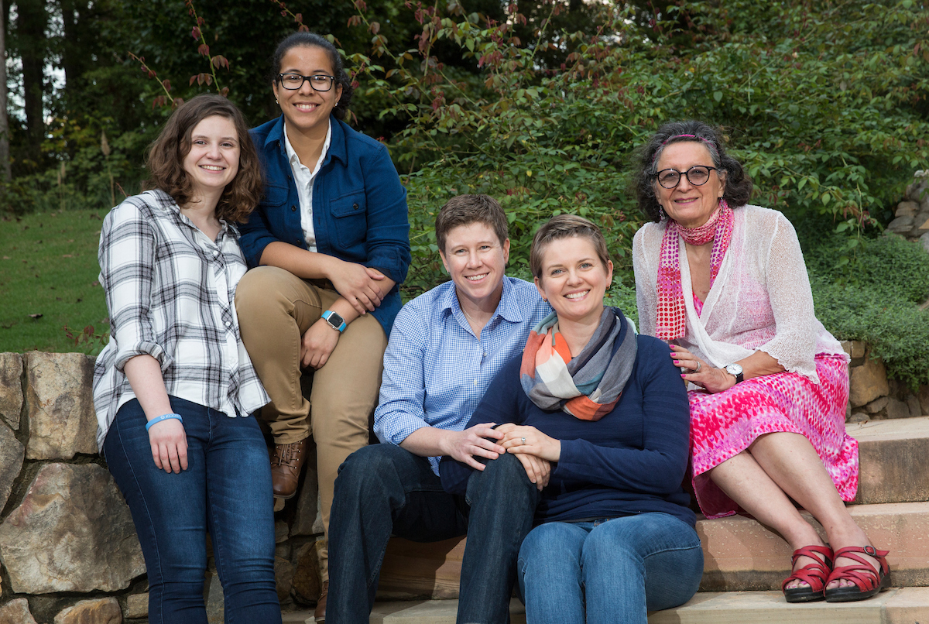
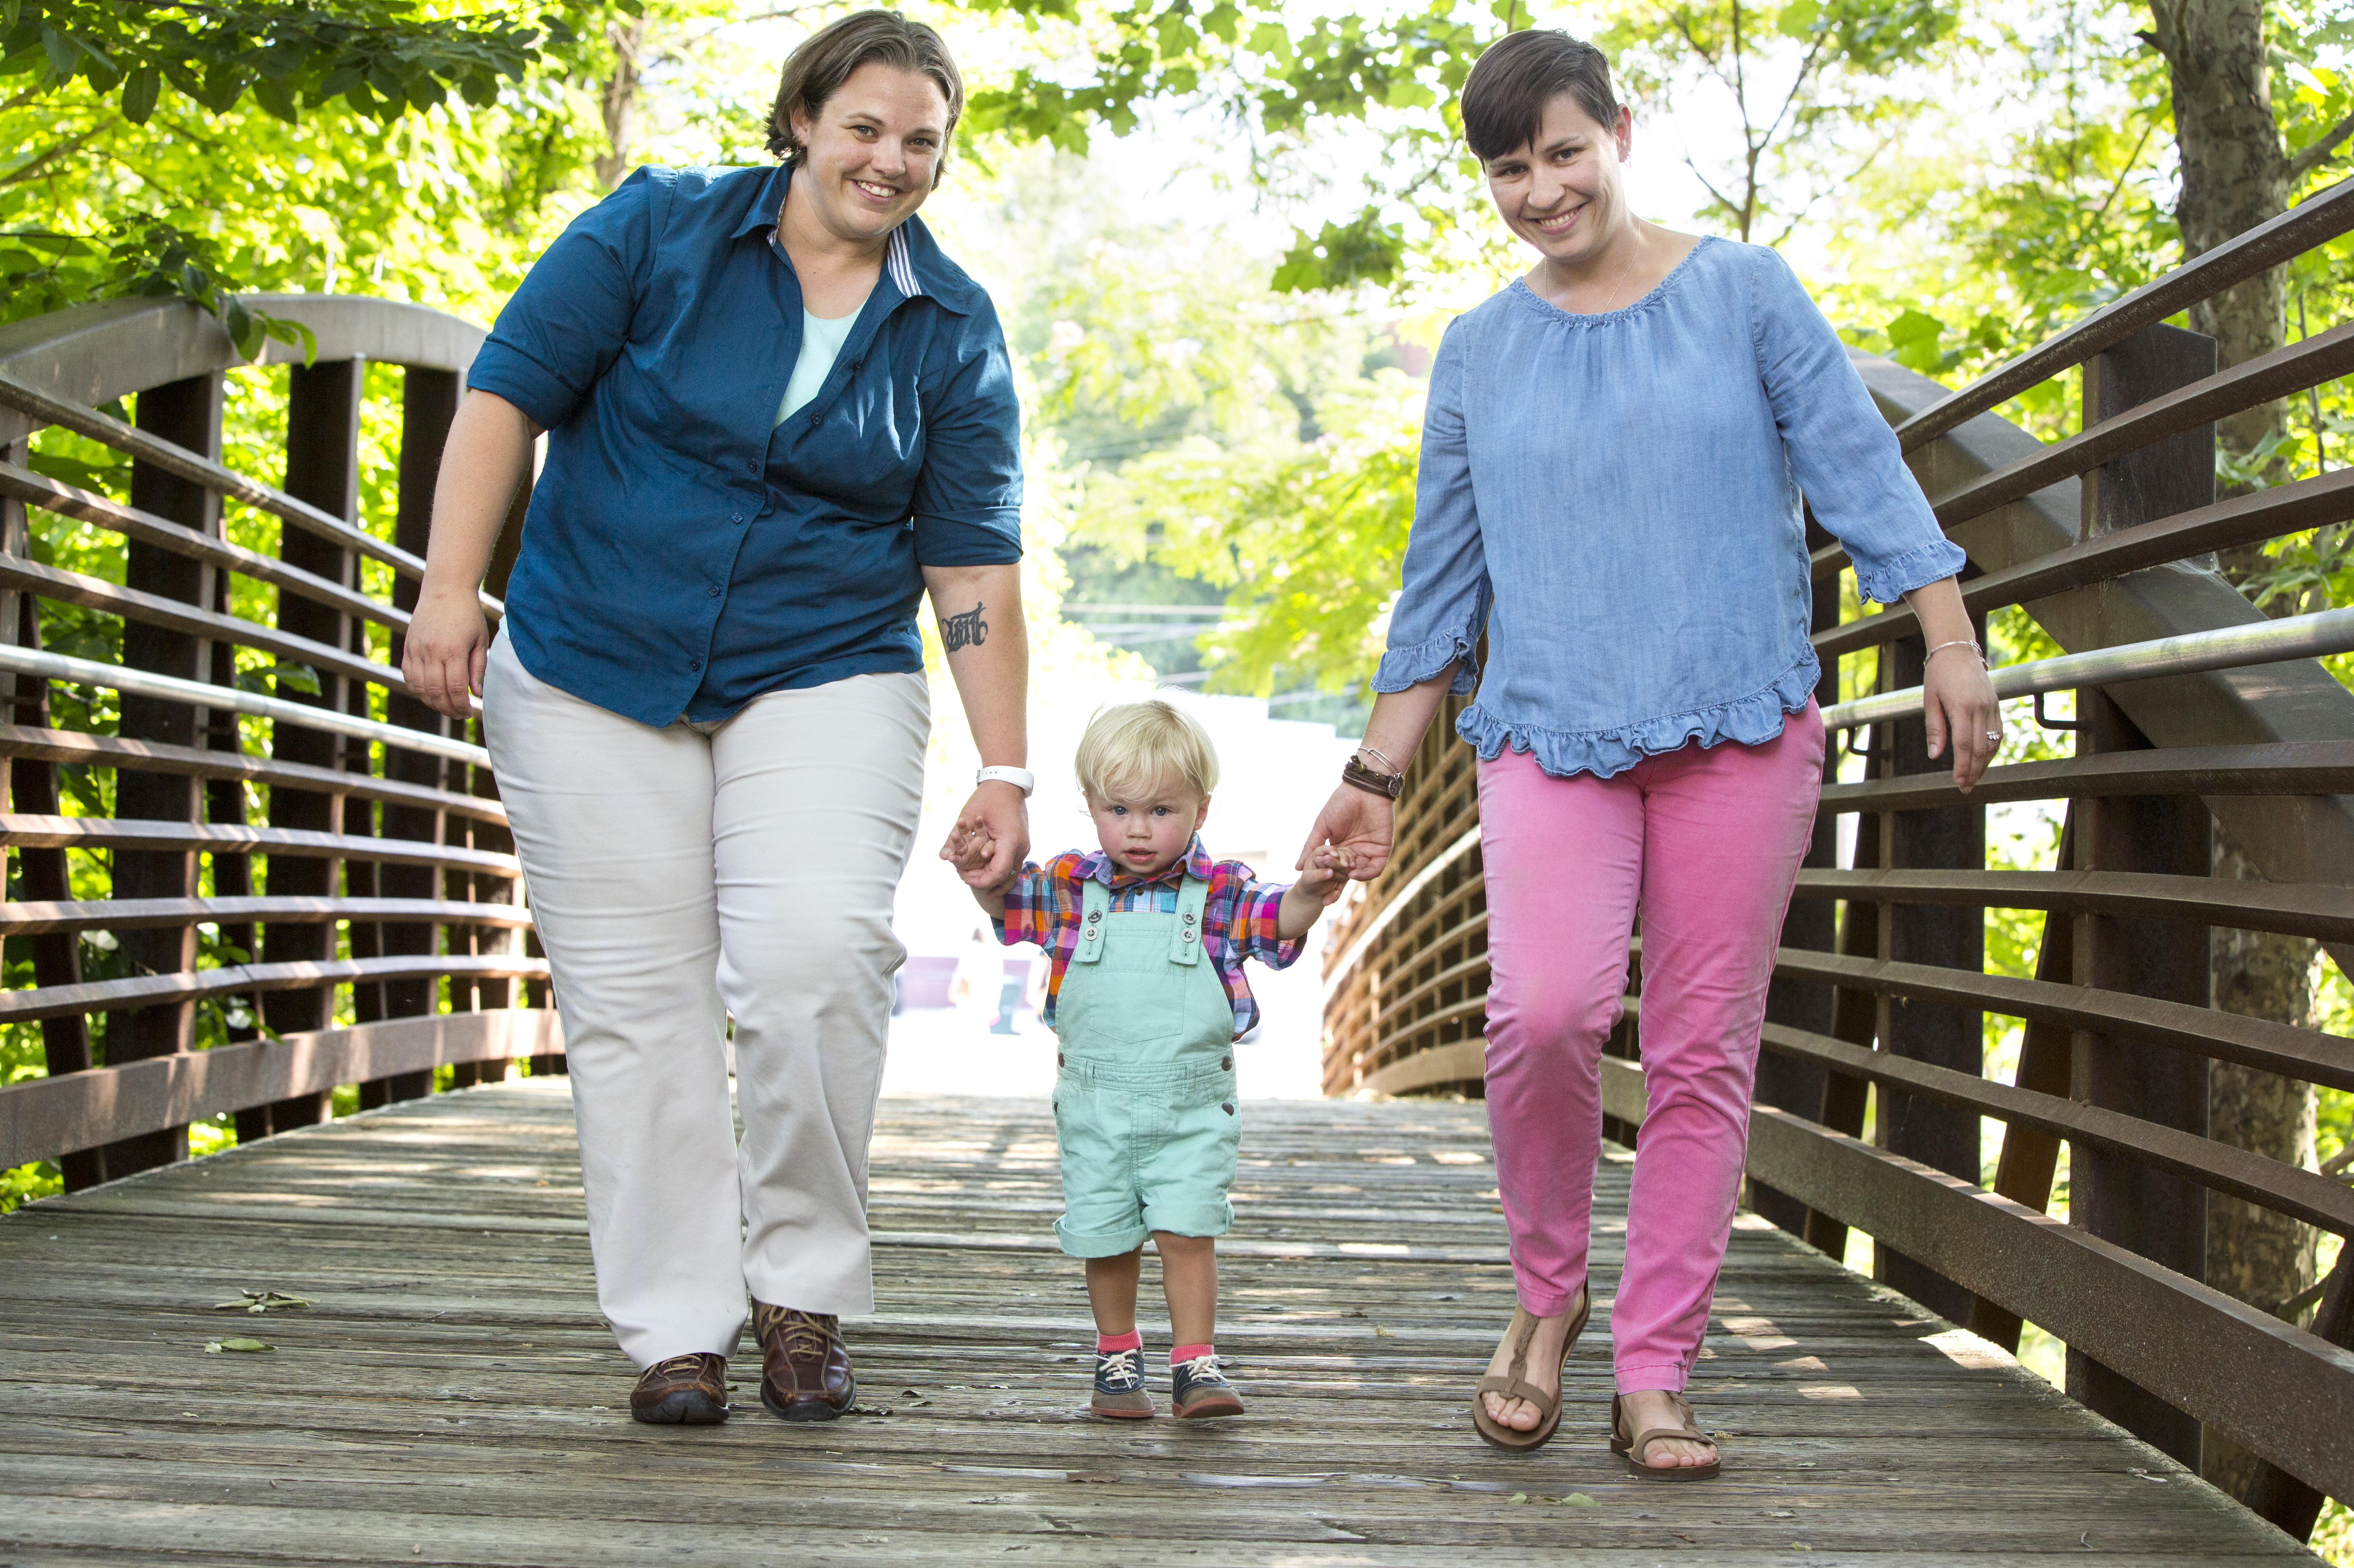
Visibility Campaign:

Slide 11
Research
Research is the foundation upon which our profession lies.
Lack of local research as it relates to the LGBTQ+ community
True innovation in regards to creating strategies for decreasing health care disparities springs forth from research

Slide 12
Current Examples:
QI projects
Conferences related to LGBTQ+ research
Submitted paper for publication
Working with Dr. Nadine Barrett and the cancer institute (completed first round of research during PRIDE event)
Working with several student volunteers
Applied and received HVC GME grant
Applying for larger grants

Slide 13
Prevention
Prevent illness and promote health in not only our patients, but also our communities
Work on finding improved methods toward promoting wellness within our LGBTQ+ population

Slide 14
Current Examples:
Working on different models for approaching preventative care
Shared groups
Located at LGBTQ center
Created LGBTQ+ service line at DFM
Deliver a wide array of LGBTQ+ specific care

Slide 15
Authentic Community Engagement
Building partnerships with key community stakeholders and conducting needs assessments are crucial.
Help shape programs and services that will be most useful for our population.

Slide 16
Current Examples:
Key stakeholders and partnerships have been established throughout the past 1.5 years
Durham LGBTQ Center
Pediatric and Adolescent Gender Clinic
School of Medicine, School of Nursing, PA program, Masters programs
DRH and UNC
Community advisory board

Slide 17
Group Discussion
Structural bias and challenges faced with starting a LGBTQ PCMH

Slide 18
Visualizing Opportunities: Index Card Activity
FRONT:
Barriers:
Key Stakeholders:
BACK:
Solutions:

Slide 19
Please evaluate this presentation using the conference mobile app! Simply click on the "clipboard" icon on the presentation page.

Slide 20
Contact us:
Tiffany Covas, MD, MPH Residency Faculty
Tiffany.covas@duke.edu
Jessica Lapinski, DO- PGY-2 and Education Chief
Jessica.Lapinski@duke.edu
Viviana Martinez-Bianchi, MD- Residency Program Director
Viviana.martinezbianchi@duke.edu
Thank You!

