Slide 2
Disclosures
Nothing to disclose as yet.

Slide 3
Leadership and Lessons From “The Ladder,” a Family Medicine Service Learning Engagement, Building a Community of Purpose

Slide 4
Objectives
Identify Kouzes and Posner 5 Practices of Exemplary Leadership
Explain the impact of cascading mentorship on leadership development
Understand and discuss the challenges of operating a continuity-based community program following the “Winbush Principles of Community Engagement” Stay lean, stay long, and adapt to local conditions.

Slide 6
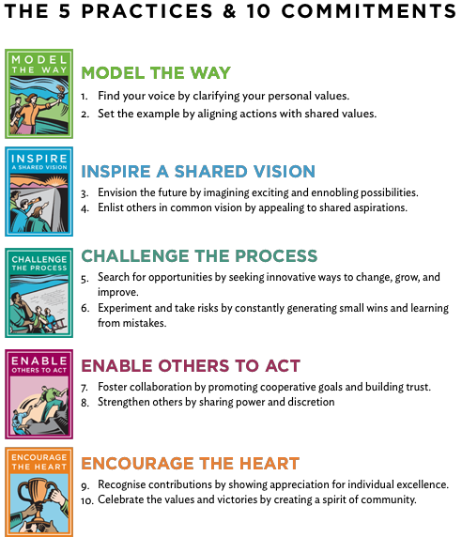
Notes:
Today we are going to share a story see if you can recognize the stages of leadership and how one contributes to the others

Slide 7
“Leadership is the art of mobilizing others to want to struggle for shared aspirations.”

Slide 8
Leadership is managing change with growth and vision and helping others to do the same.
Notes:
In order to lead we must be able to define our own values

Slide 9
Family Physicians guide patients through the challenges and changes of life, health, and illness.
Notes:
AAFP Definition

Slide 10
Leadership is a journey
More than anything
Notes:
Journeys are best described in stories, we give you the story of The Ladder an intergenerational organization of mentorship for low wealth communities

Slide 11
“Lift as you Climb, Build as you Grow” The motto of The Ladder
Notes:
The leadership story we will tell today is The genesis of The Ladder…is a model of this motto

Slide 12
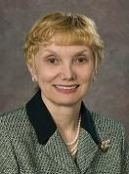
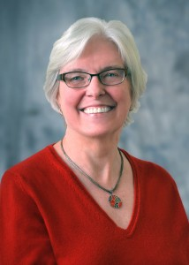
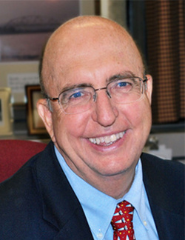
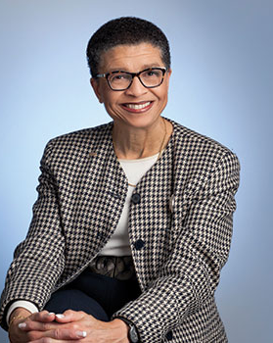
Dr. Bertakis
Dr. Fahrenwald
Dr. Baird
Dr. South-Paul
Thanks.
Notes:
This Dept Chair Told a Young Chief Resident that she should consider becoming and academic, AND then also hired her as Faculty
This program Director entrusted a new faculty member with leading teams to build programs and curriculum she would often quote French novelist teaching“If you want to build a ship, don't drum up people to collect wood and don't assign them tasks and work, but rather teach them to long for the endless immensity of the sea.”
This Dept chair told a mid career faculty member she should get leadership training and stood up at an STFM conference and asked how can we get our Physicians into the Communities we serve to address the challenges our patients face
This Dept Chair and philanthropist funded the scholarship that allowed the mid-career faculty engage in the year long STFM Emerging Leader Fellowship where The Ladder was born.

Slide 13
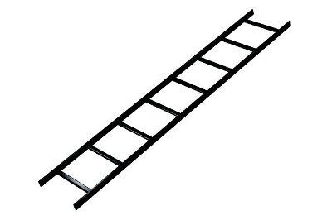
The Ladder
Notes:
Why? Where we live learn work and play and 5k story show the path, model the way and encourage…

Slide 14
What The Ladder is…
What The Ladder isn’t…
A Community of Purpose
A Path, not a Pipeline
We change each others lives
The members are not outcomes or products, they are people
An organization that models the path of success
Resilient
Mission driven
Growth mindset
Supportive and interconnected
A quick fix
A source for research
Low wealth communities do not trust researchers, if the parents ASK for a study we may consider a study, otherwise, no. Period.
Notes:
The basic idea is the organization itself demonstrates by our actions the ideals and values that prepare youth and others for successful career. If your want to help grow Resilient, Mission driven, Growth mindset, Supportive and interconnected people you must have a Resilient, Mission driven, Growth mindset, Supportive and interconnected organization. In Complexity science it is called self similarity .

Slide 15
The Ladder Video
http://youtu.be/sjDjHOdpdY4
Notes:
The video is five minutes long the sound get too loud sometimes sorry. We would love to gets some funding to have an updated professional video made.

Slide 16
Principles
Long term commitment and adapt to local conditions
Create a lean interconnected organization that can get by on limited funding so that it can maintain a LONG TERM commitment in a low wealth community
Each one, Teach One…this is cascading mentorship
Notes:
Kids from low wealth communities often do not have people in their lives who can know and show the path to success in school and careers The Ladder provides a long term commitment to be in its members lives as we all live and grow in community

Slide 17
Outcomes…
Members who are all mentors
Everyone knows the path to success is full of failure and perseverance
Growth Mindset replaces perfection pursuit
Understand no one succeeds alone and helping others is critical for long term success
Each member/mentor can model living a life of purpose by participating in and Building a Community of Purpose
Our purpose to help each other succeed, and
Help our Communities Succeed

Slide 18
Further Outcomes
Increased Academic Faculty Diversity
The presence of The Ladder demonstrates commitment and mission for engagement in low wealth communities, this is attractive to Diverse faculty
Increased Medical School Diversity
When choosing a medical school underserved students have expressed the presence of The Ladder as having influence their choice of schools
Decreased Physician Burnout
Resident, Community and Faculty physicians have all expressed their participation in The Ladder as a prophylaxis against career burnout
Decrease Middle school suspensions
None of our middle members have had suspension or expulsions, this is in the neighborhood with highest level of suspensions and repeat suspensions on the county

Slide 19
Long term Commitment required for Long term Data
High School on time graduation
4 year College graduation
Community Leadership
Participation in post graduate education
Medical, Dental, Nursing, etc.

Slide 20
The ladder is a long term investment and commitment to building a community and culture of purpose
This is why we stay lean, work with partners, and adapt to local conditions
Notes:
Winbush Principles, Stay lean, so you can Stay long and adapt to local conditions

Slide 21
For the cost of imprisoning one youth for one year…
We can run a single Chapter of The Ladder for 33 years.
With our leanest profile meetings,
reference http://www.justicepolicy.org/research/8477
Notes:
Our leanest profile meetings share meeting space and so don’t have to pay rent and have most equipment used donated.
Can run meeting for about 250 per meeting which includes cost of food and some equipment
http://www.justicepolicy.org/uploads/justicepolicy/documents/executive_summary_-_sticker_shock_final.pdf

Slide 22
Content of The Ladder
The Intro
The Value and Appreciation
The Meal
The Rotation Stations
The wrap up
The Pledge
Notes:
The Intro
Sets the stage and expectations
The Value and Appreciation
Provides a chance to share stories of failure and resilence and qualities of character that lead to growth mindset and successful lives
The Meal
Creates culture of support, listening and mentorship bonds
The Rotation Stations
Hands on 80/20 is the goal
eighty percent hands on learning,
The wrap up
Gather and appreciate
The Pledge
Make a Commitment tour Communities and ourselves to succeed, by learning and never giving up

Slide 23
The intro

Slide 24
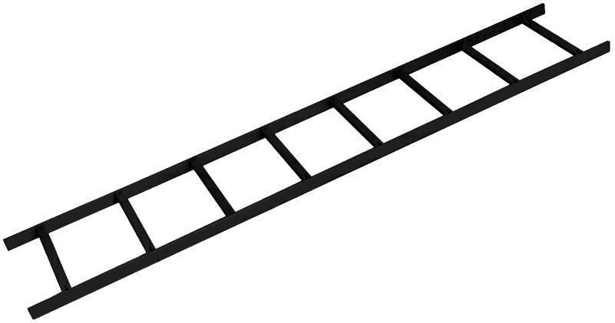
The Ladder
"Lift as you Climb Build as you Grow"
www.theladderMN.org

Slide 25
What is The Ladder?
You are The Ladder.
We together...

Slide 26
The Ladder is a Society of Medical Scholars Ages 9 and Up
What is a Scholar?

Slide 27
A Scholar Reads,
A Scholar Listens,
A Scholar Teaches and, A Scholar Learns.

Slide 28
Core Values Include...
Respecting and valuing ourselves and others
Believing in our own ability to learn, teach and grow
Believing in our ability to learn, teach and grow FROM and WITH others
"Learning is winning, losing is a chance to learn"

Slide 29
Core Values Include...
Building a strong brain,
Reading 30 minutes a day everyday
30 minutes a day everyday, even if it is re-reading something you have already read, even comic books.
A secret, reading 30 minutes each day also
makes reading more FUN and EASIER!

Slide 30
We SUPPORT each other
My Words are My Mission,
What I say about other people reflects more on me than them, I don’t call others mean names.
Before I speak I ask myself is it kind?
Am I helping this scholar feel supported?

Slide 31
Structure of The Ladder includes
Service Learning,
Leadership Development, and Cascading Mentorship
and FUN!

Slide 32
Mentorship
Support + Challenge = Mentor

Slide 33
Today’s learning…

Slide 34
Sports Medicine!

Slide 35
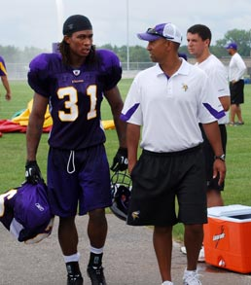
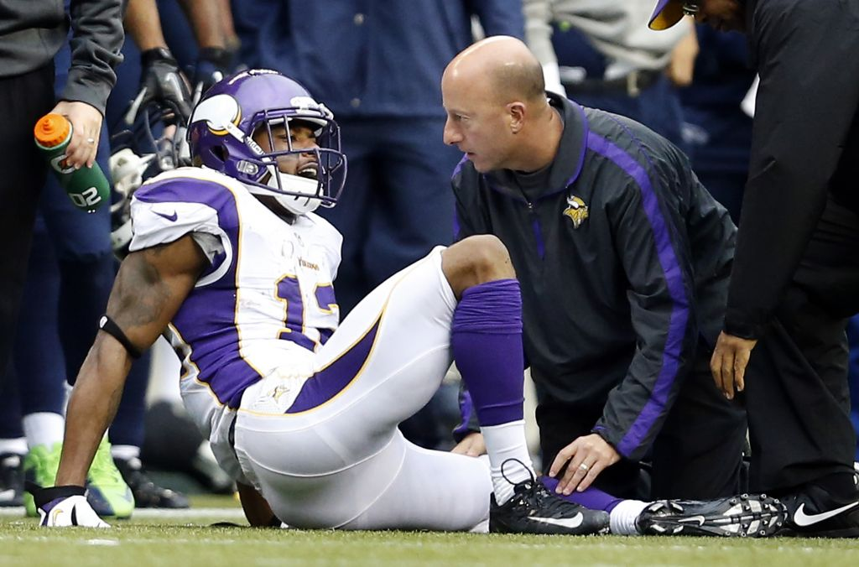
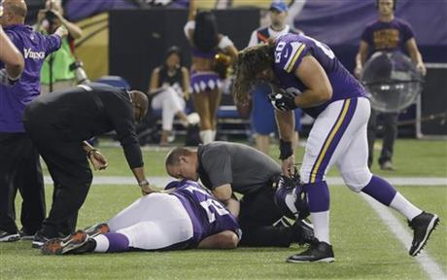

Slide 36
Who are some of the helpers?

Slide 37
Who are some of the Helpers?
NURSES,
Nurses!
Athletic Trainers
EMTs
Paramedics
Emergency Medicine Doctors
Family Medicine Doctors
Pharmacist (PharmD)
Physical Medicine, Rehab Doctors, (PM&R)
Radiology Techs
Radiologist
Trauma Surgeons
Orthopedic Surgeons
Dentists
SPORTS MEDICINE doctors!

Slide 38
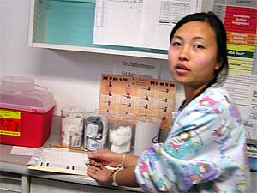
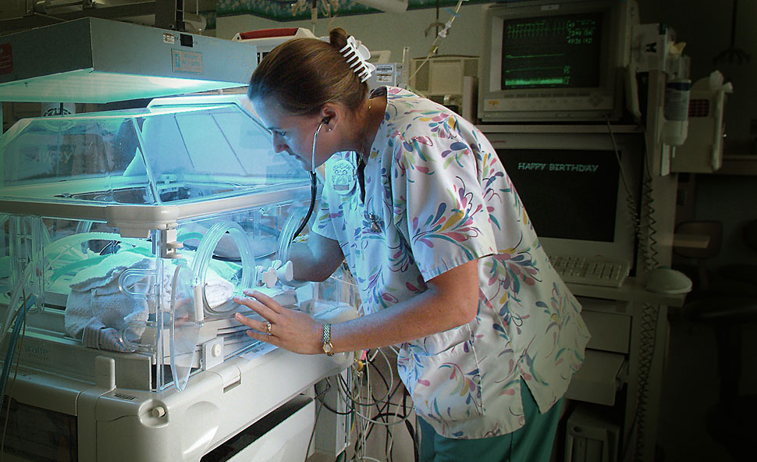
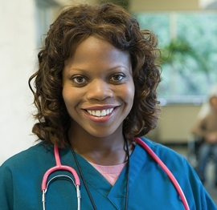
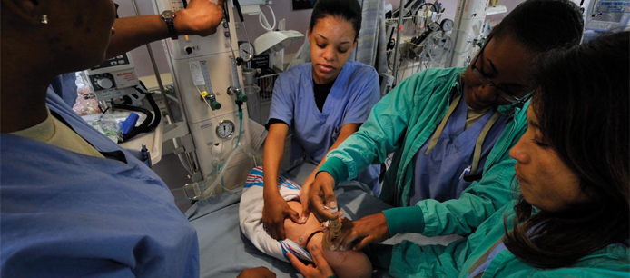
Nurses, Nurses, Nurses!

Slide 39
Value and Appreciation
http://youtu.be/TVn-G-HklLY

Slide 40
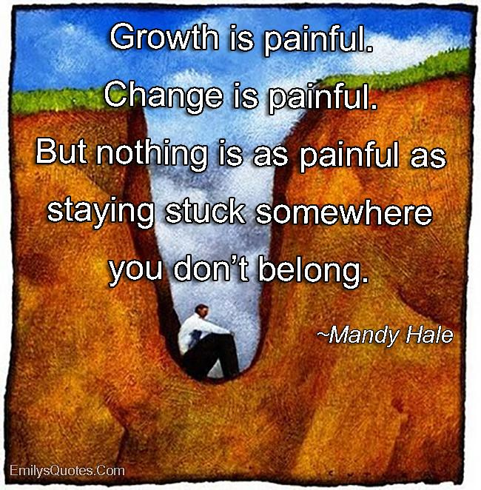
Notes:
These are the quotes that we use to introduce ourselves at the meal time. Each one choose a quote and tell a story from their own lives about what that quote means to them.

Slide 41
The Ladder
"Lift as you Climb Build as you Grow"

Slide 42
“The Ladder” Pledge, the Twelve Rungs
We believe our true self is Wise and Compassionate, and seek to know this Self.
We take full Responsibility for our choices
We take full Responsibility for our actions
We strive each day to Appreciate the good in ourselves, our community and our lives
We are Determined to correct any mistake that we may have made and Determine to take right action now and in the future.
We embrace the truth, that each day we can be the Right person and do the Right thing, starting now.
We seek to see the best parts of others and speak directly to that being.
We seek to see the good in our communities
We seek to serve the positive works in our communities
We seek Knowledge, and desire to act from Wisdom
We will spread by our actions and our lives the principles of a successful community, “Lift as you climb, build as you grow.”
We know we will succeed because we will never give up,
This I Pledge. November 12th next meeting
Notes:
This is our pledge we end each meeting with everyone reading it out loud.

Slide 43
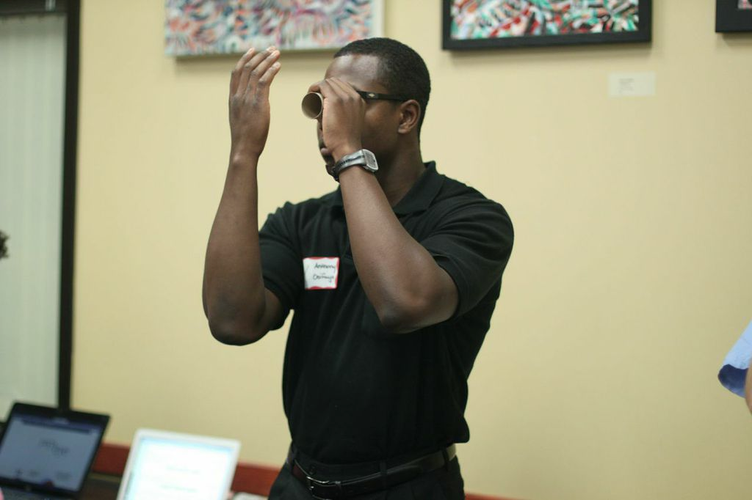

Slide 44
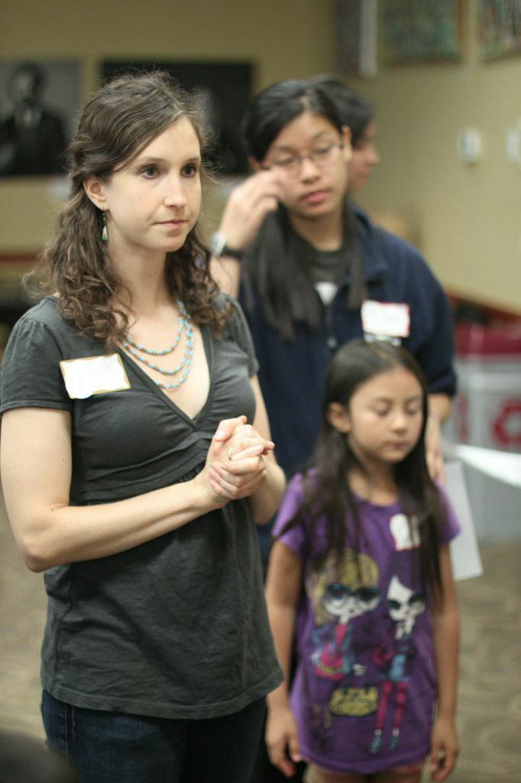

Slide 45
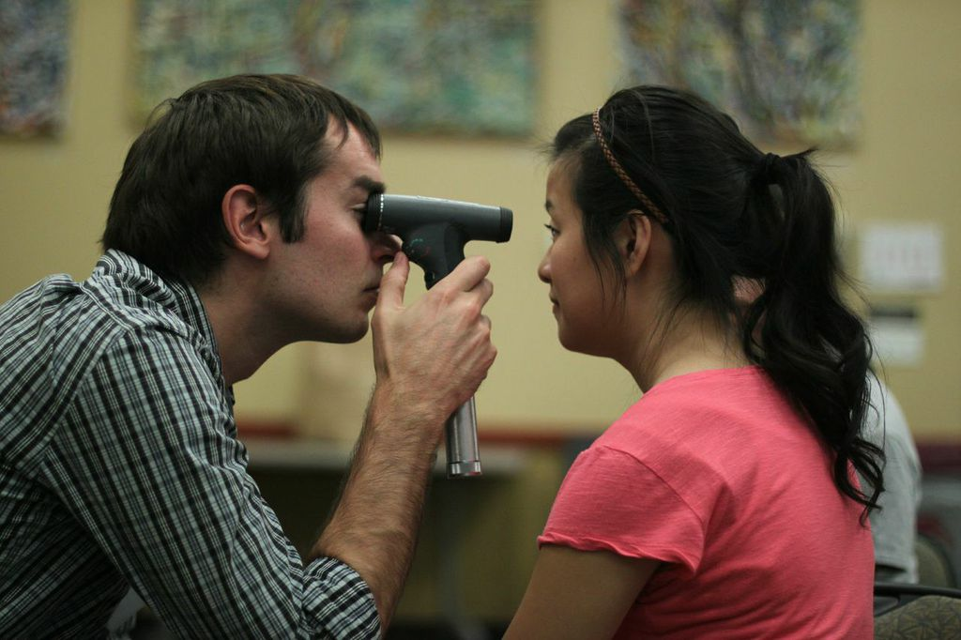

Slide 46
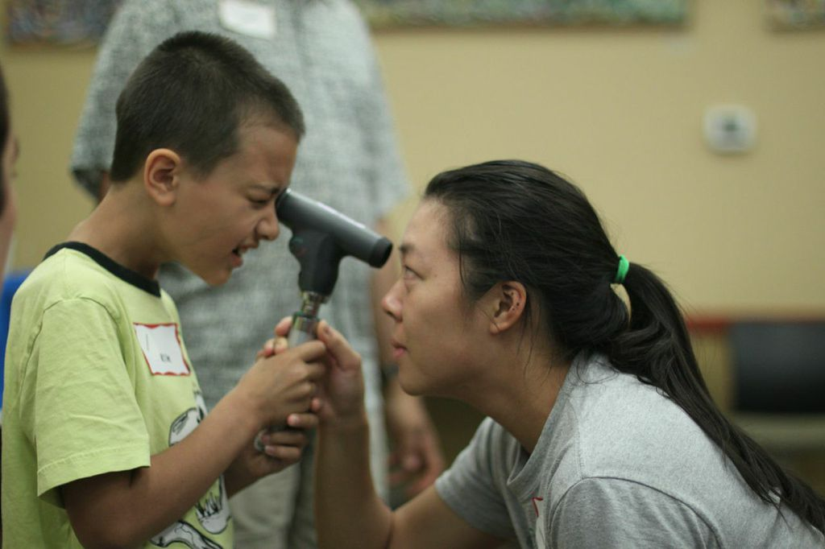

Slide 47
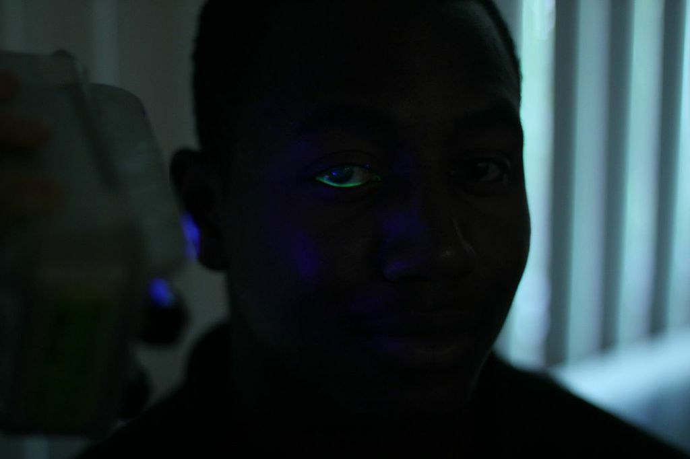

Slide 48
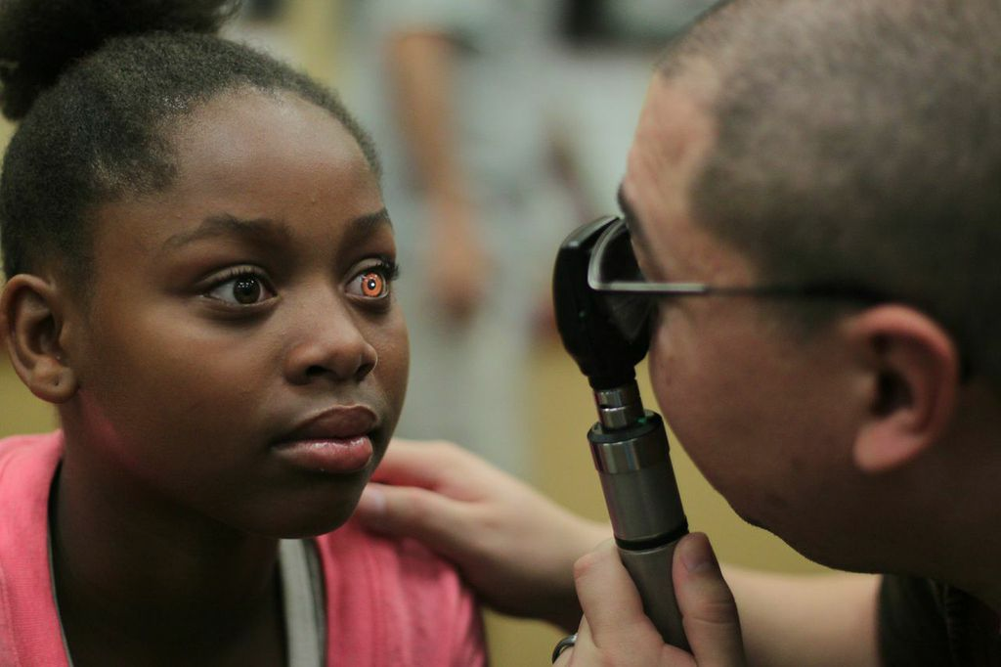
Notes:
See ONE

Slide 49
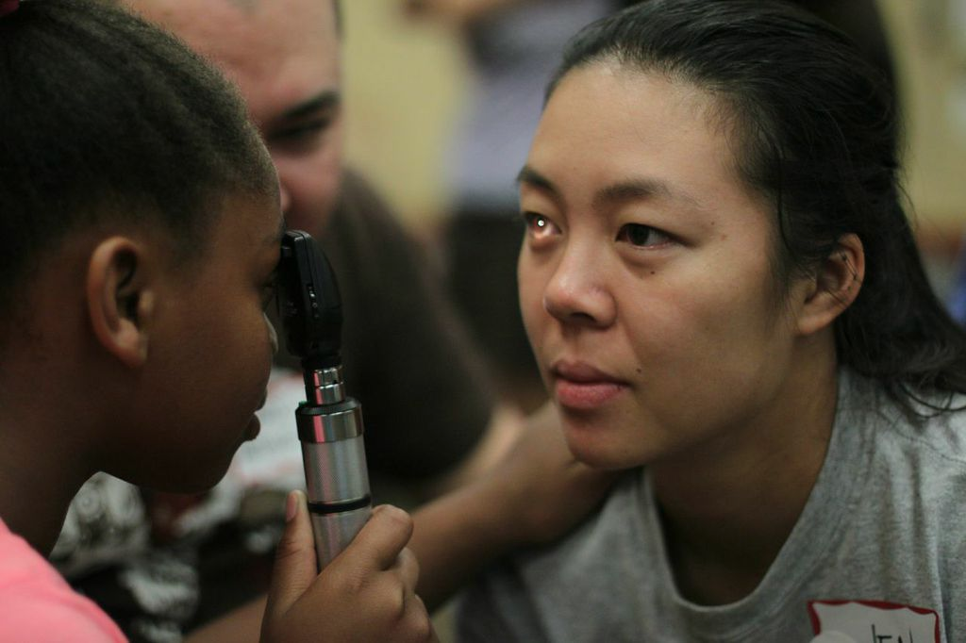
Notes:
Do ONE

Slide 50
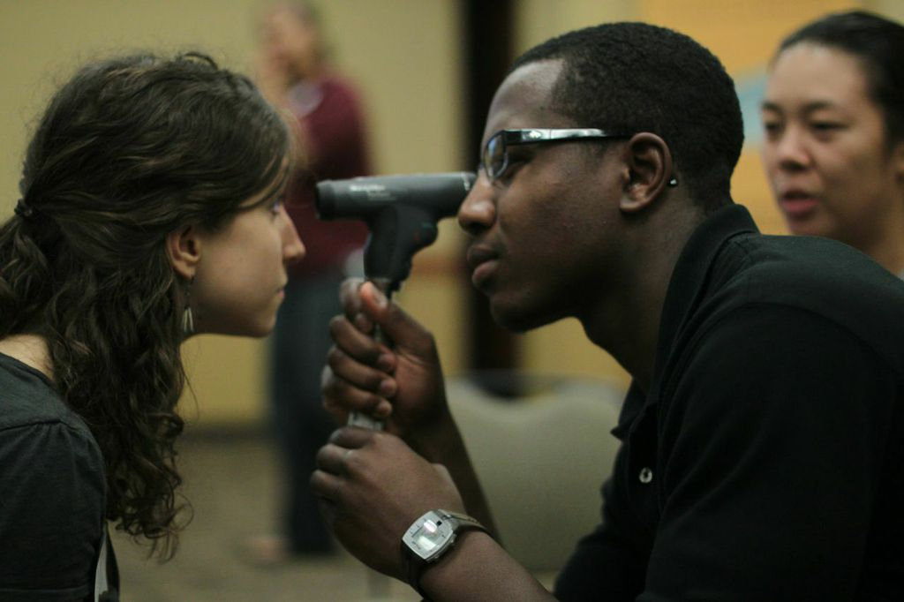

Slide 51
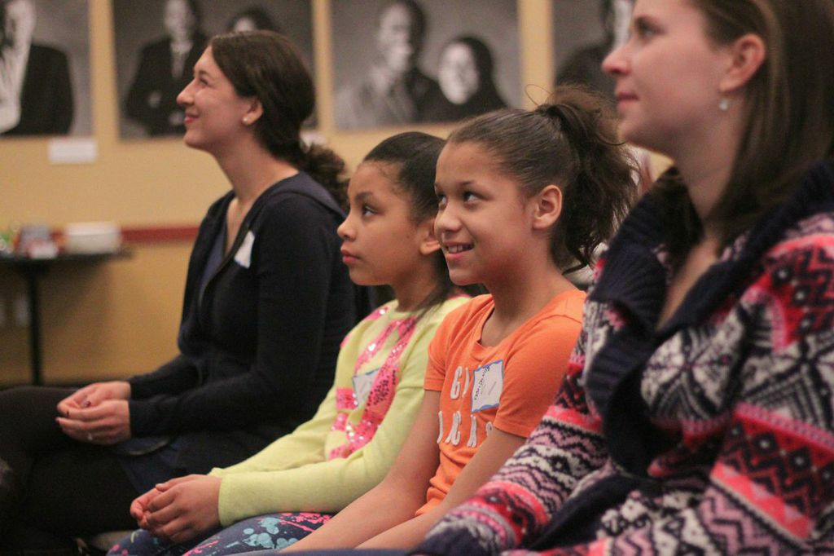

Slide 52
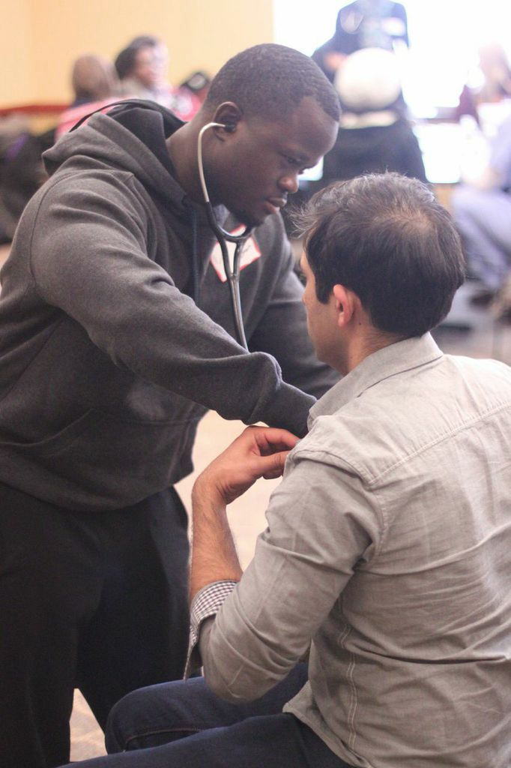

Slide 53
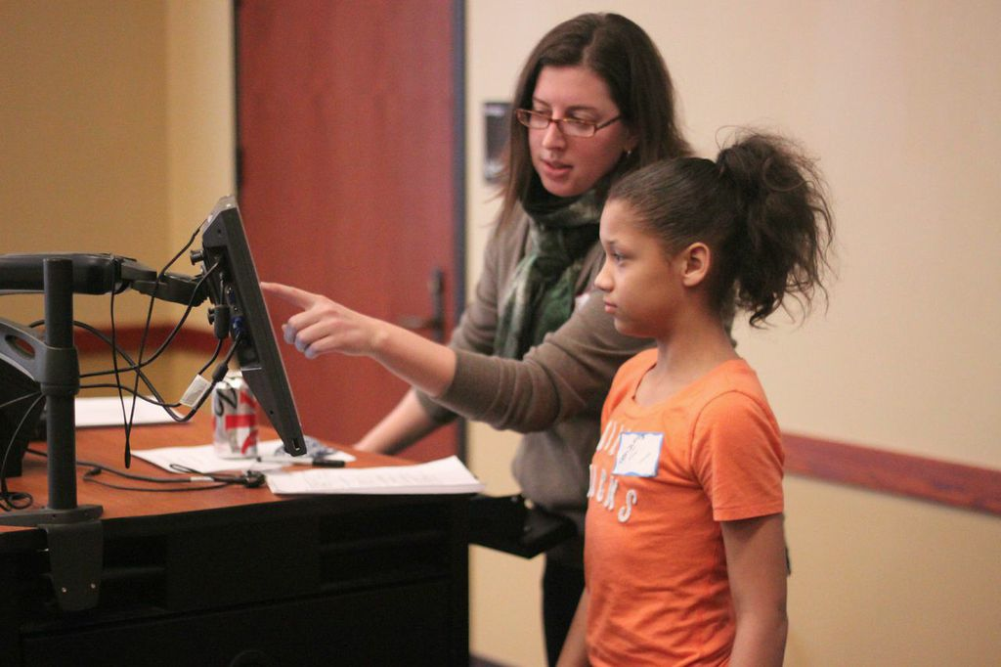

Slide 54
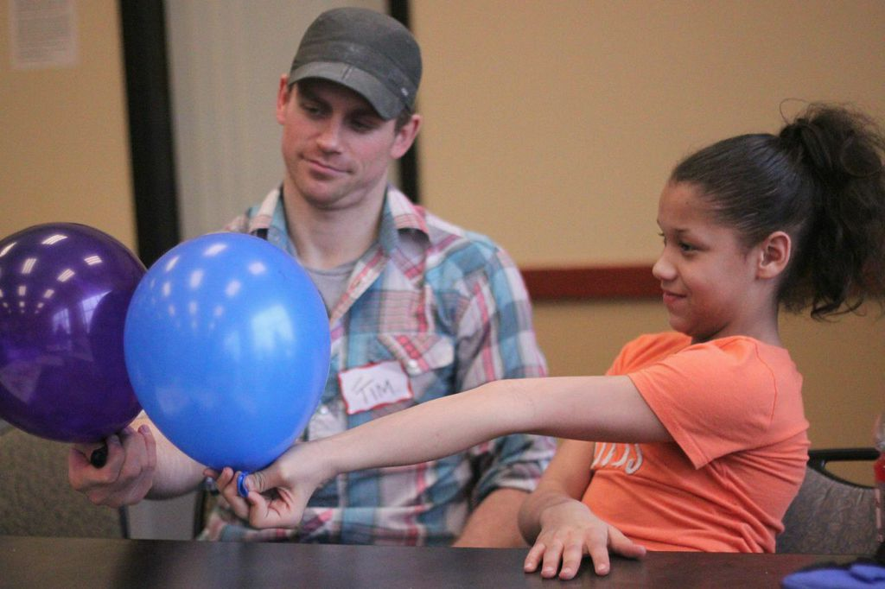

Slide 55
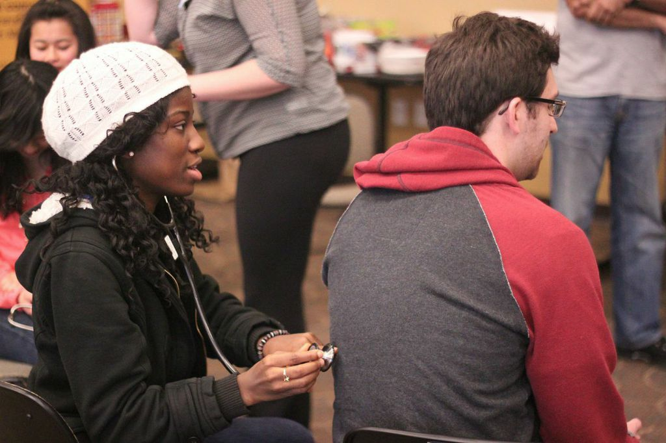

Slide 56
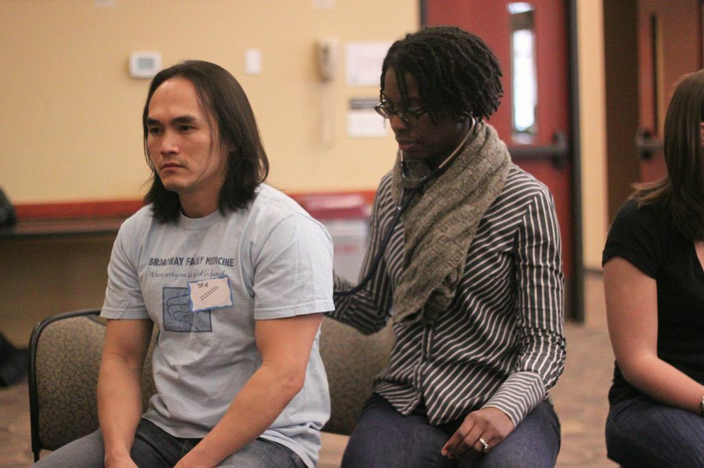

Slide 57
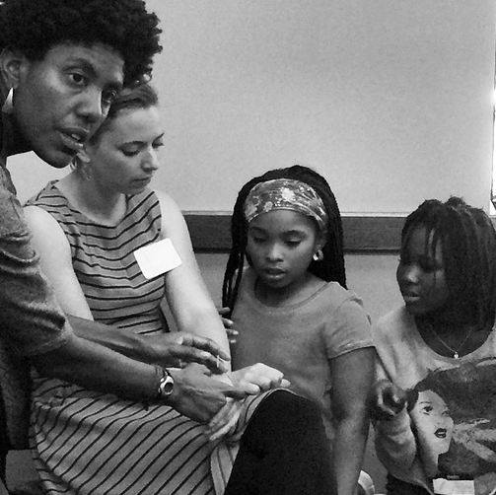
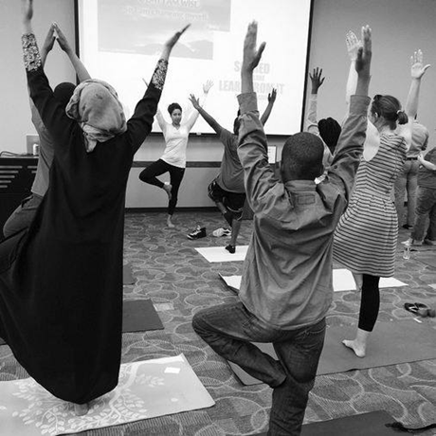

Slide 58
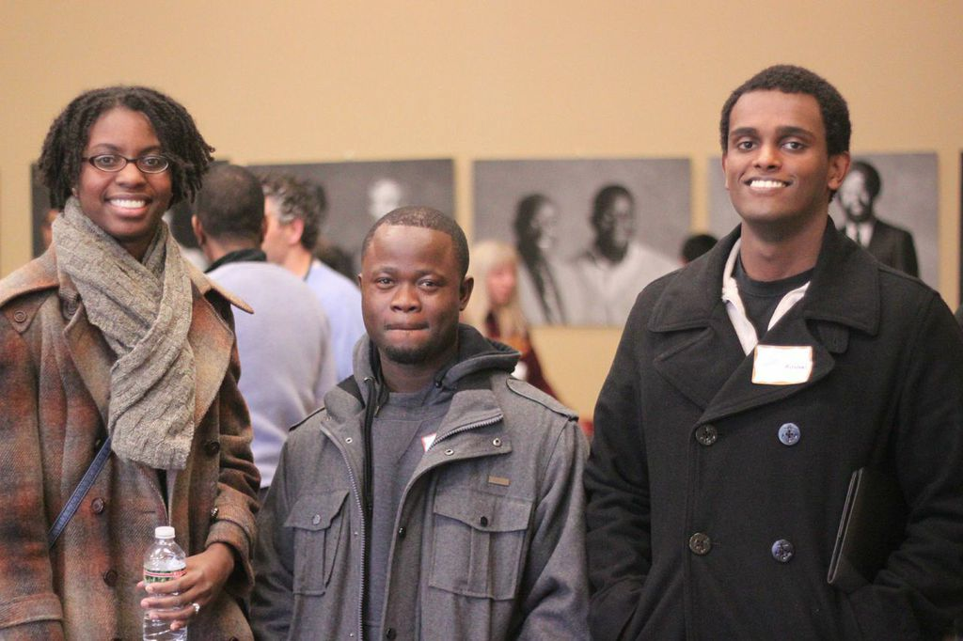

Slide 59
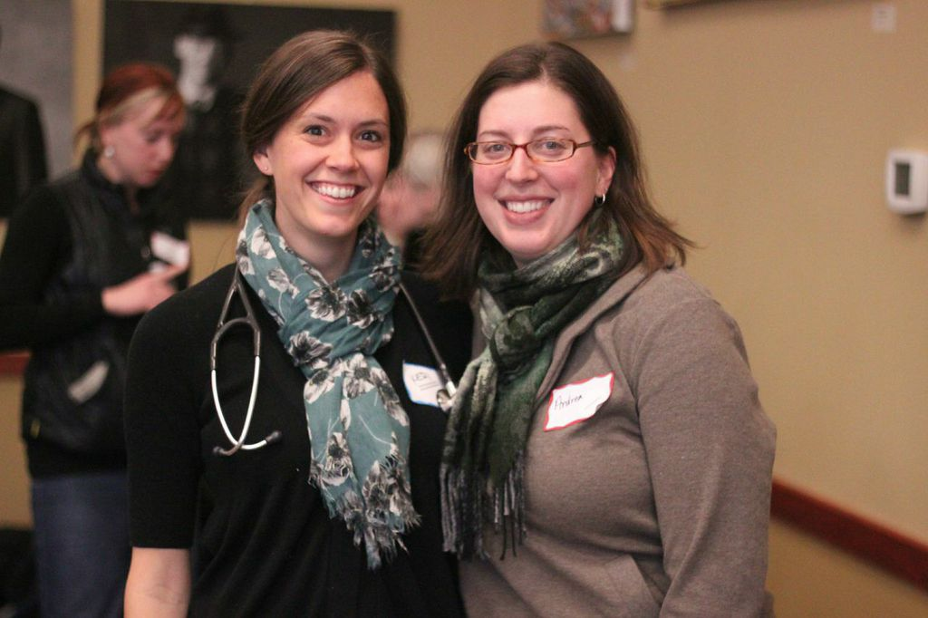

Slide 60
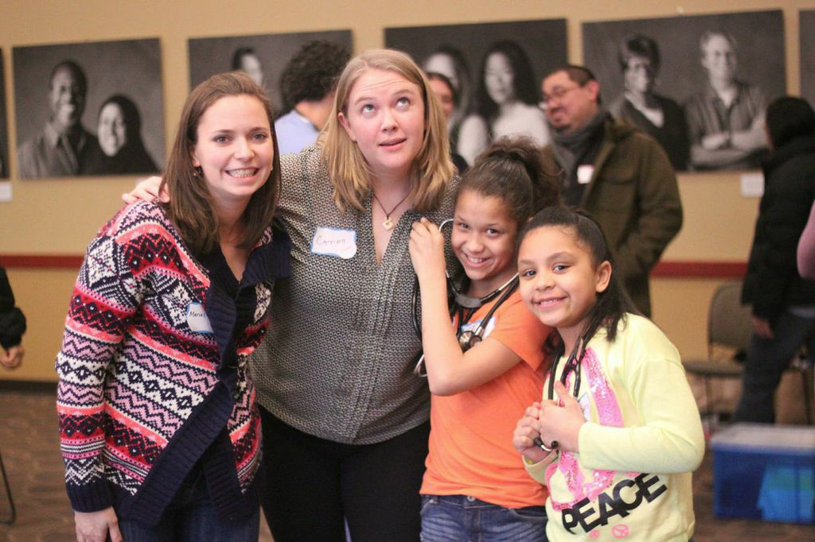

Slide 61
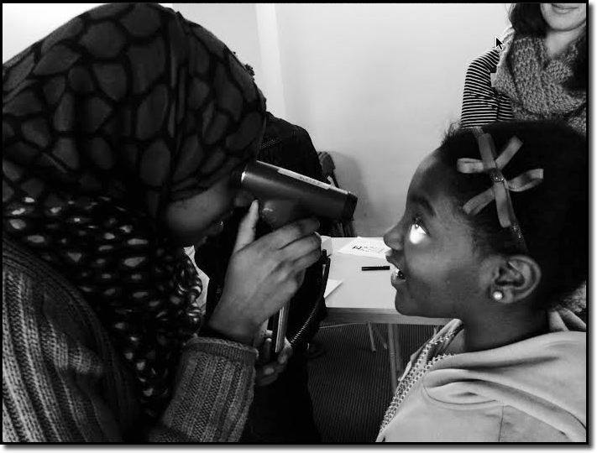

Slide 62
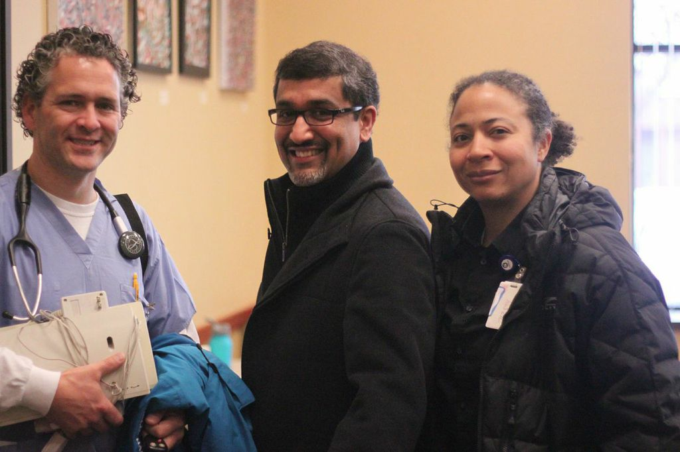

Slide 63
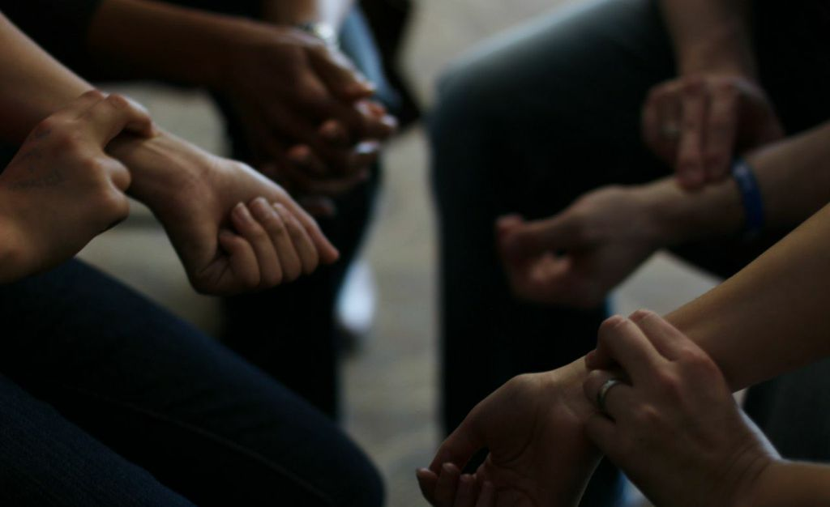

Slide 64
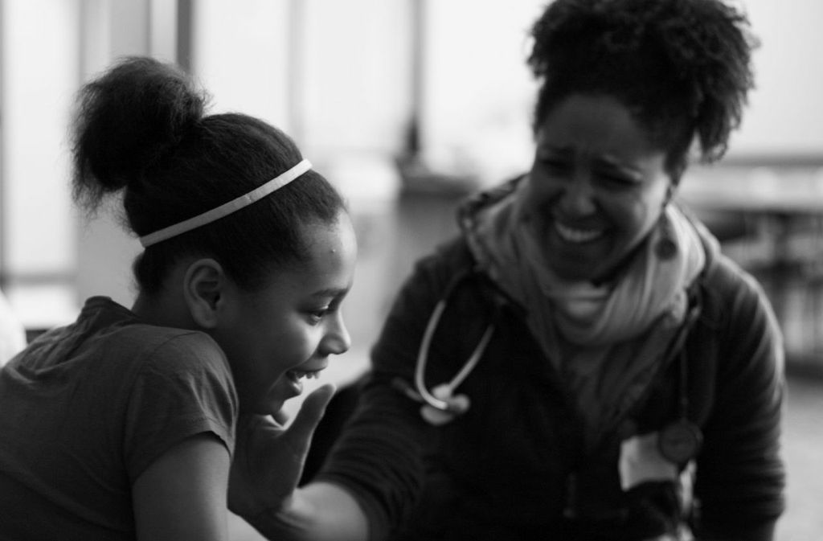

Slide 65
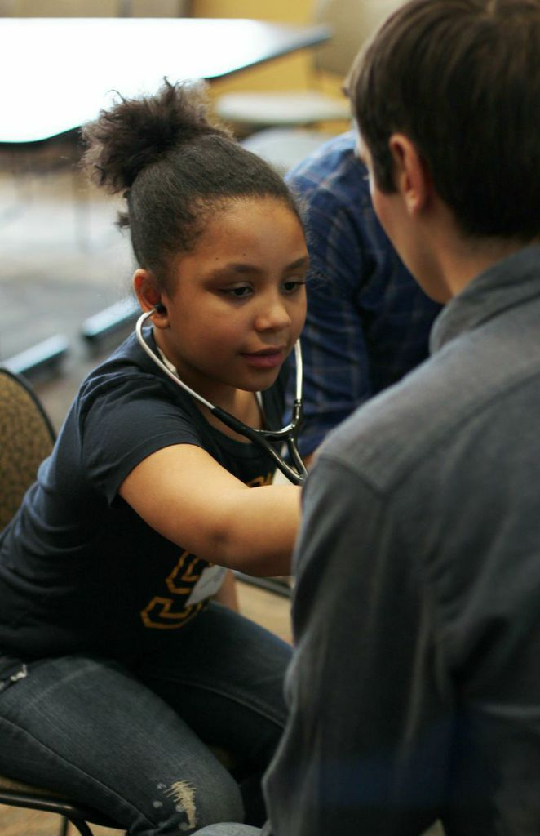

Slide 66
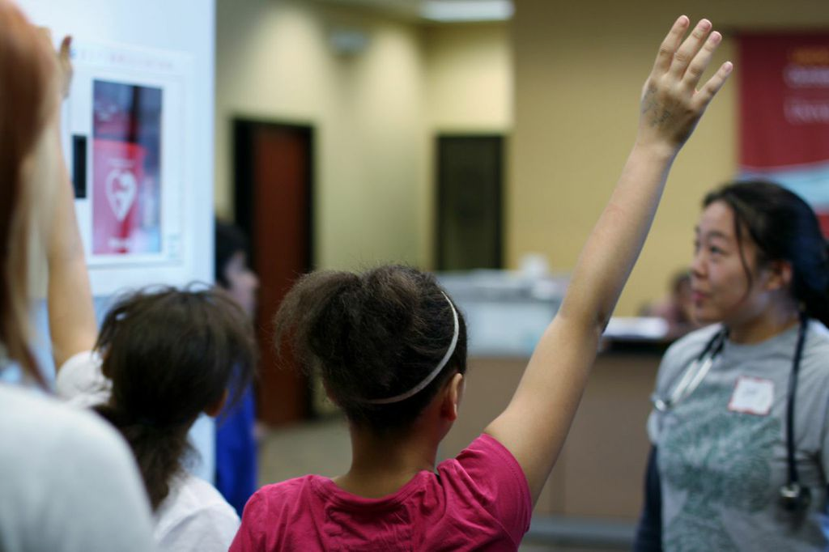

Slide 67
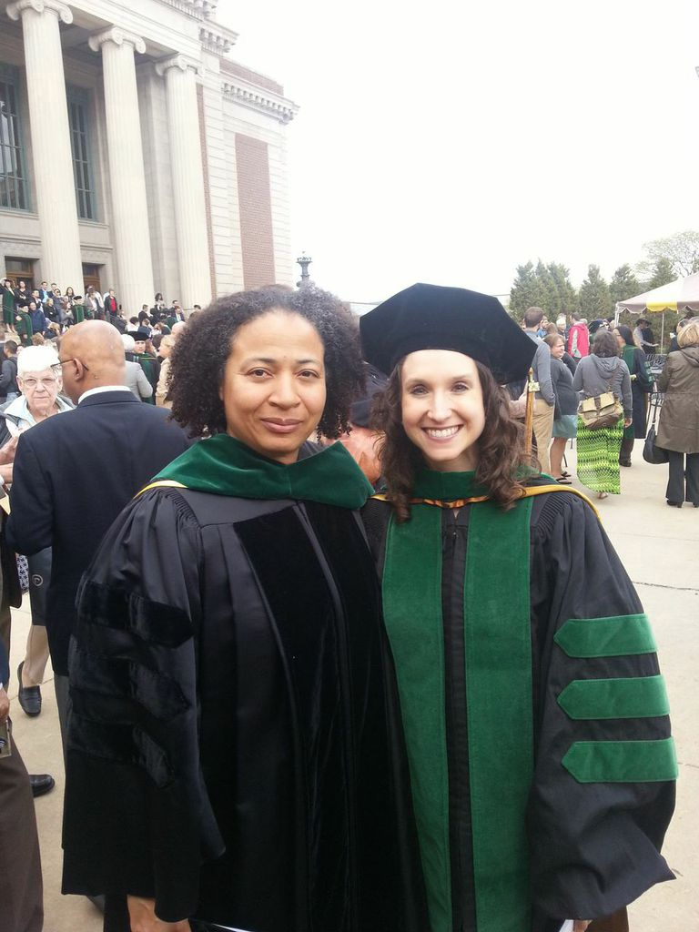
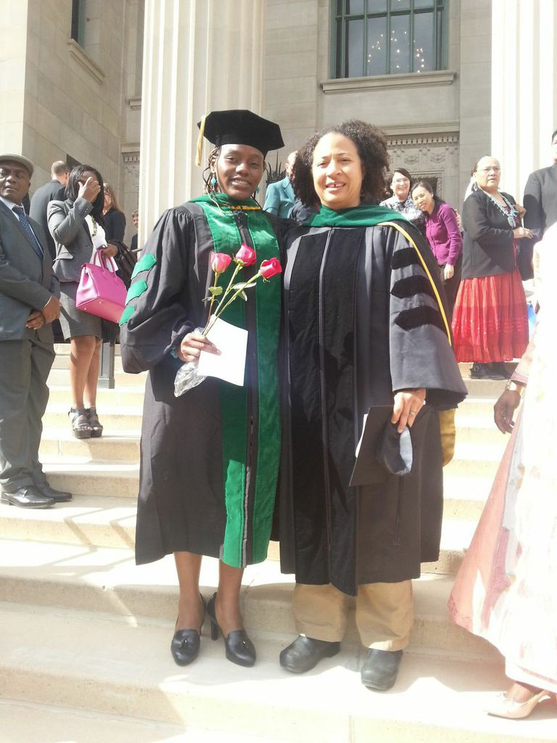
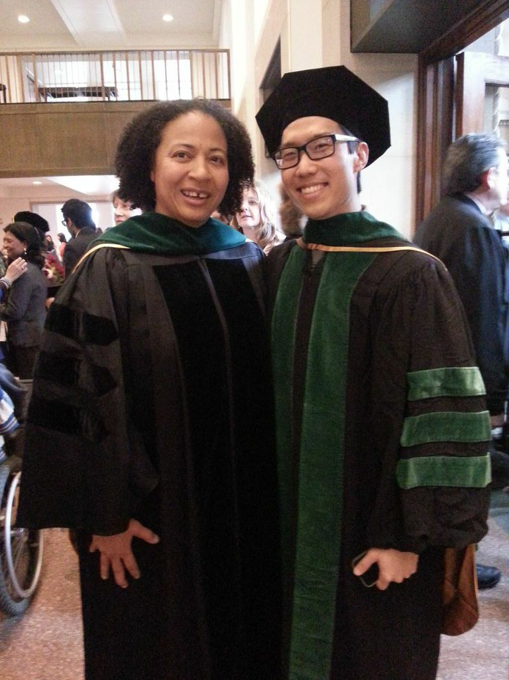
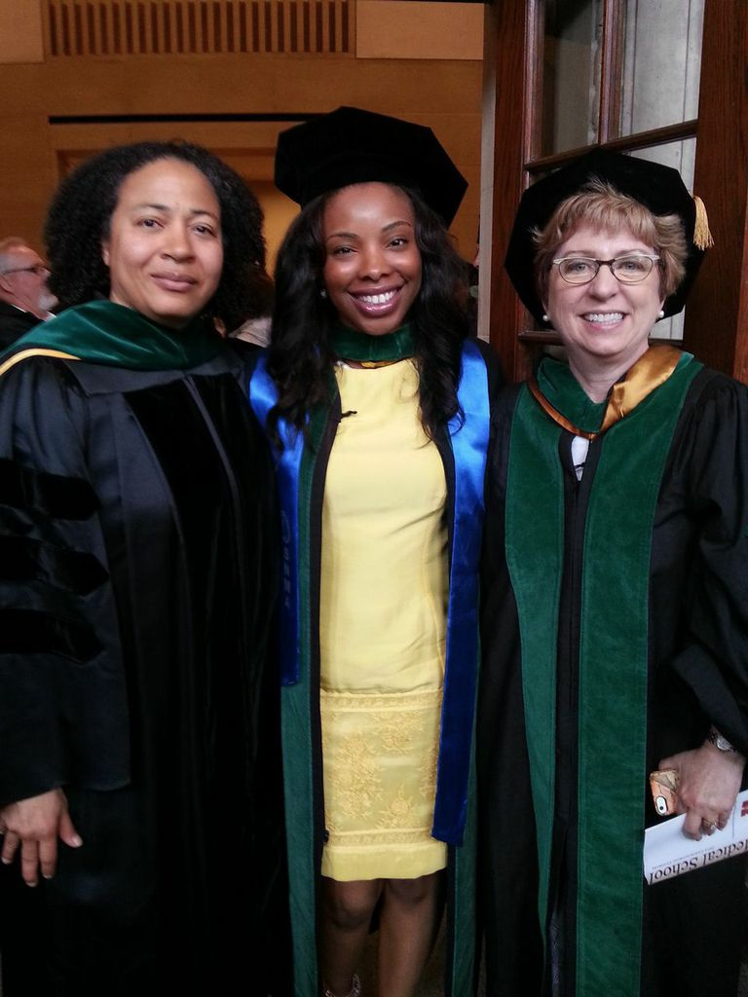
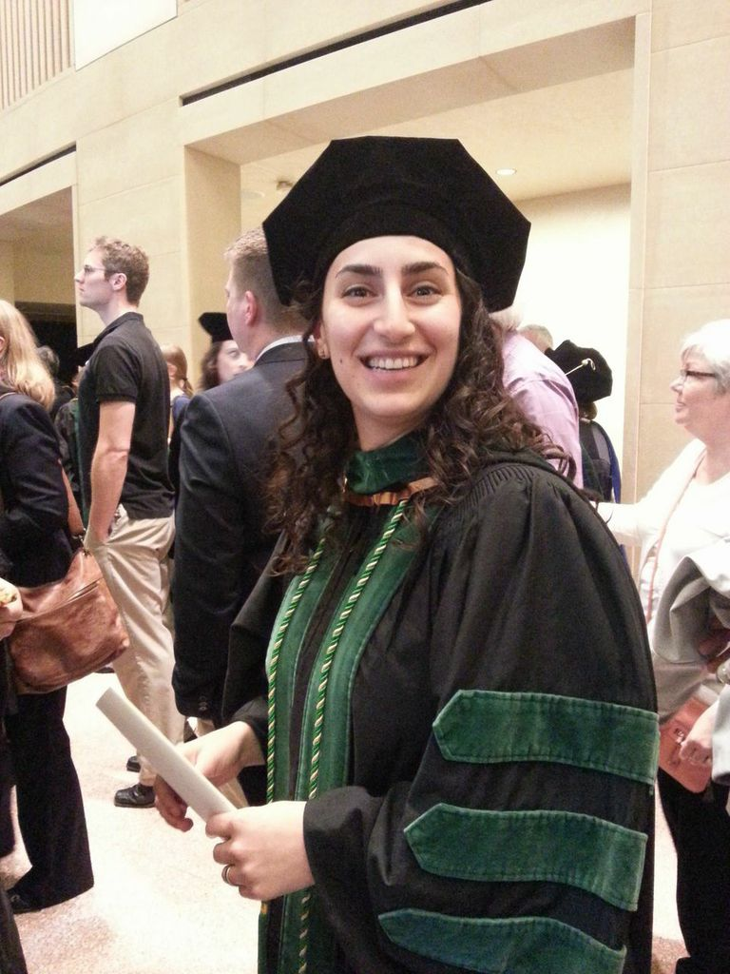
Notes:
At a school where 19 % enter Family Medicine 44% of medical student members of The Ladder enter Family Medicine

Slide 68
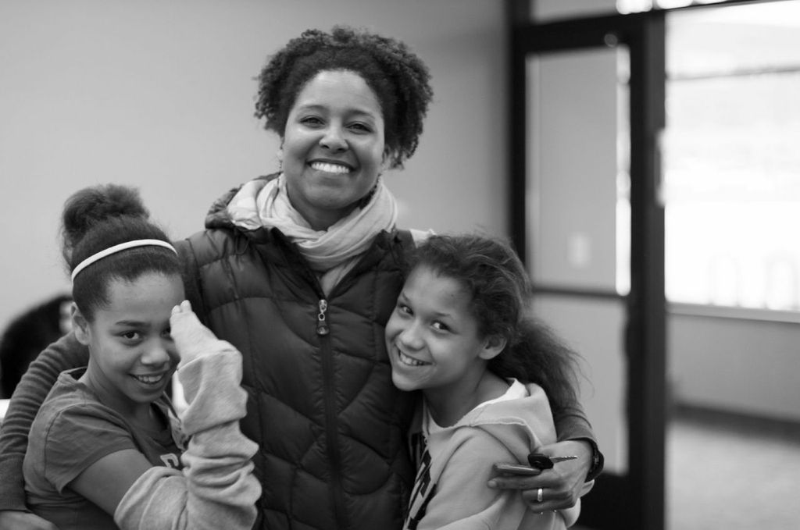

Slide 69
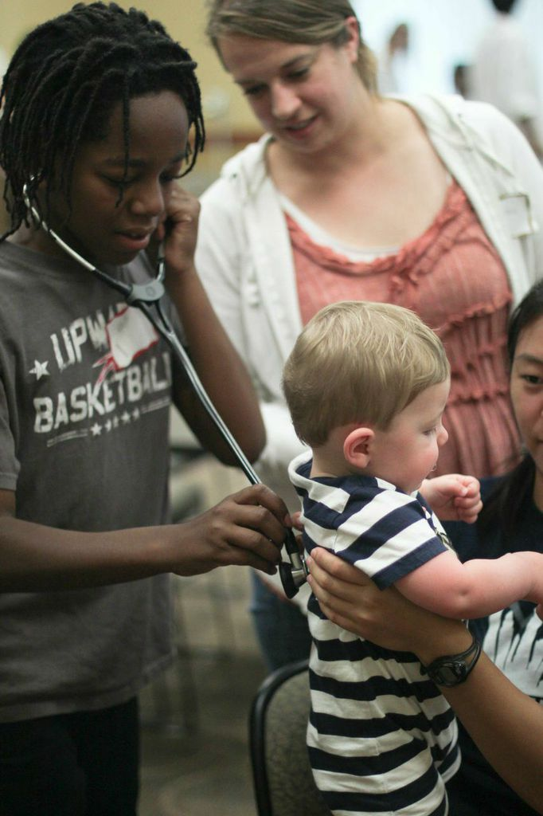
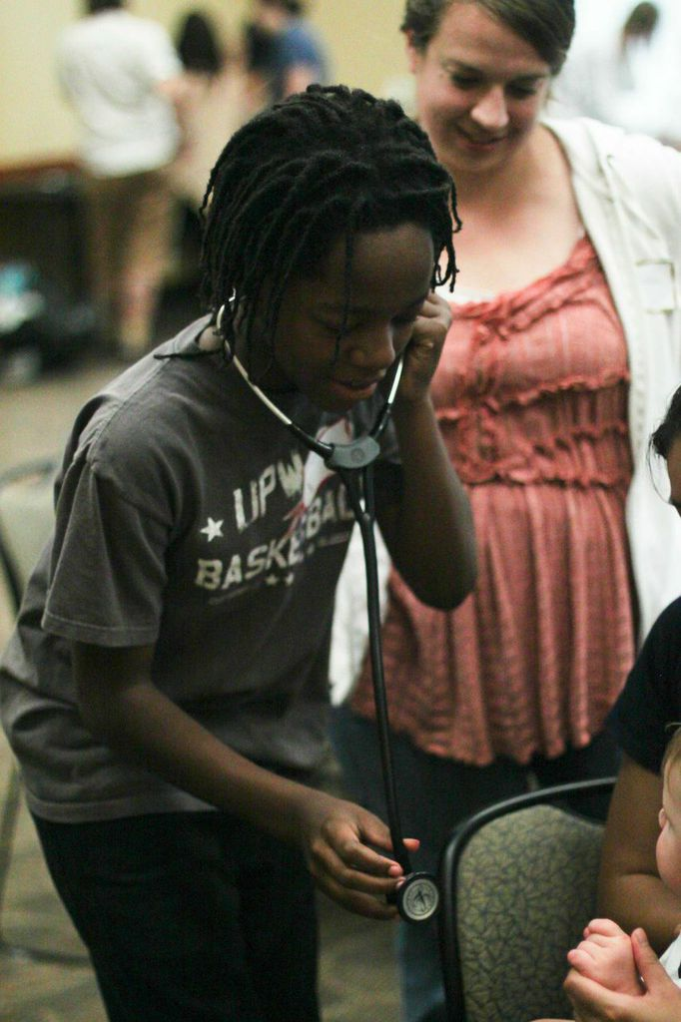

Slide 70
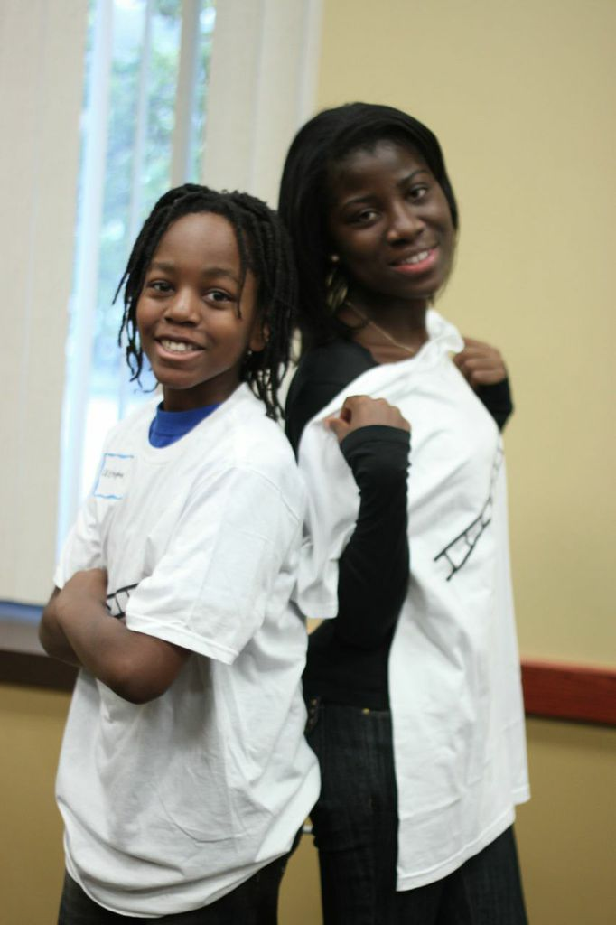

Slide 71
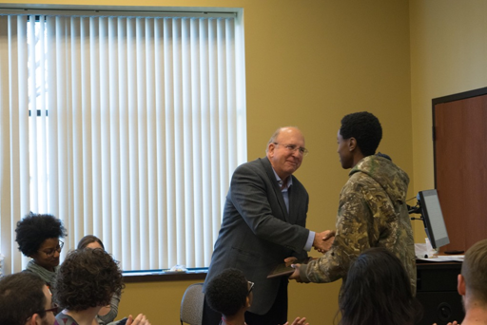

Slide 74
Notes:
FIVE years ago what started out with one kid…is now this and more

Slide 75
Notes:
Christopher and Anthony 3 years ago…This year Anthony got accepted to UMN School of Medicine. Alan and Nirml too!

Slide 76
The ladder.
“Lift as you Climb, Build as you Grow” www.TheLadderMN.org
Notes:
Big take home lesson

Slide 77
Leaders build leaders
Big Take Home…
Notes:
Soooo
tree

Slide 78
THE BEST TIME TO PLANT A TREE WAS 20 YEARS AGO. THE SECOND BEST TIME IS NOW. CHINESE PROVERB
Notes:
One of our favorite sayings in The Ladder, honestly because we are addressing a complex problem with long-term commitment and we are starting now
THE BEST TIME TO PLANT A TREE WAS 20 YEARS AGO. THE SECOND BEST TIME IS NOW. We teachers we know this is true,
so I ask you STFM…
LET’S plant some big, let’s plant a profound seed of CHANGE today/now….and see how it impacts the NEXT FIFTY YEARS!

Slide 79
Leadership is managing change with growth and vision and helping others to do the same.
Notes:
To reiterate…We put to you this day that the seed we must plant in ourselves and in our learners is the personal journey of leadership with growth and vision

Slide 80
Family Physicians guide patients through the challenges and changes of life, health, and illness.
This is a Leader’s Path.
Notes:
There are those who will say we don’t have time… we are in the exam rooms and the burdens there are heavy. Yes they heavy because someone who is NOT a Family Physician was involved in making those burdensome rules and policies that get between us and OUR patients. …..It is time we learn to use and teach the skills and lessons of LEADERSHIP...to address the real world challenge our patients, our learners, our Communities, Our Country and Our WORLD are facing...*WE NEED TO STAND AND ADVOCATE FOR OUR PATIENTS, and our learners
WE NEED TO STAND AND ADVOCATE FOR OUR COMMUNITIES and our world. These are NOT idle times, these ARE interesting times... we need to be spreading our patiets and our learners stories AND teaching the skills of how to shape the narratives that impact policy.

Slide 81
“Lift as you Climb,
Build as you Grow”
Thank you.
@ReneeCrichlowMD will Follow Back
rcrichlo@umn.edu
www.TheLadderMN.org
Notes:
The number one thing we learned from The Ladder is Leaders build leaders and if health care outcomes depend more on the SDOH, the impact of where we live learn work and play then that is where we as family docs must go and we as teachers of family medicine must teach our learners how to Humbly engage with communities, how to Courageously advocate for more SANE policies, and how to Compassionately Lead…**FROM THE BACK OF THE BOOK

Slide 82
Please evaluate this presentation using the conference mobile app! Simply click on the "clipboard" icon on the presentation page.

