Slide 1
Radiology in Family Medicine: Evaluation of a Longitudinal Curriculum
Hillary Mount, MD
Assistant Professor of Family Medicine
University of Cincinnati/The Christ Hospital FMR

Slide 2
Disclosures
None

Slide 3
Objectives
List the radiology skills taught and reasons for focusing on these skills during a family medicine residency.
Evaluate the effectiveness of this longitudinal radiology curriculum in teaching basic radiology skills to family doctors.
Reflect on how to implement longitudinal radiology skills training at your location.

Slide 4
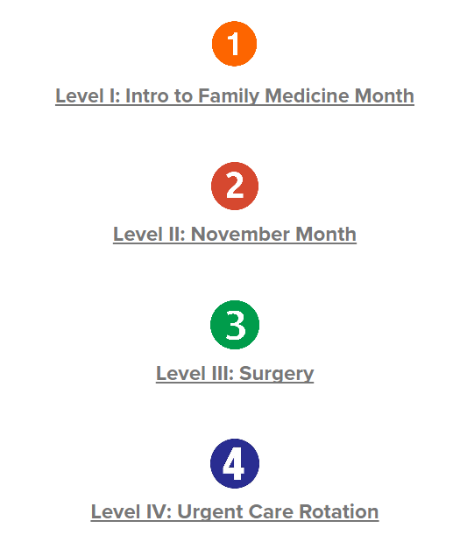
Radiology
Curriculum content
CXR
Ordering the appropriate test
Ortho: Fractures
Notes:
In our intro to family medicine month they review an online CXR module, 12 cases for what test to order, and then take an oral exam of 5 CXRs. In the November (intern) month they review AXR, lines/tubes placement, refresh on CXR and cases. Surgery rotation in their second year they do AXR and 2 more cases (diverticulitis, asymptomatic hematuria). Urgent care rotation in third year they do a fracture module (powerpoint that is being transferred to a nearpod homework exercise).

Slide 5
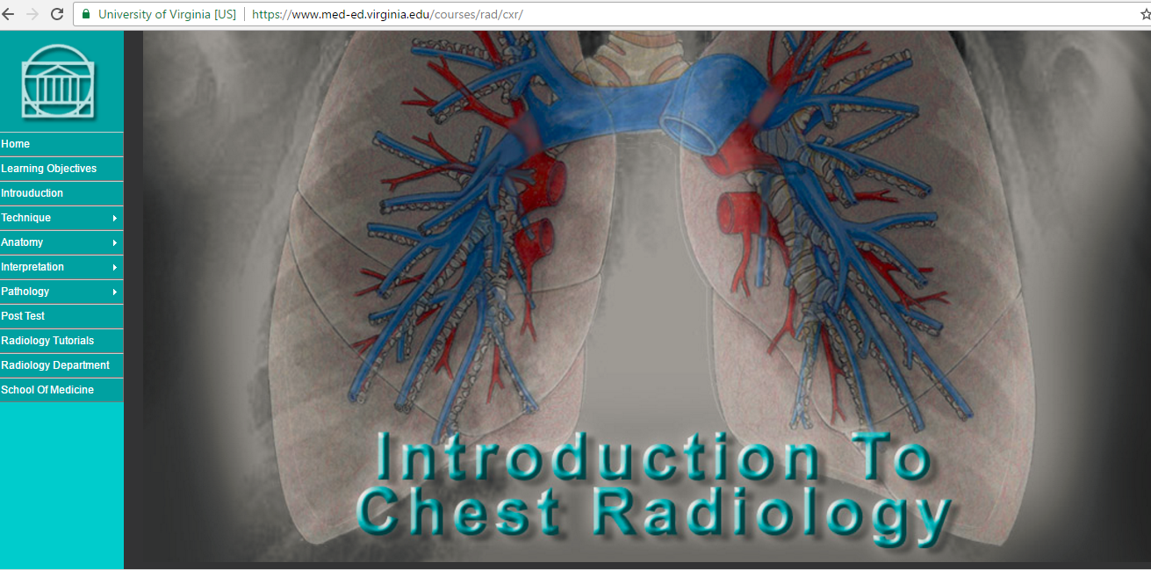
CXR curriculum
University of Virginia online tutorial
Practice case file
Practice oral exam with examples
Oral exam with faculty

Slide 6
Ordering the appropriate test
Cases:
Low back pain
Appendicitis
Nephrolithiasis
Diabetic foot ulcer
Headache
Knee injury
Ankle injury
Cholecystitis
Head injury – Adult and Child
Diverticulitis
Asymptomatic hematuria

Slide 7
Fracture module
Clavicle
Elbow: Supracondylar, Lateral condyle, Radial head, +radial head subluxation
Wrist: Colles, Tores, Greenstick
Distal radius
Scaphoid
Tibia
Coming soon: Hip, Femur, Hand: Boxer’s, metacarpal shafts, distal phalanx

Slide 8
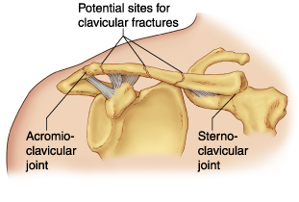
Clavicle
Most occur in the middle third (80%)
Hx: FOOSH, fall on shoulder, direct trauma
Exam: pain with any shoulder movement, holds arm to chest, point tender over fracture, subQ crepitus, often obvious deformity
If high impact mechanism of injury then pay special attention to the lung and brachial plexus exam

Slide 9
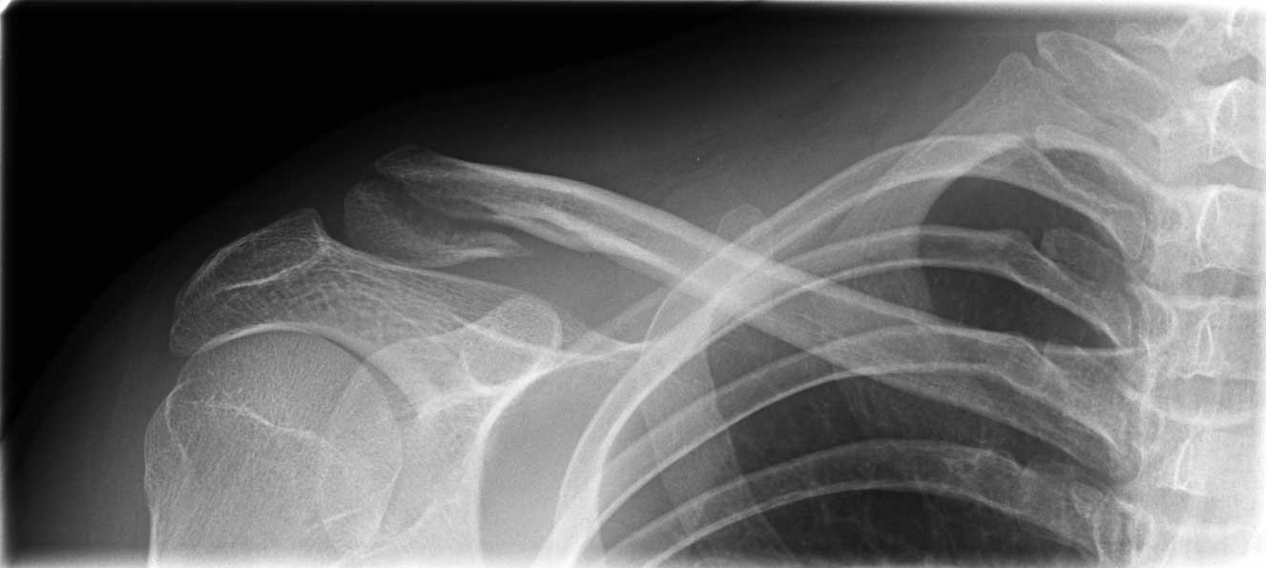
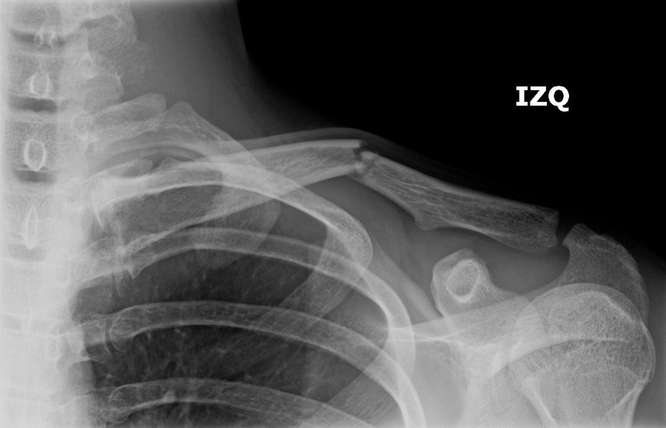
Clavicle Fracture: Imaging
Imaging:
AP view usually all that is needed, but can get 45 degree cephalic tilt prn
Prox segment often pulled up by sternocleidomastoid while distal segment is pulled down by the weight of the arm

Slide 10
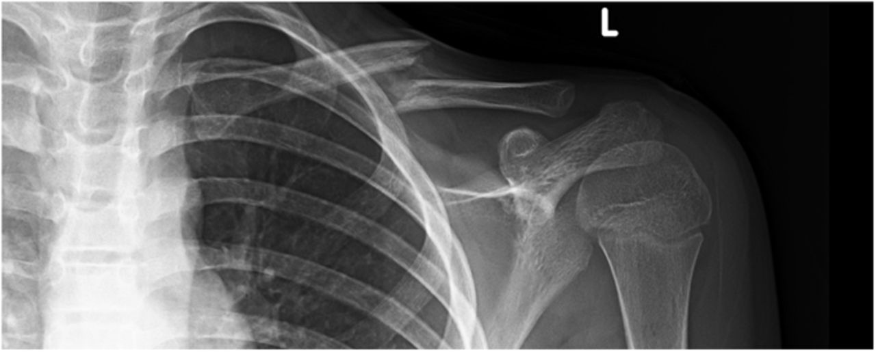
Clavicle fracture: Management
Reasons to refer:
NV compromise
“floating shoulder” (clavicle and glenoid fx)
complete displacement (displaced greater than one bone width) in kid or ANY displacement in adult
Shortening
comminution
Completely displaced clavicle fx: Note the displacement is greater than the width of the clavicle.

Slide 11
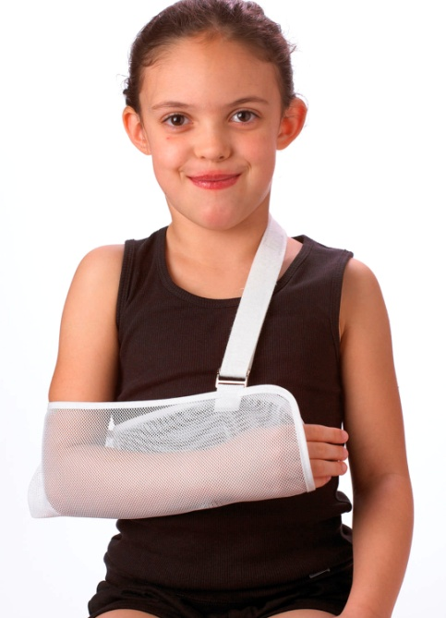
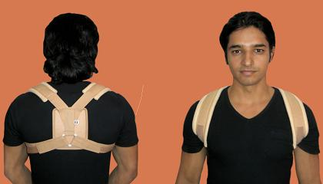
Clavicle fracture: Management
Pain control: Ice 20 min every 1-3h while awake, opioids, acetaminophen, NSAIDs
Immobilization: Figure of 8 vs sling

Slide 12
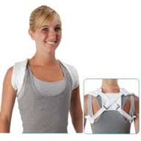
Clavicle fracture: Management
Sling
Pros: More comfortable, better for
minimally displaced fractures, distal
fractures
Cons: Elbow stiffening
Figure of eight
Pros: Elbow & hand usable
Cons: Requires frequent tightening, requires second individual to adjust since it’s on the back, may not be enough support initially (can use sling with it early)

Slide 13
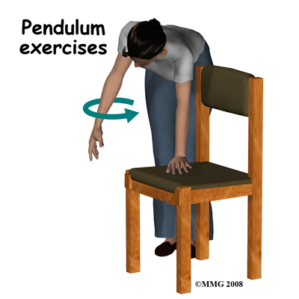
Clavicle fracture: Management
Follow up:
3-4 days then every 2-3 weeks until clinical union takes place (full ROM with minimal pain and nontender).
Union time 3-6 weeks in kids, 6-12 weeks in adults.
Patient instructions:
Complete immobilization 2-3d then ROM at elbow at least 3-4 times daily.
“Pendulum” exercises in sling to prevent frozen shoulder (lean forward and let arm swing in circles gently).
Counsel on possibility of permanent bump with callus formation (exuberant callus formation!).
Callus (rarely) can cause brachial plexus compression at 2-3 mo
No contact sports x 3 months

Slide 14
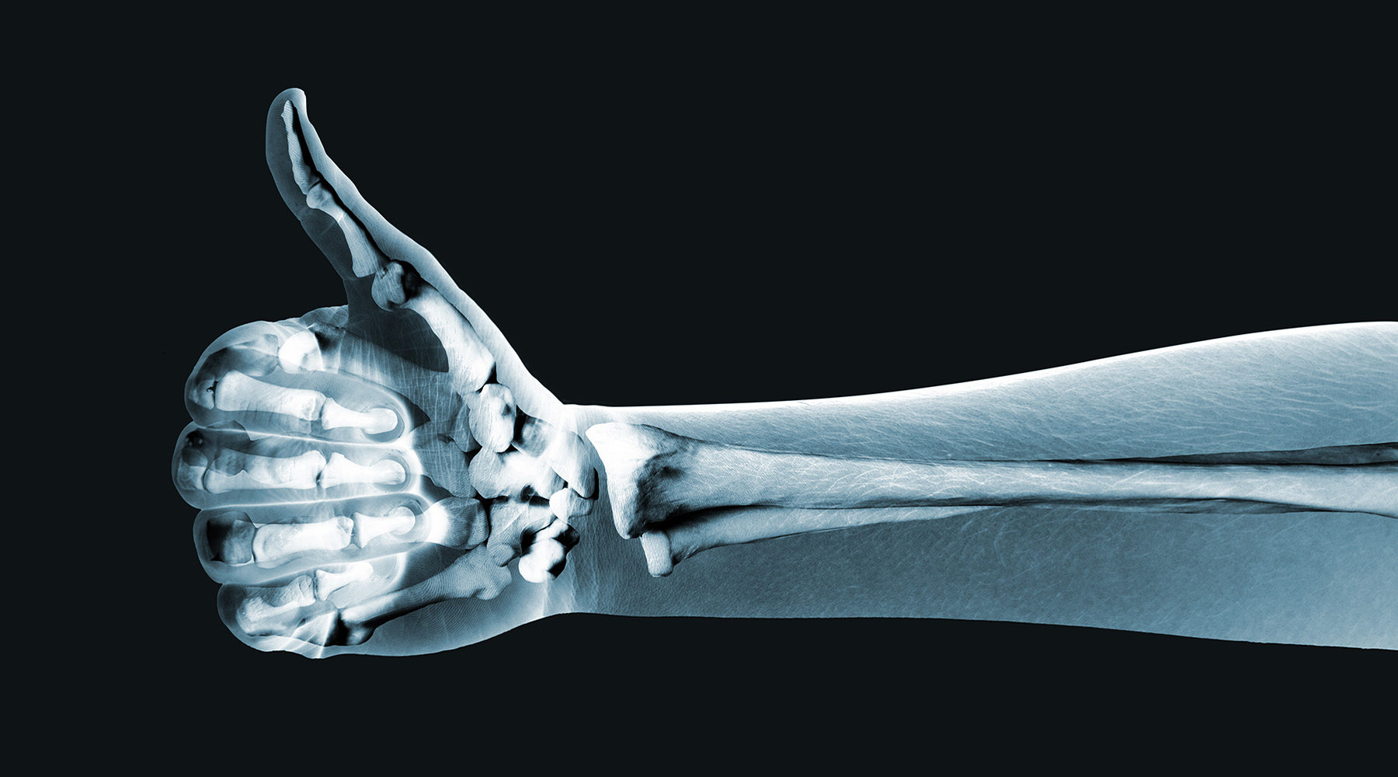
Evaluation methods
CXR oral exam: Interns and Graduates
Pre- and post-test online for self-study cases
Exit survey for graduating residents

Slide 15
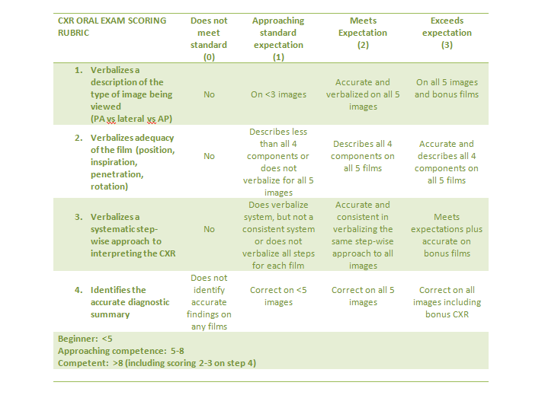
Oral exam: CXR grading rubric

Slide 16
Initial results

Slide 19
Future plans
Increased practice – noon conference, inpatient medicine rotation
Input fracture module into canvas or nearpod format
Evaluation tool for fracture module
Data analysis and resident input

Slide 20
Questions

Slide 21
Please evaluate this presentation using the conference mobile app! Simply click on the "clipboard" icon on the presentation page.

