Slide 1
Engaging Millennial Learners by Overcoming Our Generational Differences
Beverlee Ciccone, PhD
Julianne Lucco, MD
Margaret Ciavarelli, DO
Hunterdon Healthcare Family Medicine Residency
Flemington NJ

Slide 2
Disclosures
We have none.

Slide 3
Acknowledgements

Slide 4
Learning Objectives
Upon completion, participants will be able to describe the qualities and characteristics of the teaching and learning styles of the past and present generations of medical educators and learners.
Upon completion, participants will be able to identify personal biases, values and barriers which impede learner engagement and teaching efficacy.
Upon completion, participants will be able to develop strategies to improve engaging the millennial medical learner within the many competency areas involved in family medicine training.

Slide 5
Background
Why we began looking into this topic:
Milestone evaluations – self-evaluations
“Professionalism” issues
Wellness curriculum development addressing burnout
Leadership workshop
Notes:
*Break into generational groups after this slide*
Milestone - some resistance to completing self assessment, wanted more immediate feedback
Professionalism - won’t necessarily attend conferences if they do not find it valuable, want to leave work at a reasonable time
Wellness - increasing emphasis from ACGME, hospital, residents themselves on importance of self care which makes traditional approach to residency education unsustainable
Leadership workshop - inspired us to look at teaching leadership as a way to more effectively engage our learners, taking current roles and identifying them as teaching leadership (ie recruitment chair as learning leadership)

Slide 6
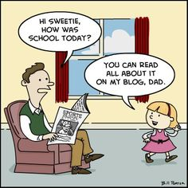
What Brings You Here Today
Share issues which have come up related to intergenerational differences

Slide 7
Who are we?
Breakout into generational groups:
Traditional
Baby Boomers
Gen X
Millennials (Gen Y)
Notes:
What we thought of the preceding (teachers/parents) generation?
How we viewed our generation?
What we think about the generation below us?

Slide 8
Technology:
Communication
How did we communicate with one another?
Music
What did we listen to?
Screen
What did we watch?
How often?
Social media
Who were our “stars”?
Notes:
things which may have influenced your view

Slide 9
Role Models and Values
Family
Who were our television role model families?
How did the older and younger generations regard each other?
Work Ethic
What was success?
How did one attain success?
Family Doctor
Who were our medical role models?
Medical Education
What were the demographics of the medical school & residency class?
What was the expectation of undergoing medical training?
Notes:
Ask about what they talked about in their smaller groups (generational groups)

Slide 10
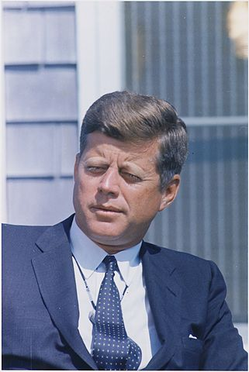
The Traditionalists (1922-45)
War veterans
The Great Depression
Listened to radio, went to movies
Crooners, Standards
Typically the husband worked (wife the homemaker)
Scrimped and saved
“Pulled up by one’s bootstraps”
Medical role model - Dr. Spock
Physician authoritative
Residency was torture, lived in the hospital
No Family Medicine—General Practitioners

Slide 11
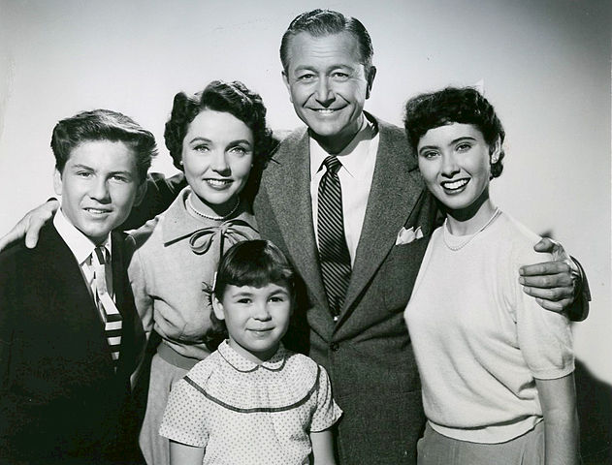
Baby Boomers (1946-64)
Offspring of veterans of WWII and Depression
Benefit from parents’ sacrifices
Grew up with TV/transistor radio
Rock n roll > Rock
Usually one phone in house/pay phones
“Don’t trust anyone over 30”
Sexual revolution/Women’s liberation/Civil rights
Family role models-”Father Knows Best”, Ozzie & Harriet
Medical role models-Dr. Kildare/Ben Casey
Physician role – paternal
Medical training still dominated by males
Residency was hard work/little quality of life concerns

Slide 12
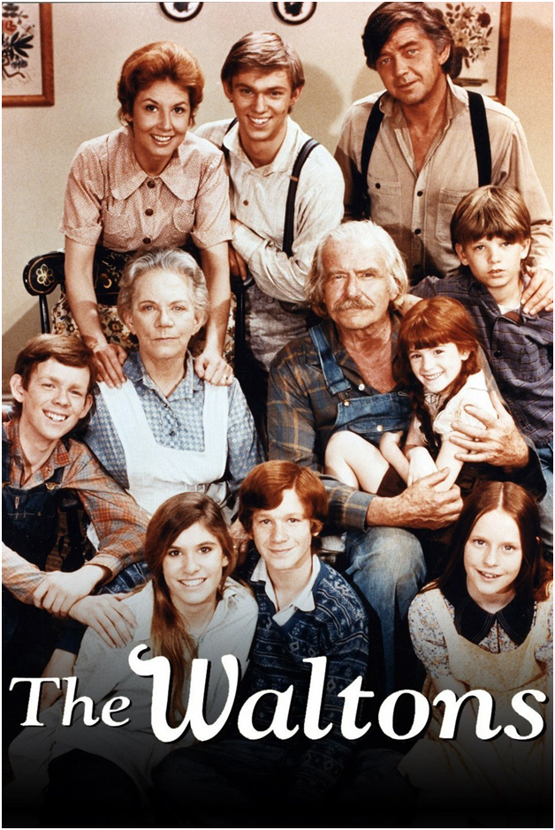
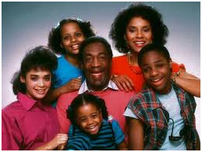
Gen X (1965-80)
Offspring of older boomers
More awareness of life, work satisfaction
Computers part of education
Punk rockers, early rap
Fax > Pagers > cell phones (BlackBerry)
Family role models “The Waltons”, Cosby
Medical role model “Marcus Welby”, ER
Increased demographic/gender equality in higher education
Physician role – still authoritative
Women and minorities worked harder to prove themselves
Work/life balance
Family Medicine became a specialty

Slide 13
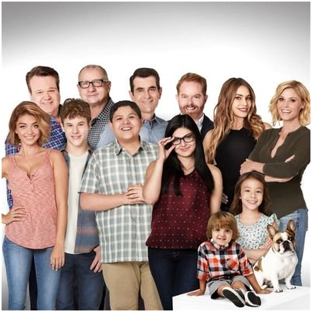
The Millennials (Gen Y, 1981-2000)
Offspring of late boomers and early Gen-X’ers (helicopter parents)
Felt special, entitled
Technically, electronically native
Hip-hop, pop, vintage rock
Me everything
Role models-Alternative family sitcoms ”Modern Family”
Medical role models - Grey’s Anatomy
Physician role model collaborator, less hierarchical
More demographically democratic
Wellness, work-life balance a priority
Family medicine – specialty with specialties
Notes:
Felt special - Everyone got a trophy

Slide 14
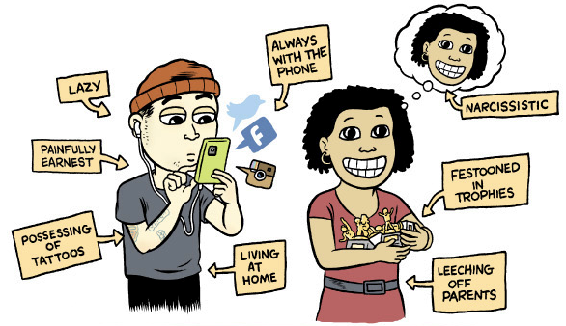
Stereotypes

Slide 15
Millennial Values and Strengths
Structure
Embrace diversity
Connectedness
Teamwork
Digitally native
Close relationships with authority figures
Creativity
Multi-taskers
Work-life flexibility
Free expression
Inspiration
Reinforcement/feedback

Slide 16
What qualities do we seek and value in our FM residents?
Medical knowledge
Self-directed learning
Caring, empathy
Team players
Dedication and commitment to family medicine
Responsible and professional
Follow-through
Timeliness
Working effectively with the healthcare system
Notes:
How these align millennial strengths and where there may be challenges

Slide 17
Disclaimer
Generational differences are only one factor in determining a person’s values, teaching and learning styles, and approach to life and leadership.
Other factors include:
birth order
ethnicity
culture
religion
social class
life experience
temperament
Notes:
Privilege, cultural sensitivity

Slide 18
 | Values/ Characteristics | Learning/ Teaching | Leadership style preferences
Traditionalist | Loyalty Discipline Conformity Strong problem solving skills | Expect no feedback unless a problem Pedagogical Structure and predictability | Respect authority Decisions logical and based in precedent (“don’t throw the baby out with the bathwater”) Hard work rewarded
Baby Boomer | Idealistic Work as personal fulfillment Driven to succeed Hardworking | Scheduled formal feedback Group interactions and discussion | Love meetings Formal atmosphere Have clear vision Followers work out details Achieving results rewarded
Gen X | Pragmatism Independence Work-life balance Skepticism Ambituous | Informal feedback as requested Digital immigrants (technology as a second language) Independent self directed Discretion to complete tasks their own way | Direct communication Open and informal Merit based egalitarian system Provide loose framework for projects Independent thinking rewarded
Millennial | Socially minded Collaboration Confidence Value honesty, transparency and integrity Want meaningful work | Active learning/Collaborative Digitally native/multimedia Expect instant feedback Prefer clear expectations and vision of success Personalized learning Team based Case based/ lectures optional Big picture defined | Creative and inclusive Leaders need to demonstrate competence Everyone provides input Followers want to understand reason for doing activity Flexible/adaptable Encourage autonomy Building personal competence rewarded
Notes:
Extreme Fun ?

Slide 19
Cases
Milestone category-based vignettes
What are the issues at stake
How do the elder generations view them?
How do we overcome our own biases?
How do the millennials view elder generations?
How do we overcome the barriers and best meet everyone’s needs?
How can we compromise to move forward?
Notes:
Goals of discussion: What ideas do we have to overcome the barriers posed by differences in generational perspectives to effective teaching and learning?

Slide 20
Case 1
A resident is making less than the required 75% attendance rate at noon conferences. The Program Director has spoken to him a number of times, but there has not been an improvement. The resident’s explanation is that he is unable to leave the office in time to make the conferences. Other residents with similar schedules are able to attend conference in a timely manner.
What are the prevailing generation-based values?
The Program Director (Gen X)
The resident (Millennial)
What are possible solutions?
What obstacles must be overcome to achieve a compromise?

Slide 21
Case 2
The resident has a late-morning meeting that necessitated his leaving the office early. Therefore, the office manager held his last two appointment slots. When he arrived at the meeting site, he discovers it is cancelled. Faced with two “free” hours before his next session, he decides to go to the gym. When the office manager later finds out he was at the gym, she is furious; she was looking for him to follow up on a patient issue from the morning. She then reports this to the faculty advisor.
What are the prevailing values in this scenario?
Resident (Millennial), faculty (Gen X), manager (Boomer)
How would you make this discussion constructive among those involved?
Notes:
What are the prevailing generation-based values?
The Program Director (Gen X)
The resident (Millennial)
What are possible solutions?
What obstacles must be overcome to achieve a compromise?

Slide 22
Case 3
A new mom and her infant come twenty minutes late for a follow-up visit. The resident wants to tell the mom to reschedule because he wants to stay on time. The teacher says that he must see the mom because there is a concern of the baby not gaining weight. The resident complains loudly to their faculty advisor, but begrudgingly sees the baby.
What are the prevailing values here (generation-based) from both the faculty (Gen X) and resident’s perspectives?
Notes:
why does the resident want to stay on time?

Slide 23
Case 4
In a milestone review, the resident is given feedback that she is often abrasive with patients. She wants to know specific cases where this happened, saying that she doesn’t know what to do with this feedback because she is unaware of this behavior. She wants to know why she wasn’t told this at the time of the visit.
What are the prevailing values here (generation-based) from both the faculty and resident’s perspectives?
How do you think the resident feels? Why might she be resistant to the feedback?
What would be a solution going forward?

Slide 24
Case 5
A senior resident wants to place an IUD for a patient who can’t come in any other time but during the lunch hour. The resident wants to meet the patient’s needs, so she agrees to do this during lunch. There is a staff in-service scheduled that day during lunch, so the resident asks her nurse (Gen X) to miss her meeting to assist in the IUD insertion. The nurse is upset that she will miss the in-service, and she complains to the office manager (Boomer) about the resident.
What are the prevailing values here (generation-based) from both the nurse and resident’s perspectives?
How might the office manager respond to this?
What mechanisms could be put in place to avoid this type of conflict?
Notes:
the millennial is trying to be patient centered value

Slide 25
Case 6
A senior resident and junior resident are on night float together. The junior resident approaches the residency director asking that he not be put on night float with that senior resident in the future. The junior resident says this is because his senior would stay in his room sleeping while he was “running around on the floors taking care of multiple issues.” When the Program Director addresses the senior resident about sleeping on night float, he states he was in his room studying for the boards, which he is worrying about passing.
What are the values displayed by both residents?
How would the Program Director best facilitate communication and a solution towards a working relationship?

Slide 26
Case 7
It has come to the faculty’s attention that many of the residents are using their “group-texting app” to call out other residents’ behavior. All of the residents have access to this phone app, and at times residents are texting overnight. A number of residents have complained that the texts are waking them up, and they feel that some of the texted comments are hurtful.
What are the prevailing values here (generation-based) from both the faculty and resident’s perspectives?
How might people of different generations handle this situation?

Slide 27
Case 8
Dr. R, a third-year resident (Gen Y) is preparing an academic day presentation on hypertension. By chance, one of the faculty discovers that his powerpoint was taken verbatim from an AFP conference presented last year. The resident did not give acknowledgement to the AFP author, nor did he obtain permission to use their material.
What are the prevailing values and issues in this situation?
How should this be handled?

Slide 28
Strategies By Competency
Patient Care/Precepting
Increase feedback (thoughtful, personalized, timely)
Establish a sense of personal responsibility
Increase mentoring - model desired behavior
Medical Knowledge/Didactic teaching
Tell learners what they need to learn and why
Go multimedia (games, websites, polls, twitter) if you have the skill - if not, just make sure it is interactive
Determine when personal technology is prohibited and when acceptable

Slide 29
Strategies By Competency
Systems based practice
Use multidisciplinary teams to promote understanding and effect of one individual’s actions on the system
Practice Based Learning
Promote self directed learning and evidence based medicine with clear statement of goals
Professionalism
Set clear expectations
Include learners in decision making (what are expected behaviors and consequences for deviation)

Slide 30
Strategies by Competency
Communication
Discuss communication preferences with learners
As always, critique behavior not people
Plan for learner input in plan

Slide 31
And for the Behavioral Scientists (of previous generations):
Be open to adapting B.S. curriculum
Let go of the old stuff that just isn’t as relevant
Find ways of incorporating old stuff that is important in novel ways
Be stealthy
Convey inter-generational connecting is a two-way street:
a part of cultural sensitivity
Encourage residents to take leadership roles
Include residents in decisions affecting their learning
Reinforce their productive ideas
Inspire, inspire, inspire!

Slide 32
Wrap-Up
Every generation has criticised the one succeeding them
Generational differences along with many other factors can cause conflict at work and school
Being culturally responsive to these differences can make for a more effective teaching and learning environment
Listen to each other - recognize that we all have biases based on our own experience
Be honest with yourself (Ex: Was working 36 hour shifts really the key to becoming a competent, caring, knowledgeable physician?)

Slide 33
“The young do not know enough to be prudent, and therefore they attempt the impossible, and achieve it, generation after generation”
Pearl Buck
(1st American woman to win the Nobel Prize for Literature)

Slide 34
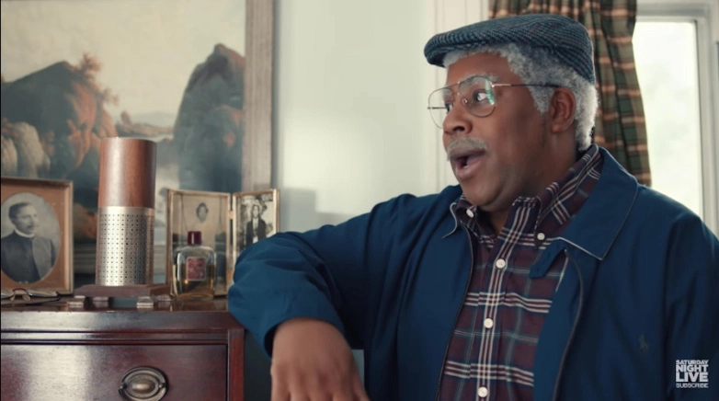

Slide 35
References
1. Potts S et al. Preparing the next generation to lead: celebrating the strengths of the millennial generation. Nov 1, 2013, 32nd FMEC Ann Northeast Region Mtg, Philadelphia PA.
2. Puchalski M. What's in a name? digital native, millennials, net generation. Engagement Institute, Spr 2007, [ppt slides] Retrieved from slideplayer. com/slide/4163311/.
3. Toohey SL et al. Ten tips for engaging the millennial learner and moving an emergency medicine residency curriculum into the 21st century. West J Emerg Med. 2016 May; 17(3):337-43.
4. Haynes, C. (2010-12-10) Generation gaps in medical education: implications for teaching and learning. [ppt slides] Retrieved from https://scs. msu. edu/.
5. Minor S. (2014-06-06) Communicating effectively with the millennial generation student. STFM June 2014 Education Column, Retrieved from www. stfm. org/News. Journals/Education Curriculum.
6. Sachdev N. Leadership in Residency: The Not-So-Hidden Curriculum. ppt presentation at Fac Dev, RWJ Network of Fam Med Residencies, New Brunswick, Feb 8, 2017.
7. Huffman M et al. Educating millennials: what works, what doesn't, and why. 2015, 48th STFM Ann Spr Conf, Orlando, FL.
8. Eckleberry-Hunt J, Tucciarone J. The challenges and opportunities of teaching "Generation Y". J Grad Educ 2011 Dec; 3(40): 458-61.
9.Potts S et al. Preparing the next generation to lead: celebrating the strengths of the millennial generation. Nov 1, 2013, 32nd FMEC Ann Northeast Region Mtg, Philadelphia PA.
10.Glauser W, Tepper J. Can family medicine meet the expectations of millennial doctors? 5/26/16, Article retrieved from http://healthydebate.ca/author/wgit.
11. 2013 The Accreditation Council for Graduate Medical Education and The American Board of Family Medicine. The Family Medicine Milestone Project. Version 9/2013. 2013 The Accreditation Council for Graduate Medical Education in Family Medicine. ACGME Milestones slide deck. December 2013.
12. Levonius, Don. Generational Differences in the Classroom. 2/3/15, article retrevied from www.td.org/Publications/Newsletters/Links/2015/02/Generational-Differences-in-the-Classroom
13. Warner, J. and Sandberg, A. Generational Leadership.2010. Retrieved from www.ReadytoManage.com
14. Hines, Joseph. Millennials: The Good, the Great, and the Awesome! Presented at the PA Academy Residency Program Collaborative Workshop, Sept 9, 2017

