Slide 1
Global Medical Education:
There’s an App for That!
Presenters: Elise Duggan, Janelle Billig
Authors: Jason Kroening-Roche, John Meda, Emmanuel Sindato, Charles Warles
Hubert Kairuki Memorial University
University of Dodoma College of Health Sciences

Slide 2
Disclosures
No financial relationships to technology companies mentioned in this presentation

Slide 3
Objectives
The participants will be able to
understand current technology access among medical students in limited-resource settings
explore student perceptions of new technology tools in their learning
discover the advantages and disadvantages of using new technology in low resource medical education

Slide 4
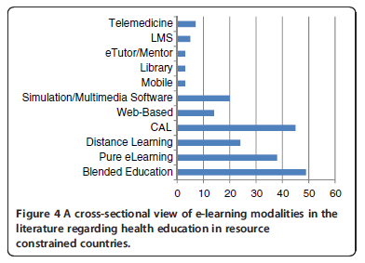
What is E-Learning?
Umbrella term for technology tools and strategies to enhance education
Has unique potential and challenges in resource-constrained settings
LMS= Learning Management System
CAL=Computer Assisted Learning
Frehywot et al. E-learning in medical education in resource constrained low- and middle-income countries. Human Resources for Health 2013, 11:4

Slide 5
Types of E-learning Programs
Google Classroom
Teleconference
Online Modules
Audience Response
Facebook
Moodle
WhatsApp
Computerized Exams

Slide 6
E-Learning in TZ Medical Education
Medical Education Partnership Initiative (MEPI)
Goal: help fill gap between
Need to train more students
AND
Faculty shortages
Learning resources access
Tanzania: KCMC & Duke
LMS
ICT infrastructure
Videoconferencing
Examination platform
Vovides, Y et al. A Systems Approach to Implementation of eLearning in Medical Education: Five MEPI Schools’ Journeys. Academic Medicine. 2014;89;S102-S106

Slide 7
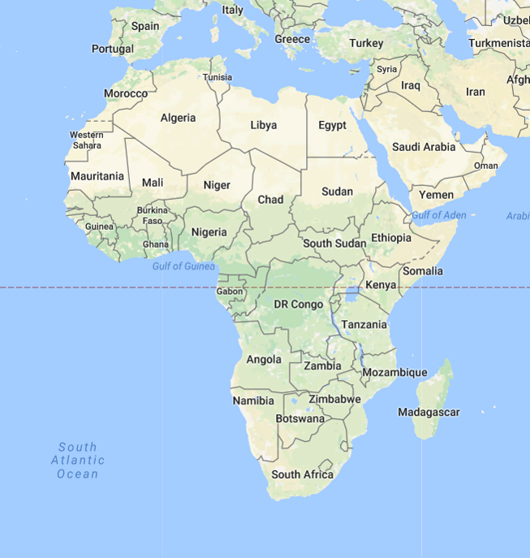
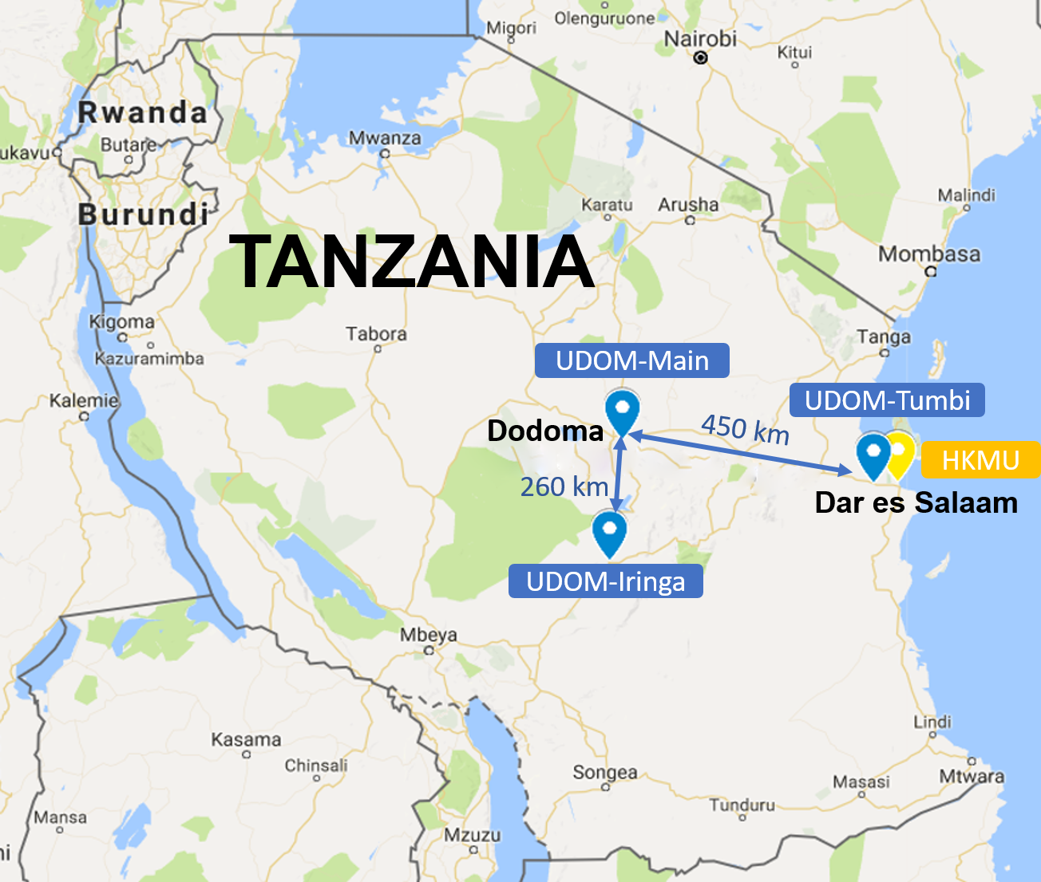
Tanzania

Slide 8
Our Team

Slide 9
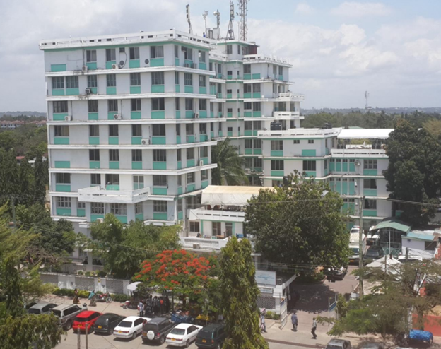
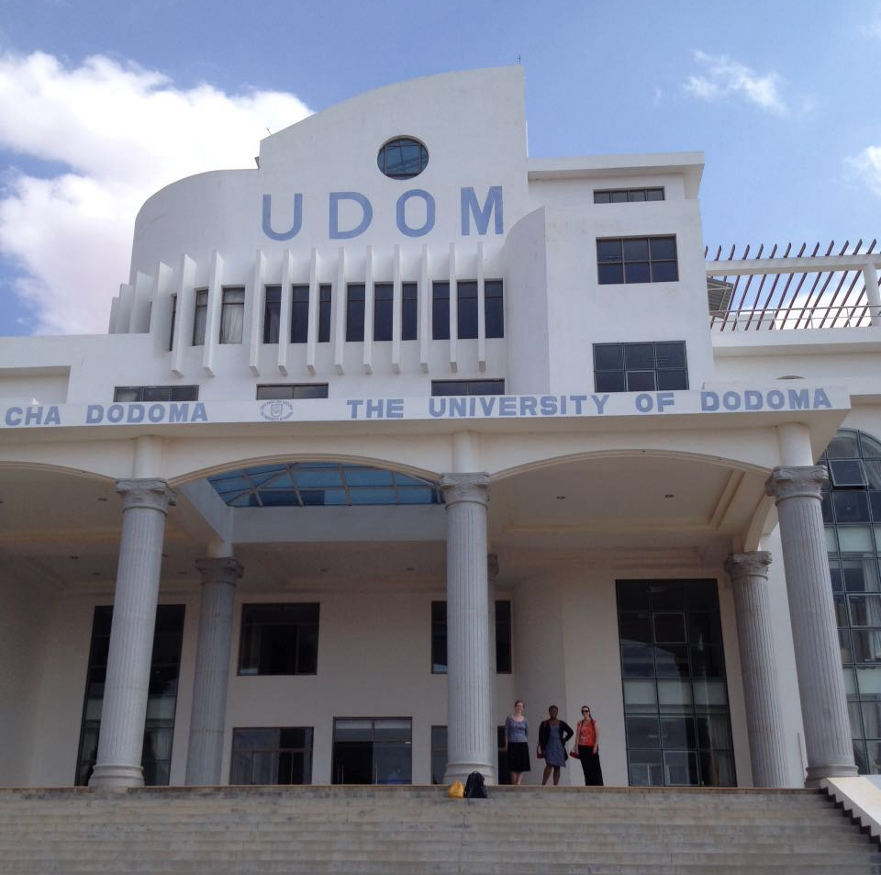
HKMU and UDOM
Hubert Kairuki Memorial University
University of Dodoma
Private, Urban
Health Professions Only (~1000 students)
1 Campus
2 computer labs
Internet available for faculty
wireless internet for students projected for 2017/18
IT department with 2 employees
Public, Suburban
Many Colleges (20,000 students)
1 Main & 2 Clinical Campuses
1 CHS library w/computer lab
No wireless internet
Central IT Dept

Slide 10
Challenges
Large class sizes
Faculty/student ratio
Internet access
Limited resources
Distance between campuses - UDOM

Slide 11
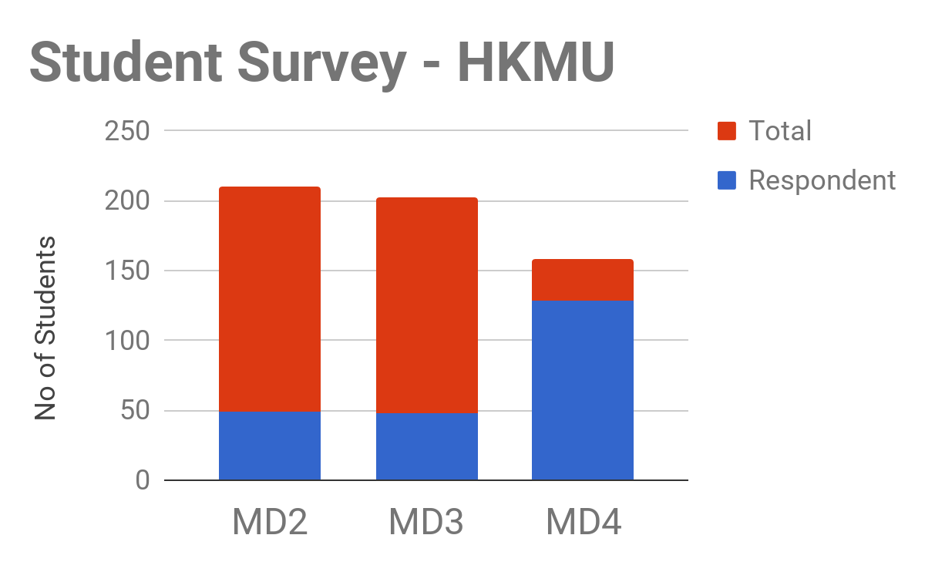
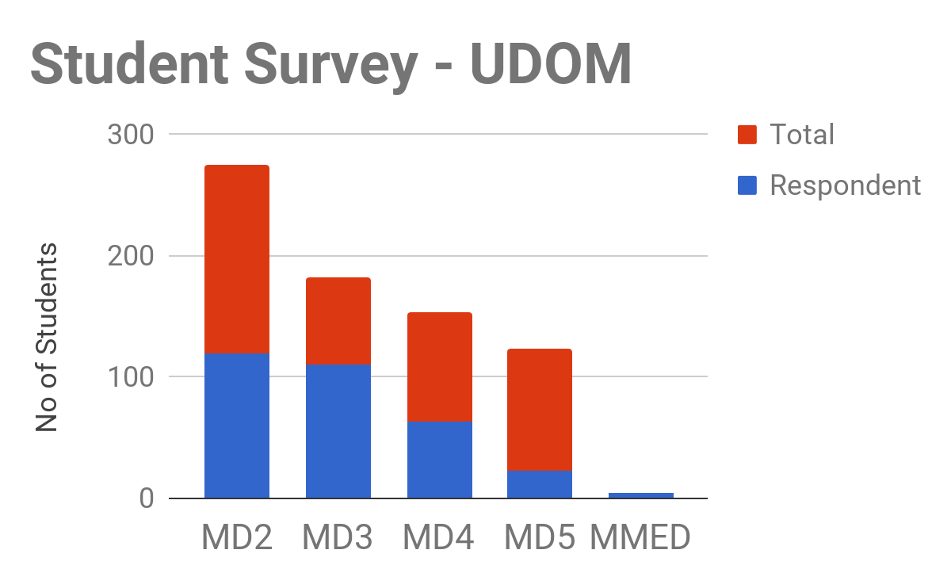
Student Demographics and Class Sizes
HKMU |  | UDOM
226/571 | Respondent/ Total Students | 320/738
40% | Response Rate | 43%
50:50 | Male:Female Ratio | 77:23

Slide 12
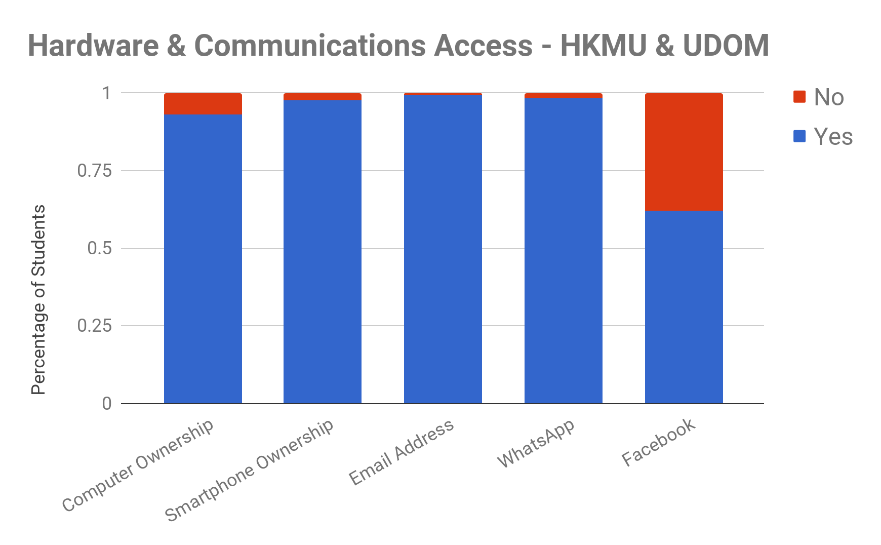
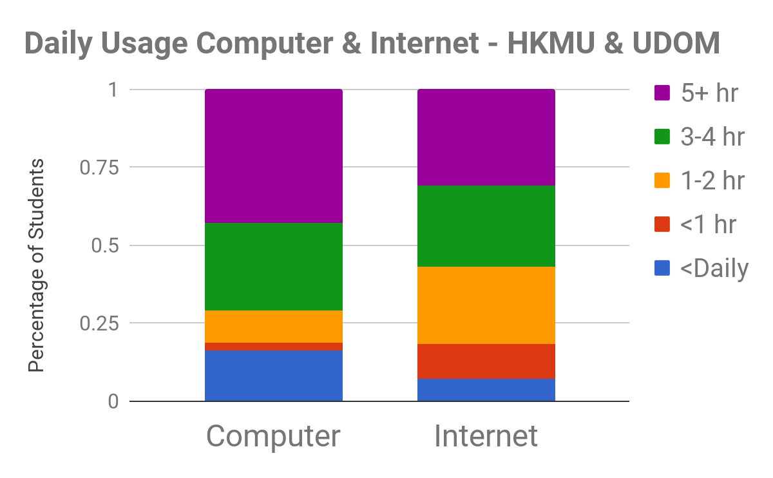
Technology Ownership & Usage

Slide 13
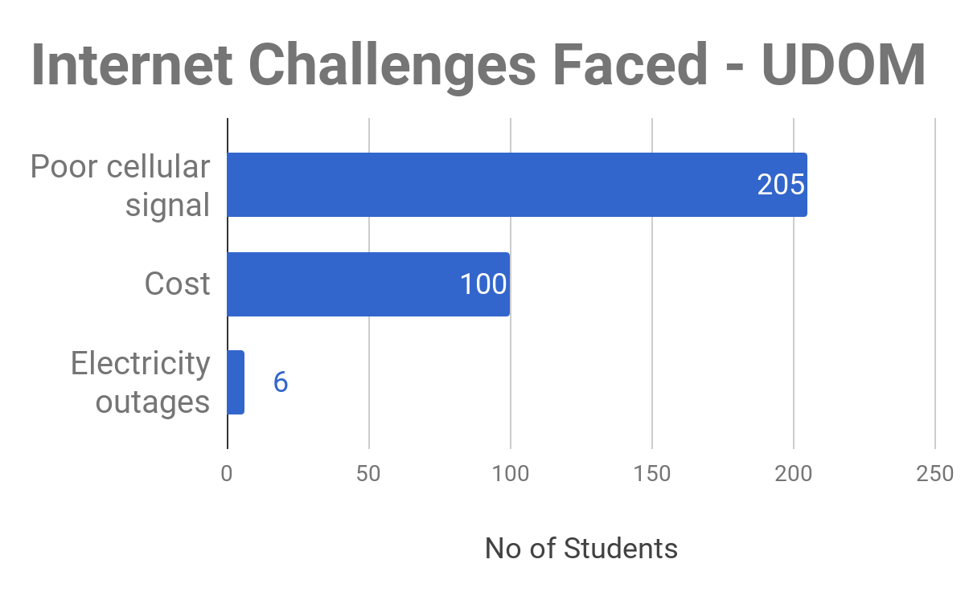
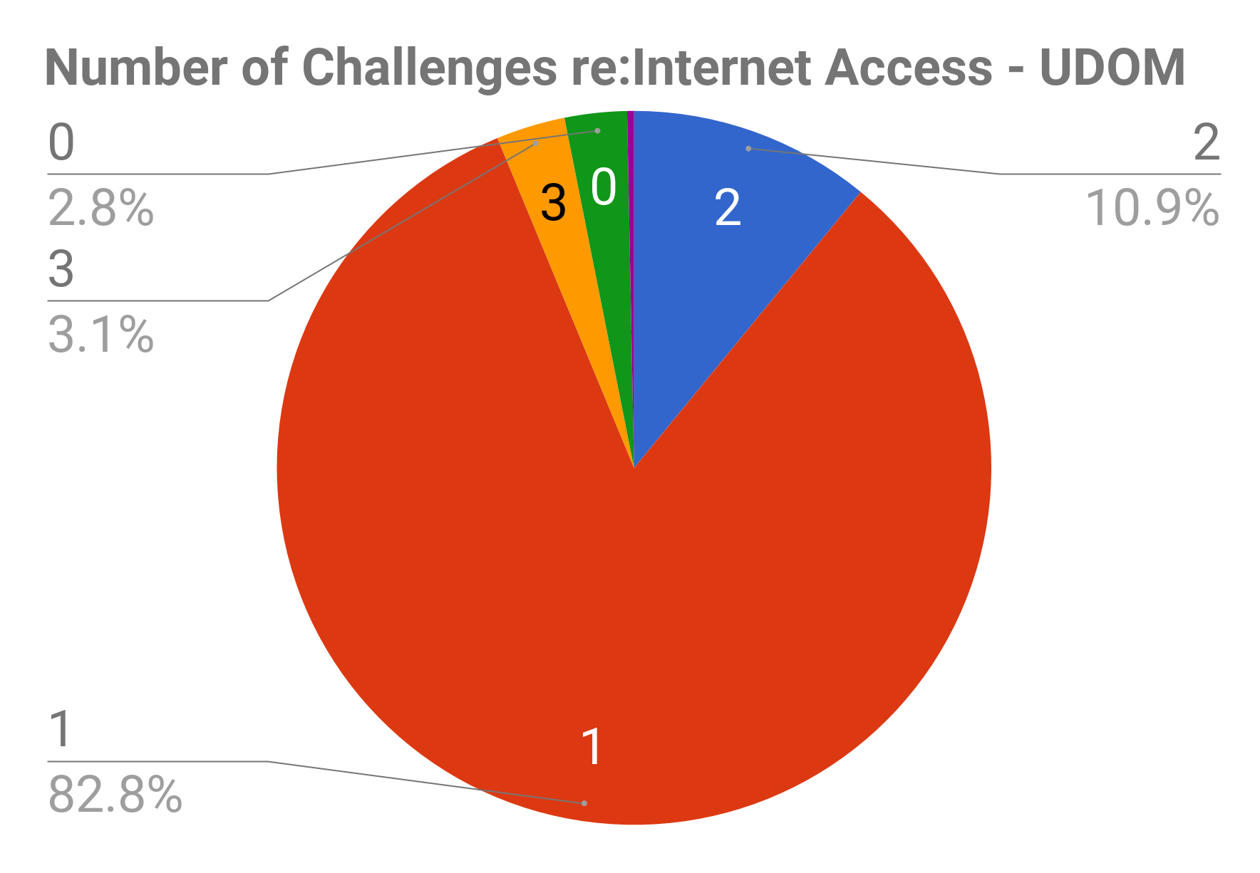
Internet Access Challenges

Slide 14
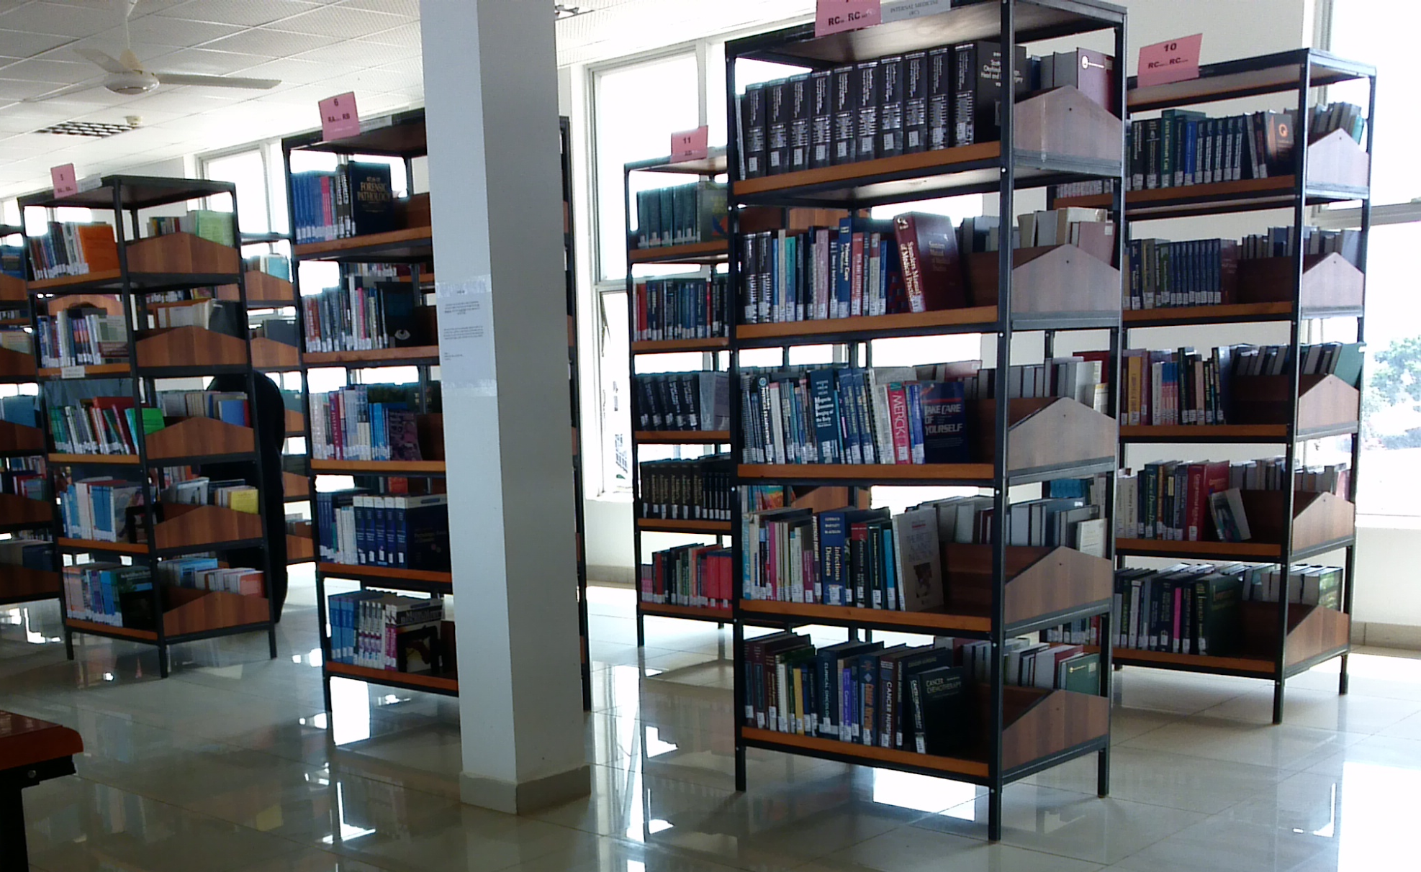
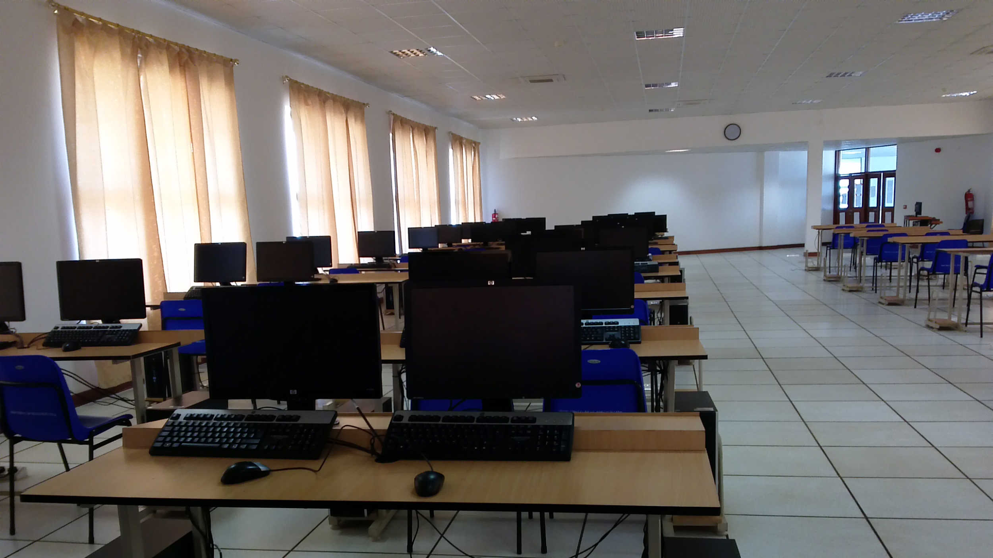
Learning Resources

Slide 15
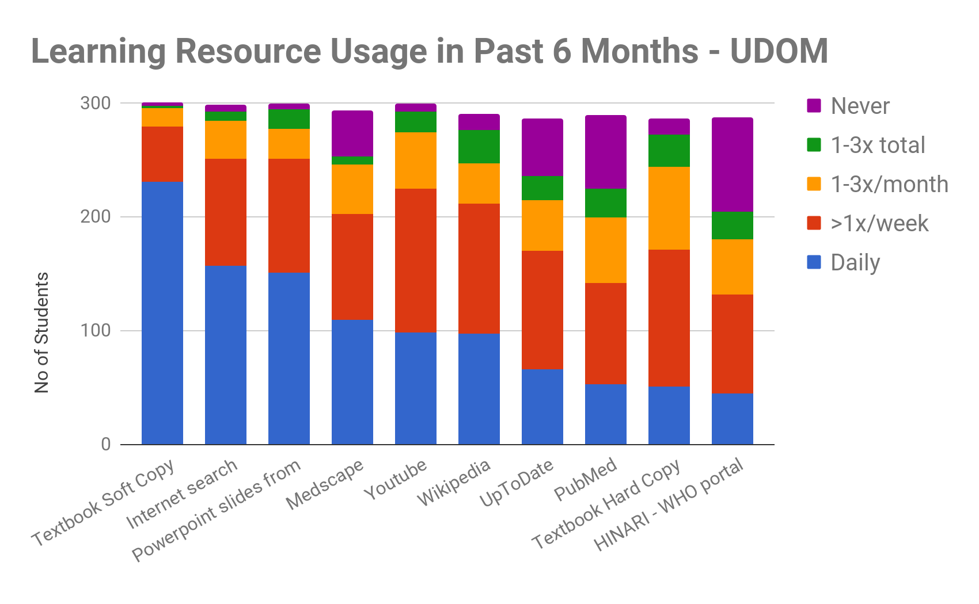
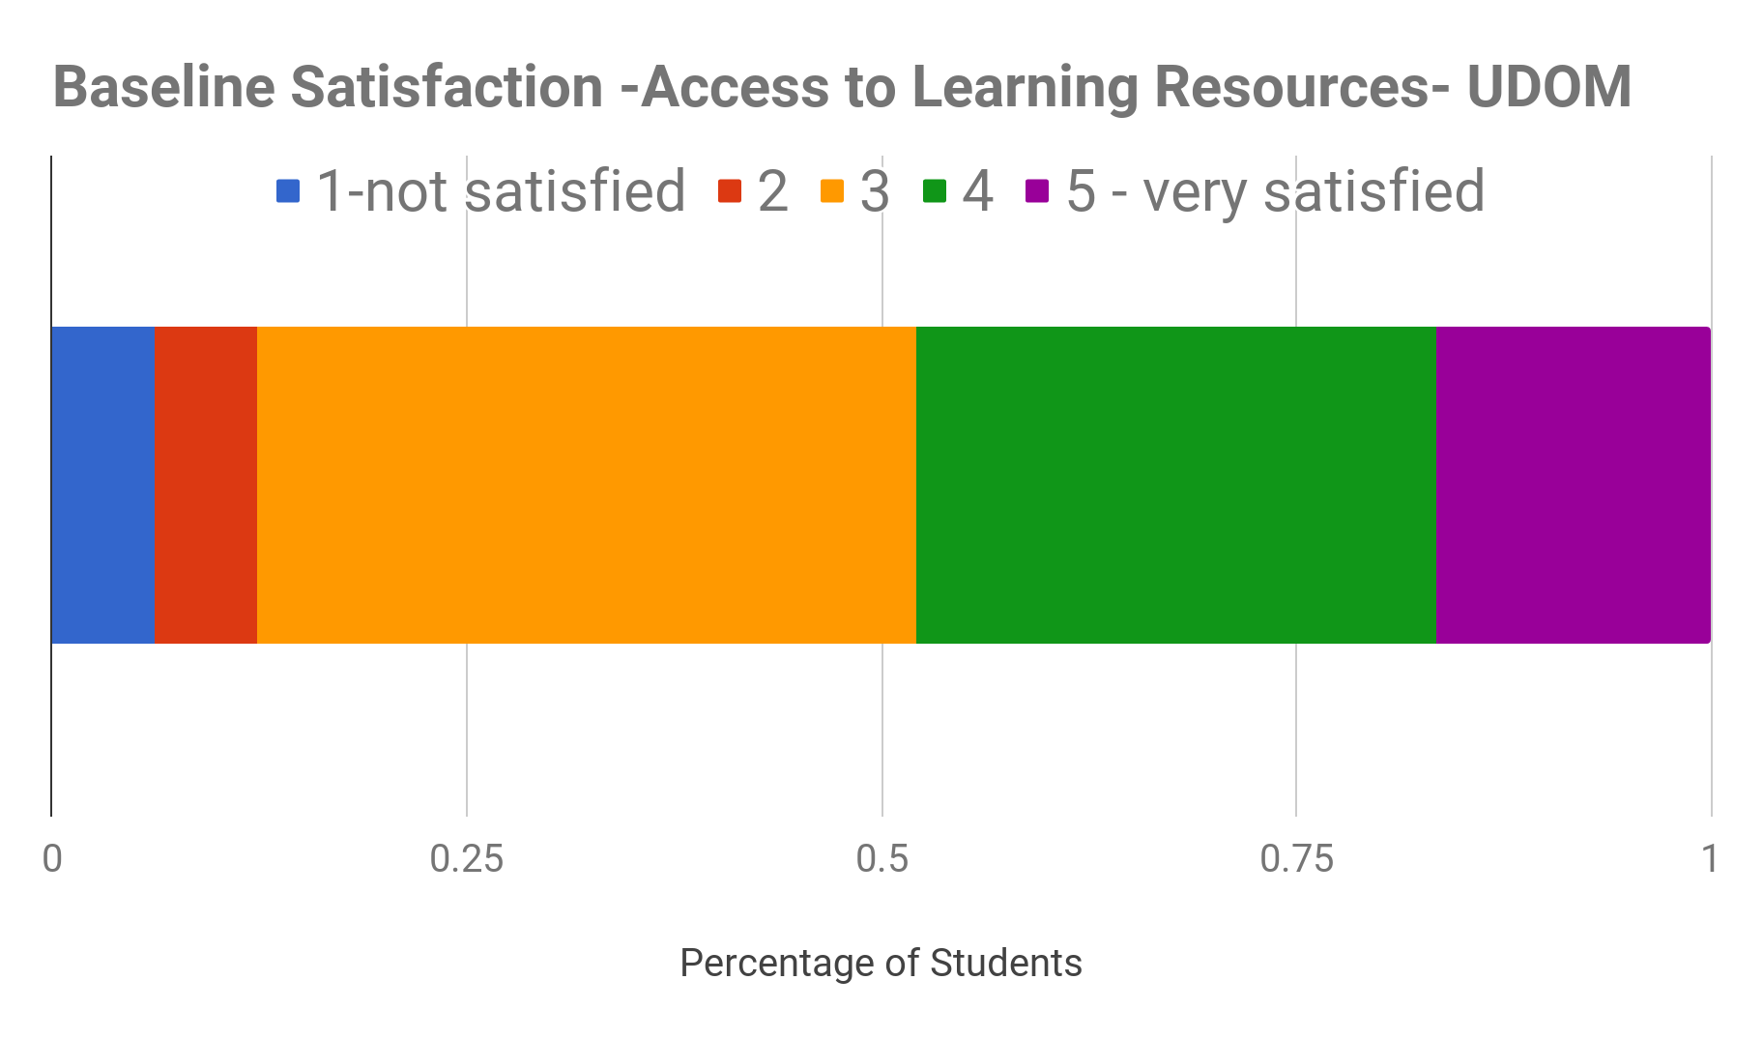
Learning Resource Usage & Access

Slide 16
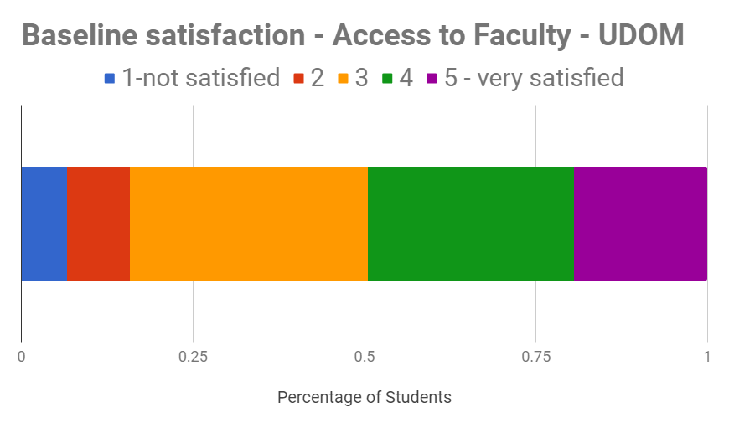
Faculty Access and Interactions
Increased supervision
Enhanced communication
Feedback

Slide 17
Goals & Objectives of Projects
HKMU
UDOM
Communicate effectively and equitably with large class sizes
Distribute online resources
Coordinate patient case write-ups and provide timely personalized feedback
Increase student-faculty contact between campuses
Reduce variability between clinical teaching sites
Optimize the time used by faculty when visiting sites

Slide 18
Description of project
HKMU
UDOM
Google Classroom
ZipGrade Exam Marking
Audience Response System
Videoconferencing

Slide 19
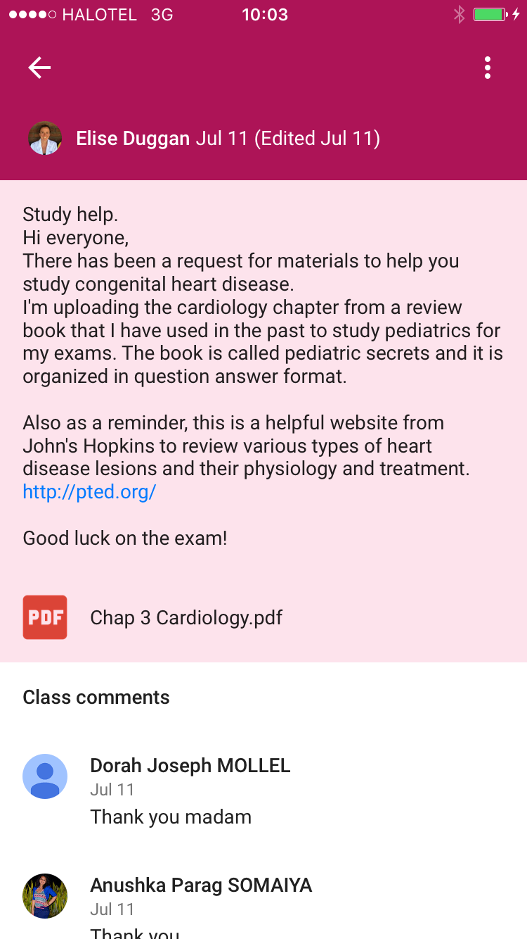
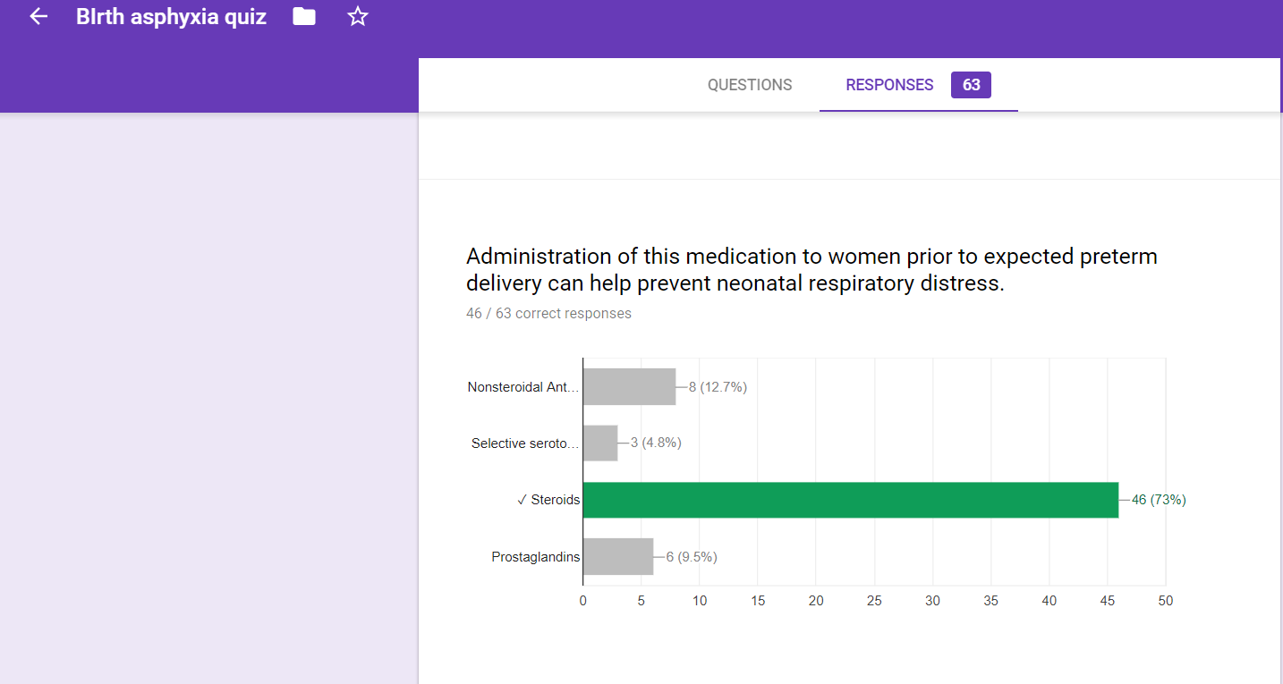
What is Google Classroom?
Demonstration of E-Learning Platform

Slide 20
Post-Implementation Outcomes
Confidence
Evaluation
Satisfaction with program
Barriers vs helpfulness
Ease of use
Challenges

Slide 21
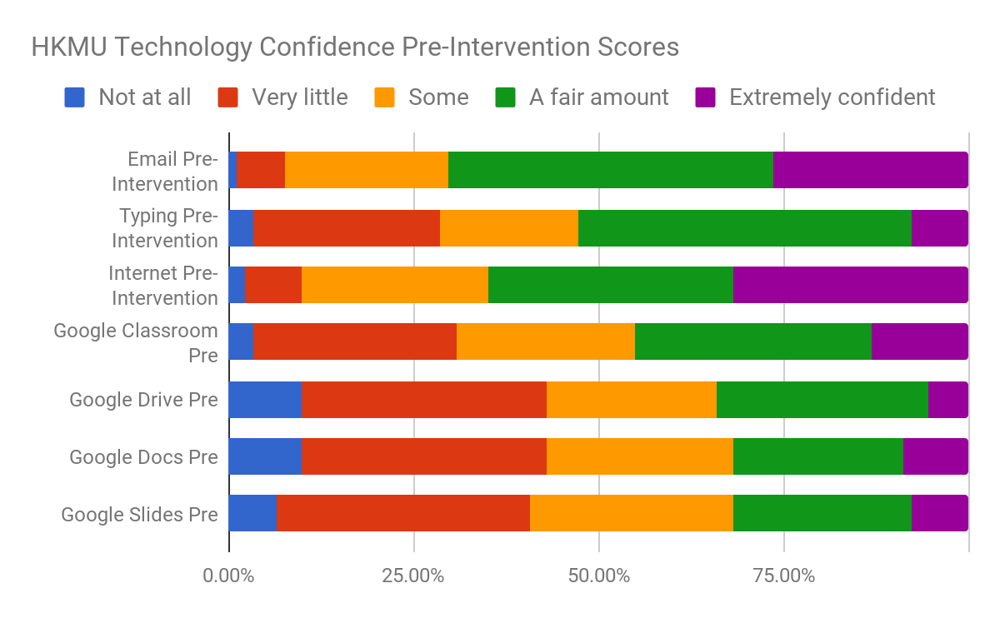
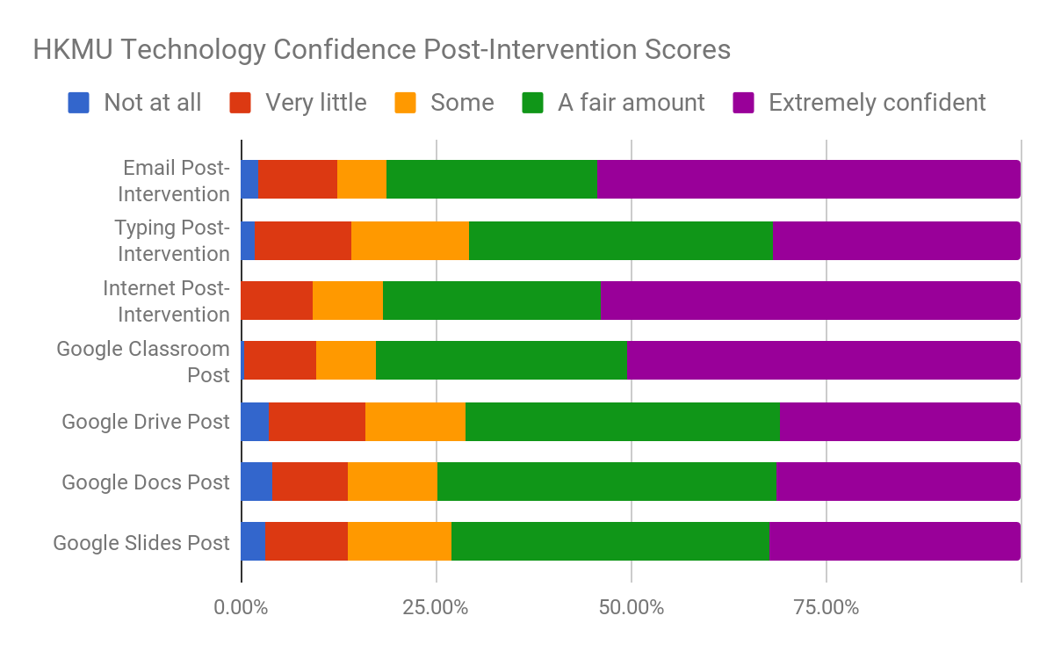
Confidence in Using Technology Tools

Slide 22
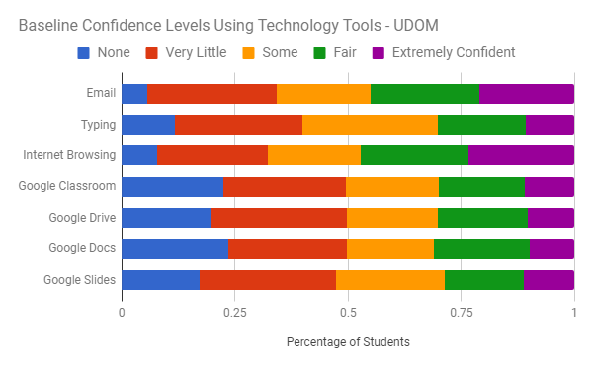
Confidence in Using Technology Tools

Slide 23
Benefits of Google Classroom
Theme | n
Enhanced communication | 38
Enhanced communication w/teacher | 25
Easier to submit assignments | 23
Able to check understanding or get feedback | 19
Timely | 18
Direct/Efficient | 11
Helped Studies | 8
Helped Organization | 6
HKMU Post-Intervention Qualitative Student Responses
Notes:
“Google classroom made it possible for us to interact with our lectures even when we were not in a physical class setting. It also made it possible to have an idea what other groups have being learning in the rotation rounds despite not being in that group just by going through what is being posted by the teachers and students of other groups. It made the submissions of various of assignments easy. And lastly google classroom made sharing of various lectures slides, medical journals, physical exam videos and various medical research way easy.” - student quote

Slide 24
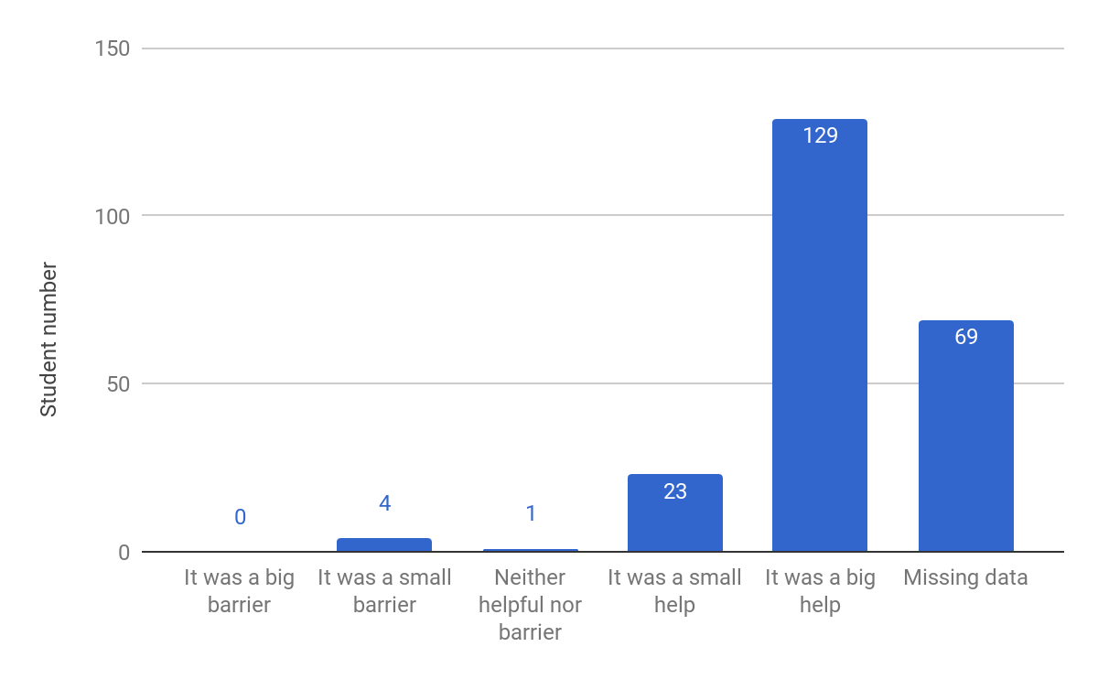
Benefits: Helpfulness of Google Classroom to Learning (n=226)

Slide 25
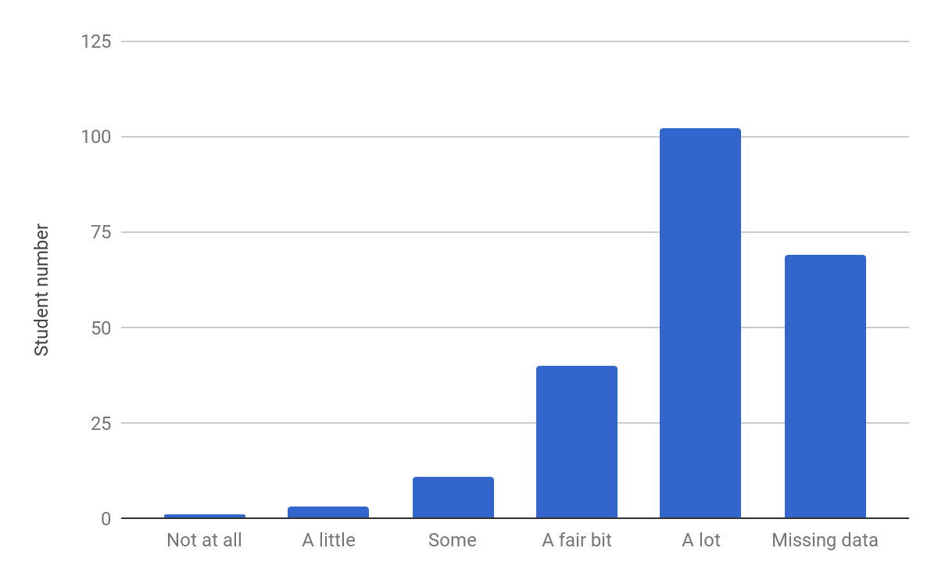
Benefits: Enjoyment of Google Classroom (n=226)

Slide 26
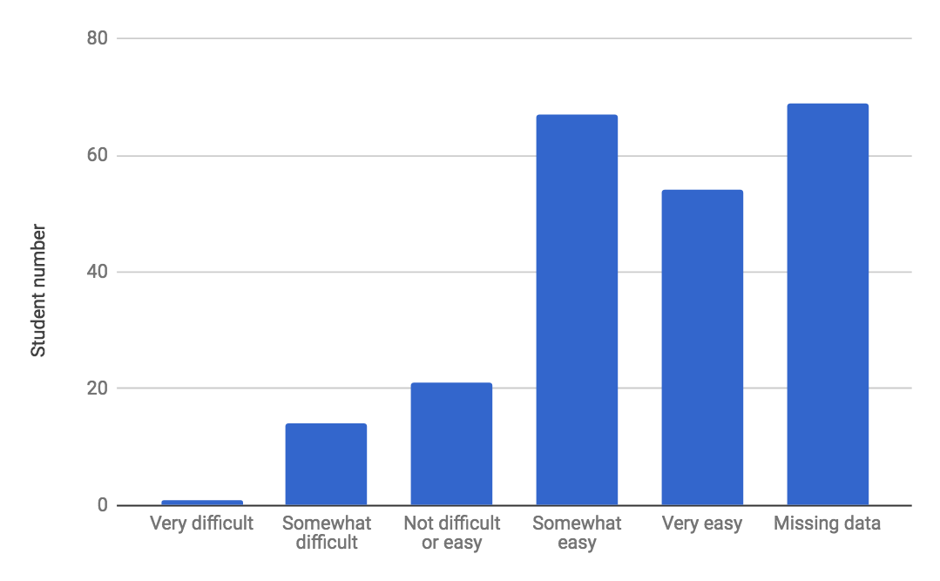
Benefits: Ease of Use of Google Classroom (n=226)

Slide 27
Challenges of Google Classroom
Theme | n
Internet | 58
Submitting assignments | 16
Uploading/downloading files | 11
Knowledge of platform | 11
Computer skills/typing | 8
Login | 6
Cost | 5
Need google docs or other app | 3
HKMU Post-Intervention Qualitative Student Responses

Slide 28
Implementation Challenges:
HKMU
UDOM
Faculty computer literacy
Multiple email login issues (personal vs HKMU email)
Lack of wireless internet access
Institutional support
Large university navigation & coordination with central IT office
Need for faculty training

Slide 29
Next Steps for Our Teams
HKMU
Continued use of Google Classroom in dept of medicine and pediatrics
Expansion to use in Psychiatry MD4 clerkship increased rigor of course (per student reports)
UDOM
Launch Google Classroom 2017-2018 Academic Year
Videoconferencing sessions across campuses

Slide 30
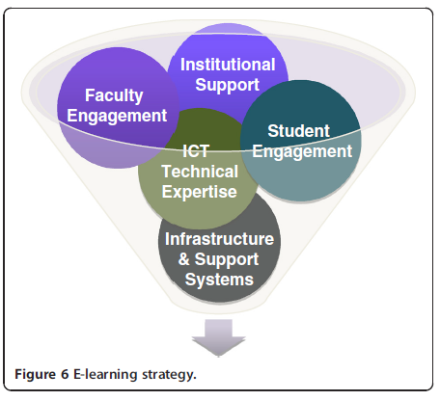
Summary
Frehywot et al. E-learning in medical education in resource constrained low- and middle-income countries. Human Resources for Health 2013, 11:4

Slide 31
Summary
Medical students in Tanzania have access to technology more than expected
Students in Tanzania were receptive to incorporating e-learning into their medical education and the majority of respondents found it helpful and easy to use
Institutions and individuals should consider using new technology tools in low resource medical education to overcome challenges faced

Slide 32
References
Frehywot et al. E-learning in medical education in resource constrained low- and middle-income countries. Human Resources for Health 2013, 11:4
Vovides, Y et al. A Systems Approach to Implementation of eLearning in Medical Education: Five MEPI Schools’ Journeys. Academic Medicine. 2014;89;S102-S106

Slide 33
Asanteni sana!
Thank you!

