Slide 1
Ethics: Global or Local?
Catherine Scarbrough, MD, MSc, FAAFP
M. Shawn Morehead, MD, MPH, FAAFP
Gordon Zubrod, MD, FAAFP

Slide 2
Objectives
Define the medical ethical principles of autonomy, beneficence, nonmaleficence, and justice
Identify the influence of other core ethical values of trustworthiness/honesty, professionalism, and dignity
Compare and contrast medical ethics and publicly observable behavior
Apply Western vs Eastern views of autonomy and informed consent to case presentations

Slide 3
Notes:
Our experience/travels

Slide 4
Bioethics: Early Influences
Religion:
Judaism (1500 BC: Talmud); Maimonides (12th Century)
Christianity/Catholicism: (0-400 AD: Old Testament, Gospels, Papacy); Thomas Aquinas 1200’s
Islam (610 AD: Quran, Sunnah, Islamic jurists); Conduct of a Physician (1st text on medical ethics)
Medical Tradition:
Hippocrates
Formula Comitis Archiatrorum (5th Century, Ostrogothic king Theodoric the Great)

Slide 5
Bioethics: Modern Influences
Philosophical Concepts
Secularization
Multiculturalism
Legal Concepts
Advance Directives
Informed Consent

Slide 6
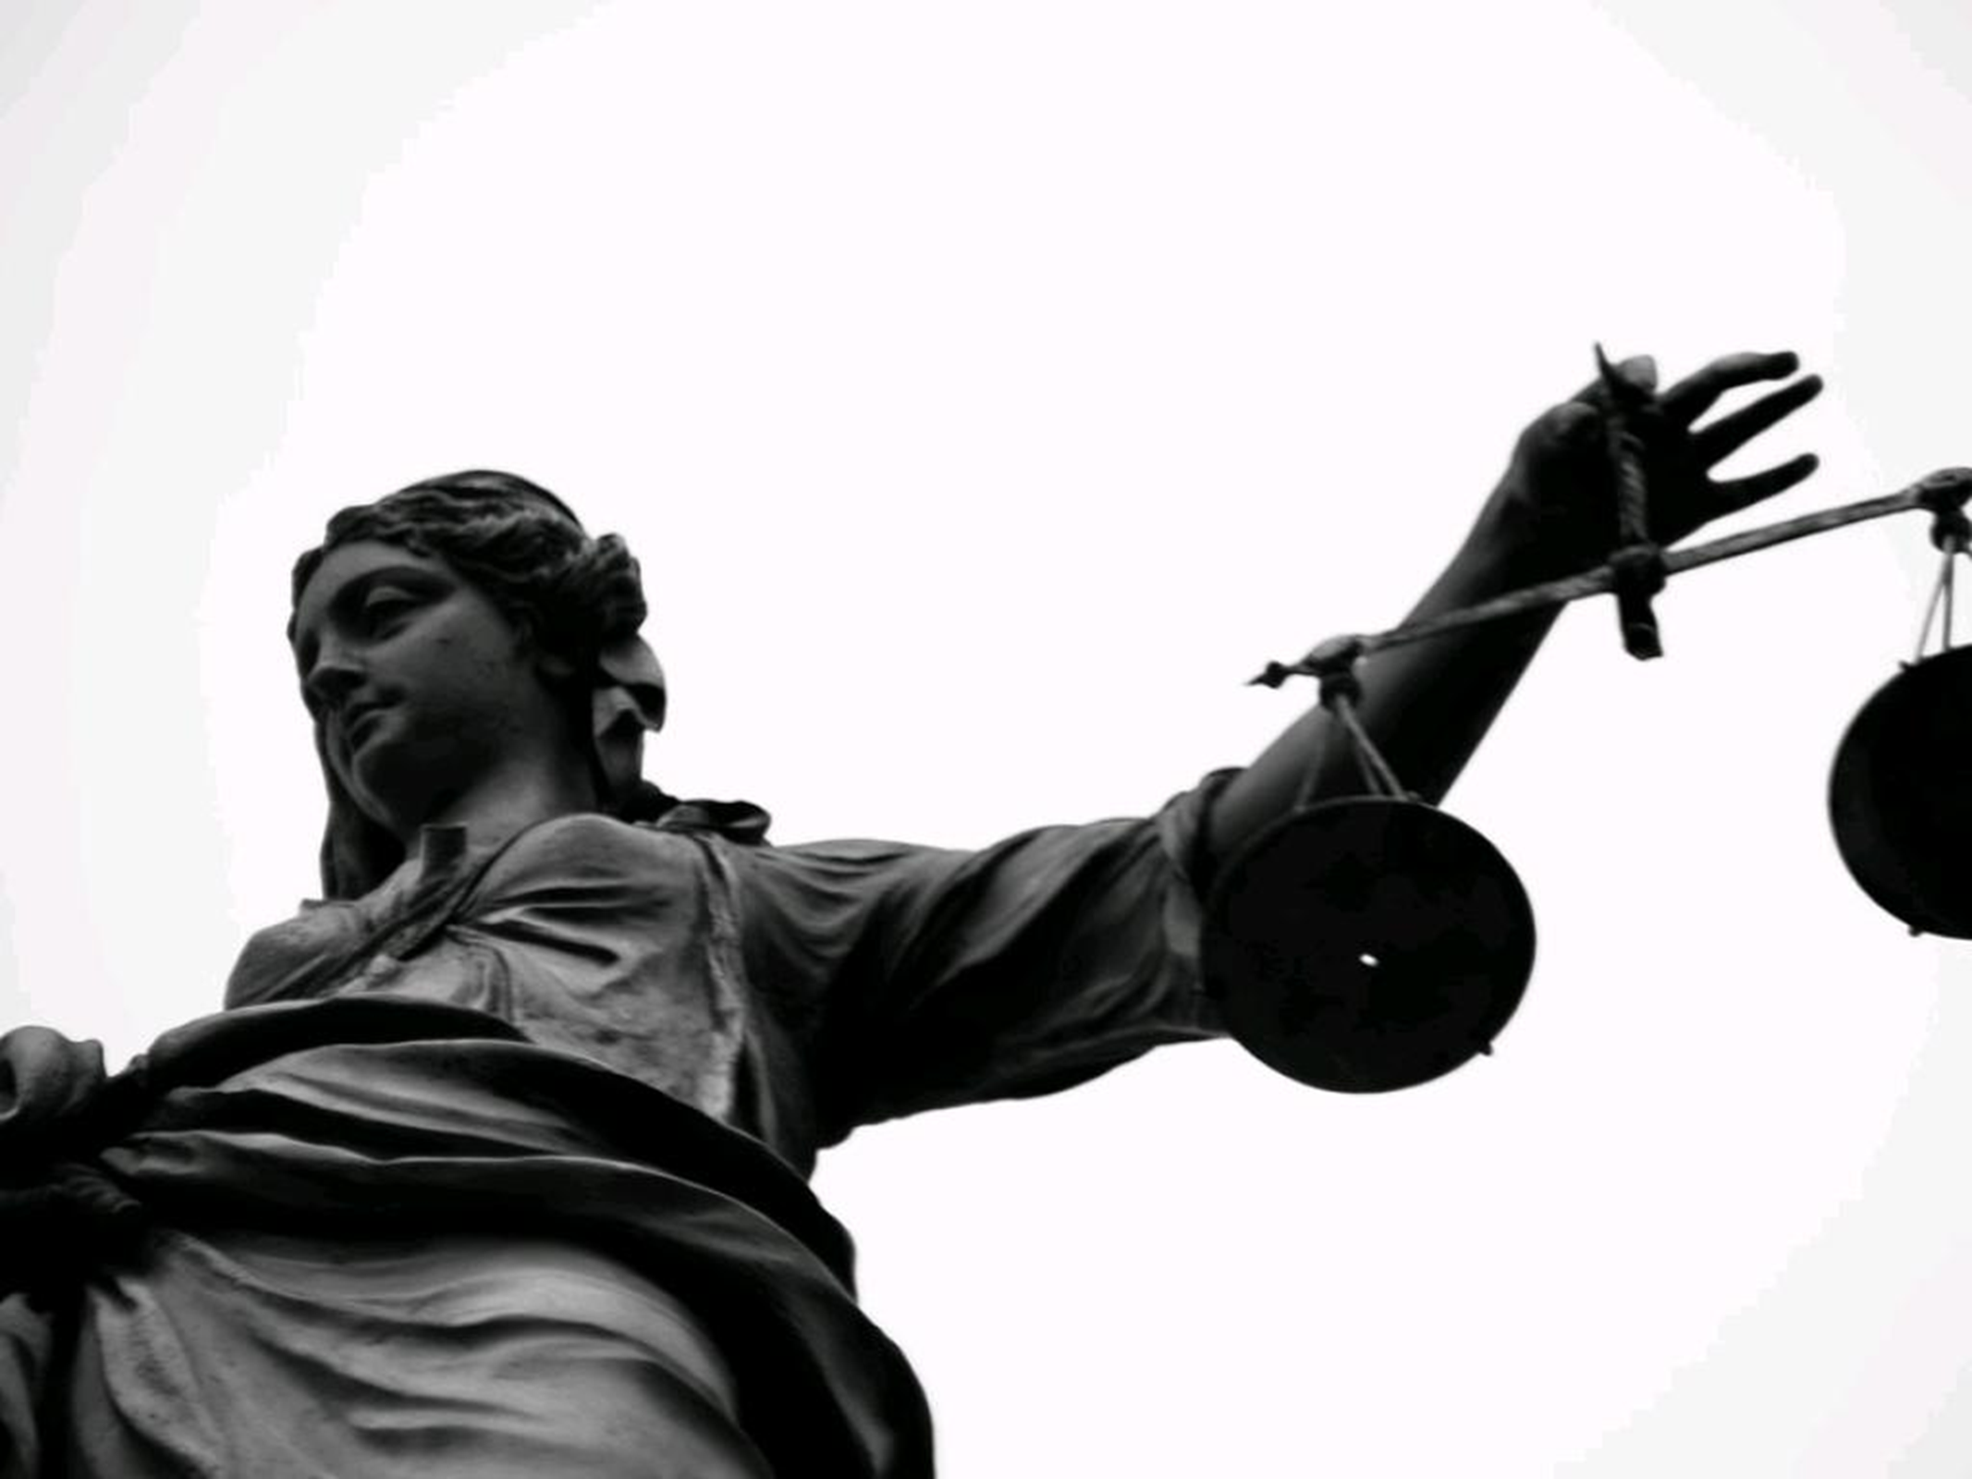
Medical Ethical Principles
Autonomy | Beneficence
Nonmaleficence | Justice

Slide 7
Other Core Values
Trustworthiness/honesty
Professionalism
Dignity
Confidentiality
Medical Futility
Conflict of Interest
Informed Consent
Principle of Double Effect

Slide 8
Comparison of the Three Monotheistic Religions with Respect to Relevant Bioethical Principles
Principle/Issue | Judaism | Christianity | Islam
Autonomy | + | +++ | +
Beneficence | +++ | +++ | +++
Nonmaleficence | ++++ | +++ | +++
Justice | ++ | ++ | +
Family/Community Roles | +++ | + > +++ | +++
2nd Religious Opinions | * | * | **
Withholding Truth | ** | * | ***
Withholding Artificial Nutrition | * | *** | *
Moral equivalent of withholding and withdrawing Life Support | * | *** | *
Advance Directives | * | **** | *
+ to ++++ = Least to Most Important
* to **** = Least to Most Acceptable

Slide 9
Individual Autonomy & Informed Consent
Western Concepts
Eastern Concepts
“Cornerstone of bioethics”
Truthfulness
Abide by legal standards
Accurate disclosure
Shared decision-making with physician
Voluntary decision
Individualism not recognized concept in Muslim societies
Balance between individual and community interests
At times, collective good outweighs individual good
Withholding truth accepted/required in some areas

Slide 10
Truth Disclosure in Muslim Contexts
Controversial
2 major determinants:
Religiosity: fatalism
Social/Family Structures: concealment
Misperceptions/Misinformation
Patient: treatment options, prognosis
Physician: less educated patients, psychological stress on patient

Slide 11
Truth Disclosure in Muslim Contexts
Social stigma
Paternalism
Lack of formal training of MDs in communication skills
Last 2 decades, increase in full disclosure
Still discrepancies between patient and MD on disclosure effectiveness

Slide 12
Truth Disclosure in Muslim Contexts
Studies on Barriers to “Breaking Bad News”
Lengthy preparation (slow disclosure)
Lack of time
Lack of formal training
Lack of commitment to concept of full patient disclosure/informed consent
Lack of psychosocial support networks
Family pressure (desire for concealment)
Lack of standardized legal codes, legislation, standards

Slide 13
Truth Disclosure in Muslim Contexts
Protocol for Muslim context: I-G-A-D (vs Western contexts)
Interview: patient/desired family present
Gather: background info/education/level of desired disclosure
Assess: influence of religion/family concerns
Achieve: rapport via prioritizing patient
Decide: on level of disclosure
Disclose: sensitively
Discuss: summarize/questions/support

Slide 14
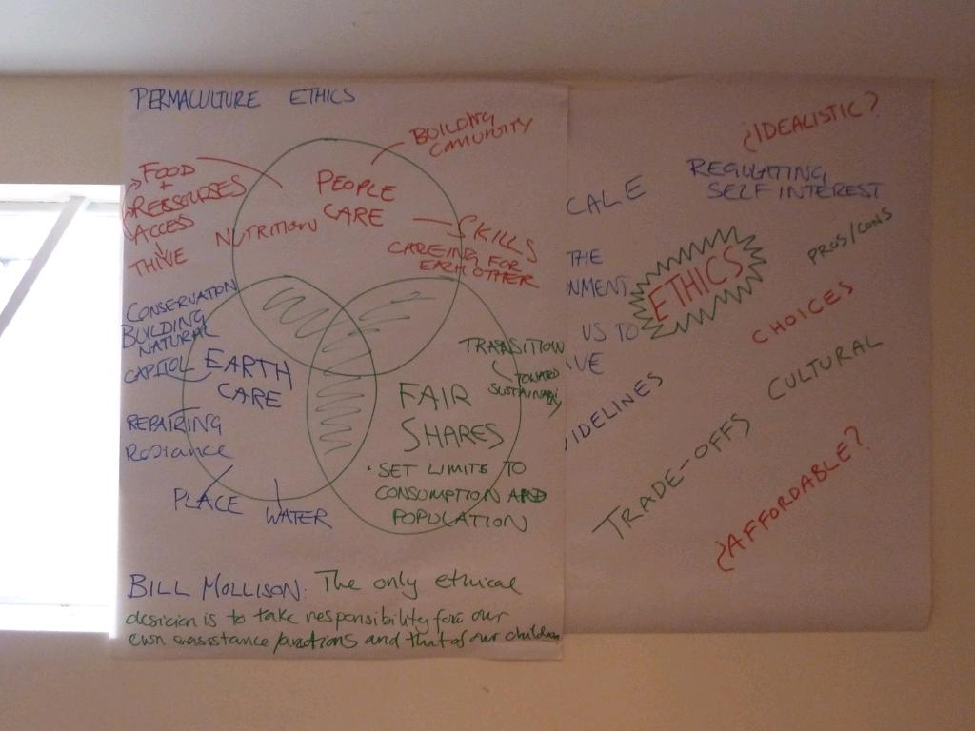
Case 1: Principles vs. Public Behavior
cc: London Permaculture - https://www.flickr.com/photos/7371031@N08

Slide 15
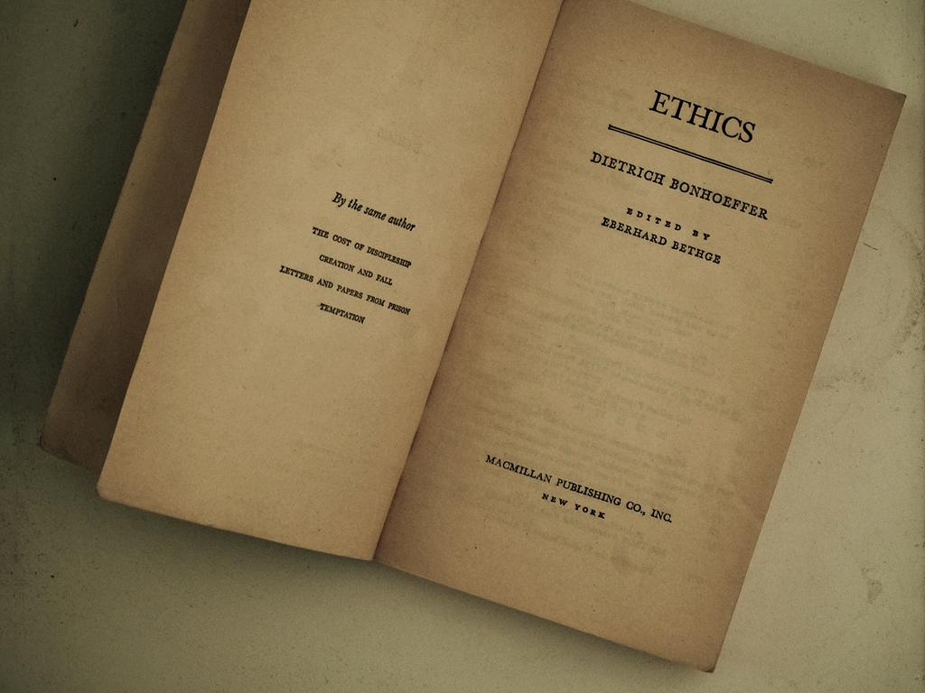
Case 2: Autonomy
cc: JosephGilbert.org - https://www.flickr.com/photos/76089221@N00

Slide 16
Cultural Diversity and Ethical Relativism
Principle of Multiculturalism
Requires respect for cultural diversity
Requires considering each culture EQUAL to all others
Precludes making legitimate cross-cultural moral judgments
Women under Taliban
Female circumcision
Honor killing
Burning of children
No universal standard for morality
Fosters ethical relativism

Slide 17
Cultural Diversity and Ethical Relativism
Ethical Universalism
Flexibility in the application of principles
Circumstance specific
Principles remain unchanged
Moral absolutes
Inflexible application of principles regardless of circumstance
Ex: full disclosure in all scenarios regardless of potential harm or patient preference
Avoidance of ethical relativism ≠ moral absolutism

Slide 18
Cultural Diversity and Values
Does Diversity mean Diversion from Fundamental Values?
Different weighting/prioritization
Core values found in most cultures
Respecting diversity ≠ acceptance of all diverse practices as legitimate
Explanation (custom/tradition) of Practice vs Moral Justification of Practice
Notes:
Different weighting/prioritization
Individual Autonomy
Truth Disclosure
Core values found in most cultures
Do good
No harm
Respect for persons/life
Respecting Diversity does not equal acceptance of all diverse practices as legitimate
Explanation (custom/tradition) of practice vs Moral Justification of practice
Reasoning, analysis, ethically defensible, evidence of harm, wrongdoing, consequences

Slide 19
Criteria for Moral Progress
2 Key Criteria as Litmus Test for a Culture or Group:
Humaneness: compassion for the suffering of all living beings
Humanity: fundamental respect for all humans as moral agents
Macklin, R. Against Relativism: Cultural Diversity and the Search for Ethical Universals in Medicine. New York: Oxford University Press, 1999.

Slide 20
Case 3: Informed Consent
cc: IrisDragon - https://www.flickr.com/photos/92074988@N00

Slide 21
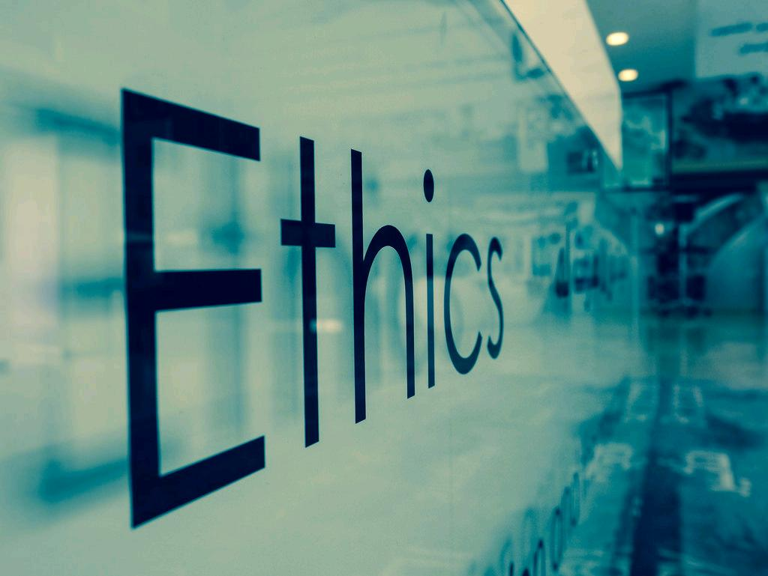
Case 4: End of Life Care
cc: masondan - https://www.flickr.com/photos/35935741@N07

Slide 22
Ethics of the Physician
Defines patient/physician relationship
Sets expectations of both physician and the patient
“Doctors need to recognize their own values, attitudes towards disability, training, and experience will influence their decision-making.”
Journal of Medical Ethics

Slide 23
Ethics and Patient-Centered Care
Whole-person care
Honesty with ourselves and others
Shared (not sole) responsibility for care
Protection of patients
We should be concerned with motives as well as actions,
with process as well as outcomes.
Notes:
Ventres Ann Fam Med 2017 article

Slide 24
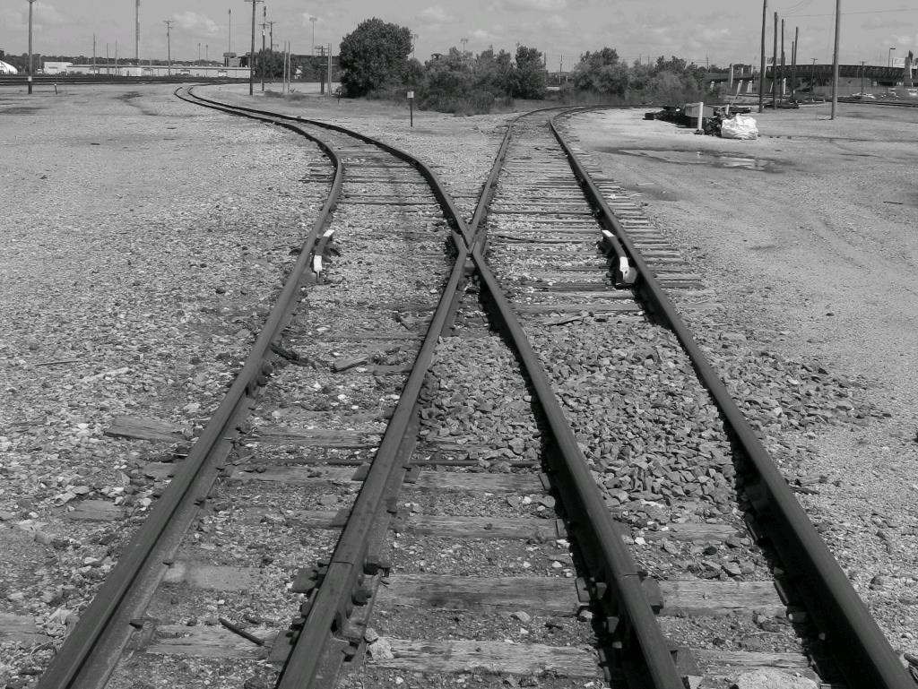
Questions?

Slide 25
References/Bibliography (handout)

