Slide 1
Building the family medicine resident team from day one of orientation. Sonia Velez, MD, JD Laurie Sullivan, PhD, MSW October 10, 2018

Slide 2
Disclosures
None

Slide 3
Intended audience
This seminar is intended for faculty who are responsible for new resident orientation and who will continue to be a part of the resident’s training.

Slide 4
St. Joseph’s Family Medicine Residency
Yonkers, New York (inner city borders on the Bronx)
40+ year old residency
10-10-10
Many of the faculty & hospital attending are alumni.
80/20 IMG/US grads
100% Board Pass Rate for last four years.

Slide 5
Sonia Velez, MD, JD
Program Director since 2006
Faculty for 9 years prior to becoming PD
Graduate from this program
Interview all 120+ candidates annually

Slide 6
Laurie Sullivan, PhD, MSW lsullivan@saintjosephs.org
Director of Behavioral Medicine
Co-facilitate a monthly Resident Well-Being conference
Chair Recruitment Committee
Chair of the CCC; and
Point person for Orientation.

Slide 7
Goals and Objectives
By the end of this session, it is our hope that you will:
1. Appreciate that team-building begins before new residents arrive;
2. Become familiar with the elements that create trust among a group of individuals so that they may begin to become a team; and
3. Leave with a repertoire of activities that support team development.
.

Slide 8
Goal #1: Team-building begins before new residents arrive
Team–Building?

Slide 9
CORE TENANTS OF TEAM BUILDING
Effective teams are strengths based- they know their strengths and organize to optimize them;

Slide 10
Effective teams are strengths based- they know their strengths and organize to optimize them;
They provide a buffer to stress and a support in times of distress;

Slide 11
Effective teams are strengths based- they know their strengths and organize to optimize them;
They provide a buffer to stress and a support in times of distress;
They provide a community in which to share successes, failures and fears;

Slide 12
And because conflict well resolved is the root of all personal growth, strengthening the team from early on provides skills for productive conflict resolution.

Slide 13
#1: Team-building begins before new residents arrive;
Screening Applicants
Interviewing (The Ideal Team Player, Lencioni)
Selection
Orientation

Slide 14
MATCH DAY and the group chat is born!
The On-Boarding Checklist was ready! We are ready to receive you. Model what you expect.
An invitation to share about you in May.

Slide 15
Hello and Welcome to the St. Joseph’s Family Medicine Residency Program,
My name is Laurie Sullivan and I am looking forward to working with you on the Behavioral Medicine curriculum that is an integral part of your journey toward becoming a family physician. In preparation for your orientation to the Program in June, I would like to request a bit of information about you that I might use in some of the sessions that I will facilitate. I would appreciate hearing back from you by -----so that I might have time to prepare. A simple reply email is sufficient- it is not necessary to spend more than a few minutes answering these questions. If you have any questions, please feel free to contact me. I look forward to working with you all. Laurie

Slide 16
In what town/city and country were you born?
What is the name and author of your favorite book?
In what birth order are you in your family?
How many countries in the world have you visited?
During what time of day are you most relaxed?
What is your favorite food?
What is one thing that few people know about you
that you are willing to share?

Slide 17
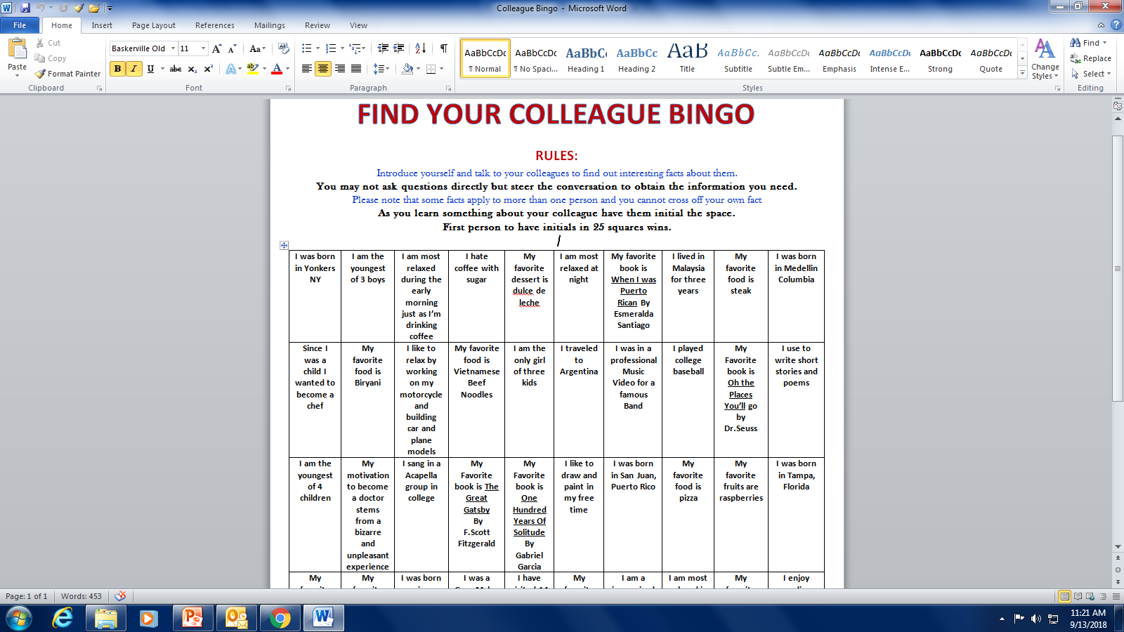

Slide 18
#2. Creating trust among a group-
Compelling direction;
A strong structure;
A supportive context;
A shared mindset.
Leading Teams: Setting the Stage for Great Performances; J. Richard Hackman, 2002

Slide 19
#2. Creating trust among a group-
Time- 14 day orientation

Slide 20
#2. Creating trust among a group-
Time- 14 day orientation
Variety of activities

Slide 21
#2. Creating trust among a group-
Time- 14 day orientation
Variety of activities
Empathy and Exposure

Slide 22
#2. Creating trust among a group-
Time- 14 day orientation
Variety of activities
Empathy and Exposure
Invitations- “I don’t know.”

Slide 23
#2. Creating trust among a group-
Time- 14 day orientation
Variety of activities
Empathy and Exposure
Invitations- “I don’t know.”
Setting Tones-Adult Learner-Ownership

Slide 24
#2. Creating trust among a group-
Time- 14 day orientation
Variety of activities
Empathy and Exposure
Invitations- “I don’t know.”
Setting Tones-Adult Learner-Ownership
From the Source-meeting with residents

Slide 25
#2. Creating trust among a group-
Time- 14 day orientation
Variety of activities
Empathy and Exposure
Invitations- “I don’t know.”
Setting Tones-Adult Learner-Ownership
From the Source-meeting with residents
Curiosity

Slide 26
#3. Activities to Build this Team Afternoon of Day One
Name; Introductions in dyads; Check in/out (30 minutes)
“What I want you to know about me in a group.” (75 minutes)
BREAK (15 minutes)
Bridge Exercise (60 minutes)
TOTAL: 3 hours

Slide 27
#3. Activities to Build this Team
Names –Introductions

Slide 28
#3. Activities to Build this Team
Names –Introductions
Introductions in dyads (Managing stress)

Slide 29
#3. Activities to Build this Team
Names –Introductions
Introductions in dyads (Managing stress)
Check In/Out Word (no “Ok” or “Fine”)

Slide 30
#3: Activities to Build Team
Previous Team and Group Experience
(10 minutes)

Slide 31
#3: Activities to Build Team
Previous Team and Group Experience (10 minutes)
Individual Preparation & Sharing:
What would you like others to know about how you work in a group/team as you embark on this journey? (20 min)

Slide 32
#3: Activities to Build Team
Previous Team and Group Experience (10 minutes)
Individual Preparation & Sharing:
What would you like others to know about how you work in a group/team as you embark on
this journey? (20 minutes)
Museum walk through “what I want you to know about how I work in a group.” (30 minutes)

Slide 33
#3: Activities to Build Team
Previous Team and Group Experience (10 minutes)
Individual Preparation & Sharing:
What would you like others to know about how you work in a group/team as you embark on
this journey? (20 minutes)
Museum walk through “what I want you to know about how I work in a group.” (30 minutes)
Debrief: Sitting- observations/attribution (15 minutes)

Slide 34
#3. Activities to Build this Team
Some thing to think about:
Depending on the country where the resident was raised/educated, engaging in these reflective exercises can be new and or stressful. Emphasize there is no right or wrong answer -

Slide 35
#3. Activities to Build this Team
Review-
Manage stress
Reflection on group experience
Reveal how you work in a group

Slide 36
Show of Hands
How many here have seen the movie Apollo 13?

Slide 37
#3. Activities to Build this Team
Bridge Building
Describe Task

Slide 38
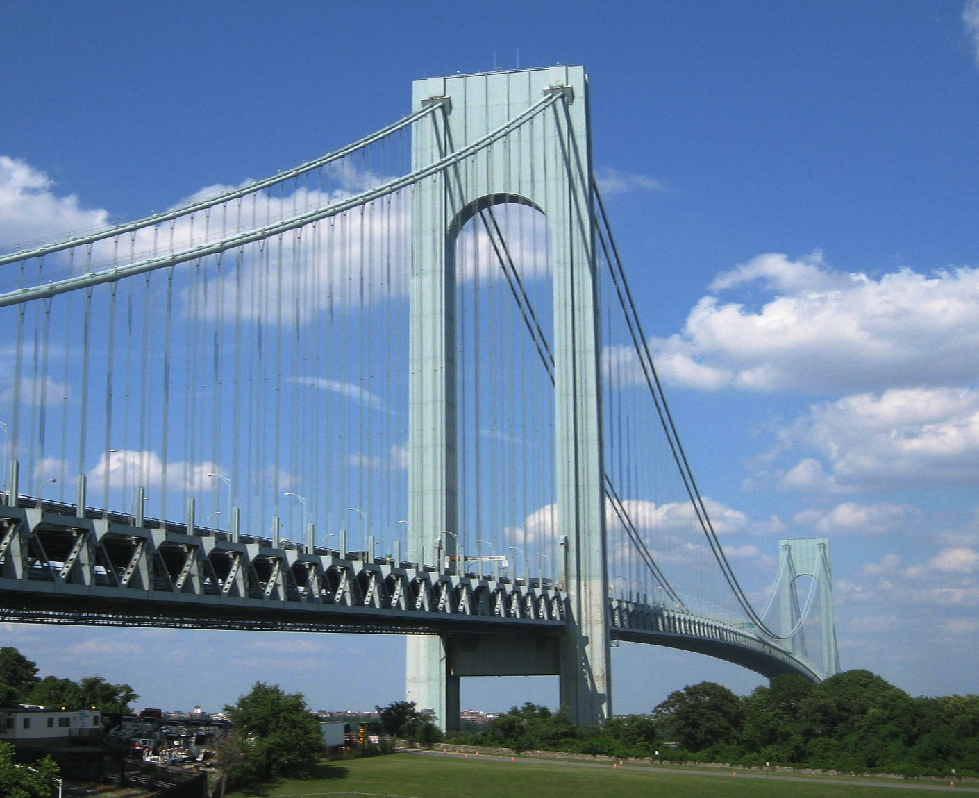
By H.L.I.T. - originally posted to Flickr as Verrazano, CC BY 2.0, https://commons.wikimedia.org/w/index.php?curid=12715051

Slide 40
The task is to build the longest, free standing expansion bridge with only two pillars. The bridge must stand independent of your support for 10 seconds and will be measured from end to end – the team with the longest span wins.

Slide 41
#3. Activities to Build this Team
Bridge Building
Describe Task
Competition – who wins?

Slide 42
#3. Activities to Build this Team
Bridge Building
Describe Task
Competition – who wins?
Divide in two groups (count off)

Slide 43
#3. Activities to Build this Team
Bridge Building
Describe Task
Competition – who wins?
Divide in two groups (count off)
Provide materials in a bag.

Slide 44
#3. Activities to Build this Team
Bridge Building
Describe Task
Competition – who wins?
Divide in two groups (count off)
Provide Materials in a bag
Questions

Slide 45
#3. Activities to Build this Team
Bridge Building
Describe Task
Competition – who wins?
Divide in two groups (count off)
Provide Materials in a bag
Questions
Time Keeper

Slide 46
#3. Activities to Build this Team
Bridge Building
Describe Task
Competition – who wins?
Divide in two groups (count off)
Provide Materials in a bag
Questions
Time –Keeper 30 min
Debrief 20 min
10 minutes

Slide 47
Debrief Suggestions
Check in word;
2. Ask for general observations.
What did you see happen in your group?
What surprised you the most about the group interaction?
What role did your find yourself playing?
3. Observations by the team members who were changed; their colleagues?
4. What similarities are there between this exercise & residency?
5. Check out word

Slide 48
Day One
Name; Introductions in dyads; Check in/out (30 minutes)
What I want you to know about me in a group. (75 minutes)
BREAK (15 minutes)
Bridge Exercise (60 minutes)
TOTAL: 3 hours

Slide 49
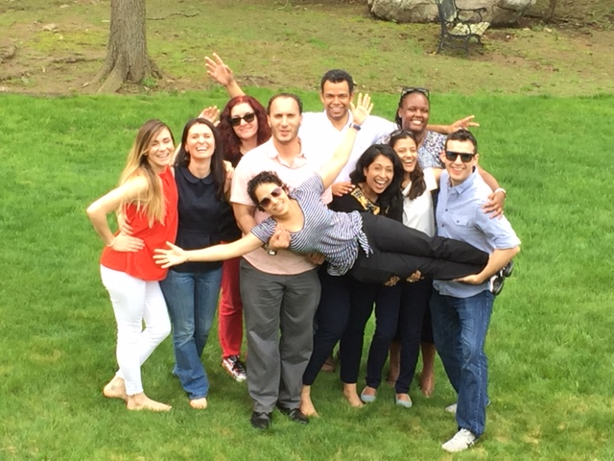

Slide 50
Summary
Appreciate that team-building begins before new residents arrive;
2. Become familiar with the elements that create trust among a group of individuals so that they may begin to become a team;
3. Leave with a repertoire of activities that support team development.

Slide 51
Thank you
Questions/Comments

