Slide 1
Family Practice Stories: Teaching Professionalism, Ethics, and Family Medicine Values Through Storytelling
The 44th Forum for Behavioral Science in Family Medicine
Richard D. Feldman, M.D., FAAFP Program Director Emeritus
Franciscan Health Indianapolis Family Medicine Residency Indianapolis, IN
Clinical Assistant Professor Indiana University School of Medicine
Associate Professor
Marian University College of Osteopathic Medicine
Former Indiana State Health Commissioner

Slide 2
The 44th Forum for Behavioral Science in Family Medicine
Please check-in to this session
You can use the QR code to the right which should also be available in written form at the entrance to the room.
You can also use this code in your app.
Session Code: SQQXH

Slide 3
The 44th Forum for Behavioral Science in Family Medicine
Disclosures
Dr. Feldman has no relevant conflicts to disclose

Slide 4
The 44th Forum for Behavioral Science in Family Medicine
This Workshop Will Present
The book, Family Practice Stories, a tool for longitudinal teaching of professionalism, ethics, and FM values through storytelling
Introduction to a study and facilitator’s guide for the related curriculum and providing at least two example stories
General discussion of the values of family medicine
How storytelling can fit well into any curriculum

Slide 5
The 44th Forum for Behavioral Science in Family Medicine
Goals and Objectives
List the values and basic tenants of family medicine
Describe what it is to be a family physician including what they do and believe in.
Explain the power of teaching professionalism, ethics and family medicine values by example from the words and actions of family medicine's founding fathers

Slide 6
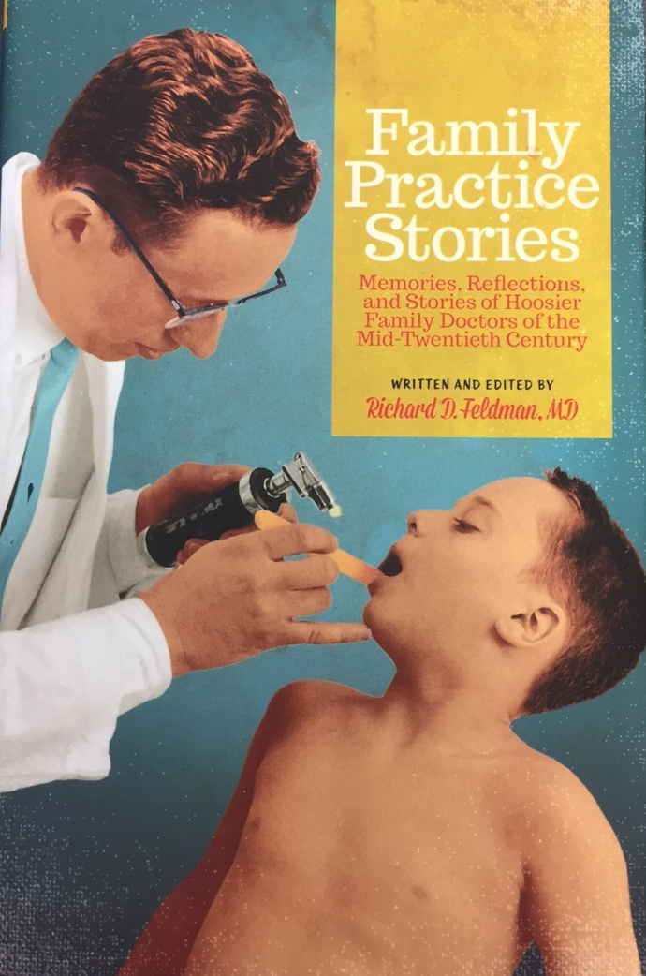
The 44th Forum for Behavioral Science in Family Medicine

Slide 7
The 44th Forum for Behavioral Science in Family Medicine
Family Practice Stories
Published 2013
Written and edited by Richard D. Feldman, M.D.
Indiana Historical Society Press
Book was a project of the Indiana Academy of Family Physicians Foundation and also supported by the AAFP Foundation’s Family Medicine Philanthropic Consortium.
Recipient of the first fellowship grant of the AAFP Foundation’s Center for the History of Family Medicine and the 2017 AAFP Foundation most outstanding Chapter Program Award.
All royalties donated to the IAFP Foundation. Author has no financial interest in promoting the book.

Slide 8
The 44th Forum for Behavioral Science in Family Medicine
An Oral History
Originally intended as a historical work
Large collection of stories and essays told by, or about, 48 family doctors practicing in the mid-20th century
Reveals style of practice and how they touched their patients and their communities
Captures stories about our founding fathers before they were lost forever
A time when professionalism, the art of medicine, and the art of healing were at a zenith; Crucial time in history and development of specialty’s philosophical underpinnings
Today, family medicine emulates the core values and character of these physicians

Slide 9
The 44th Forum for Behavioral Science in Family Medicine
A Tool for Teaching Professionalism, Ethics and Values
There are lessons to be learned from the collective wisdom and life experiences of these doctors

Slide 10
The 44th Forum for Behavioral Science in Family Medicine
Organization of the Book
The book is divided into three sections
The history and development of family medicine
Details traditions, principles, beliefs, and values of family medicine
A collection of reflective essays on various subjects
A large collection of stories told by older family physicians

Slide 11
The 44th Forum for Behavioral Science in Family Medicine
The Stories
Specific episodes; some stories are humorous, some sad, others touching
Each story stands by itself as a single chapter taken from original transcripts

Slide 12
The 44th Forum for Behavioral Science in Family Medicine
The Study and Facilitator’s Guide
Presented here is a longitudinal curriculum guide for utilizing selected stories for group discussion with a faculty (or resident) facilitator
Placed on Residency Curriculum Resource (RCR) of the AFMRD/STFM under PGY2 and 3/Ethics/professionalism

Slide 13
The 44th Forum for Behavioral Science in Family Medicine
The Study and Facilitator’s Guide
Utilized by residency programs and medical schools
Remedially for individual residents with pervasive problems with professionalism
Storytelling and analysis of messages and lessons contained in narratives through group discussion are ideal ways in which to consider professionalism and ethics

Slide 14
The 44th Forum for Behavioral Science in Family Medicine
Key Points
The importance of professionalism and ethics in medicine is increasingly emphasized
An essential element for residency accreditation inclusion in the ACGME competencies, milestones, and the CLER site visits
We tend not to discuss our basic values in FM as we once did years ago.
There is value in focusing on professionalism specifically as it relates to the specialty of family medicine – and by doing so - discover or rediscover the specialty’s values

Slide 15
The 44th Forum for Behavioral Science in Family Medicine
Selected Study Guide Objectives
Discuss the core values of family medicine
Define professionalism in the context of medical practice
Describe the professional, ethical, and personal characteristics of what makes an effective family physician
Discuss how the practice and values of family medicine have changed over the past 60 years
Identify the contemporary barriers and pressures that discourage optimal professionalism in medical practice

Slide 16
The 44th Forum for Behavioral Science in Family Medicine
Selected Study Guide Objectives
Describe the value of “mindfulness” in the practice of medicine, and how it can promote meaningful relationships with patients

Slide 17
The 44th Forum for Behavioral Science in Family Medicine
Process
Simple for the facilitator
Stories are short and can be read aloud in a group setting by one of the residents
Stories are summarized in the Study Guide
Suggested questions to ask the group for each story

Slide 18
The 44th Forum for Behavioral Science in Family Medicine
Process
Discussions are free-flowing
No correct or incorrect responses
Facilitator, generally a faculty member, guides the group discussion by use of the questions in the study guide
Millennials like interactive experiences, not lectures

Slide 19
The 44th Forum for Behavioral Science in Family Medicine
Some Thoughts
Physicians are part of something of great importance, and something that is bigger than oneself
If anything characterizes our founding fathers of family medicine…. it was being there for their patients

Slide 20
The 44th Forum for Behavioral Science in Family Medicine
Example Study Guide Story and Questions
Chapter 14 – A Lesson in Professionalism
This is a story about a patient who owed the doctor a large amount of money for the care that he received. The doctor collected a nominal amount of money from the patient each month to pay off the bill even though it cost more money to send the bill compared to the amount collected. Dr. Feldman also bartered for services when patients could not pay their bill and occasionally had patients do odd jobs around his home (repair work, landscaping, etc.). The physician was very concerned about preserving his patient’s dignity and self-respect. Many patients were eager to work off their bills rather than accept charity.

Slide 21
The 44th Forum for Behavioral Science in Family Medicine
Example Study Guide Story and Questions
How does this story relate to professionalism? Is it all about the money nowadays? How have things changed in medicine and why?
What do you do in your practice that preserves a patient’s dignity?
Would this scenario likely occur today?
Were professional boundaries blurred?
Would you feel comfortable having patients at your home working off their bill?

Slide 22
The 44th Forum for Behavioral Science in Family Medicine
Availability
The book is available through:
Amazon http://www.amazon.com/s/ref=nb_sb_noss?url=search-alias%3Daps&field (keywords=family+practice+stories)
Indiana Historical Society Press
http://shop.indianahistory.org/SelectSKU.aspx?skuid=101142
Also available through other outlets including Barnes and Noble
Available on all e-book formats

Slide 23
The 44th Forum for Behavioral Science in Family Medicine
Study Guide Authors and Contact Information
Richard D. Feldman, M.D., FAAFP
Jacqueline A. Maxwell, Psy.D., HSPP
Franciscan Health Indianapolis Family Medicine Residency
5230A East Stop 11 Road #250
Indianapolis, Indiana 46237
317-528-8641
richard.feldman@franciscanalliance.org

Slide 24
The 44th Forum for Behavioral Science in Family Medicine
Further Readiing
. et al. Teaching professionalism in medical residency programs: a scoping review protocol. Syst Rev (2020).
Charon, R. At the Membranes of Care: Stories in Narrative Medicine. Acad Med. 2012; 87:342-7
Coulehan, J. MD. Today’s Professionalism: Engaging the Mind but Not the Heart. Acad Med 2005; 80:892-898
Quaintance, J.L., Arnold, L., & Thompson, G.S. What Students Learn about Professionalism from Faculty Stories: An “Appreciative Inquiry” Approach. Acad Med 2010; 85(1):118-23
O’Sullivan, H., Van Mook, W., Fewtrell, R., & Wass, V. Integrating Professionalism Into the Curriculum: AMEE guide no. 61. Medical Teacher 2012; 34;e64-e77
Shapiro, J., Nixon, L.L., Wear, S.E., & Doukas, D.J. Medical Professionalism: What the Study of Literature Can Contribute to the Conversation. Philosophy, Ethics and Humanities in Medicine 2015 10:10
Wald, H.S., Davis, S. W., Reis, S.P., Monroe, A. D., & Borkan, J.M. Reflecting on Reflections: Enhancement of Medical Education Curriculum with Structured Field Notes and Guided Feedback. Acad Med 2009;84: 830-837
Page, M., Crampton, P., Viney, R. et al. Teaching medical professionalism: a qualitative exploration of persuasive communication as an educational strategy. BMC Med Educ 20, 74 (2020). https://doi.org/10.1186/s12909-020-1993-0
Ghaffarifar, S., Asghari-Khatooni, A., Akbarzadeh, A. et al. Teaching professionalism in medical residency programs: a scoping review protocol. Syst Rev 9, 281 (2020). https://doi.org/10.1186/s13643-020-01529-w/10.1186/s13643-020-01529-w

Slide 25
The 44th Forum for Behavioral Science in Family Medicine
Discussion of Values and Basic Tenants of Family Medicine
Who Are We and What Do We Believe In?

Slide 26
The 44th Forum for Behavioral Science in Family Medicine
Summary Statements of Our Values
Comprehensive, continuous, compassionate, personalized first contact care for all people throughout the lifespan within the context of the family and community.
Committed to whole person care, not just diseases, fostering an environment of trust and mutual respect. Family Physicians value mindful communication and continuous healing relationships over time. Family Medicine has always been patient-centered.
Committed to patient advocacy and coordination of care while navigating the patient, through the health-care system. Family physicians have always been trusted advisors and compassionate counselors. We are driven by the need to make people whole in mind, body, and spirit.
Family physicians are committed to, and involved in, their communities.
Newer additions to our values: cultural sensitivity and shared decision-making

Slide 27
The 44th Forum for Behavioral Science in Family Medicine
The Bottom Line
Relationship!
We have been honored to be invited into the lives of our patients.

Slide 28
The 44th Forum for Behavioral Science in Family Medicine
Q&A

Slide 29
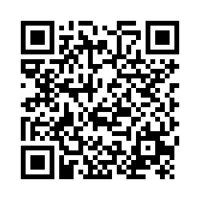
The 44th Forum for Behavioral Science in Family Medicine
Session Evaluation Link
Session Evaluation Link
Please complete an evaluation of this session. There is a direct link in your conference app. You can also use this QR code.

