Slide 1
Why Wiki? Exploring Advantages of Innovative Information Management
Amoreena Ranck Howell, MD, MSPH
Ali Abdallah, DO, PGY-3
National Family Medicine Residency at Unity Health Care
University of Maryland
Family Medicine Residency
Notes:
Ali

Slide 2
DISCLOSURES
None

Slide 3
Upon completion of this session, participants should be able to…
List at least three advantages of a wiki compared with other forms of information management, i.e. note sharing programs.
Describe at least three different features of wiki platforms that are relevant for an individual program to consider when creating their own wiki site.
Create their own wiki site if desired.

Slide 4
As a resident (or student…or even faculty) in clinic, what types of information do you need?
Where do you go to find this information?
How long does it take to find good information?

Slide 5
Types of Information
Residency-specific administrative information
Policies & Procedures
Schedules, Leave
Rotations
Relevant clinical references
Guidelines
Diagnosis and management algorithms
Didactics
Lecture slides
Handouts
Faculty Expertise

Slide 6
Notes:
Ali
Takes time!!!!

Slide 7
Clinical Information
Notes:
Amoreena: Pre-wiki survey of residents from well-established program

Slide 8
Administrative Information

Slide 9
Time?
Notes:
Faculty opinions of residents

Slide 10
Time?
Notes:
Residents use multiple resources while seeing patients…

Slide 11
Time?

Slide 12
Time?

Slide 13
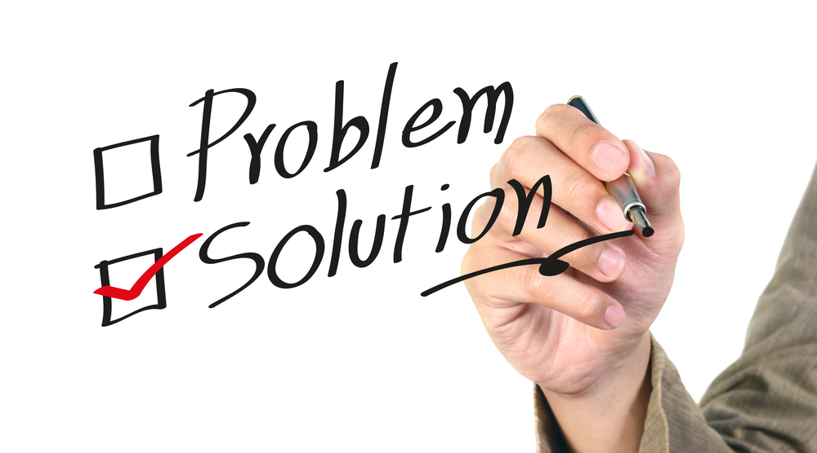
Solution?
Cork boards
Email
Google Docs
Blackboard
Evernote
Website
Wiki!

Slide 14
What Is a Wiki?
A website that allows collaborative editing of its content and structure by its users
Notes:
Amoreena

Slide 15
Wiki Advantages
Rapid access to information, including during clinic
Any format of digital information/media
Delegates the responsibility for maintaining such a broad level of information
Program-specific, “need to know” format and can include hospital, clinic, and EMR-specific instructions
Changes to a page are unobtrusively tracked automatically and easily reversed
QI and other collaborative projects can be easily managed
Faculty development
Accessible to non-tech-savvy people (everyone!)
Notes:
Amoreena
Rapid access to program-specific information needed at any given time, including during clinic; other media, i.e. inhaler videos
Delegating the responsibility for maintaining such a broad level of information to both residents and faculty increases the wiki’s utility and sustainability.
Faculty and residents both contribute content: creates a more program-specific, “need to know” format and can include hospital, clinic, and EMR-specific instructions
Changes to a page are unobtrusively tracked automatically and very easily reversed to any prior version. This provides a system to monitor and correct inaccurate information.
QI and other collaborative projects can be easily managed using the wiki platform.
Great tool for faculty development.
Accessible non-tech-savvy people (everyone!)
Unique section to disseminate individual faculty expertise and experience to the entire program

Slide 16
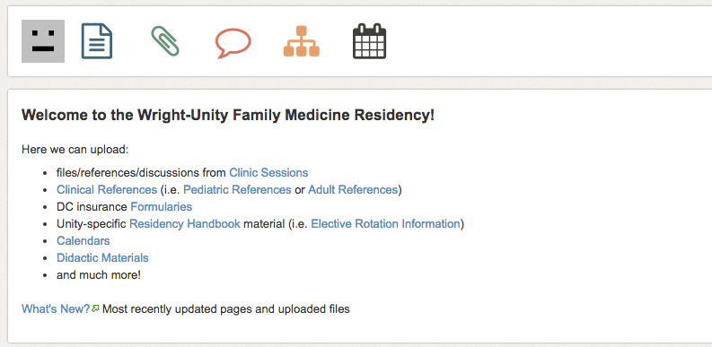
Unity’s Wiki
Notes:
Ali

Slide 17
Clinical References
Preventive Medicine
Well Child Checks
Asthma
Diabetes
Keeping Up (EBM Resources)
Notes:
A few topics (among many)

Slide 18
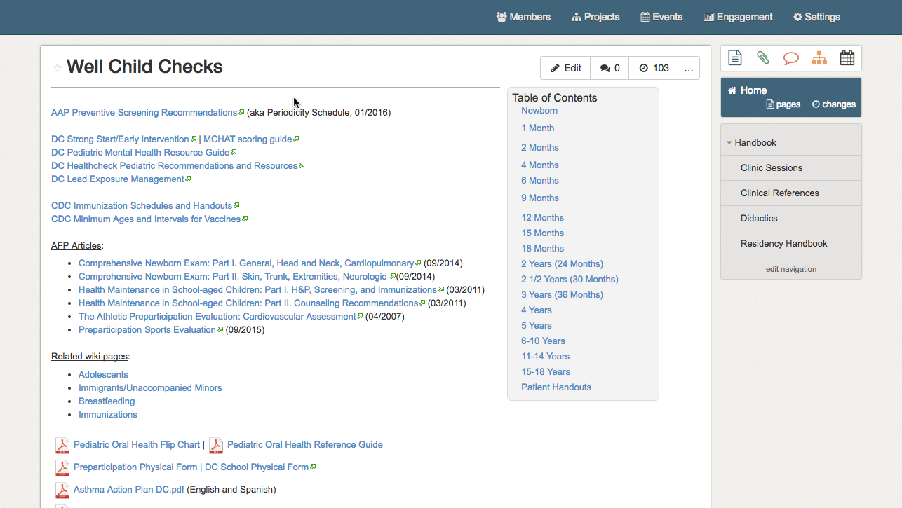
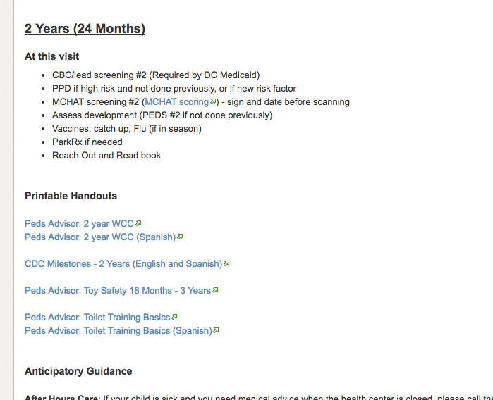

Slide 19
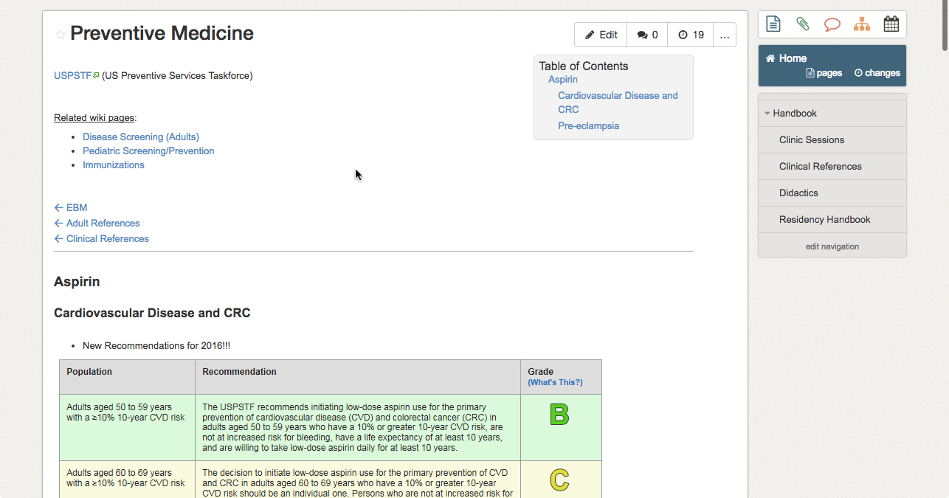

Slide 20
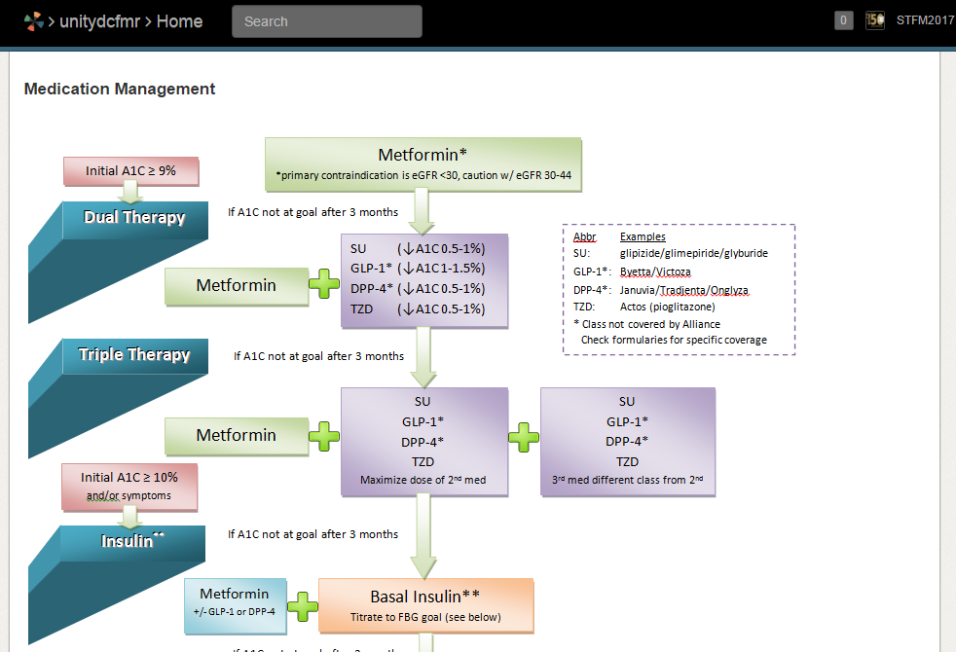
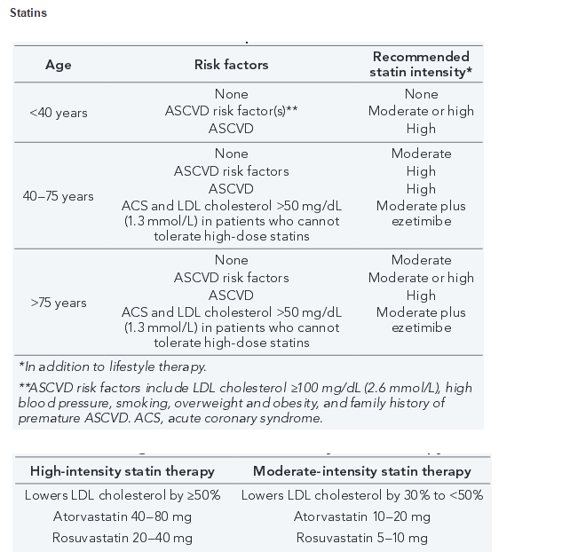

Slide 21
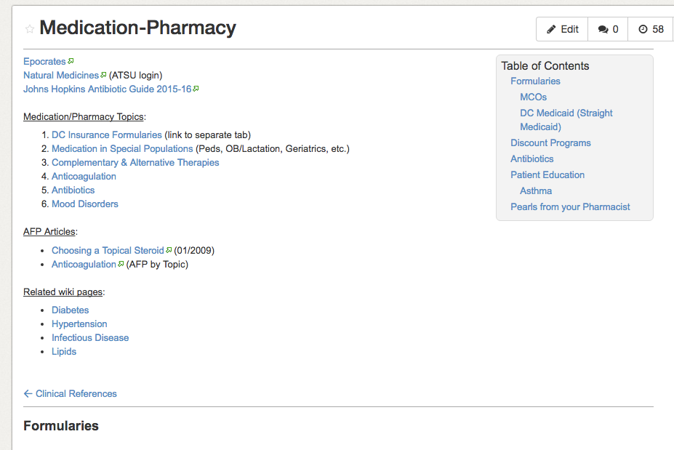
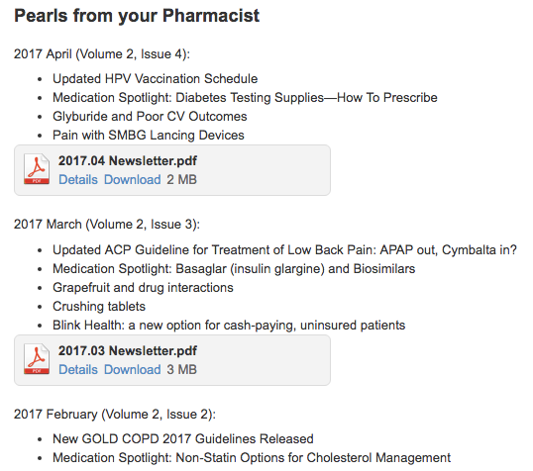

Slide 22
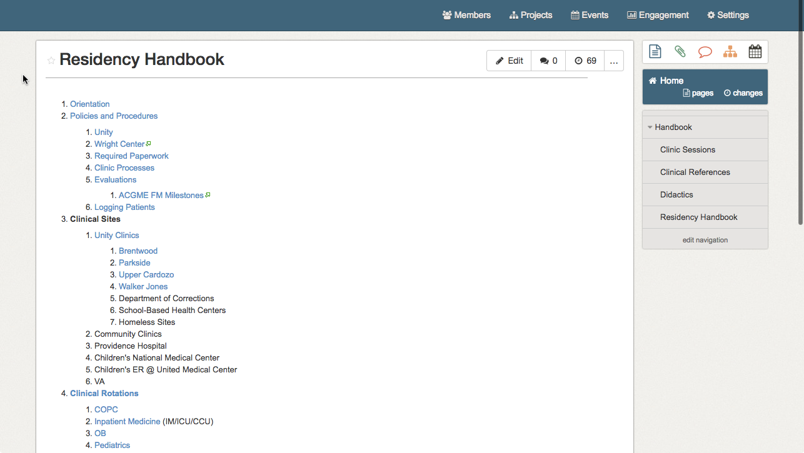
Administrative Information
Notes:
Amoreena

Slide 23
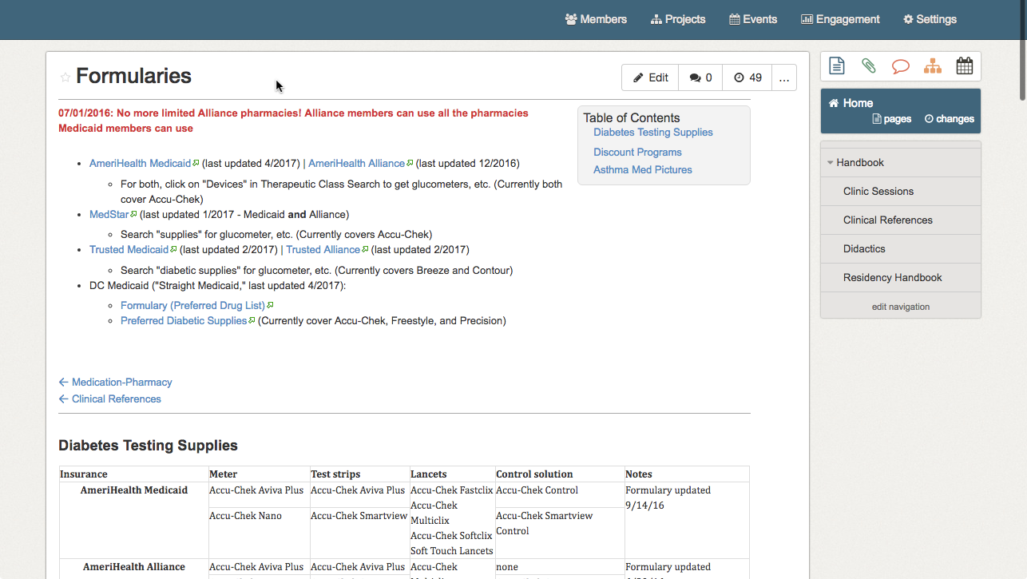
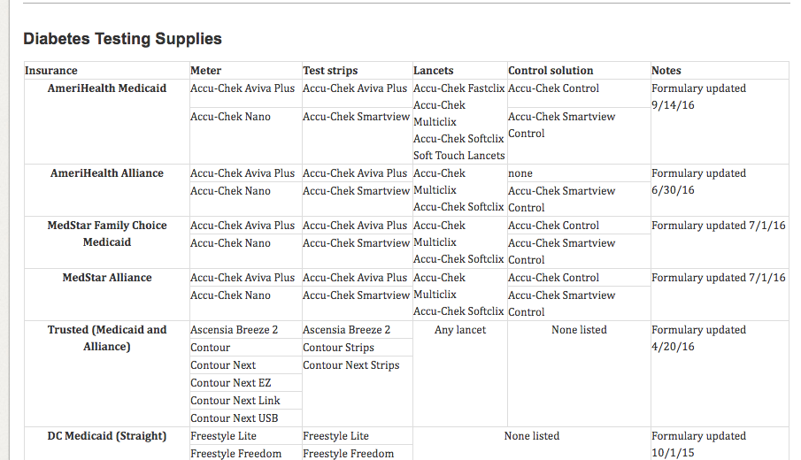

Slide 24
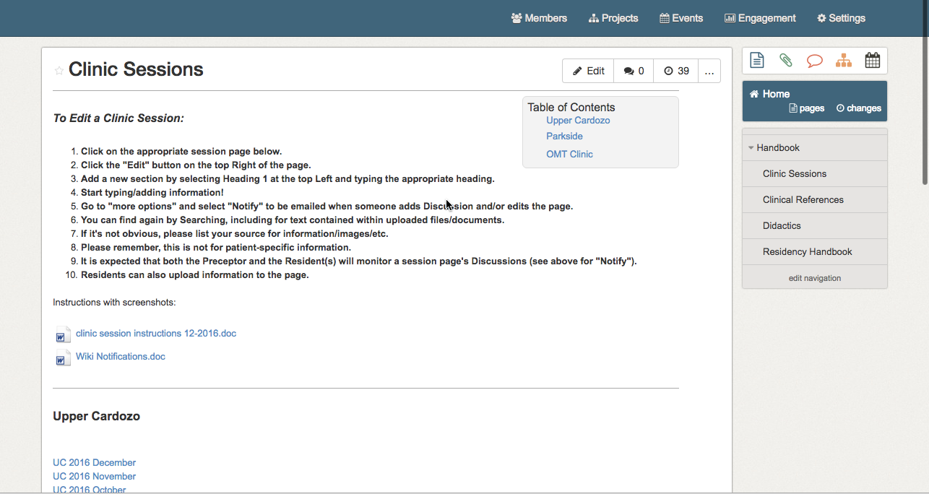
Faculty Expertise
Notes:
Ali

Slide 25
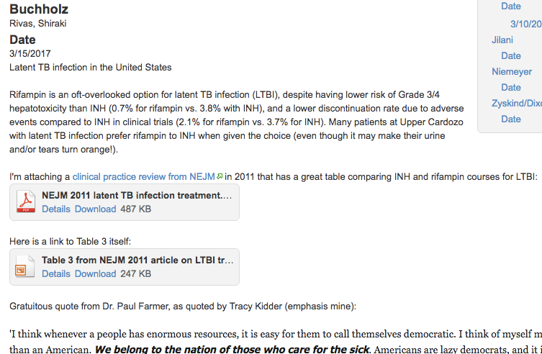

Slide 26
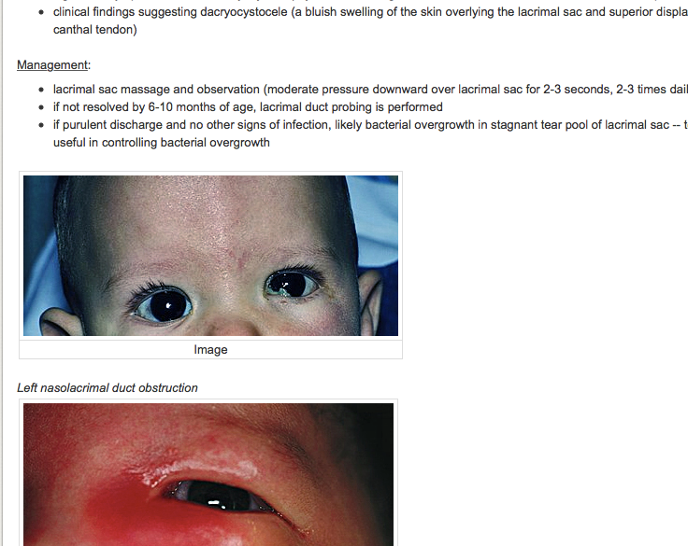

Slide 27
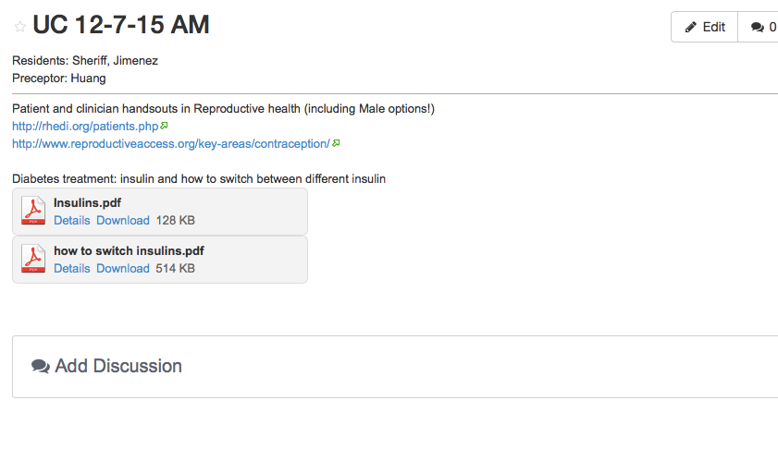

Slide 28
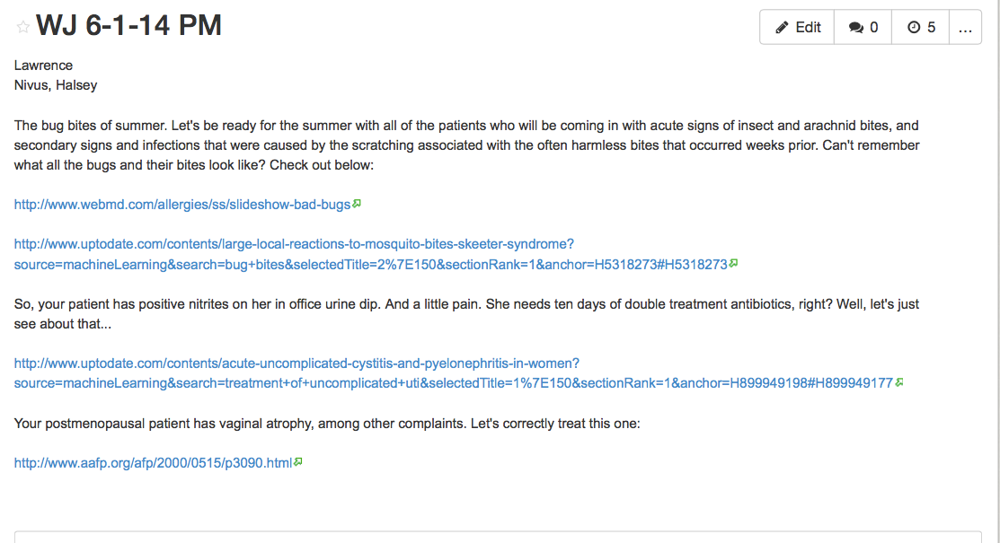

Slide 29
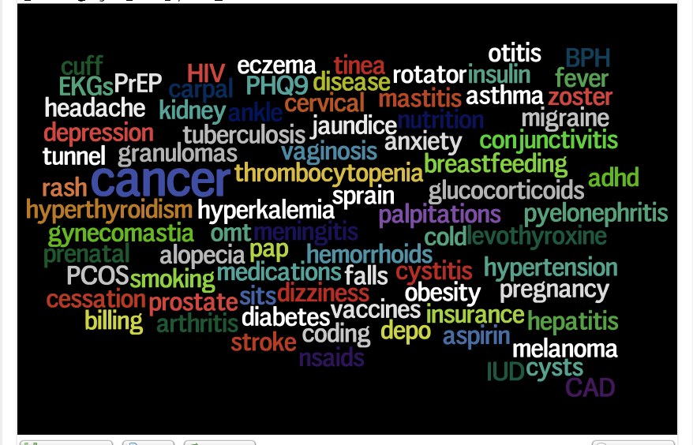
Notes:
Some topics covered in Clinic Sessions

Slide 30
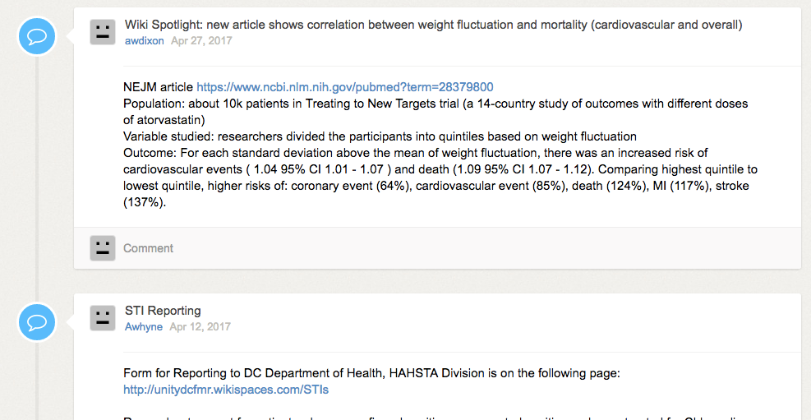
Updates
Notes:
Emailed out to all users (if desired)

Slide 31
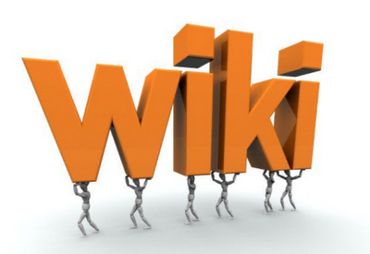
Utilization
Do the residents actually use the wiki?
Notes:
Amoreena

Slide 32
Utilization

Slide 33
Utilization

Slide 34
Let’s Try It!
Please pair up with your neighbor and go to the wiki site on your own device (laptop or tablet preferred, smart phone ok)
http://unitydcfmr.wikispaces.com
Notes:
Everybody!

Slide 35
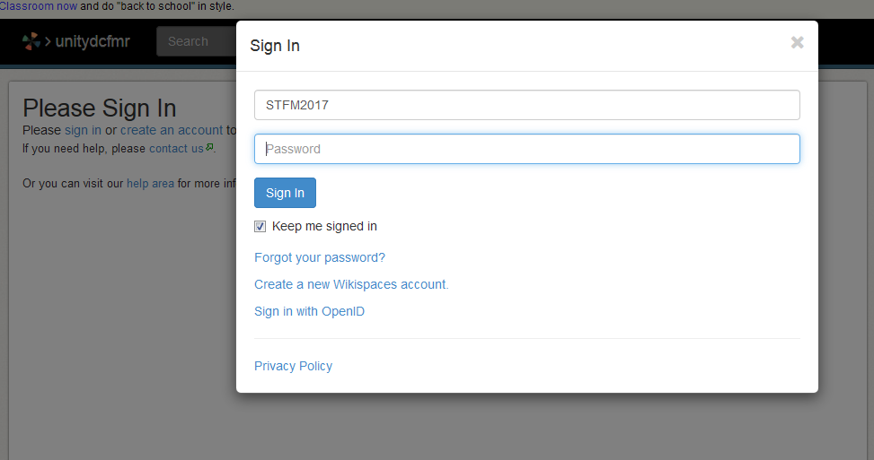
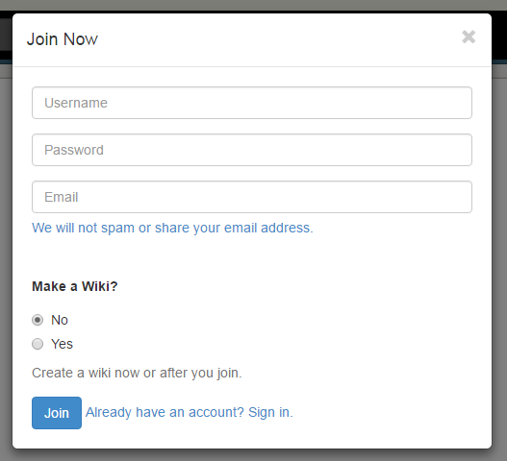
Let’s Try It!
stfm2017
Notes:
Everybody!

Slide 36
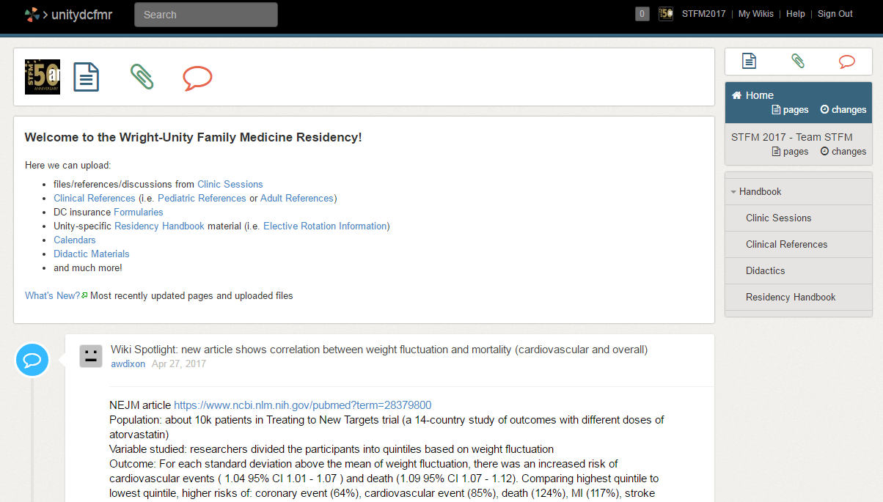
Add a Page

Slide 37
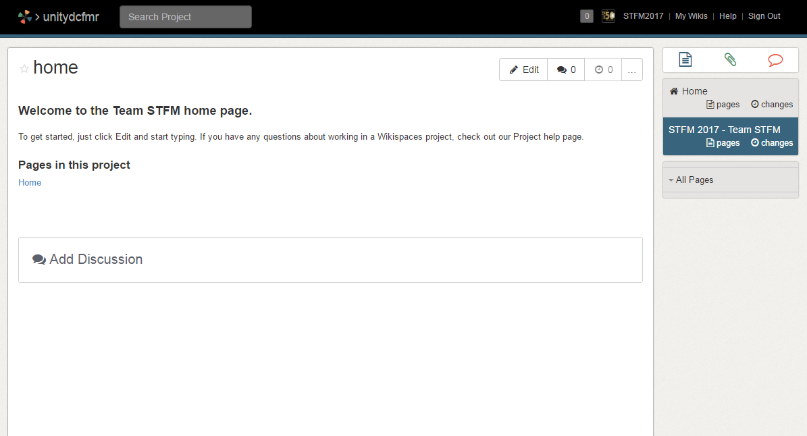
Add a Page

Slide 38
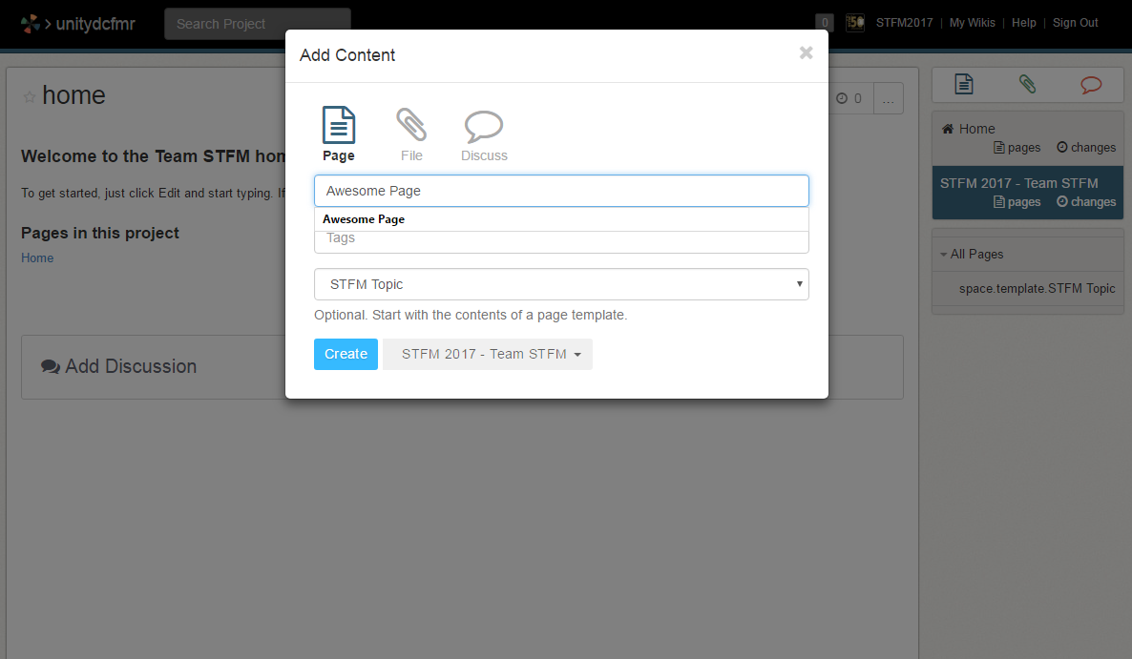
Create a Page

Slide 39
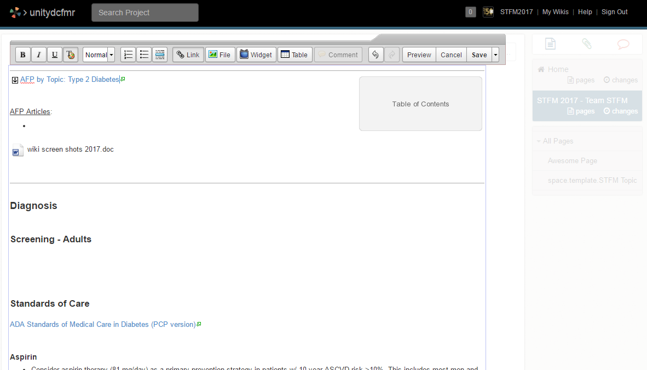
Start Editing!

Slide 40
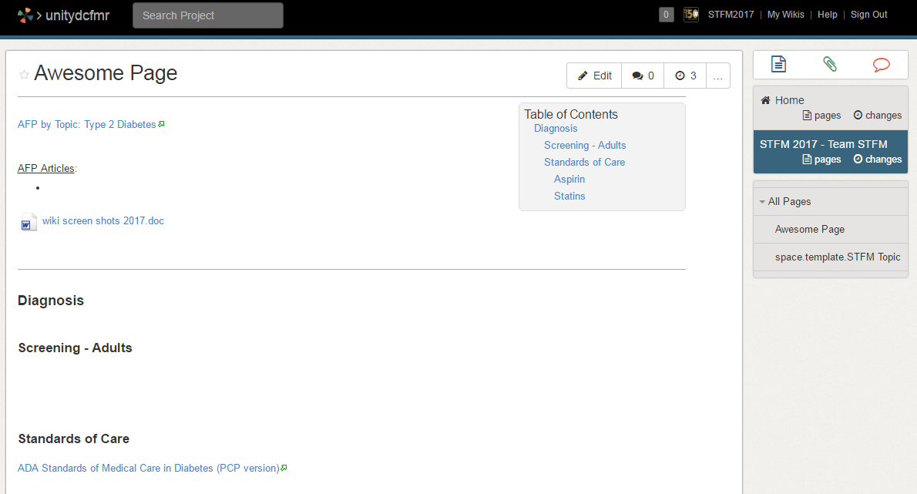
Save your page

Slide 41
Maintenance
Wiki champions – 3 residents (1/year)
weekly review of clinic sessions and post to wiki
Faculty oversight
review edits of reference pages
lead faculty for rotations assigned to maintain their topic
Notes:
Amoreena

Slide 42
Comments
Please keep educating us on hope to best use the wiki!!! is there a table of contents?
My concern is that the wiki page gets "too much" information. It is nice that everyone has access to the page with editing capability, but there is no process of "cleaning up.“
I know it's a good resource, it's just not the first thing I go to instinctively. But if I am shown where/what the information is on the wiki, I am more likely to use it as a source the next time something similar comes up.
I believe the wiki should continue to be integrated into our residency culture, especially amongst faculty
It would be helpful if residents used it. But I don't see residents routinely logging in and having the Wiki up and running.

Slide 43
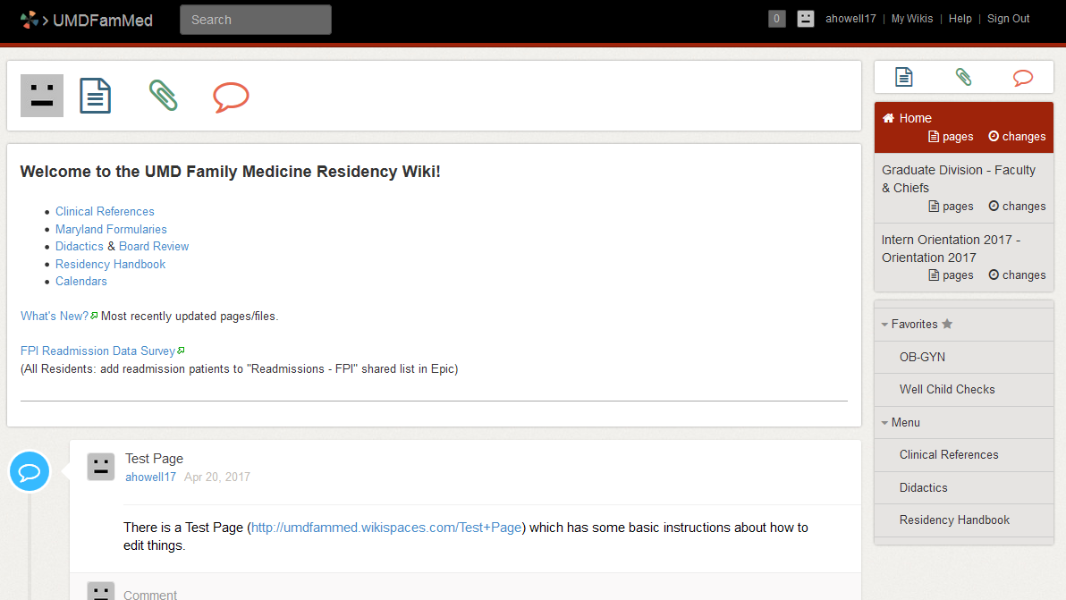
Moving On…
Notes:
Amoreena

Slide 44
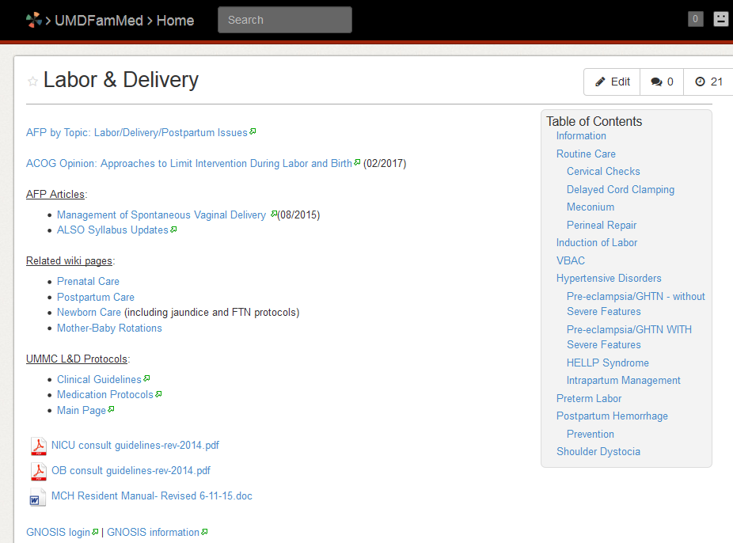
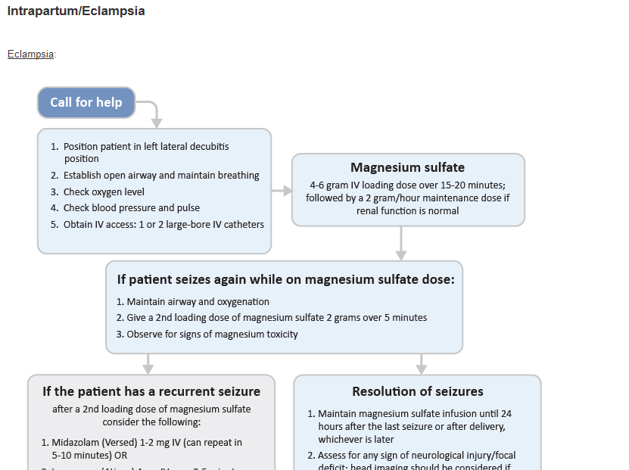

Slide 45
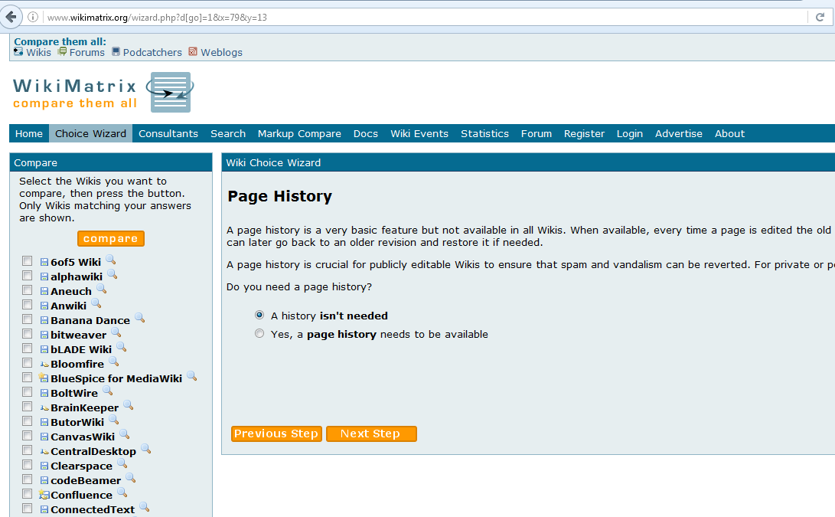
Where to Start?
http://www.wikimatrix.org/
Notes:
Howell

Slide 46
Where to Start?
STFM Member Forum - Online learning platform:
Canvas
pbworks
Google wiki
Sharepoint (Microsoft)

Slide 47
Features to Think About
Free vs. Paid subscription
Software vs. web-based/hosted remotely
WYSIWYG (What You See is What You Get)
Page version history/tracking
Calendar

Slide 48
Ask Us!
a.howell.md@gmail.com
ali.abdallah.do@gmail.com

Slide 49
Questions?
Thank You!

Slide 50
Please evaluate this presentation using the conference mobile app! Simply click on the "clipboard" icon on the presentation page.

