Slide 1
Health Systems and Behavioral Science
Experiential Learning and Competency Evaluation
Leanne Chrisman-Khawam, MD, MEd, Director Transformative Care Continuum, OUHCOM Terri Dalton, IMFT, Behavioral Science Director and Inaugural TCC Faculty, Cleveland Clinic FMR September 23, 2021 3:30-5:00 PM workshop
Notes:
TD

Slide 2
Planting Seeds for the future
“A society grows great when [people] plant trees in whose shade they shall never sit.” Greek proverb
This Photo by Unknown Author is licensed under CC BY-SA
Notes:
TD

Slide 3
Participants will
1. Describe the Tyler Model of Curriculum Development and Evaluation
2. Describe one NBME/NBOME sub-competency domain learning trajectory.
3. Utilize one Spiral learning trajectory in a small group experience to propose a learning arc. that includes:
4. defining which activities are Knowledge, Attitudes, Behaviors and Skills (KABS) in response to an area of curricular need in their program or teaching.
5. Suggest an active, culminating activity that builds on the KABS learned.
Notes:
TD

Slide 4
Tyler Model of Curriculum Development and Evaluation
Define objectives
Based on desired outcome/ trajectory
Task/Activity
Content
Learning Experience
Sequence Content
Build experiences on one another
Deliver content Mentor Learners Learner Self Reflection
Evaluate Learning (learners)
Evaluate Tasks/Activities/ Refine, Reframe, Rescope
Design (objectives and creation of activities)
Implementation
Review/Improvement
Notes:
TD/LCK

Slide 5
Transformative Care Continuum
Spiral approach to Knowledge, attitudes, skills, behaviors and experience .
Didactics/socratic discussions give BASE with new knowledge.
Activities: tasks, experiential learning at the core of learning and proof of competency
Notes:
LCK TALK about the way the program was built
PD: lack of skills in BS, EBM, Pt Safety: based on evidence
ACES, Trauma, SUD, Mental health, Racism, gender,

Slide 6
Notes:
Terri Leanne will https://youtu.be/Un4OdcPwHoI

Slide 7
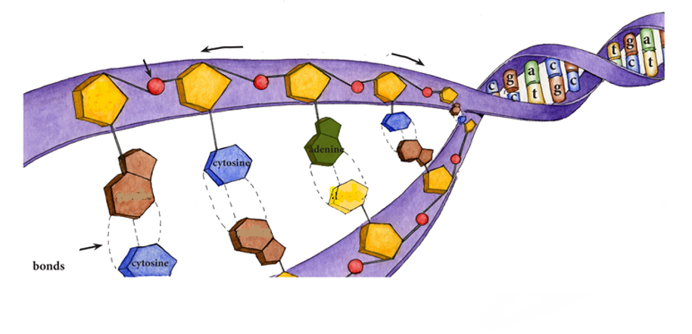
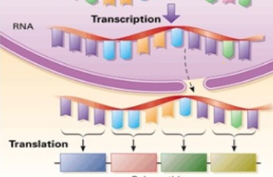
Experiences serve as learning opportunities, as well as formative and summative feedback opportunities, and evidence of competency
HSS Student reflections
Course work in HSS
Lecture & seminars
QI projects
clinic
Coursework in LIC Pt-centered Care
Clinic
POVE
STAMP HSS
POVE
QI Projects
STAMP
HSS
Bridges between HSS –LIC occur in clinical settings and experiential learning opportunities (QI and community projects) eventually translated into individual capstone community projects
STAMP HSS
STAMP= Strengthening Teams in Advanced Management of Populations
POVE = Peer, Patient-oriented Video Evaluations
LIC = Longitudinal Integrated (clinical) curriculum
HSS = Health Systems Science
clinic
LIC Student reflections

Slide 8
NBOME to ACGME RRC FM EPA
UME:
EPA 13 Identify System Failure and Contribute to the Culture of Safety and Improvement
GME: 15. Develop trusting relationships and sustained partnerships with patients, families and communities.
16. Use data to optimize the care of individuals, families and populations.
17. In the context of culture and health beliefs of patients and families, use the best science to set mutual health goals and provide services most likely to benefit health.
18. Advocate for patients, families and communities to optimize health care equity and minimize health outcome disparities.
19. Provide leadership within inter-professional health care teams.
20. Coordinate care and evaluate specialty consultation as the condition of the patient requires.
Notes:
Give participants AACOM/AAMC EPAS and AFMRD EPA’s as well as NBOME (similar to NBME) NBOME Medical Competencies digital file - http://www.nbome.org/docs/NBOME%20Fundamental%20Osteopathic%20Medical%20Competencies.pdf
competencies: Crosswalk subcompetencies here: MK3, ICS and Professionalism 5 Practice Based learning and improvement 3 System Based Practice 3, 5

Slide 9
Group Activity 1
Suggest Competencies that build to EPA 13 (only UME)
NBOME Medical Competencies digital file - http://www.nbome.org/docs/NBOME%20Fundamental%20Osteopathic%20Medical%20Competencies.pdf

Slide 10
Competencies you suggest for EPA 13

Slide 11
Competency Scores for EPA 13, MK 3.3, ICS5.4, P6.5, PBLI4.3, SBP 3, SBP5
MK3.3 effectively apply clinically relevant foundational biomedical science knowledge related to
ICS 5.4 The candidate must demonstrate effective written and electronic communication in the care of patients and in working as a member of the interprofessional collaborative team with other physicians and health care professionals. MEASURABLE OUTCOME
P6.5 The candidate must demonstrate a commitment to excellence and to continuous learning behaviors by achieving personal-development milestones
PBLI3 The candidate must be able to describe and apply evidence-based osteopathic medicine principles and practices
SBP7.3 The candidate must demonstrate an understanding of the value, quality, and methods of allocating resources in the health care delivery system.
SBP7.5 The candidate must demonstrate knowledge of, and ability to, implement safe, effective, efficient, timely, patient-centered, and equitable dimensions of quality care, recognizing the need to improve patient safety while practicing osteopathic medicine.

Slide 12
EPA 13 TASKS to EVALUATE (and learn) in TCC
Didactic Learning on Patient Safety, Health Systems Errors and Systems (KNOW)
IHI Module on medical ERRORS in Patient Care (KNOW, KNOWs HOW)
Review the IOM Article on Crossing the Quality Chasm (KNOW—knowledge)
Try QI project with mentor aid Spring of OMS1 (permission to fail) (Shows, Shows How)
Summer session: All Institute of Healthcare Improvement modules and Lean Six Sigma Yellow Belt (Knows How) Planning for Fall QI Projects, Aims Statement +/- process/outcome measures (Knows How)
Summer QI project ( IDD, Pneumococcal Vaccination rate Project)(Shows, Shows How)
Individual QI projects Fall of OMS 2 (Shows How, Does)
Quality and Safety in populations Spring of OMS 2, leading to the Capstone: Community Population Health Projects (Knows How, Shows, Shows How to Does)
Projects Continue through the GME: Residency as a part of Community Health/Population Health (Shows How, DOES)
Notes:
Along those activities define which are K A B S and what area of curricular need in program/teaching, Small distinction between Competency evaluation

Slide 13
Outcomes of Success EPA 13
Med Reconciliation QI
Impacts Quality and Safety
Has become CULTURE!! @ their future residency site (98-99%)
Fewer Calls, Lower Drug interactions and wrong pharmacy or drug RX

Slide 14
Capstone Success
HIV Screening in Individuals experiencing Homelessness $ 6,000 grant from AIDS collaborative to screen and educate about PEP/PREP

Slide 15
Capstone Success
Mental Health and Care coordination in Complex Medical Patients
Student Worked with Metanoia Homeless Shelter, screening Mental Health PHQ9, GAD7 and other with attempts to refer to mental health services
This resulted in relationship with Frontline’s new Housing for Complex Medical patients with history of Mental illness and/or Trauma
This Fall, Residents will participate in Care Coordination for these complex patients as a part of their Community Health Month supervised by Psychiatry and Family Medicine
Notes:
These represent Performance Evaluation—Formal competency evaluation is not performance evaluation—and some may consider this real world performance a more important element as it represents that pinnacle of professional identity (DOES)

Slide 16
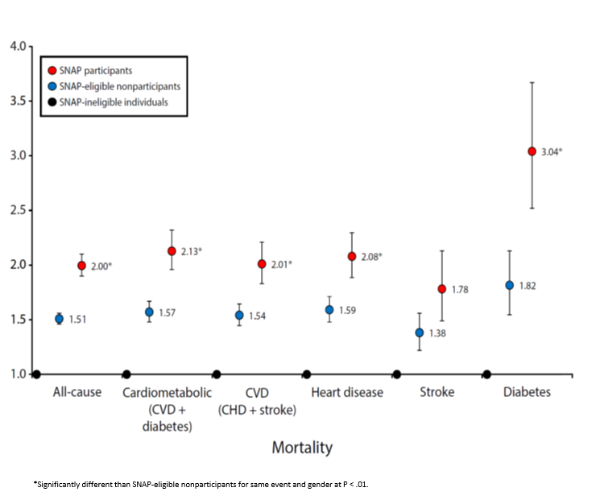
CAPSTONE Success
Food as Medicine $88 K grant initiated by OMS3 and Being implemented as intern –in food prescriptions a collaborative of Food Bank, Nutrition Department, Produce Growers and Akron General CCF Center for Family Medicine

Slide 17
Small Groups # 2– 20 min to develop/describe an activity to address an EPA
AFMRD EPA 16 Use data to optimize care of patients, families and populations
PC 3 Disease Prevention and Health Promotion
MK2 Applies critical thinking
SBP1 Cost Conscious Care
SBP2 Emphasizes Patient Safety
SBP3 Advocates for Individual and Community Health
PBL2 Self-Directed Learning
PBL2 Improves Systems
C4 Uses Technology
EPA 7 Form a clinical question and retrieve evidence to advance pt. care
PC 4 Elicit and consider the patient’s perspective in developing and planning the diagnostic and care plan with patients and their families
PBLI 1 Fundamental Epidemiologic Concepts,
PBLI 2 Clinical Decision-Making Tools,
PBLI 3 Evidence-Based Medicine Principles and Practices
PBLI 4 Clinical Significance of Research Evidence and Statistical Inference,
PBLI 5 Translating Evidence into Practice and Continuous Learning,
PBLI 6 Continuous Evaluation, Feedback, and Reflection for the Improvement of Osteopathic Clinical Practice
Notes:
10 min Debrief
(we include UME/GME EPA) Consider Behavioral Health--- one group do UME? One group do GME?

Slide 18
Activity Descriptions to address EPA 7
Group 1
Group 2

Slide 19
Large group activity.
Task Driven Medical Education
Knowledge
Attitudes
& Behavior
Self-Reflection
Skill
Mentorship
Development
Learning
Style
Working Style
Reflect
Experi-ment
Explore
Know-ledge
Development
Based on Small group #2 debrief
Create one large culminating activity that builds on KABS and serves as a learning/Performance evaluation of skills
Can we suggest Summative or Competency based evaluation of skills?
Learning
Style
TASK
Motivation
Knowledge
Skill
Attitudes
& Behavior
Attitudes
& Behavior
Skill
Knowledge
Learning Style
Motivation
Working Style
P
D
S
A
Developmental Level
Developmental Level
Motivation
Knowledge
Attitudes
& Behavior
Working Style
Skill
Burnout
Dissonance
Discrepancy
Notes:
Our culminating activity for EPA 7 is an open book, open internet examination testing their ability to utilize all resources available and relative use of Clinical Guidelines and Metanalyses vs individuals RCT, systemic Review, and case series/reports in that order. After Debrief and also paint the picture that where we’ve been is where they will go. (seed planted)

Slide 20
Evaluation Tasks—Tests
Open Book, Open Internet test on use of EBM (emphasis on the use of well-developed clinical guidelines, meta-analysis and well done RCT)
Suggestions from large group and the program to both evaluate performance, test competency in more objective manner

Slide 21
GLOSSARY
UME= Undergraduate Medical Education “Medical school”
GME=Graduate Medical Education “Residency”
AACOM: American Association of Colleges of Osteopathic Medicine (Doctor of Osteopathic Medicine, DO)
AAMC: Association of American Medical Colleges (MD, Allopathic Physicians)
NBME: National Board of Medical Examiners
NBOME: National Board of Osteopathic Medical Examiners
USMLE: United States Medical Licensing Examination
COMLEX: Comprehensive Osteopathic Medical Licensure Examination
EPA: Entrustable Professional Activities
Competencies: 7 domains that build to and crosswalk to the EPAs (Same in NBME/NBOME has one extra) Osteopathic Principals
Subcompetencies: subskills under the 7 domains, 6 domains in NBOME
KABS: Knowledge, Attitudes, Behaviors, and Skills
QI: Quality Improvement
LIC: Longitudinal Integrated Clinical Curriculum
HSS: Health Systems Science
STAMP: Strengthening Teams in Advanced Management of Populations
POVE = Peer, Patient-oriented Video Evaluations
Osteopathic Principals (true for NBOME only), PC= Patient Care, P=Professionalism, PBLI= Practice Based Learning and Improvement, SBP=Systems Based Practice, ICS=Interpersonal and
Communication Skills, MK=Medical Knowledge

Slide 22
References
Baker, Alastair. (2001). Crossing the Quality Chasm: A New Health System for The 21st Century. BMJ. 323. 10.1136/bmj.323.7322.1192.
AAMC Core Entrustable Professional Activities for Entering Residency Toolkits for the 13 Core EPA’s, Abridged, https://www.aamc.org/media/20211/download accessed 09-16-2021
NBOME: National Board of Osteopathic Medical Examiners competency and EPA: NBOME Medical Competencies digital file - http://www.nbome.org/docs/NBOME%20Fundamental%20Osteopathic%20Medical%20Competencies.pdf accessed 09-13-2021.
Mauksch L, Farber S, Greer HT, Acad Med. 2013;88:843–851. First published online April 29, 2013 doi: 10.1097/ACM.0b013e31828fd5ed
Wald, Hedy S. PhD Professional Identity (Trans)Formation in Medical Education, Academic Medicine: June 2015 - Volume 90 - Issue 6 - p 701-706 doi: 10.1097/ACM.0000000000000731 IHI
Hulsman RL1, van der Vloodt J2.Self-evaluation and peer-feedback of medical students' communication skills using a web-based video annotation system. Exploring content and specificity.Patient Educ Couns. 2015 Mar;98(3):356-63. doi: 10.1016/j.pec.2014.11.007. Epub 2014 Nov 20.
Hulsman RL, Peters JF, Fabriek M. Peer-assessment of medical communication skills: the impact of students' personality, academic and social reputation on behavioural assessment.Patient Educ Couns. 2013 Sep; 92(3):346-54. Epub 2013 Aug 2
Engerer C, Berberat PO, Dinkel A, Rudolph B, Sattel H, Wuensch A.Integrating 360° behavior-orientated feedback in communication skills training for medical undergraduates: concept, acceptance and students' self-ratings of communication competence.BMC Med Educ. 2016 Oct 18;16(1):271.
Kleib, M., Jackman, D., & Wisnesky, U. D. (2021). Interprofessional simulation to promote teamwork and communication between nursing and respiratory therapy students: A mixed-method research study. Nurse Education Today, 104816.
Brown, K., & Shine, B. (2021). Internships and On-Line Capstone Courses: Transforming High Impact Teaching Practices and Fostering Equity and Inclusion during the COVID-19 Crisis and Beyond.
Collins-Nelsen, R., Koziarz, F., Levinson, B., Allard, E., Verkoeyen, S., & Raha, S. (2021). Social context and transferable skill development in experiential learning. Innovations in Education and Teaching International, 1-10.
Schirmer JM, Mauksch L, Assessing Communication Competence: A Review of Current Tools, Fam Med 2005;37(3):184-92.)

Slide 23
Addendum 1 Documents attached and Contents
Power point and working document
UME Competency Domains (AACOM)
AACOM EPA’s
Family Medicine/ACGME/AFMRD EPA and Competency Domains

