Slide 1
Title of presentation: Implementation and Expansion of an Early Male Infant Circumcision Program for HIV Prevention – Toolkit and Lessons Learned at Shyira District Hospital, Rwanda
David Baltierra, MD
Tembele Yangandawele, MD
WVU Rural Family Medicine Residency
September 13-15, 2018
Jacksonville, FL

Slide 2
Conflicts of Interest and Disclaimer None to report

Slide 3
Abstract
Male circumcision has been promoted by WHO and individual countries as an effective strategy for HIV prevention in the continent of Africa. At the request of health care providers and the medical director of Shyira District Hospital, Rwanda and using training and evaluation materials from JHPIEGO, USAID, WHO, and UNICEF a team from WVU Rural Family Medicine Residency developed and implemented a program to train physicians, midwives, nurses, and surgical technicians in early infant medical circumcision (EIMC). Using traditional didactic methods and low cost simulation the program provided equipment and expertise to train providers in the performance of early male circumcision. Further, the program trained certified trainers that would then train additional providers at local community health centers in EIMC and established a system of outreach and training to provide remote communities with EIMC services.

Slide 4
Objectives
Participants will identify the importance and benefits of early infant male circumcision for the prevention of HIV transmission in a global health context
Participants will learn how to develop and replicate a program to implement and expand early male infant circumcision for HIV prevention in a resource limited environment
Participants will be able to identify barriers and techniques to teaching and implementing de novo a program for early male infant circumcision for HIV prevention in a resource limited environment

Slide 5
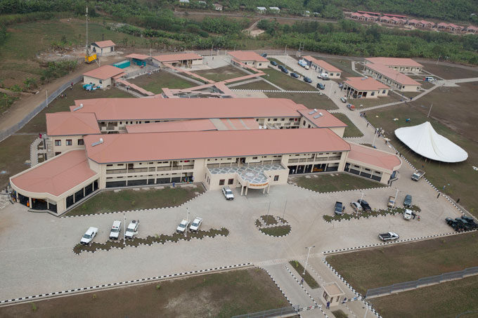

Slide 6
Background Information
Surgical removal of all parts of the foreskin tissue (prepuce)
Widely practiced around the world, in 2007 the WHO reported that about 30% of male world wider were circumcision
Done for multiple reasons; religious, cultural and medical
Can be performed at any age or stage of life
Consideration must be taken to assess different risks and benefits based on the age when the procedure is performed

Slide 7
Medical Benefit of Circumcision
Decrease risk of STI (HSV, HPV)
-Prevention of phimosis
Prevention of paraphimosis
Prevention of balanitis

Slide 8
Medical Benefit of Circumcision
Prevention of prostatitis
Decrease risk for cancer of the penis (penile cancer common in uncircumcised societies)
Decrease risk of cervical cancer in female partners
Decrease vaginal infection in female partners

Slide 9
Medical Benefit of Circumcision
Prevent female to male HIV transmission by 55-65% in HIV prevalent regions
Trend emerged in the 1980’s
3 large controlled trial
Langerhans cell involvement
Not an absolute method of prevention therefore must be used in association with other safe sex practices

Slide 10
Early Infant Male Information
Early Infant Male Circumcision
The practice of circumcision in infant less than 60 days of life
Timing
Performed after at least 12-24 hours of life
Allows the delivery of initial neonatal care
Allows time for observation of patient voiding prior to procedure
More convenient if done prior to mother and infant discharge
Can also be performed in an outpatient setting

Slide 11
Who is eligible
All full term male infants weighing >2500 g, without contra-indications and parental approval
EIMC should be postponed when:
Critically ill infant
Weight less than 2500 g
Preterm (<37 week)
Penile length less than 1 cm
Anatomical abnormalities

Slide 12
Advantages of EIMC
Simpler procedure when compared older male
Thinner foreskin
Less vascular
Easy to break adhesion
Quicker healing time
5-7 days compared vs up to 14 weeks in adulthood
Most of the complication are immediately after the procedure.

Slide 13
Advantages of EIMC
Fewer complications
patient not sexually active
Less erection problem during procedure
less traumatic for the patient
Decrease incidence of UTI in the first 3 month of life
10 times more common in uncircumcised male infant

Slide 14
Advantages of EIMC
Programs promoting early infant male circumcision are likely to lower morbidity rates and lower costs than program targeting adolescent boy and adult (WHO)
Disadvantages
Patient too young to give consent
Some of the health benefits are not to be seen until patient reaches adulthood.

Slide 15
Background about Rwanda
In 2009 Rwanda launched a mass campaign promoting male circumcision in an attempt to help decreased the incidence off HIV in the nation
Presented significant challenges and limitation due to staffing and time constrains
personnel
Cost
Culture
Cost analysis study conducted found that early infant study was cheaper than adolescent or adult circumcision
15 usd vs 59 usd

Slide 16
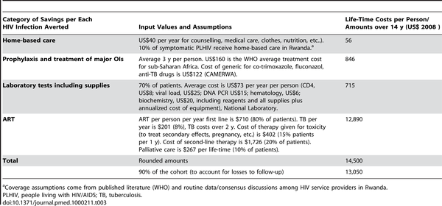
Table 3. Life-time savings per each HIV infection averted.
Binagwaho A, Pegurri E, Muita J, Bertozzi S (2010) Male Circumcision at Different Ages in Rwanda: A Cost-Effectiveness Study. PLOS Medicine 7(1): e1000211. https://doi.org/10.1371/journal.pmed.1000211
https://journals.plos.org/plosmedicine/article?id=10.1371/journal.pmed.1000211

Slide 17
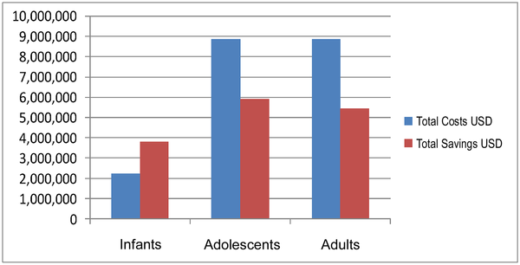
Figure 1. Total costs and savings for neonatal, adolescent, and adult MC (cohort 150,000 people), Rwanda, 2008.
Binagwaho A, Pegurri E, Muita J, Bertozzi S (2010) Male Circumcision at Different Ages in Rwanda: A Cost-Effectiveness Study. PLOS Medicine 7(1): e1000211. https://doi.org/10.1371/journal.pmed.1000211
https://journals.plos.org/plosmedicine/article?id=10.1371/journal.pmed.1000211

Slide 18
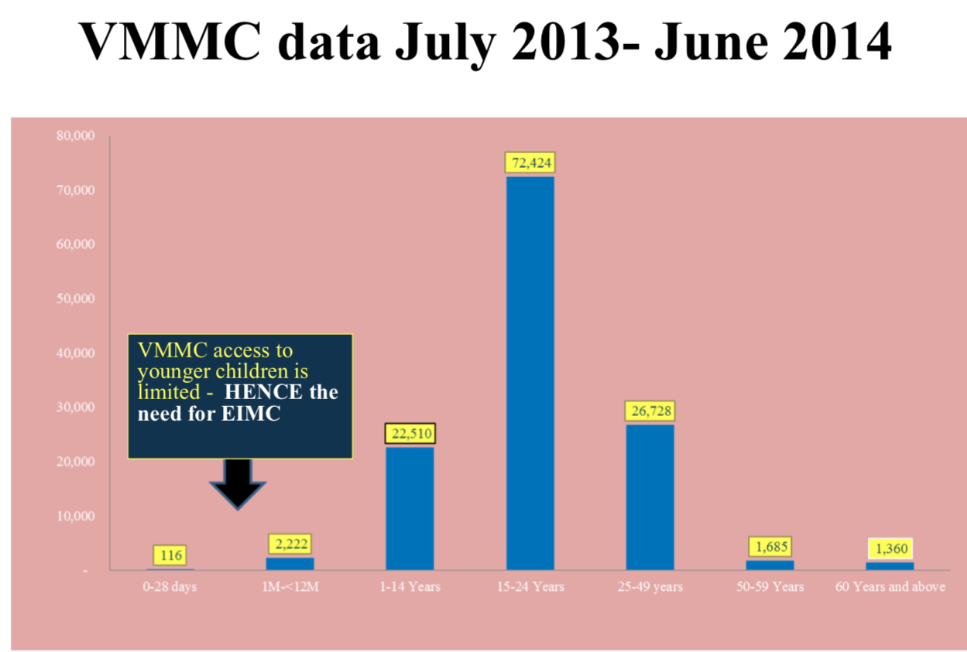
Building the capacity to Deliver Early Infant Male Circumcision services in Rwanda: Lessons learnt Presenter: Placidie Mugwaneza

Slide 19
EIMC in Rwanda
Report for EIMC using Mogen clamp training workshop at Ruhengeri Hospital
Date of training: 1st to 5th June 2015 Venue of the workshop: Ruhengeri Hospital
Participants (trainees): 8 participants from Ruhengeri, Gisenyi, Muhima and Rwamagana District Hospitals.
During the training work shop 48 babies were circumcised using Mogen clamp and the age of the babies ranged between 12 hours and 60 days.
Challenges -The main challenge we encountered was a small number of babies which was lower than the expected where 80 to 100 babies were expected. We had also some logistic issues which were addressed along the exercise.
Conclusion - The training was successful, the trainees gained theoretical and practical skills to perform EIMC using mogen clamp device and there was no incident throughout the training.

Slide 20
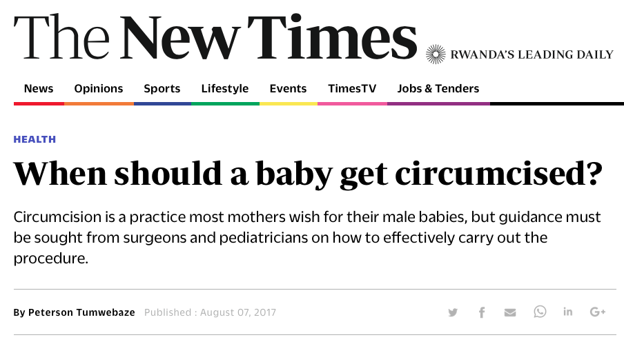

Slide 21
Training Method
Used Training Package on Early Infant Male Circumcision under Local Anesthesia from Clearinghouse on Male Circumcision for HIV prevention
WHO, JHPIEGO, UNICEF, USAID, PEPFAR, MCHIP resources
Modified, condensed, and reformatted material
Lecture, video demonstration, group learning, ongoing group and individual assessment, simulation practice and testing
Provided Equipment – enough for 100 circumcisions; re-suable instruments, circumcision board, bandages, etc.
Assessment of infrastructure – re-supply, injectables, dressings, sterilization, facilities, technicians, etc.

Slide 22
Who was trained
Health Professionals – Physicians, midwives, nurses, surgical technicians (10 trained)
Circumcision Master Trainers – Physician and Surgical Tech (Adult circumcision trainers) (2 trained)
Hospital Director
Pharmacy technician
Surgical staff
Nursing staff

Slide 23
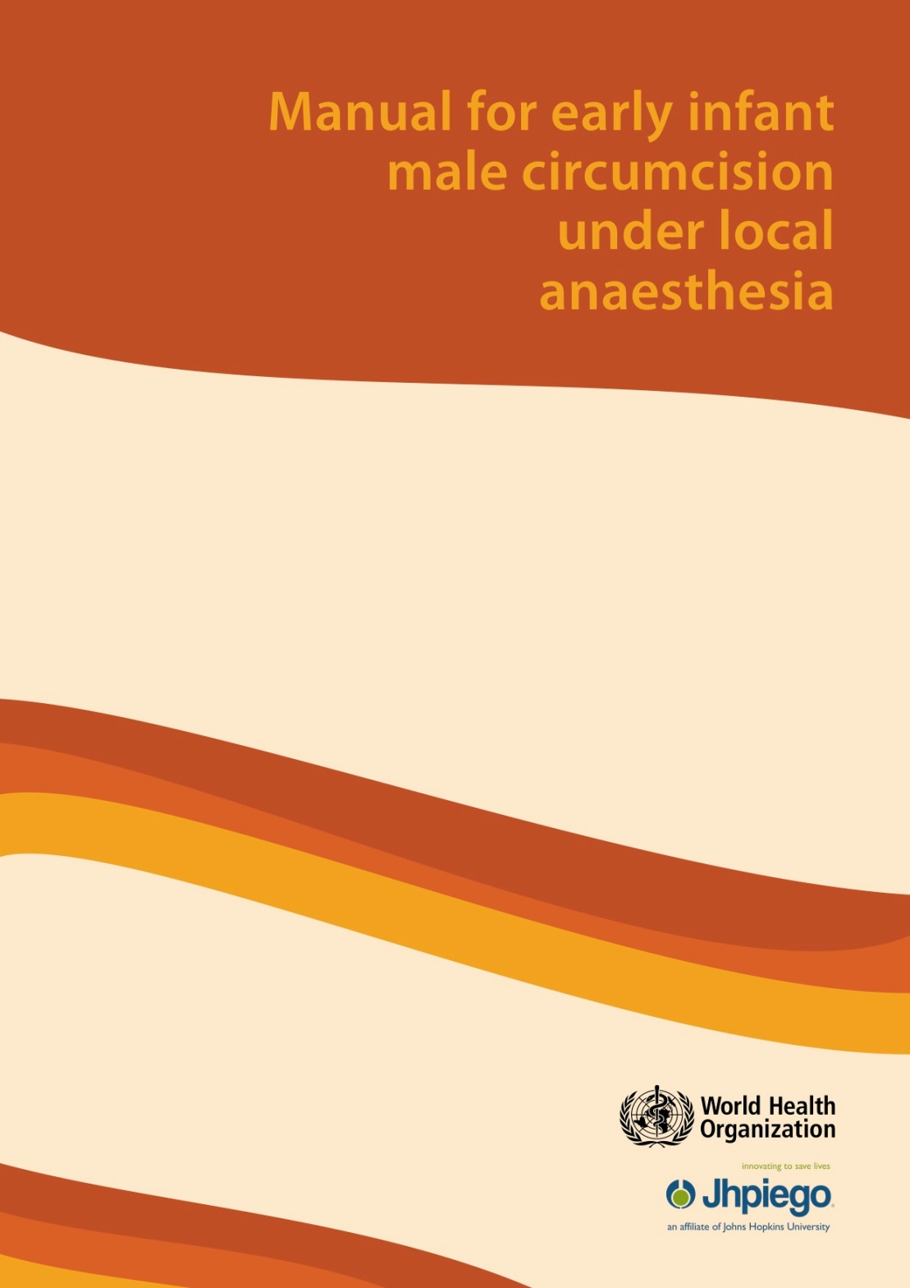
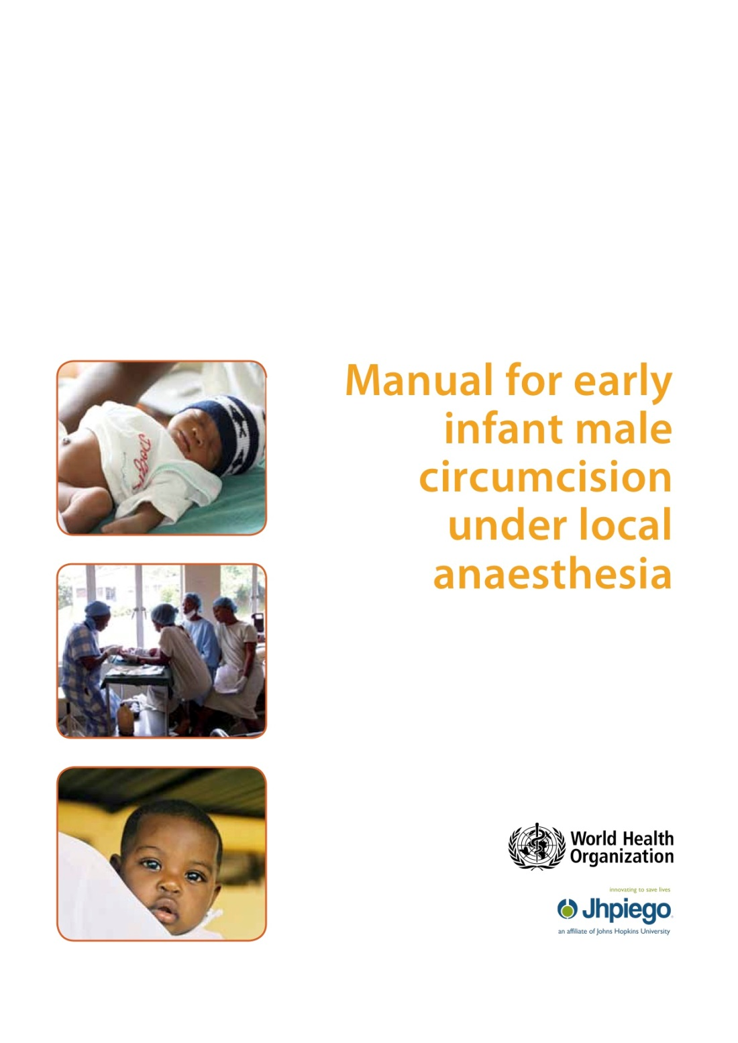
Early Infant Male Circumcision
https://www.malecircumcision.org/content/training-package-early-infant-male-circumcision-under-local-anaesthe

Slide 24
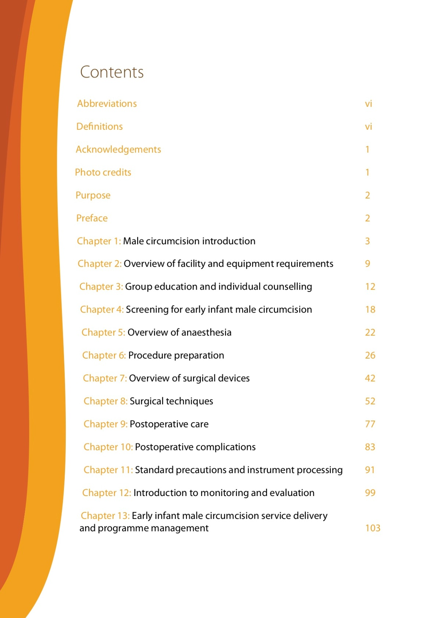
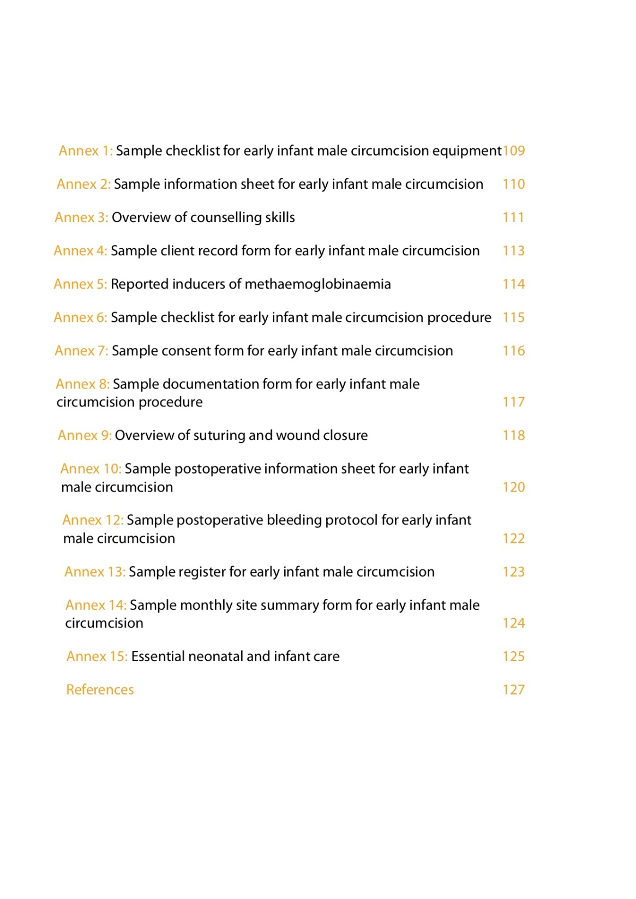

Slide 25
Chapter 1: Male circumcision introduction
Chapter 2: Overview of facility and equipment requirements
Chapter 3: Group education and individual counselling
Chapter 4: Screening for early infant male circumcision
Chapter 5: Overview of anaesthesia
Chapter 6: Procedure preparation
Chapter 7: Overview of surgical devices
Chapter 8: Surgical techniques
Chapter 9: Postoperative care
Chapter 10: Postoperative complications
Chapter 11: Standard precautions and instrument processing
Chapter 12: Introduction to monitoring and evaluation
Chapter 13: Early infant male circumcision service delivery and programme management

Slide 26
Annex 1: Sample checklist for early infant male circumcision equipment
Annex 2: Sample information sheet for early infant male circumcision
Annex 3: Overview of counselling skills
Annex 4: Sample client record form for early infant male circumcision
Annex 5: Reported inducers of methaemoglobinaemia
Annex 6: Sample checklist for early infant male circumcision procedure
Annex 7: Sample consent form for early infant male circumcision
Annex 8: Sample documentation form for early infant male circumcision procedure
Annex 9: Overview of suturing and wound closure
Annex 10: Sample postoperative information sheet for early infant
male circumcision
Annex 12: Sample postoperative bleeding protocol for early infant
male circumcision
Annex 13: Sample register for early infant male circumcision
Annex 14: Sample monthly site summary form for early infant male circumcision
Annex 15: Essential neonatal and infant care

Slide 27
Early Infant Male Circumcision
David A Baltierra, MD
Amanda J Baltierra, DNP, FNP, PMHNP
Tembele Yangandawele, MD
Shyira Distric Hospital
February 2018

Slide 29
Equipment
Equipment
Secure work surface (table or infant warmer) – height should be such that the surgeon does not have to stoop or bend (We built our own but used assistant to hold baby)
Assistant or mechanism to restrain/position infant
Hand-washing/cleaning facilities
Light source
Supplies
Infant padding, blankets and towels
Clean nappies/diapers and wipes
Sterile gloves
Sterile drape with small opening in the centre (fenestrated)
Betadyne or other skin-sterilizing preparation
Sterile marking pen or gentian violet
Sterile 2 x 2 or 4 x 4 gauze pads
White petrolatum (Vaseline) or white petrolatum gauze

Slide 30
Equipment (cont)
Instruments
Instrument tray wrapped with sterile drape
One 7.5-cm to 12.5-cm (3-inch to 5-inch) flexible probe
Three small mosquito haemostats, two curved and one straight
Small straight scissors
Desired male circumcision device (Mogen, Gomco, Plastibell) and all appropriate parts
Scalpel – no. 10 blade or similar
Anaesthesia administration
1% lidocaine (WITHOUT EPINEPHRINE)
1-ml sterile syringe with small 27-gauge or similar needle
Alcohol wipes

Slide 31
Equipment (cont)
Post-circumcision bleeding
Topical epinephrine
Gelfoam or equivalent
Adson forceps
5-0 or 6-0 absorbable suture (chromic or catgut) on a needle (6-0 chromic on PC-1 needle or equivalent)
Needle-holder
Petrolatum-coated gauze
Postoperative processing
Check sterilizing and reprocessing equipment
Check that means are available to handle and dispose of contaminated sharps
Check that means are available to handle and dispose of contaminated supplies

Slide 32
Mogen Clamp
Infant/newborn size
Quality Manufacturing Varies
Internet and models purchased with significant variability in size of opening
This is the clamp we used. Least expensive of German clamps available in US to us.
V. Mueller Mfr# GL7021
V. Mueller Circumcision Clamp Mogen
CLAMP, CIRCUMCISION MOGEN 2 7/8X1 1/2"

Slide 33
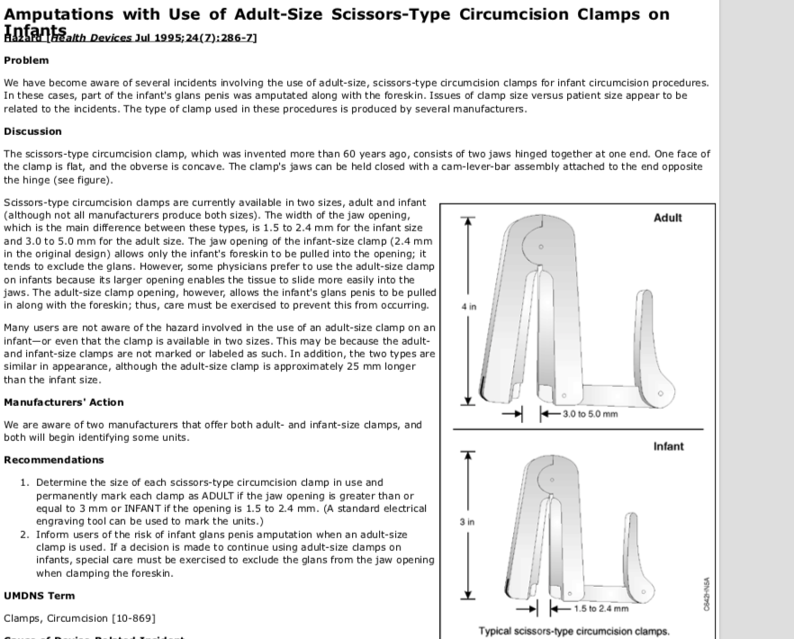

Slide 34
Circumcision Kit
CLAMP, CIRCUMCISION MOGEN 2 7/8X1 1/2" CARVMU | $187.28 | 1 | $187.28
FORCEP, HALSTED MOSQUITO STRT5" D/S | $4.74 | 3 | $14.22
PROBE, W/EYE 5"MILTEX | $6.06 | 1 | $6.06
SCISSOR, METZENBAUM STRT 5 3/4" | $8.16 | 1 | $8.16
Total |  |  | $215.72

Slide 35
Suture Kit
FORCEP, ADSON DEL 1X2TH 4 3/4"CARVMU | $3.30 | 2 | $6.60
NEEDLE HOLDER, MAYO HEGAR OG5" | $8.01 | 1 | $8.01
SCISSOR, IRIS RIBBON-STYLE HNDL STRT 4" D/S | $6.16 | 1 | $6.16
Total |  |  | $20.77

Slide 36
Circumcision Materials 100 circumcisions
MARKER, PRE-SURG FINE TIP MINIXLG (200/CS) | $87.40 | 1 | $87.40
PAD, ALCOHOL PREP MED STR LTWT(200/BX 20BX/CS) MGM16 | $1.31 | 3 | $3.93
PETROLATUM JELLY, WHT 5GM (144/BX 6BX/CS) | $6.85 | 1 | $6.85
SPONGE, GELATIN SURGIFOAM ORAL(24/BX) | $64.52 | 1 | $64.52
SPONGE, GZE 2"X2" 12PLY STR LF(100/BX 24BX MGM16 | $2.97 | 10 | $29.70
SUTURE, GUT PL 5-0 C17 (12/BX)SURSPC | $29.51 | 1 | $29.51
SUTURE, PLAIN 5-0 27" LG C-6 NDL (12/BX) | $24.35 | 1 | $24.35
SYRINGE/NDL, TB 1CC 27GX1/2" (100/BX 10BX/) | $7.66 | 2 | $15.32
XYLOCAINE, MDV 1% 20ML (25/CT)9APPPH | $37.62 | 1 | $37.62
SWABSTICK, PVP STR (3/PK 25PK/BX 10BX/CS) | $4.39 | 4 | $17.56
PETROLEUM JELLY, WHITE 1OZ TU(6/BX 12BX/CS) | $2.68 | 17 | $45.56
DRAPE, FENES STR 18"X26" (50/BX) | $12.75 | 2 | $25.50
SCALPEL, DISP NON-SFTY STR LF#10 (10/BX 10BX/CS) | $4.72 | 10 | $47.20
Total |  |  | $435.02

Slide 37
Suture Kit
Circumcision Kit | $215.72 | 3 | $647
Suture Kit | $20.77 | 3 | $62.31
Material for 100 circumcisions | $6.16 | 1 | $435.02
Total |  |  | $1,144

Slide 38
Evaluation
Group and Individual
Pretest, post test, post post test…..
During each chapter
Final evaluation
Evaluation of facilities
Evaluation of processes
Evaluation of registration and record keeping
Evaluation of consent and counseling procedures and skills

Slide 40
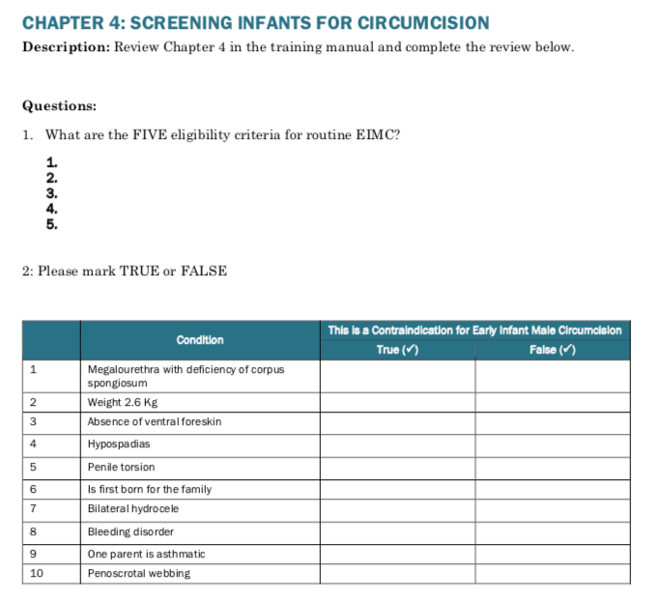

Slide 41
Additional Material
Early Infant Male Circumcision Under Local Anesthesia: Facilitator’s Guide https://www.malecircumcision.org/resource/early-infant-male-circumcision-under-local-anaesthesia-facilitators-guide
Early Infant Male Circumcision: Learner Workbook https://www.malecircumcision.org/resource/early-infant-male-circumcision-learners-workbook
Neonatal Circumcision Using Mogen Clamp on a Patient https://vimeo.com/74547360

Slide 42
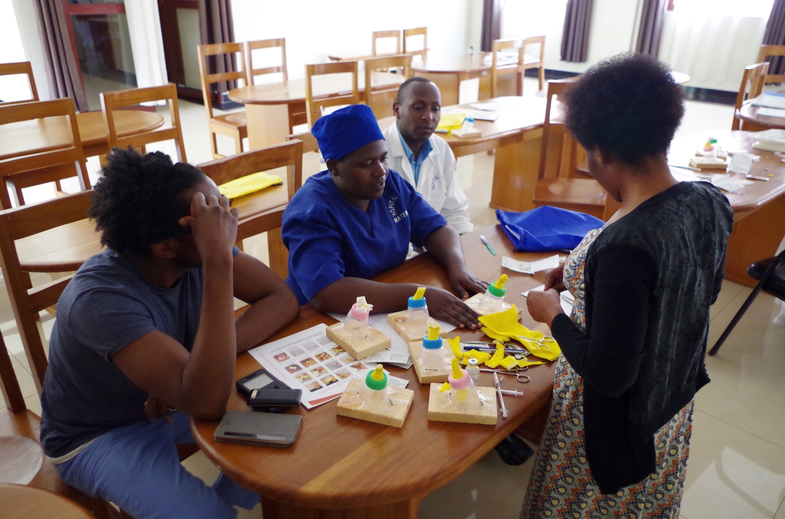
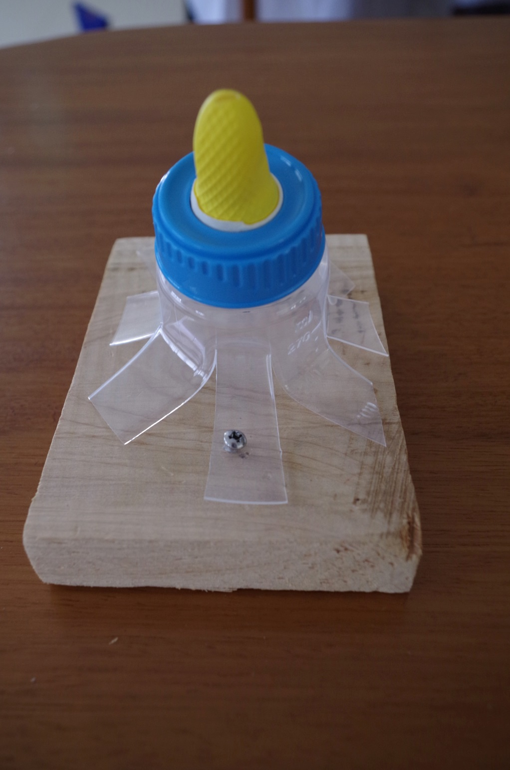

Slide 43
Barriers and ways to overcome
Provider mindset:
Importance of thinking outside the box
Understand the difference in the way medicine is practice in the us vs targeted region
How program can be implemented and sustained in the targeted region

Slide 44
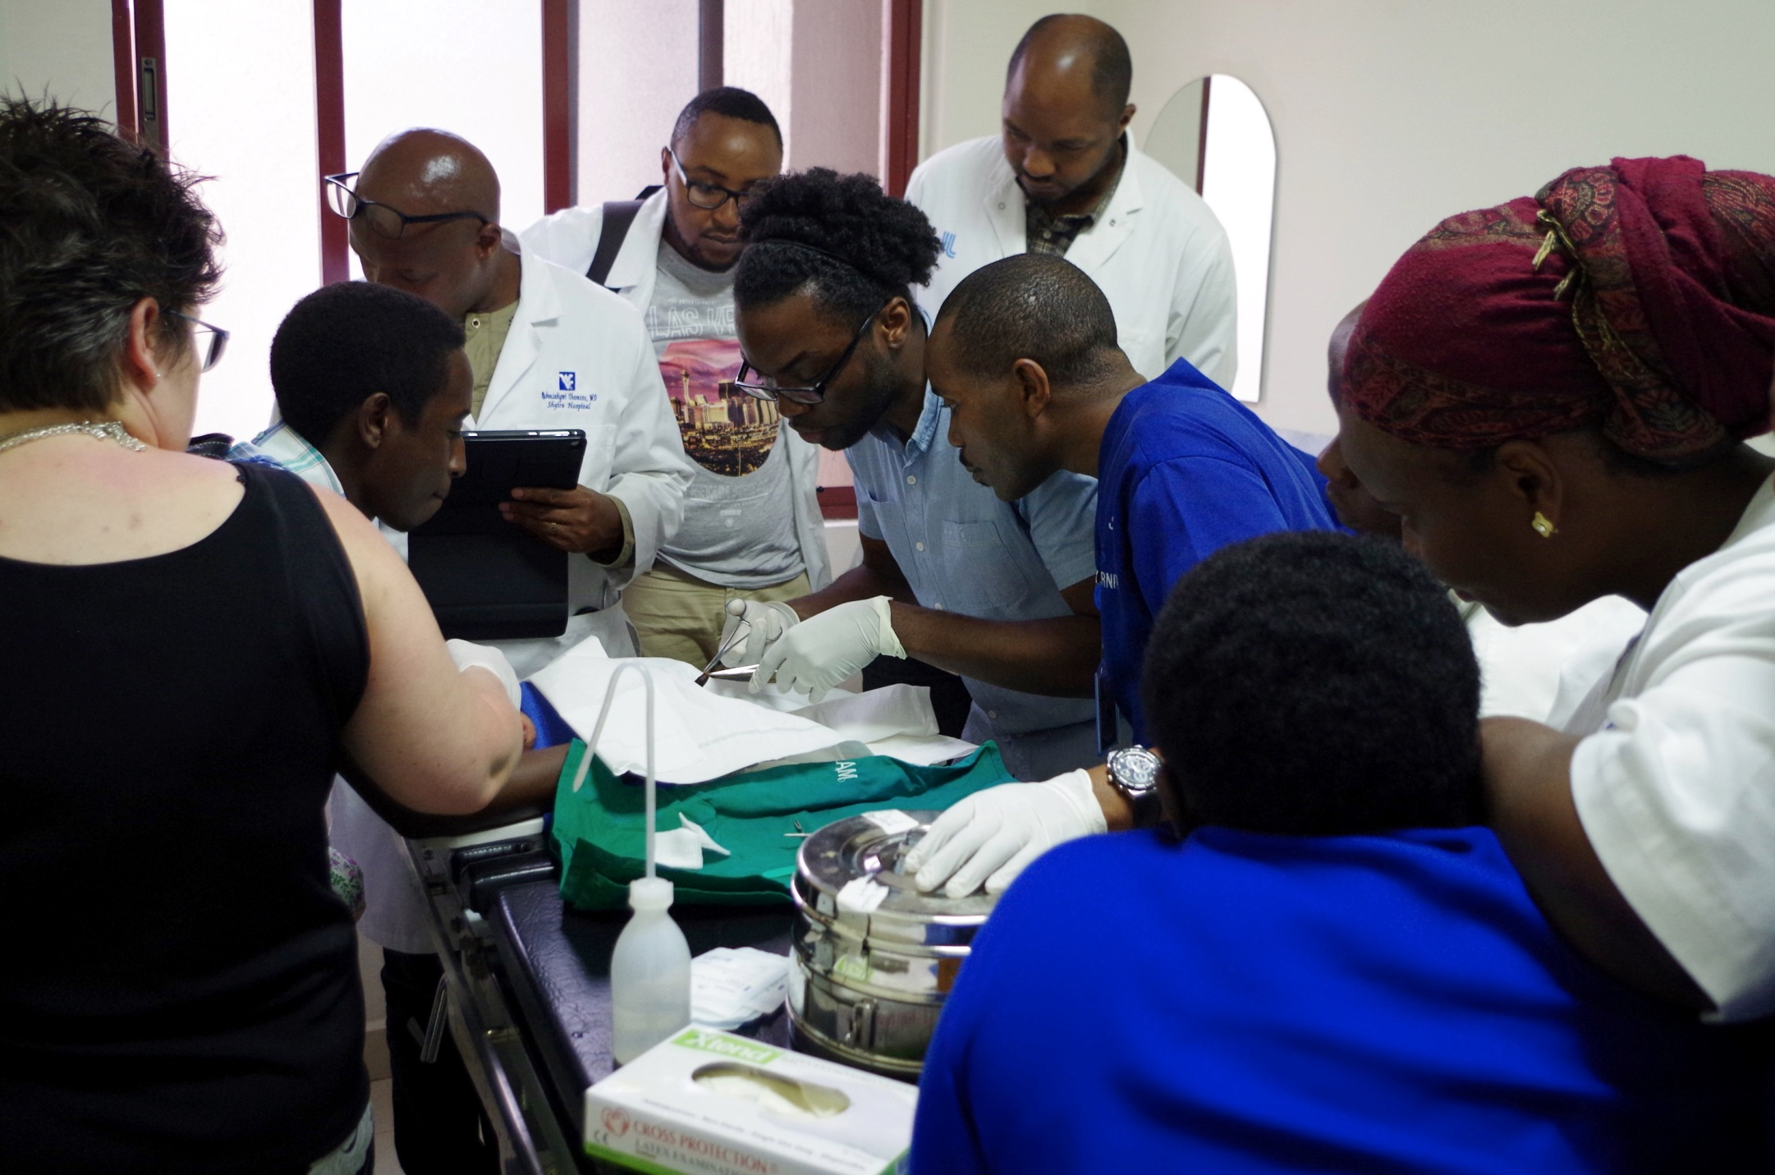

Slide 45
Barriers and ways to overcome
Cultural barrier
Requires back ground understanding of local community practices and belief
Consent (hierarchy complexes)
Must finds ways to address both medical and cultural concern
Must be adapted to each individual community
Requires integration of medical staff, local provider and community members
Requires trust building among medical team and within the target community

Slide 46
Barriers and ways to overcome
Resource Barriers
Cost of procedure must be assessed in advance
Must consider estimated cost for procedure relative to average income of community at hand
Can require a business mindset at times
Limitation of staff
Adjusting time frame of training material
May require additional funds to train staff during time off
Keep in mind both facility and patient limitations
Require a lot of flexibility and creativity

Slide 47
Barriers and ways to overcome
Barriers to Sustainability
Requires constant reminders and motivation to keep
Intermittent review of material after teaching
Introduction of CME system
Implementation in places where intervention are needed
Requires some marketing
Still trying to figure it out

Slide 48
Teaching technique
Teaching can be hard
The good thing is that materials already available
We modified ours to account for the limitation of resources and simplify the process
Team base approach
Must integrate both physician and non-physician personnel

Slide 49
Teaching technique
Incorporate didactic, simulation and real life practice teaching techniques
Use of repetition and mock scenario for adequate assimilation of materials
Taking advantage of local health care system structure and resources
Enthusiasm and marketing

Slide 50
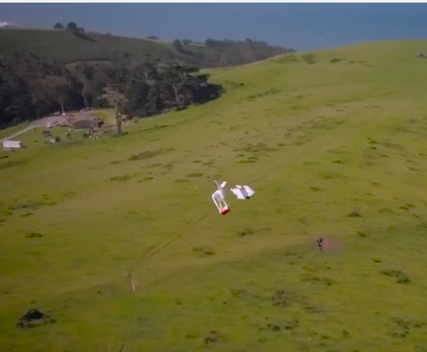
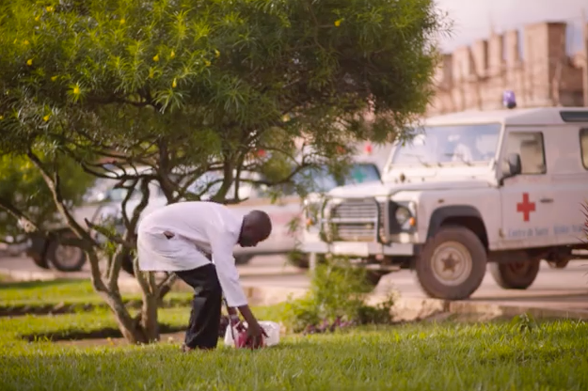

Slide 51
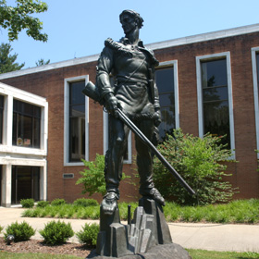

Slide 52
References
Introducing Early Infant Male Circumcision for HIV Prevention: Considerations for Policy, Safety, Cost, Acceptability and Demand - Guest Editors: Emmanuel Njeuhmeli, MD, MPH; Tin Tin Sint, MBBS, MSc; June N. Pierre-Louis, PhD, MPH http://www.ghspjournal.org/content/ghsp/4/Supplement_1/local/complete-issue.pdf
Binagwaho A, Pegurri E, Muita J, Bertozzi S. Male Circumcision at Different Ages in Rwanda: A Cost-Effectiveness Study. Kalichman SC, ed. PLoS Medicine. 2010;7(1):e1000211. doi:10.1371/journal.pmed.1000211.
Neonatal and child male circumcision: a global review http://www.who.int/hiv/pub/malecircumcision/neonatal_mc/en/
Manual for early infant male circumcision under local anaesthesia http://www.who.int/hiv/pub/malecircumcision/manual_infant/en/
Training Package on Early Infant Male Circumcision under Local Anaesthesia https://www.malecircumcision.org/resource-bundle/training-package-early-infant-male-circumcision-under-local-anaesthesia

Slide 53
© 2018 American Academy of Family Physicians. All rights reserved.
All materials/content herein are protected by copyright and are for the sole, personal use of the user.
No part of the materials/content may be copied, duplicated, distributed or retransmitted
in any form or medium without the prior permission of the applicable copyright owner.

