Slide 1
Using a New Smartphone App to Document Milestones and Augment Resident Evaluation
Roger Musa, MD
Keith Werstler, MD
www.mededtrack.com

Slide 2
Disclosures
Roger and Keith are owners of MedEdTrack, LLC and have a financial interest in the company
The smartphone app that will be demonstrated is for sale by MedEdTrack, LLC

Slide 3
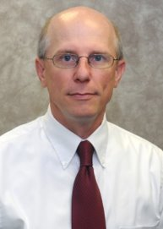
Who are we?
Roger Musa, MD
Program Director
Keith Werstler, MD ​
Associate Director

Slide 4
Frustrations with Milestones?
From faculty perspective
From resident perspective

Slide 5
Demo

Slide 6
Contact Us
Keith Werstler
Keith.Werstler@mededtrack.com
Roger Musa
Roger.Musa@mededtrack.com

Slide 7
Visit Us
Go to www.mededtrack.com for videos, tutorials and FAQs

Slide 8
Please evaluate this presentation using the conference mobile app! Simply click on the "clipboard" icon on the presentation page.

