Slide 1
"Our Recipe to Attract and Retain Family Medicine Bound Students"
Judy Gary, MEd
Carolyn Peel, MD
Sydney Davis, M4
Notes:
Sydney
Introduce us and ask by show of hands how many people are …
med ed faculty /staff
Residency faculty
Students
Other, if so… what?

Slide 2
Disclosure
Judy Gary, Med, Carolyn Peel, MD and Sydney Davis, MS4 have nothing to disclose.

Slide 3
What’s Cookin’?
What initiatives or programs do you already have that provide students with a positive exposure to family medicine?
Notes:
Judy
Topic overview and session objectives
Our common goal
“What’s cookin’ in your department?” (Worksheet) - Group discussion /share

Slide 4
Cookin’ @ VCU
Underserved Track
MATCH
M1 Outreach
Summer Research
Premed Shadowing
FMIG
M3 Clerkship
M4 Advising
M4 Electives
Community Service
Global Health Programs
fmConnect
M1/M2 Course
Notes:
Judy
Brief program background
What we already had – leverage what we’re good at (what we were already cookin’)

Slide 5
Mission
IMPROVE the health and wellbeing of the people of Virginia and beyond
ADVANCE the science of epidemiology, family medicine, and public health by means of innovative, interdisciplinary research
EDUCATE ourselves, our patients, our learners, and other stakeholders
PROVIDE high quality primary care, public health services, and lead their integration
TRAIN the next generation of epidemiologists, family physicians, and public health professionals
Notes:
Judy
Mission driven
Focus on what we can influence

Slide 6
Family Medicine Scholars Training & Admission Track
Virginia Commonwealth University School of Medicine
Notes:
Judy
fmSTAT: Cooking something new
FOCUS ON WHAT WE CAN INFLUENCE
Work with a subset of people who, upon matriculation have an intent to become family physicians
Now six cohorts and recruiting our 7th

Slide 7
Ingredients
Dual admission
Support
Curriculum
Personalized experiences
Scholarships
Notes:
Carolyn
“Birds-eye view” of the key ingredients to our fmSTAT Program
I’m going to tell you about the first ingredient…. Then we’ll tag team to tell you about the others
Dual Admission
Worked with Admissions Office from beginning
Joined Admissions committee (three members of our program committee
Worked with IT to identify, invite and manage candidates
Worked out extra application and interview process that would be acceptable to Admissions office and committee
Present fmSTAT applicants at committee meetings

Slide 8
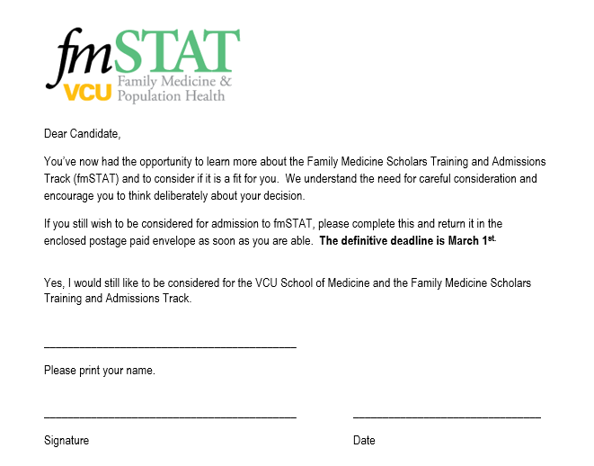
Notes:
Carolyn
Applicants interview for school of medicine and fmSTAT on same day
Information session about program
Two interviews with structured questions designed to assess knowledge of and commitment to/likelihood of pursuing family medicine
Ability to meet and socialize with current scholars
Group discussion centered on fitness for program and school followed by a ranking system
Applicants must turn in a letter of intent to pursue fmSTAT sometime after their interview if we are to consider them for our program further.
SOM decisions are made separate from our ranking system but once the Admissions Office communicates that an fmSTAT applicant has been offered admission to the SOM, we contact the applicant and either accept them to our program, let them know that we are currently full but they are on our waitlist if there is space, or let them know that they were not selected for the program but we would love to help them in their pursuit of family medicine and invite them to make connections from the beginning.
Why did we intentionally design this with a dual admissions process?
We can have more influence over the process of helping qualified candidates with a high likelihood of becoming family physicians through a sometimes spurious system
We hope to attract FM bound people to our school over another school that may not support their FM interest as much because we have this program
And have the opportunity to begin working with them “day 1”

Slide 9
Ingredients
Dual admission
Support
Curriculum
Personalized experiences
Scholarships
Notes:
Sydney
The 2nd ingredient is unquestioningly the most valuable part of fmSTAT – more than was envisioned

Slide 10
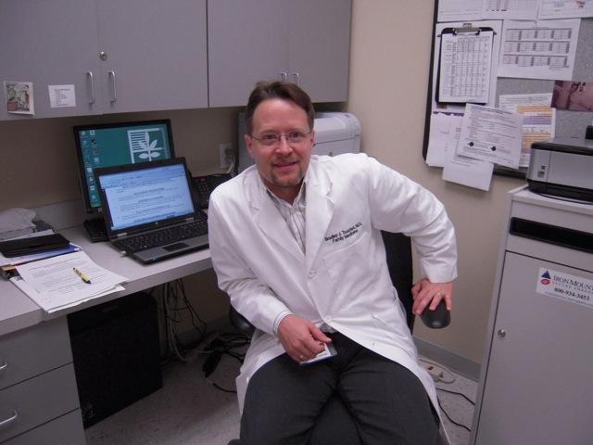
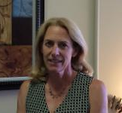
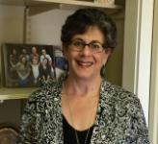
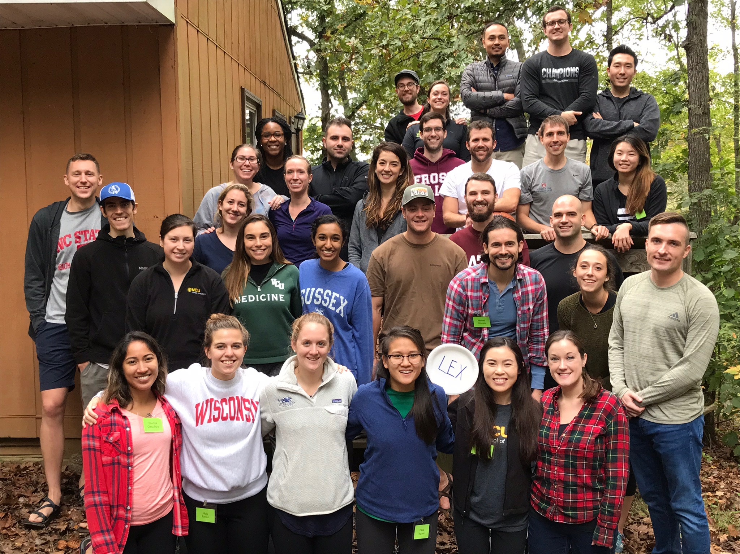
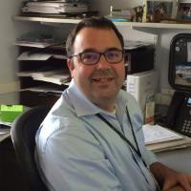
Notes:
Sydney
fmSTAT learning activities and events purposefully bring fmscholars from all four years together which facilitates socialization, support, resources
Events include welcome dinner, retreats, seminars, optional socials
HEART
comprised of fmscholars in each class
Vice Chair of FM as the faculty facilitator and academic advisor
FM faculty engagement
Judy & Carolyn provide program support
Presence of faculty in FM department
Study and coffee space for students
Intentional matching with family physician preceptors for clerkships and preceptorships
Designated FM mentor for each fmScholar

Slide 11
Ingredients
Dual admission
Support
Curriculum
Personalized experiences
Scholarships
Notes:
Carolyn
Advanced FM curriculum

Slide 12
Advanced Curriculum
Themes
Notes:
Carolyn
Presented on a rotating 4 year basis so each class exposed once
Themes
Patient safety and quality improvement in an outpatient setting, models of care
Patient centered care and partnering with patients for improved health
FM research, policy, and advocacy
Care coordination and team-based care
Not lectures – EXPERIENTIAL
We bring in guest facilitators with expertise to provide exposure to the students (and students to them) and prevent them from getting fatigued with us.

Slide 13
Ingredients
Dual admission
Support
Curriculum
Personalized experiences
Scholarships
Notes:
Judy
I’m going to tell you about last two ingredients.

Slide 14
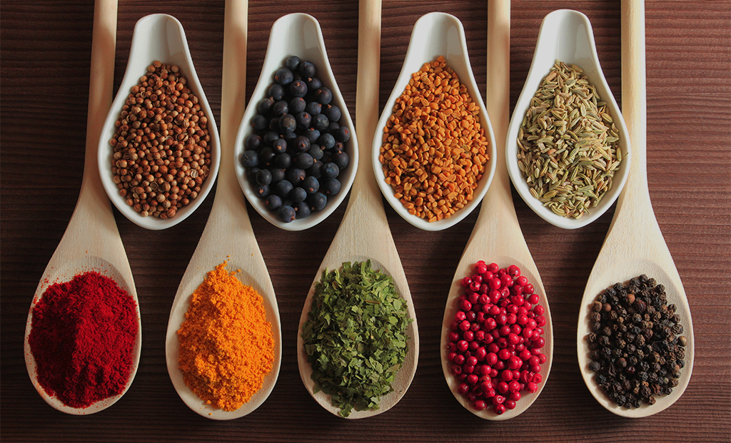
Personalized Experiences
Preceptorship and Clerkship
Summer Opportunities
M4 Electives
Scholar’s Project
Professional
Development
Notes:
Judy
Personalized experiences
Sydney already mentioned the first one. Intentional placement in preceptorships and clerkships that we feel will best meet each student’s needs and special interests.
Summer research
2 fourth year electives
Scholars project to be presented at the end of the fourth year which we work with scholars individually to shape

Slide 15
Professional Development
Notes:
Judy
Professional development e.g networking, recommendations for research projects, community and national experiences

Slide 16
Scholarships
Notes:
Judy
Scholarship support
Currently working with DAR to establish an endowment for scholarships; far from the $10,000 per year support that we envision
Some support from SOM too and great relationship with Financial Aid Dean
This year, all graduating scholars will get a few thousand dollars

Slide 17
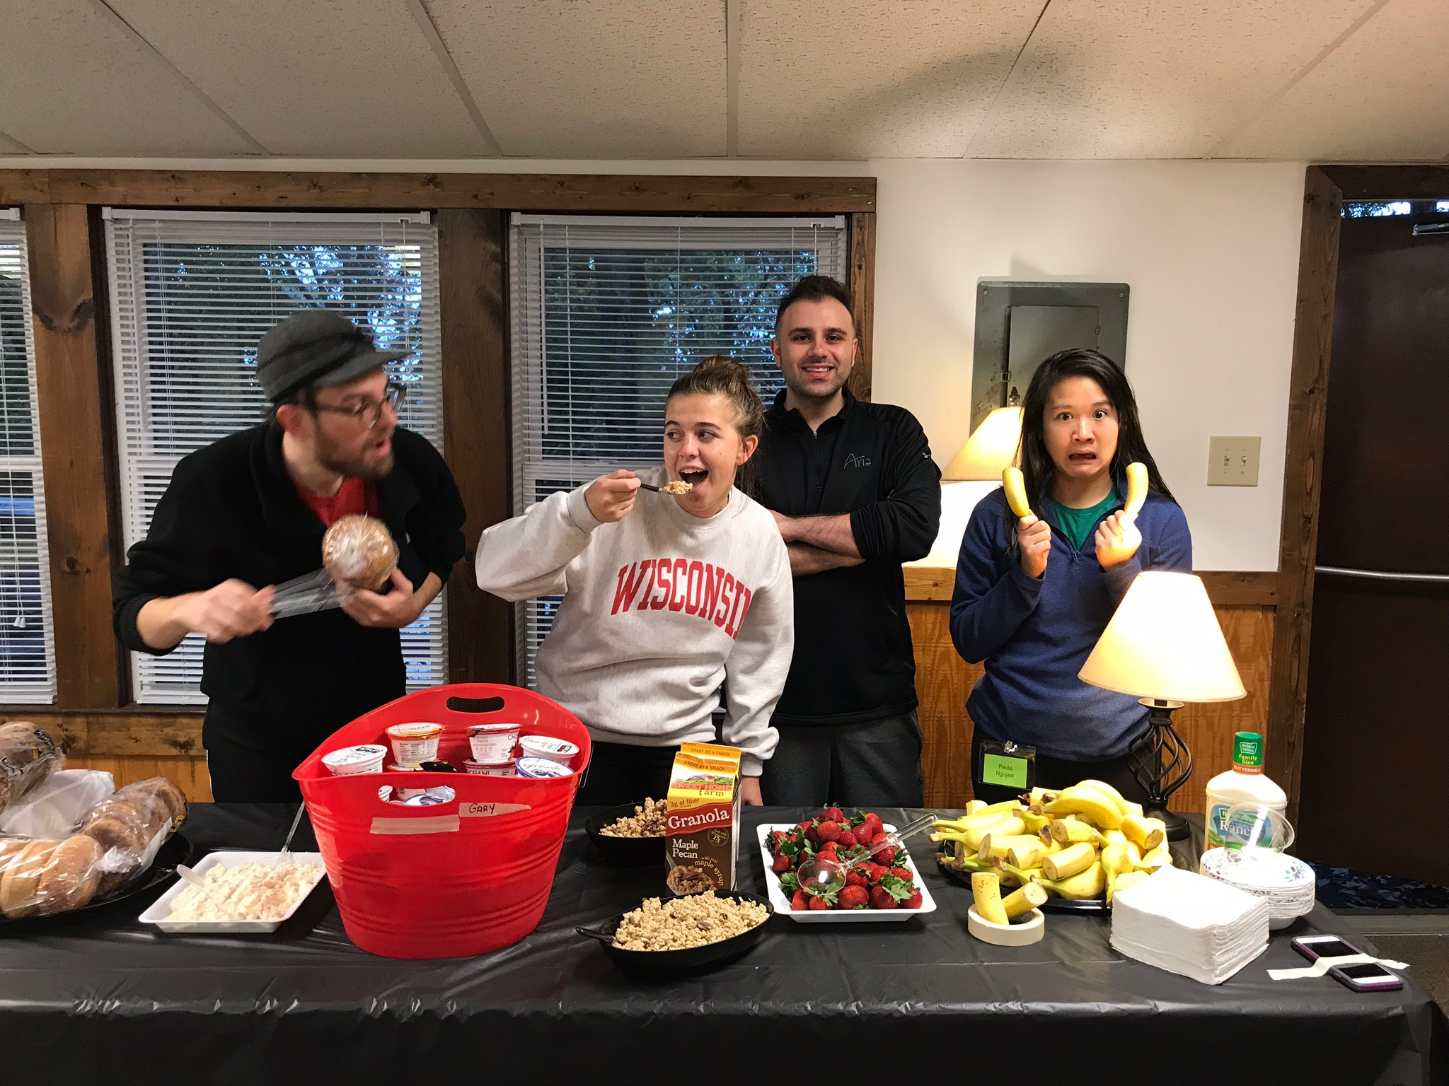
Mmm…
Notes:
Judy
Put all of those ingredients together to create something special.

Slide 18
The Reviews…
Recruitment
Retention
Program evaluation
Secondary gains
Notes:
Carolyn
All that sounds good, but would do the reviews say? We’ll consider that in a few ways…
Recruitment
We have learned a lot over the 7+ years we have been doing this
Our school is 50% in-state and 50% out-of-state. Out-of- state students who interview here are less likely to come compared with similar cohort of in-state students due to financial and personal pressures
Competition with other in state institutions with more money for primary care scholarships
General lack of scholarship money
We know that we need to interview approximately 50 applicants to fill a class of 10
We know that there will be a lot of movement in the spring when students have to narrow their choices.
We want to get applicants in and excited about being fmscholars as early as we can in the process
We have fine-tuned the interview process based on each year’s experience

Slide 19
A few numbers…
1 w/d SOM
2 PC grads
84%
1 tx
5 other spec
1 w/d fmSTAT
Notes:
Carolyn
Retention
Withdrawal hurts at a personal and program level because we love these students and want to see them in family medicine
84% of the fmSTAT matriculants are either currently in the program or have completed fmSTAT and graduated
2 program completers dually applied and matched in other PC specialties
Of the 8 program non-completers
1 withdrew from SOM
1 transferred to FM track in home state
5 chose another specialty (1? “gamer”)
1 withdrew from program for personal reasons

Slide 20
Program Evaluation
Notes:
Carolyn
Program Evaluation
We evaluate every seminar/retreat/ event/ mentor match/ clerkship
Also at year-end
Favorable evaluations

Slide 21
Secondary Gains
Class | fmSTAT Match | VCU FM Match
2016 | 4 | 24
2017 | 5 | 33
 |  | 2006-2015 VCU avrg matching in FM = 20.7
Notes:
Carolyn
Secondary Gains
Match rate: Our first cohort of students graduated in 2016. The average number of students from VCU SOM matching in family medicine from 2006-2015 was 20.7. In 2016 we matched 24 and in 2017—33. We are looking forward to another strong match in 2018 based on our knowledge of current students.
Each year starts with a visible group of Family medicine identified students; anecdotally, the profile of family medicine within the SOM class seems enhanced through students in the program. We think this may be enriching non-fmSTAT student interest in FM.
More FP’s participating in the admissions process; valuing applicants inclined toward primary care – hope to impact “bottom line.”
Students tell us that they value being in the program
Have Sydney tell you a little about her personal experience.
---------------------------------------
Small Numbers
Like patient care focusing value v volume

Slide 22
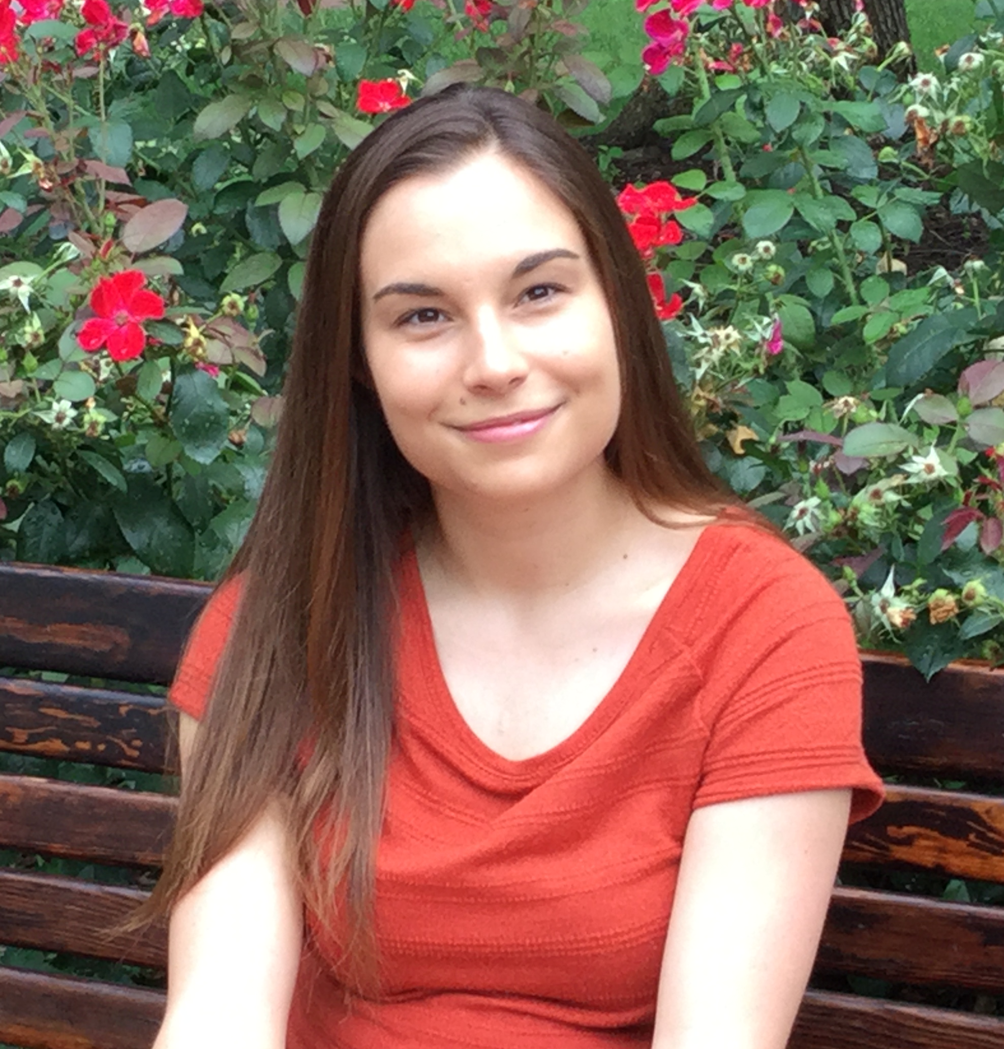
Notes:
Sydney
Personal experience as an fmScholars – (whatever is meaningful to you; a few thoughts…)
Admission to the program
Connection with Susan
Connection with scholars of different levels e.g. staying with Suzanne during residency interviews, working with Paulius on telemedicine, etc.
Applying for STFM

Slide 23
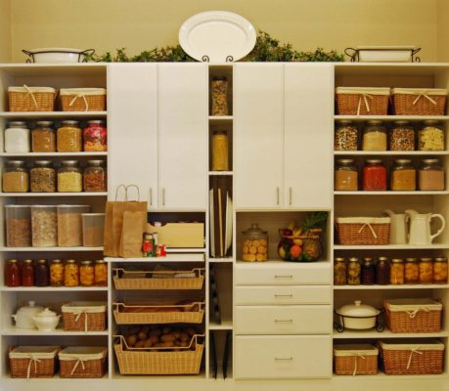
What’s in Your Pantry?
Notes:
Judy
Your pantry (group discussion)
What ingredients do you have (or can you get) in your pantry?
Anticipating and addressing challenges
-------------
Post Assessment?

Slide 24
Please evaluate this presentation using the conference mobile app! Simply click on the "clipboard" icon on the presentation page.

