Slide 1
Building Primary Care Capacity: Training of General Practitioners Affects their Knowledge and Performance: The Jordan Experience at UNRWA Clinics
Amjad Al-Shdaifat, MD
Therese Zink, MD, MPH

Slide 2
Learning Objectives
Articulate the need and challenges of building capacity for primary care in areas where family medicine is underdeveloped.
Understand the missing ingredients for practicing primary care/family medicine in countries with a biomedical approach to training.
Communication skills, psycho/social, evidence based medicine
List the cultural challenges to delivering education
Language, cultural mores, patient expectations, clinical realities
Consider how US faculty might support building capacity in different settings.

Slide 3
Overview
Background Jordan and FM in the Middle East
Background United Nations Relief and Works Agency for Palestine Refugees (UNRWA)
What is needed to build capacity in Family Medicine
Dr. Al-Shdaifat’s program and evaluation
Conversation with Dr. Al-Shdaifat (skype)

Slide 4
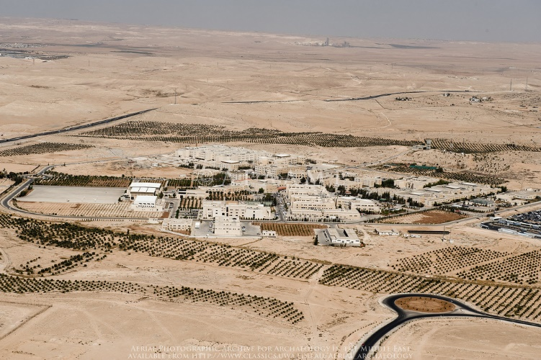
Hashemite University

Slide 5
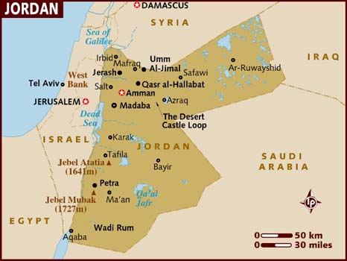

Slide 6
Medical Training in Jordan & elsewhere
US and Canada
Undergraduate degree and pass entrance test
4 years of graduate education and pass 3-step USLME for license
Specialty training 3-7 years
Jordan
6 years of medical school follows “secondary/high school”, take national exam and highest scorers can enter medical school get undergraduate degree in medicine which is equivalent to MD or DO in the US
One year internship in the hospital (rotate through the 4 majors: Peds, Gyn, Surg, IM), then can practice as GP or pursue specialty—10%
Research project during residency is equivalent to a masters thesis in the US
Notes:
Lots of graduates, but limited # of specialty positions. 3000 students graduate /y, only 200-300 can do a specialty.

Slide 7
Medical School/FM in Jordan
Jordan University of Science and Technology – Irbid (1995) # $
Hashemite University – Zarqa #
University of Jordan – Amman # $
Ministry of Health (1989) $
Yarmouk University – Irbid $
Mutah University – Karak $
Al-Balqa` Applied University – Salt $
$ Family medicine residency
# Family Medicine Faculty
Notes:
http://www.stfm.org/fmhub/fm2007/November/Abdulrazak736.pdf 2007
In Jordan, there are currently four residency programs
in family medicine. The first program was started by
the Royal Medical Services in 1981 in response to the
perceived need for comprehensive and cost-effective
medical services. The first Board Examination in Family
Medicine was in 1986. In 1989, the MOH started
its first residency program in family medicine. And
in 1995, Jordan’s medical schools, Jordan University
and the Jordan University of Science and Technology,
both initiated family medicine training programs. In
the same year, the Jordan Medical Council modified
the length of the family medicine training program
from 3 years to 4 years, standardizing the content of
the training programs and establishing a “specialist”
in family medicine
https://www.ncbi.nlm.nih.gov/pmc/articles/PMC5471080/ 2017
-- underline issue lots 600 students just
--hashmite 300 students
Apply Jordan Bd FM – Part 1-after 2; and Part 2-after 4 y (OSCE)

Slide 8
Jordan—Location of medical schools and FM residencies

Slide 9
Why is capacity building imperative?
Current Capacity Building courses
Family Medicine Diploma
American University Beirut
Rila, UK
National FM Committee developing online and on-the-job
Train 50 GP/year
Challenges GPs in rural areas –Dr. Amjad UNRWA style program
Notes:
https://gpcourses.co/courses/postgraduate-diploma-family-medicine/
Problem:
2700 practice without additional training. Becomes a cumulative problem, hence the need diploma program
Cannot take a specialty program after age 35y.
With GP only training lots of referrals to specialty clinic that are not necessary
4 hours with 80-100 patients—most are referred because GP does not have training to manage. Hence overloaded specialty clinics with patients that they do not need to see and specialist has only 2-3 min /patient which means poor quality. Most healthy, most have minor issues. i.e. any chest pain go for EKG and cardiac enzymes irrespective of age.
FM Diploma—online, no on the job, very expensive ~5000 online component + ~12,000 if add face to face and pulled out of setting
Working on 2 solutions to this:
FM diploma—online and face to face
Amjad work with national committee FM (MOH and universities) program—MDs continue to see patient—build on ABU and on the job. More economic and don’t take docs out of clinic.
50/year w/ online and on the job training—more economical total cost $20k
2) UNRWA program for GPs above 35 y in rural areas—unqualified GPs

Slide 10
UNRWA: United Nations Relief and Works Agency
for Palestine Refugees in the Near East
GAZA
West Bank
SYRIA
LEBANON
JORDAN
Notes:
Developed for refugees from Palestine after creation of Israel in 1948
5 divisions:
GAZA
WB
SYRIA
LEBANON
JORDAN 4 million, 2 million refugees
25 clinics 1.2 million—90 GPs serve

Slide 11
Assess Training Needs
MODEL for Building Capacity
In UNRWA Clinics
Pre-test
Face to Face Training
Post-test
On-the-Job Training
Check-list: initial, mid and final

Slide 12
Needs Assessment—What do you need to do your job?
Continued professional development or how to continue learning throughout a career
Knowledge, skills and attitudes
Evidence Based Medicine—Search strategy and how and where to get valid information
Knowledge of the most common topics in primary health care
Most common diseases seen at UNRWA clinics
Notes:
Open ? Survey what are weak points/ what are strengths
Look at clinic charts
How to manage common issues in clinic—what are they?
How do you get the answers you need

Slide 13
Family Health Approach
Historical UNRWA approach VERTICAL
NCD, immunizations, school health, prenatal . . .
Change to HORIZONTAL or teams: same MD, nurse, pharmacist
--Have to train doctors how to do this.
--Just do it and start training.
Notes:
Topic and initiative
UNRWA vertical approach—NCDs, school health, immunizations—see different doctor, nurse and pharmacy
Divide into teams: MD/RN/pharmacist—whole family served by the same team. Including basic MH
Just do it
--Have to train doctors how to do this

Slide 14
Communication Skills
Calgary Cambridge Framework
How to establish rapport
How to make patient comfortable, i.e. where to sit, directions during the exam
Eye contact
Active listening
Encourage patient’s expression of feeling
Discussion of plan
Check patient understanding
Arrange follow-up http://www.skillscascade.com/handouts/CalgaryCambridgeGuide.pdf
Notes:
Calgary /Cambridge modules—71 points on how to do communication skills
Amanda Howe—trained Amjad

Slide 15
Evidence Based Medicine
Textbooks are not enough
What is EBM?
Search strategy and how to get valid information
Sites
Free subscriptions
Medscape
Medpagetoday
How to appraise and article?
Different types of studies: meta anyalsis, cohort study, case study, RCT,
Notes:
What is it?
What are sources for valid information—
-with internet lots of options: ADA site for DM, HTN-JACAH; Asthma/COPD-Gold; prevention US prev TF, infec-CDC
-need Medscape, med page today https://www.medpagetoday.com/ subscriptions
-textbook out of date these days need to have access to update information
Continuing profess development
How to appraise an article—good or not
Different kinds of studies

Slide 16
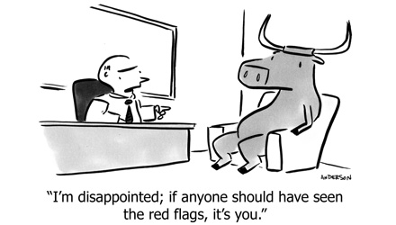
Basic Clinical Skills
Focused history and exam
—how to make best use of time
(3-4 min w/ the patient)
Look for red flags
Use of equipment
Documentation
Notes:
The baseline is hospital experience
Key questions for HA
cold case can send home
Hot need to refer

Slide 17
Rational Drug Use
Look at all drugs and evidence
Max drug dosing before add another
First choice for patient and diagnosis
Avoid polypharmacy
UNRWA GPs lots of training about Antibiotic misuse
Resources: WHO http://www.who.int/medicines/areas/rational_use/en/
http://www.phrplus.org/Pubs/WP015_fin.pdf
Notes:
All drugs
Have lots of training on ATB use in UNRWA; a problem in community and MOH
Antihistamine for common cold—EBM no real value
DM-use metformin as first line of TX, use max then add another drug
HTN-if DM then ACE = first drug of choice, if over 45y start with diuretic
Also keep up
AA-has studied how MD prescribe drugs—just published in Pal Health Alliance—how many drugs /RX; how many additional drugs;

Slide 18
Disease Oriented Topics
Approach to Headache
Upper respiratory infection (when to give Antibiotics)
Dizziness
Low Back Pain
Psychosomatic Disorder
Dyspepsia
Chronic diseases: DM, Hypertension
Disease surveillance
Pregnancy related: gestation DM, HTN, Micronutrients, Anemia + preconception care
Notes:
Hot and cold
Psychosomatic: Uses DMS 5 –multiple physical sx think about somatization—complaint is real, not seeking attention, 30% have psychosom element, do serial visits for patient –every week or month, or 3 m, Refugee issue—28 y/o complain of neck pain and other body complaints—have a pharmacy in their house. Explain psychosom, behavioral therapy, GP implemented—and successful
Disease surveillance—PH approach guidelines of CDC. How to manage in the community, how to report to UNRWA + MOH

Slide 19
On-the-job Training
Faculty present during ½ day of usual care
Negotiate agenda for the 4-6 hour session
Teach joint exam
Discuss learner’s difficult or challenging cases
Observe and coach during the patient care session

Slide 20
Score | NO | |YES | CLINICAL SKILLS | Domains | NO.
 |  |  | Establish rapport (yes when: greets, obtain name, or demonstrate respect | Communication skills | 1
 |  |  | Show the patient where to sit |  | 2
 |  |  | Eye contact |  | 3
 |  |  | Active listening |  | 4
 |  |  | 0-5 points
 |  |  | Identify chief complaint (using open question) | History | 5
 |  |  | Analysis of chief complaint |  | 6
 |  |  | Encourage pt. to express feeling |  | 7
 |  |  | Review systems pertaining to the main complaint |  | 8
 |  |  | 0-5 points
 |  |  | Proper exposure for the organ under examination | Examination | 9
 |  |  | Proper positioning of patient for examination |  | 10
 |  |  | proper use of available equipment's |  | 11
 |  |  | Examine all related organs to the complaint |  | 12
 |  |  | 0-5 points
 |  |  | write clear diagnoses 0-5 points | Diagnoses | 13
 |  |  | Put clear management plan | Treatment | 14
 |  |  | discuss management plan with patient |  | 15
 |  |  | Offer advice for patients in suggestive approach that give choices rather than directive approach. |  | 16
 |  |  | Ensure that patient is understanding the management plan |  | 17
 |  |  | 0-5 points
 |  |  | Tell the patient when and where to come for follow-up visit. 0-5 points | Follow-up | 18
 |  |  | Closing the session 0-5 points | Closing | 19
 |  |  | Documentation (clear hand writing or save and send at E-health clinics) 0-5 points | Documentation | 20
 |  |  | TOTAL points our of 100
Communication Skills
Rapport, eye contact, active listening . . .
History
Open ? to identify CC, encourage expression of feeling, ROS. . .
Exam
Diagnoses
Treatment Plan
Follow-up
Closing
Documentation
--5 points for each item of 20 items

Slide 22
Cultural Challenges
Notes:
Language
Cultural mores—no private time with child in Palestine, male provider—female patient,

Slide 23
Learning Objectives
Articulate the need and challenges of building capacity for primary care in areas where family medicine is underdeveloped.
Understand the missing ingredients for practicing primary care/family medicine in countries with a biomedical approach to training.
Communication skills, psycho/social, evidence based medicine
List the cultural challenges to delivering education
Language, cultural mores, patient expectations, clinical realities
Consider how US faculty might support building capacity in different settings.

Slide 25
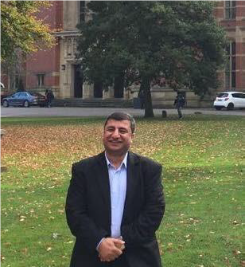
Contact information:
Amjad Al-Shdaifat, MD
drshdifat@yahoo.com
Therese Zink, MD
theresezink@gmail.com

Slide 26
© 2018 American Academy of Family Physicians. All rights reserved.
All materials/content herein are protected by copyright and are for the sole, personal use of the user.
No part of the materials/content may be copied, duplicated, distributed or retransmitted
in any form or medium without the prior permission of the applicable copyright owner.

